Slide 1
A Review of the Semester
TIME CAPSULE
Hayden
Benson
ITMG 100 — Final Project

Slide 2
About Me
SURF CLUB
FIJI
WATER POLO
Member
Member
Player
SWIMMING
FISHING
BILINGUAL
Year round
Favorite Activity
English & Spanish

Slide 3
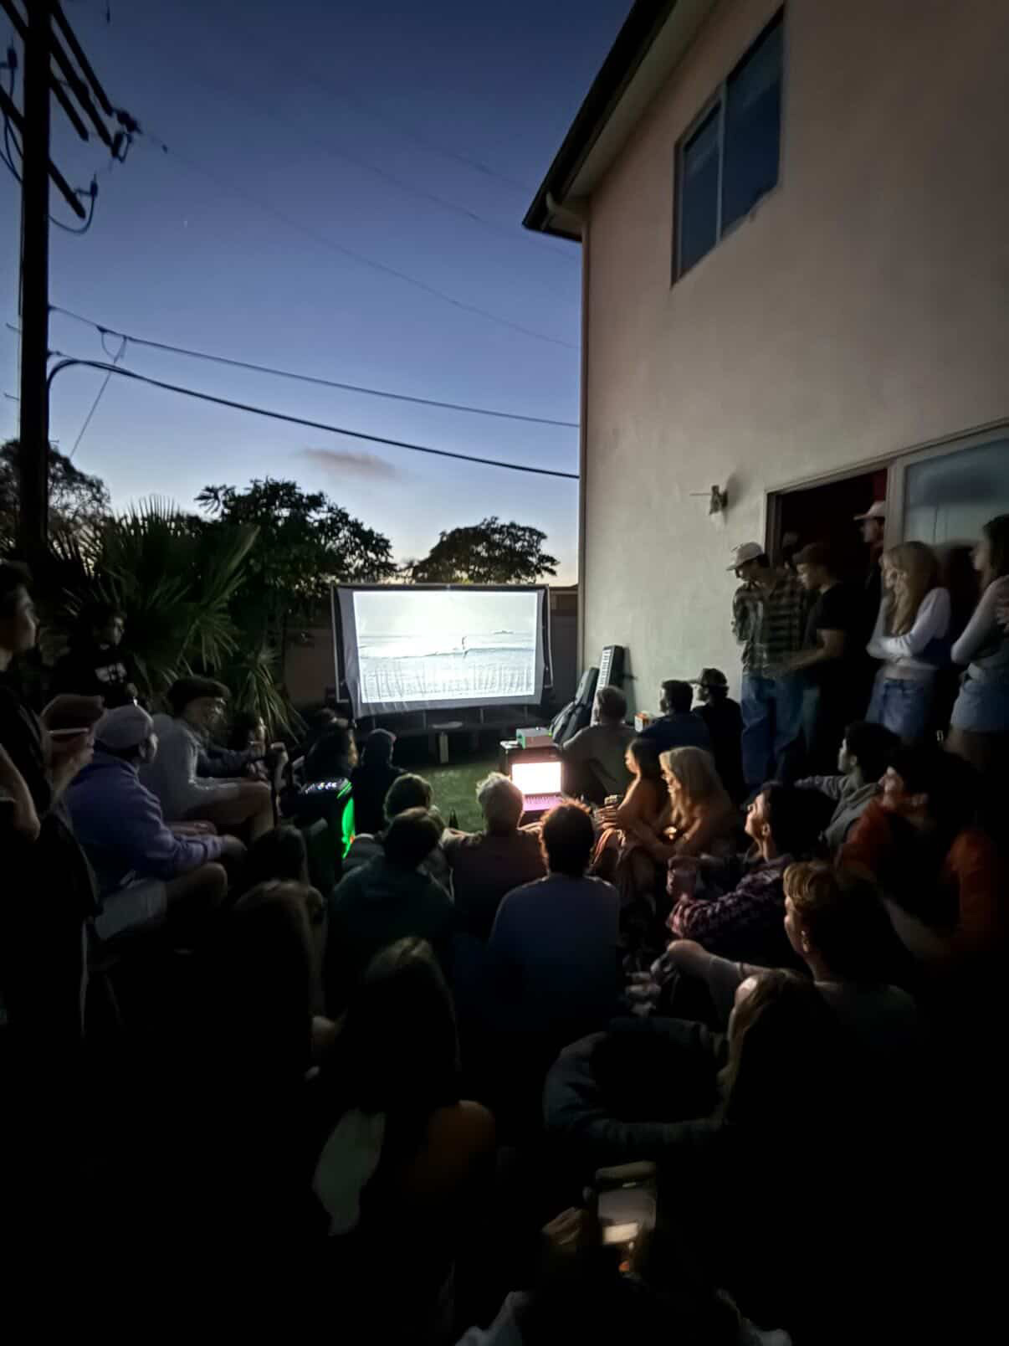
Joining the Surf Club
WHAT IT MEANT
First time joining a club in college
Found people who love the water as much as I do
Sunrise sessions became my favorite thing to look forward to
Met the best group of guys
Surf
Club

Slide 4

Joining FIJI
WHAT IT MEANT
Member
Joined Phi Gamma Delta
Built friendships I didn't expect
Learned to better manage my time with another extracurricular on my hands
Brotherhood that pushes me to always be a better person
FIJI
Phi Gamma Delta

Slide 5
I Wish I Surfed More
WHY IT DIDN'T HAPPEN
THE THING I MISSED
School and other activities took up most of my weekends
Came to USD so I could stay by the beach and surf
Didn’t put enough effort into getting myself in the water
Not Enough Surfing

Slide 6
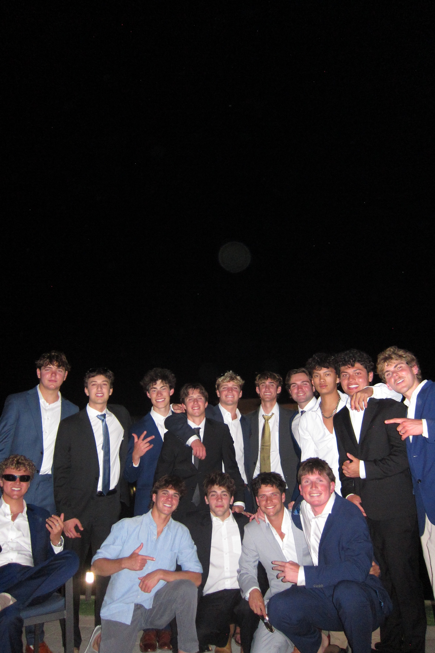
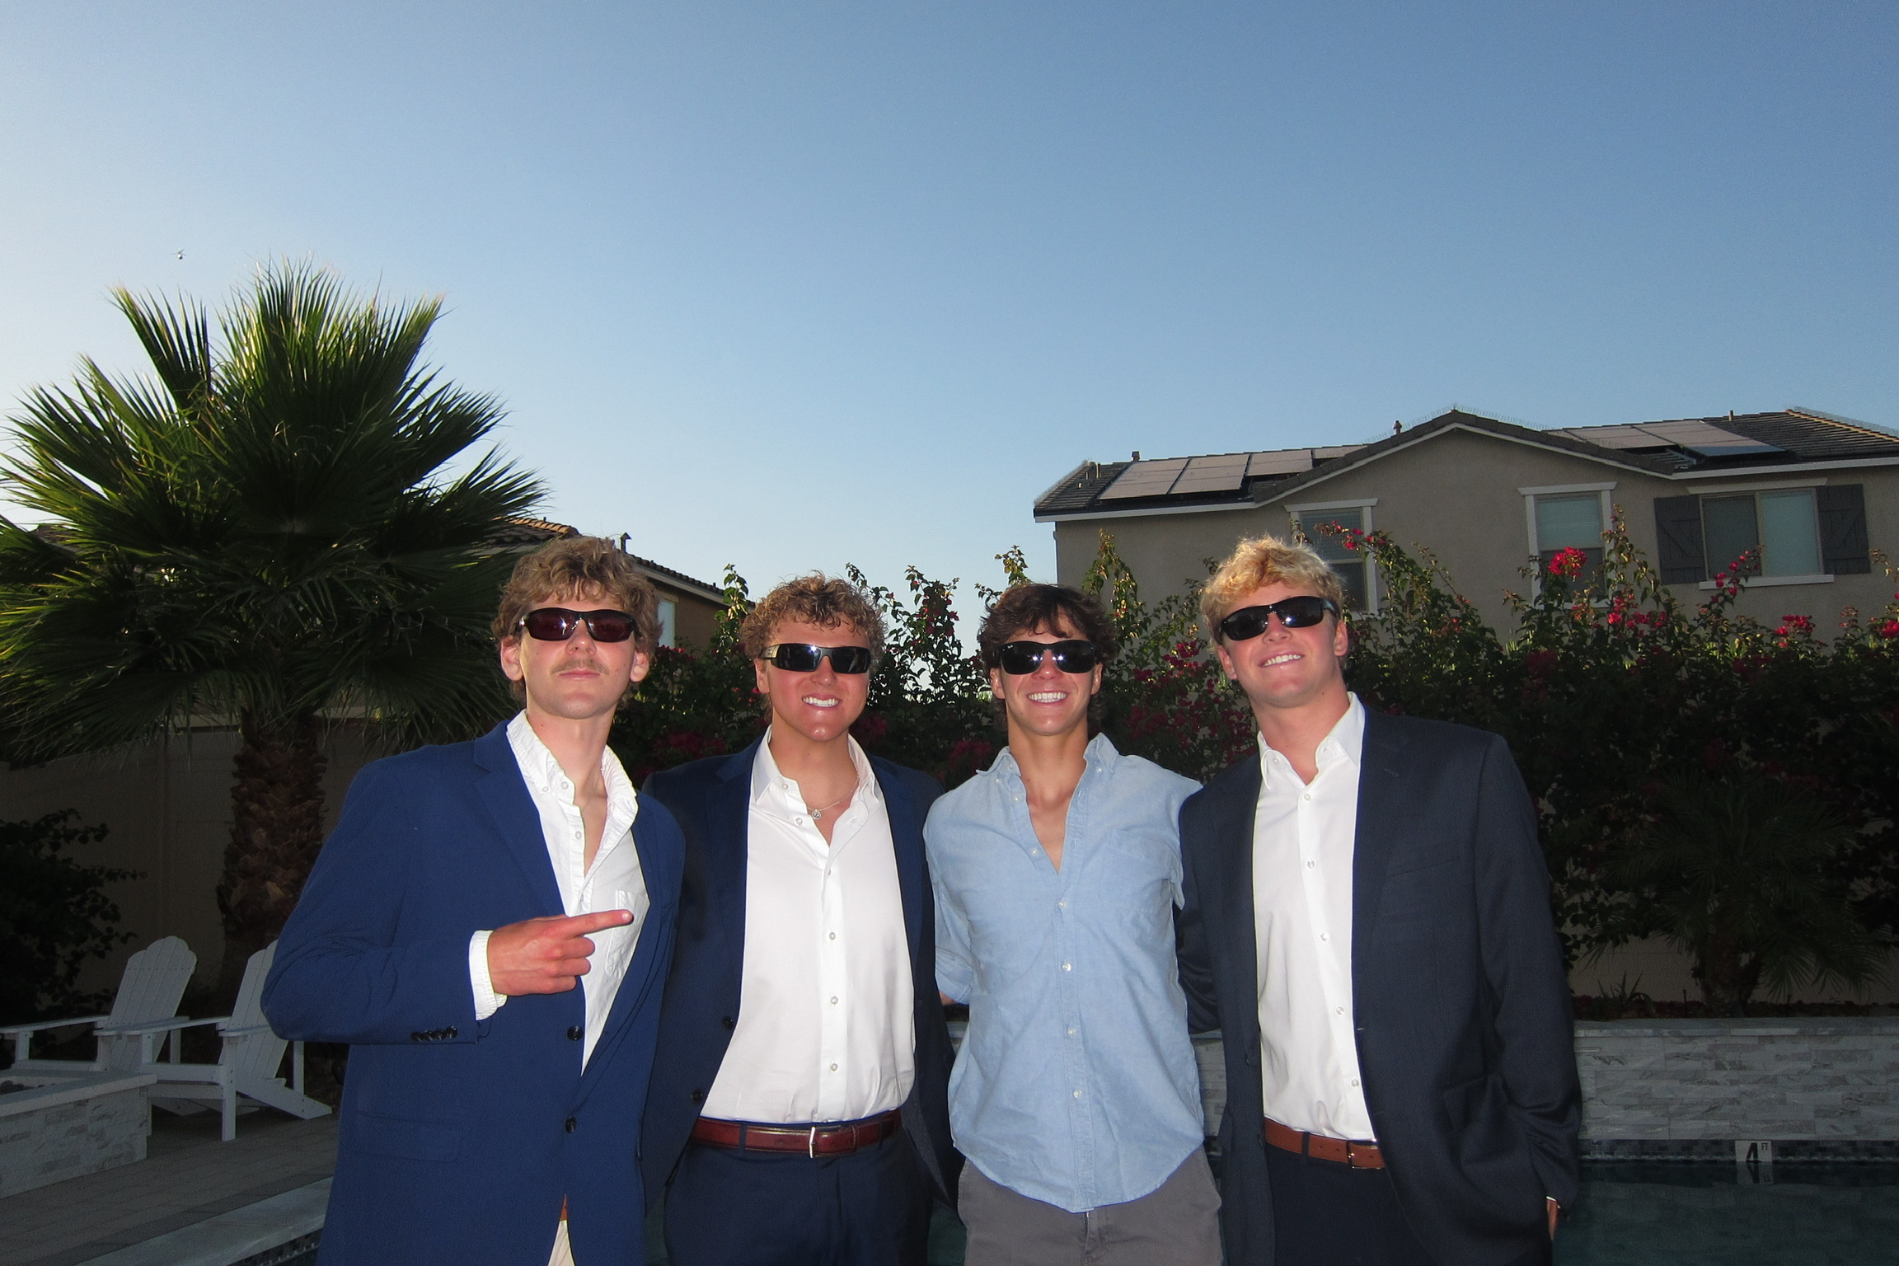
The People I Met
WHAT WENT RIGHT
Surf Club crew strangers who became regulars who are also my closest friends in FIJI
Hometown friends who already went here helped me integrate well
Plan on living off campus with my 3 best friends next year
Surrounded myself with people I strive to be like daily
My Community

Slide 7
Living Alone
WHAT I LEARNED
First semester living on my own
Learned to cook, clean, and do laundry
Figured out how to manage my own schedule
Learned to share a space with roommates
Life Away from Home

Slide 8
The GPA Didn't Go My Way
What went wrong
Moving Forward
Grades dropped below where I wanted them pretty quickly
Adjusting to college was harder than I thought
I let other things take priority over my work
Had to implement new habits to get my stuff back in order
Time Management & Procrastination

Slide 9
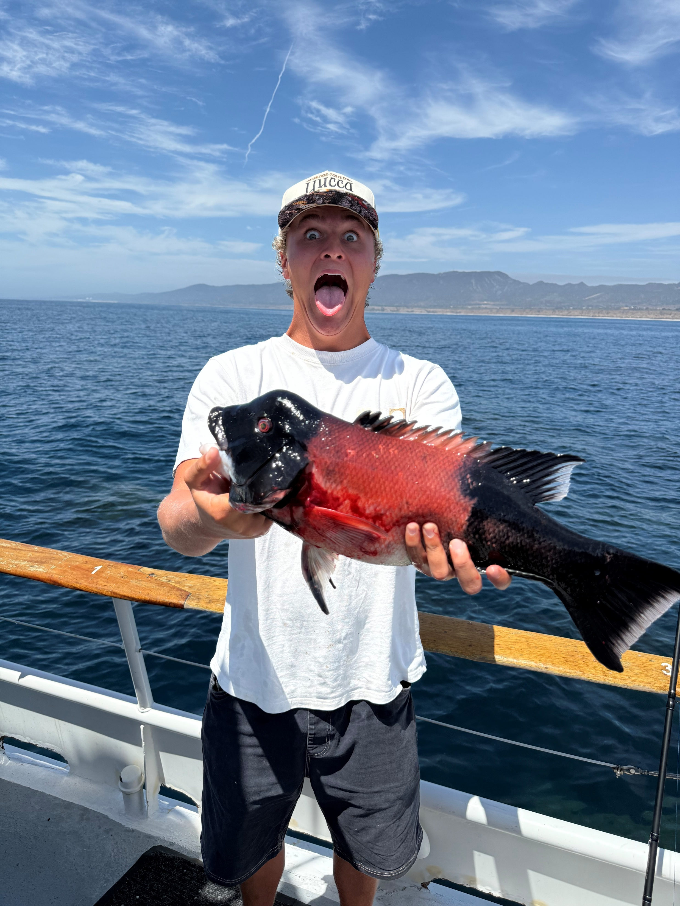
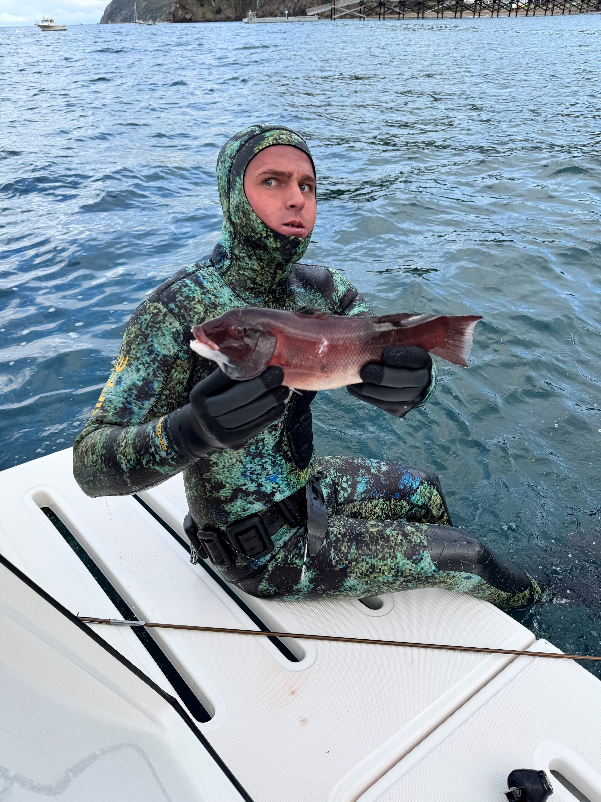
Things That Kept Me Going
WHAT KEPT ME STEADY
Water polo: team, structure, discipline
Swimming: solo, meditative, clears my head
Surf: when I make the time, it's the best activity by far
Fishing: quiet, patient, completely off the grid
Friends

Slide 10
News & World Events
WHAT I NOTICED
Things Happening in The World
AI everywhere. In classes, the news, new updates in technology
Conflicts overseas in the headlines daily
Climate stories closer to home
New viruses

Slide 11
Process Changes
WHAT I NOTICED
Most classwork is online, I barely use paper anymore
Food, groceries, rides and entertainment all on the phone
Tap to pay, no wallet needed
AI doing things in minutes that used to take hours

Slide 12
People Helping People
WHAT I SAW
Everyone always checking in on each other
Friends sharing gear, equipment, and anything else needed
Classmates sharing notes, no questions asked
Family showing up. Calls, packages, visits, and daily texts

Slide 13
Looking Ahead
WHAT'S NEXT
GOALS
Earn back the GPA
Surf multiple times a week
Stay super involved in my fraternity
Build a routine that holds
Stay close to the water and my friends
Next Semester

Slide 14
Written Statement
This semester was nothing like I expected, but that’s what made it important. I came into college thinking everything would fall into place quickly and smoothly, but instead I had to learn how to balance school, friendships, independence and responsibility all at once. Joining the organizations I did helped me meet people who made college feel like home. While living on my own taught me a lot about discipline and growing up, not everything went as smooth as I thought it would. My GPA was way lower than I wanted, I missed out on things I thought I would of loved to have done more often, and there were times where I felt overwhelmed trying to manage everything. At the same time this semester helped me understand myself better than any class could. The ocean, my friends, and the routines I started building kept me grounded through the highs and lows. Looking back this semester was less about having everything figured out and more about learning who I want to become moving forward. And I can confidently say this has been the most memorable year of my life.

Slide 15
END OF CAPSULE
Thank You
Hayden Benson
ITMG 100 / Final Project

