Slide 1
Time Capsule Final Project
Josie Wilson

Slide 2
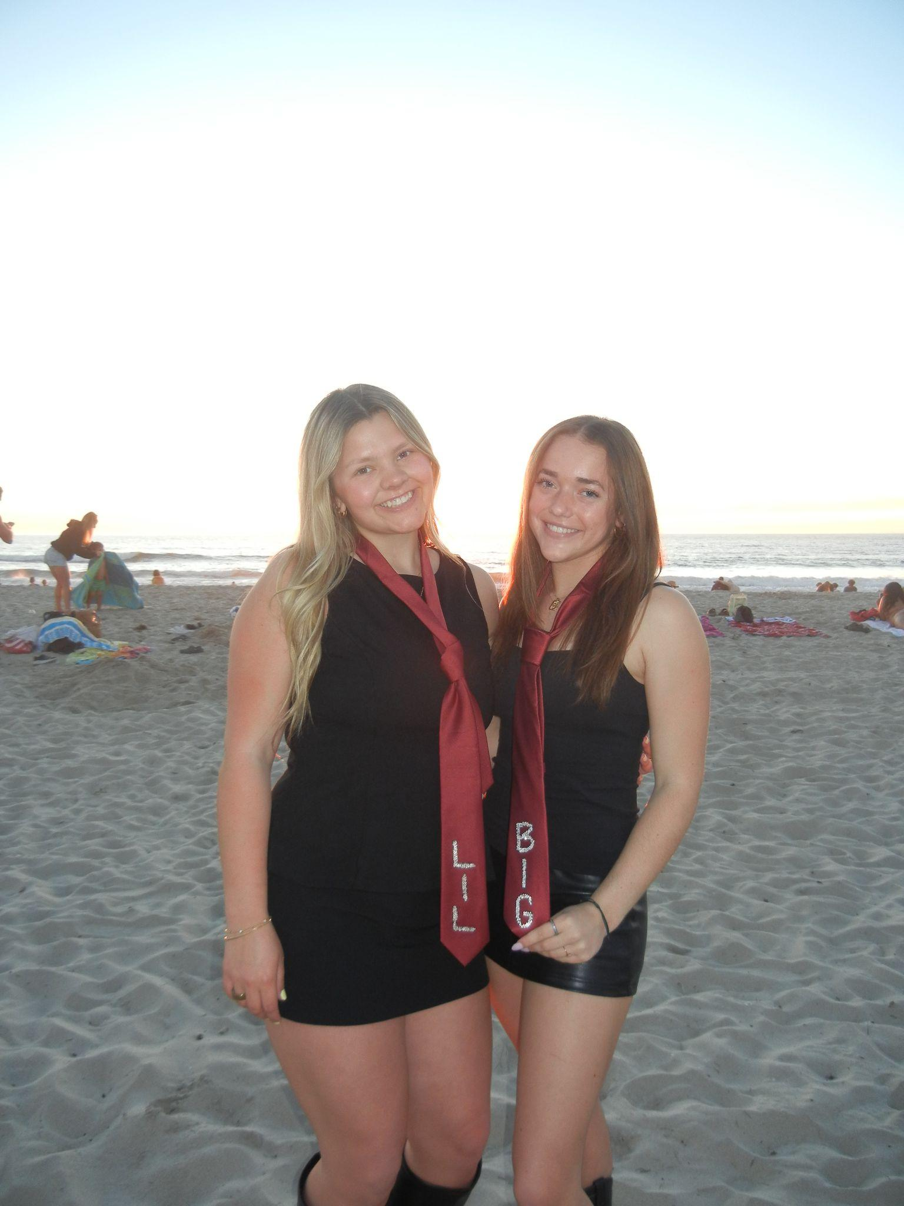
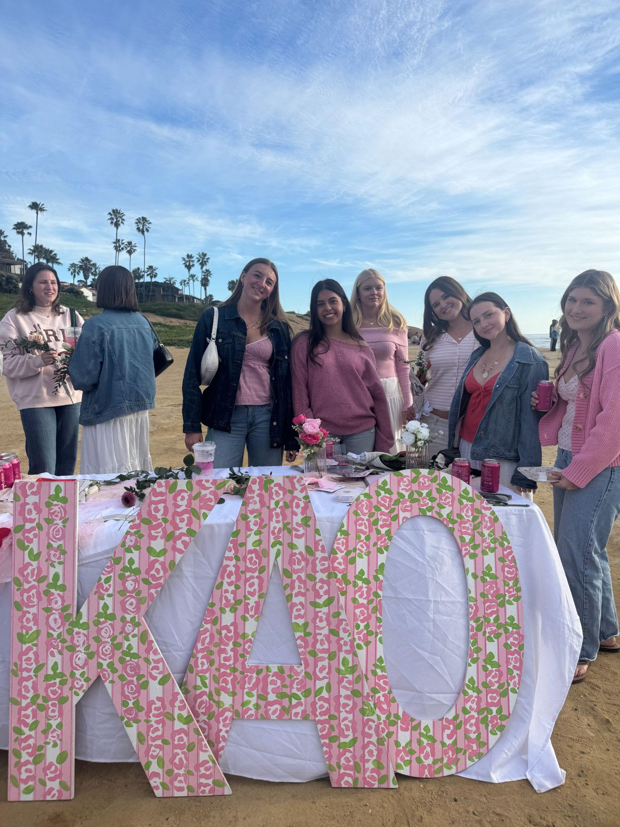
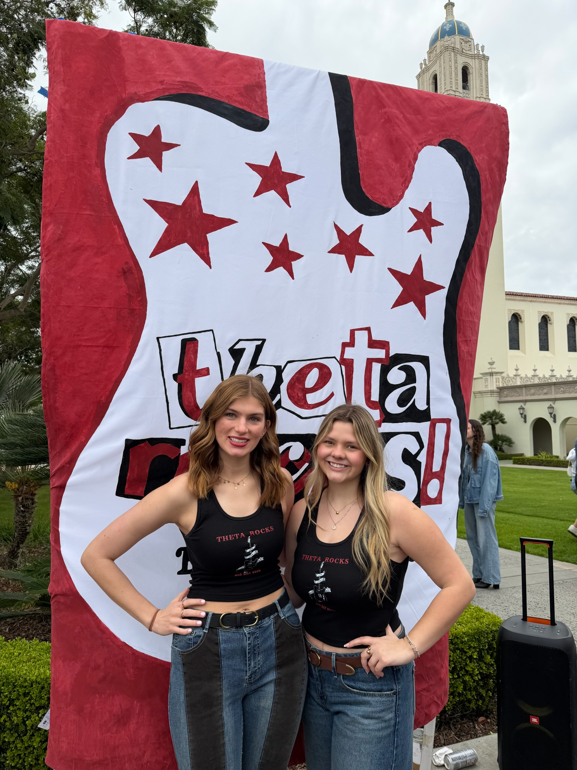
happened in the semester individually, with friends, groups, locally, nationally
Josie Wilson Time Capsule
Notes:
Went through recruitment and ran home to kappa alpha theta. Us at bid day, getting my big, and going to sisterhood events

Slide 3
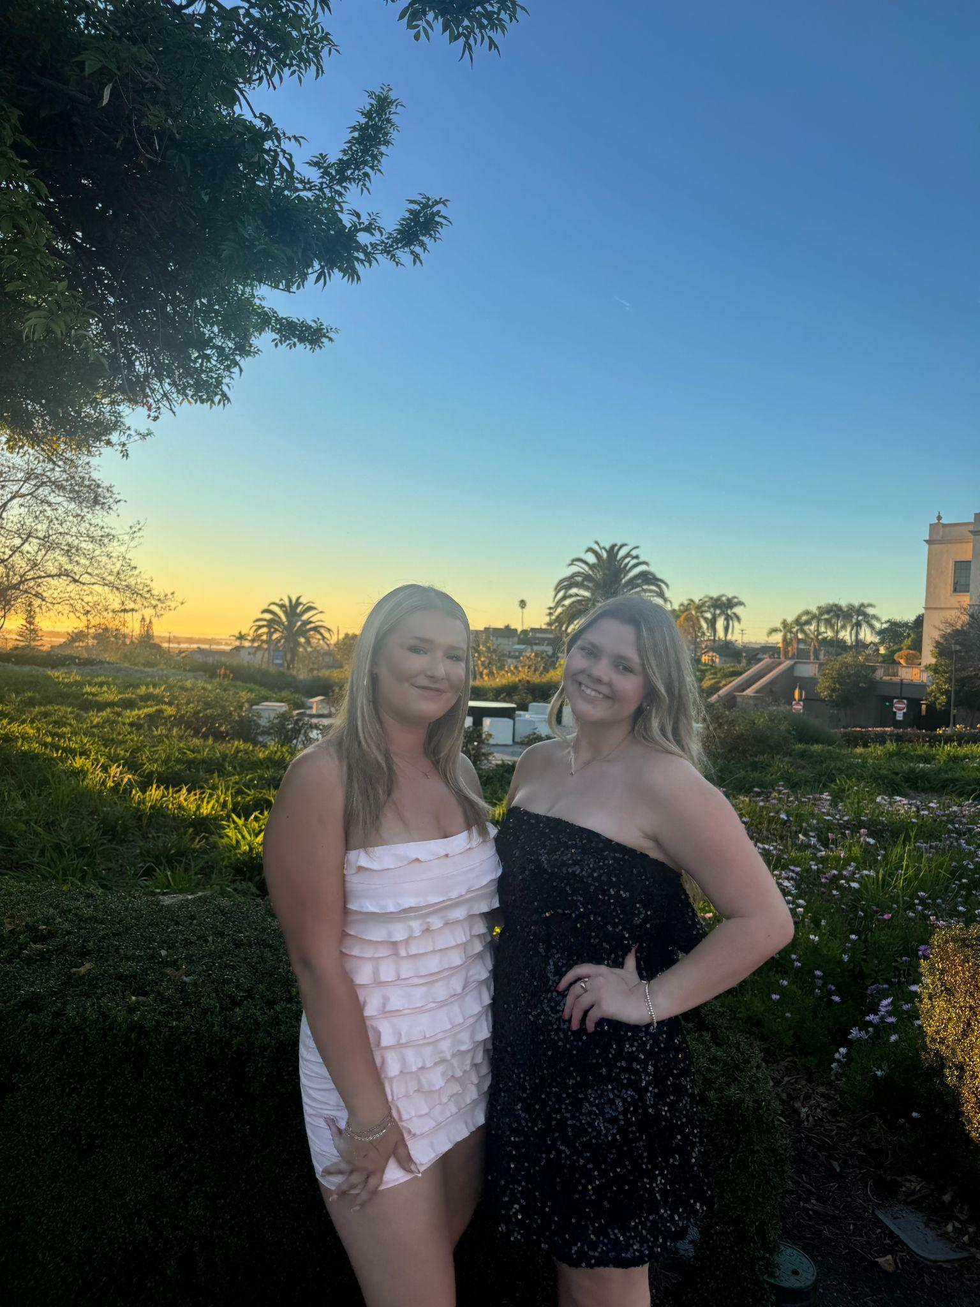
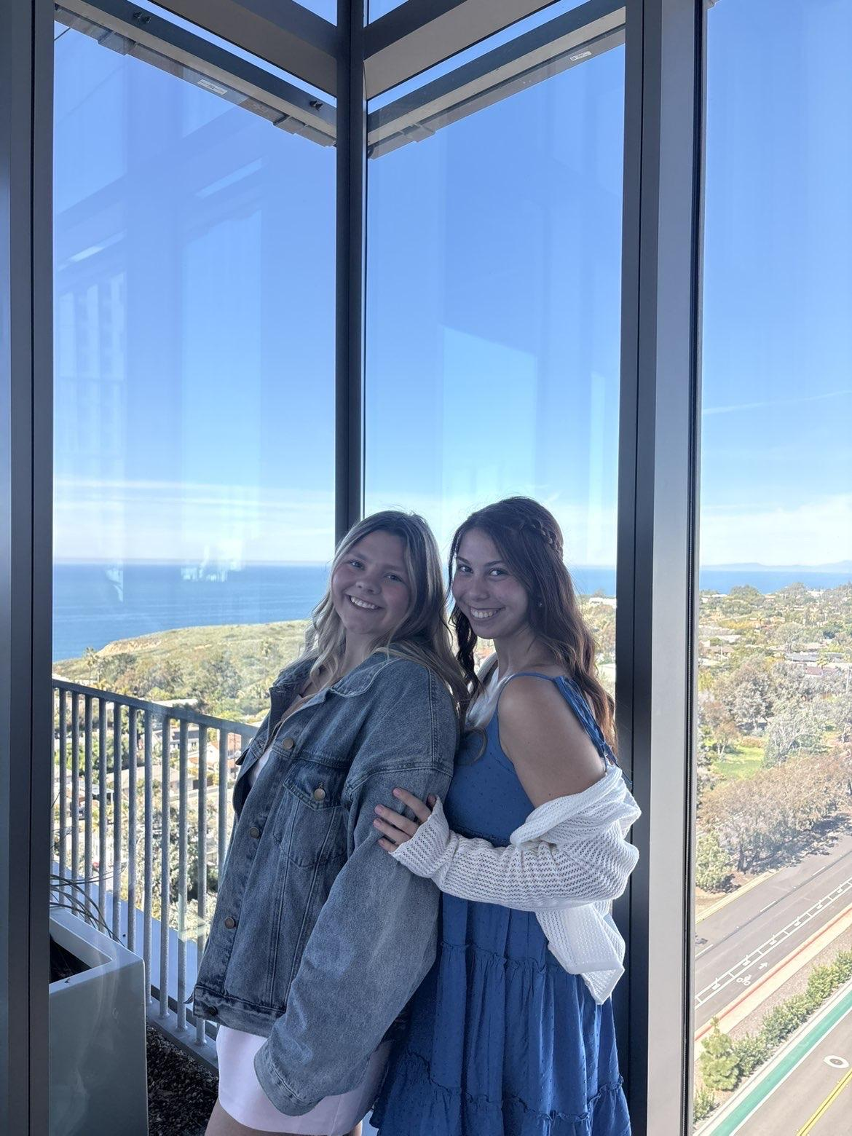
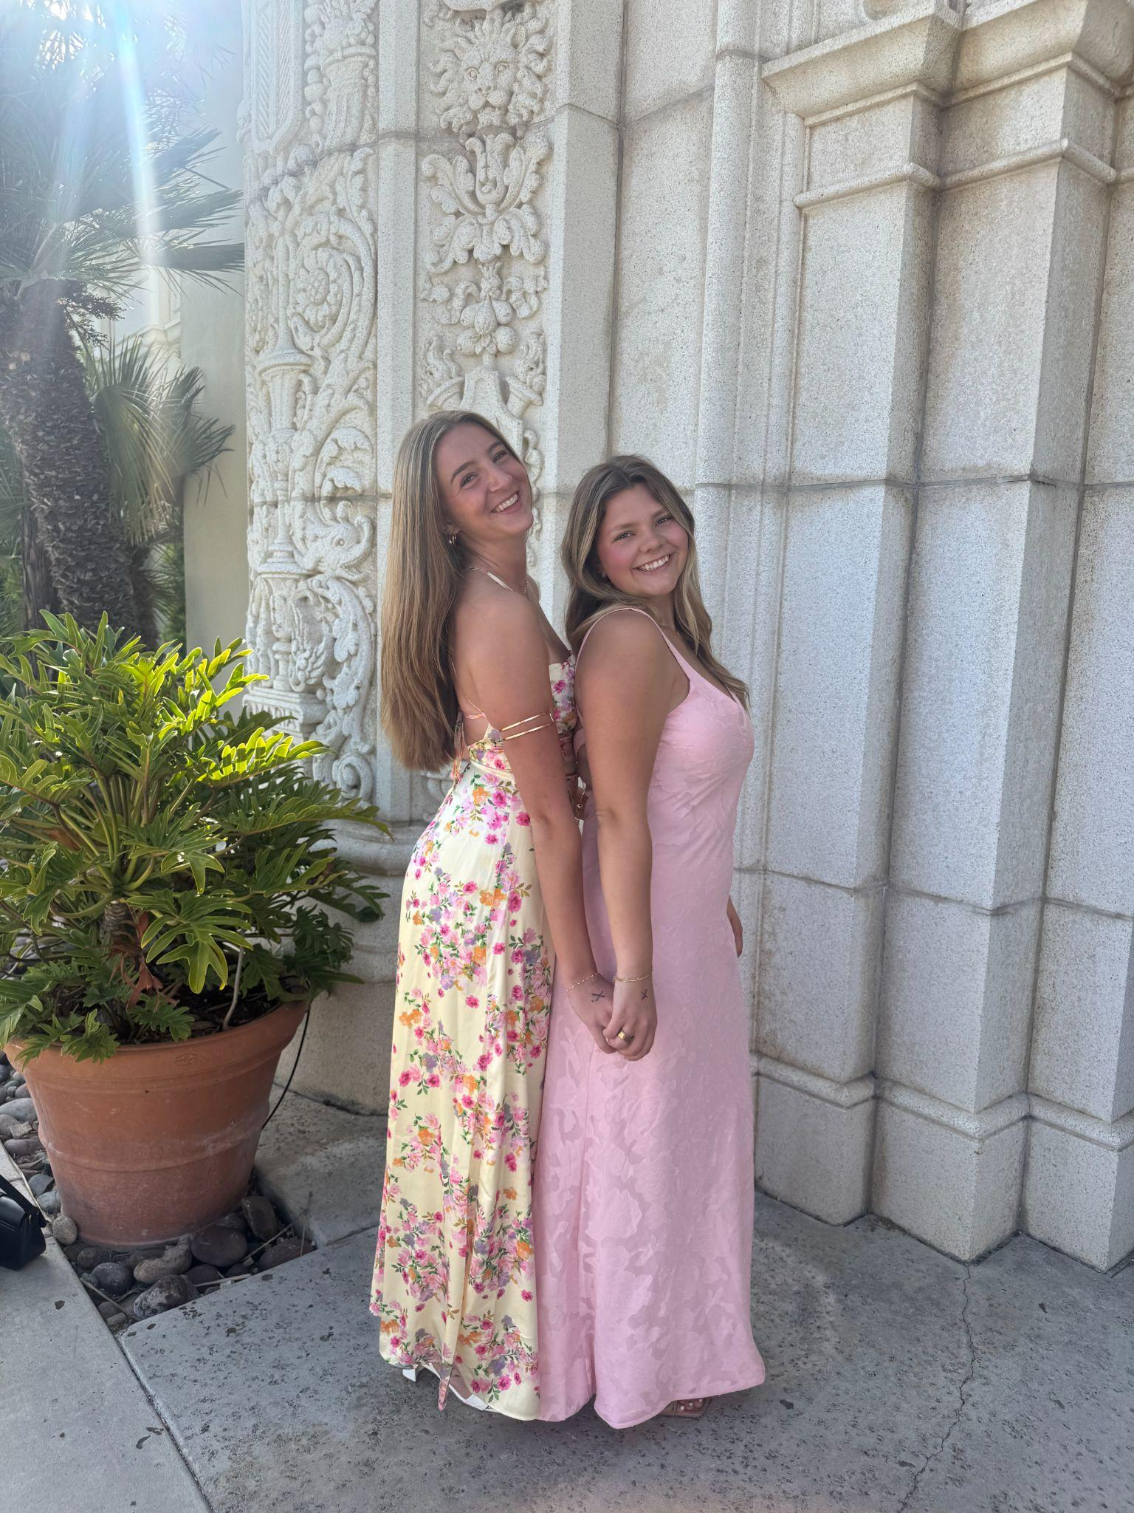
happened in the semester individually, with friends, groups, locally, nationally
Josie Wilson Time Capsule
Notes:
Theta has given me so many friendships and opportunities to connect with new people. Our events have been so fun. Us at founders day, date dash, and forma

Slide 4
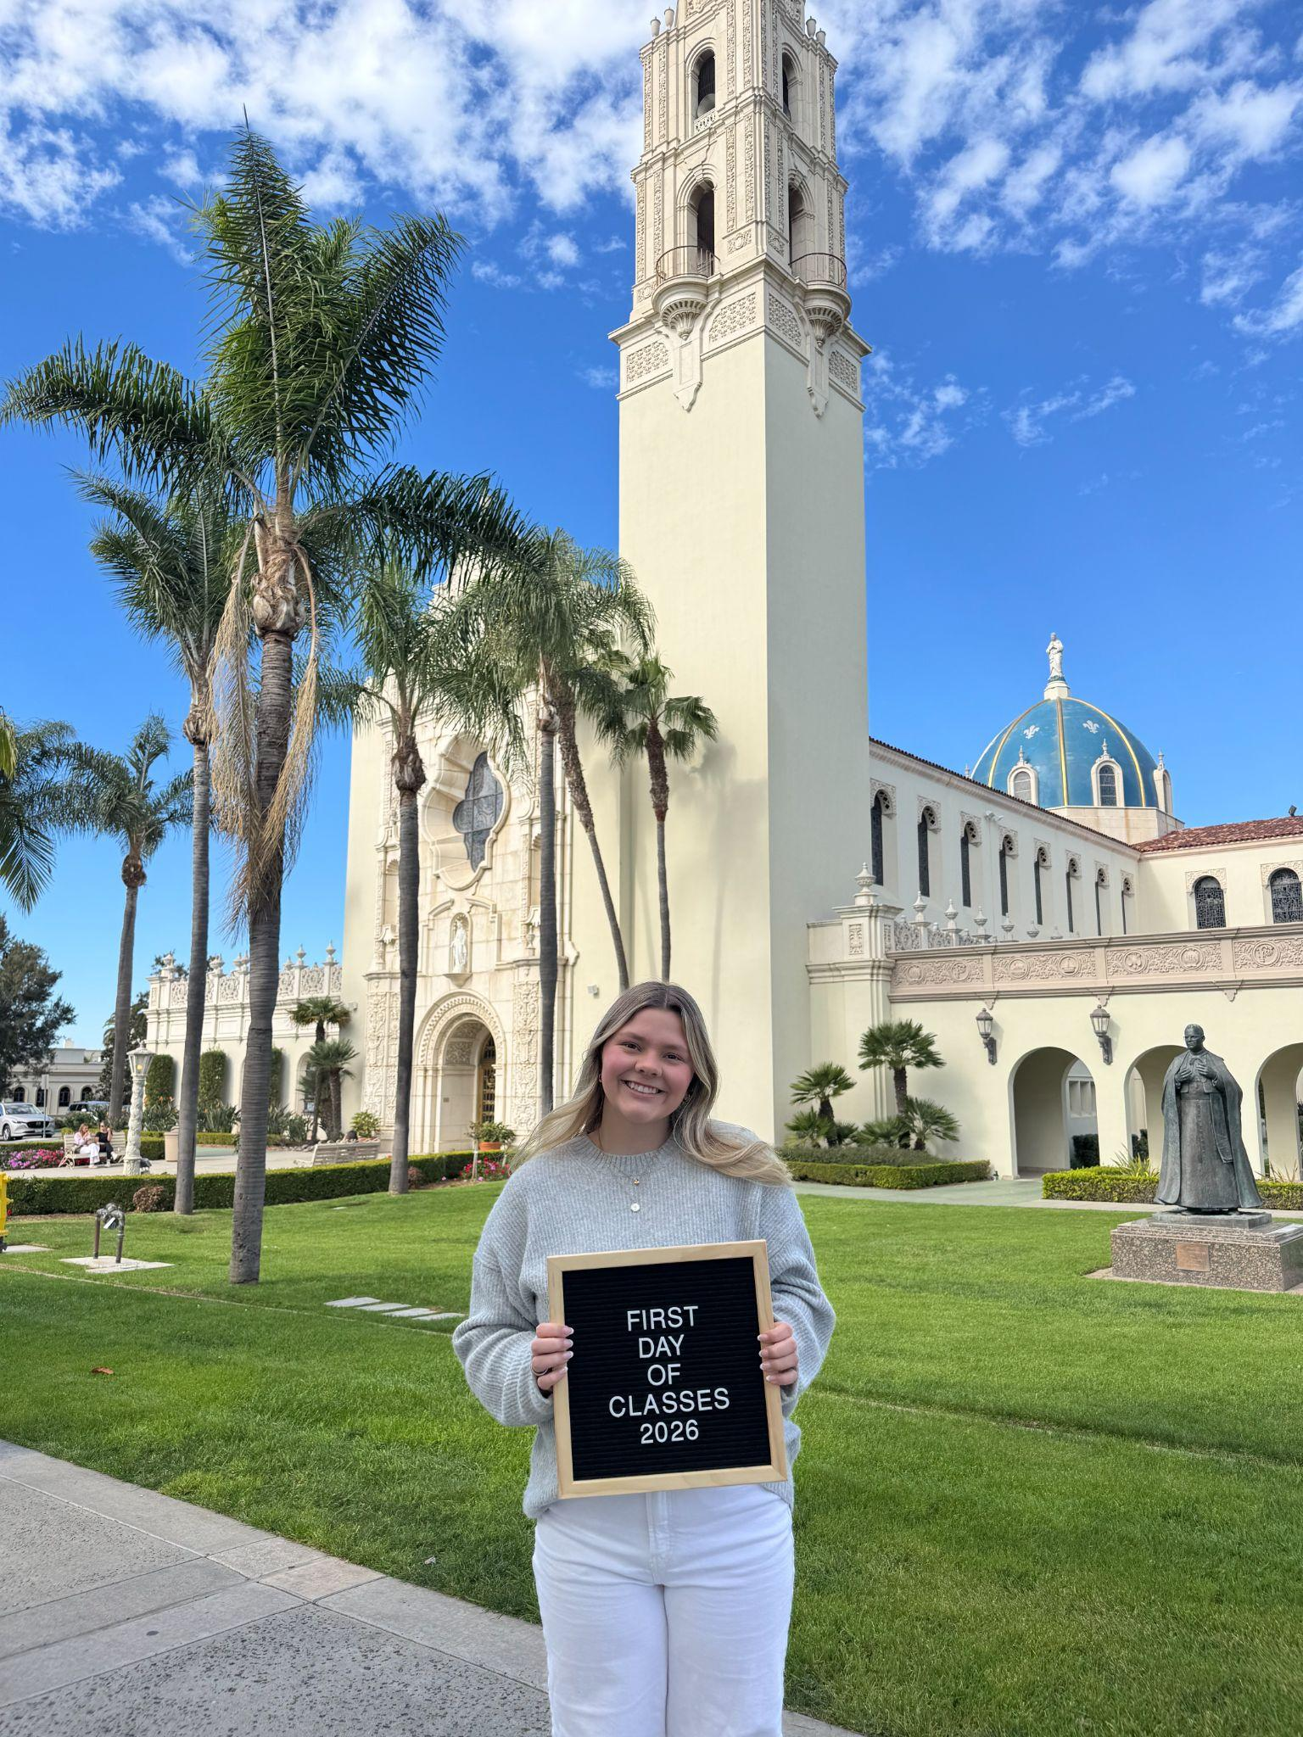
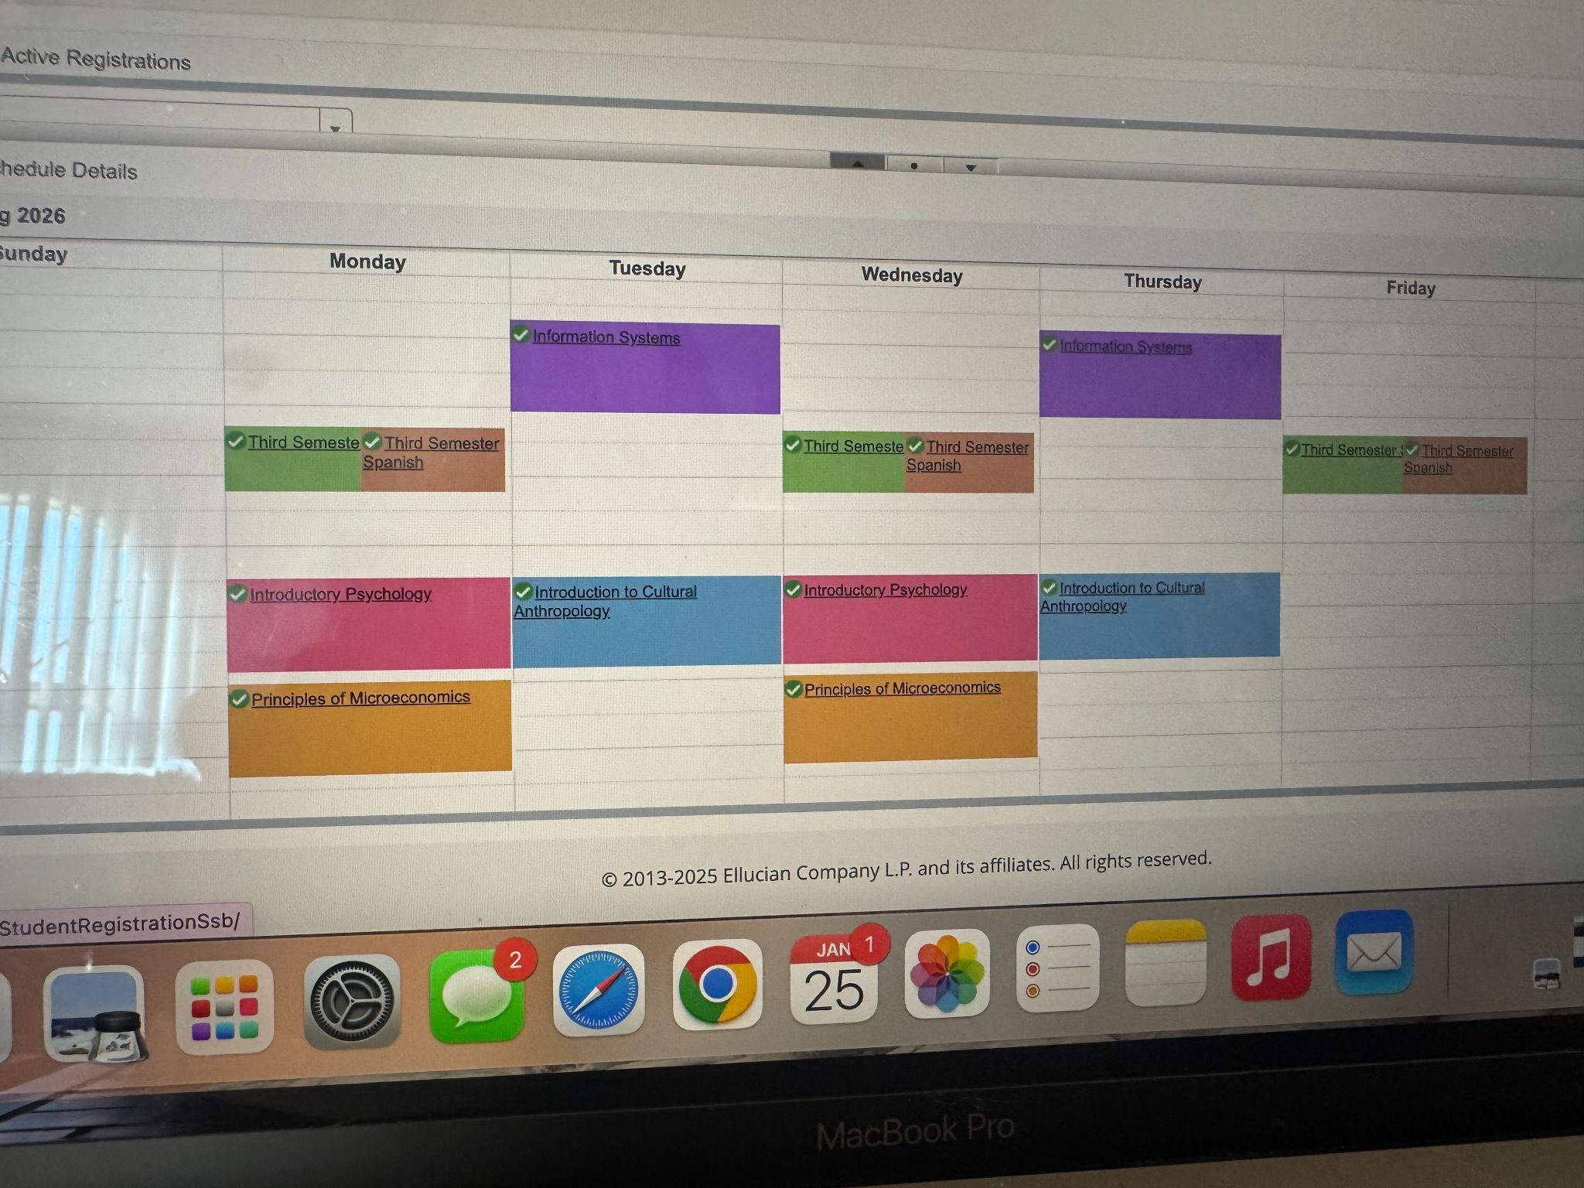
Items that did not happen that you wanted, expected
Josie Wilson Time Capsule
Notes:
I expected my classes to be easier to handle and it was an adjustment of the workload from high school and even last semester to now.

Slide 5
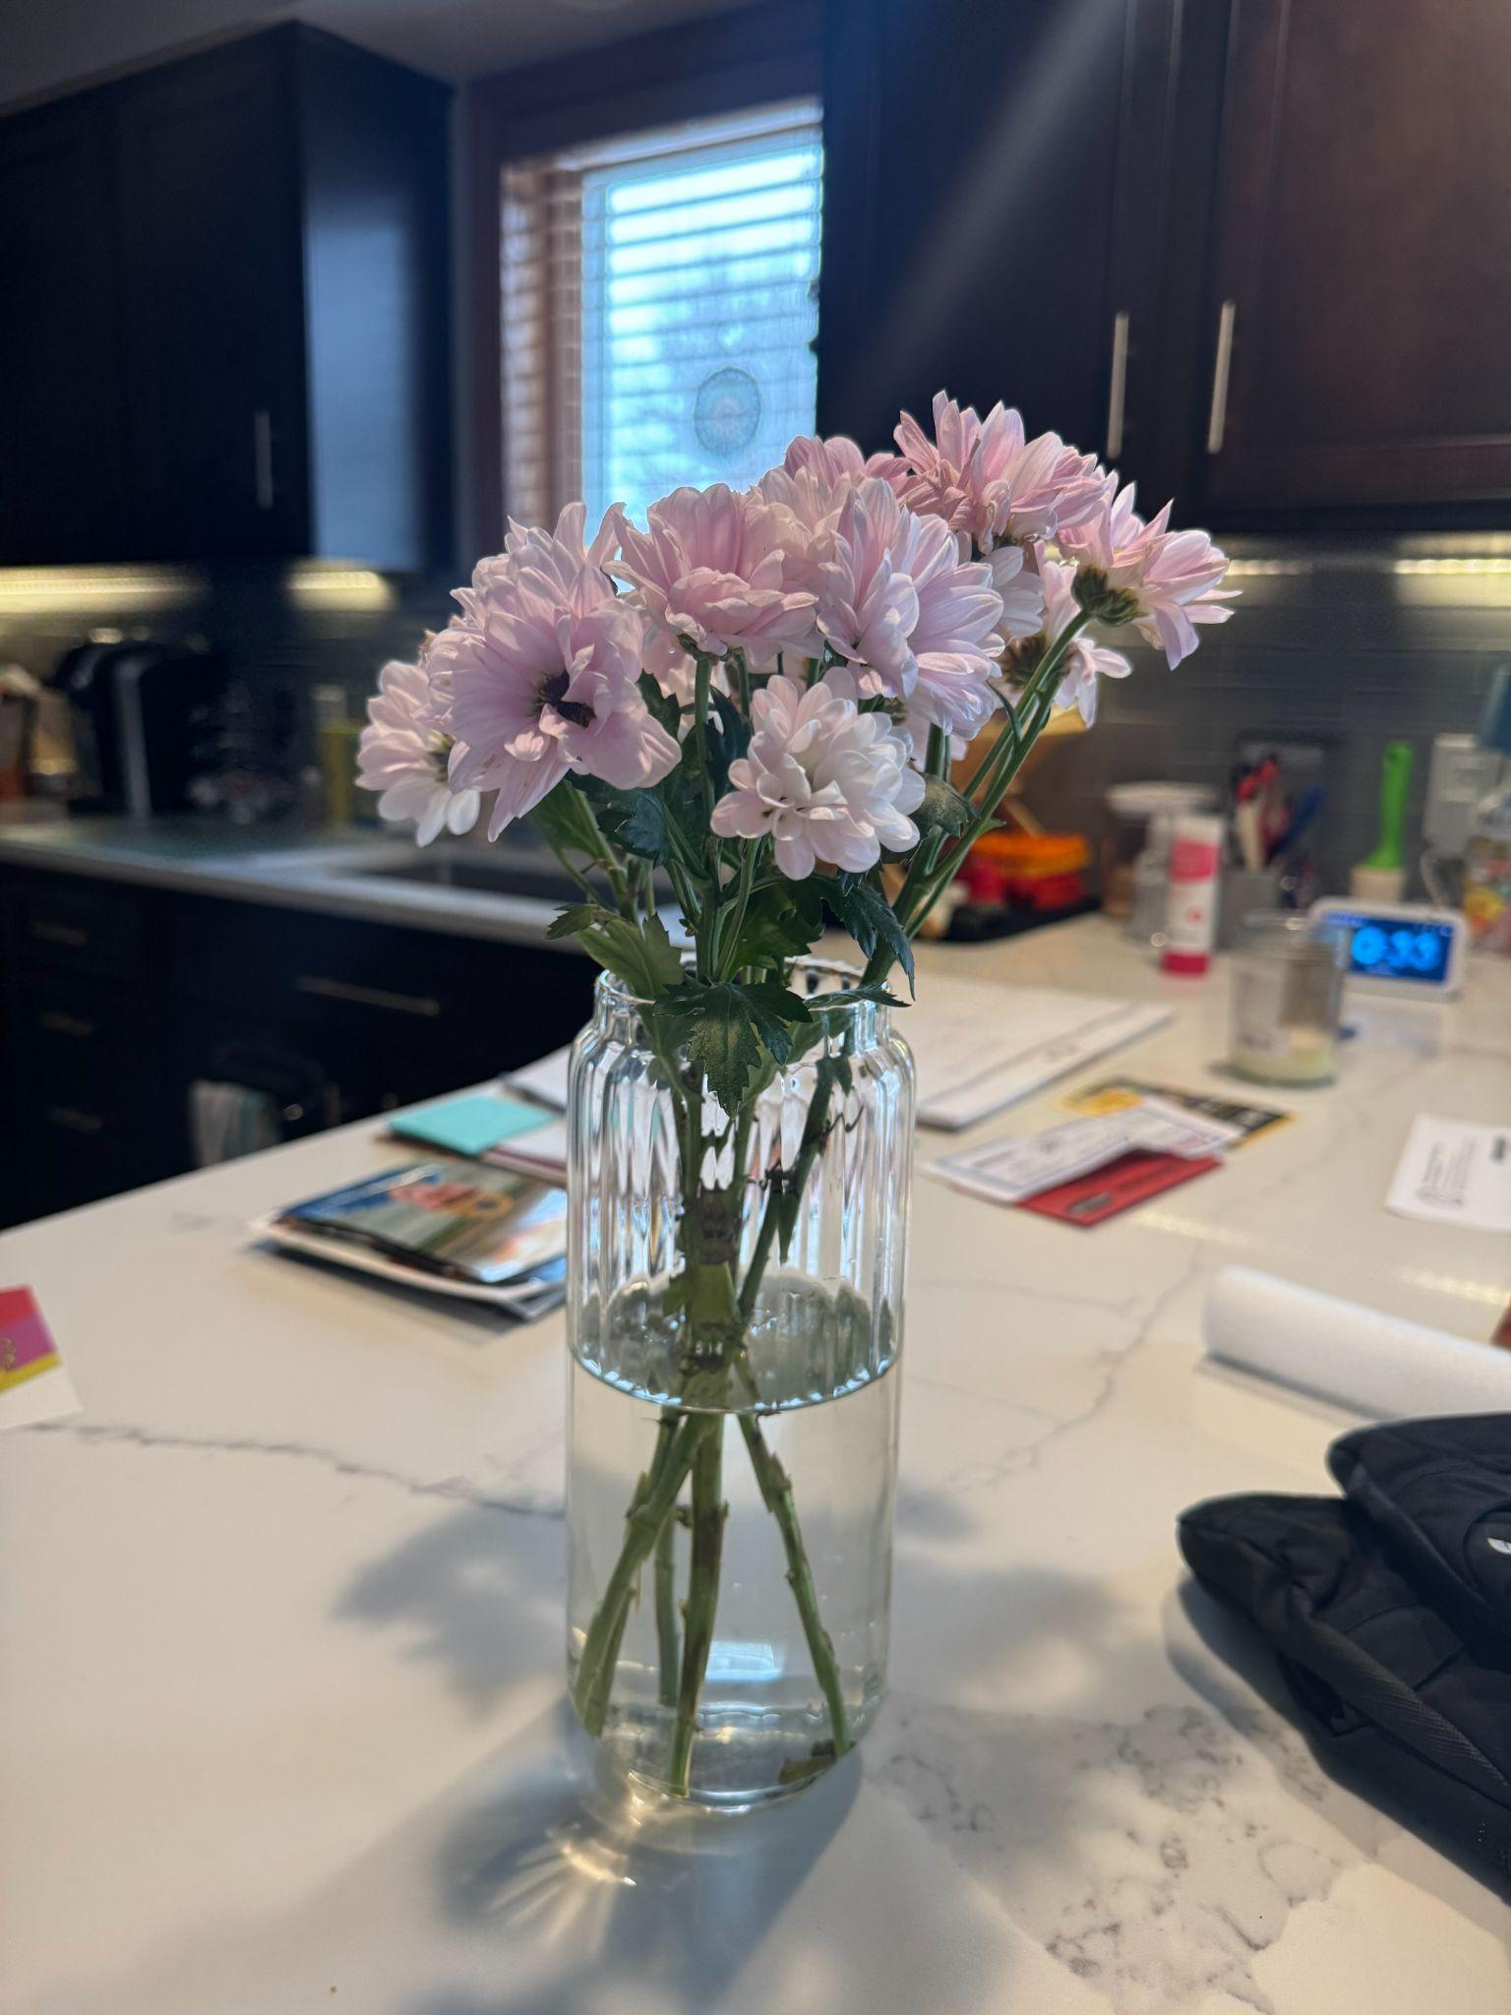
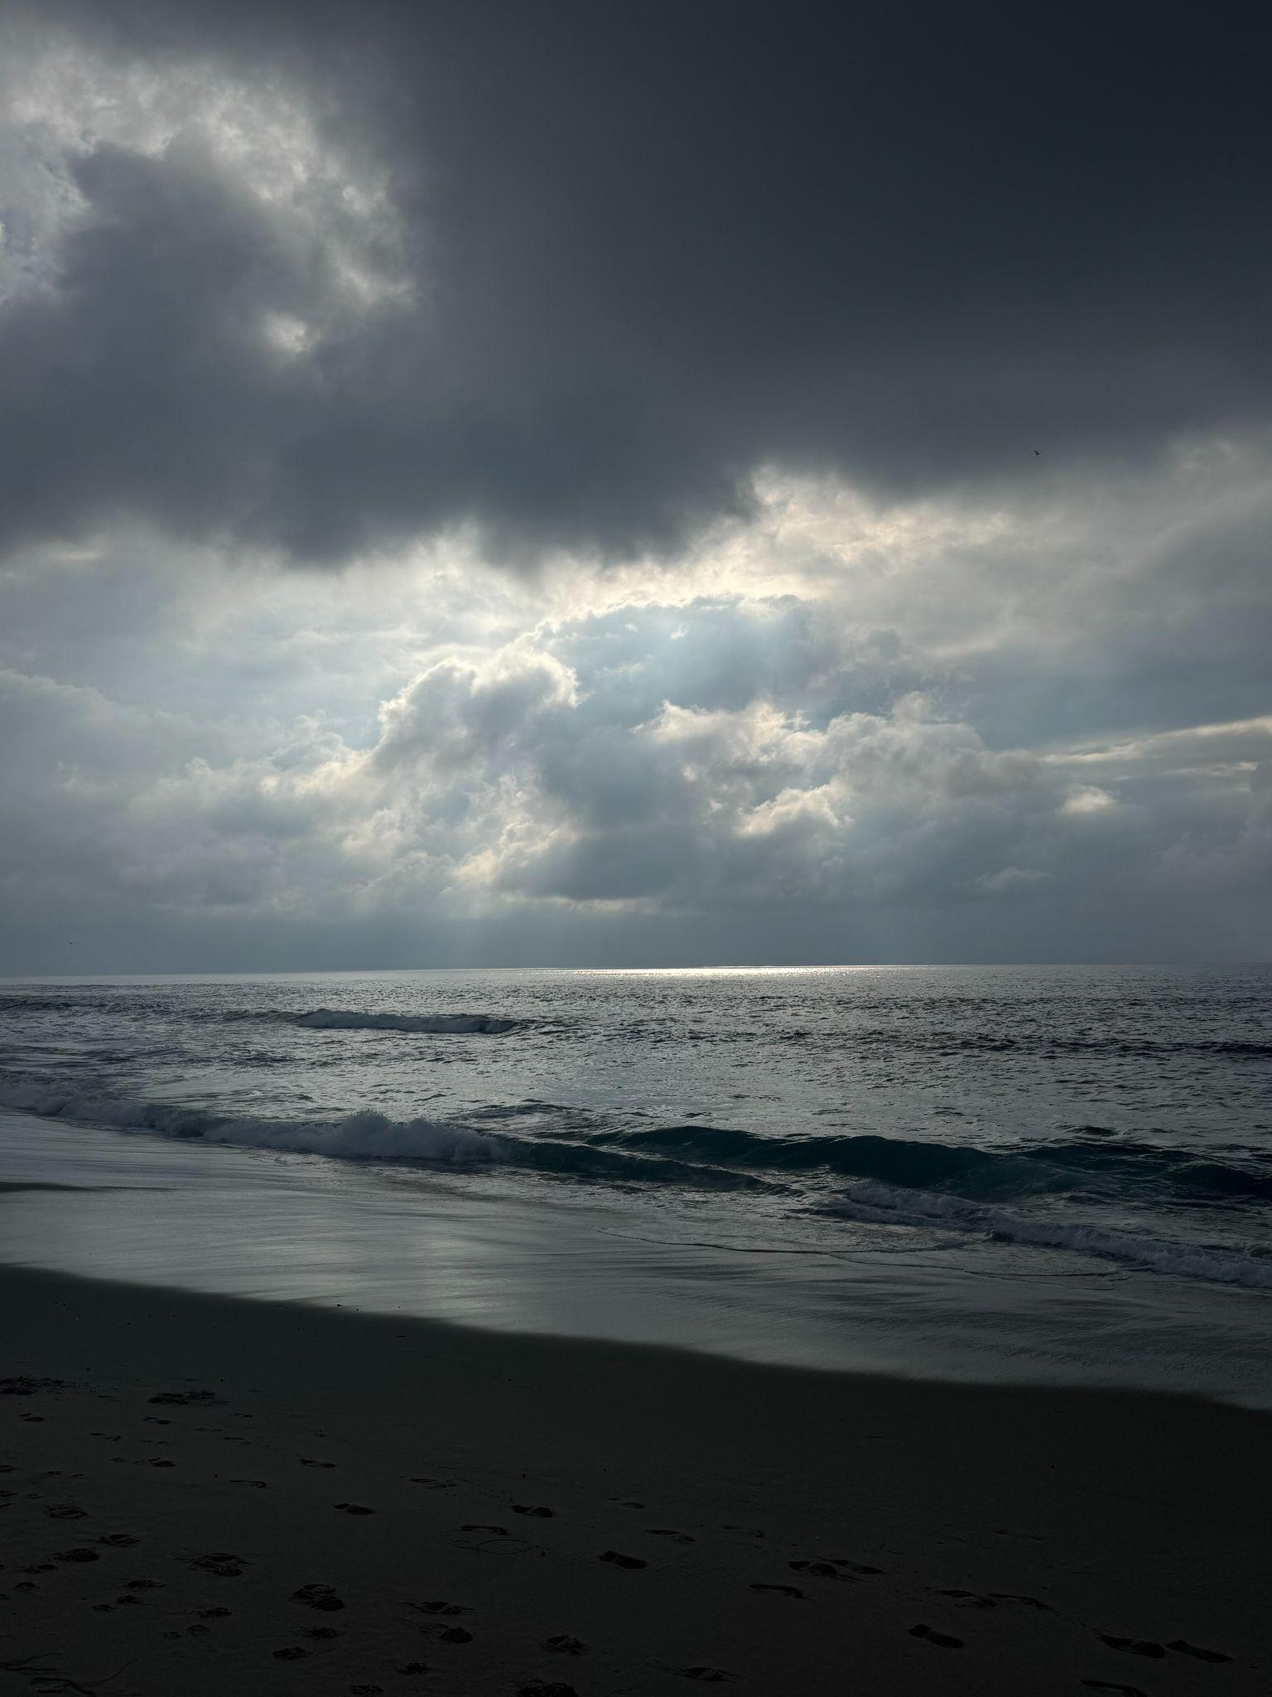
Items that you experienced that were sad or negative that you wish not to be experienced again
Josie Wilson Time Capsule
Notes:
I went through a relationship change over winter break which led the start of my semester to stressful trying to balance the start of a sorority, new classes, a leadership role, and new friendships.

Slide 6



Items that were highlighted by news, media advertisements/messages, government, other countries, other sources
Josie Wilson Time Capsule
Notes:
I listen to a lot of music so there was a lot of great music released this semester. Ella Langley,

Slide 7
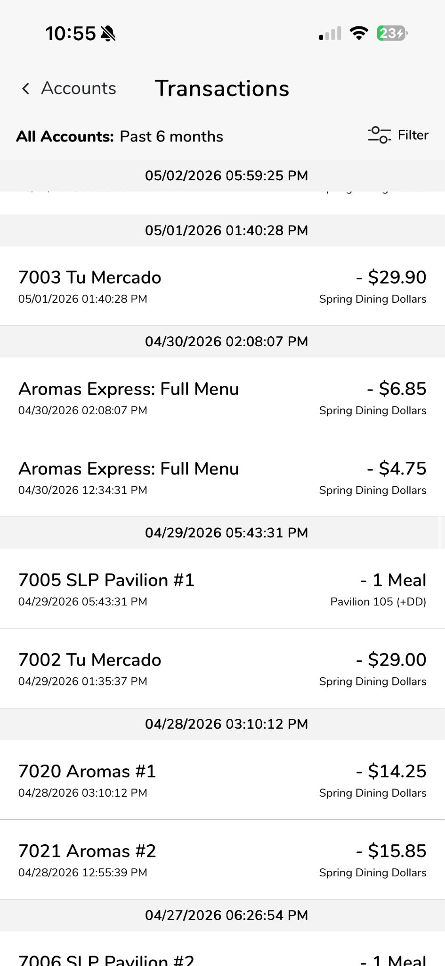
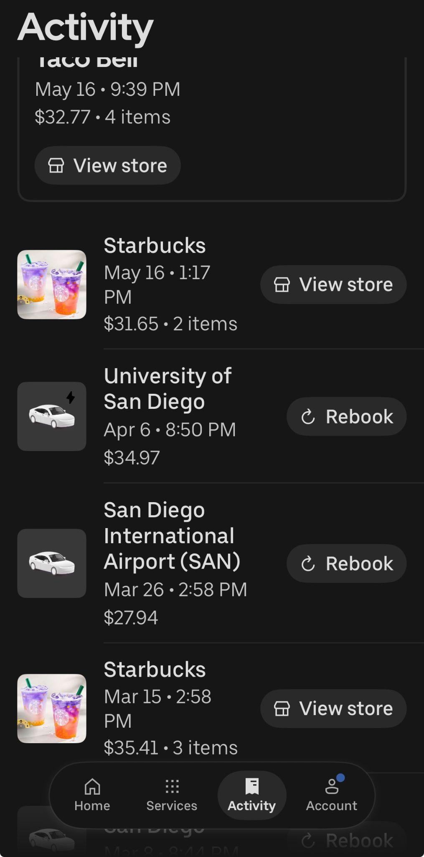
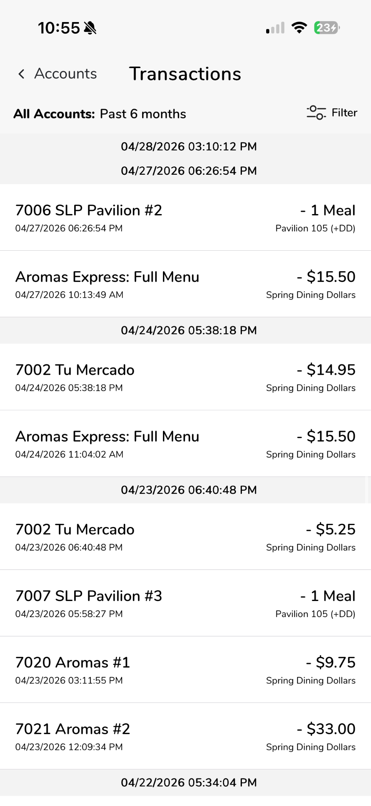
Items that illustrates changes to processes (buying food other items), laws/restrictions
Josie Wilson Time Capsule
Notes:
Prices have been rising for food, on campus, and especially delivery. Since I dont have a car, and its the end of the school year i’ve been doordashing and stuff which is very expensive. The food on campus has also been getting more expensive but the amount of dining dollars doesn’t change, therefore there is less access to the amount of food students can eat.

Slide 8
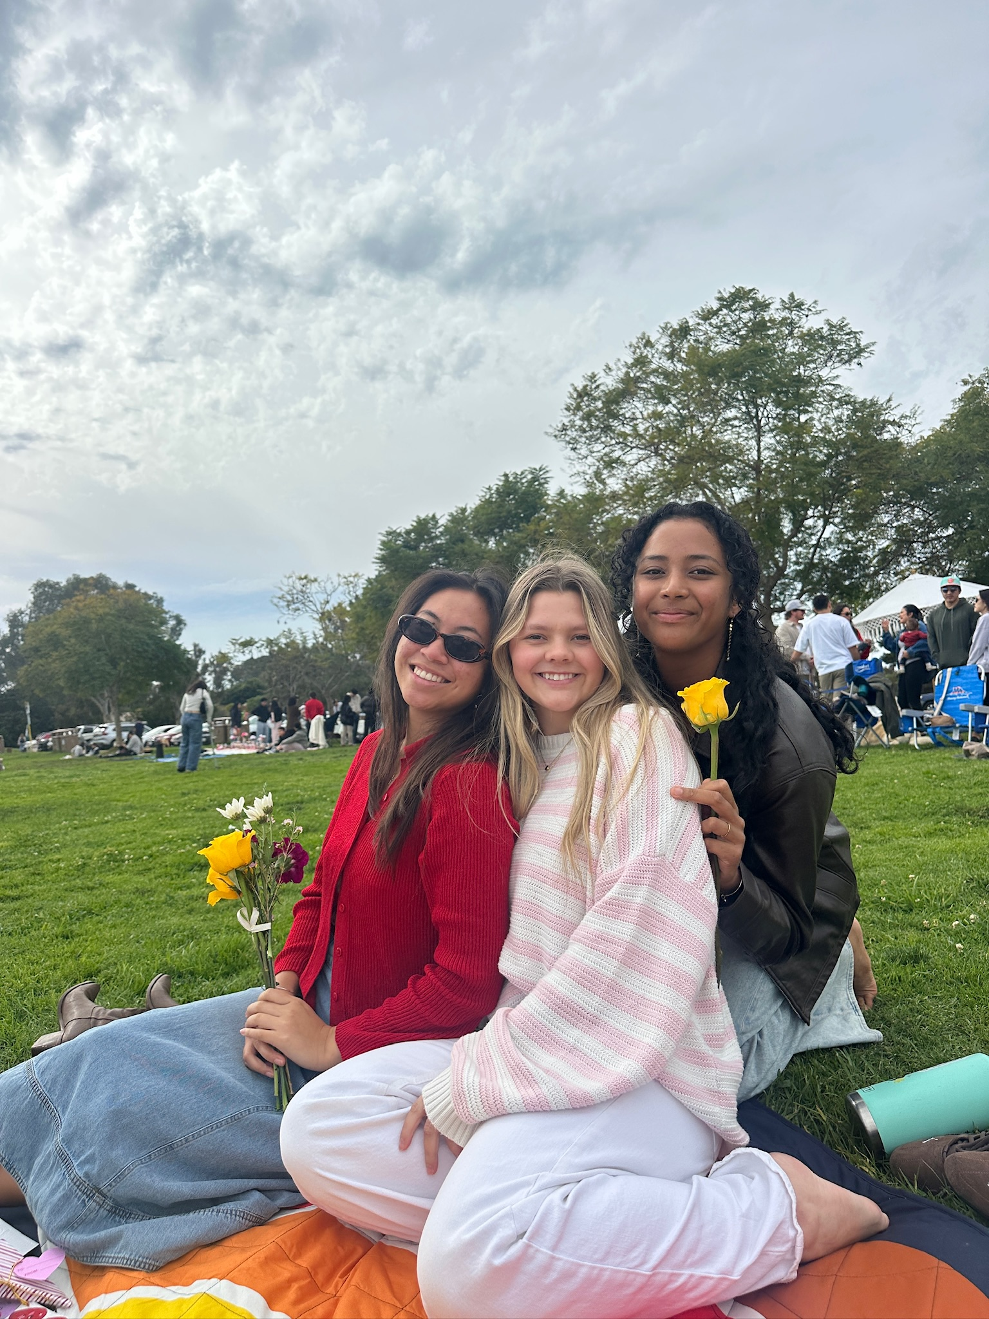
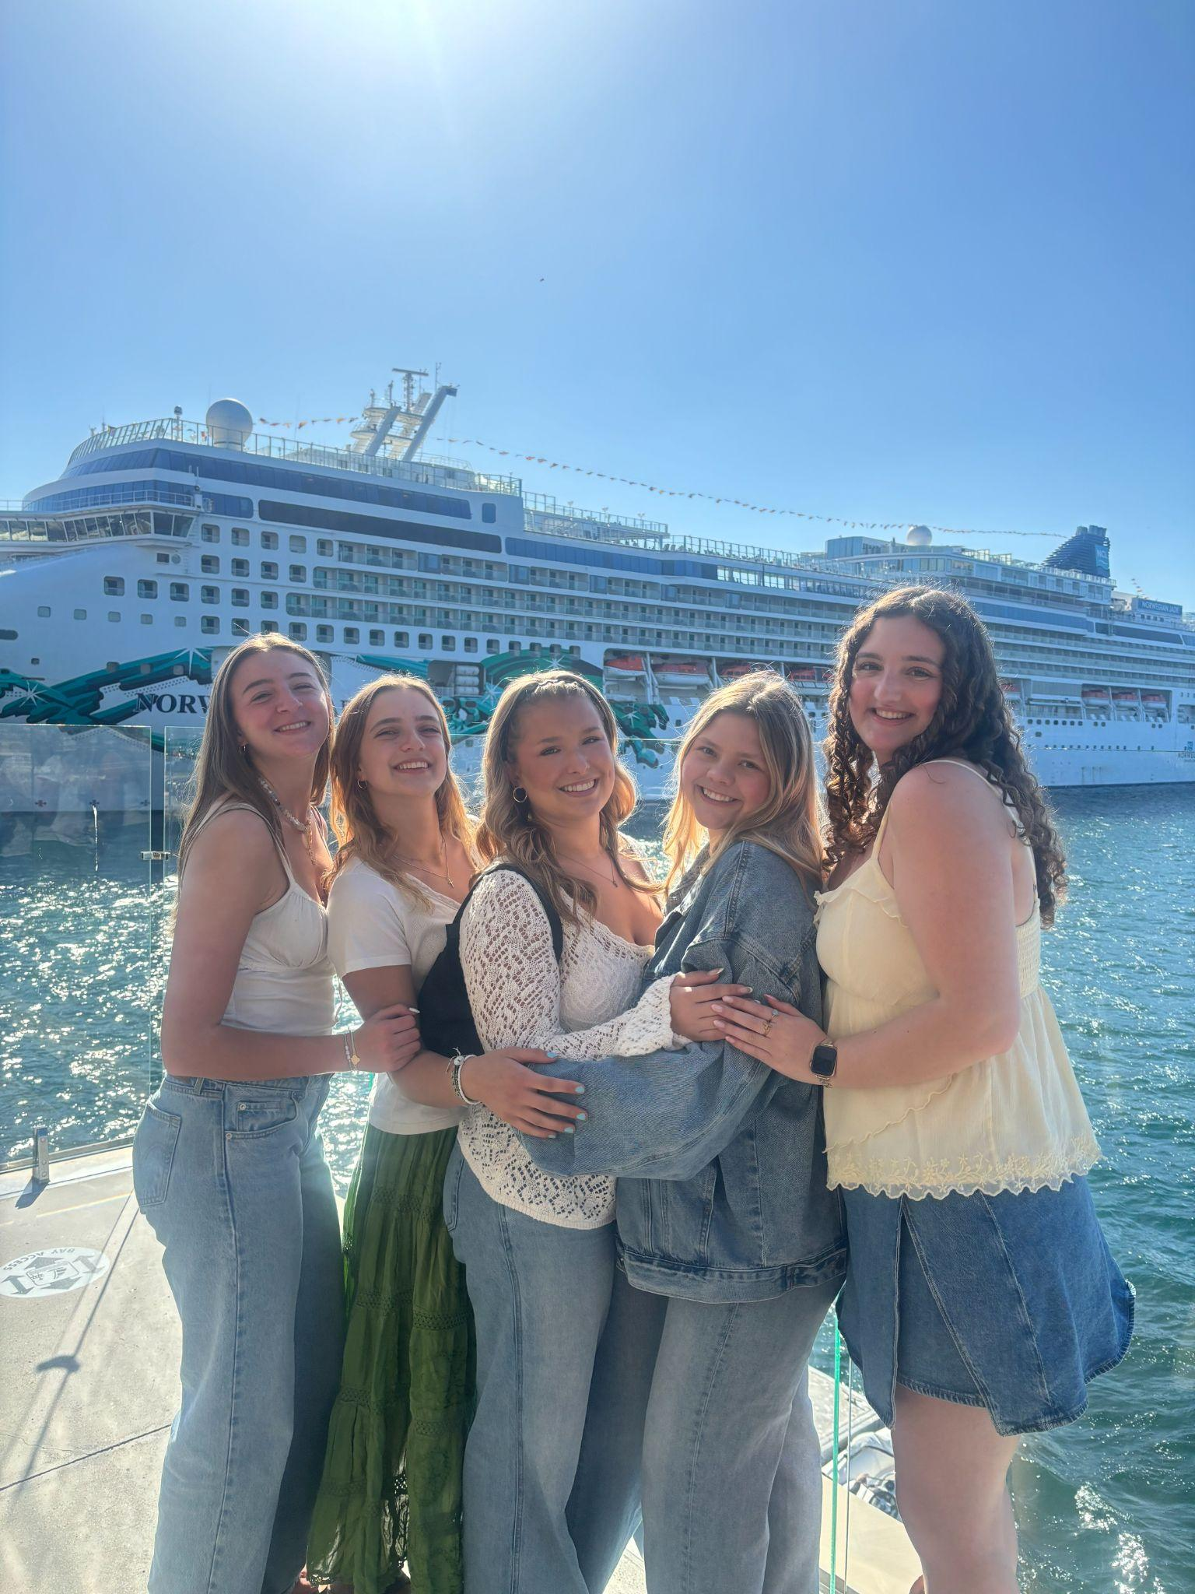
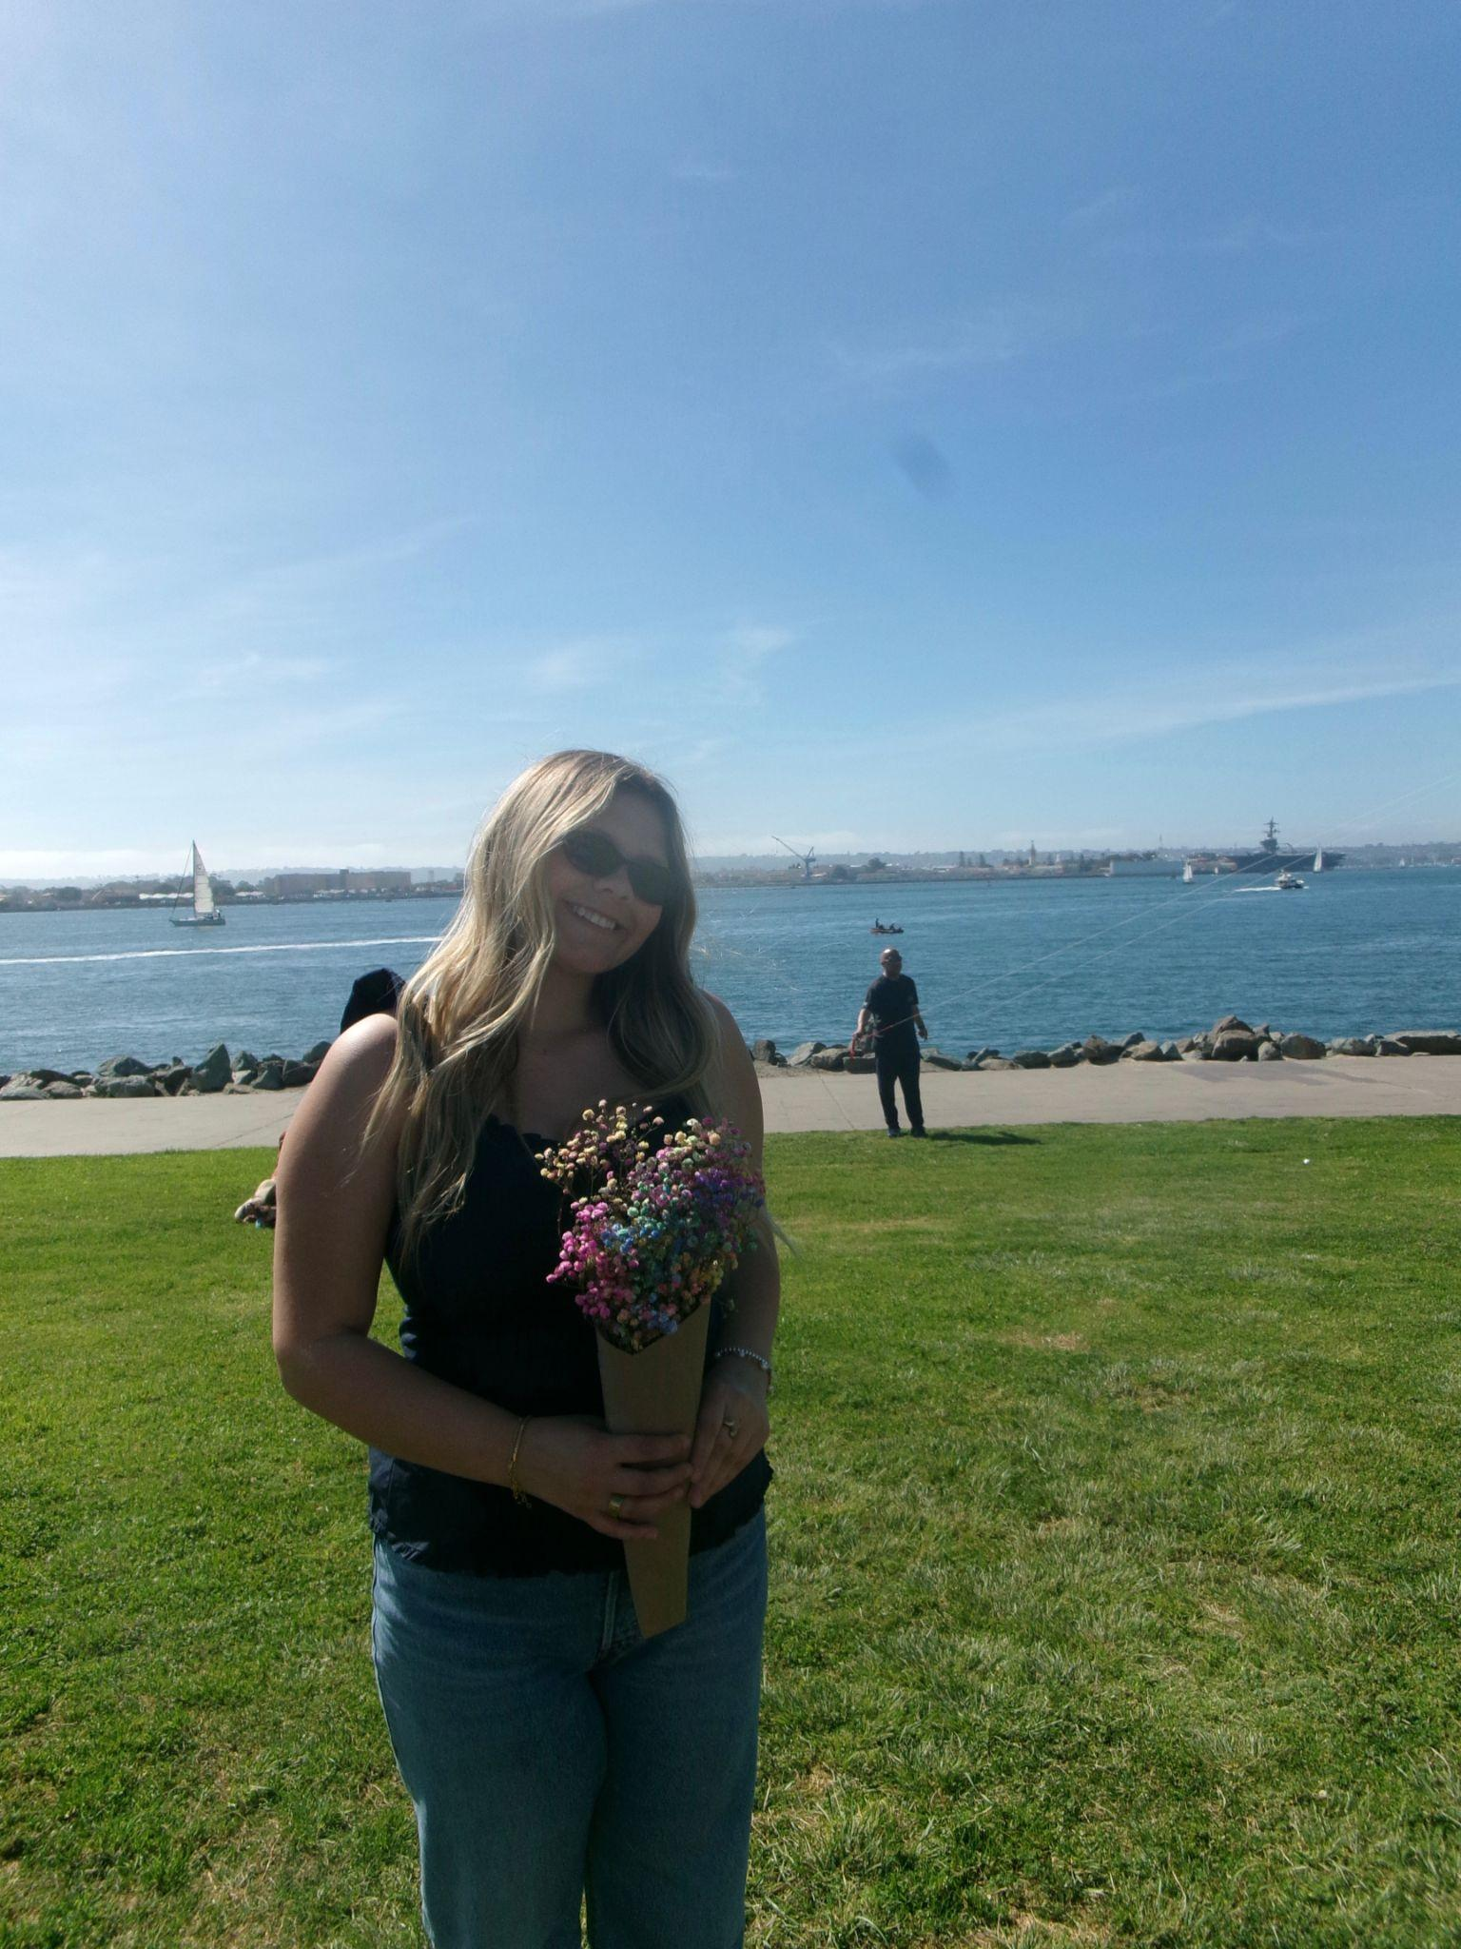
illustrates people’s creativity to assist other
Josie Wilson Time Capsule
Notes:
My friends from Intervarsity created a tradition to get together for people’s birthdays. They all came together to celebrate my birthday. We have celebrated our friends bdays too. We also did a get together for valentines day to just show appreciation for one another.

Slide 9
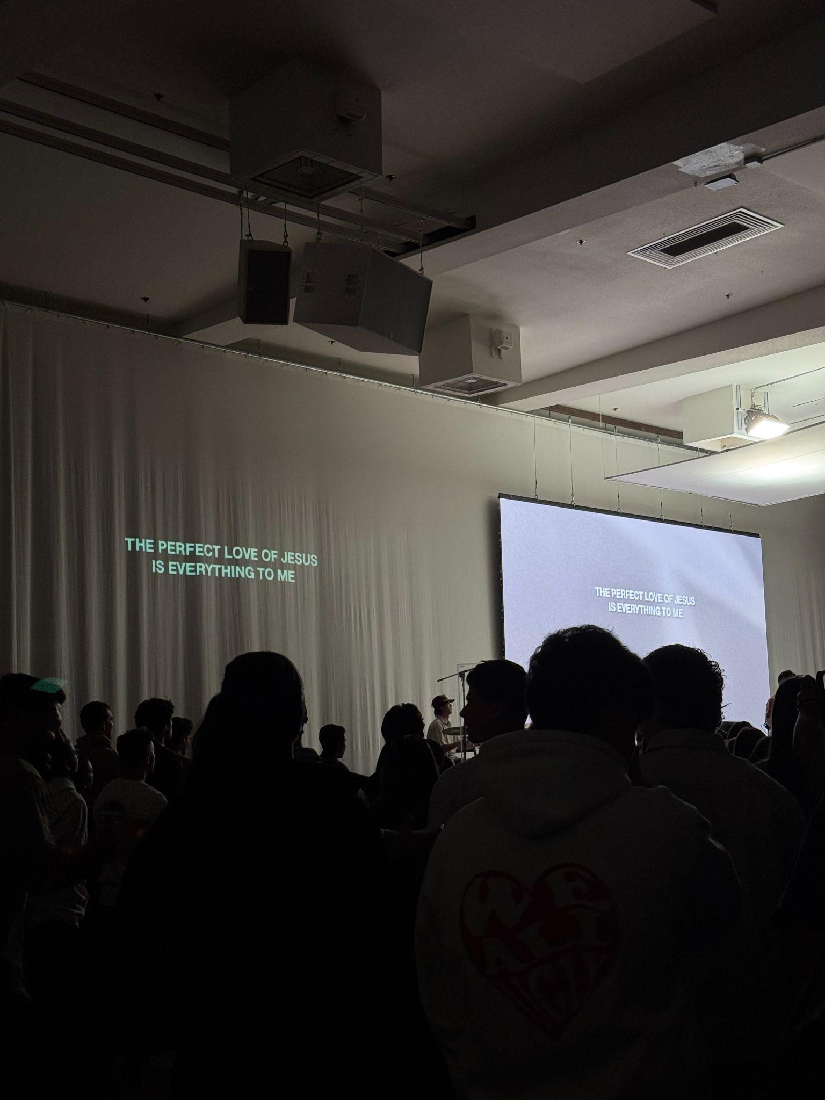
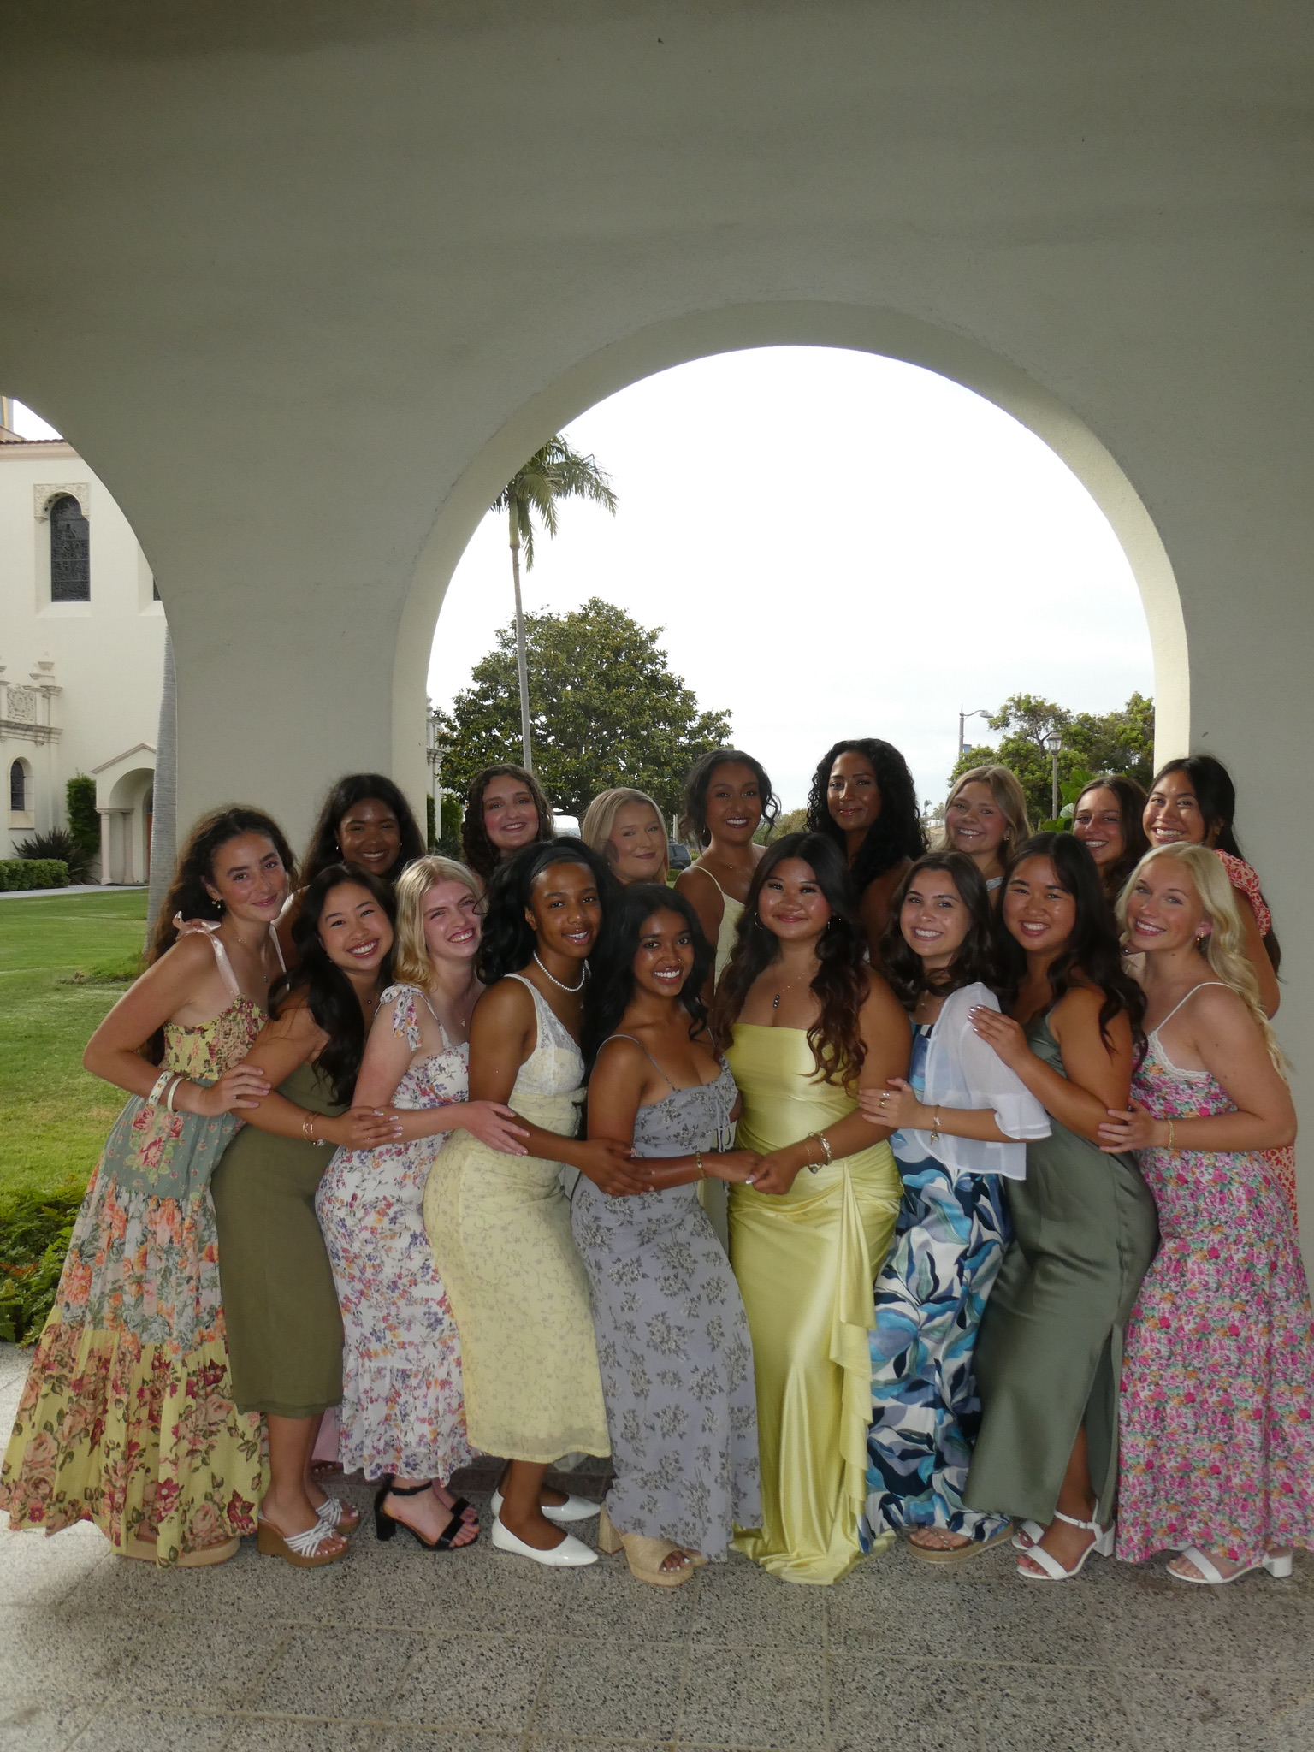
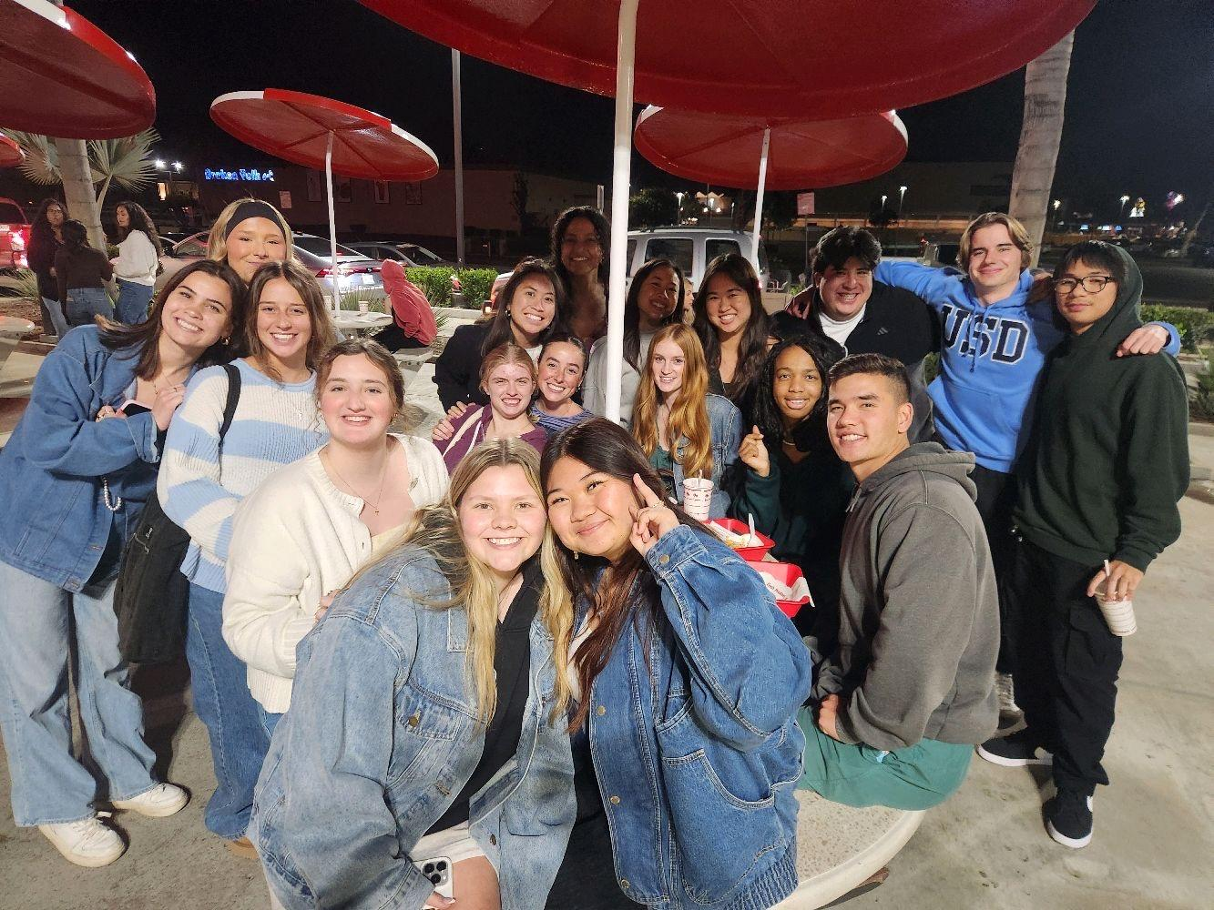
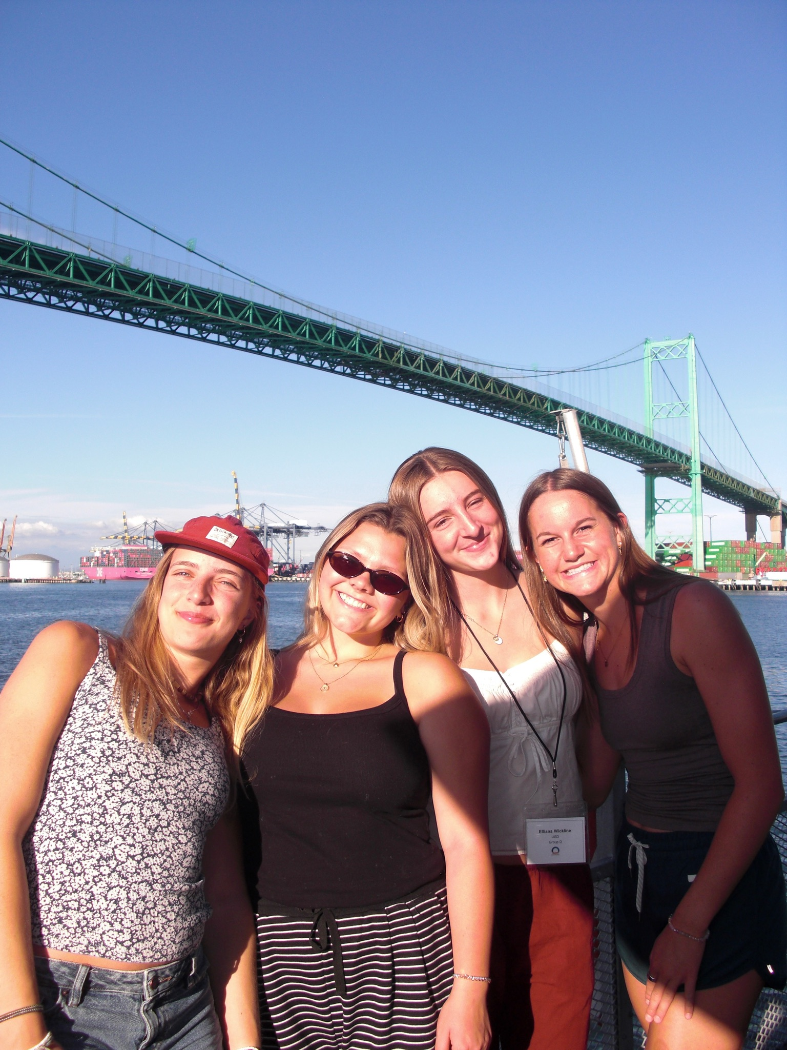
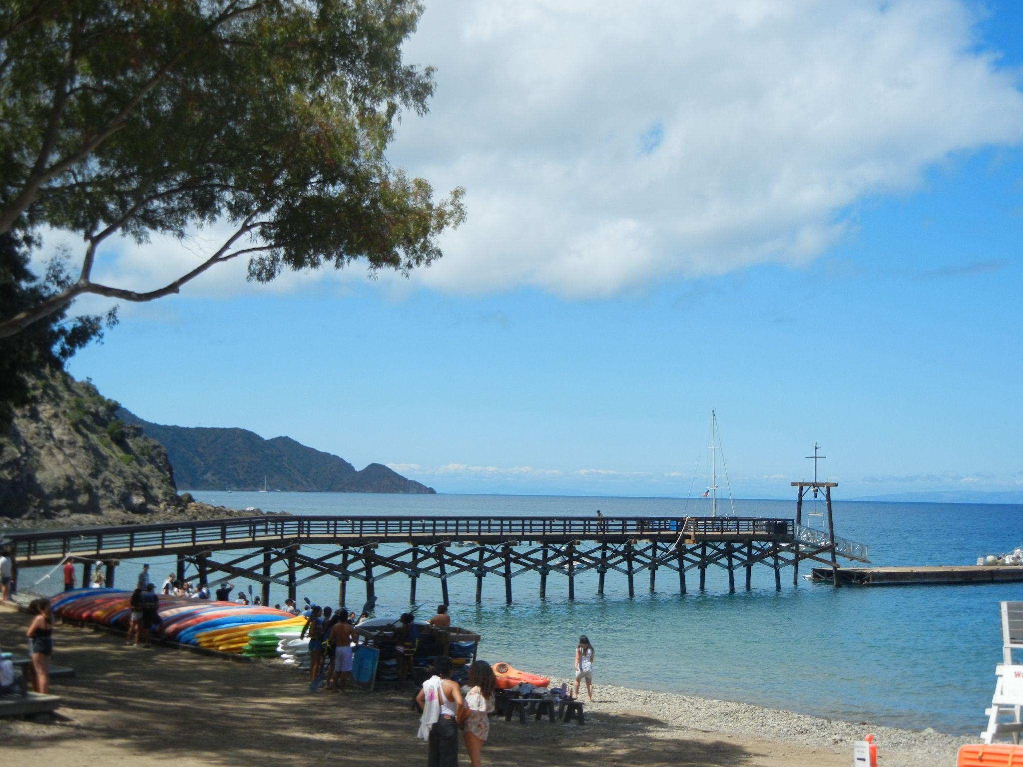
Items that you experienced that have touched your life this semester in an positive way
Josie Wilson Time Capsule
Notes:
Became a leader for Intervarsity Christian fellowship and became so much closer to everyone. Also started going to college ave young adults church which has been a great place to grow my faith. We went on a retreat to catalina island which also brings eveyerone so much closer.

Slide 10
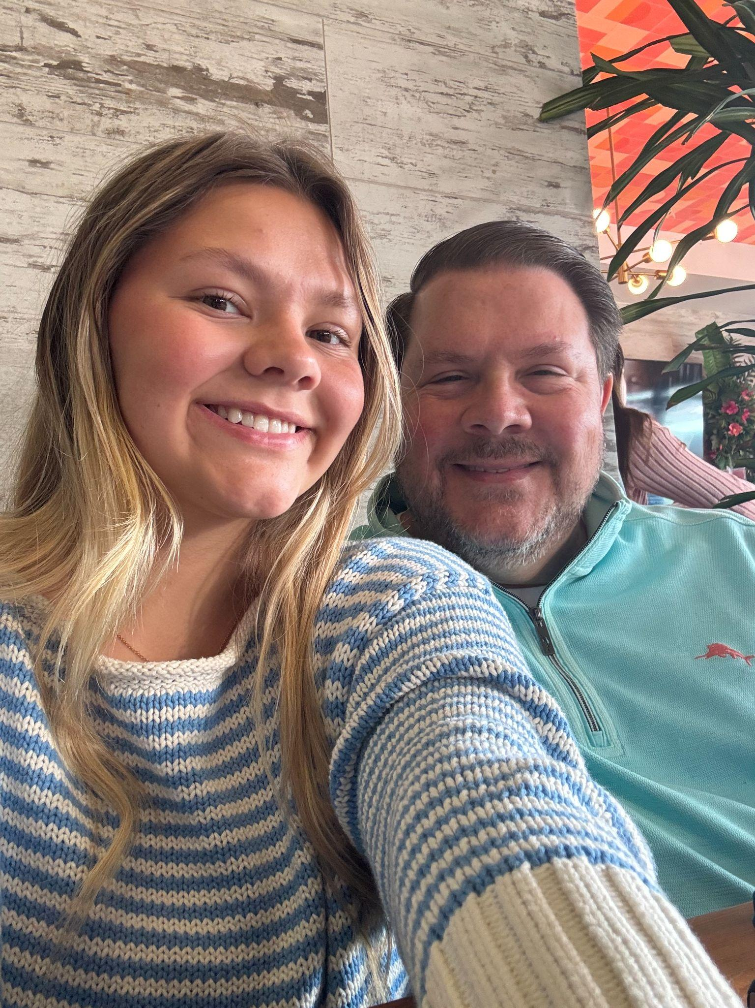
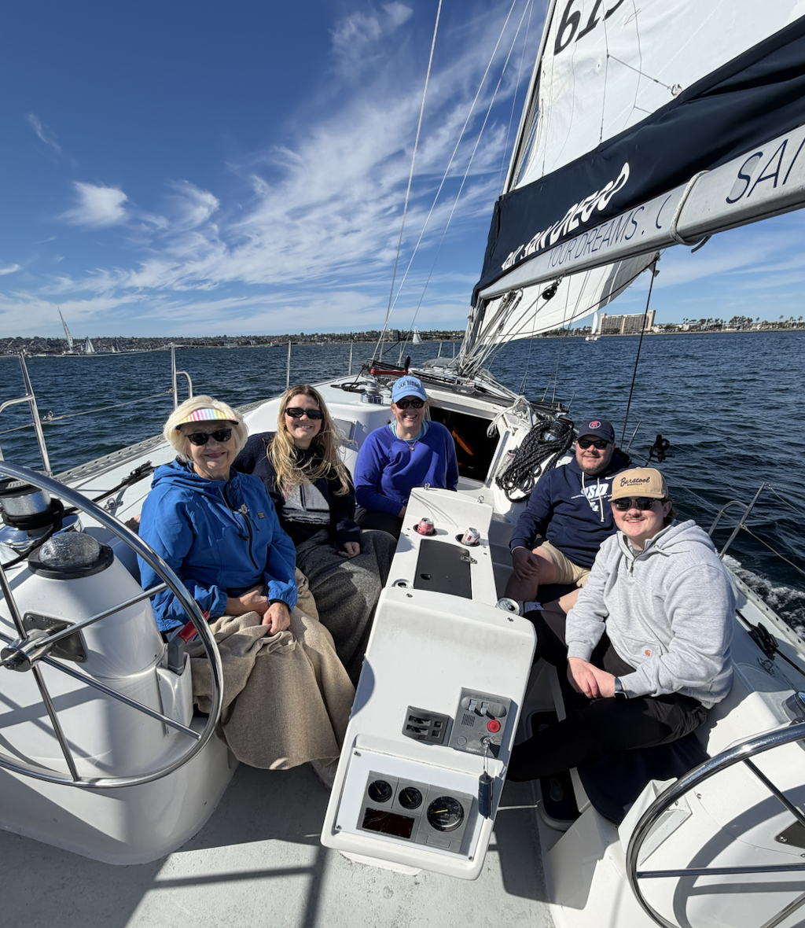
Other relevant items
Josie Wilson Time Capsule
Notes:
My family has come to visit a few times which has been so fun and sweet to share where I go to college and this place i’ve made my home with them.

Slide 11
Thank you!
Josie Wilson Time Capsule

