Slide 1
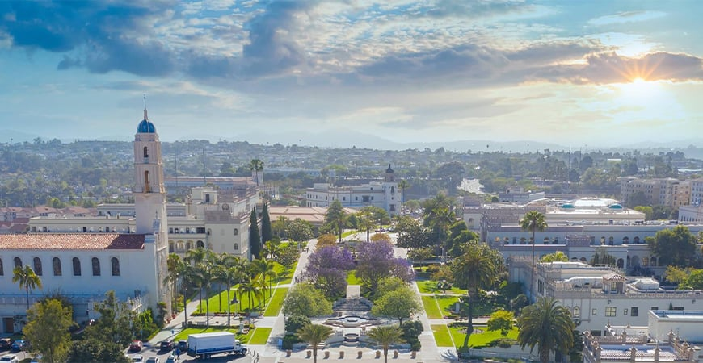
Things that happened in the semester
It was my first semester at USD, and I got to know the lay of the land, meet new people, and understand what I need to do to be a successful student.

Slide 2
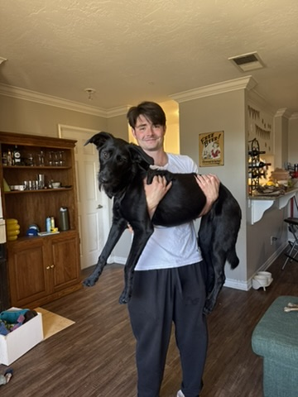
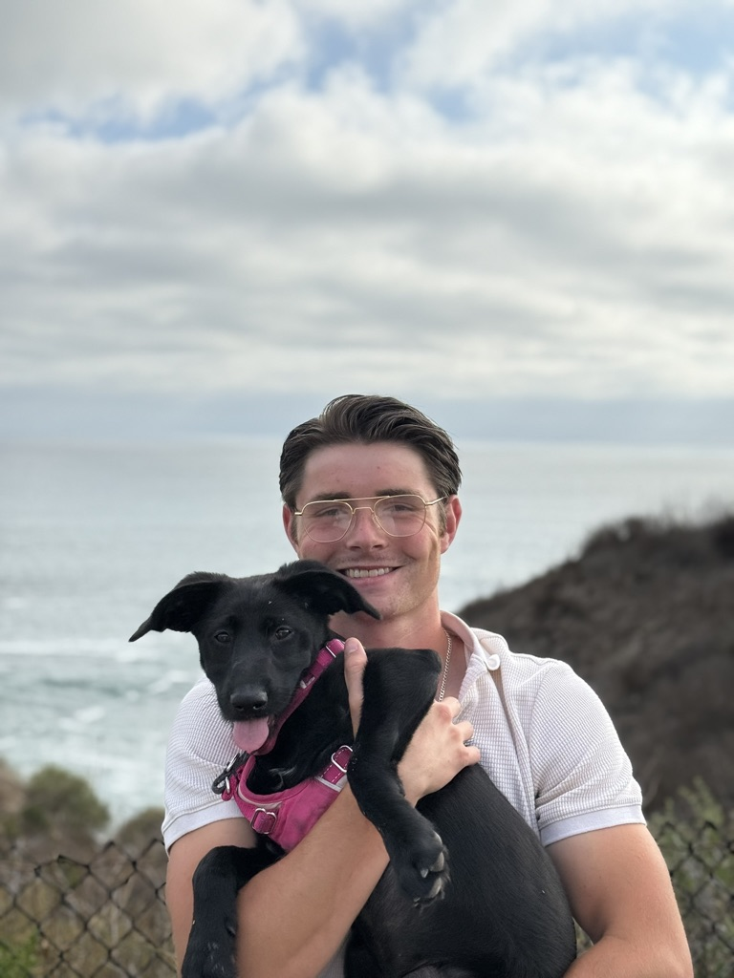
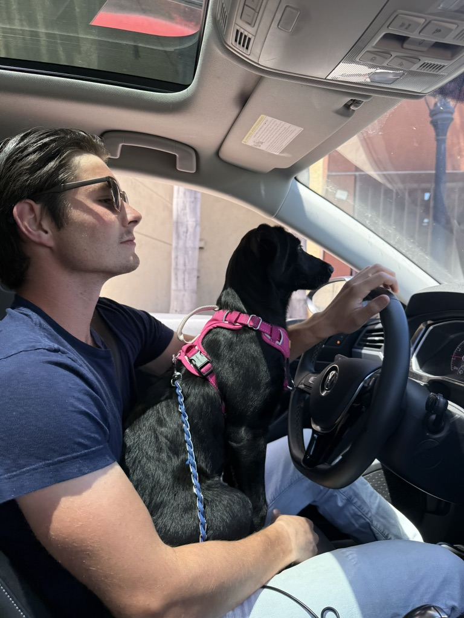
Things that have touched my life in a positive way
Watching my puppy grow into a full-grown dog

Slide 3
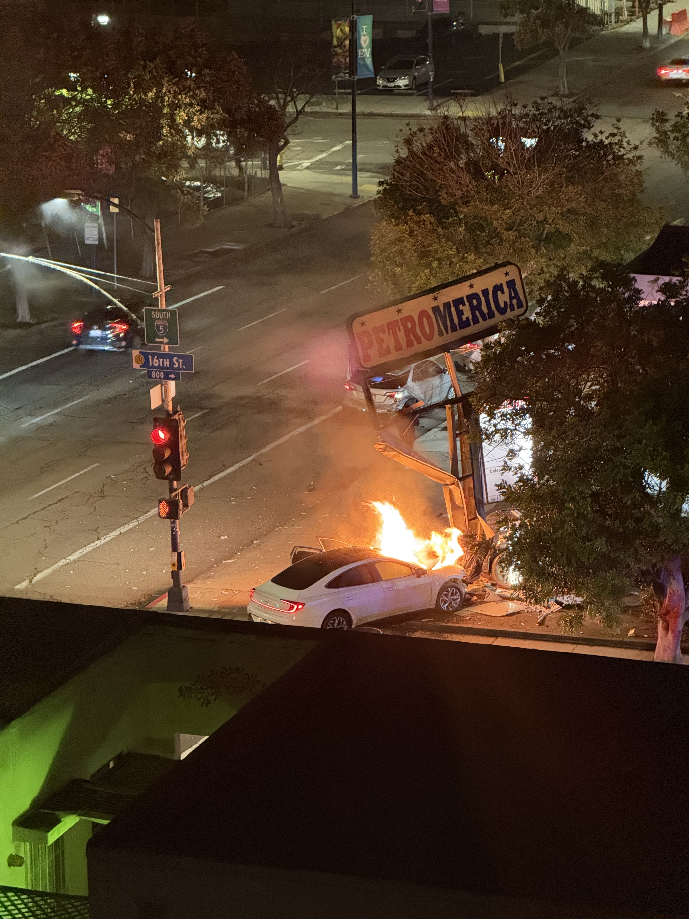
Items that you experienced that were sad or negative
Someone crashed their car into the gas station across the street from my apartment and it caught on fire. Thankfully, it seemed like everyone was okay, but it was pretty bad.

Slide 4
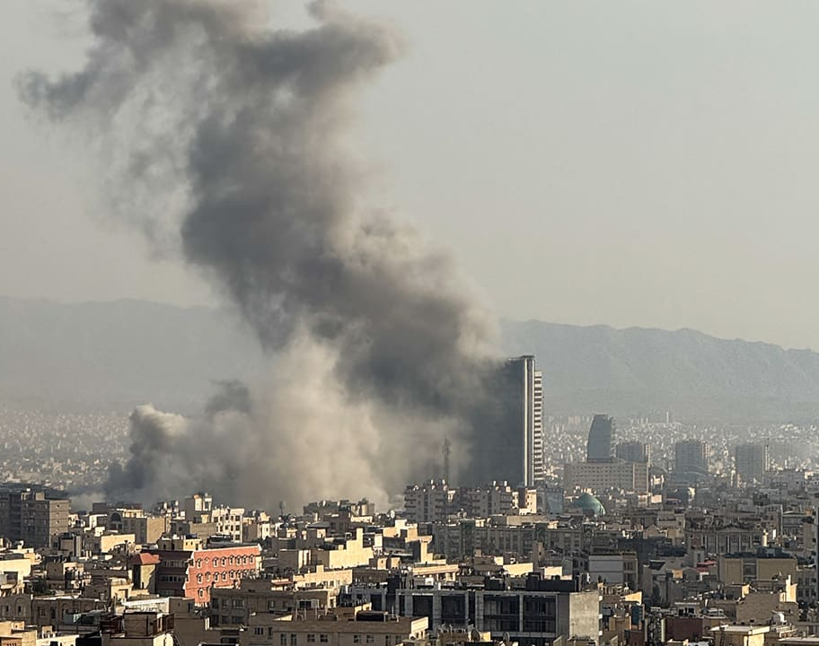
Things highlighted by news
Going to war with Iran
  Oil prices have risen by 50% since the start of the war with Iran.
  The closure of the Strait of Hormuz triggered the “largest supply disruption in the history of oil markets” (PBS News).

Slide 5
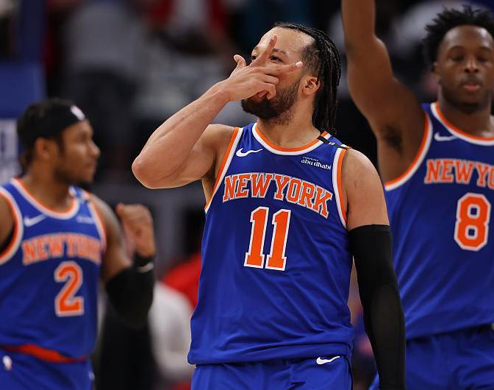
Things highlighted by media
The New York Knicks made it to the Eastern Conference Finals for the second year in a row, after sweeping the Philadelphia 76ers.
  Jalen Brunson (Guard), averaged 26.0 PTS, 3.3 REB, 6.8 AST in the 2025-2026 regular season.
  Karl-Anthony Towns (Center) averaged 20.1 PTS, 11.9 REB, 3.0 AST in the 2025-2026 regular season.

Slide 6

Other relevant items to discuss the semester you had, the semester you wanted, and the semesters that you wish to have in the future.
In the future I want to join more clubs and get more engaged with the student community. I also want to explore various master’s programs and decide if that is something I would like to pursue.

Slide 7
Written Statement
This semester was my first at USD and I spent it getting acclimated to the culture and workload. I honestly didn’t really do much besides learn how to be a better student and think about things I might be interested in pursuing in the following semesters. Outside of school I spent most of my time socializing with my girlfriend and my friends. I am very excited about what the future holds here at USD.

