Slide 1
Time Capsule Final Project
Isabella C.

Slide 2
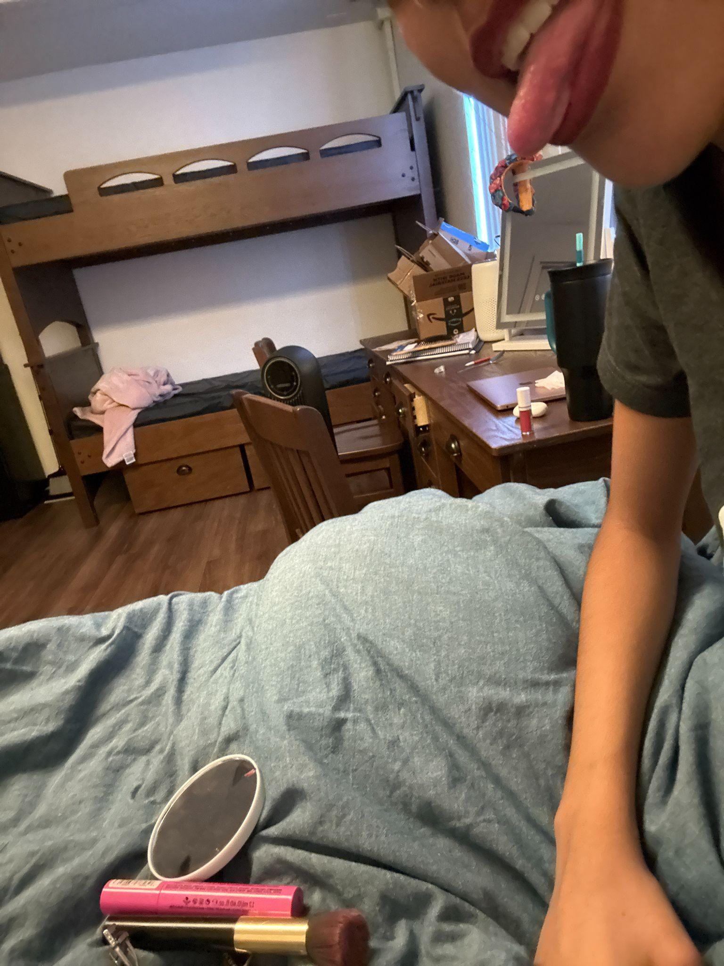
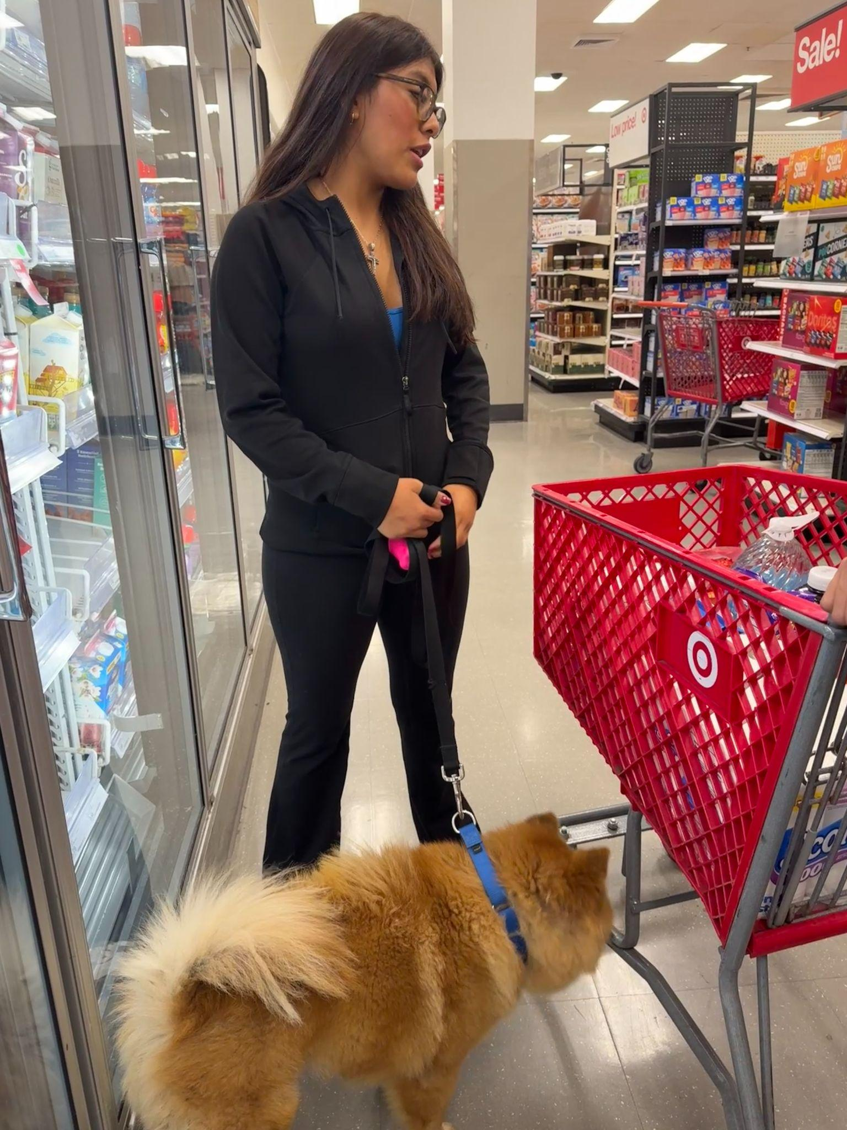
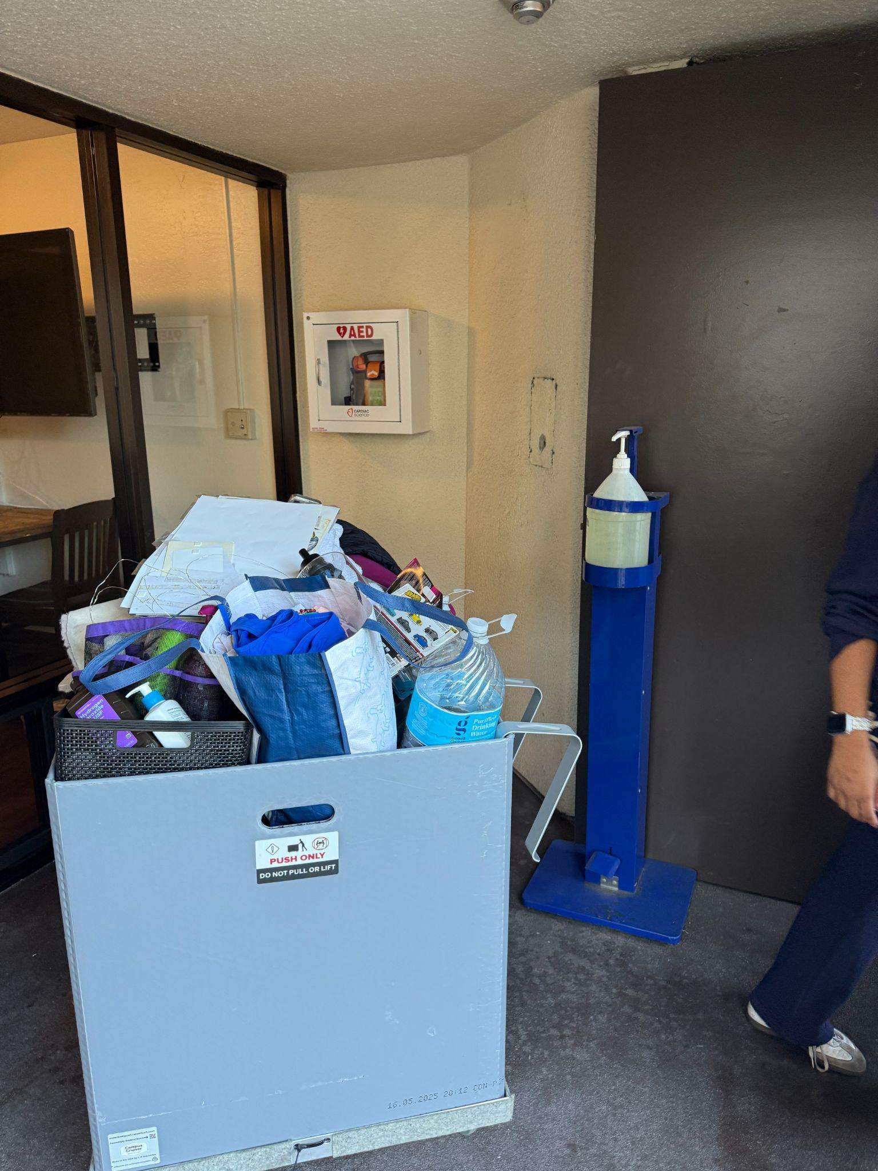
Items that happened in the semester individually, with friends, groups, locally, nationally

Slide 3
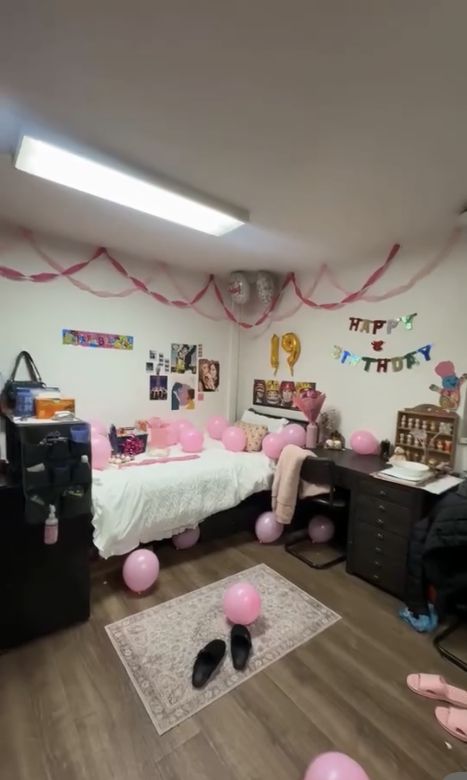
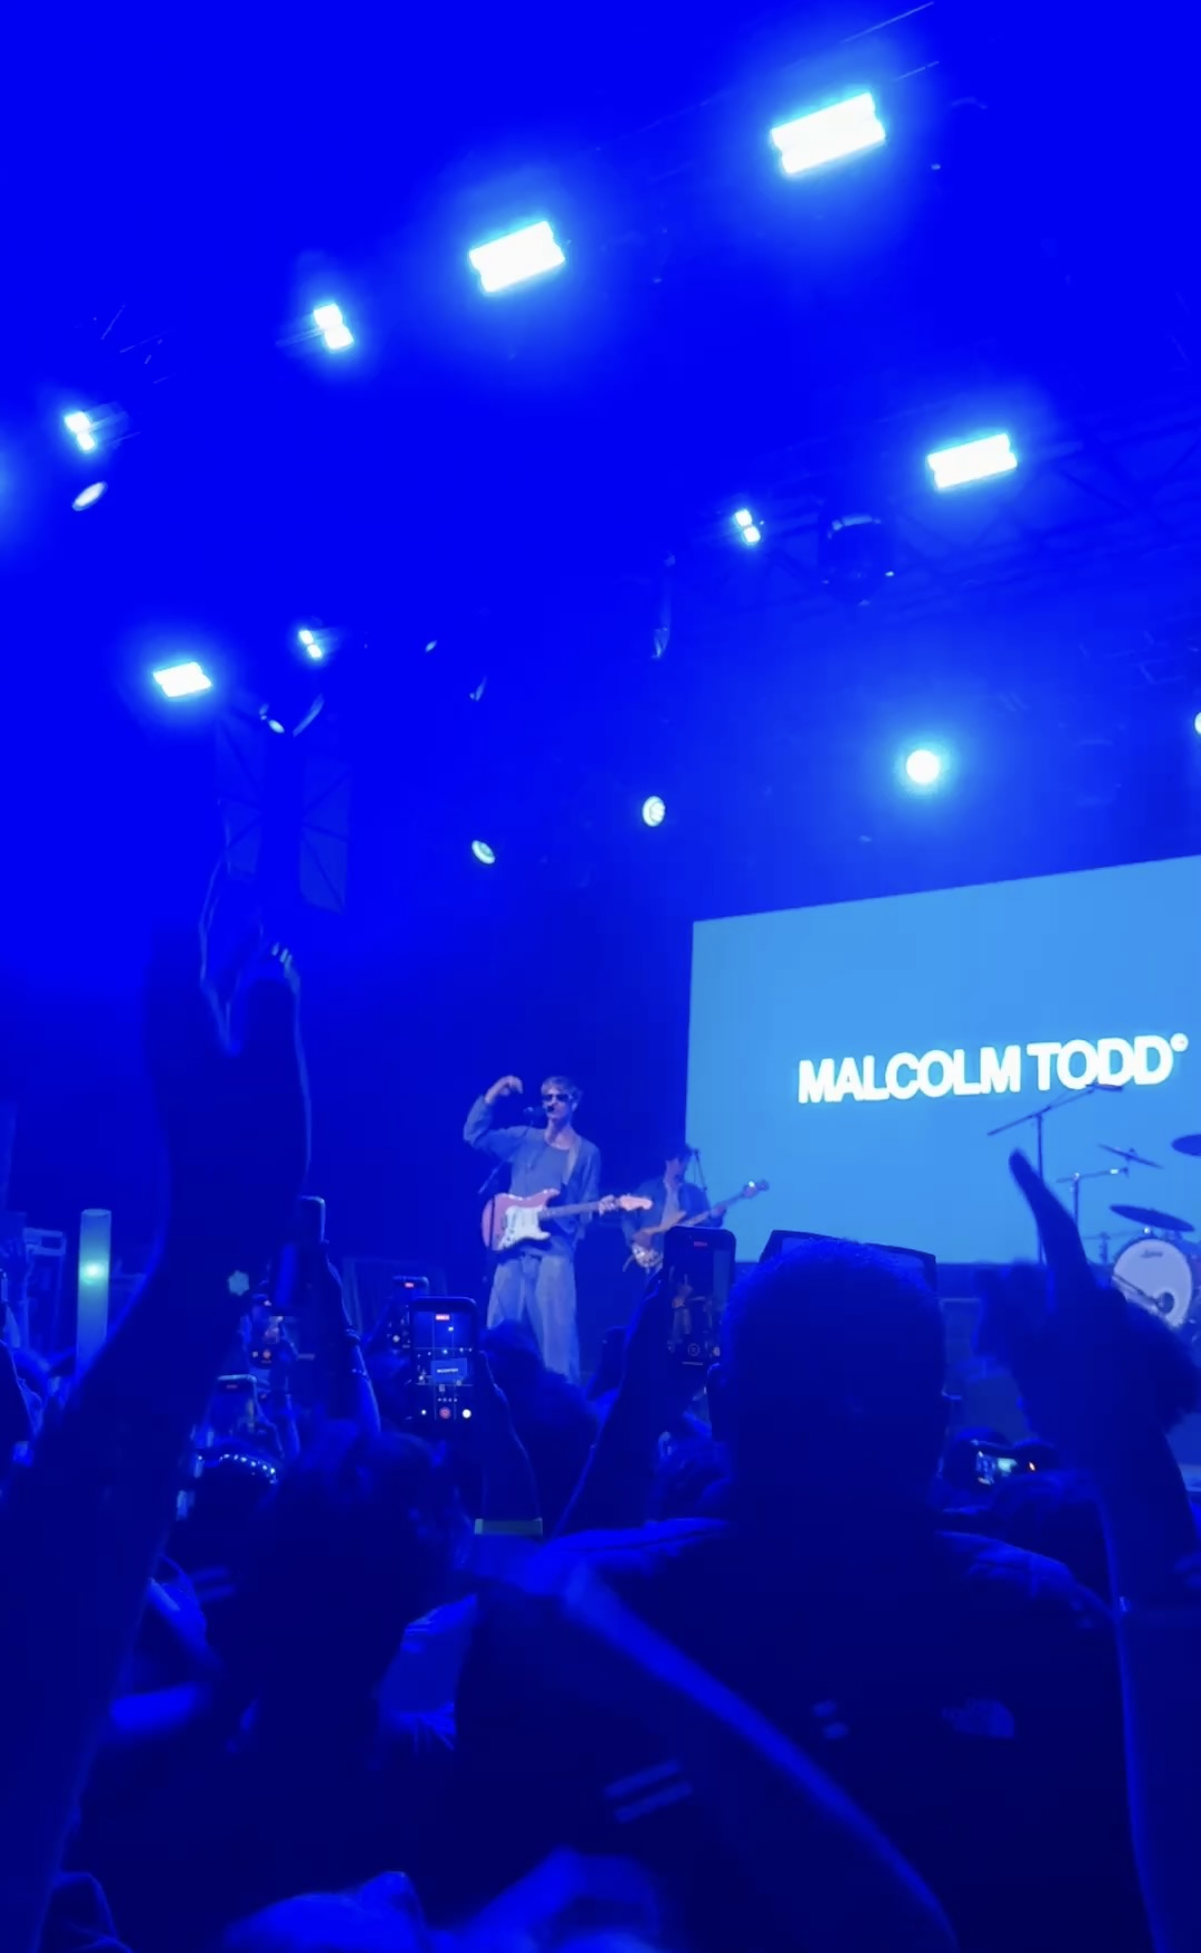
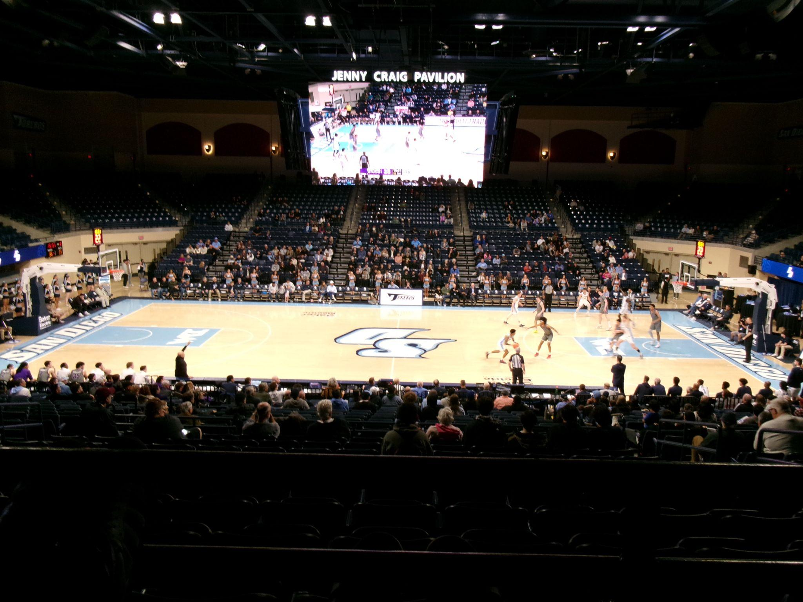
Items that happened in the semester individually, with friends, groups, locally, nationally

Slide 4
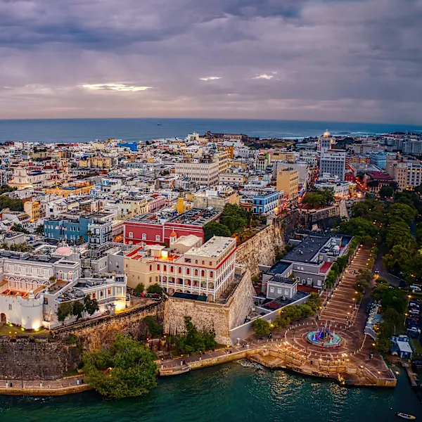

Items that did not happen that you wanted, expected

Slide 5
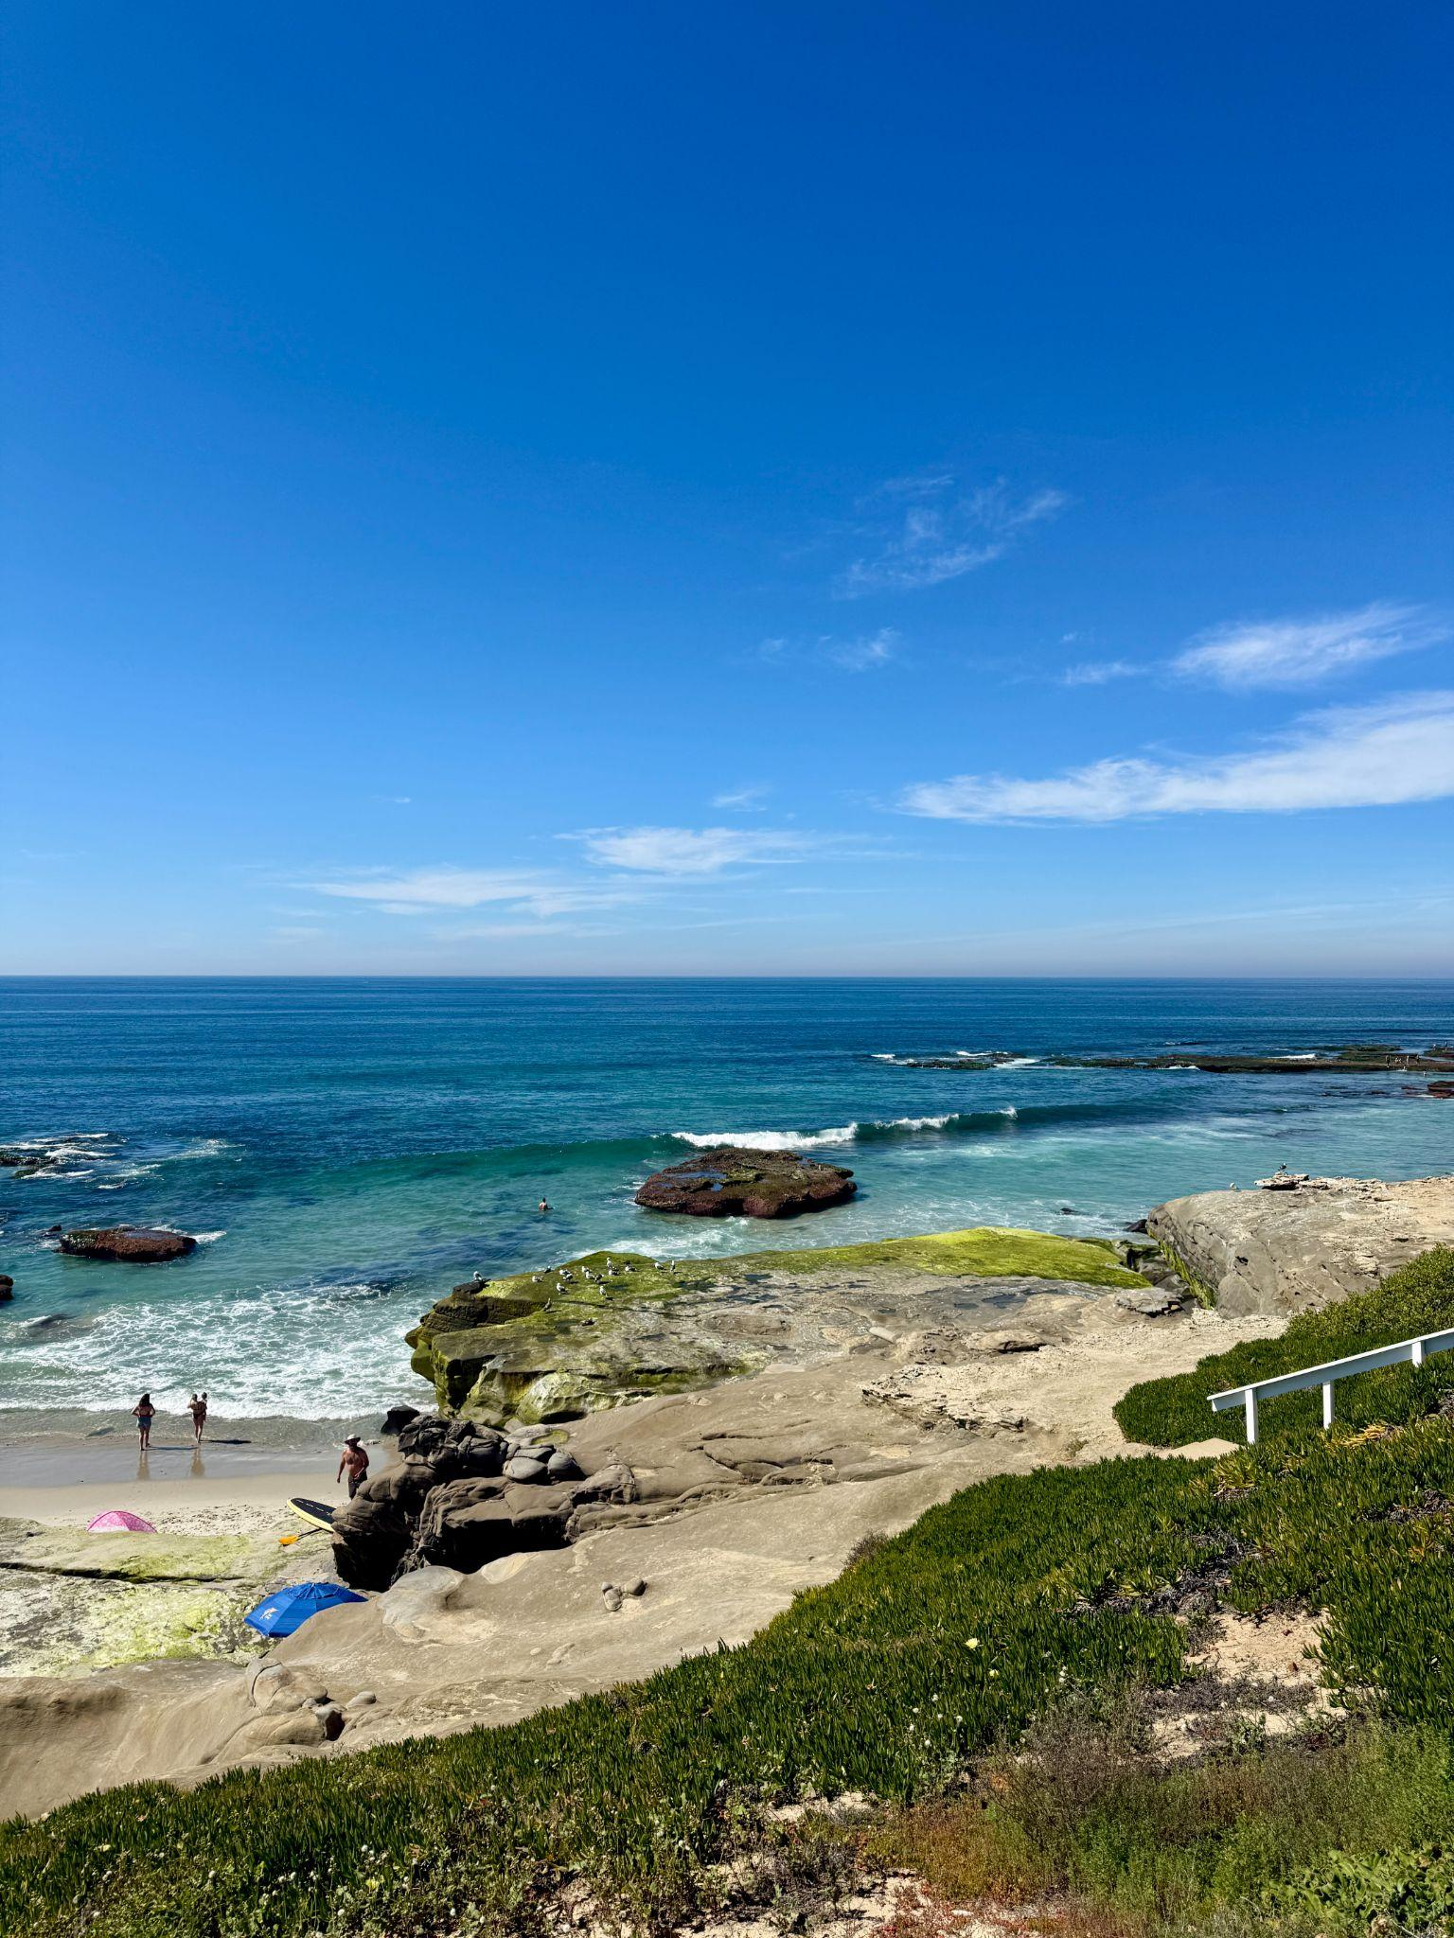
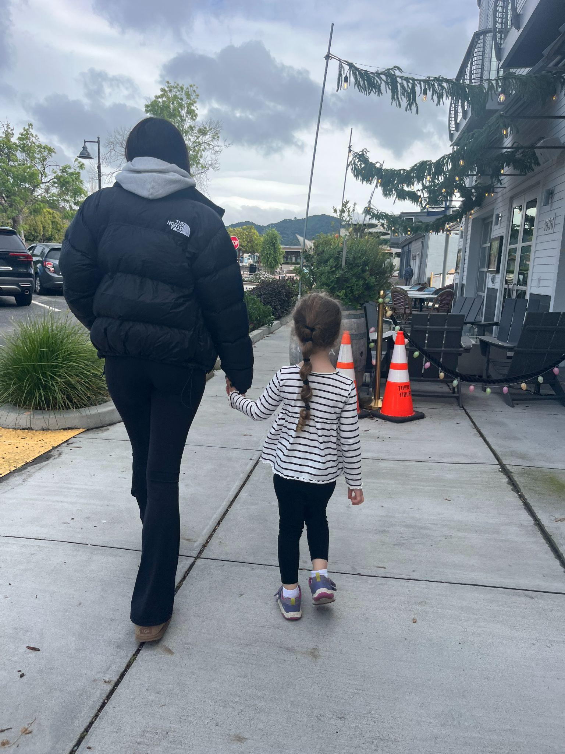
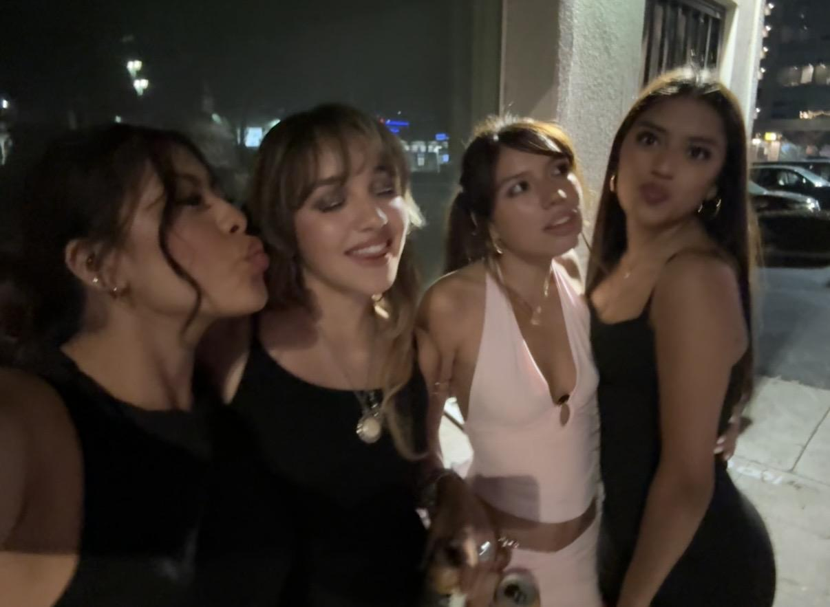
Items that you experienced that have touched your life this semester in an positive way

Slide 6
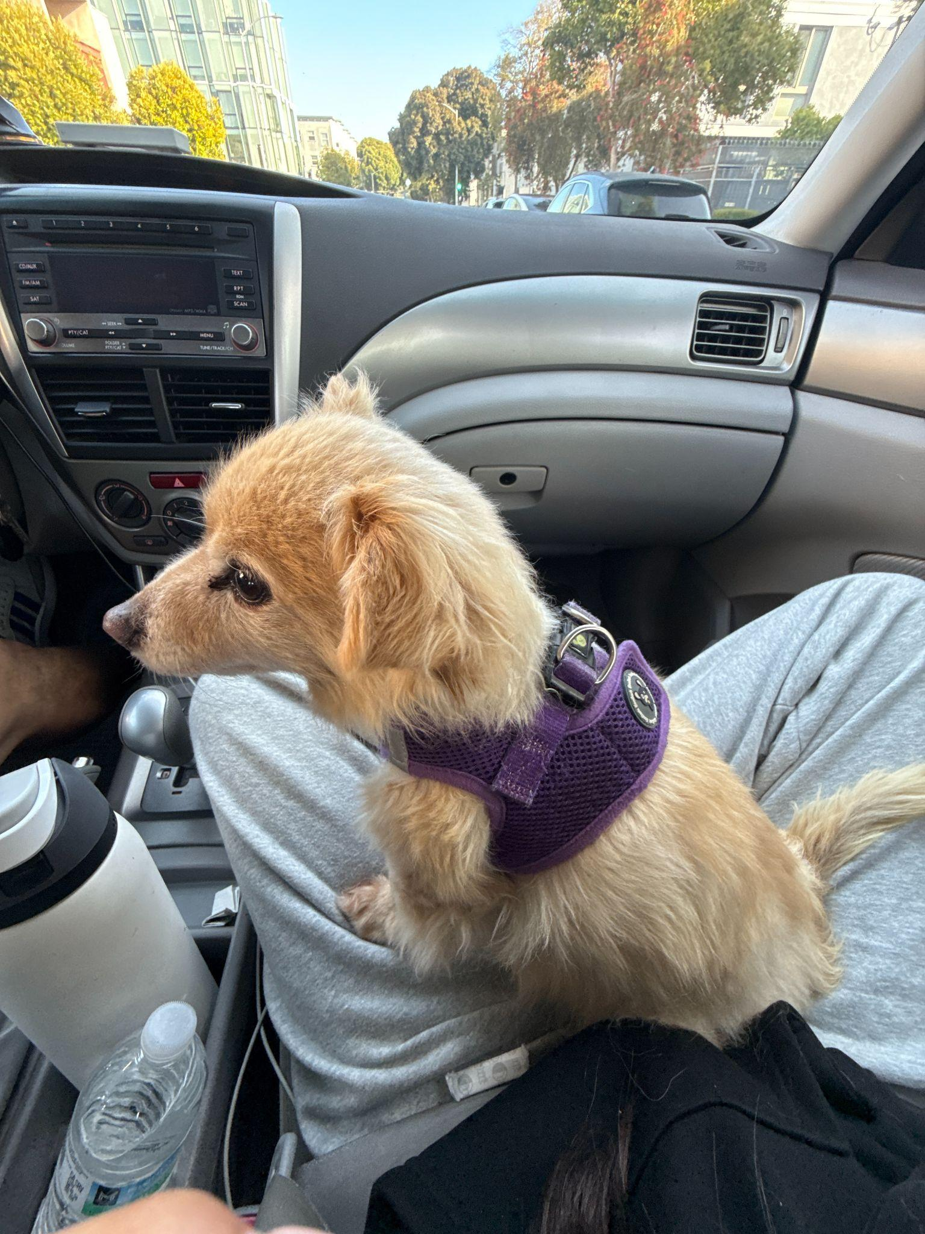
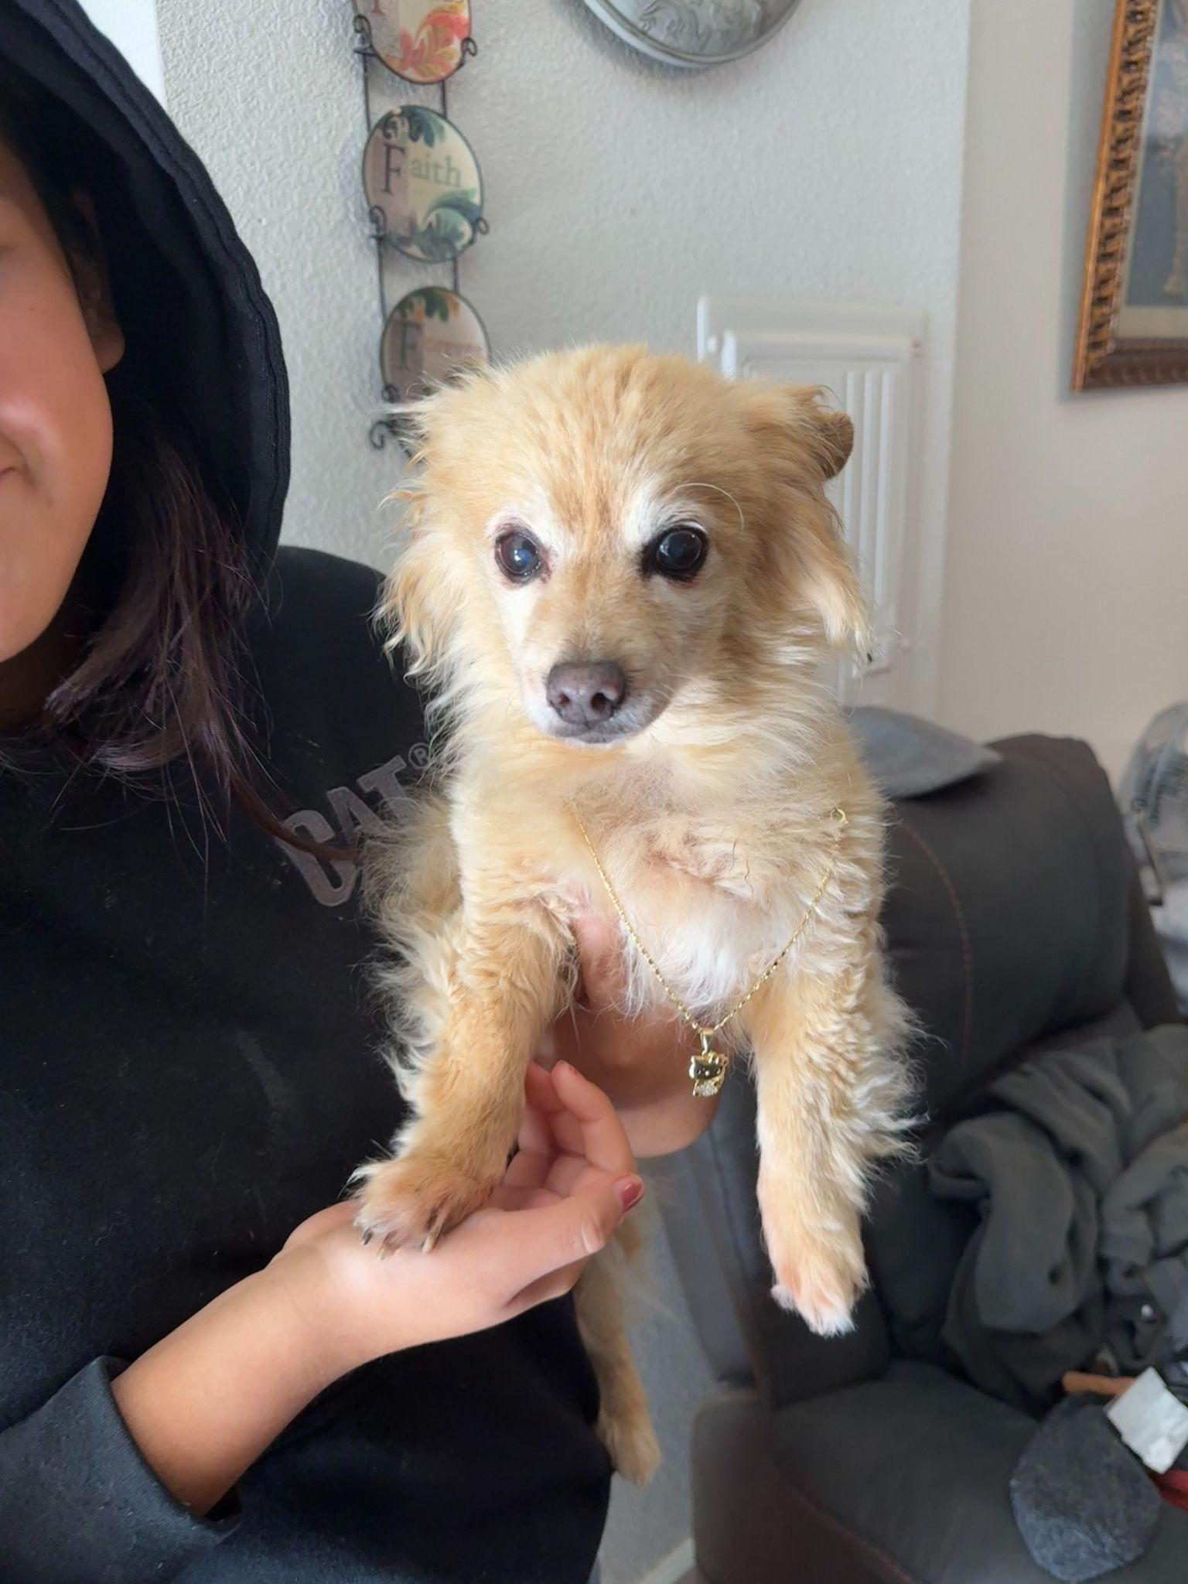
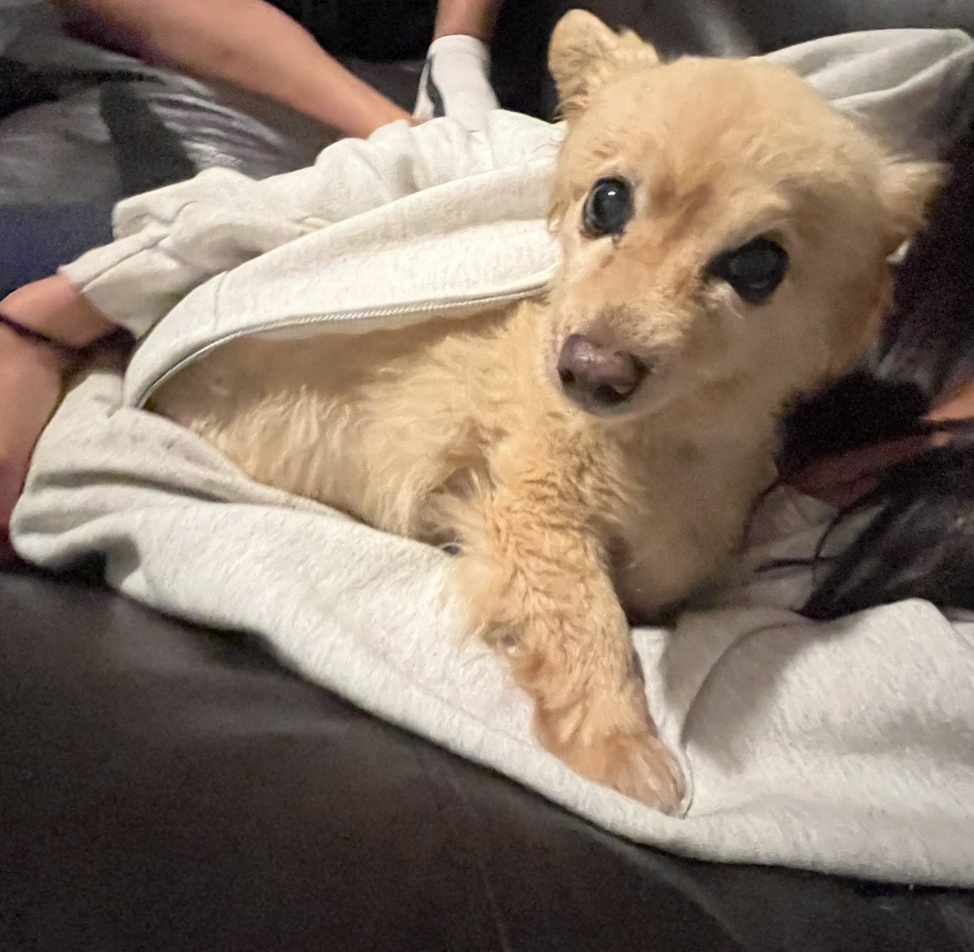
Items that you experienced that were sad or negative that you wish not to be experienced again

Slide 7
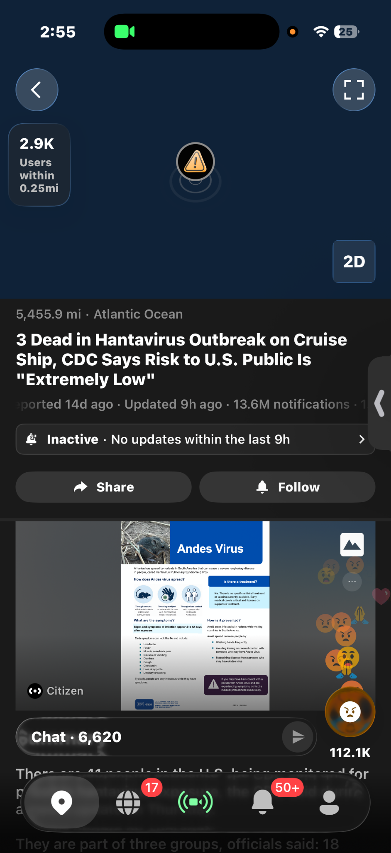
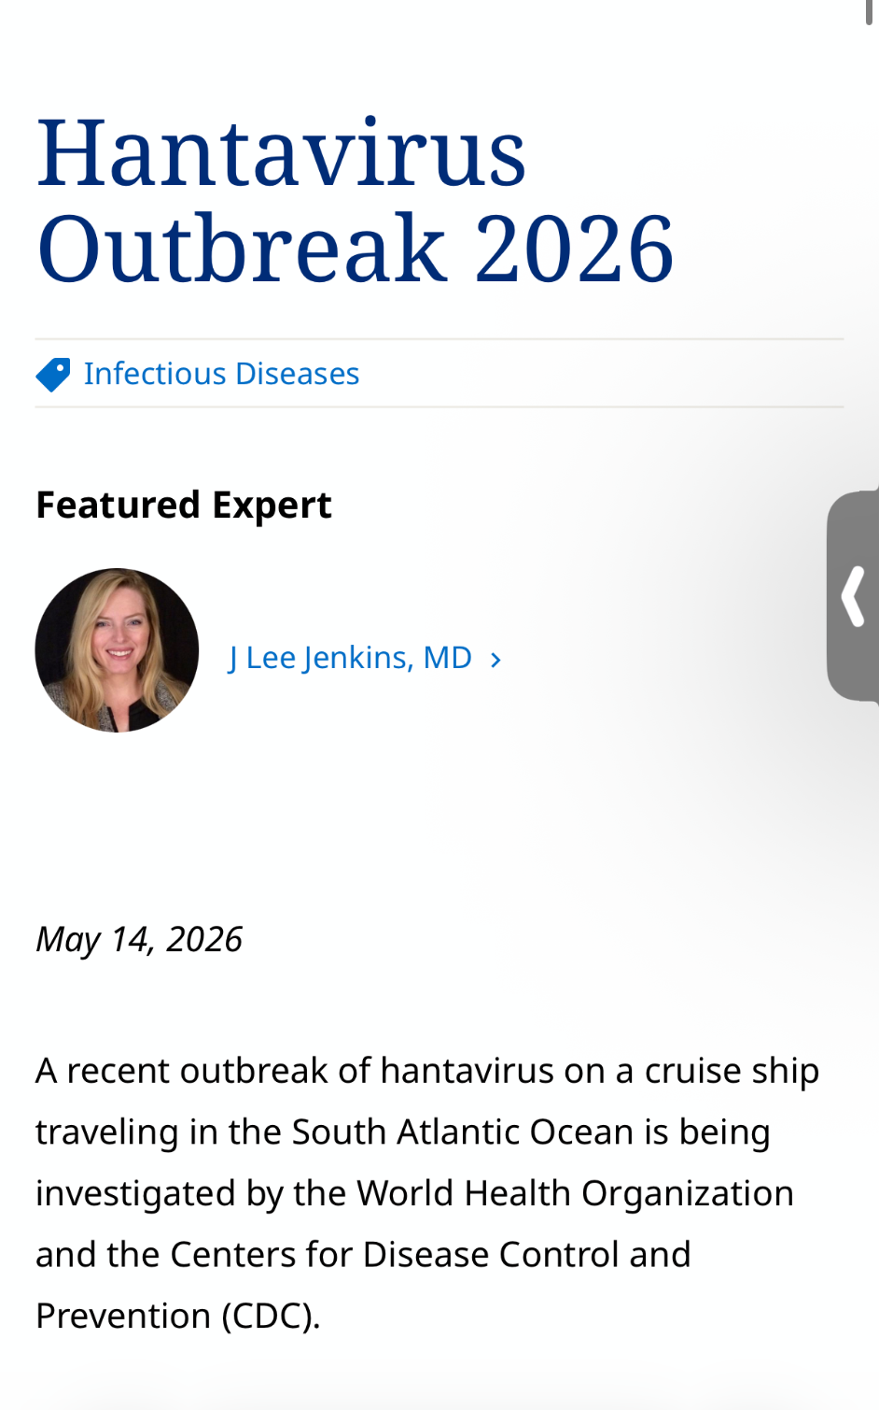
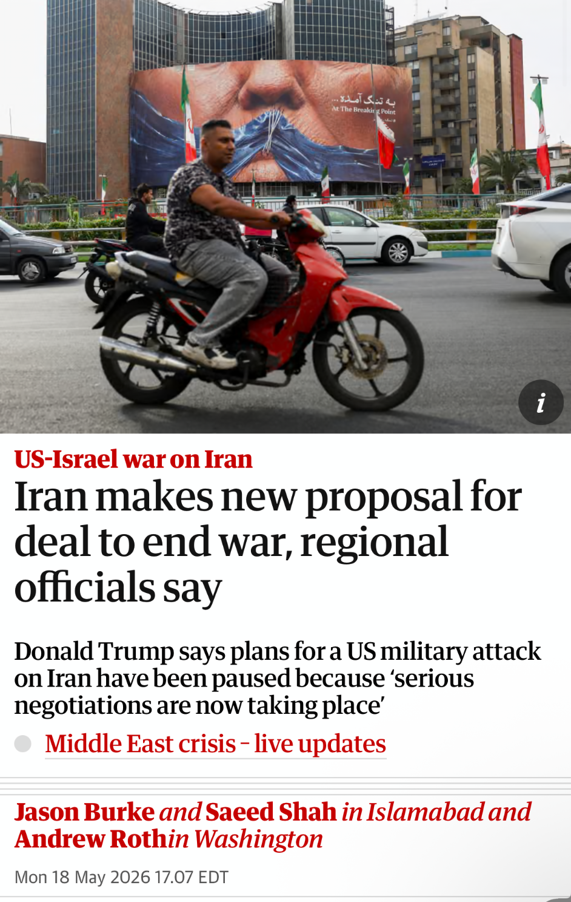
Items that were highlighted by news, media advertisements/messages, government, other countries, other sources

Slide 8
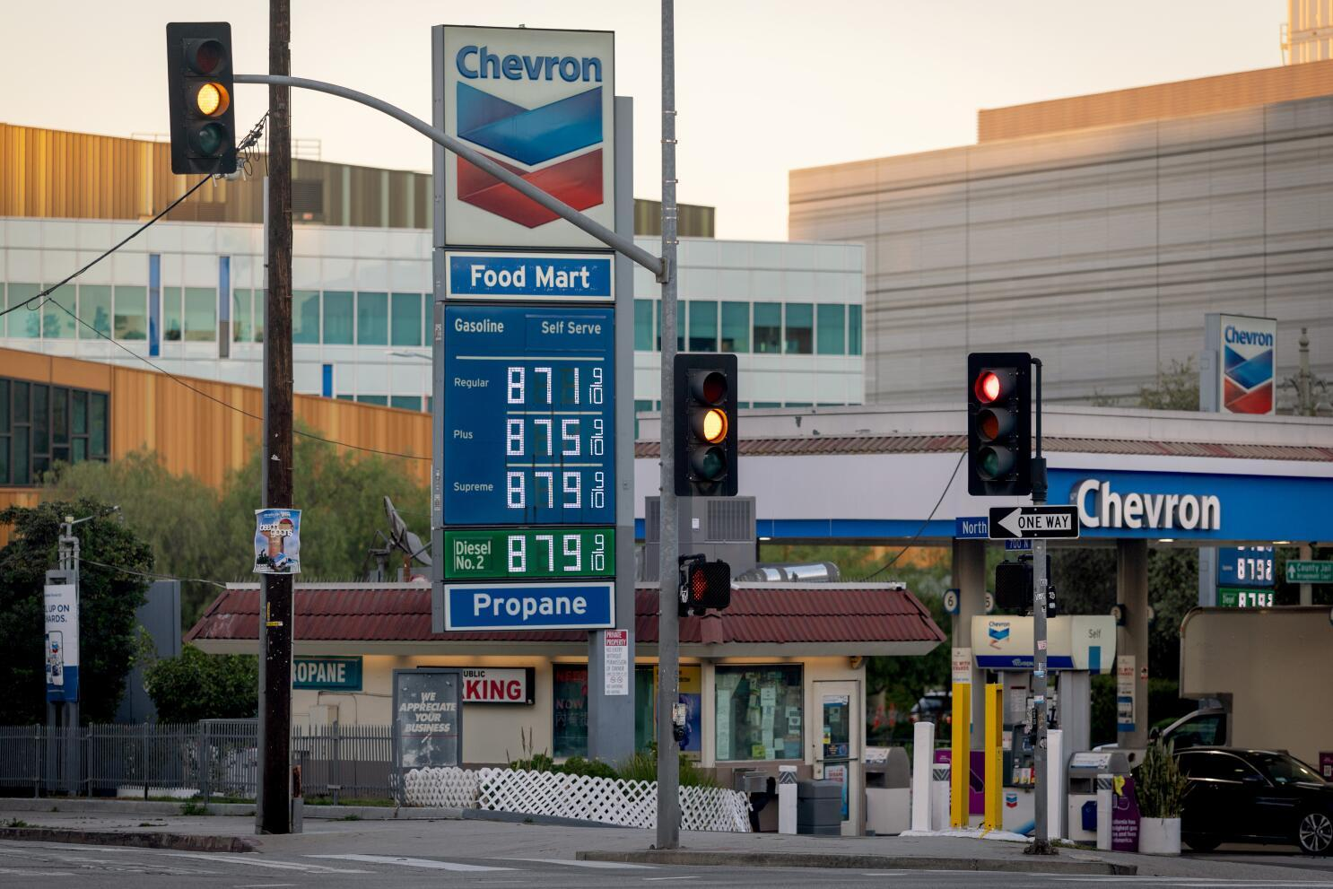
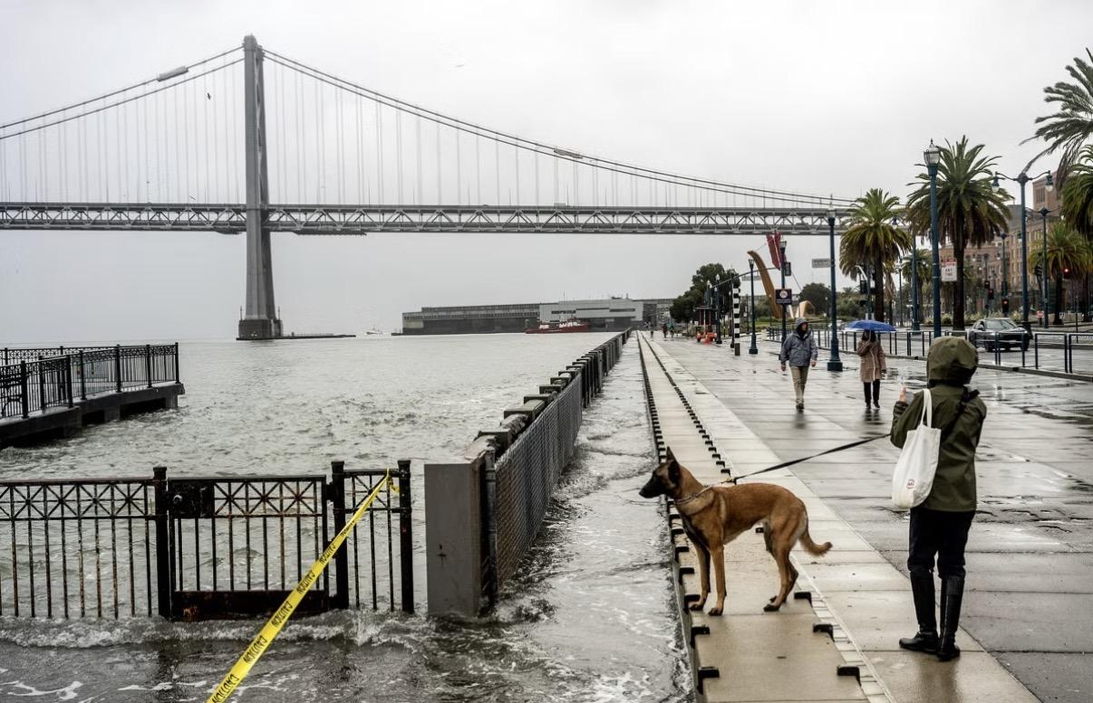
Items that were highlighted by news, media advertisements/messages, government, other countries, other sources

Slide 9

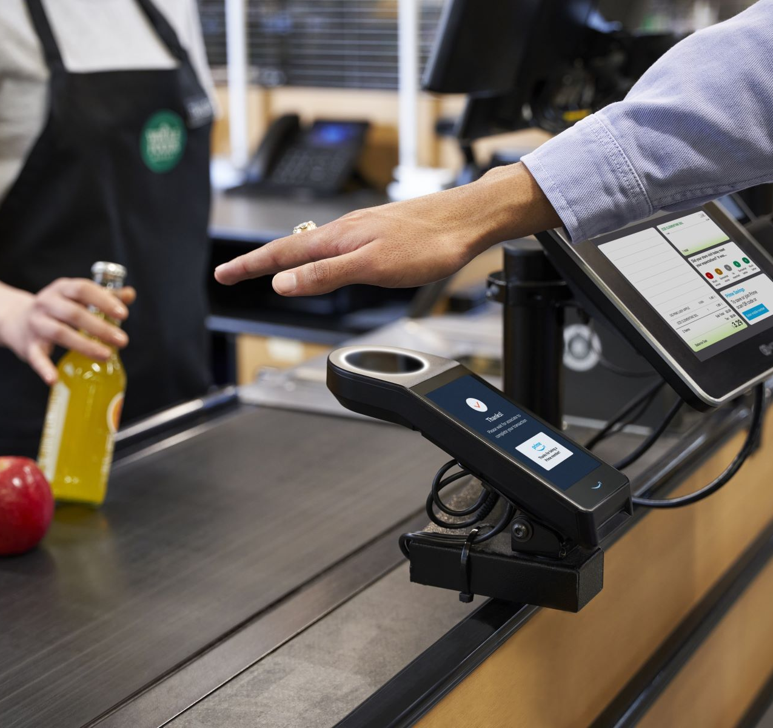
Items that illustrates changes to processes (buying food other items), laws/restrictions
Notes:
“Technology continued changing everyday life, especially how people learn and shop

Slide 10
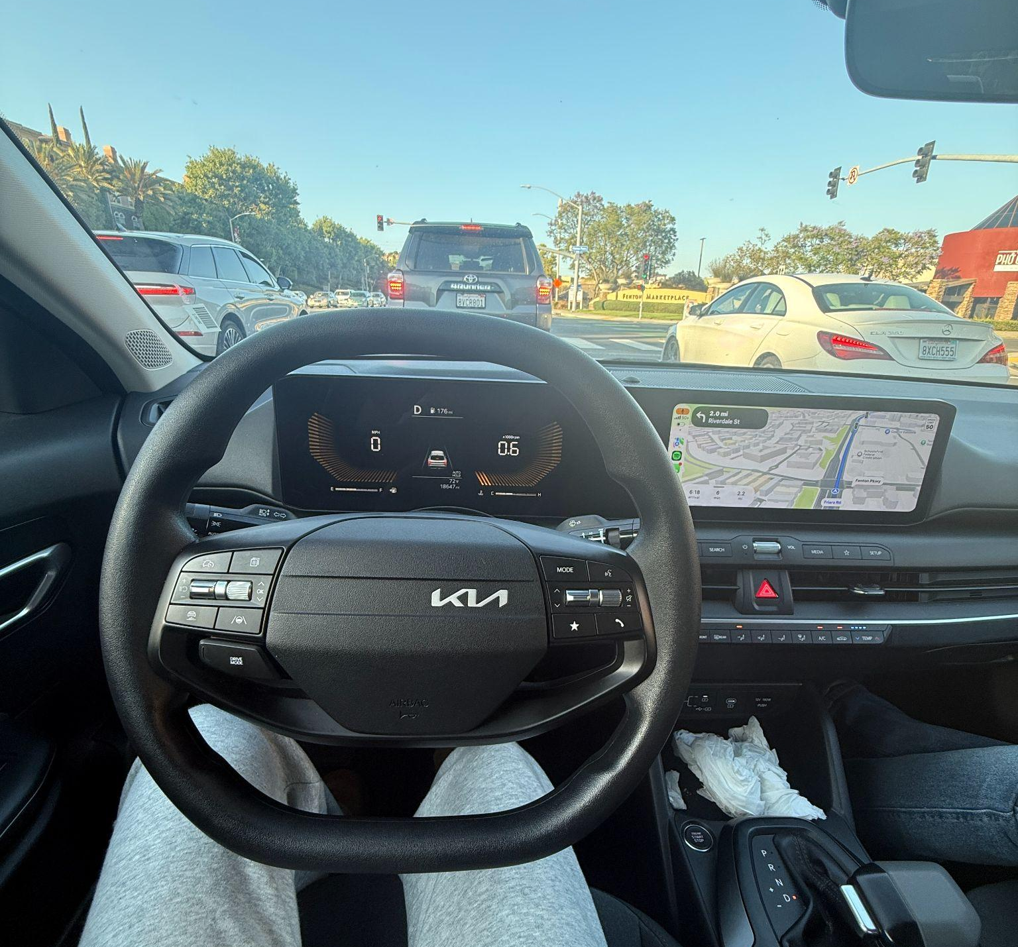

Other relevant items to discuss the semester you had, the semester you wanted, and the semesters that you wish to have in the future.

Slide 11
Thank You!

