Slide 1

1
ITMG 100
My Semester
Time Capsule
San Diego, California
Jacobo Banus Bertram

Slide 2

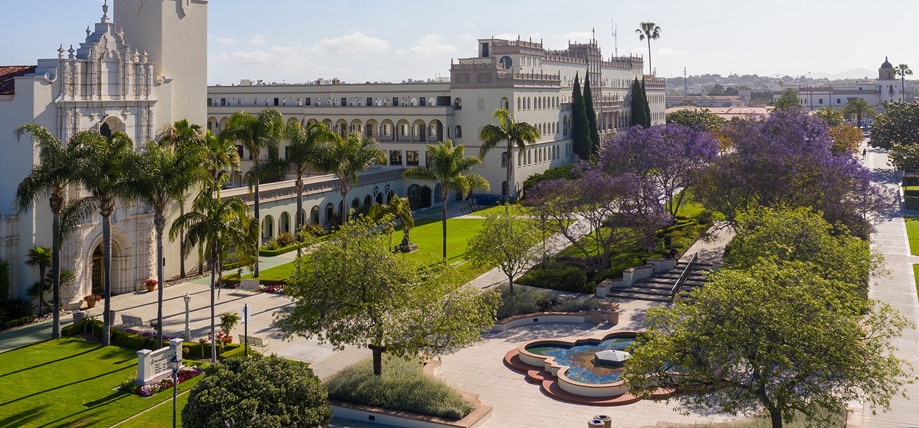
Things That Happened This Semester
2
👤 Individually
👥 With Friends & Locally
• Moved to a completely different country
• Made international friends from many different countries
• Started surfing for the first time on the Pacific
• Went to local San Diego beaches and events regularly
• Learned to be more independent and self-reliant
• Experienced American campus social life firsthand
Jacobo Banus Bertram

Slide 3
Things I Wanted or Expected that didn’t happen
3
Stay longer
Make close American friends
I expected to be ready to go home, but I wish I could stay for another year.
I met plenty of people but forming real friendships with local students was harder than I expected. Cultural differences made it slower.
Find good Spanish food
Feel fully fluent in English
I thought I'd find Spanish restaurants or at least similar food. The closest I got was Mexican food which is great but not the same.
I studied English for years but daily life conversations with slang, fast speech and jokes still tripped me up constantly.
Jacobo Banus Bertram

Slide 4

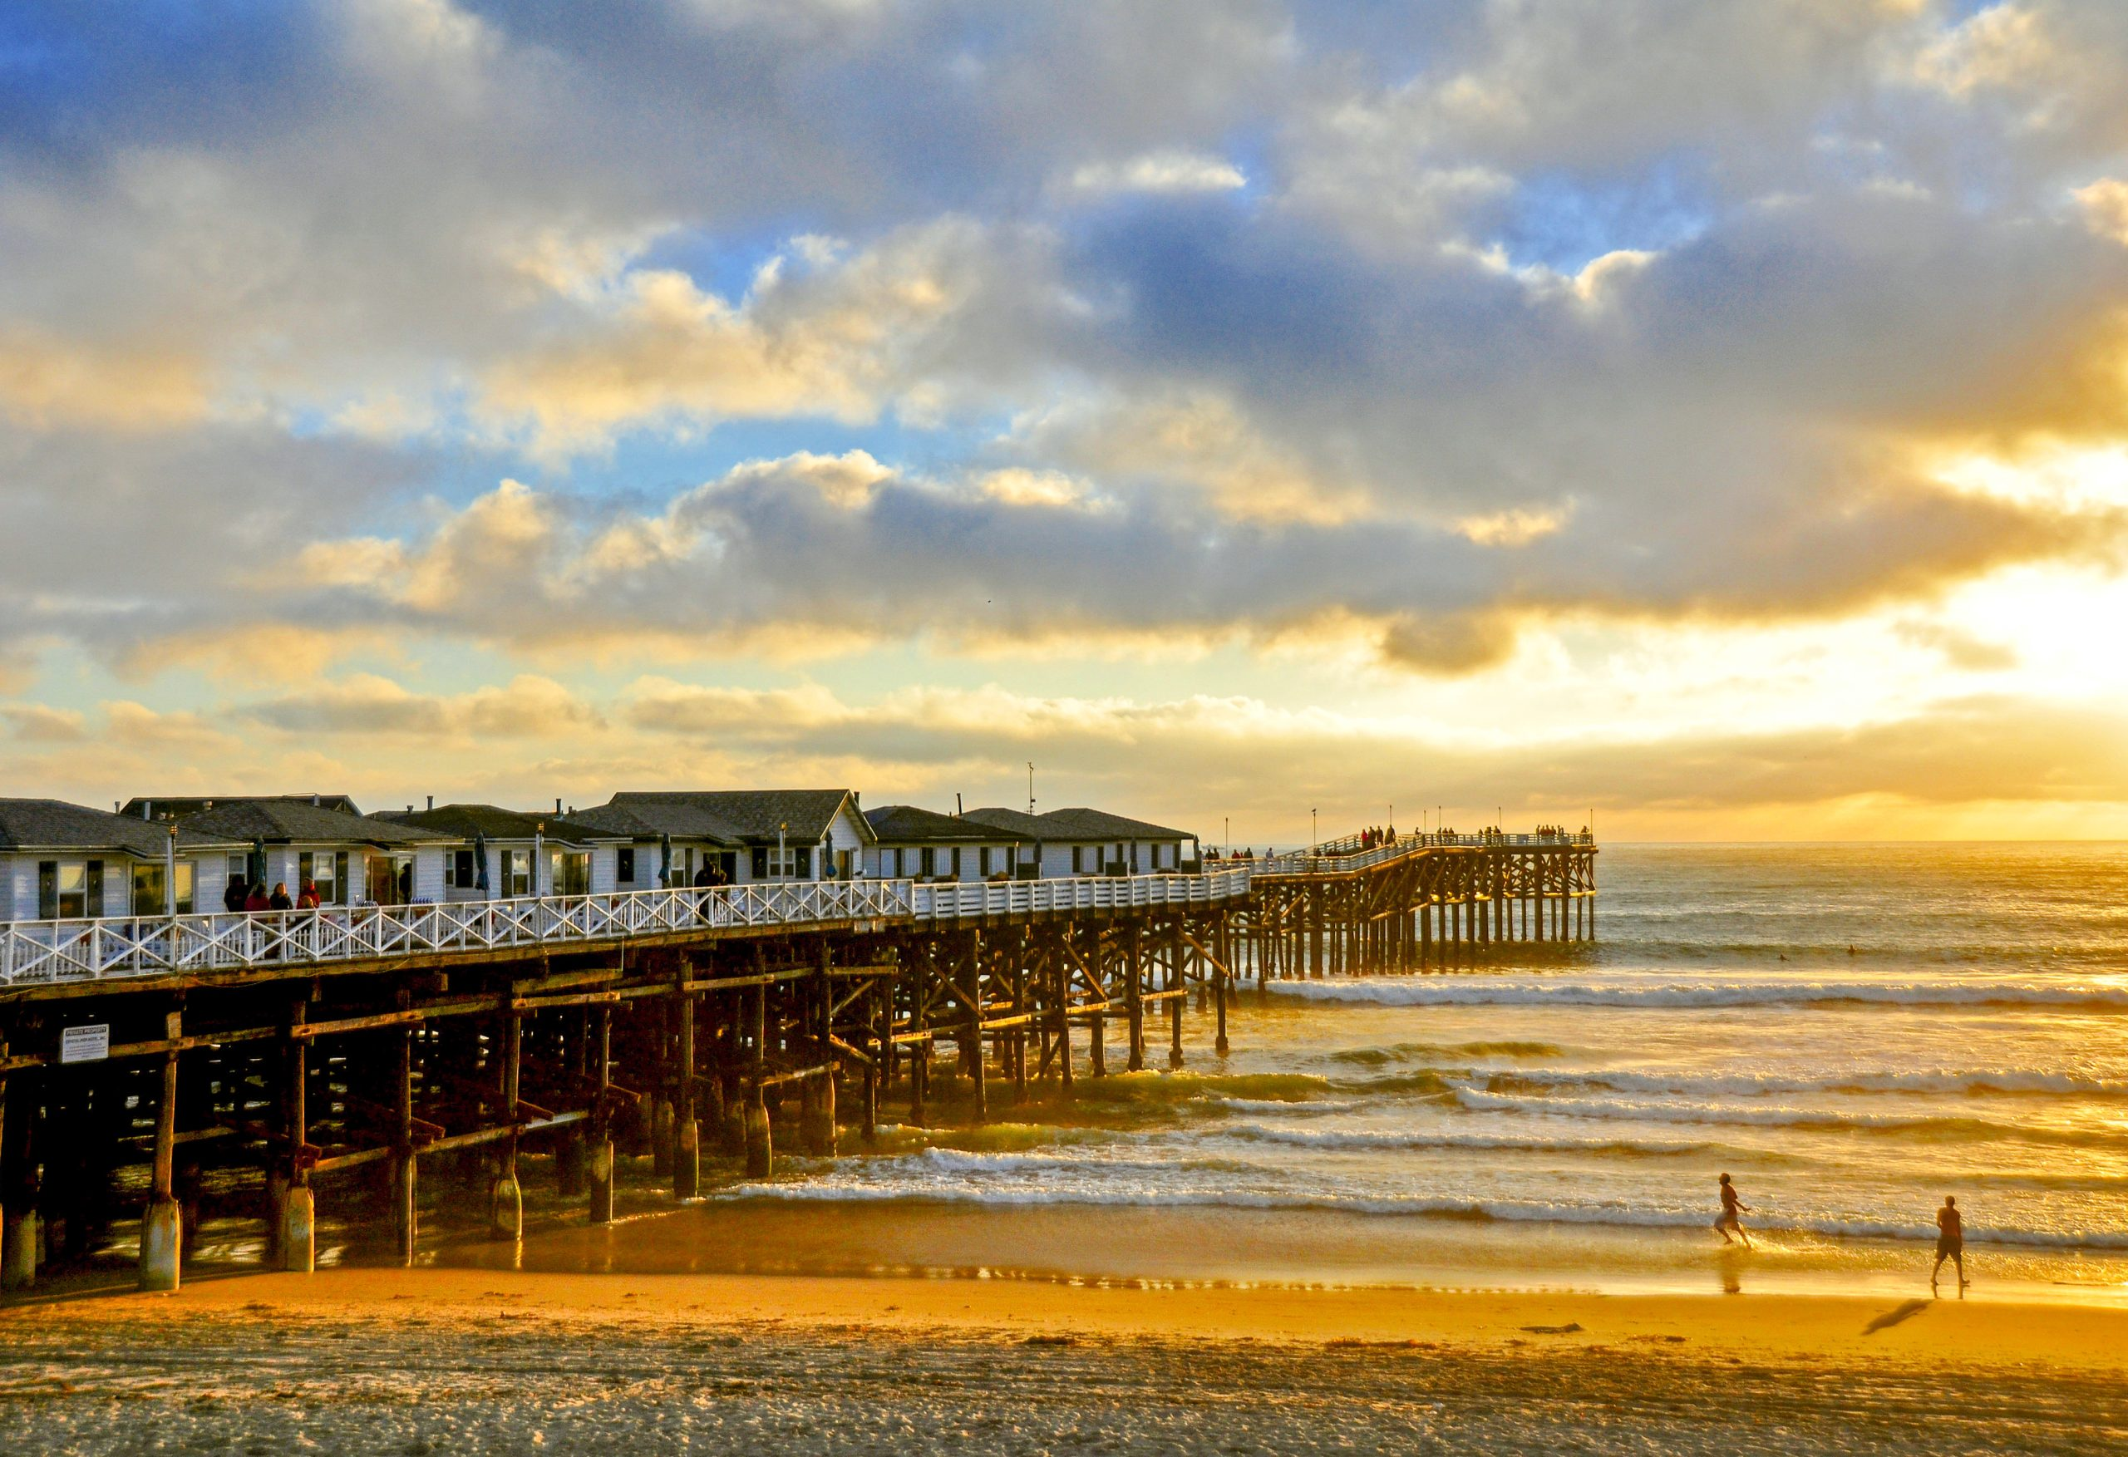

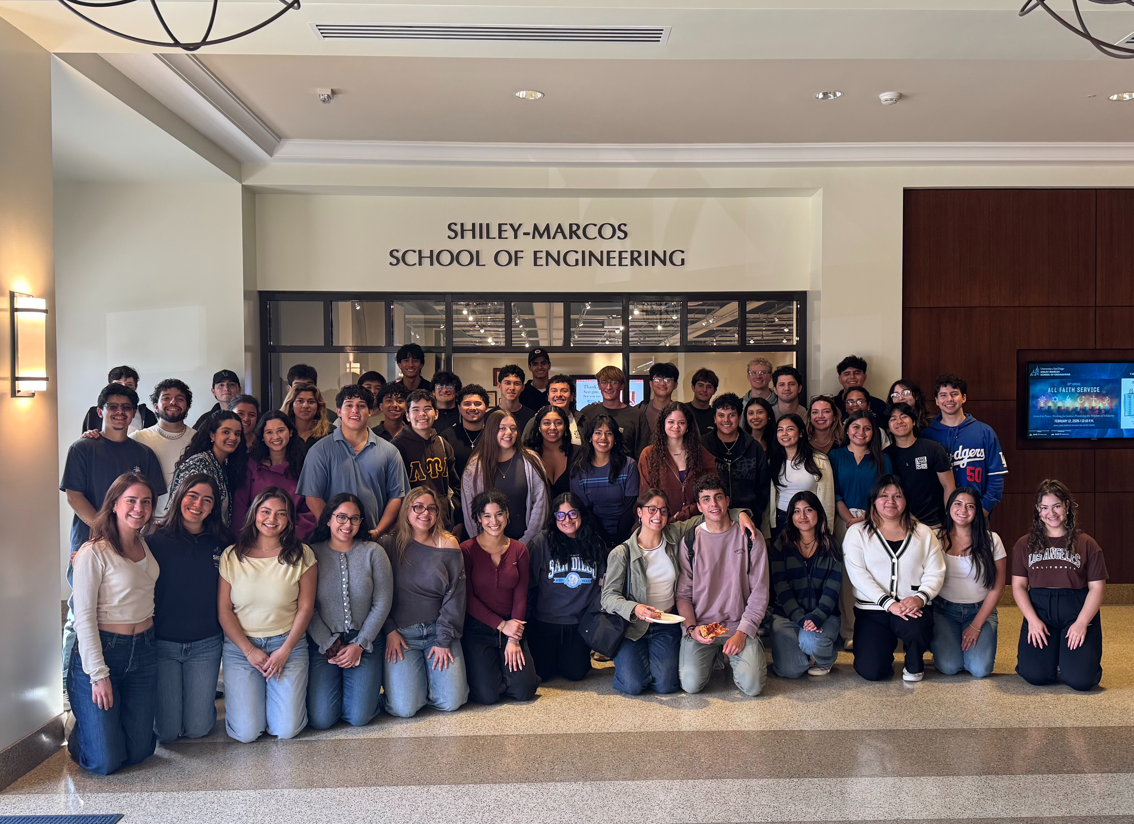
Experiences That Touched My Life in a Positive Way
4
🌊 Learning to Surf
📝 Passing my first US exam
🌎 International friendships
Pacific Beach was were I started my surfing journey. From falling off every wave to actually riding one was a beautiful progression.
The academic system here is so different. When I passed my first exam, it felt like proof I could actually adapt and succeed.
I met some amazing people from all over the world, and learned a lot from different cultures.
Jacobo Banus Bertram

Slide 5
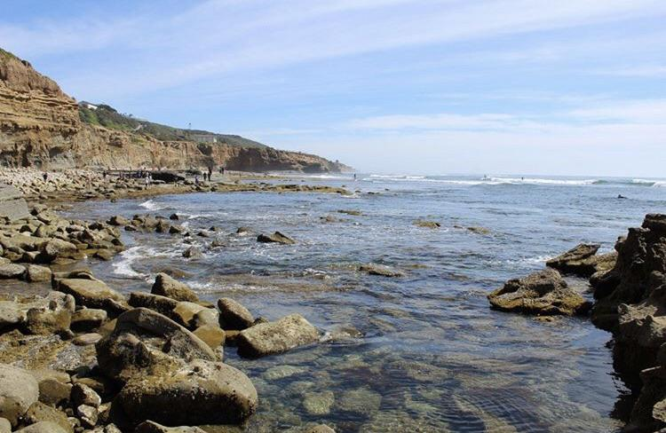
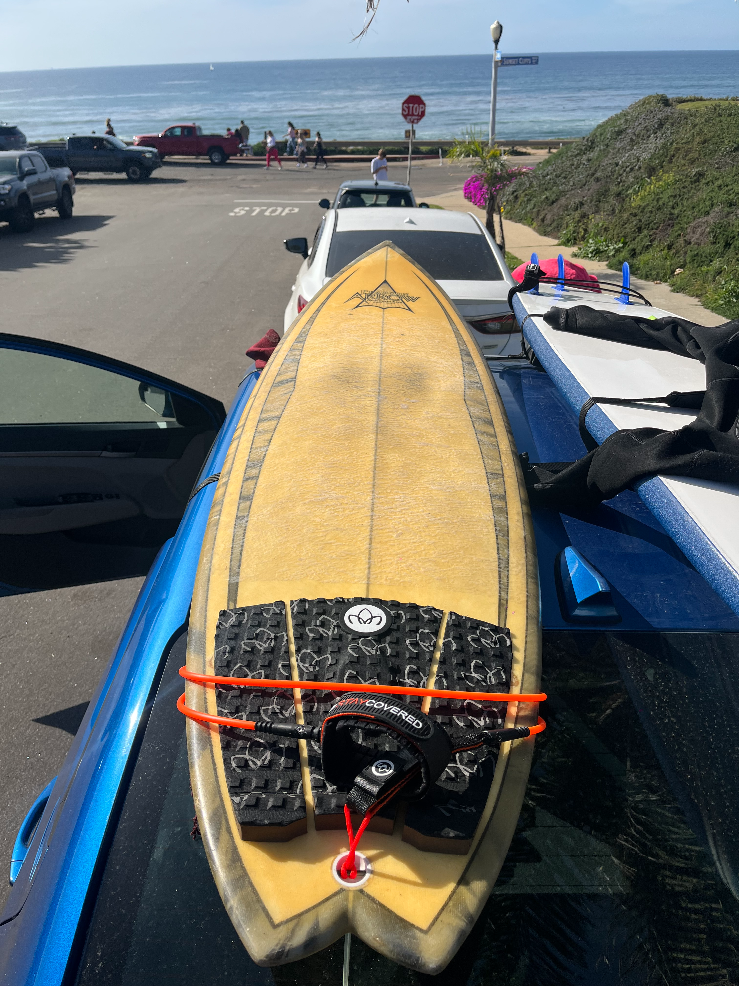
Hard & Negative Experiences
5
Language exhaustion
Speaking and thinking in a second language every single day is mentally draining in a way I didn't anticipate. Some days I was really tired of translating my own thoughts.
Shoulder Dislocation
At Sunset Cliffs, while trying to catch a wave, I got my shoulder dislocated. This was a huge drawback that forced me to stop surfing for over a month.
Jacobo Banus Bertram

Slide 6

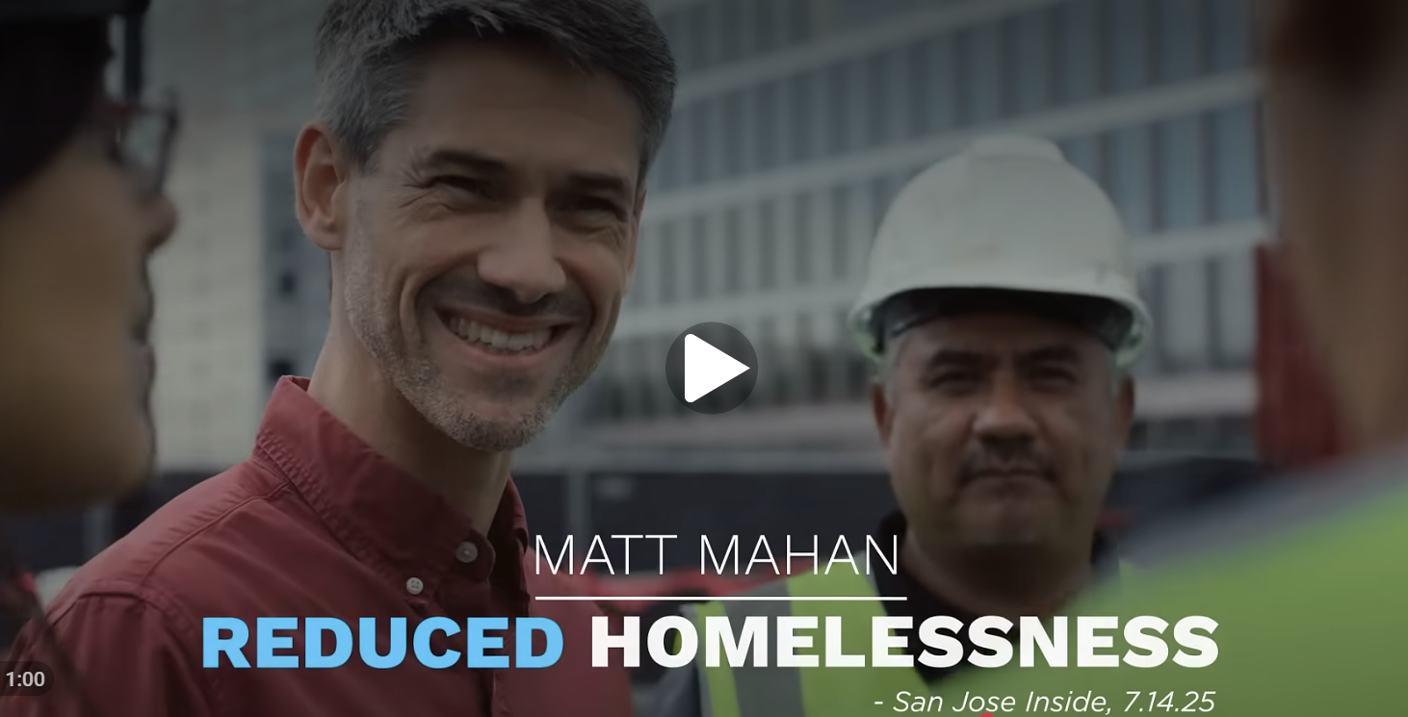

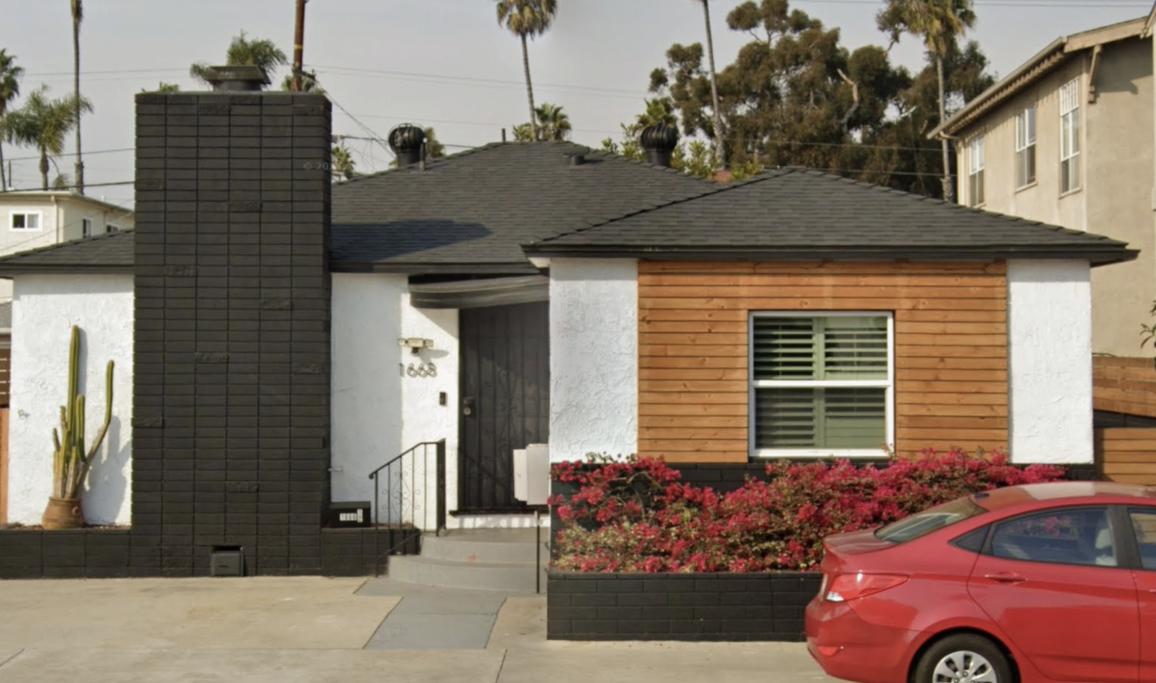
News, Media, Government & Other Countries
6
US Politics
The political climate here is unlike anything in Spain. Political Campaigns are much different form the ones back in my country.
Campus Activism
There were protests and campus movements related to global conflicts. It was powerful to see students engaged politically in a way that felt less common at universities back in Spain.
Cost of Living
Inflation and housing costs were constant news stories. As someone living on a student budget in California, this very present.
Jacobo Banus Bertram

Slide 7

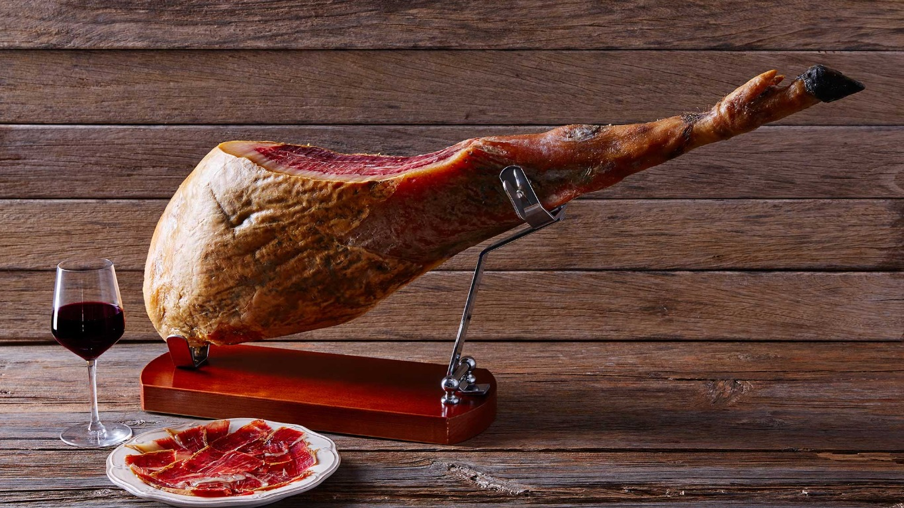
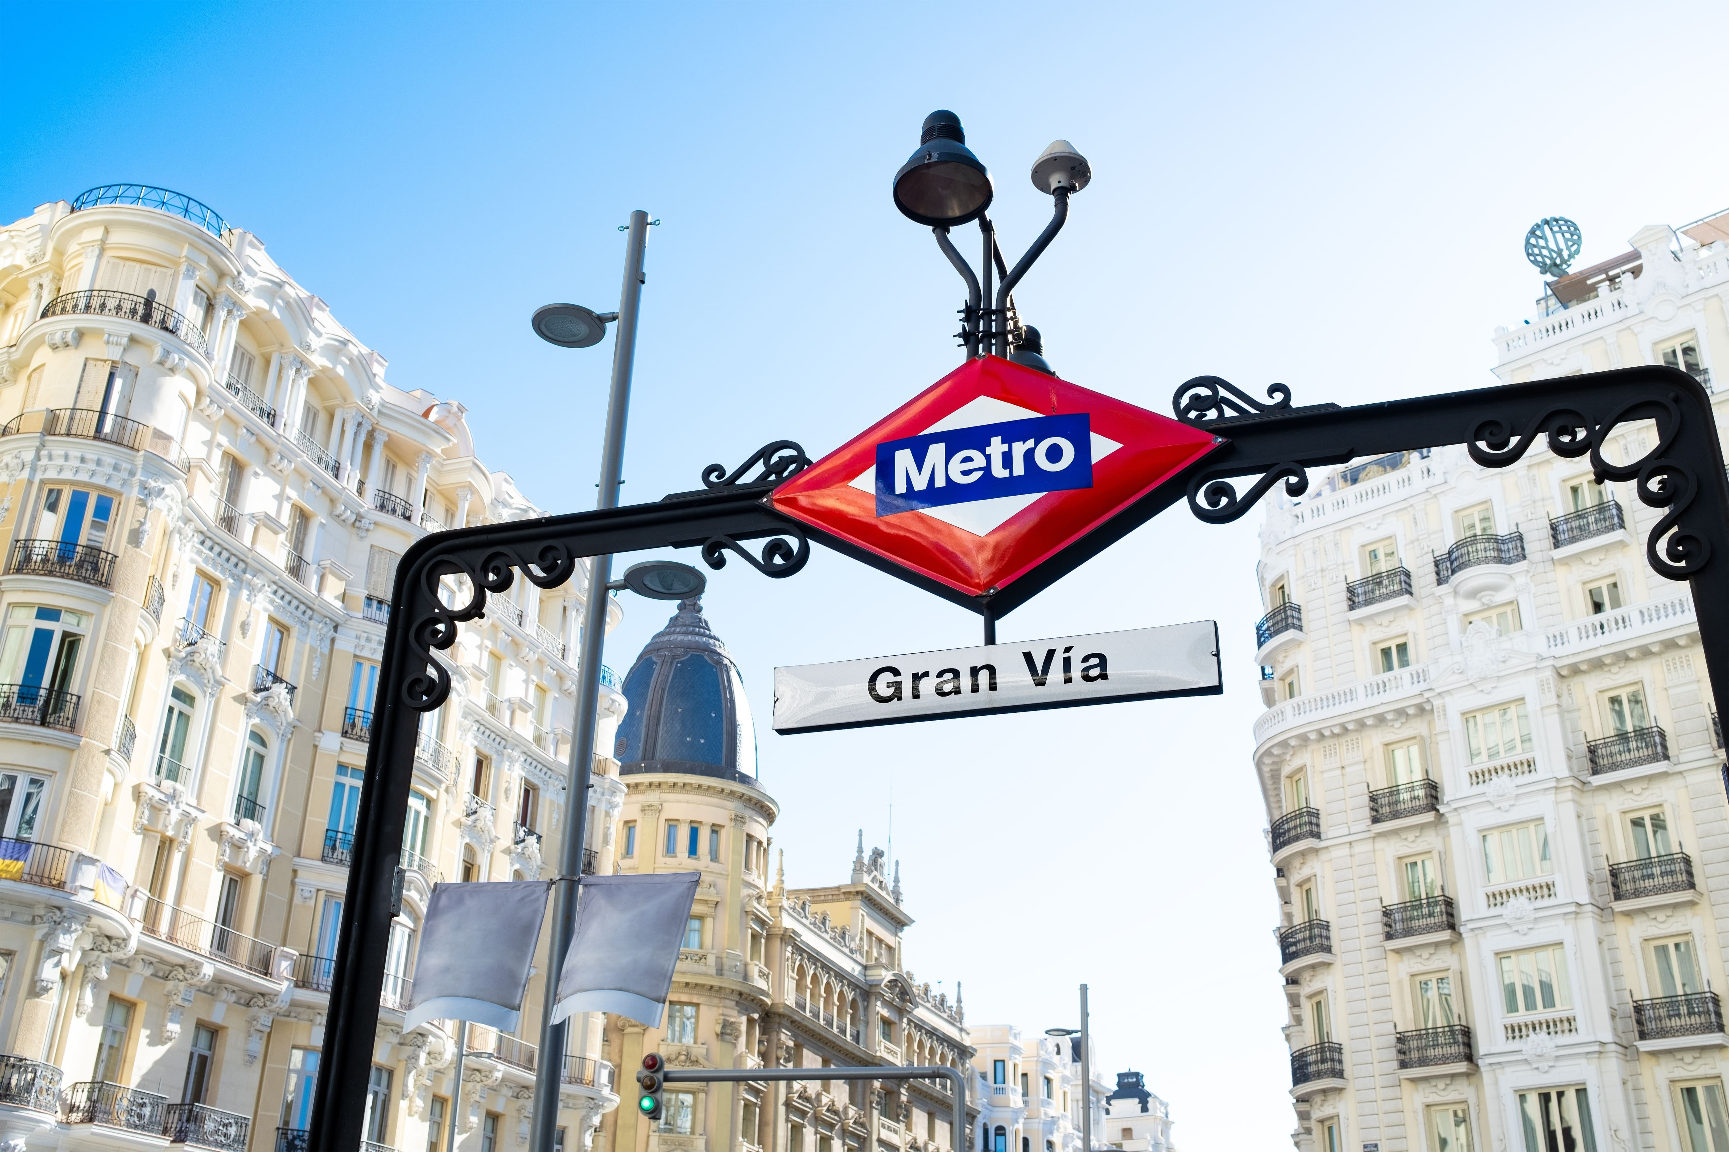
Changes to Processes, Laws & Everyday Life
7
Buying Food
Spain: Fresh Bread, Jamon
Iberico
US: everything packaged, no fresh
bread, more expensive
Getting Around
Spain: Use metro/train for
everything
US: you NEED a car or Uber.
Nothing is walkable in San Diego.
University
Spain: Campus life is limited to
class
US: people engage much more in
different activities within campus
Paying
Spain: card or cash, price is the price
US: tipping is expected everywhere,
tax added at checkout
Jacobo Banus Bertram

Slide 8

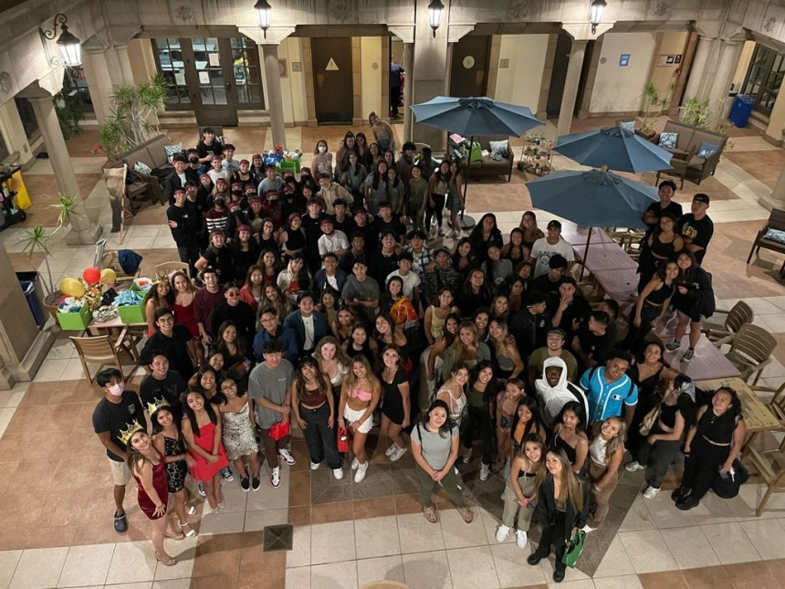
People's Creativity & Helping Others
8
Student Communities
Groups of students organizing themselves into such a variety of communities such as film clubs, surf clubs, politics clubs, Asian clubs and much more was something that genuinely impressed me.
Coffee Hours
Students formed groups dedicated particularly to international students. Each Thursday, they would serve food from some particular country, which was a great way of getting people together.
Jacobo Banus Bertram

Slide 9




The Semester I Had, Wanted & The Future I Wish For
9
The Semester I Had
The Semester I Wanted
The Semesters I Hope For
→ Arrived as a stranger, left with friends
→ More time, it ended too soon
→ Come back, there is so much more to see
→ Learned to surf the Pacific
→ Closer connections with local students
→ Keep surfing — find waves back in Spain
→ Navigated a new culture every single day
→ Below, what I would have liked to visit
→ Stay connected to the people I met here
→ Keep pushing myself out of my comfort zone
Jacobo Banus Bertram

