Slide 1
STATEMENT
Overall, my first year at San Diego was challenging, exciting, and extremely rewarding. Balancing Division I baseball with demanding college classes pushed me to grow academically, mentally, and personally. While the schedule was intense, having supportive teammates, family, and friends helped me stay motivated and grounded throughout the year. I learned the importance of time management, stepping out of my comfort zone, and making time to recharge. Most importantly, this year helped me build
lifelong friendships, become more independent, and appreciate the incredible opportunity I have to play baseball and earn a degree at such a great school in San Diego.

Slide 2
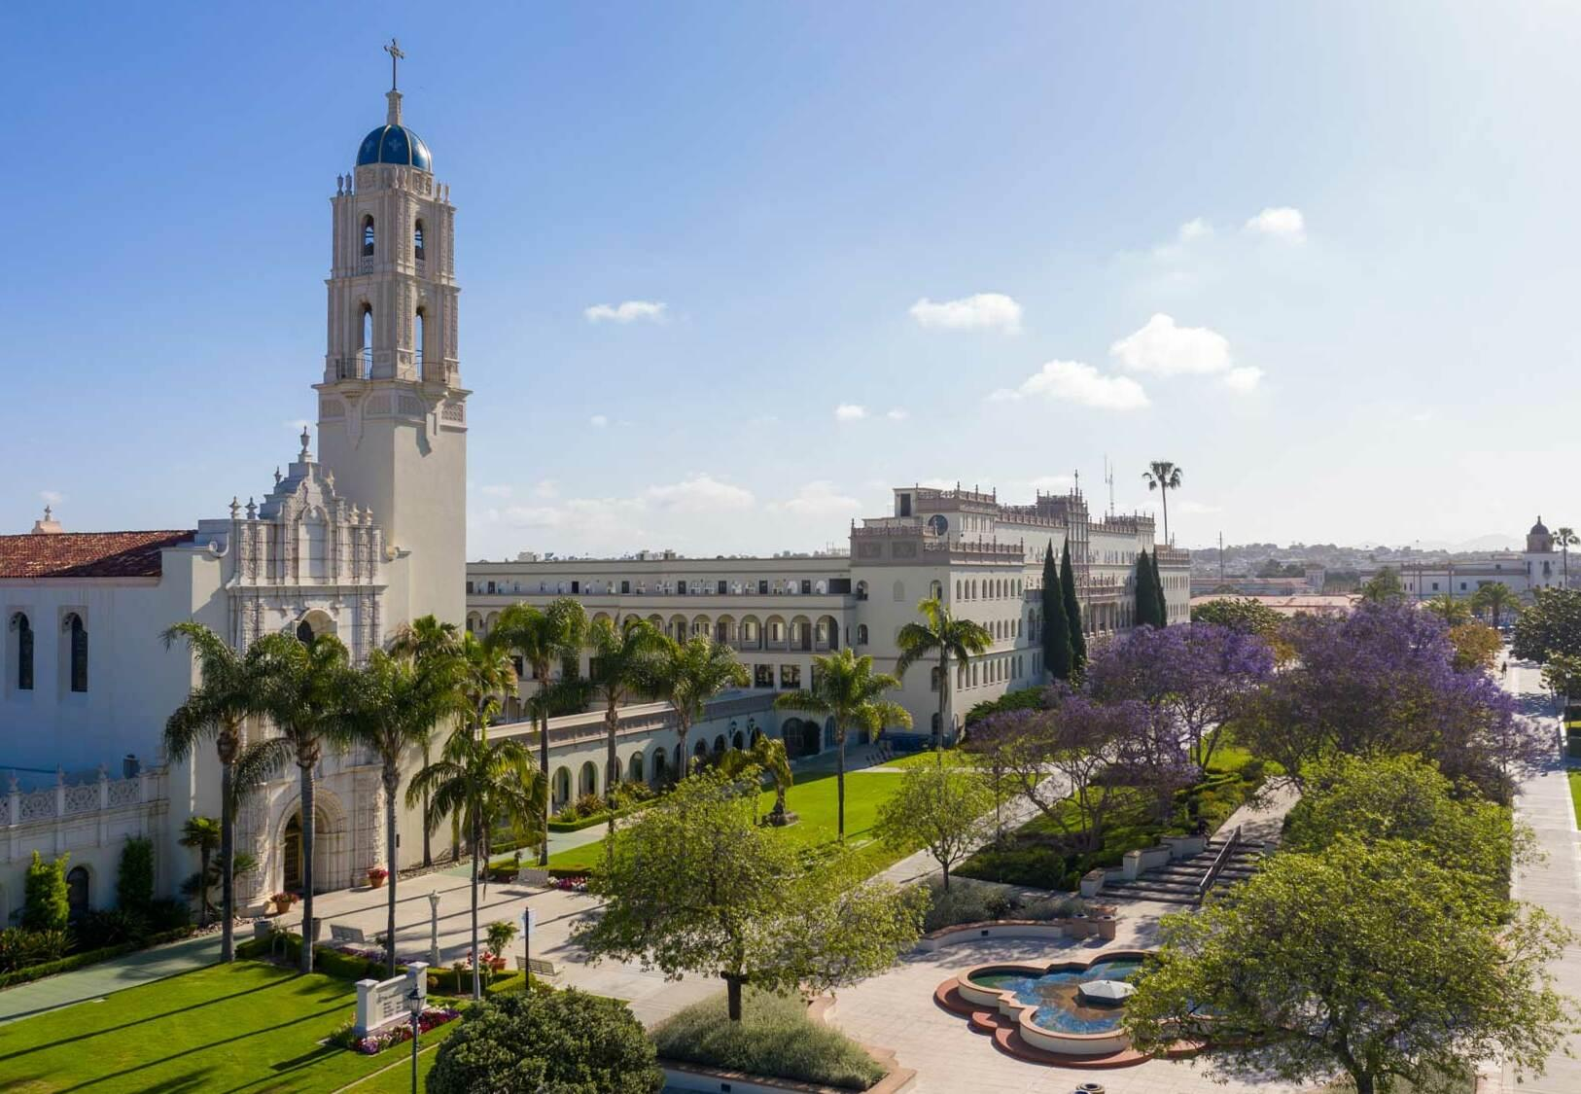
My Year in Review
By Caleb Sebek

Slide 3
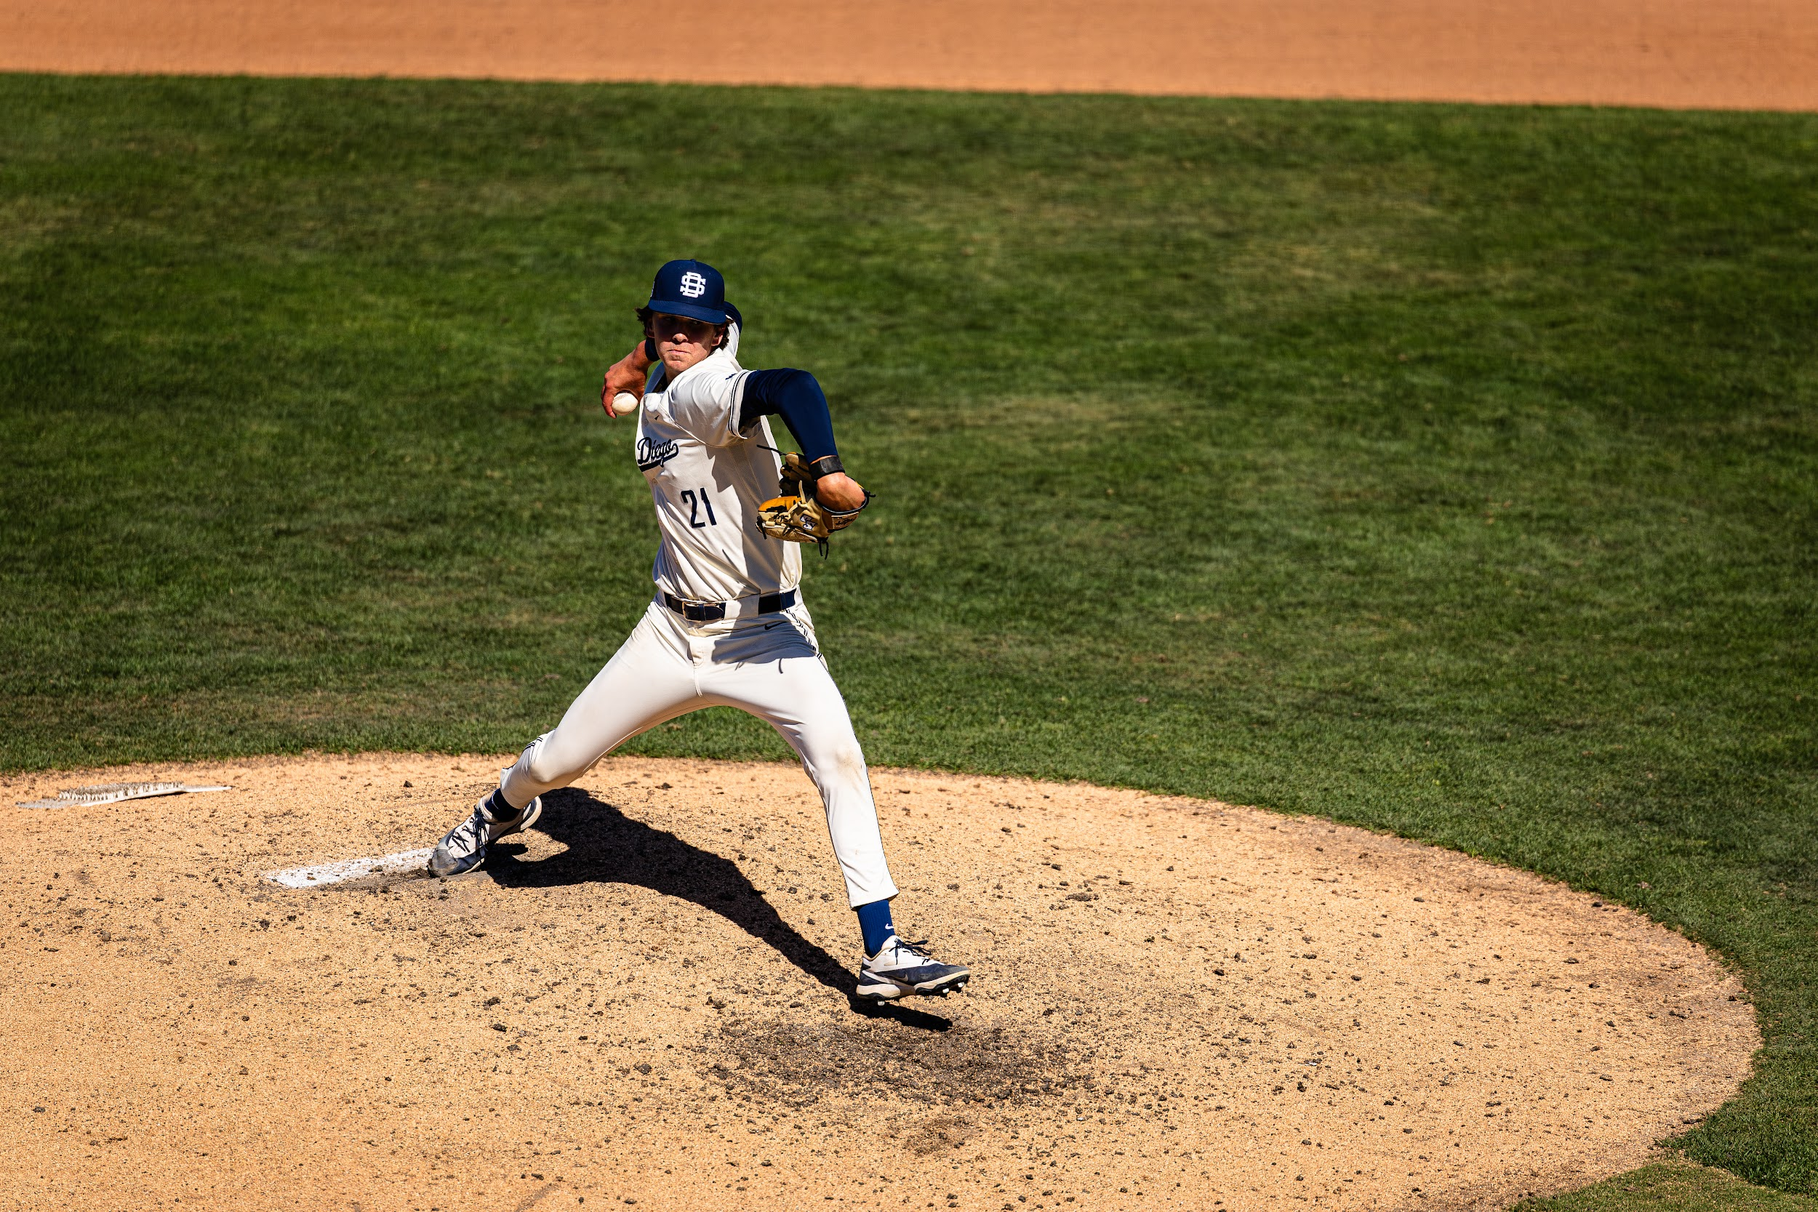

BIGGEST CHALLENGES
Demanding workload: Harder than high school classes.
D1 baseball balance: Managing school alongside sports commitments.
Travel conflicts: Missing lectures for away games.
Growth outcome: Developed strong time management skills
One of my first outings

Slide 4
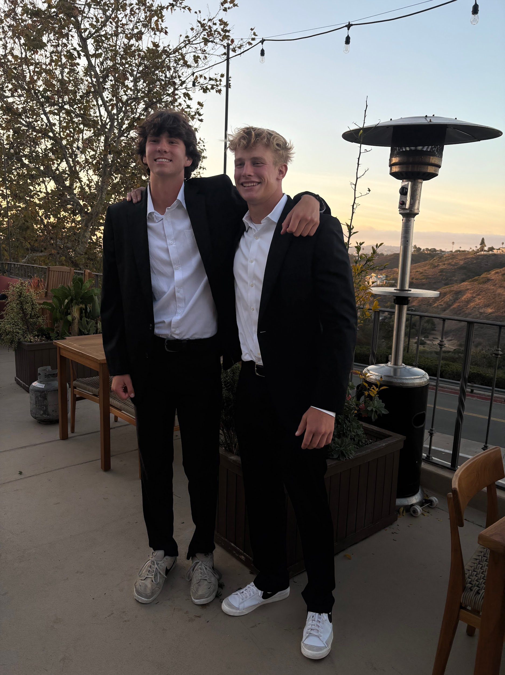
ACADEMIC GROWTH
Scheduled study time: Intentionally setting aside school hours.
Distraction-free focus: Using phone "Do Not Disturb" mode.
Accountability routine: Utilizing mandatory study hall weekly.
Environment change: Finding quiet areas to stay ahead.
My roommate and teammate, and now one of my best friends, Lucas.

Slide 5
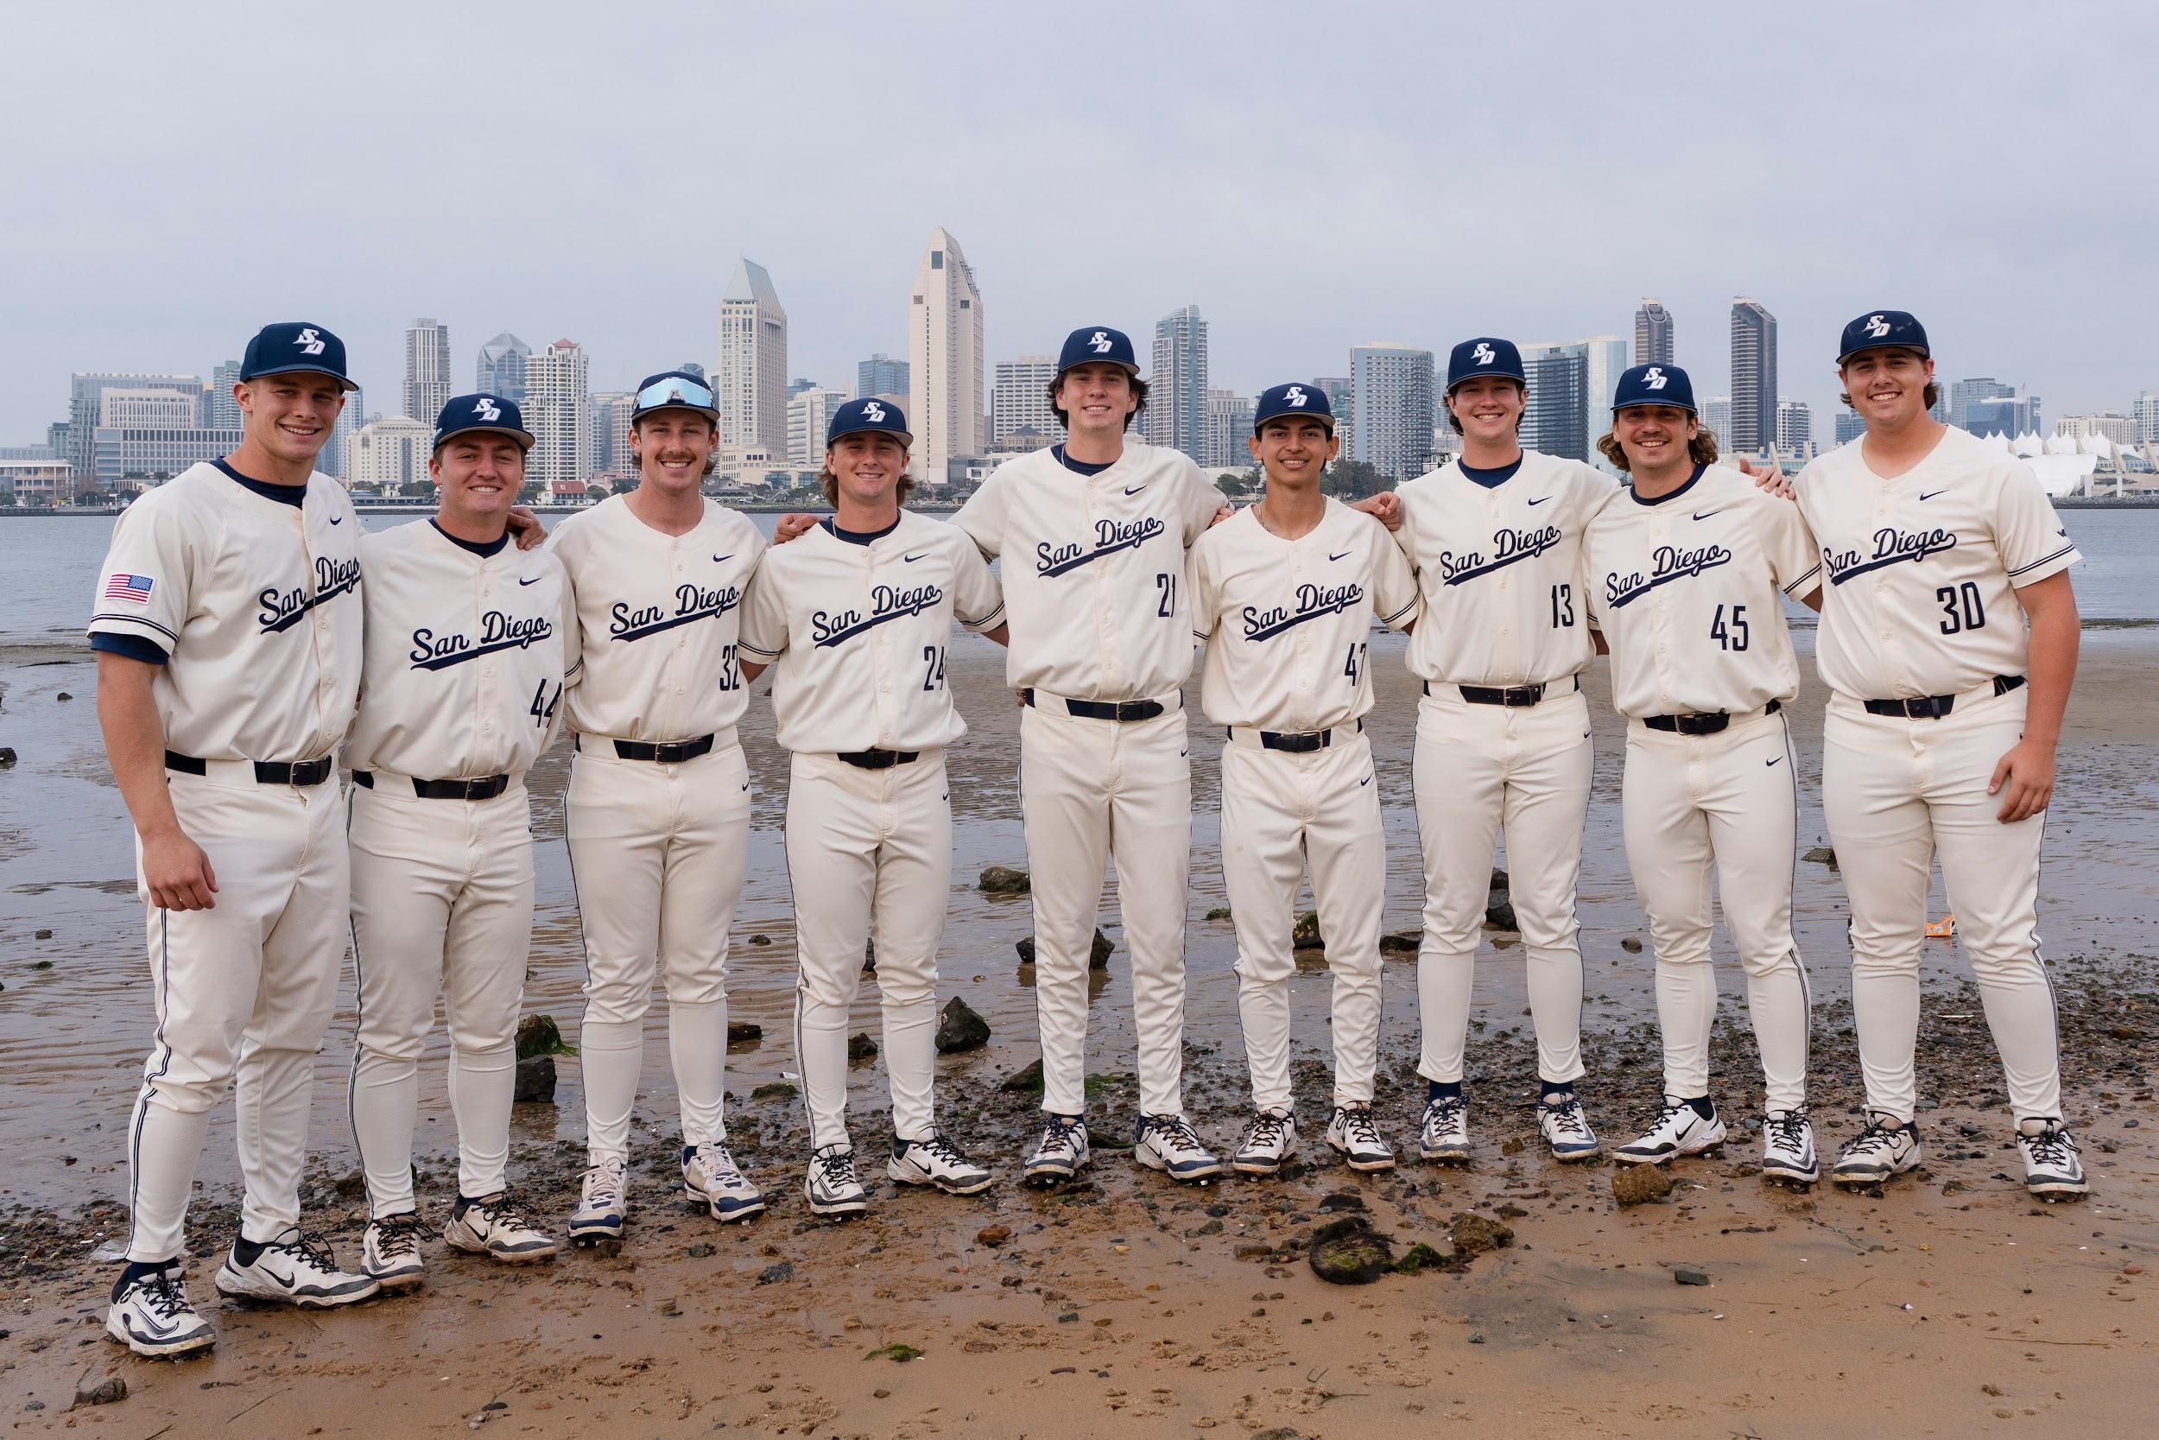
HARDEST CHALLENGES
Brutal schedule: Committing to 5 a.m. to 7 p.m. days.
Fall intensity: Navigating grueling training routines.
Team camaraderie: Leaning on teammates facing shared struggles.
Shared mindset: Finding strength in numbers to survive.
Freshman class of 2025-2026 season. Great group of guys.

Slide 6
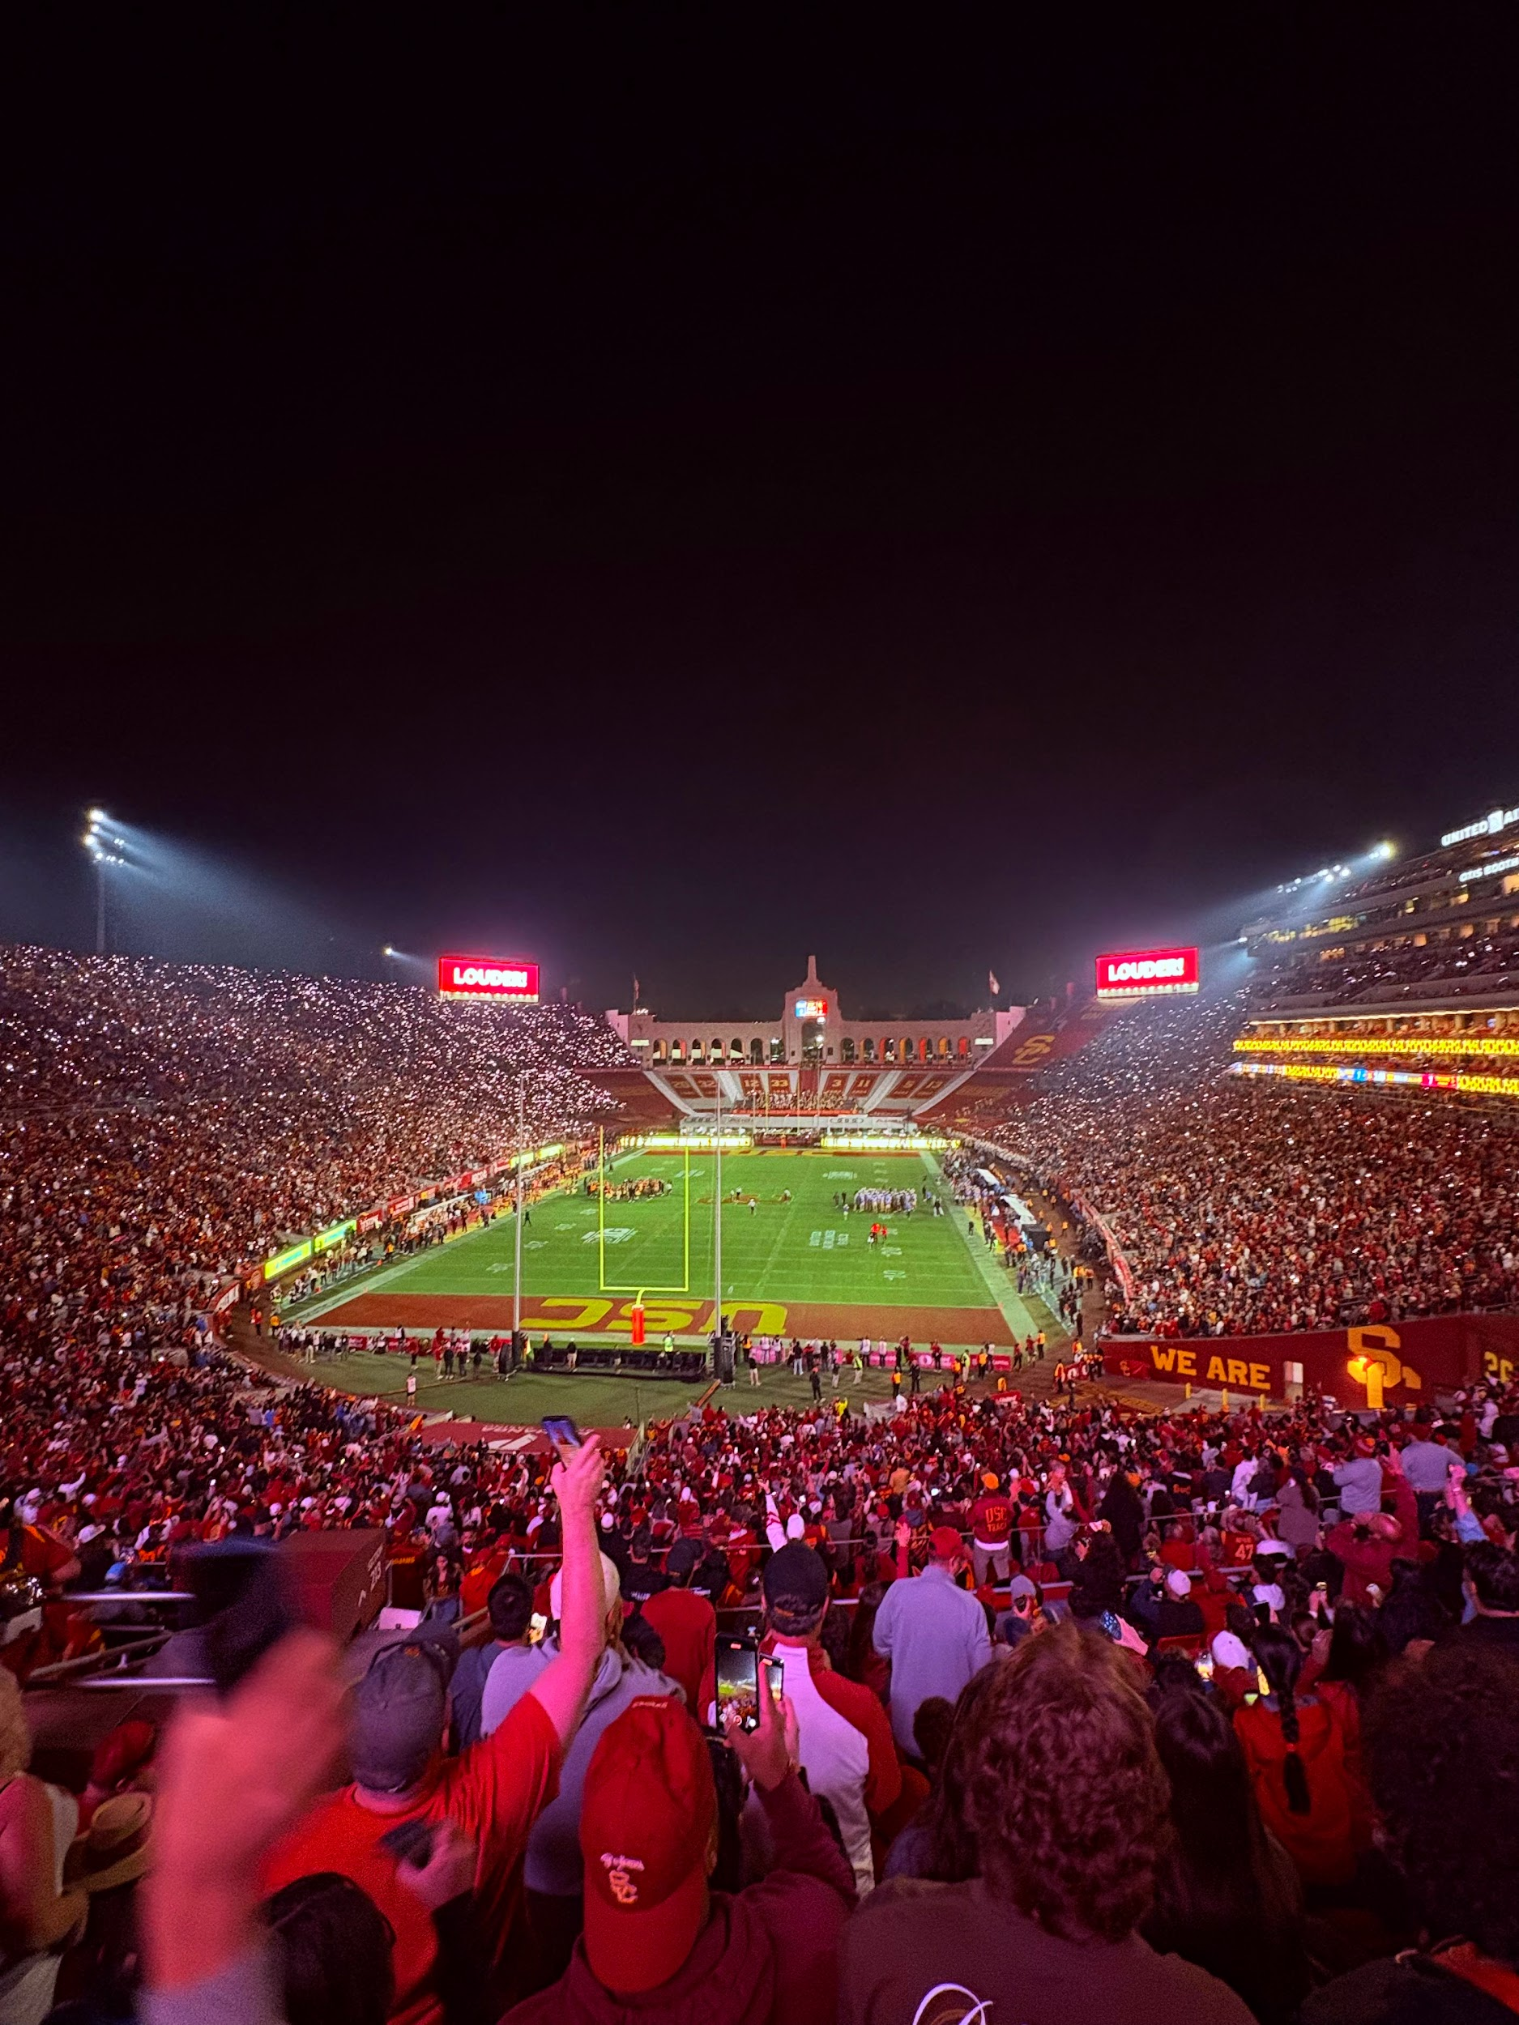
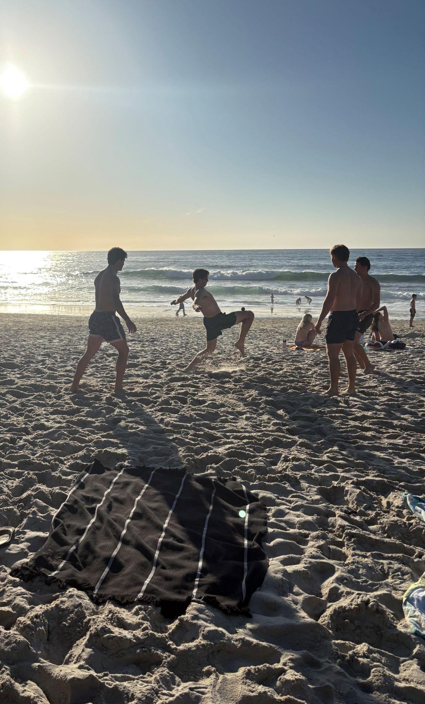
HOW DID I RECHARGE?
Beach time with the fellas.
Support system: Fueling energy from positive people.
Deliberate breaks: Gave me time to regroup and reset.
Social outings: Visiting the beach with friends.
Entertainment: Catching USC games and watching movies.
Watching a USC game with friends.

Slide 7
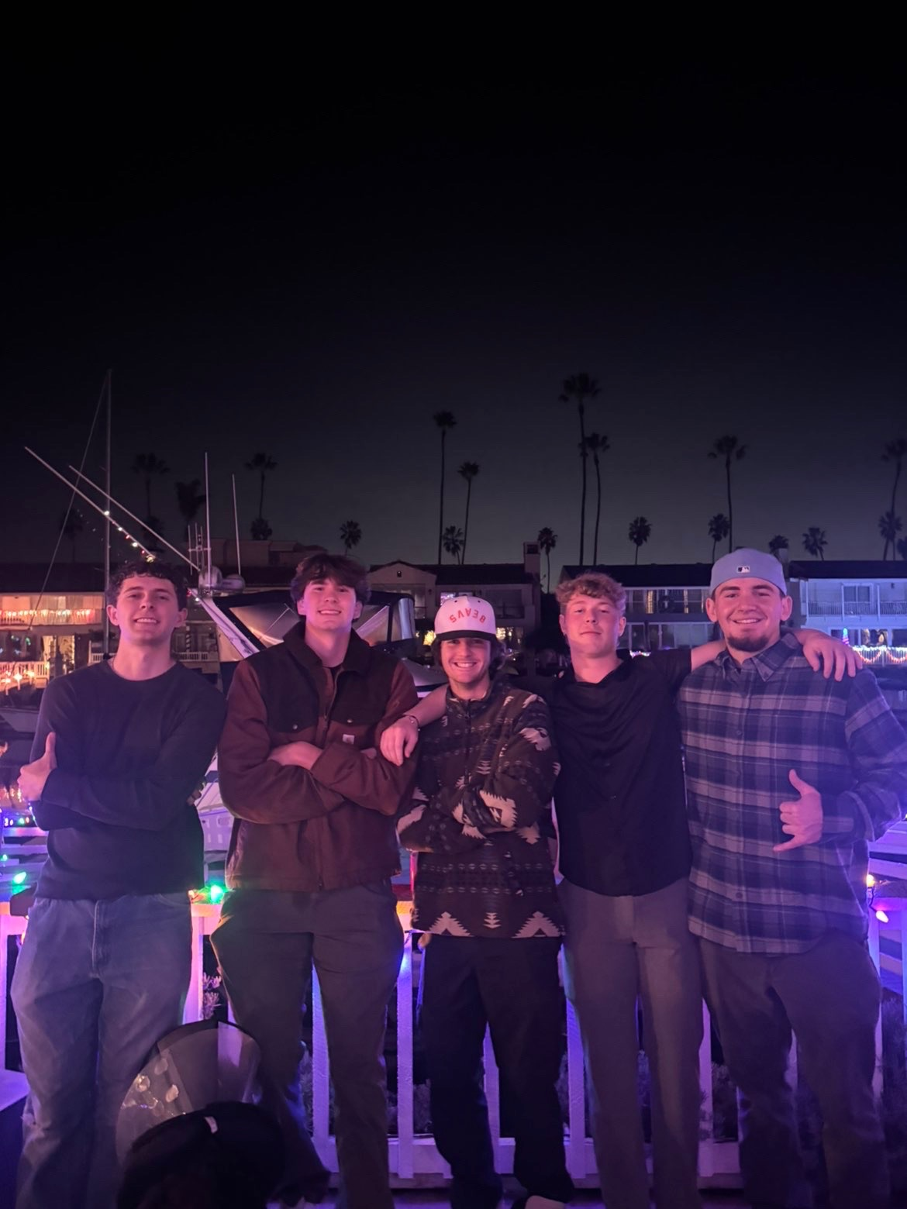
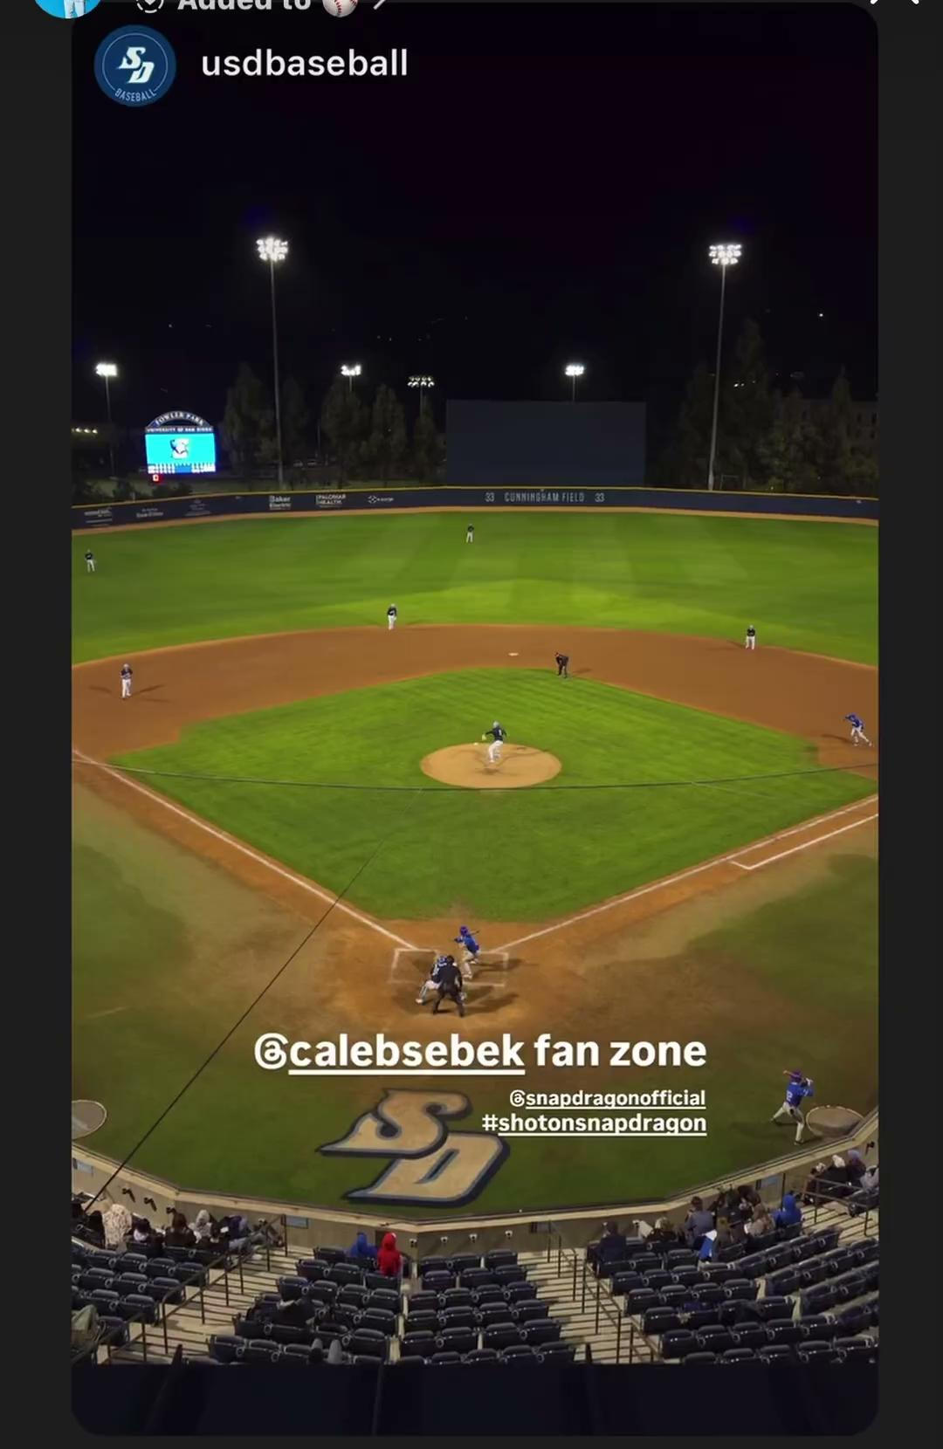
RELATIONSHIPS
Family ties: Visiting parents often on open weekends.
Home friends: Staying close through breaks and text.
New connections: Pushing out of comfort zones daily.
College bond: Building lifelong friendships with teammates.
My best friends and support system from home.

Slide 8
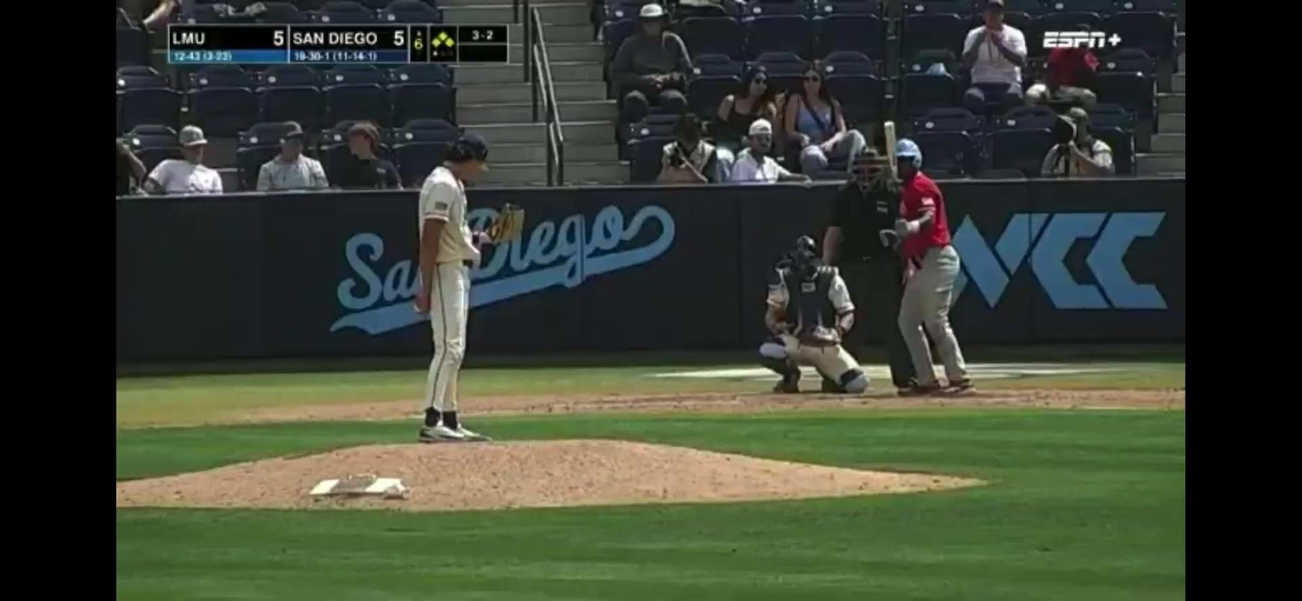

Slide 9
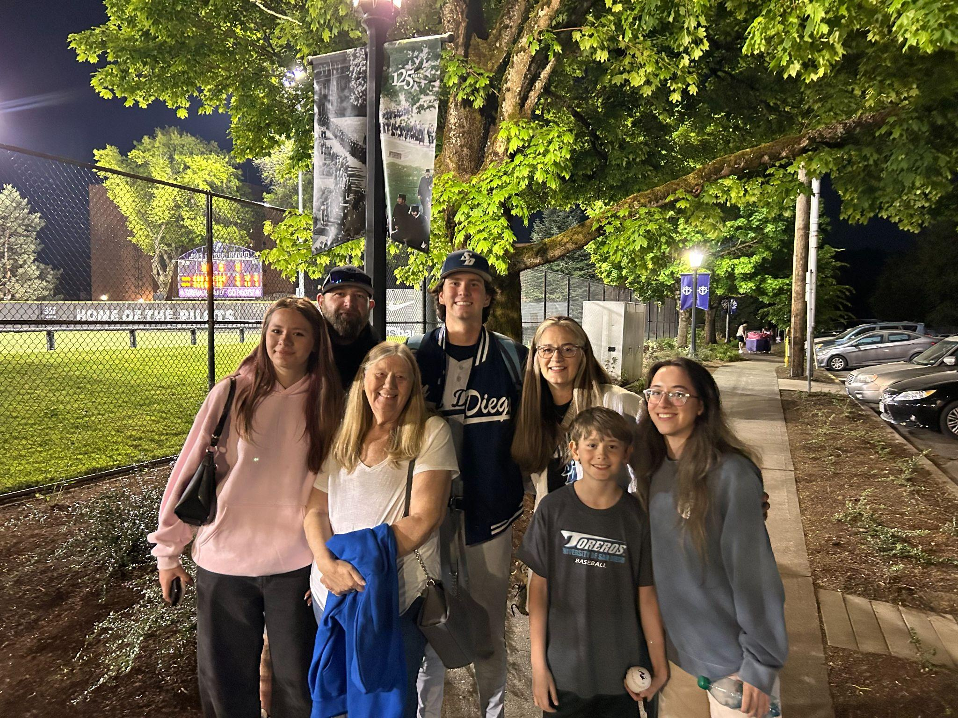
POSITIVE EXPERIENCE
Supportive community: Thankful for a loving family and great people.
Athletic opportunity: Grateful to play baseball at a respected school.
Academic pursuit: Working hard while earning a college degree.
Ideal location: Enjoying life in San Diego to elevate the experience.

