Slide 1

Jack McManus Semester Archive: Spring 2026
An information systems time capsule documenting personal milestones, academic hurdles, and global updates.

Slide 2
Personal Milestones
Moments from Santa Barbara to Professional Initiations

Slide 3
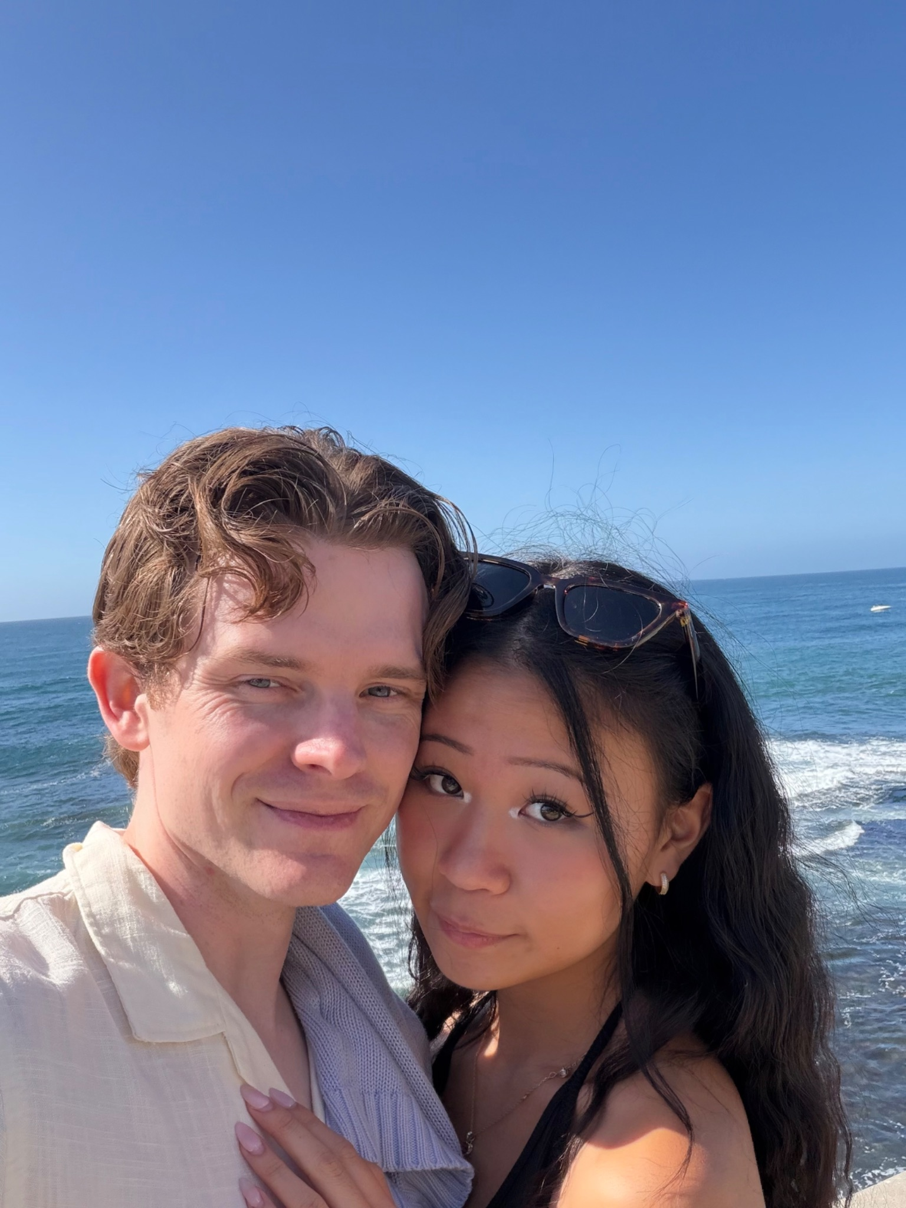
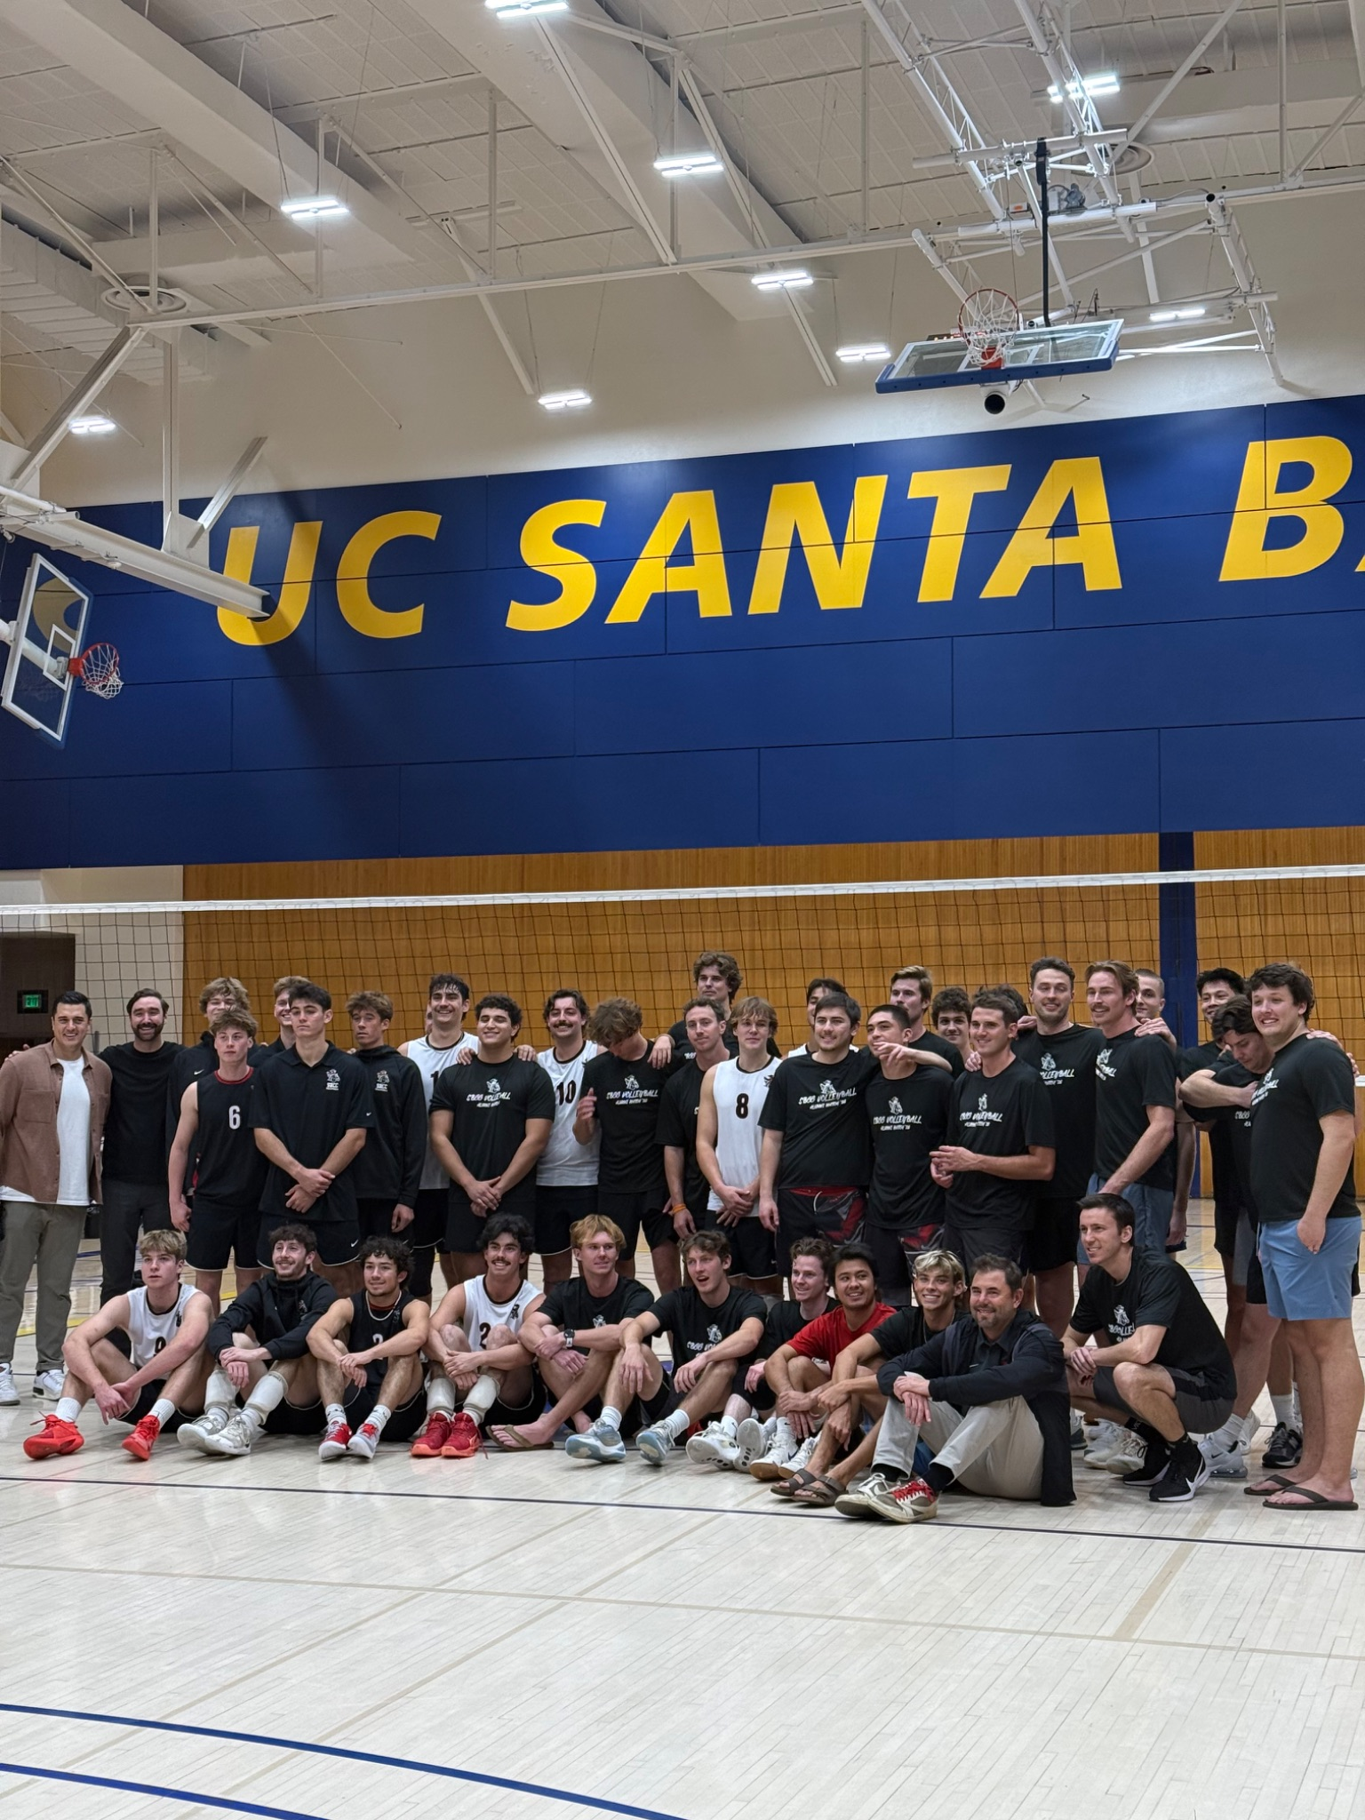
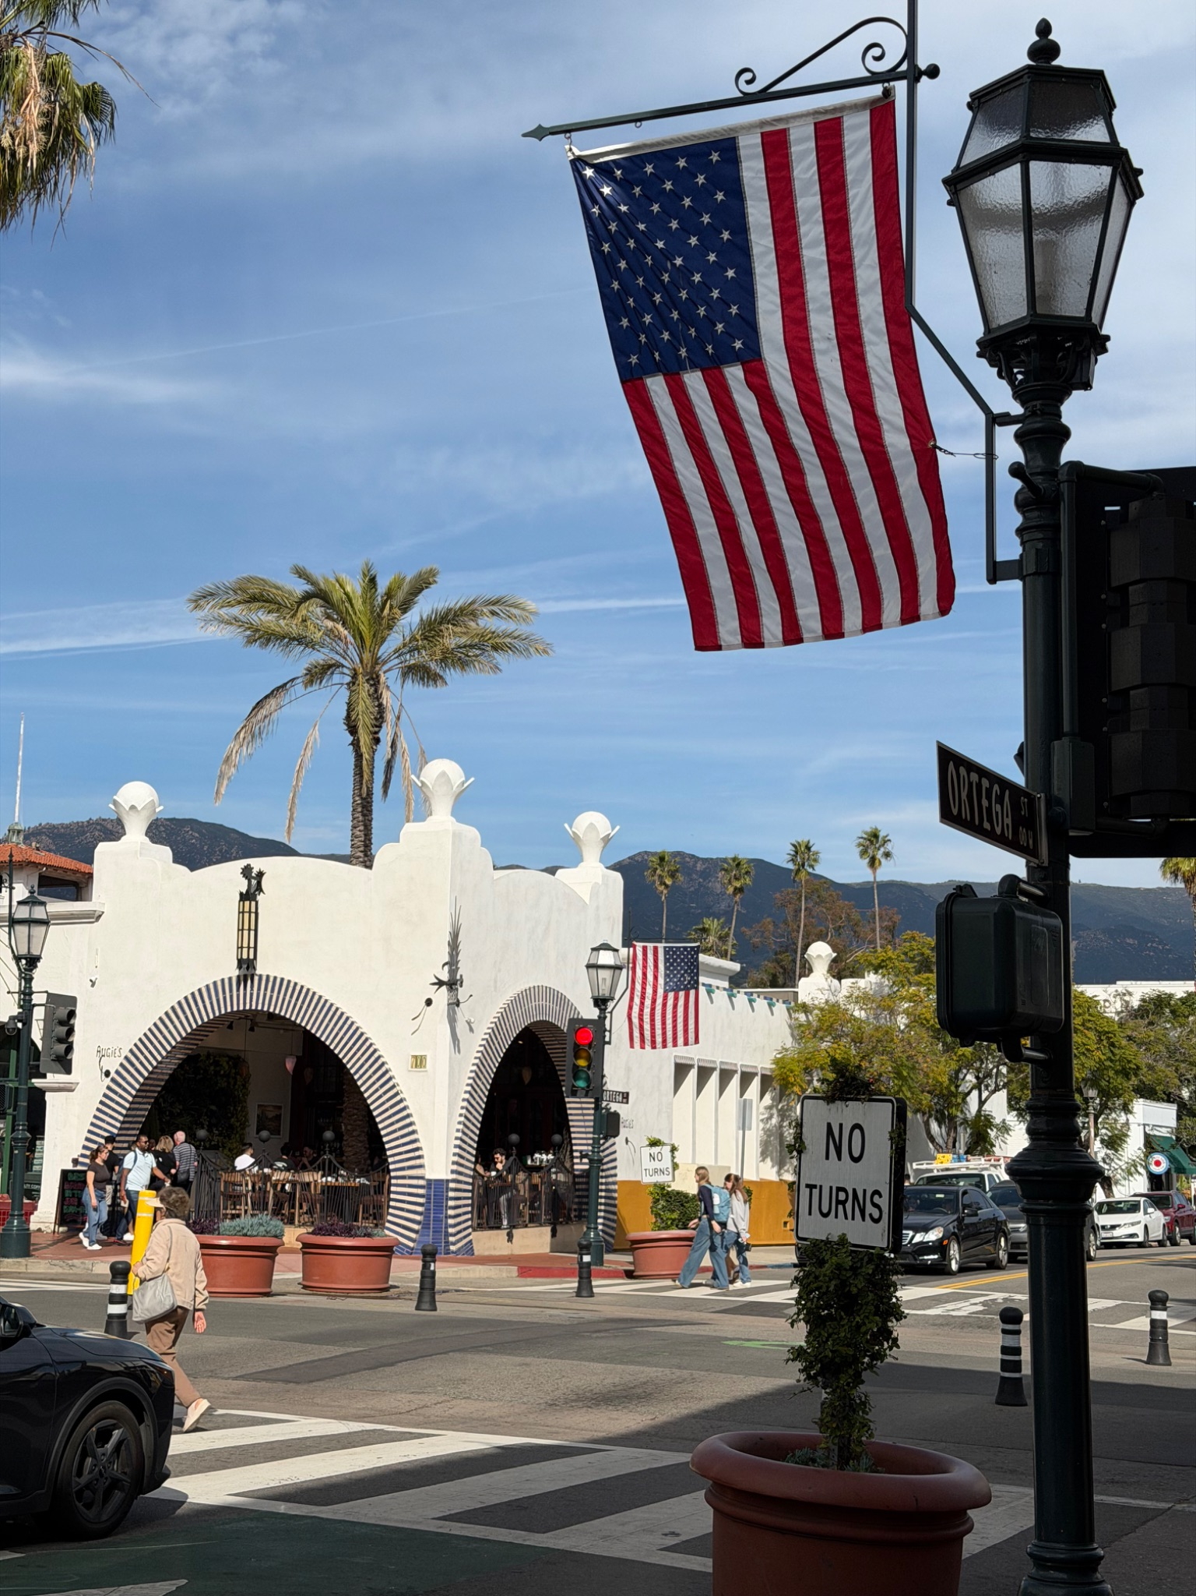
Santa Barbara & UCSB
This semester featured a meaningful trip to Santa Barbara with my girlfriend where I got the opportunity to play in the UCSB Alumni Match

Slide 4


Professional Growth
Beta Alpha Psi Initiation
Officially initiated into Beta Alpha Psi this semester.

Slide 5
The Paths Not Taken
Items that were expected or wanted but did not occur.

Slide 6

Unmet Expectations
Volleyball Nationals
International Study
Despite a strong competitive season, I was unable to travel to the National Tournament for the USD club volleyball. A tough break, but a proud run nonetheless.
I was also unable to attend the highly anticipated study abroad program to Beijing and Taiwan

Slide 7
Highs and Lows
Celebrating wins and navigating physical setbacks.

Slide 8
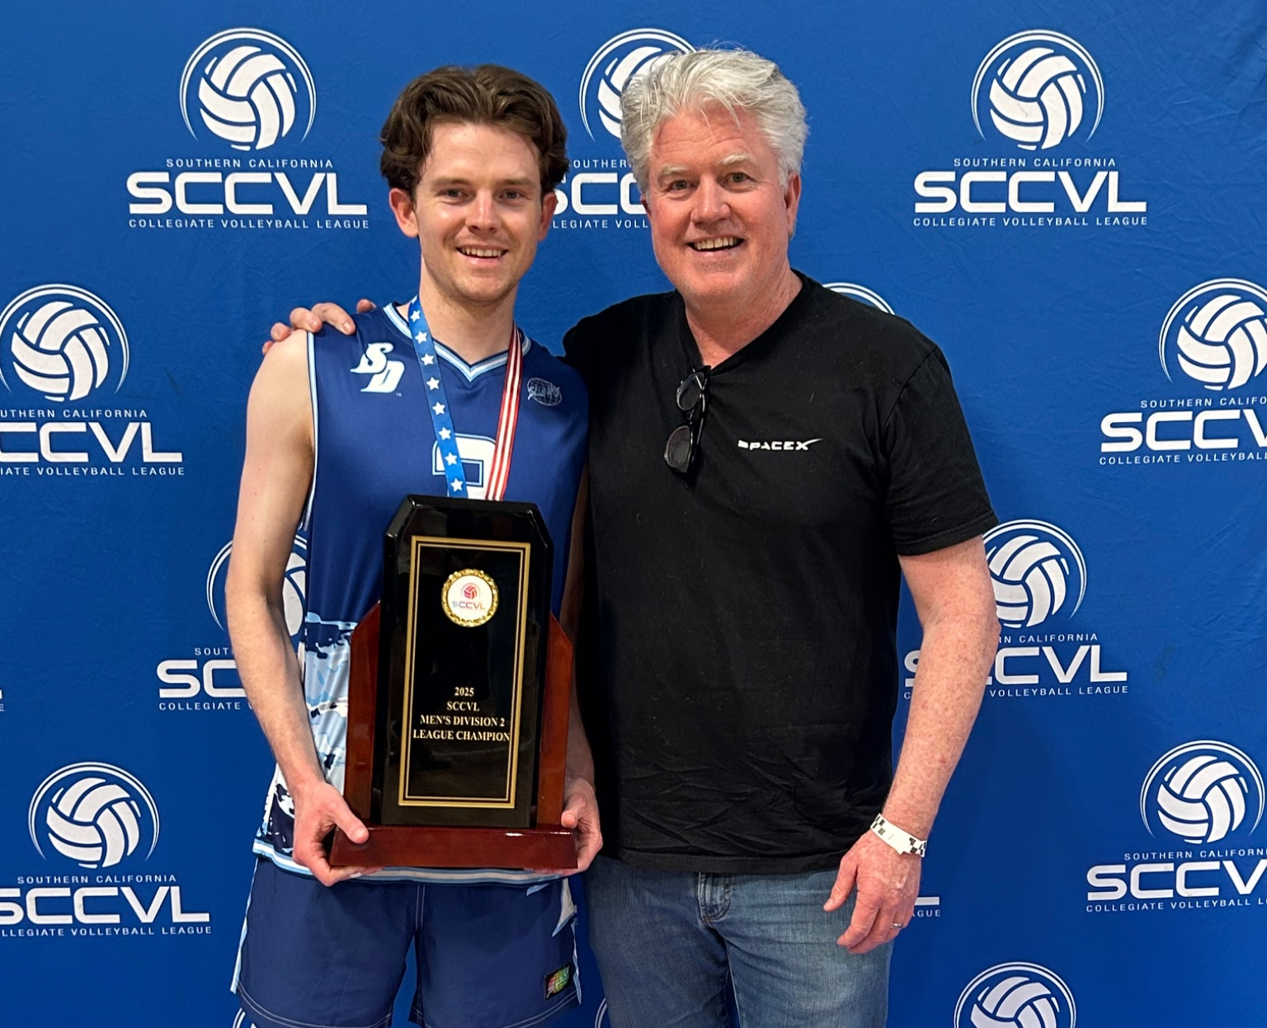
Defining Success
League Champions: Finished 1st in our volleyball league, securing the trophy after an incredible season stretch.
CPA Milestone: Sat for the first part of the CPA exam.

Slide 9
Navigating Challenges
Sprained Ankle
!
A frustrating physical setback during peak season. Which is what caused me to miss the national tournament. (I’ll spare you the image)

Slide 10
National & Legal Context
Category | Item (Past 6 Months) | Details & Impact
Global Media / News | The Artemis II Mission | NASA’s historic crewed lunar flyby dominated international headlines, marking a massive operational leap forward in modern aerospace engineering.
Law / Process Change | Digital Asset Transparency Act | Updated compliance mandates heavily modified crypto and decentralized asset reporting workflows, reshaping corporate accounting procedures for the 2026 tax window.

Slide 11
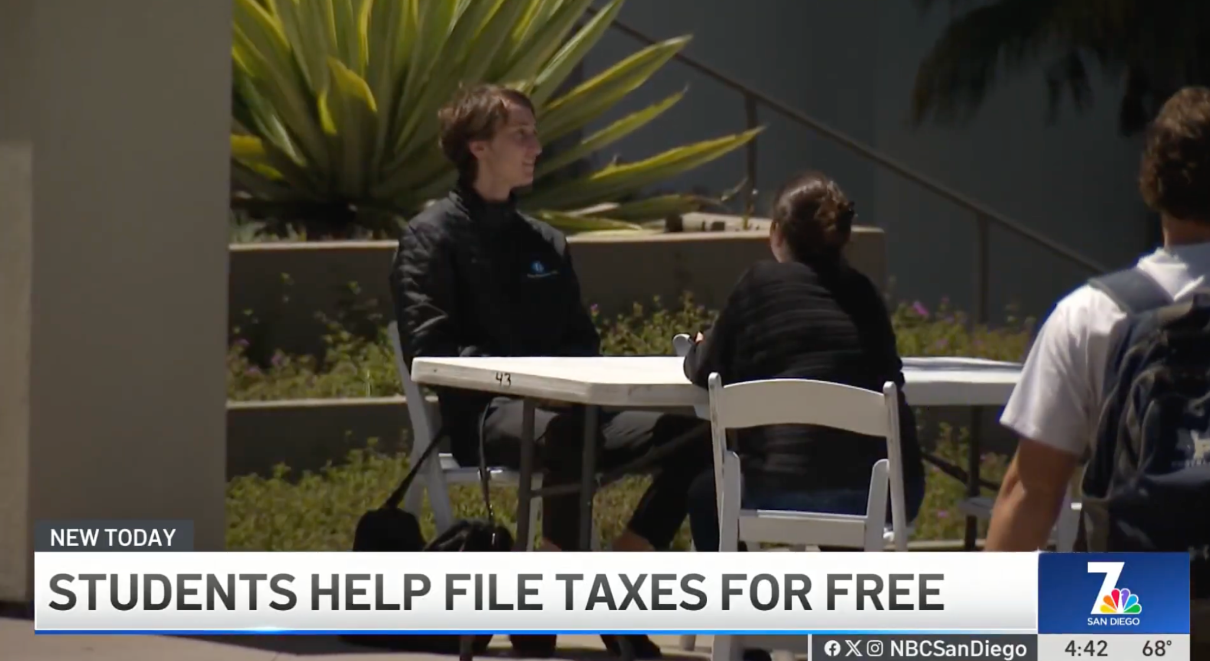
Community & Creativity
Accounting Society VITA
Witnessed peer creativity and empathy first-hand through the VITA Program.
Accounting society members provide free tax preparation services, optimizing a complex filing process for local families in need.

Slide 12

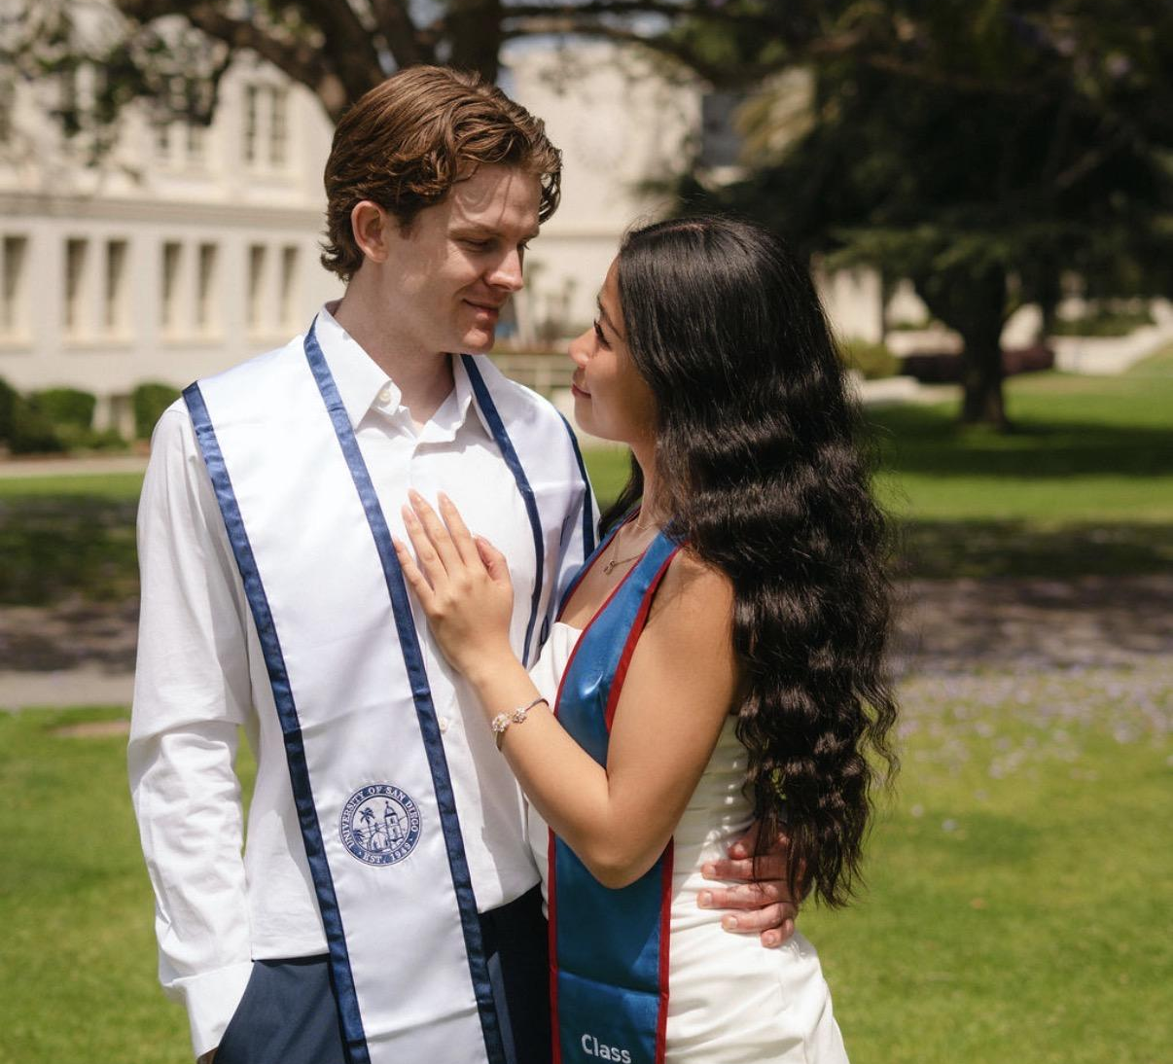
The Next Chapter
Graduation & Beyond
Closing out my time here at the University of San Diego.
Following commencement, the next professional chapter officially begins this August when I join PwC.

