Slide 1
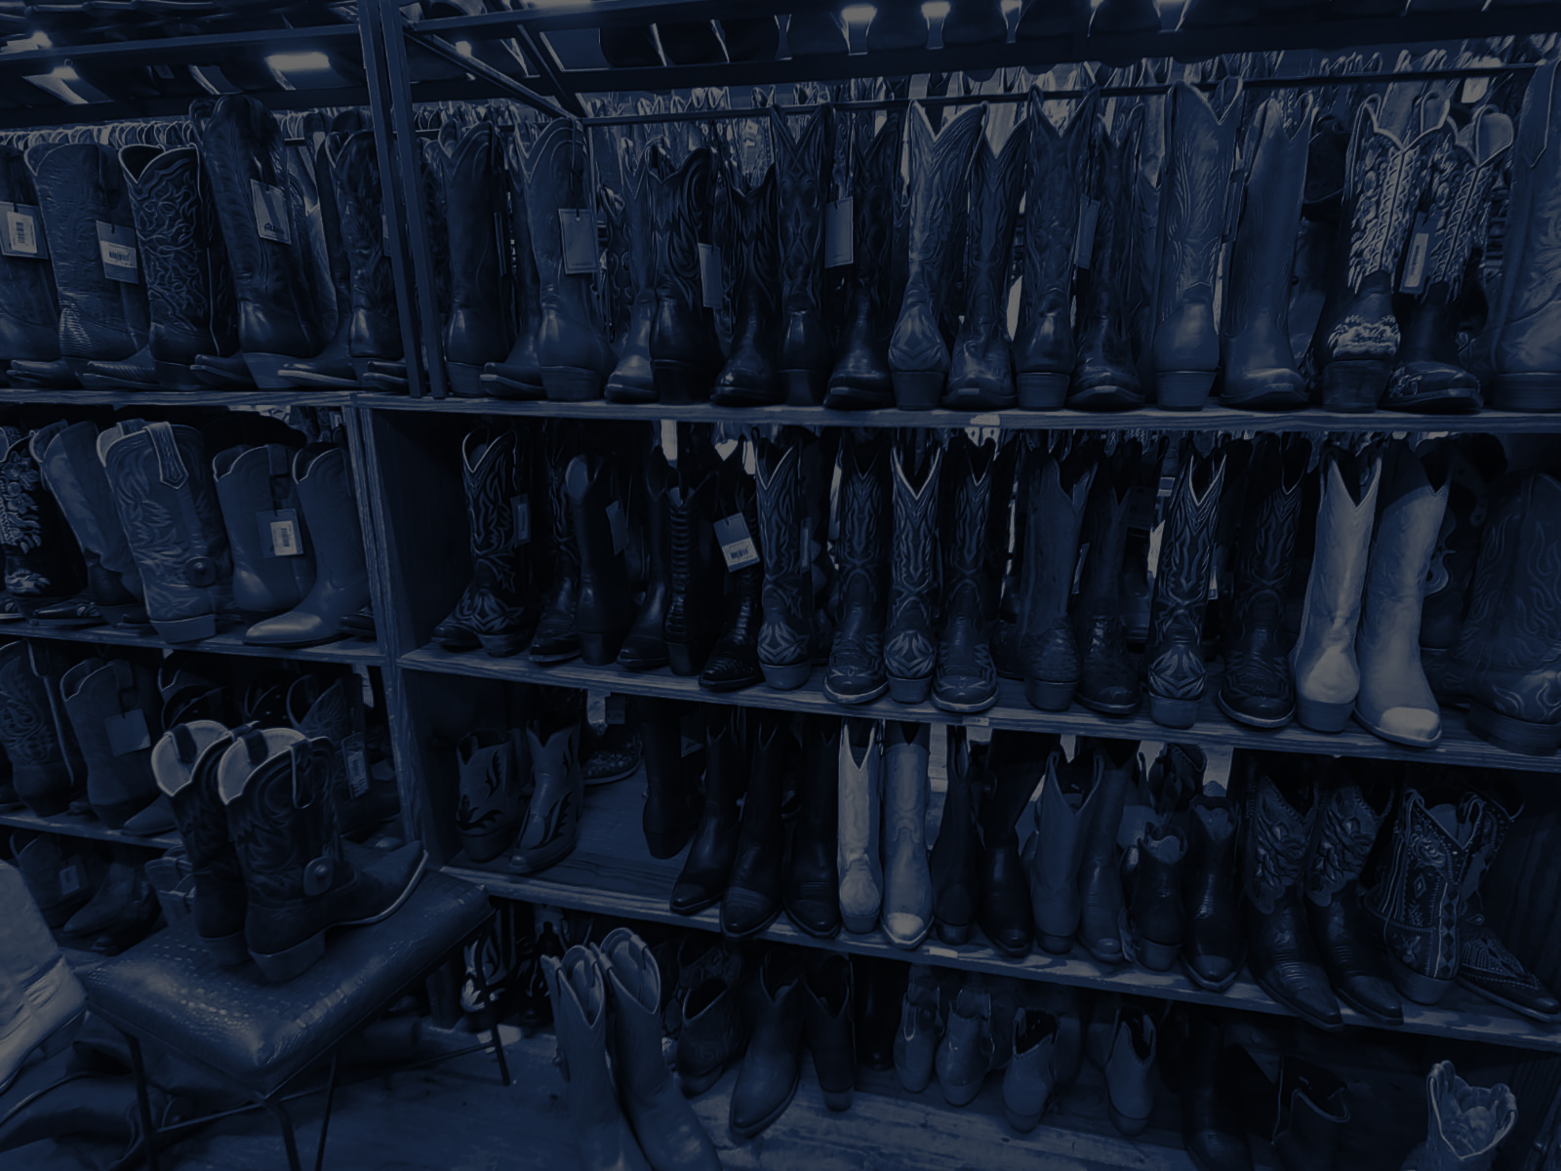
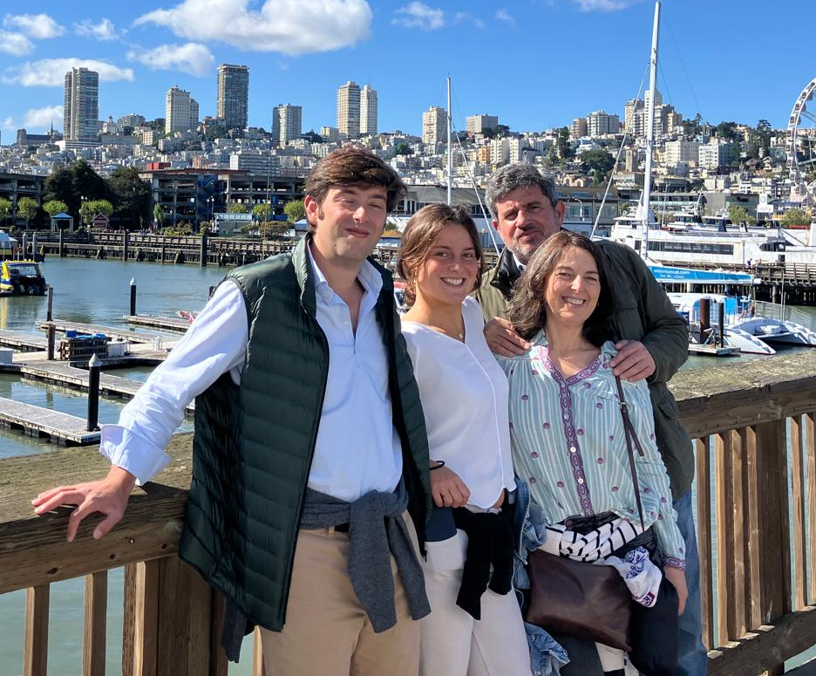
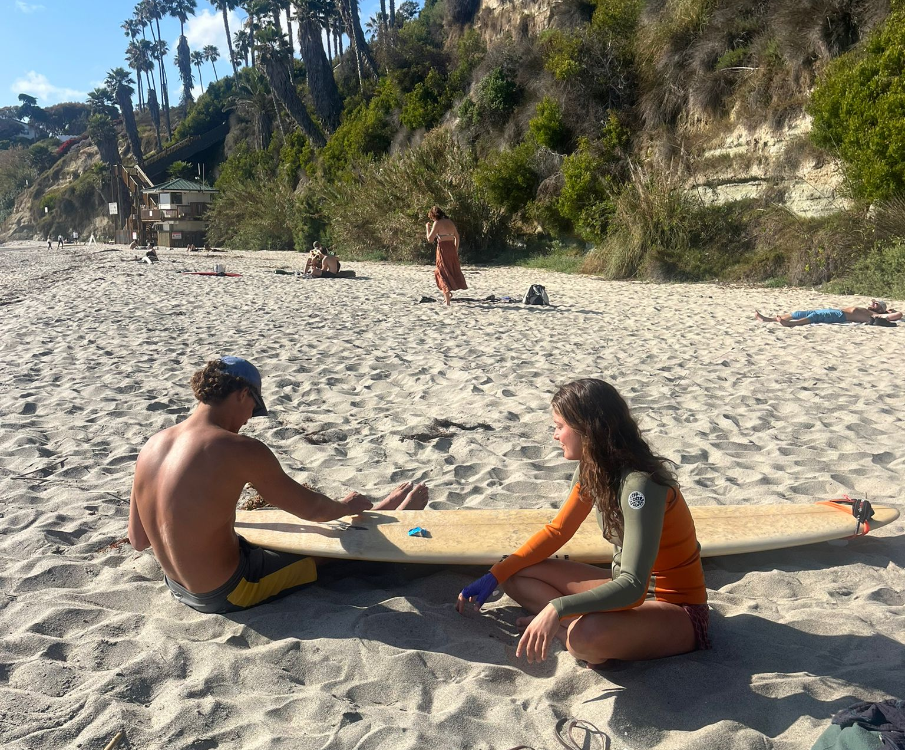
SPRING SEMESTER 2026 · SAN DIEGO
Time Capsule
Documenting the Present for the Future
Almudena Garrido · ITMG 100
GARRIDO_TIME_CAPSULE_EXAM

Slide 2
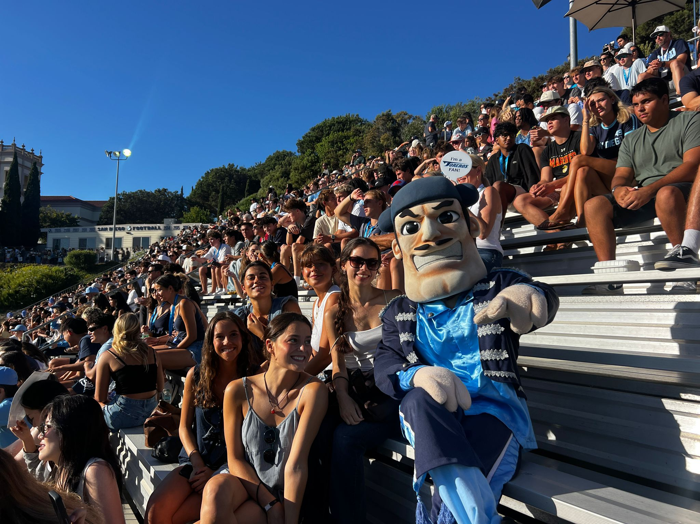
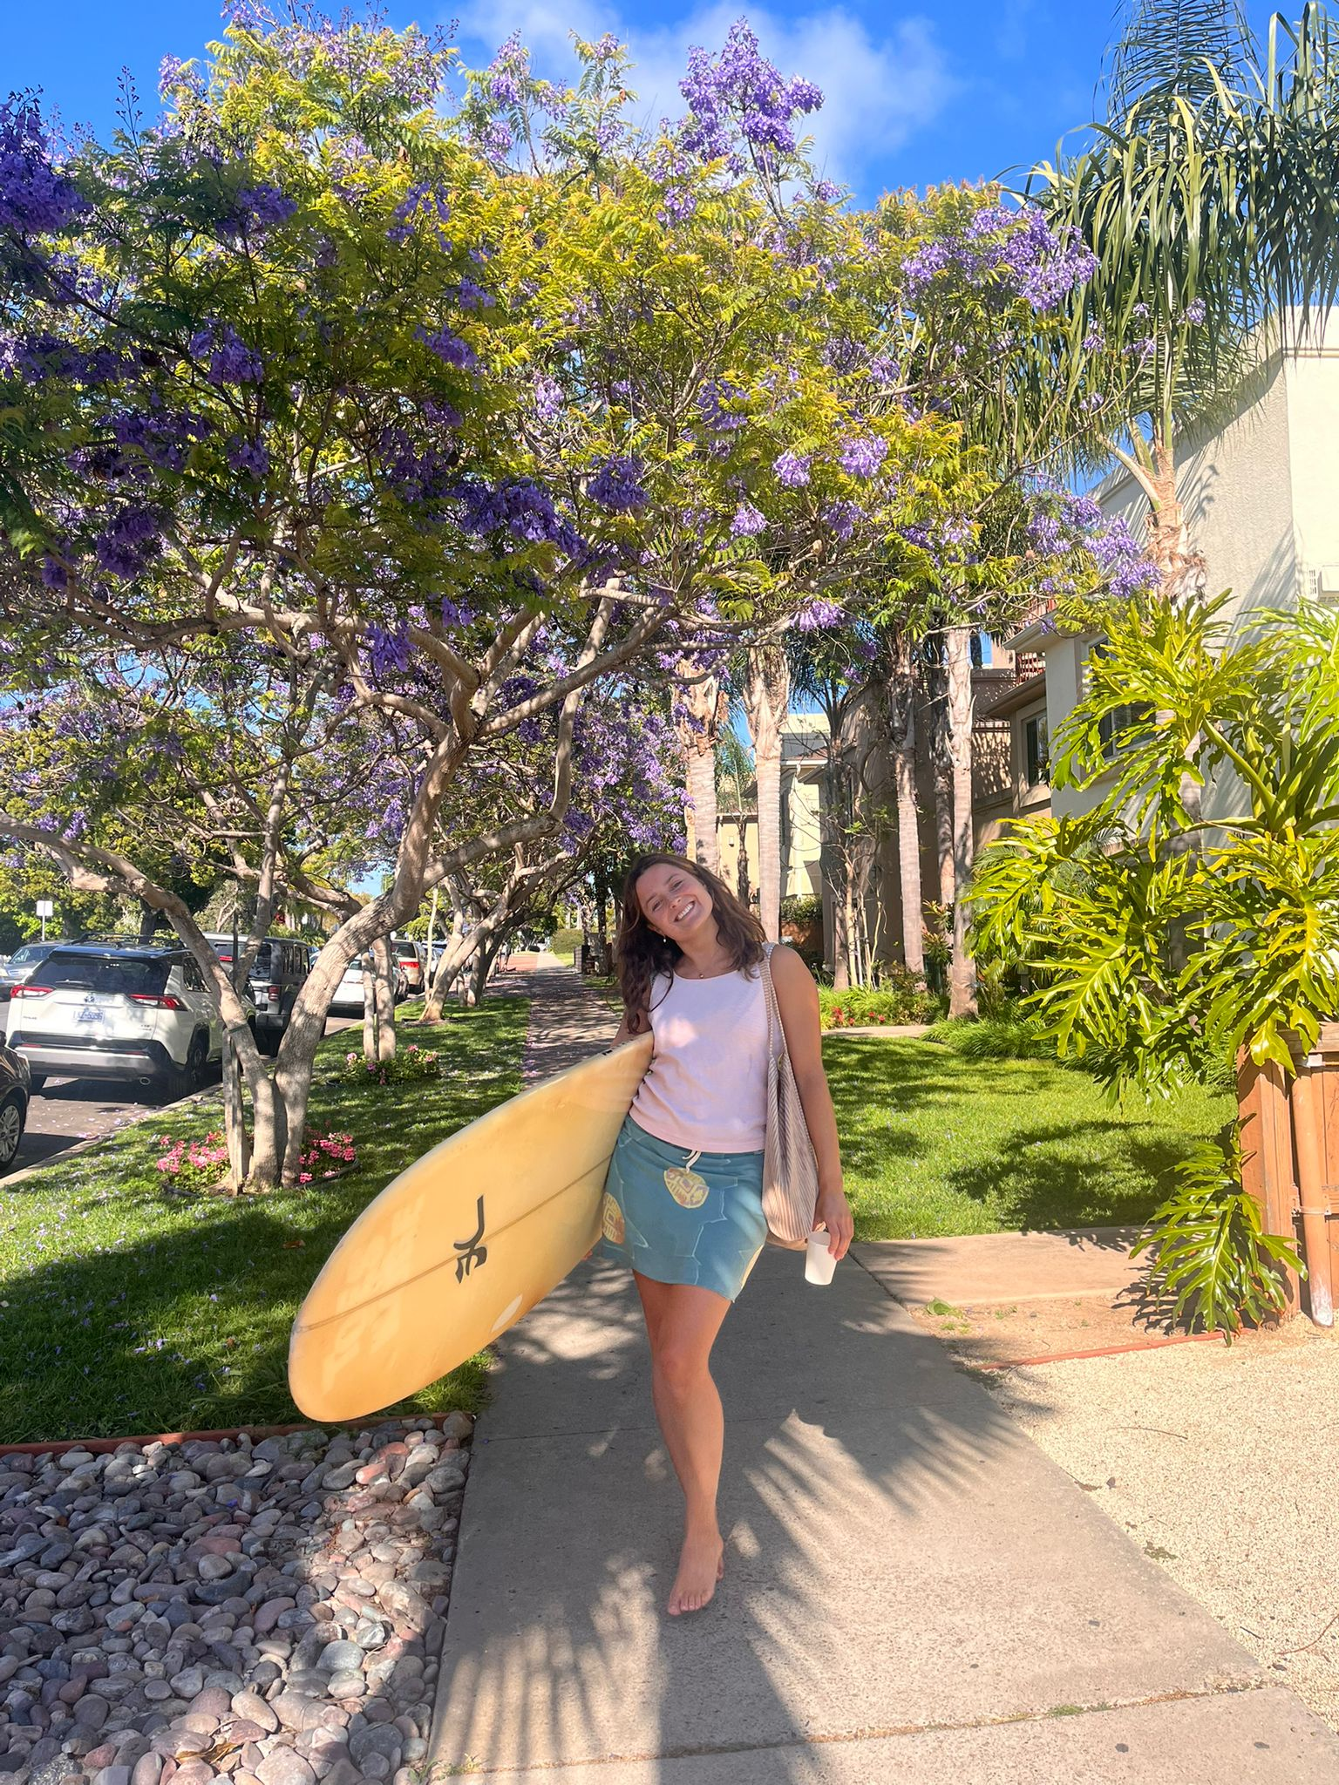
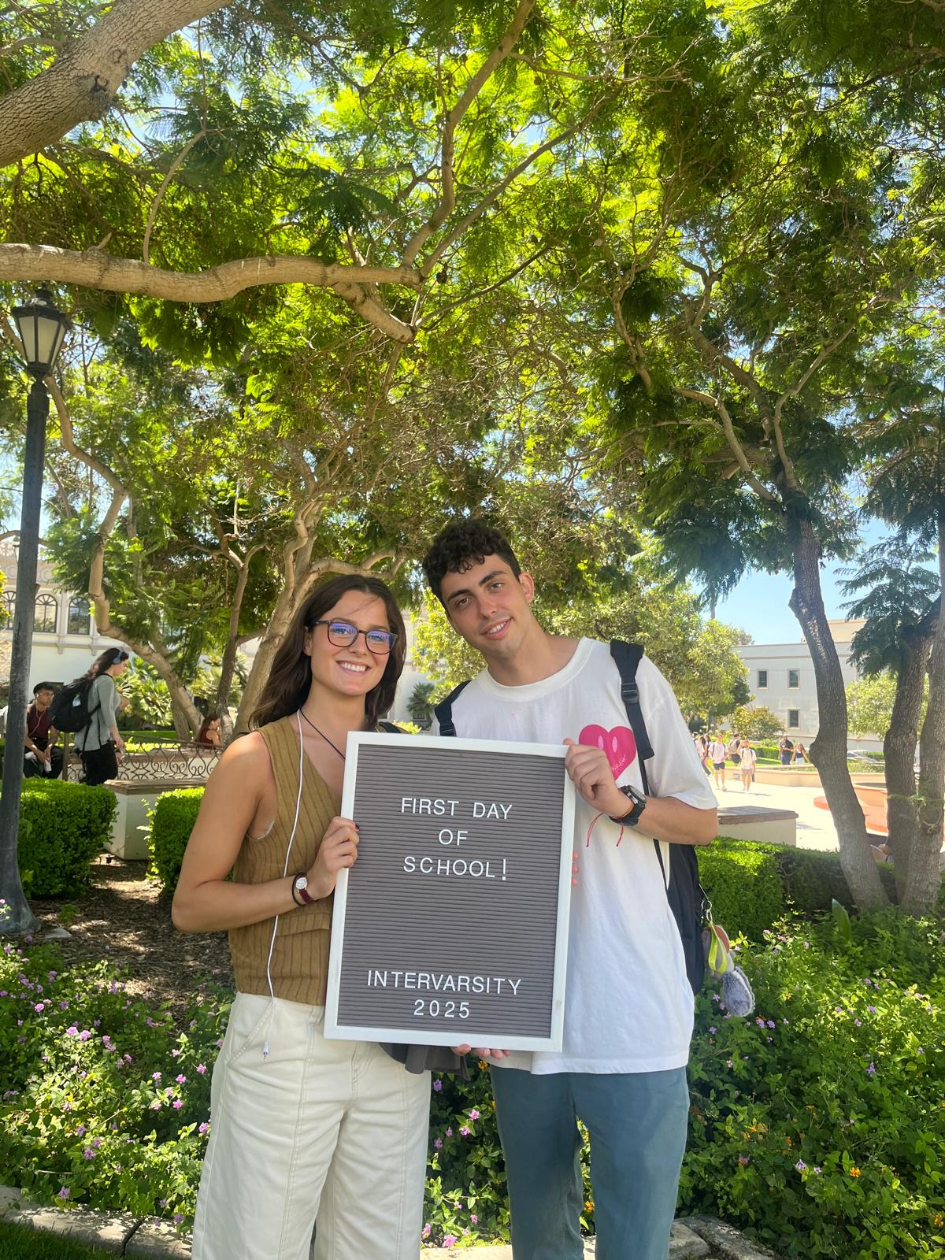
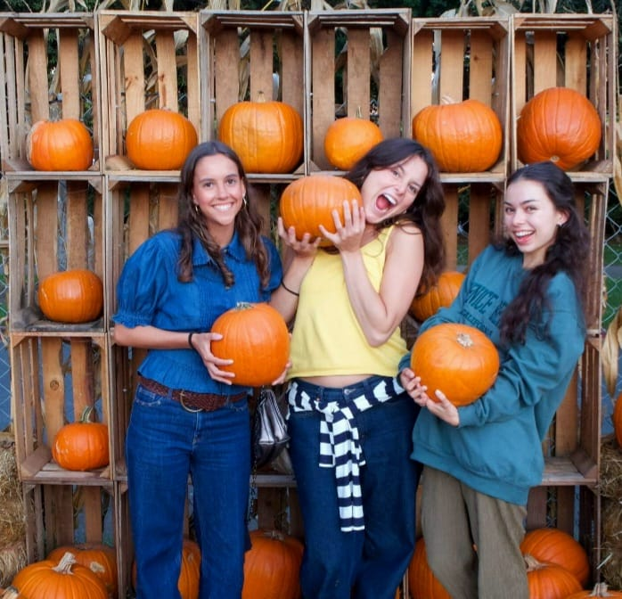
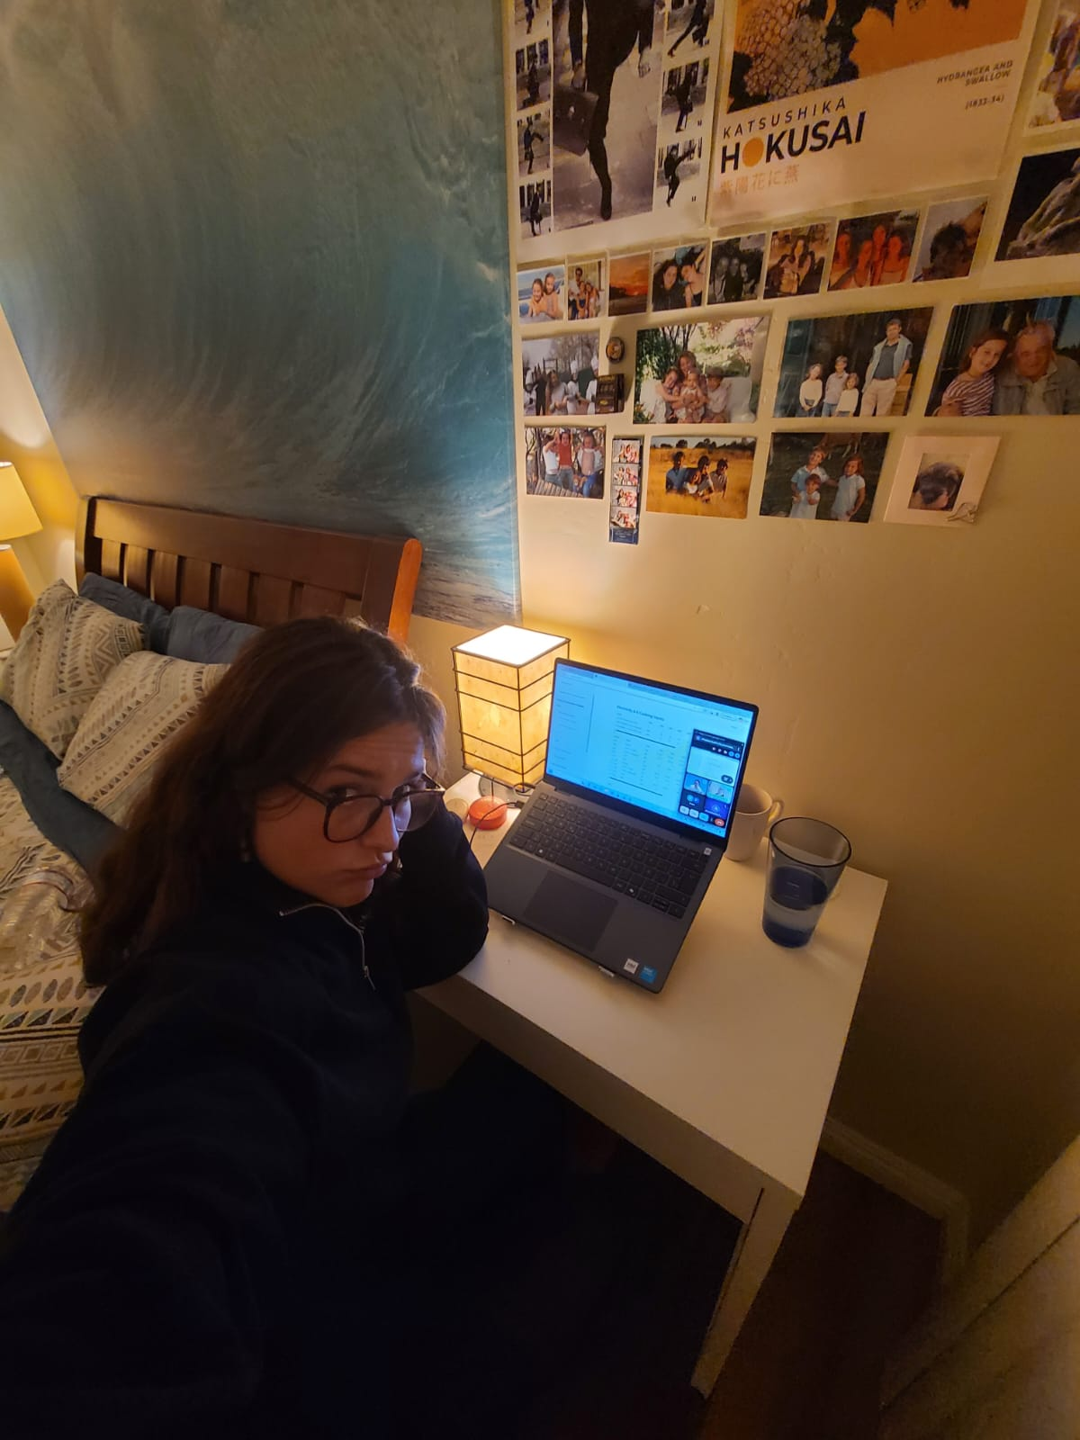
Life in San Diego
Second semester — returning “home” after Christmas in Spain.
New longboard
First day back
USD Toreros game
Fall vibes in SoCal
Hustle mode

Slide 3
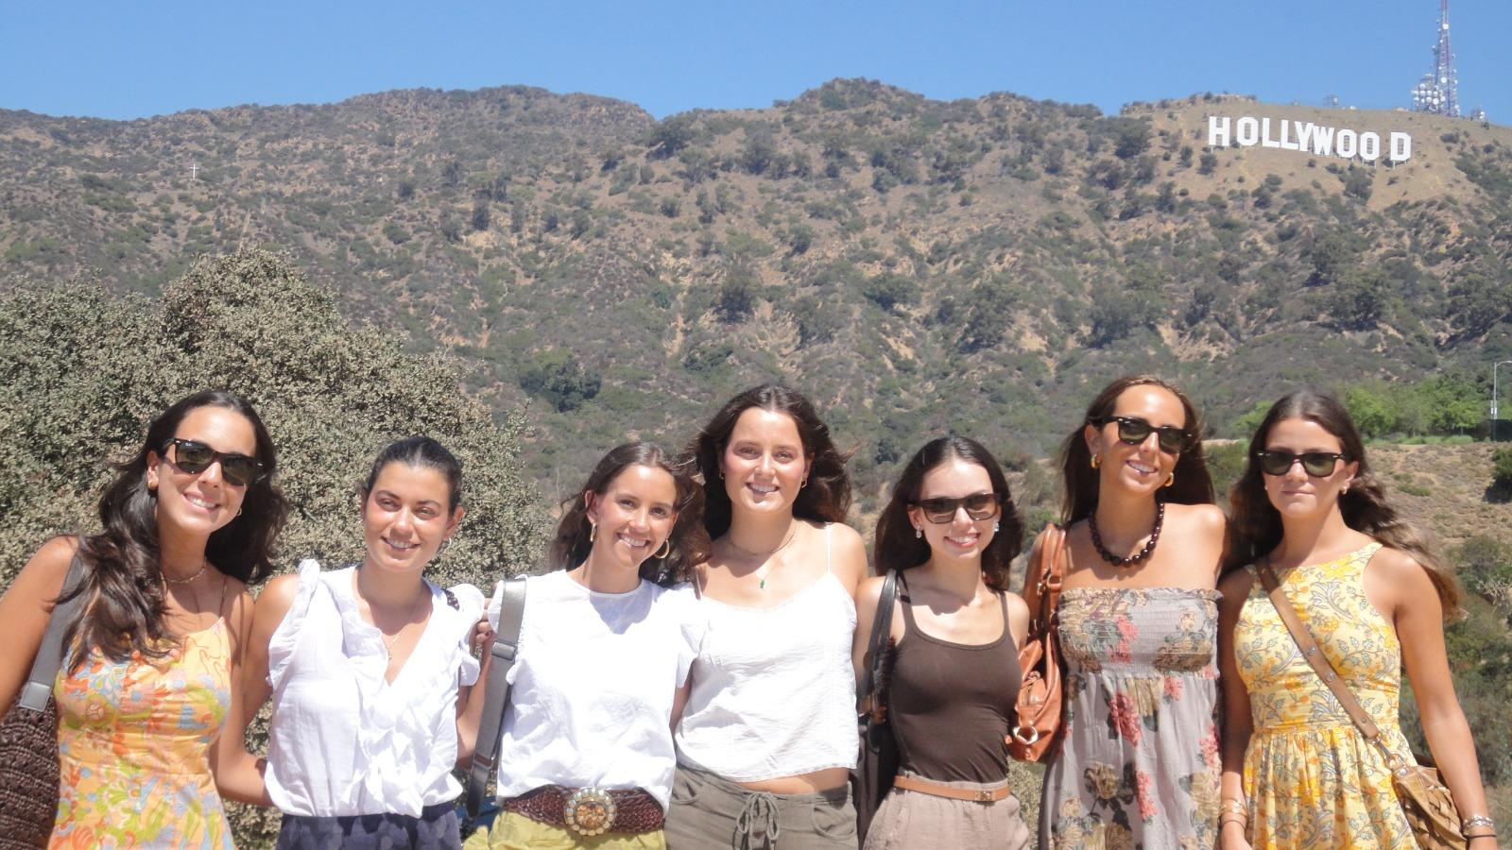
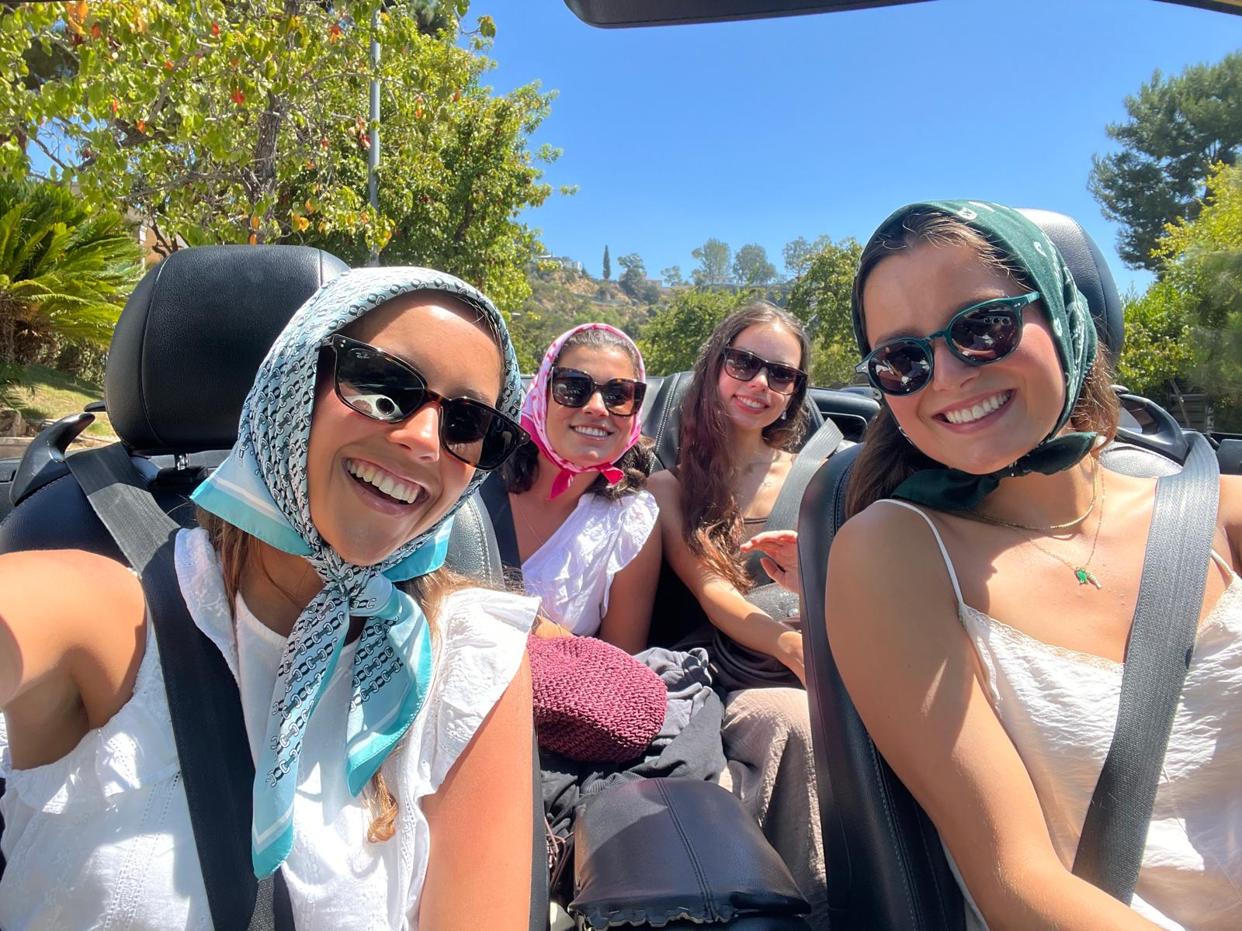
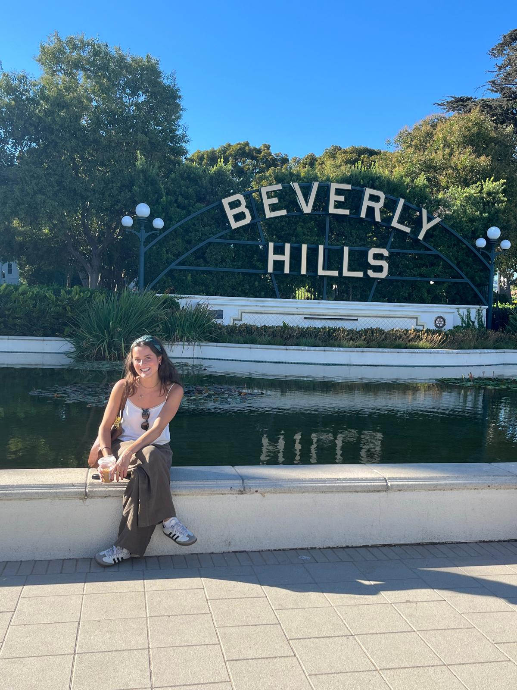
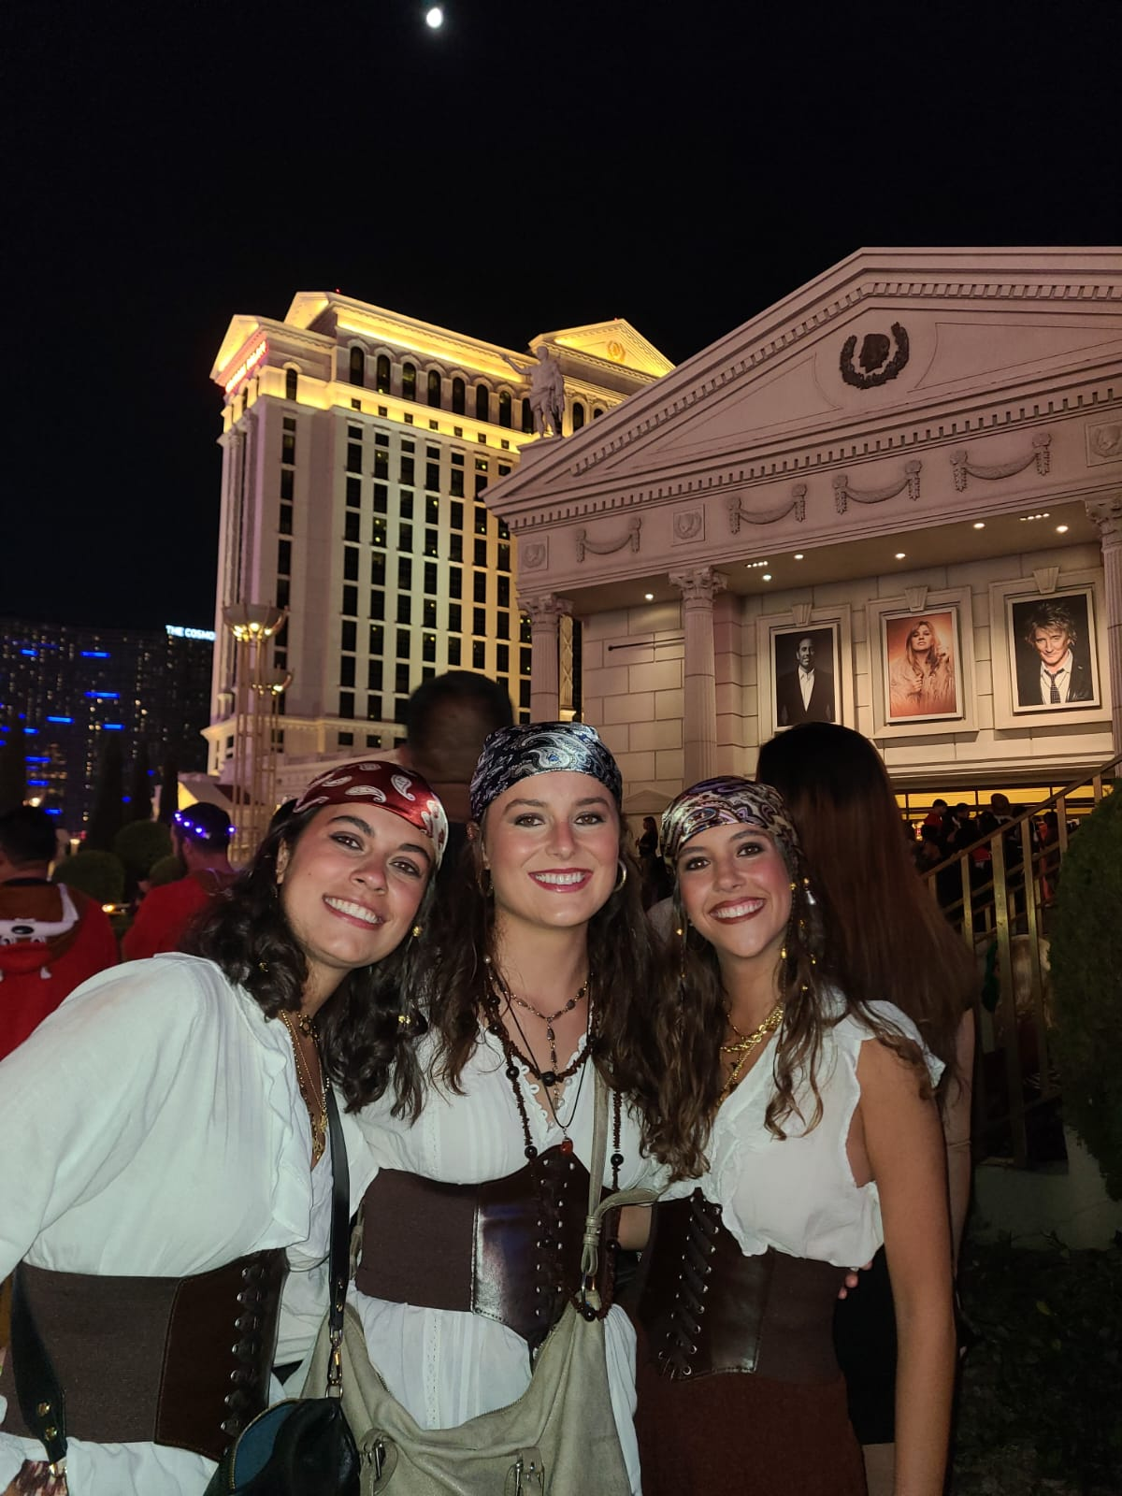
Iconic California
LOS ANGELES · LAS VEGAS
Hollywood Sign
Convertible vibes
Beverly Hills
Las Vegas (Steve Aoki night)

Slide 4
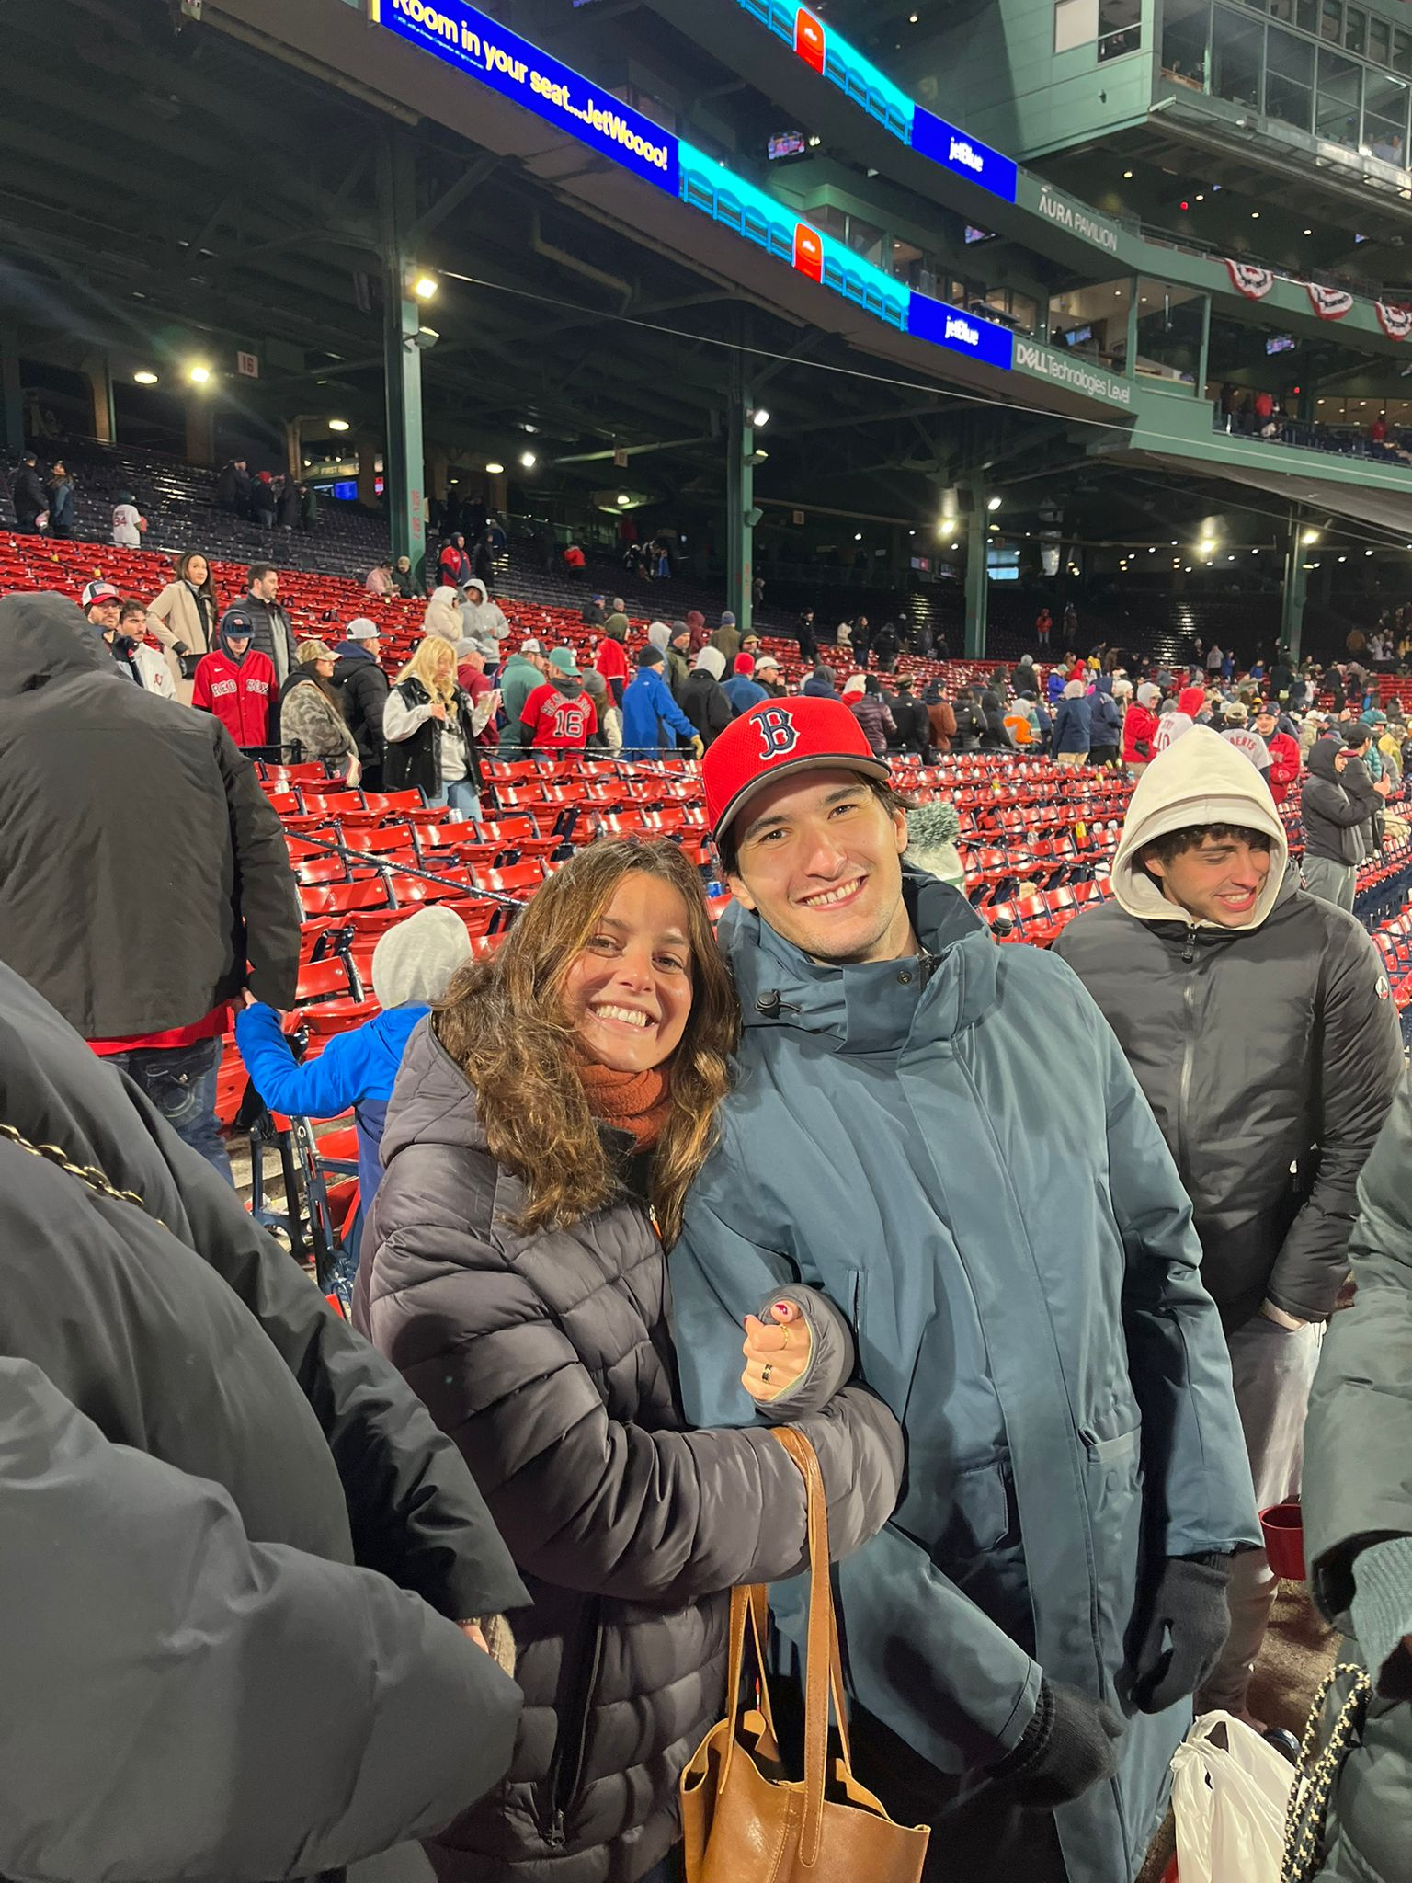
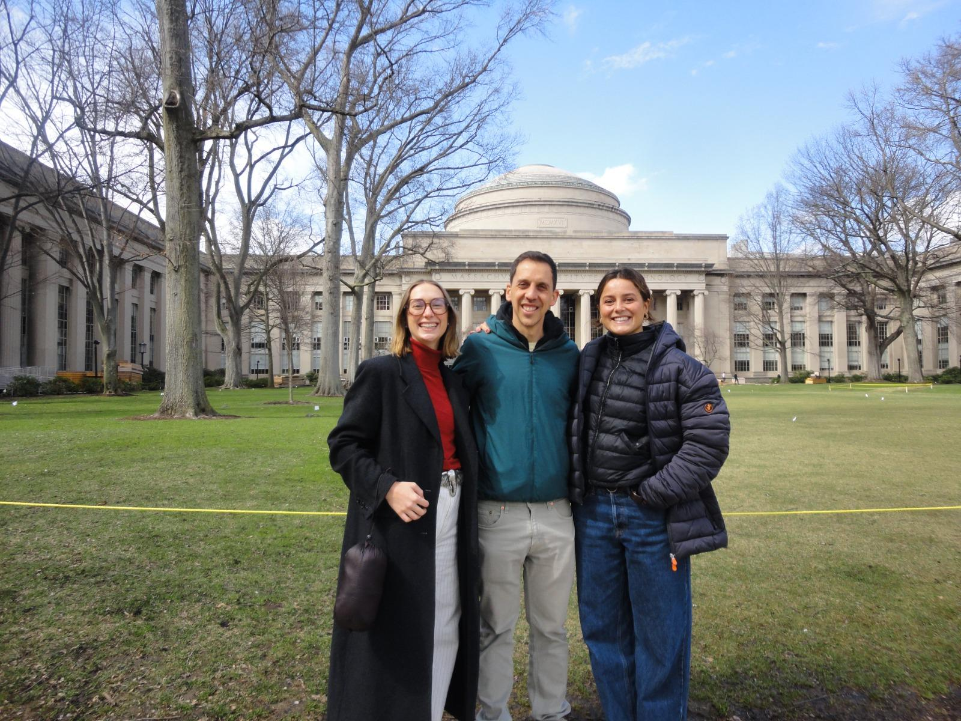
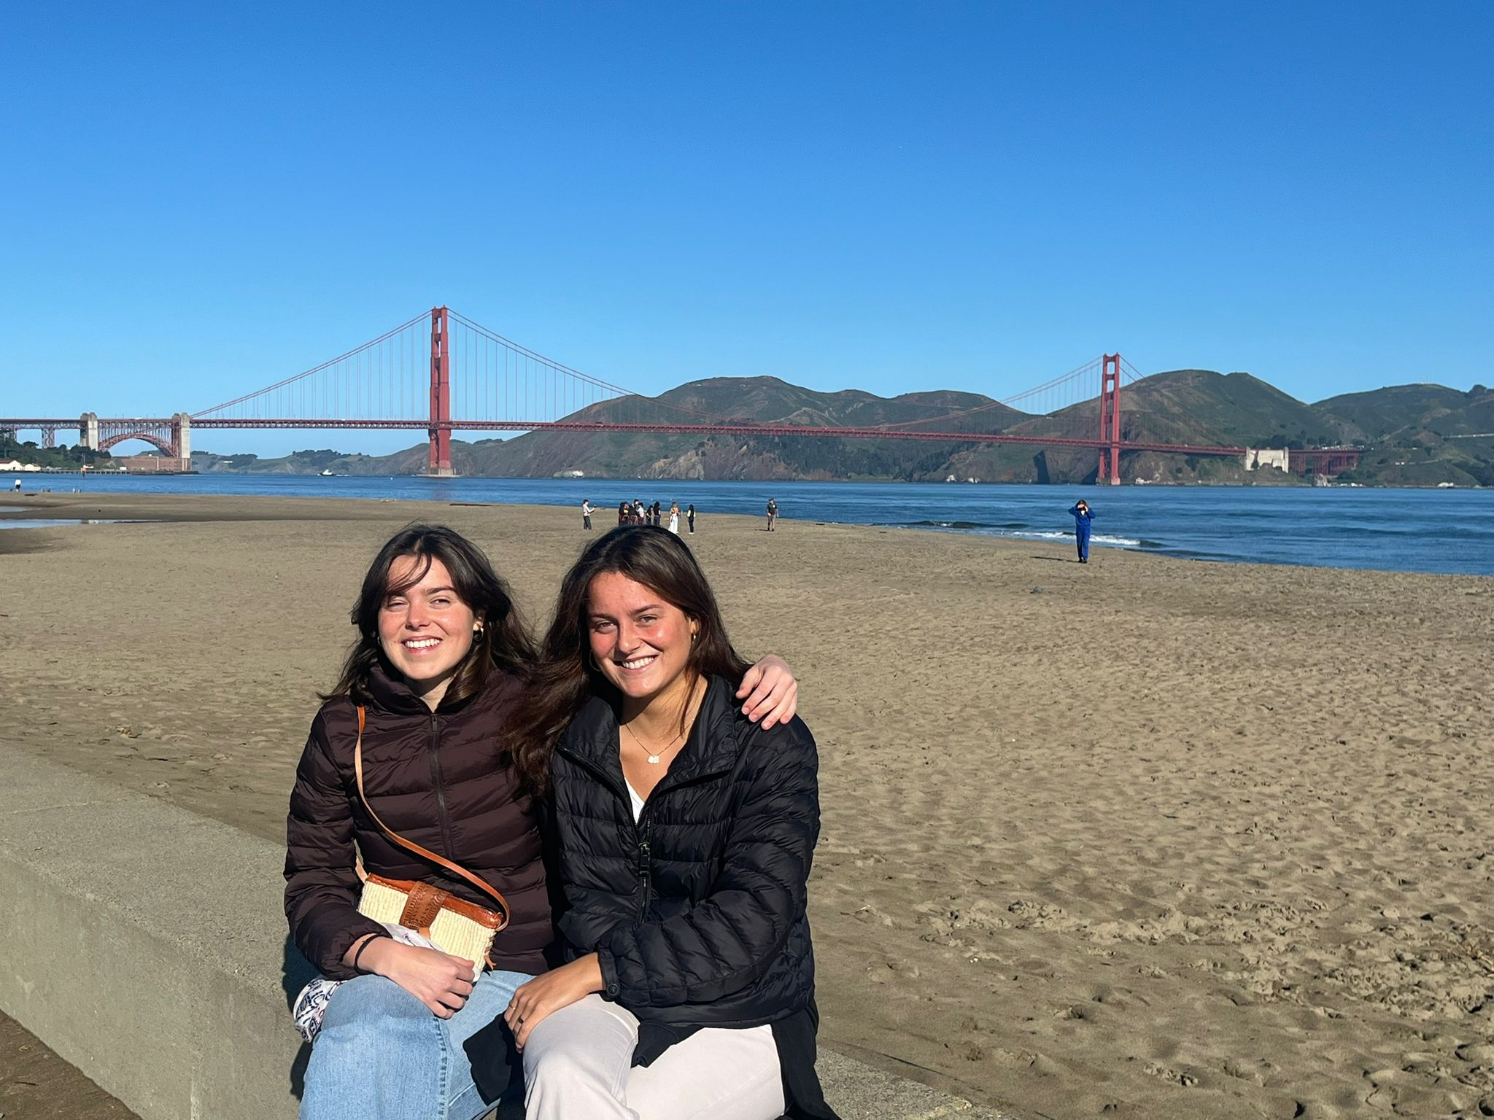
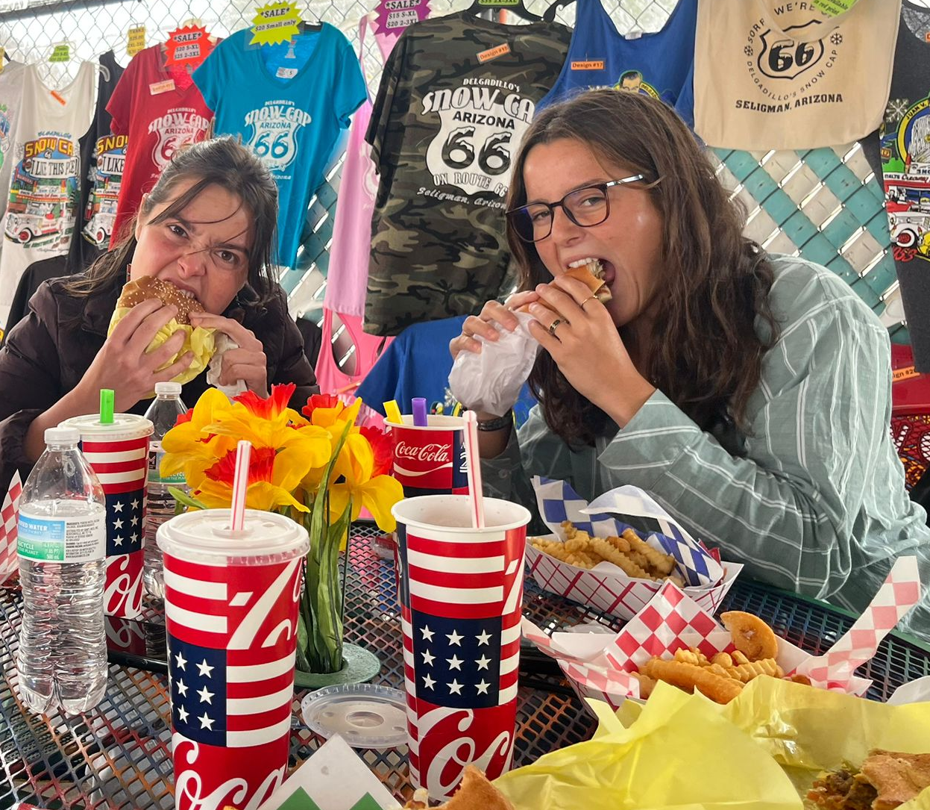
On the Road
BOSTON · SAN FRANCISCO · SELIGMAN
MIT, Cambridge
Fenway Park, Boston
Seligman, Arizona
Golden Gate, San Francisco

Slide 5

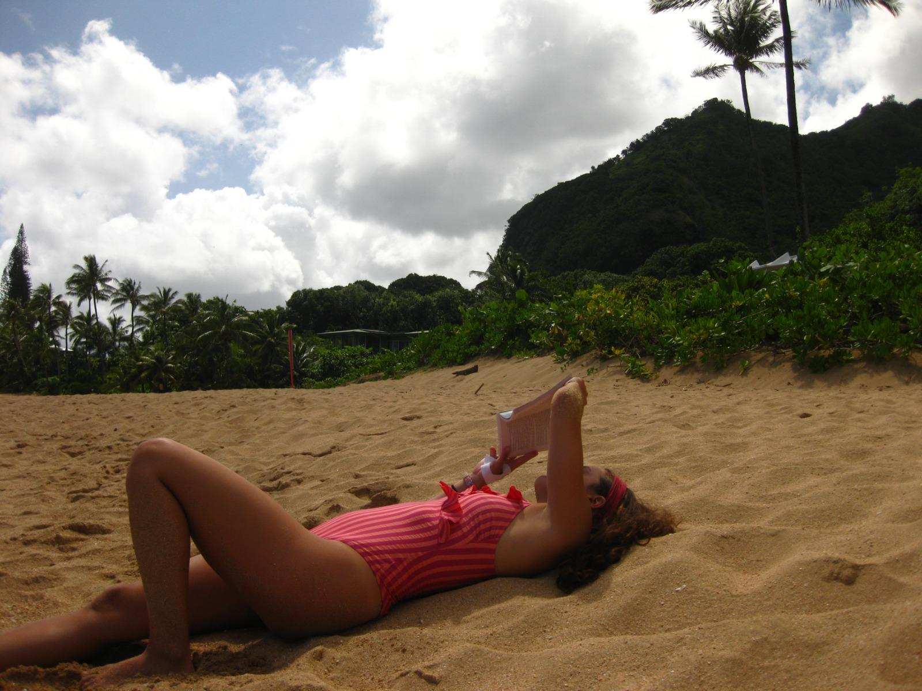
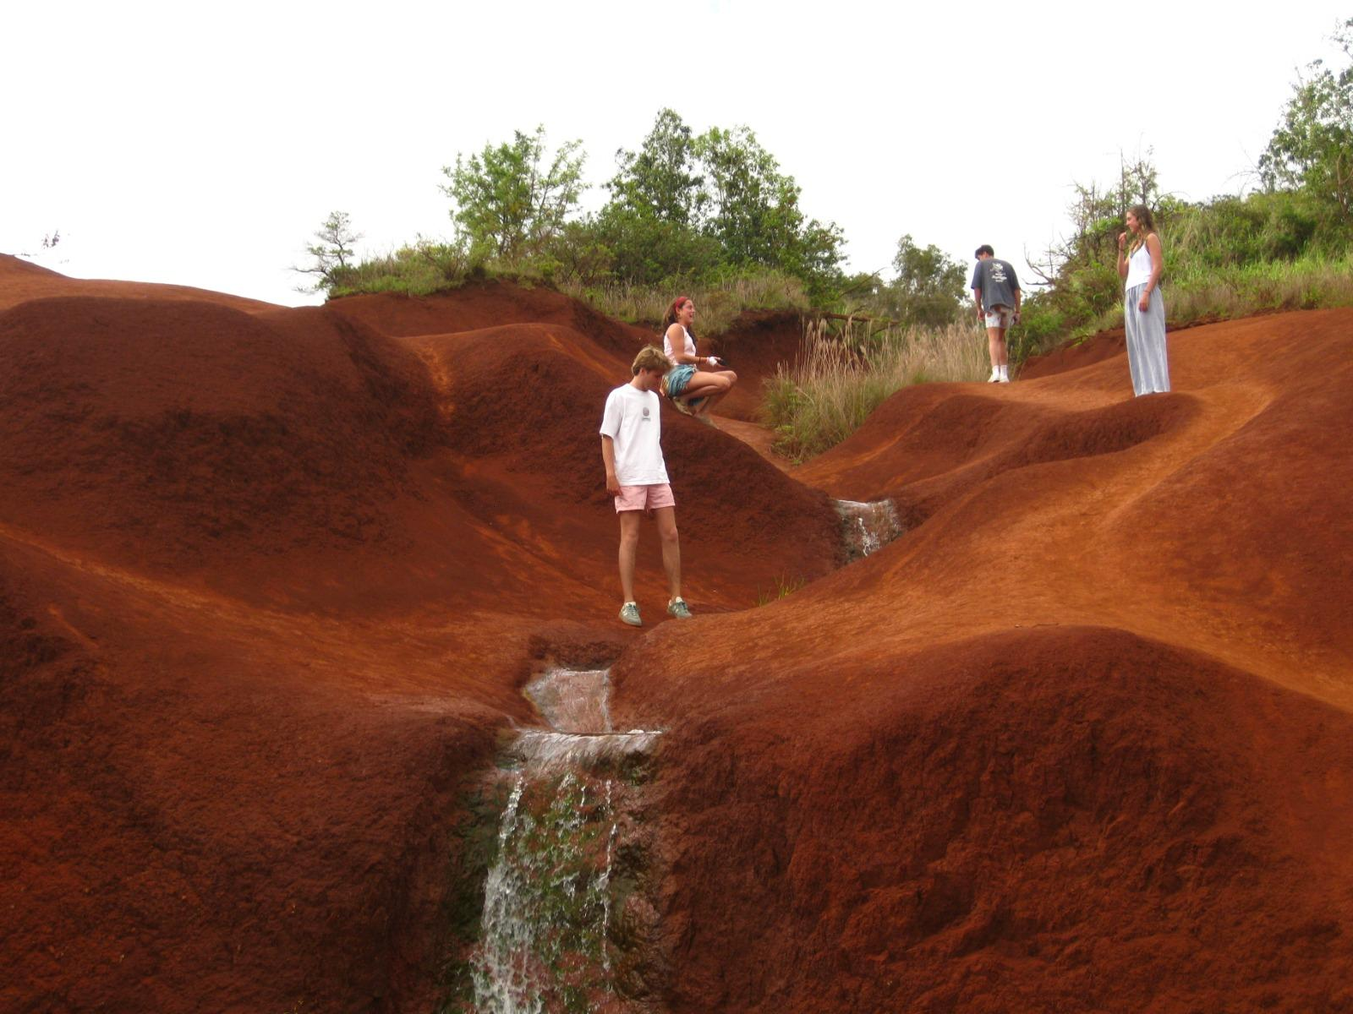
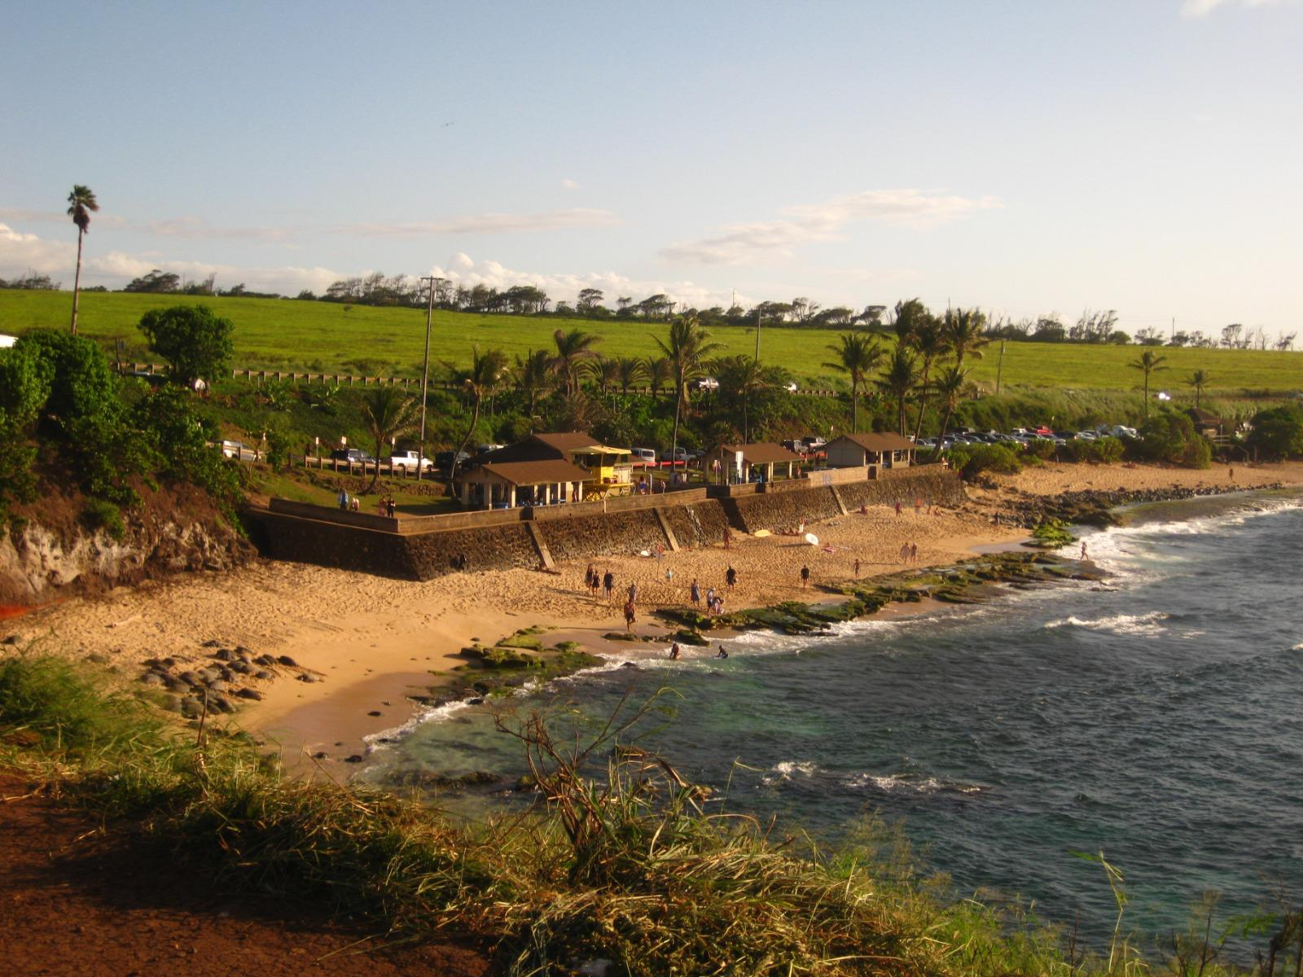
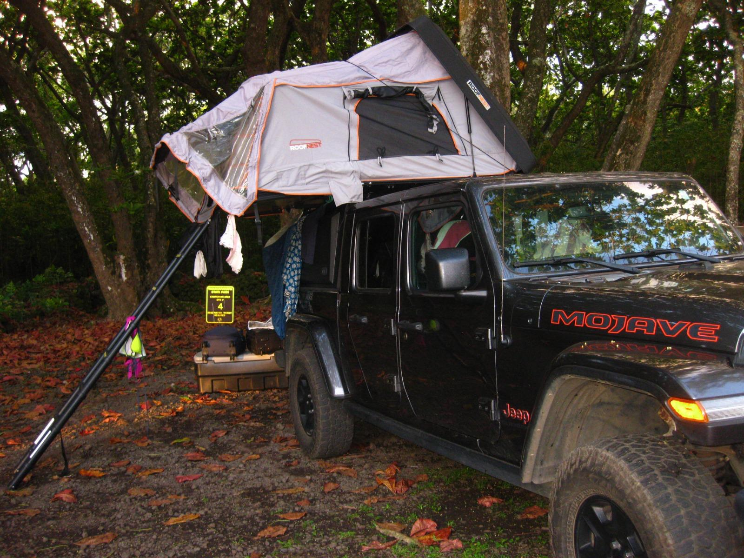
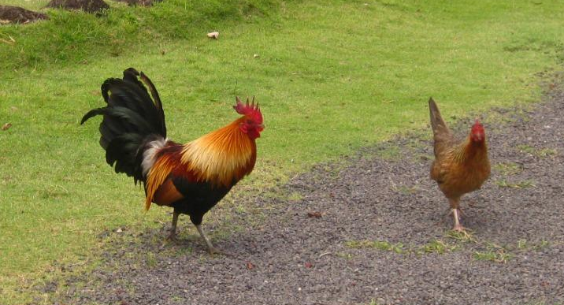
HAWAII
Maui · Kauai · The crown jewel of the semester
Black Sand Beach · Maui
Tunnels Beach · Kauai
Waimea Canyon · Kauai
Ho’okipa Beach · Maui

Slide 6

The World This Semester
What was happening around us while life unfolded in San Diego.
Immigration & Identity
Trump vs. Sanchez
Loud, political, personal. As a Spanish student on a visa you are not the target, but you are not outside it either. The word 'foreigner' lands differently depending on the day.
The US-Spain political tension went from abstract to personal. Someone makes a comment about Europeans and you smile and let it go, but you notice it.
Iran & Global Tensions
The AI Moment
The situation escalated in ways that felt alarming from a beach town. You check the news, feel the weight, and San Diego pulls you back. That gap is one of the stranger things about living abroad.
AI went mainstream this semester in a real way. Every class, every job, every conversation about the future. Watching history happen in real time.

Slide 7
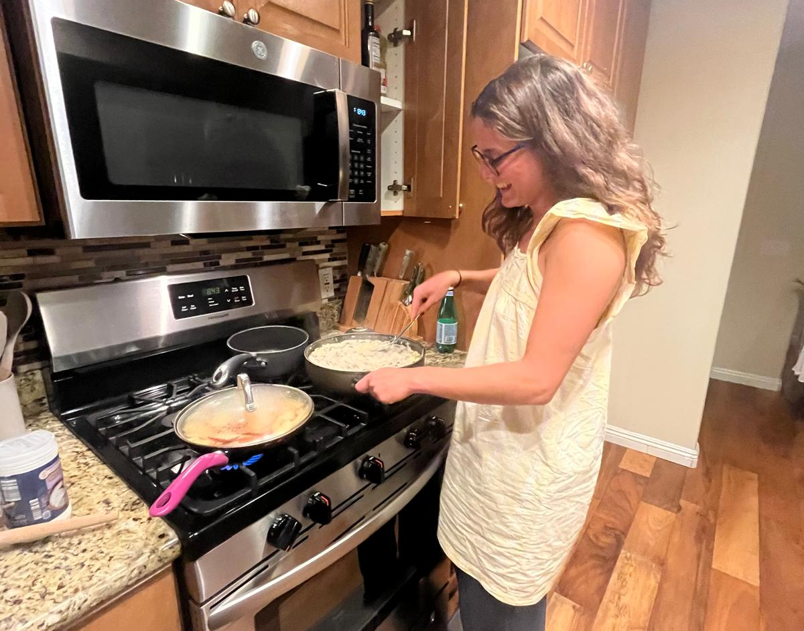
Looking Back,
Looking Forward
The semester I had
Adventures, friendships, waves and miles. From San Diego beaches to Hawaiian sunsets — a semester of saying yes to everything.
Things I missed
Spain. The quiet stuff. Sunday lunch. My parents calling at the wrong time. The ability to slow down when everything moved so fast.
What I hope for
More of the same good energy, deeper roots in San Diego, and learning to balance ambition with simply living.
GARRIDO_TIME_CAPSULE_EXAM · ITMG 100 · Spring 2026

