Slide 1
Digital time Capsule
By: Nate Chou
Using Technology to tell a story

Slide 2
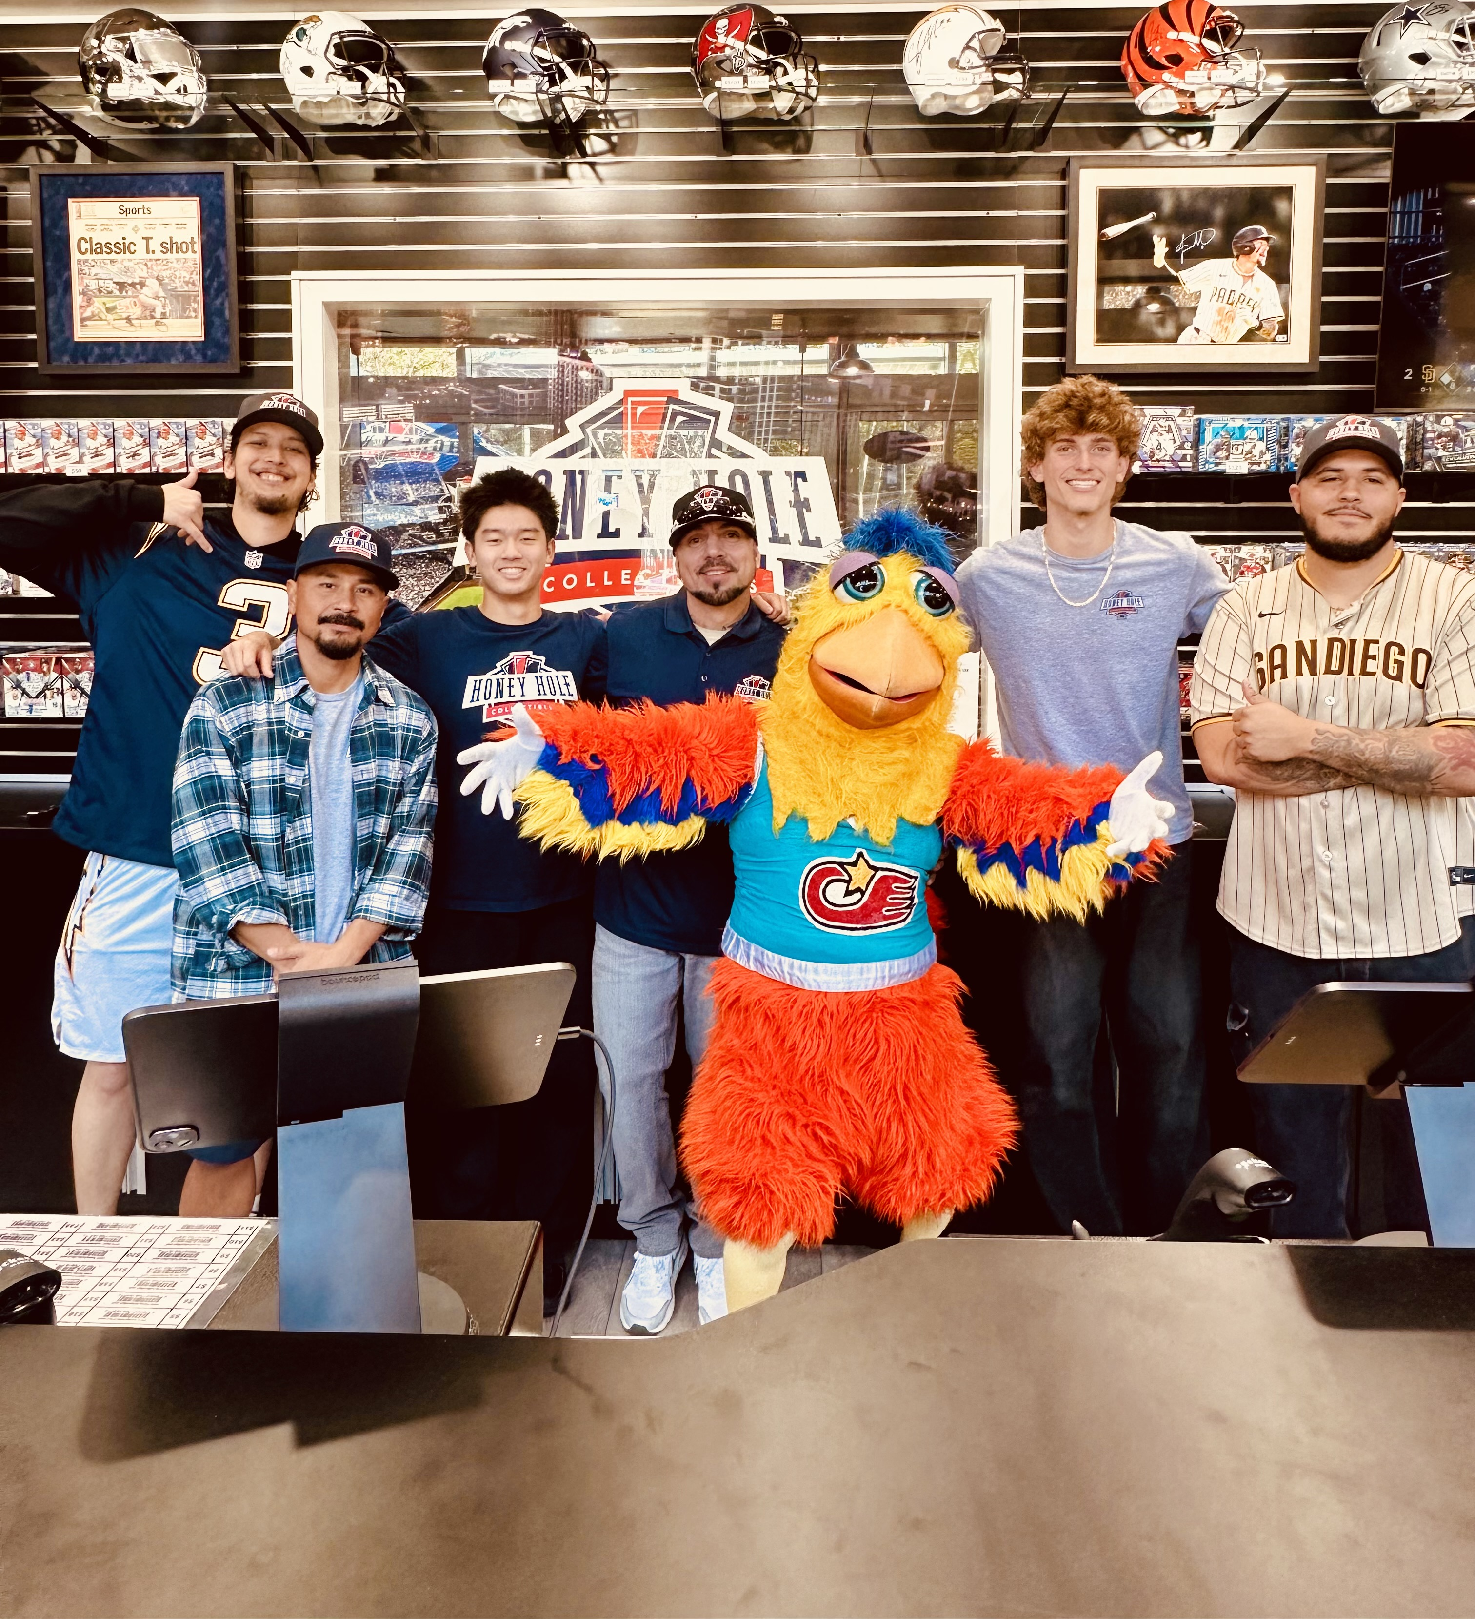
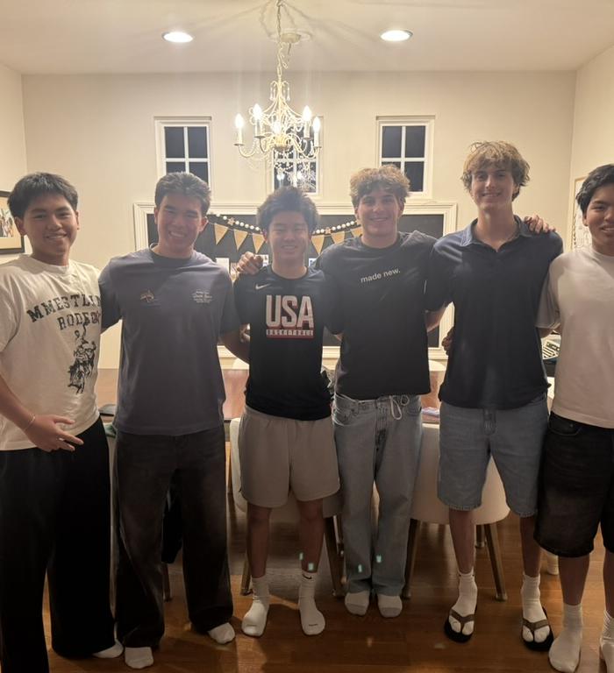
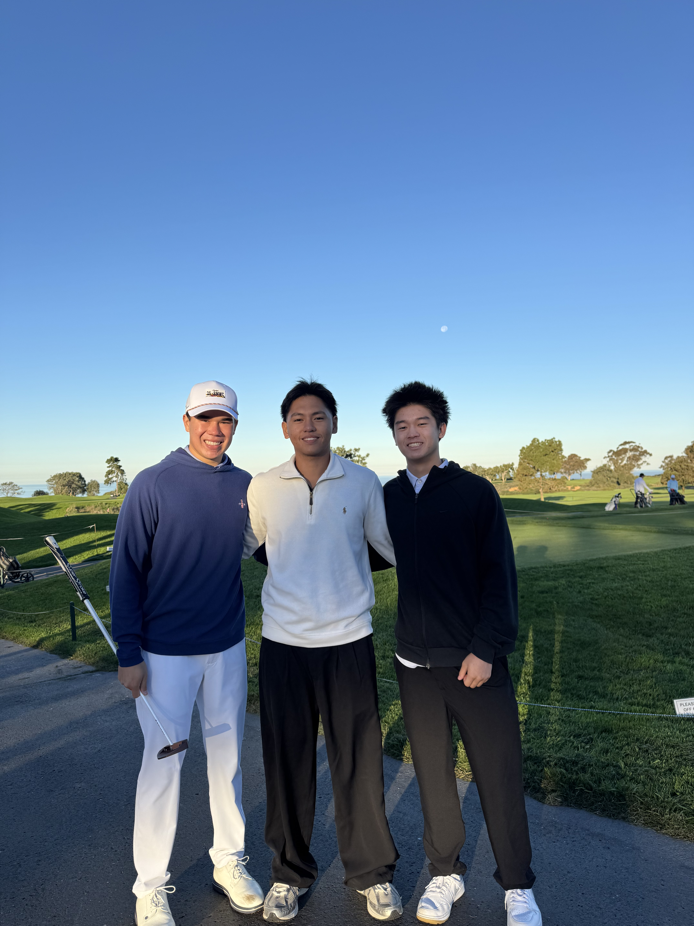
Things that happened this semester
New Job at Honey Hole
Club golf trip to Torrey Pines
Birthday with friends

Slide 3
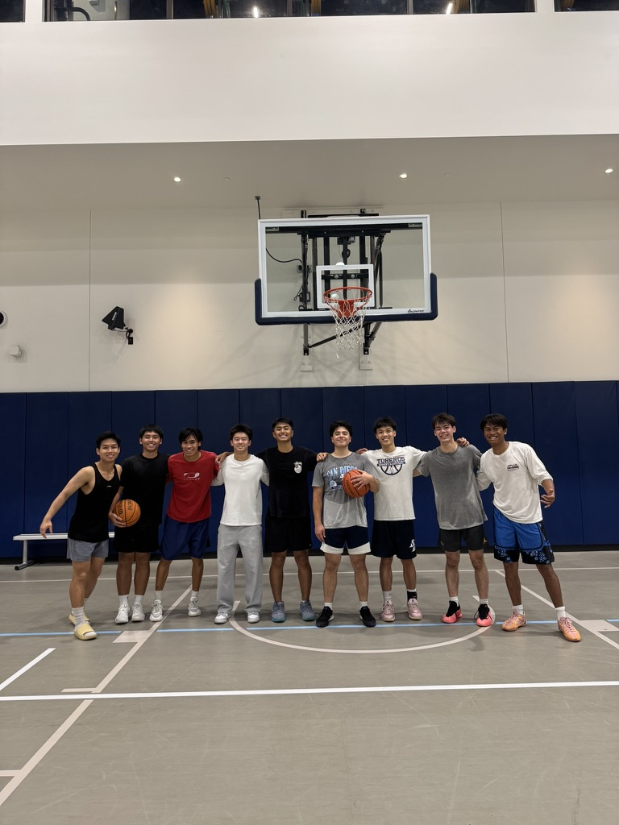
Things that didn’t happen
Intramural Basketball team
Didn’t win championship
Made it to semi-finals
St
Still PositiveStill

Slide 4
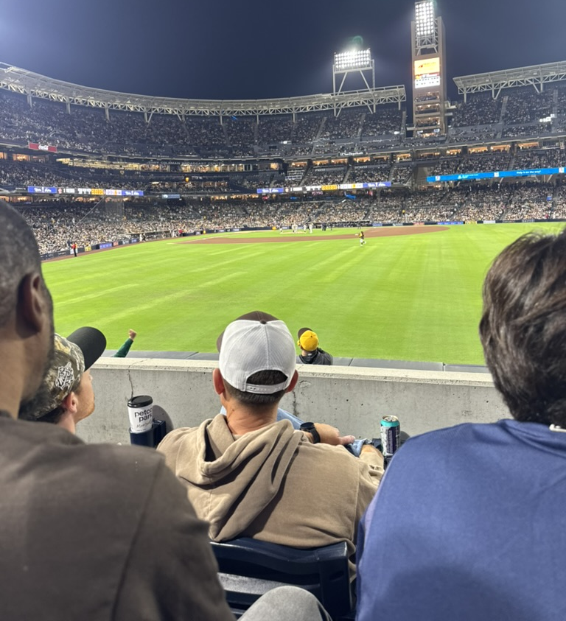
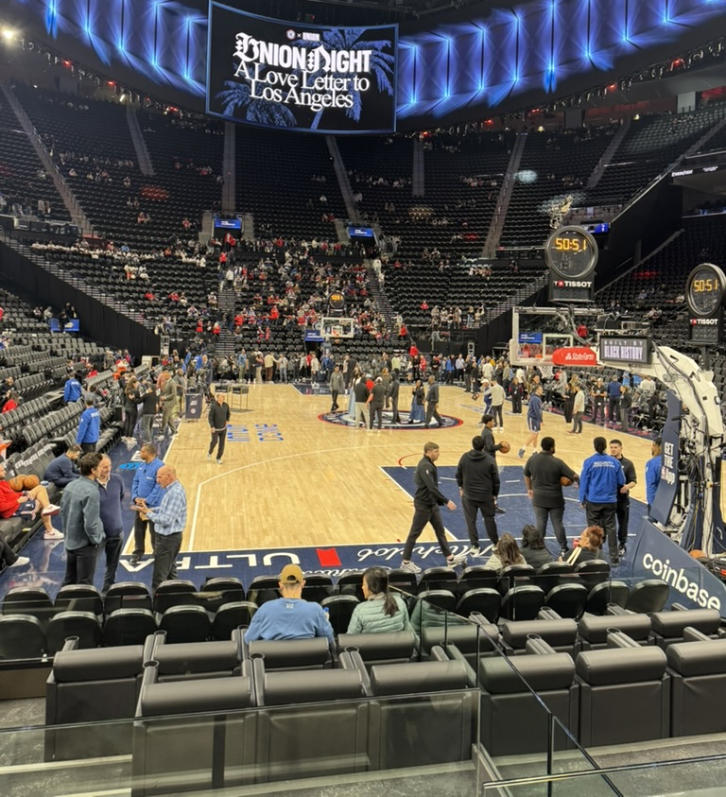
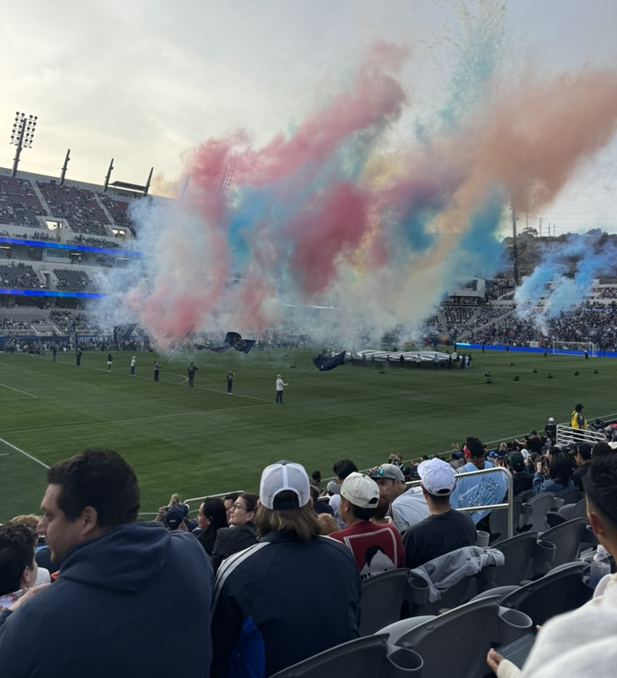
Sporting Events
Padres Game
Clippers Game
SDFC game

Slide 5
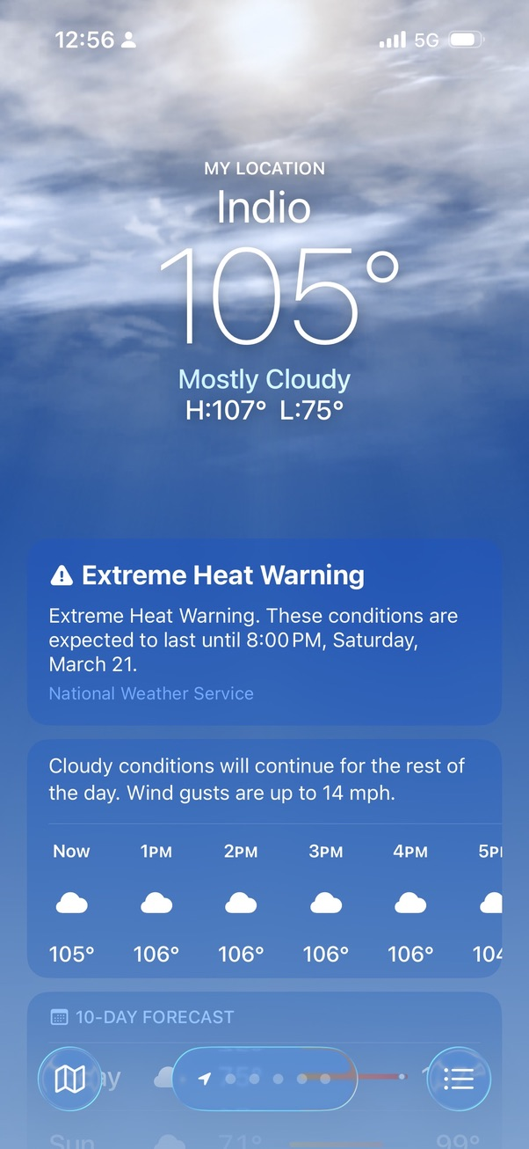
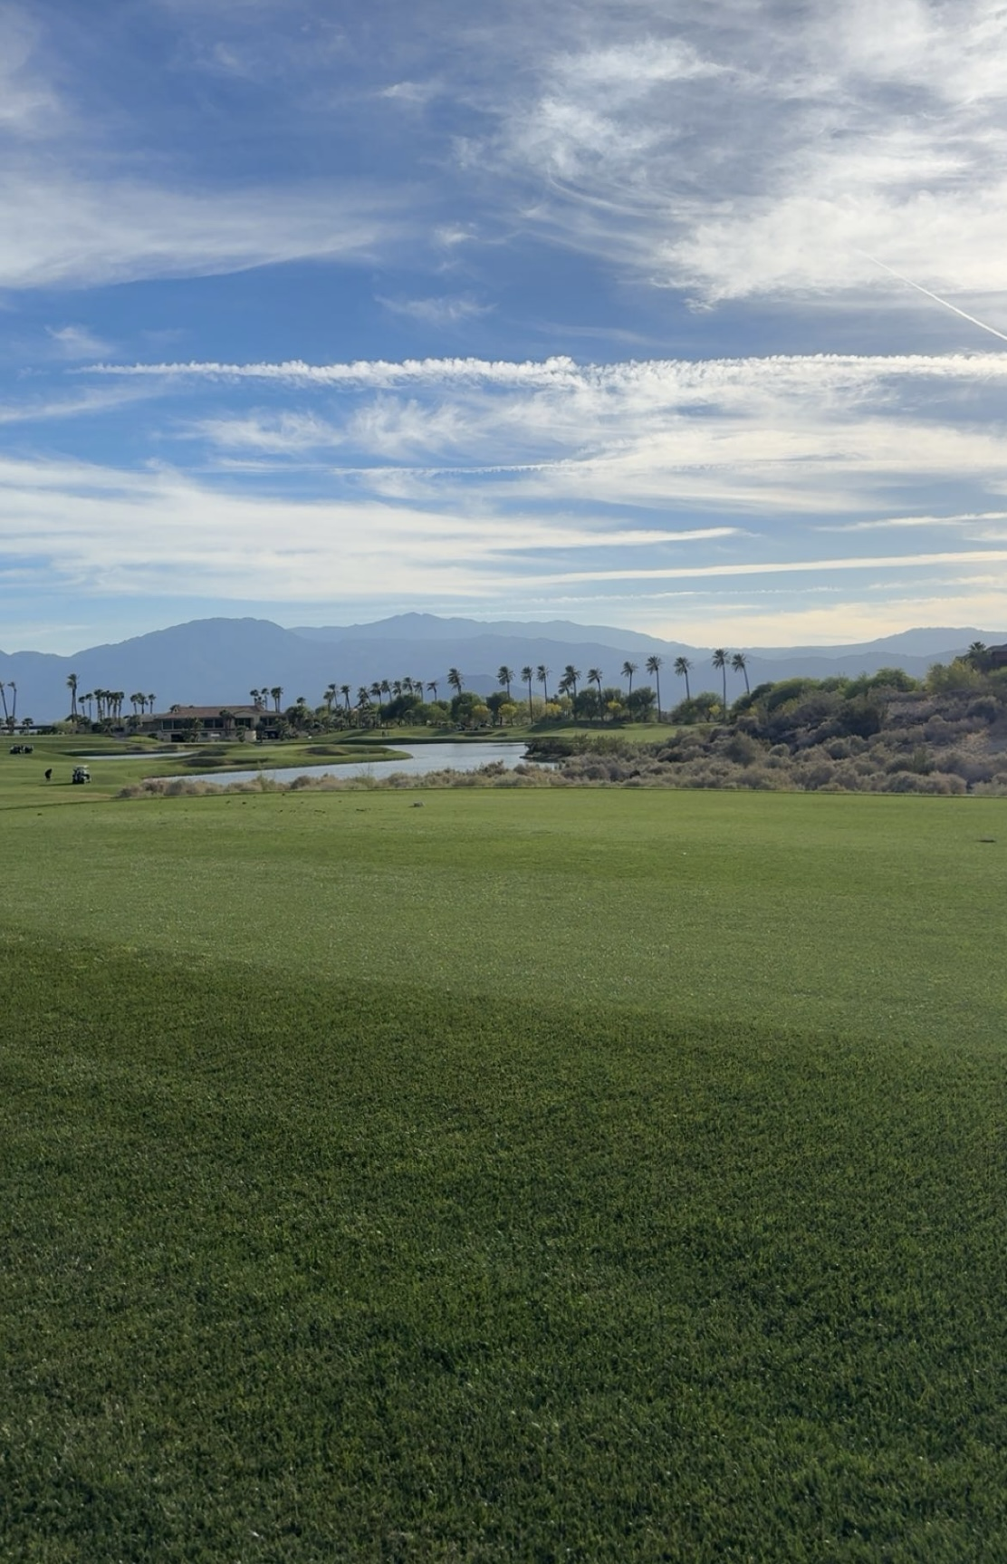
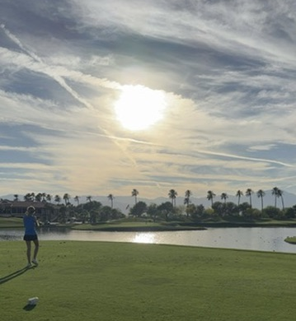
Golf Trip to palm springs

Slide 6
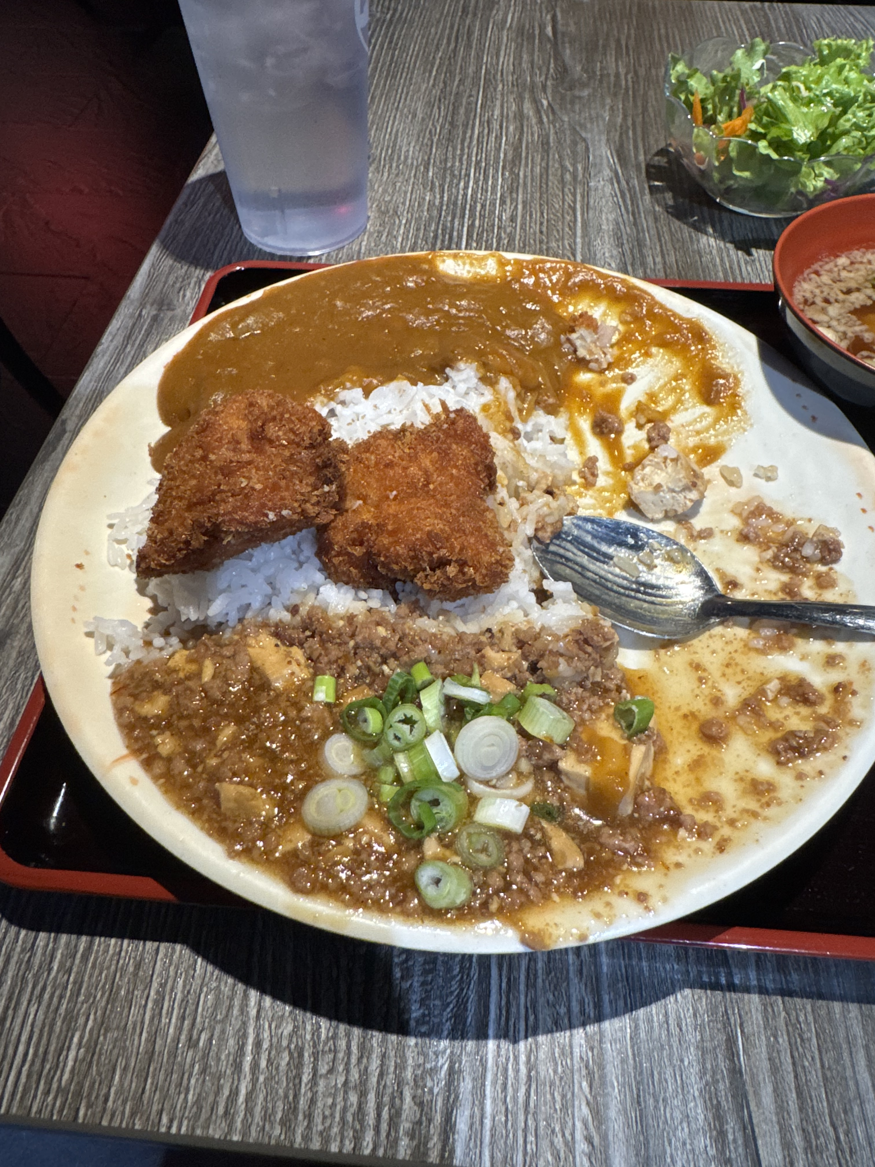
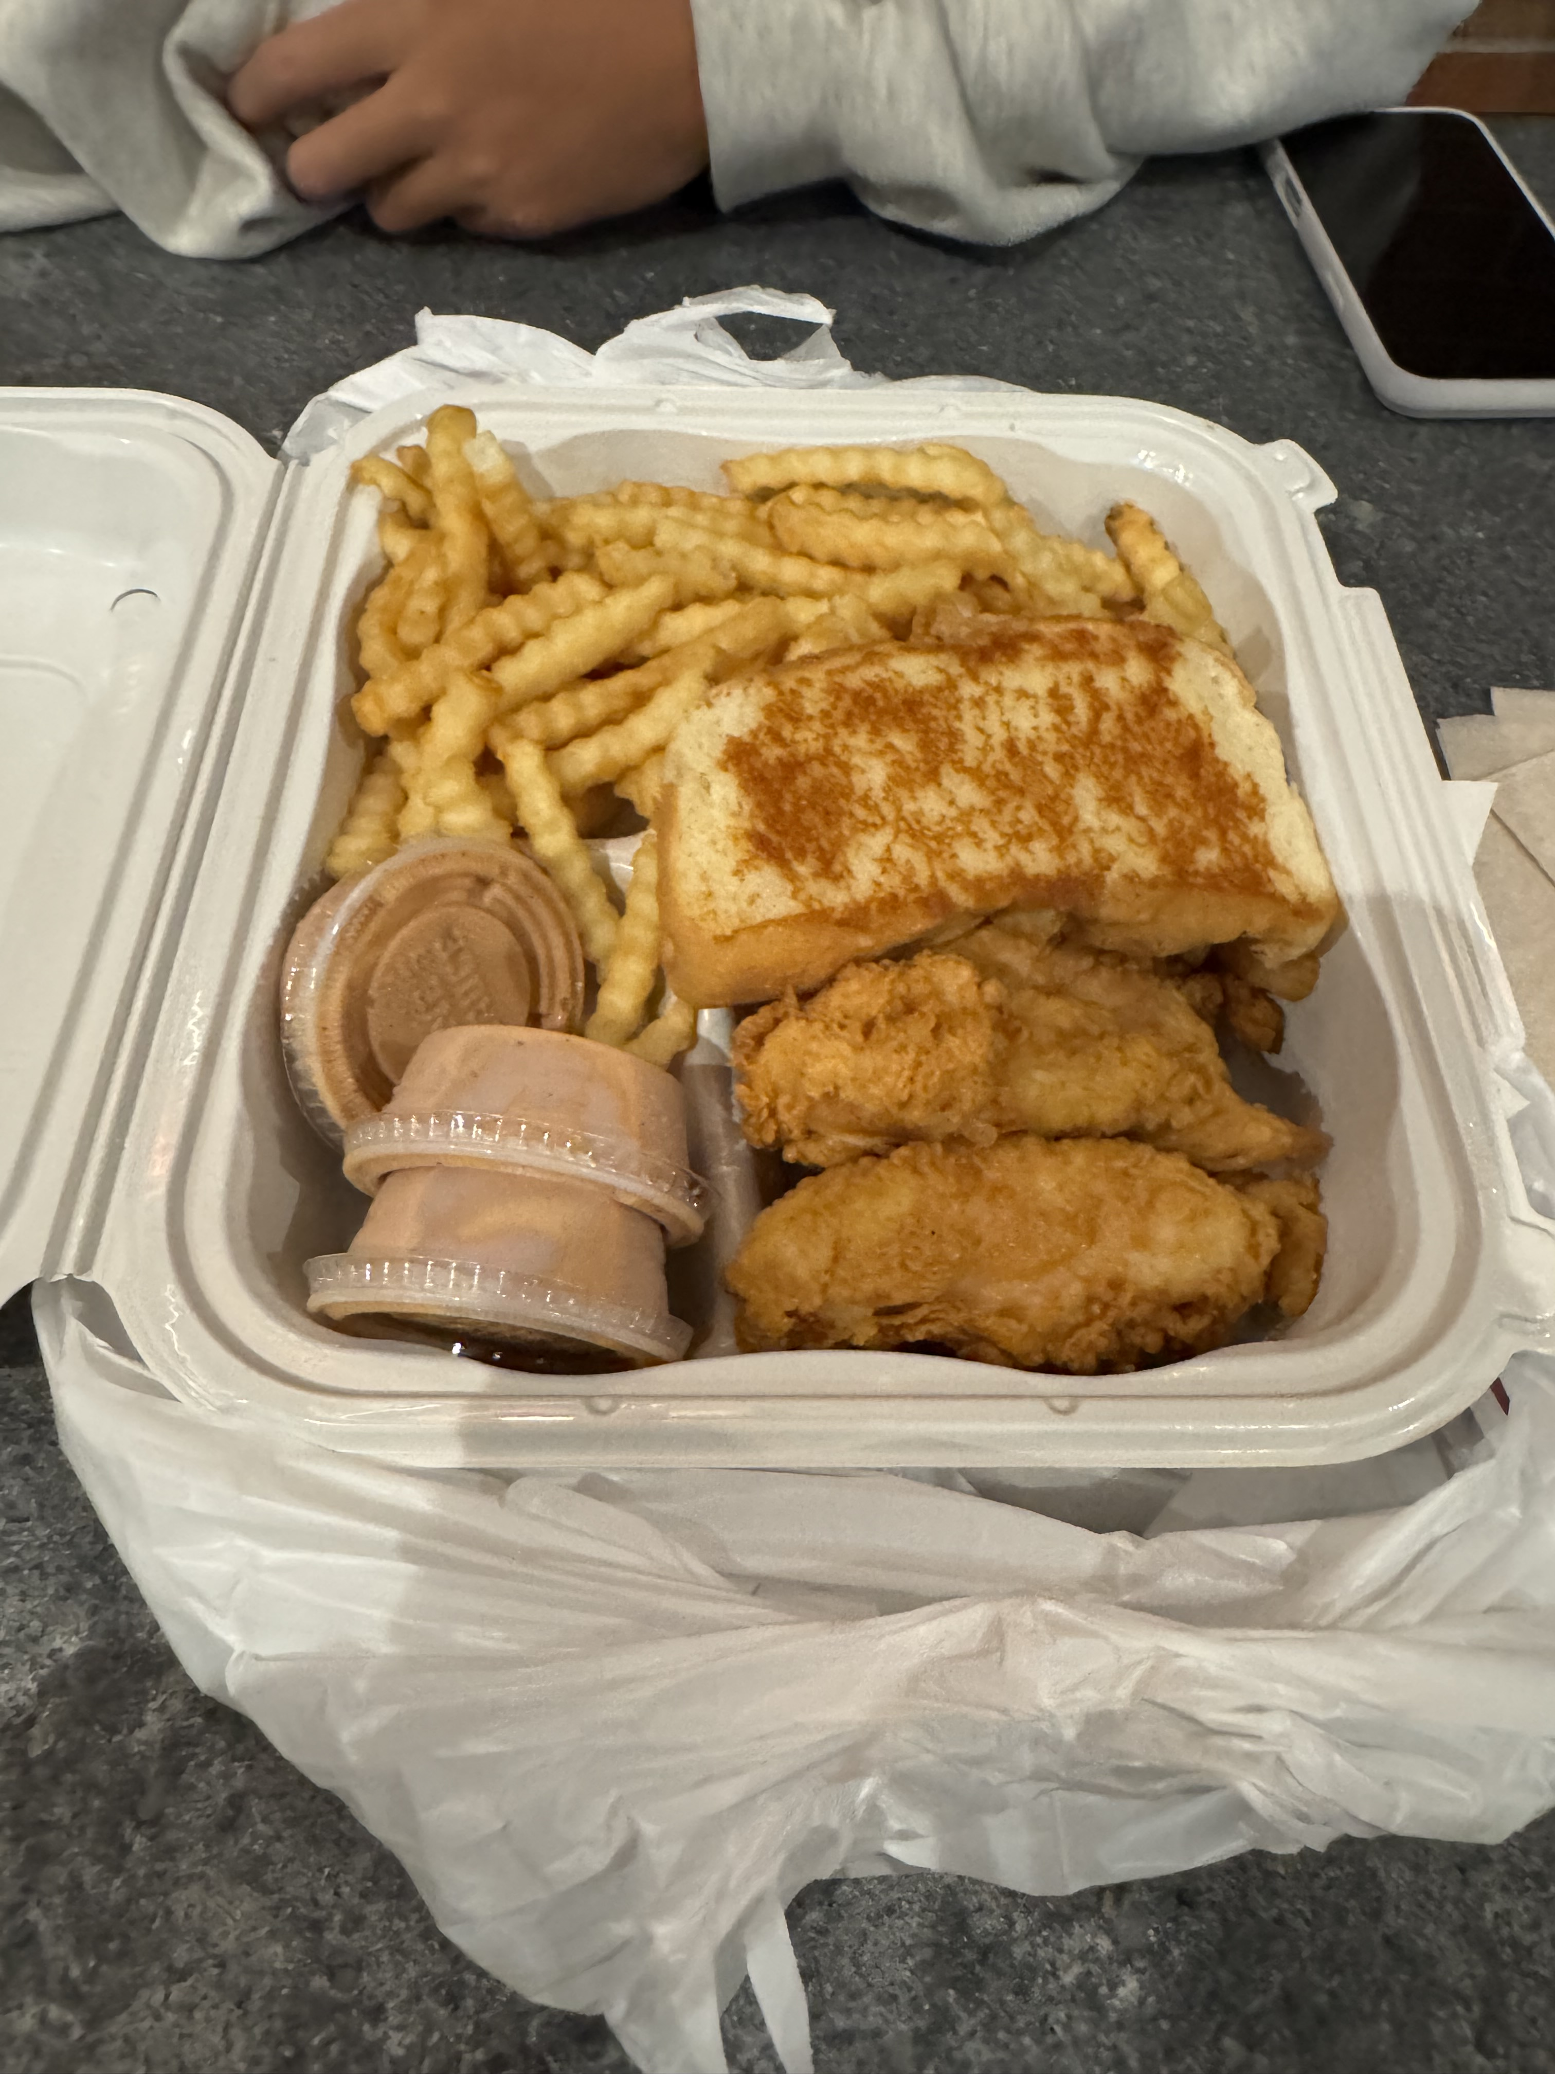
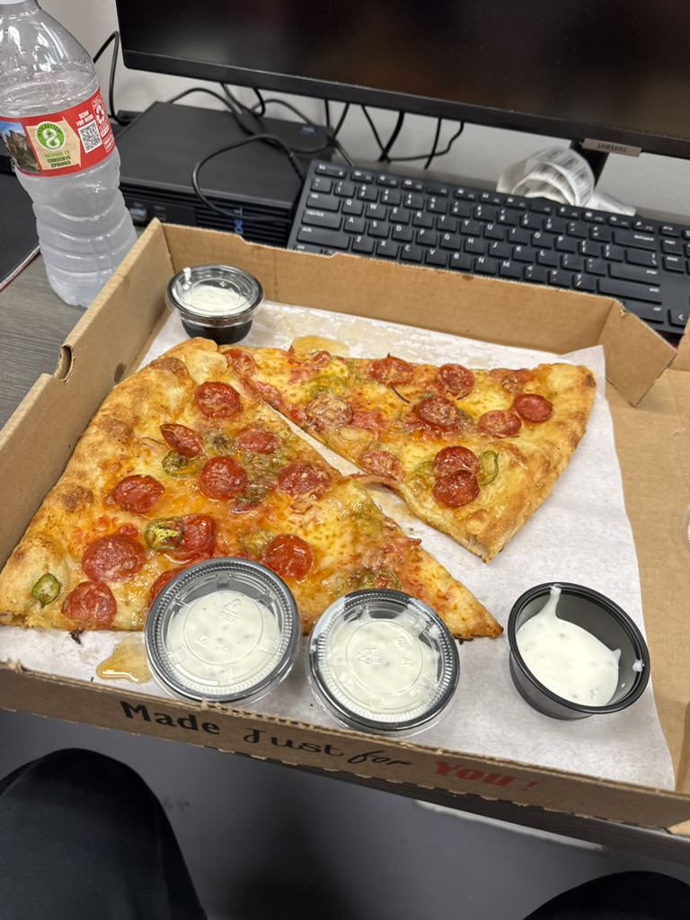
Good Eats

Slide 7
Written statement
Overall I was super happy with how this semester went. It wasn’t just about getting school work done or getting good grades, but more about building friendships and memories that will stay with me forever. I had so many good times and even through some road bumps I was able to persevere through and learn from mistakes. The visuals I have shown represent some of my best times with my favorite people on campus. I feel like they also stand for who I am and the things that I really enjoy doing. I was able to try a lot of new things and find out more about the person I want to become.

