Slide 1
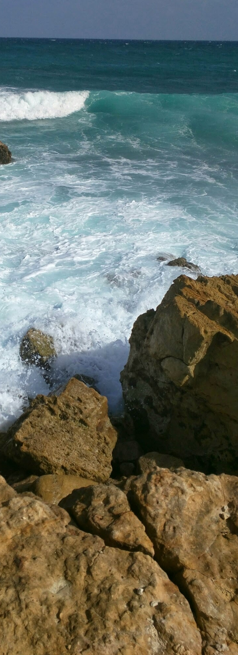
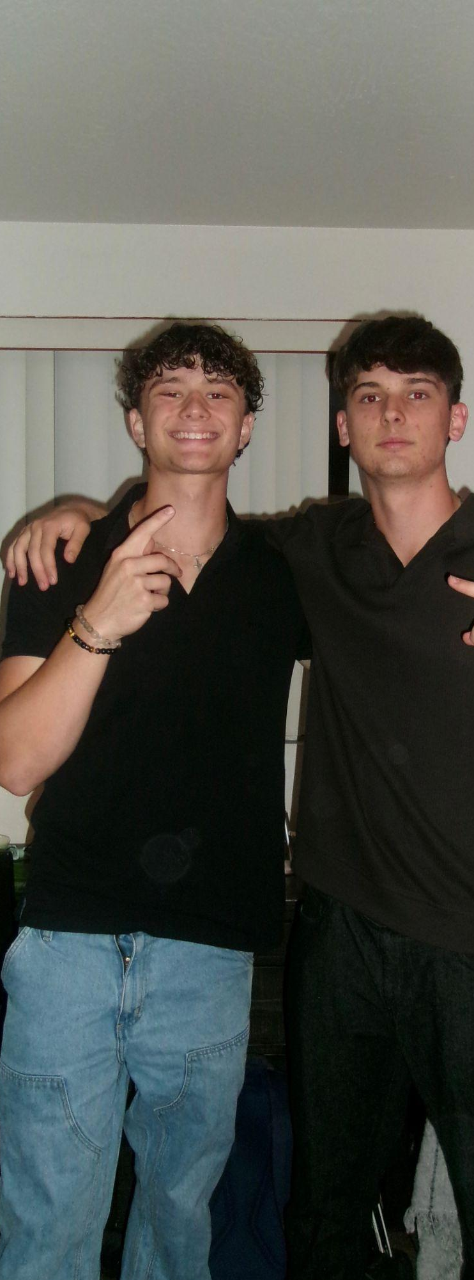
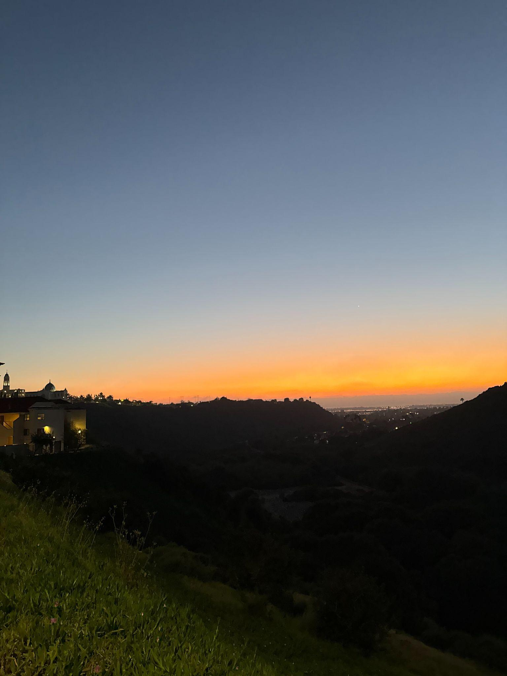

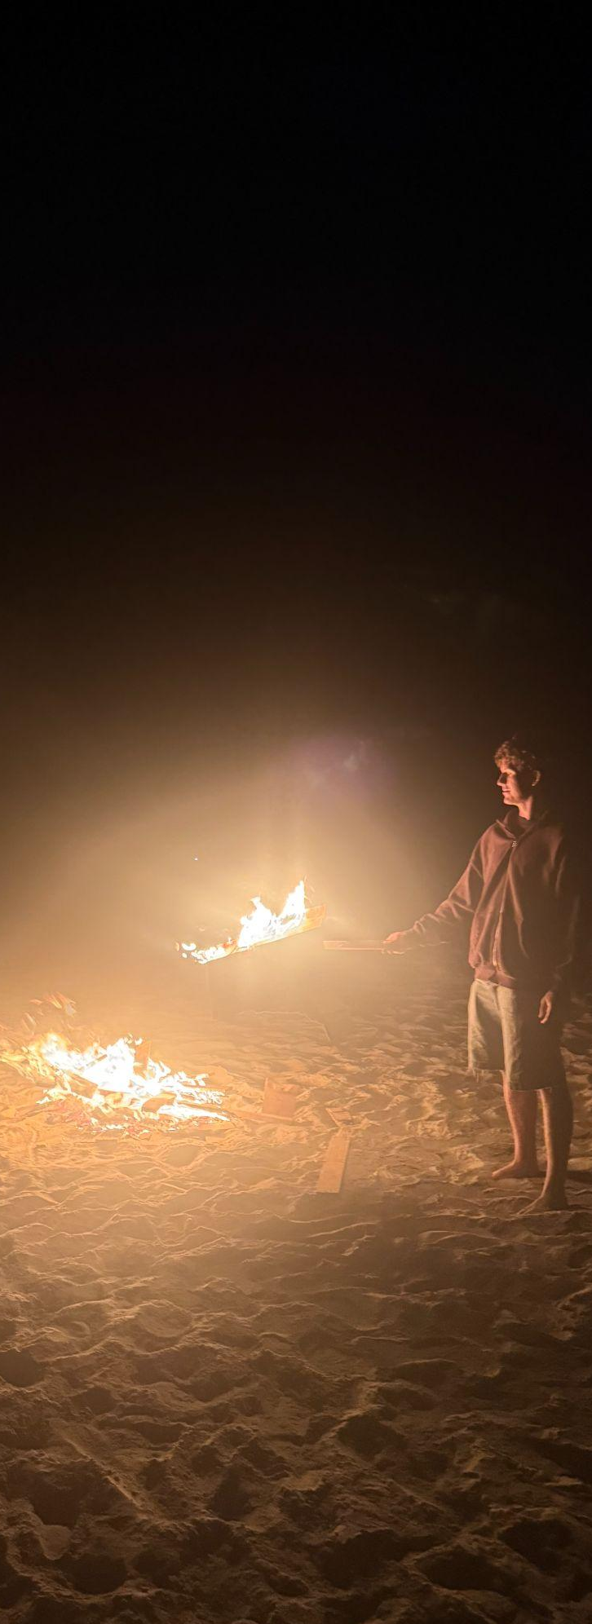
Documenting the Present for the Future… Through Tech
Jonathan Byrnes - May 19, 2026

Slide 2
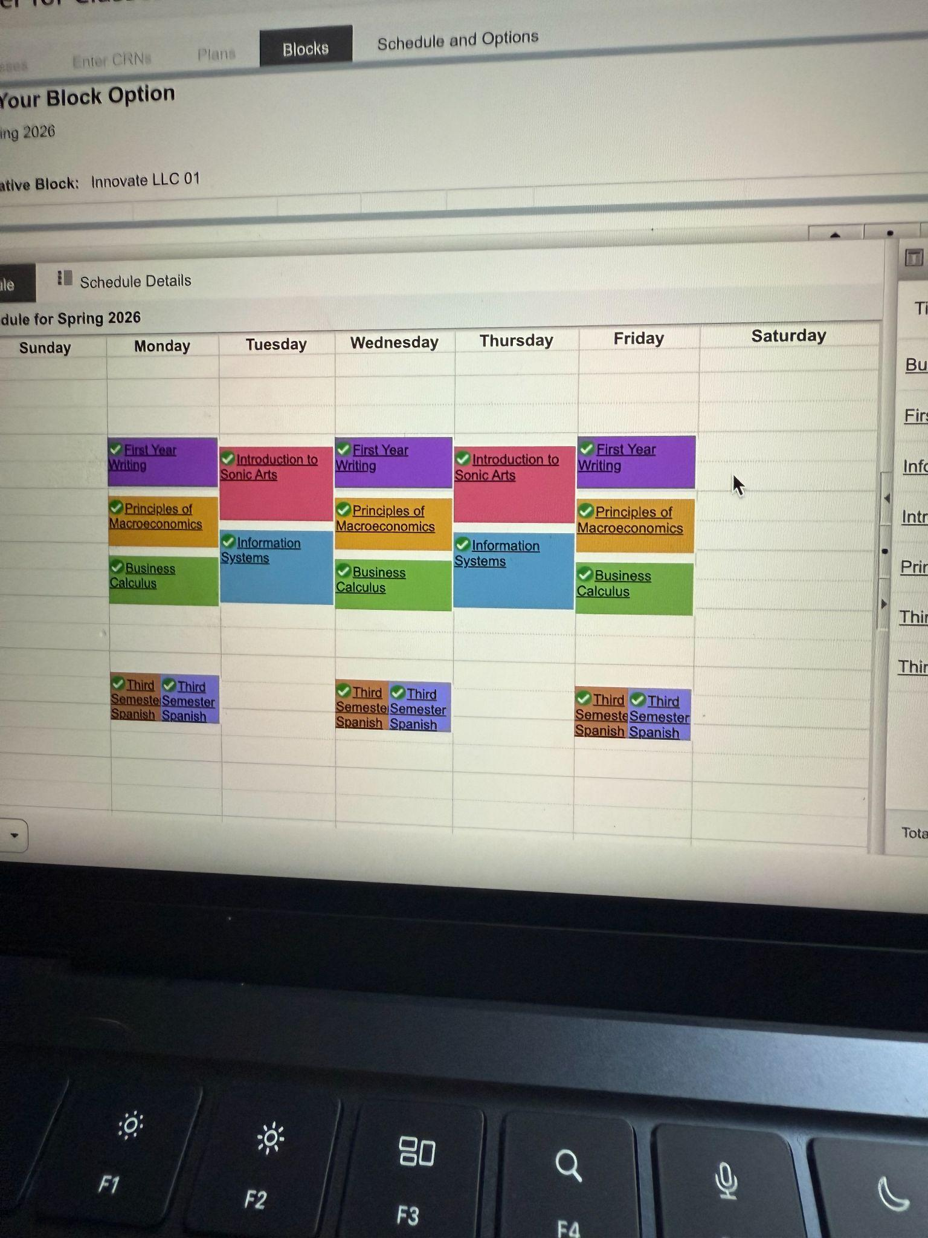
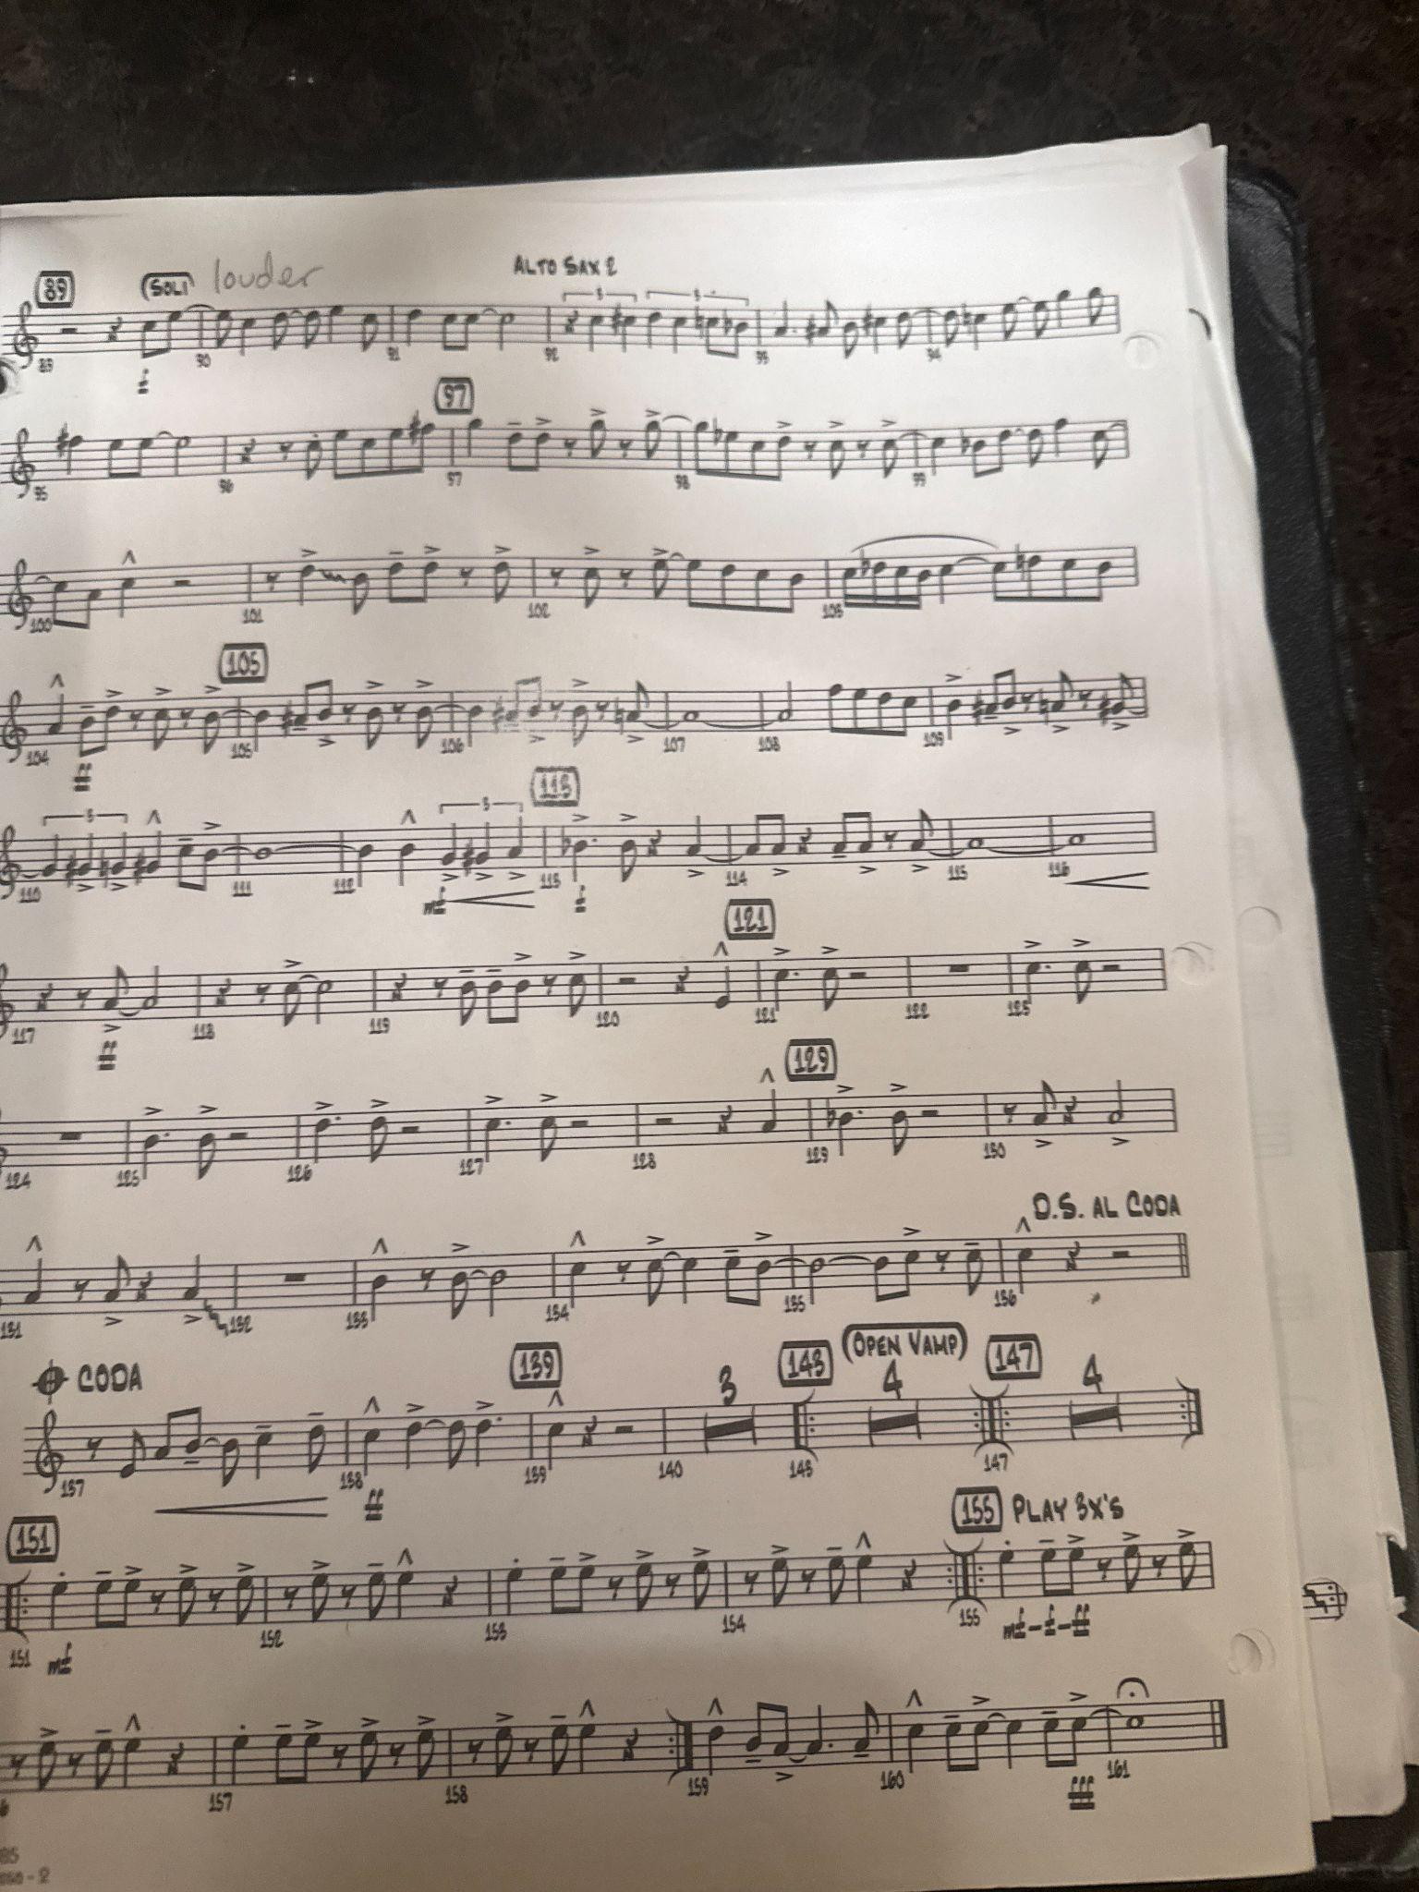
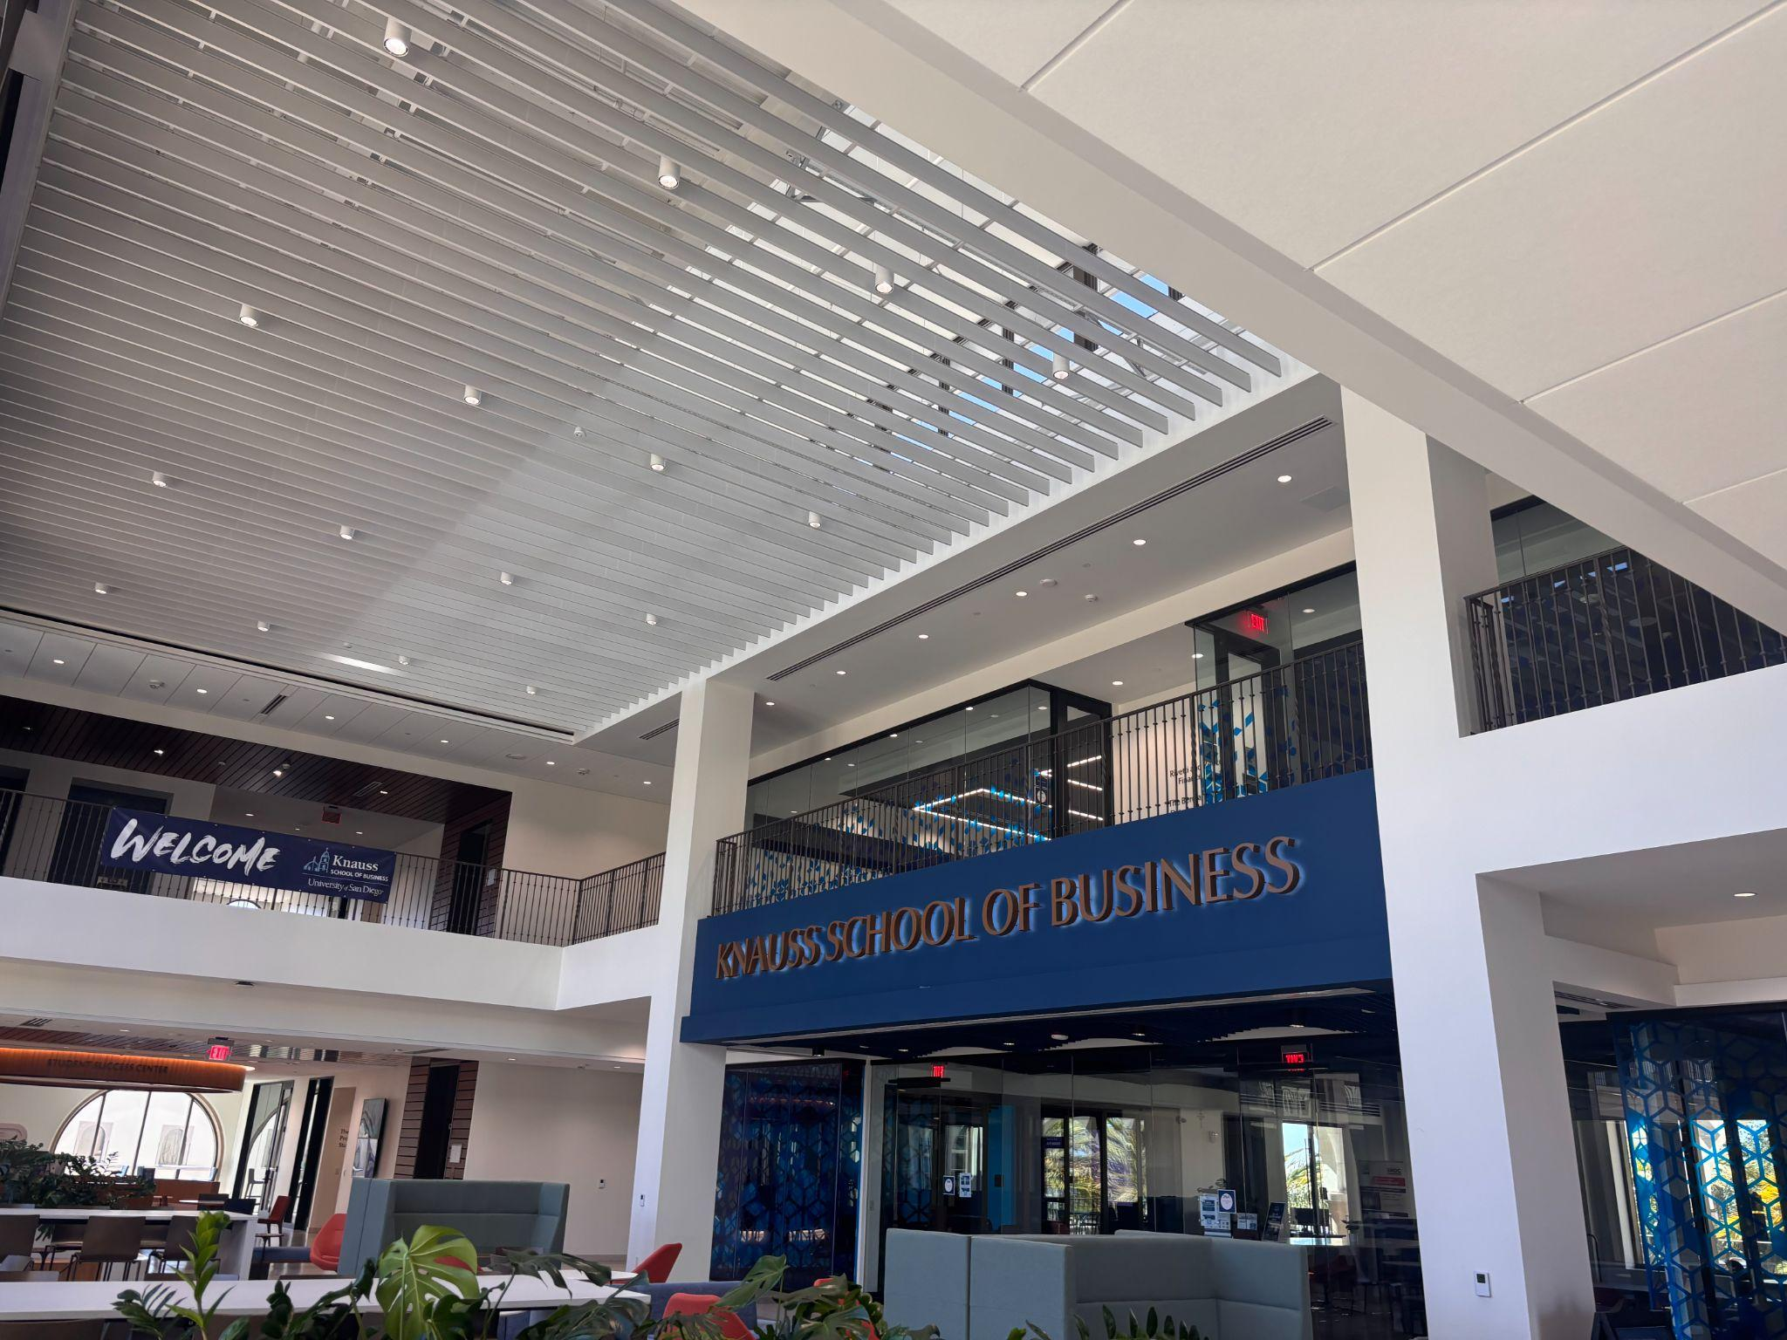
The Semester I Expected…

Slide 3
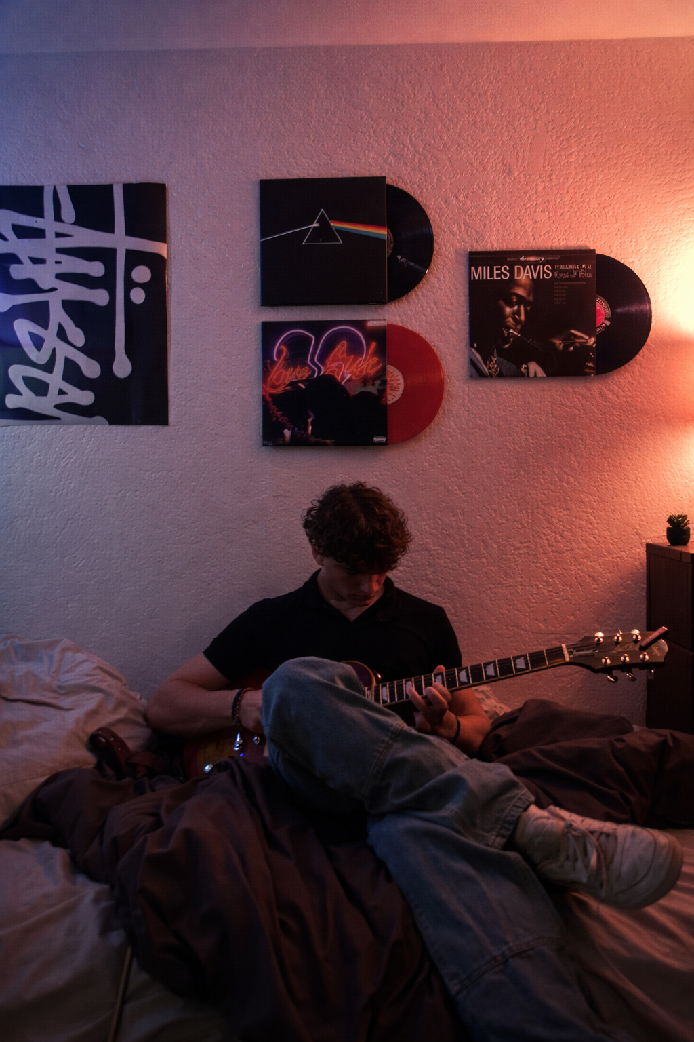
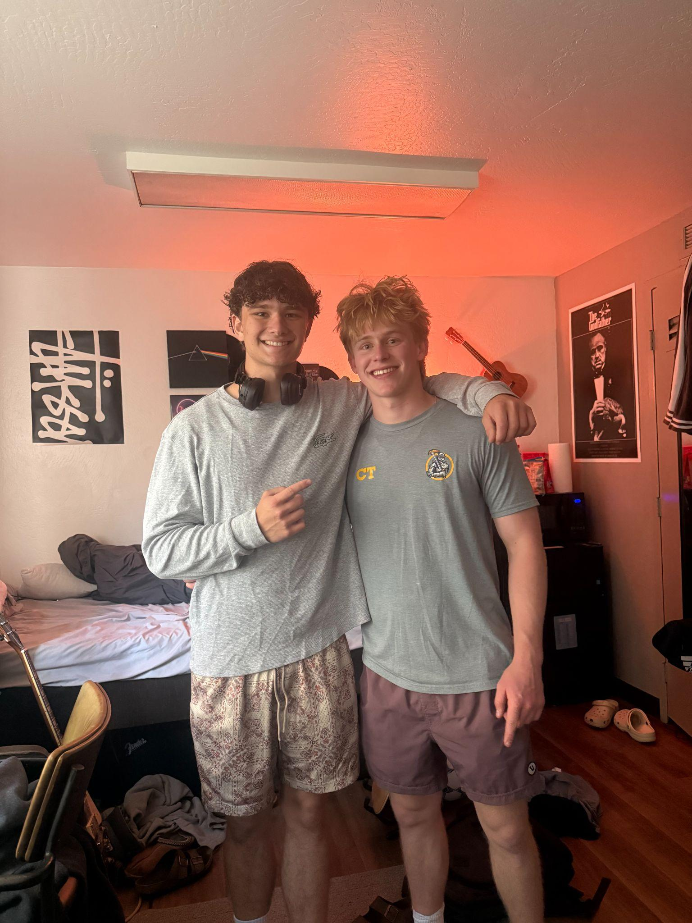
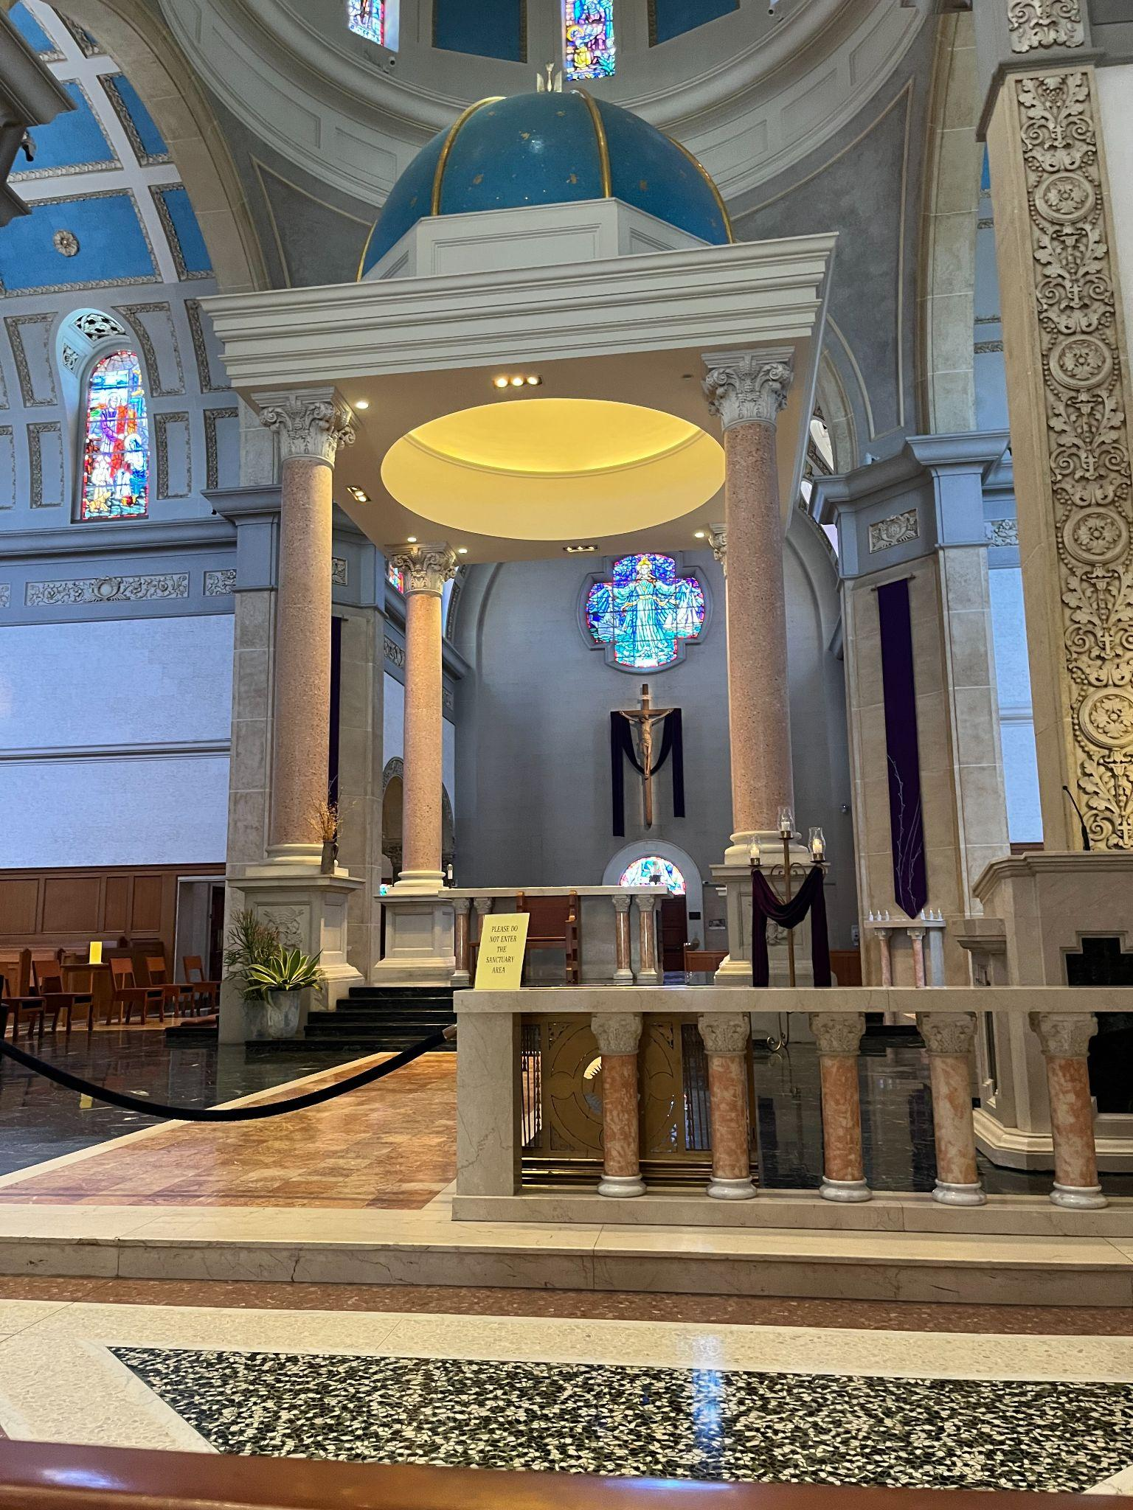
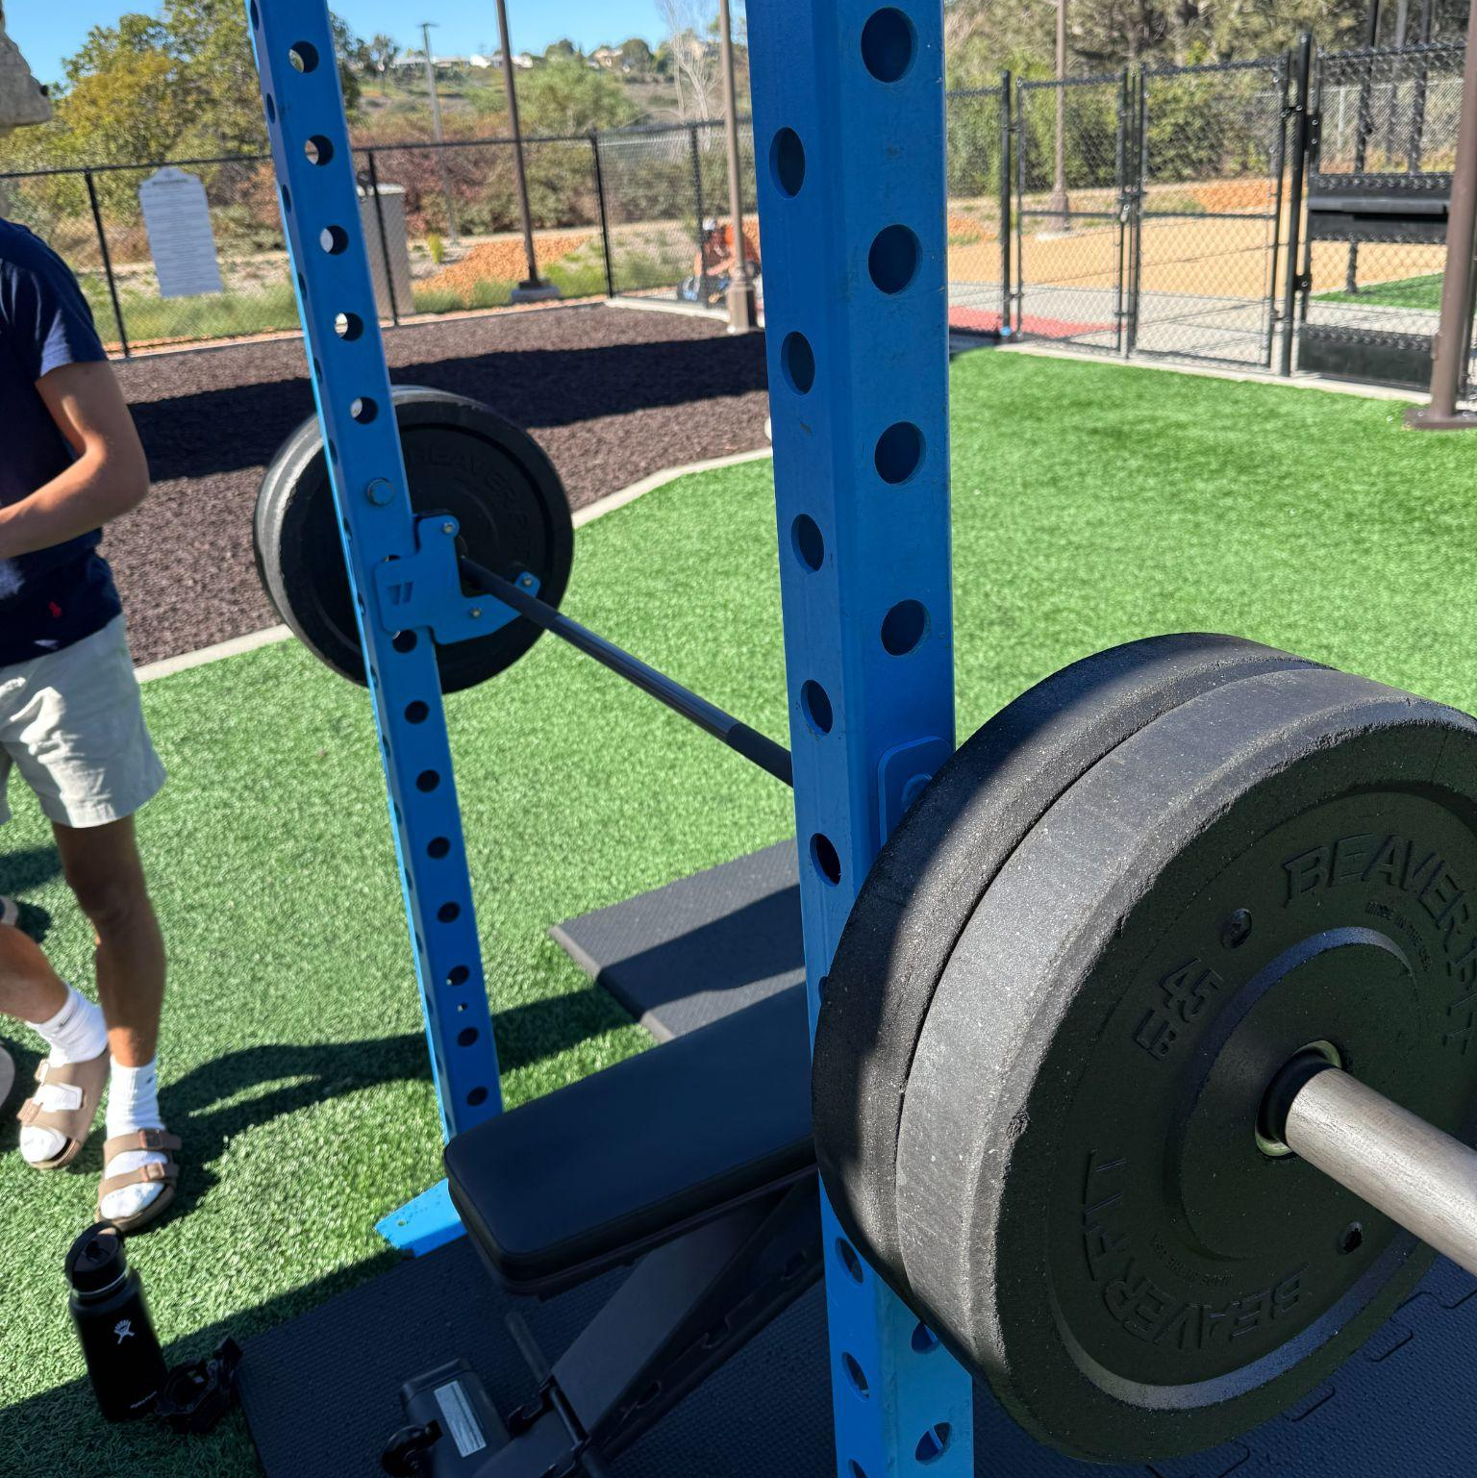
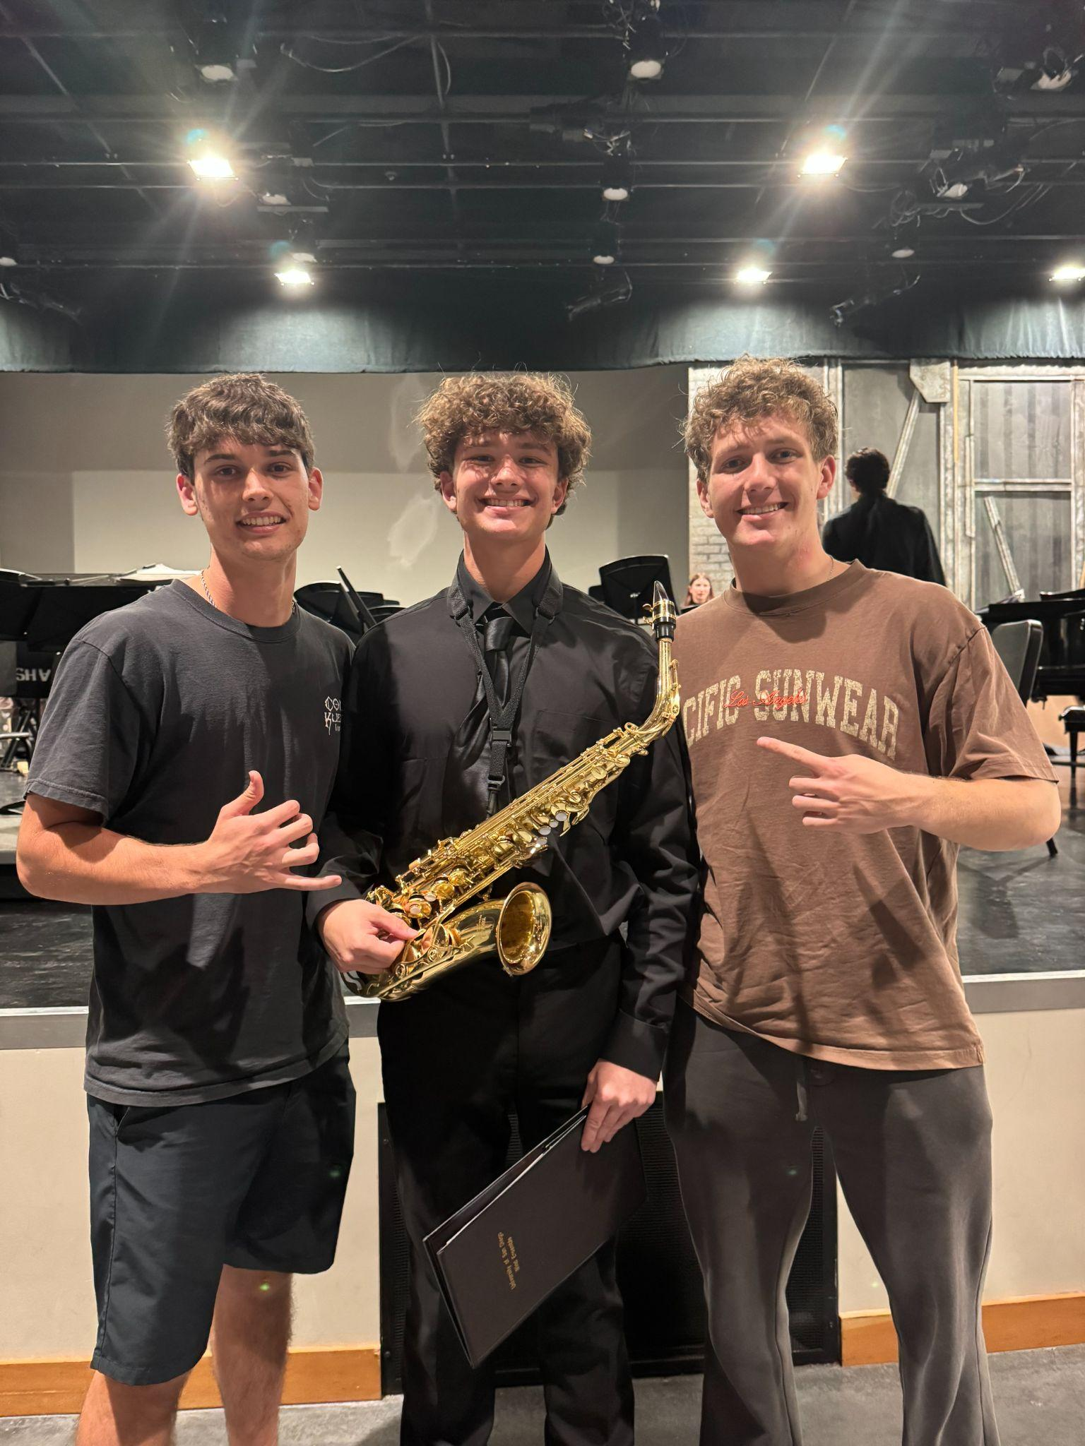
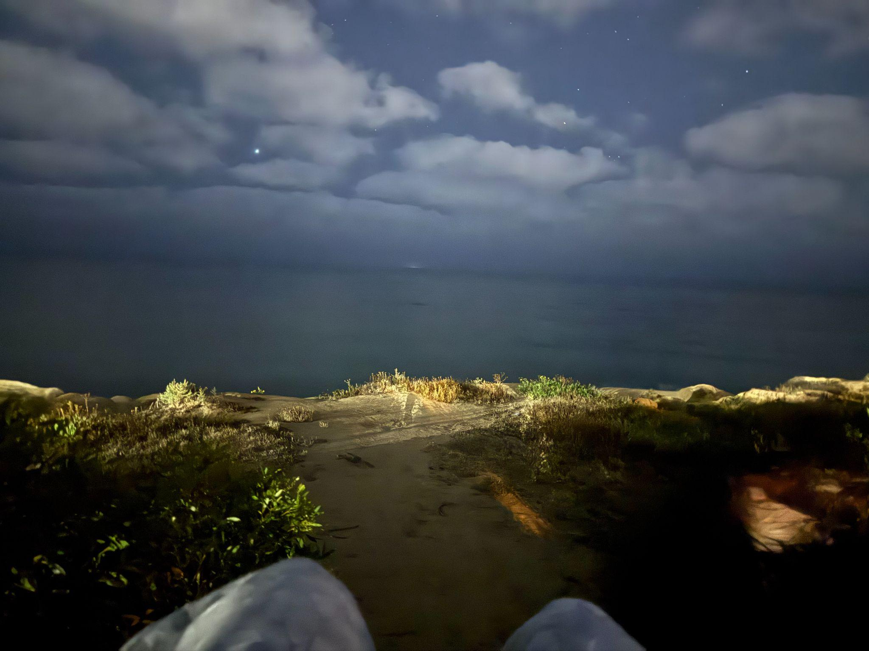
The Semester I Had…

Slide 4
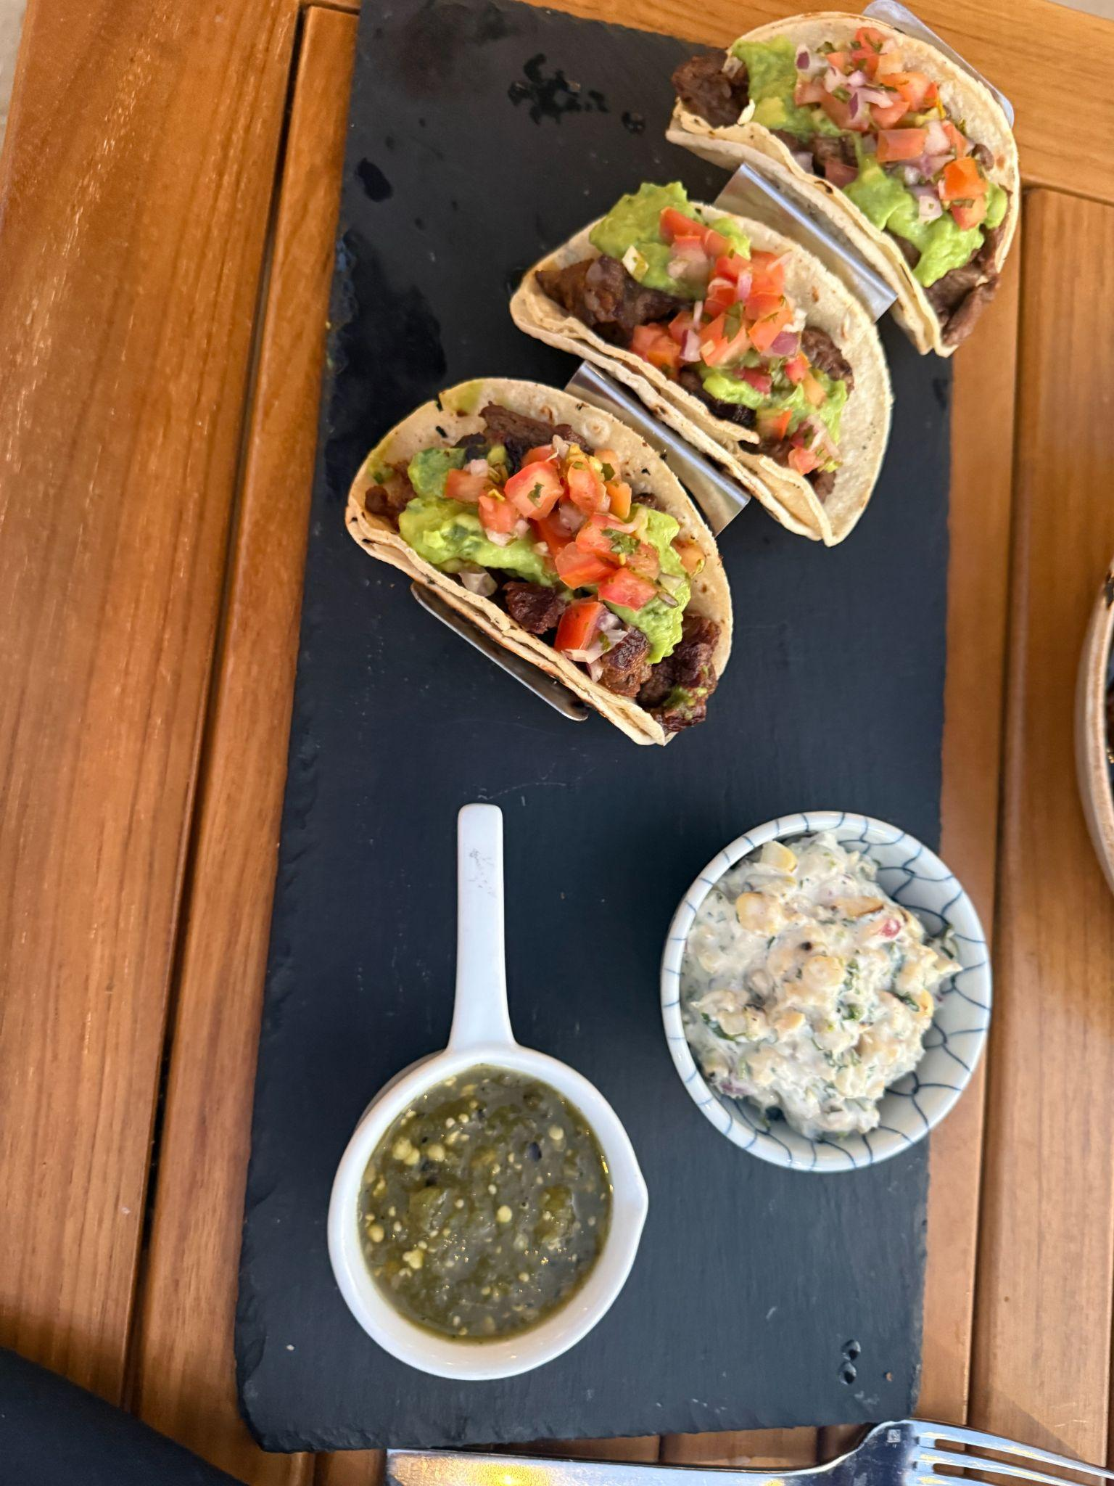
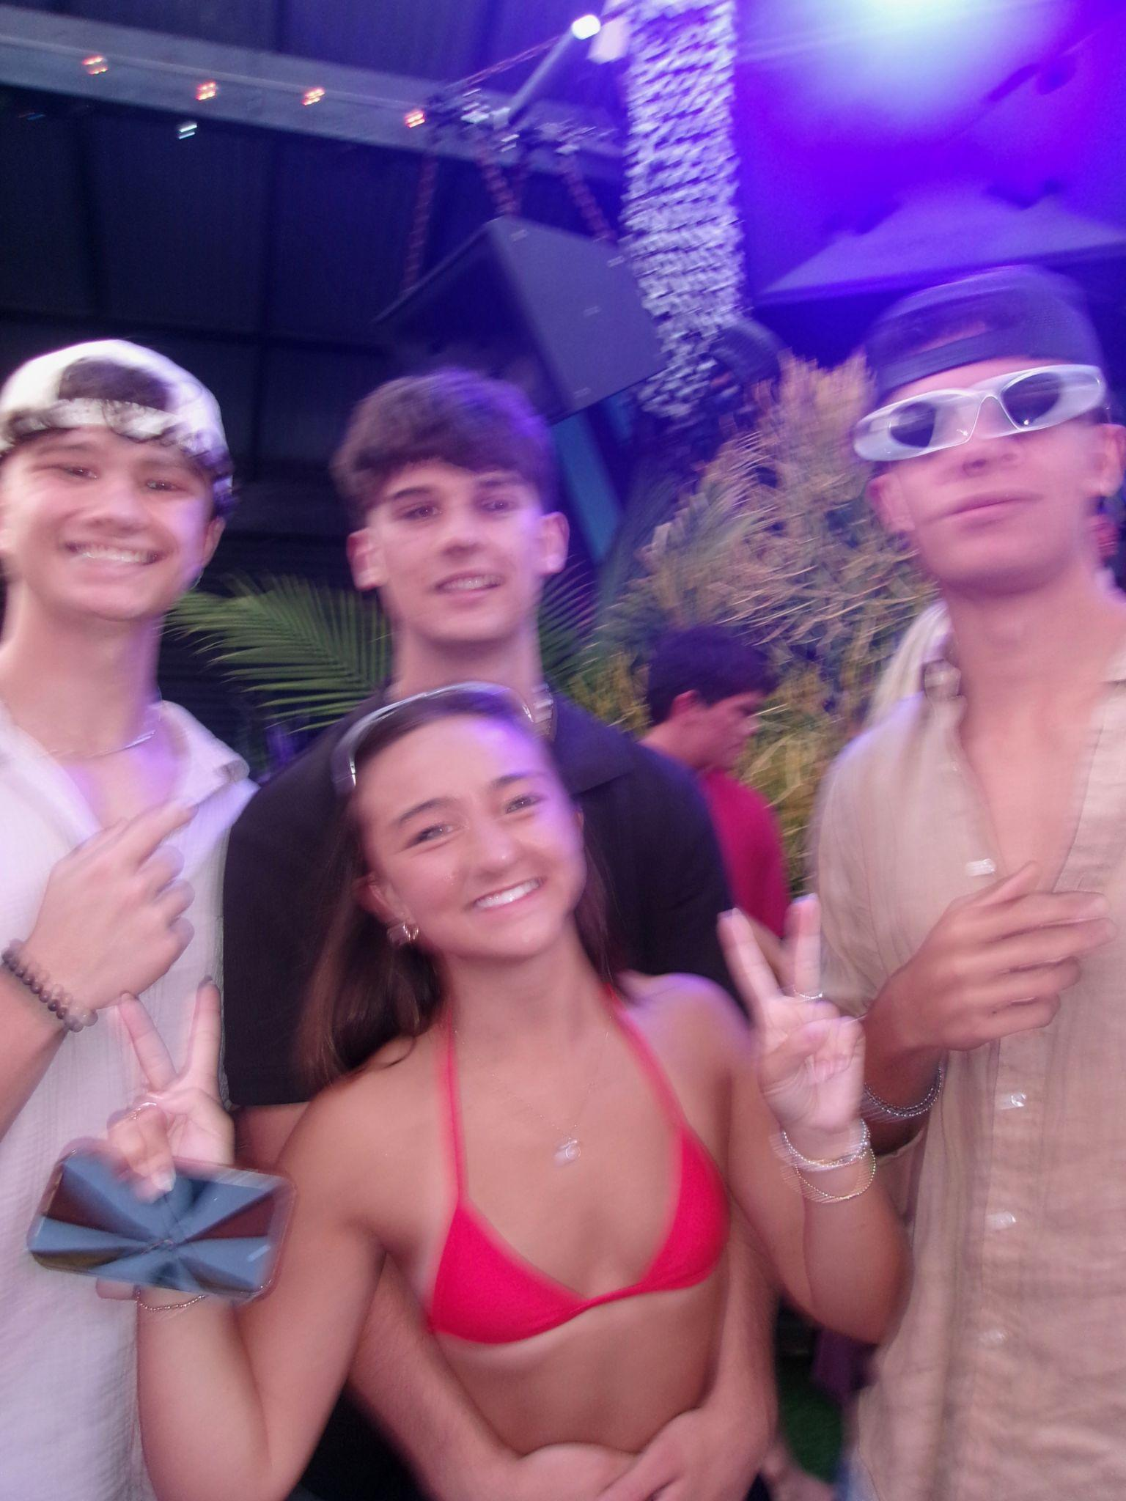
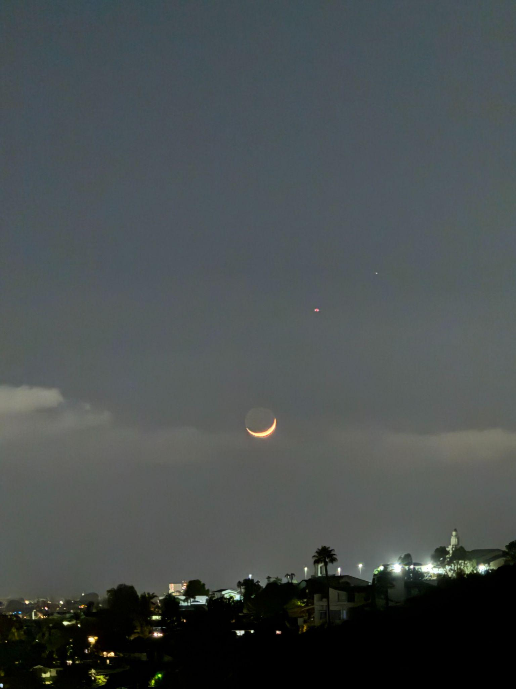
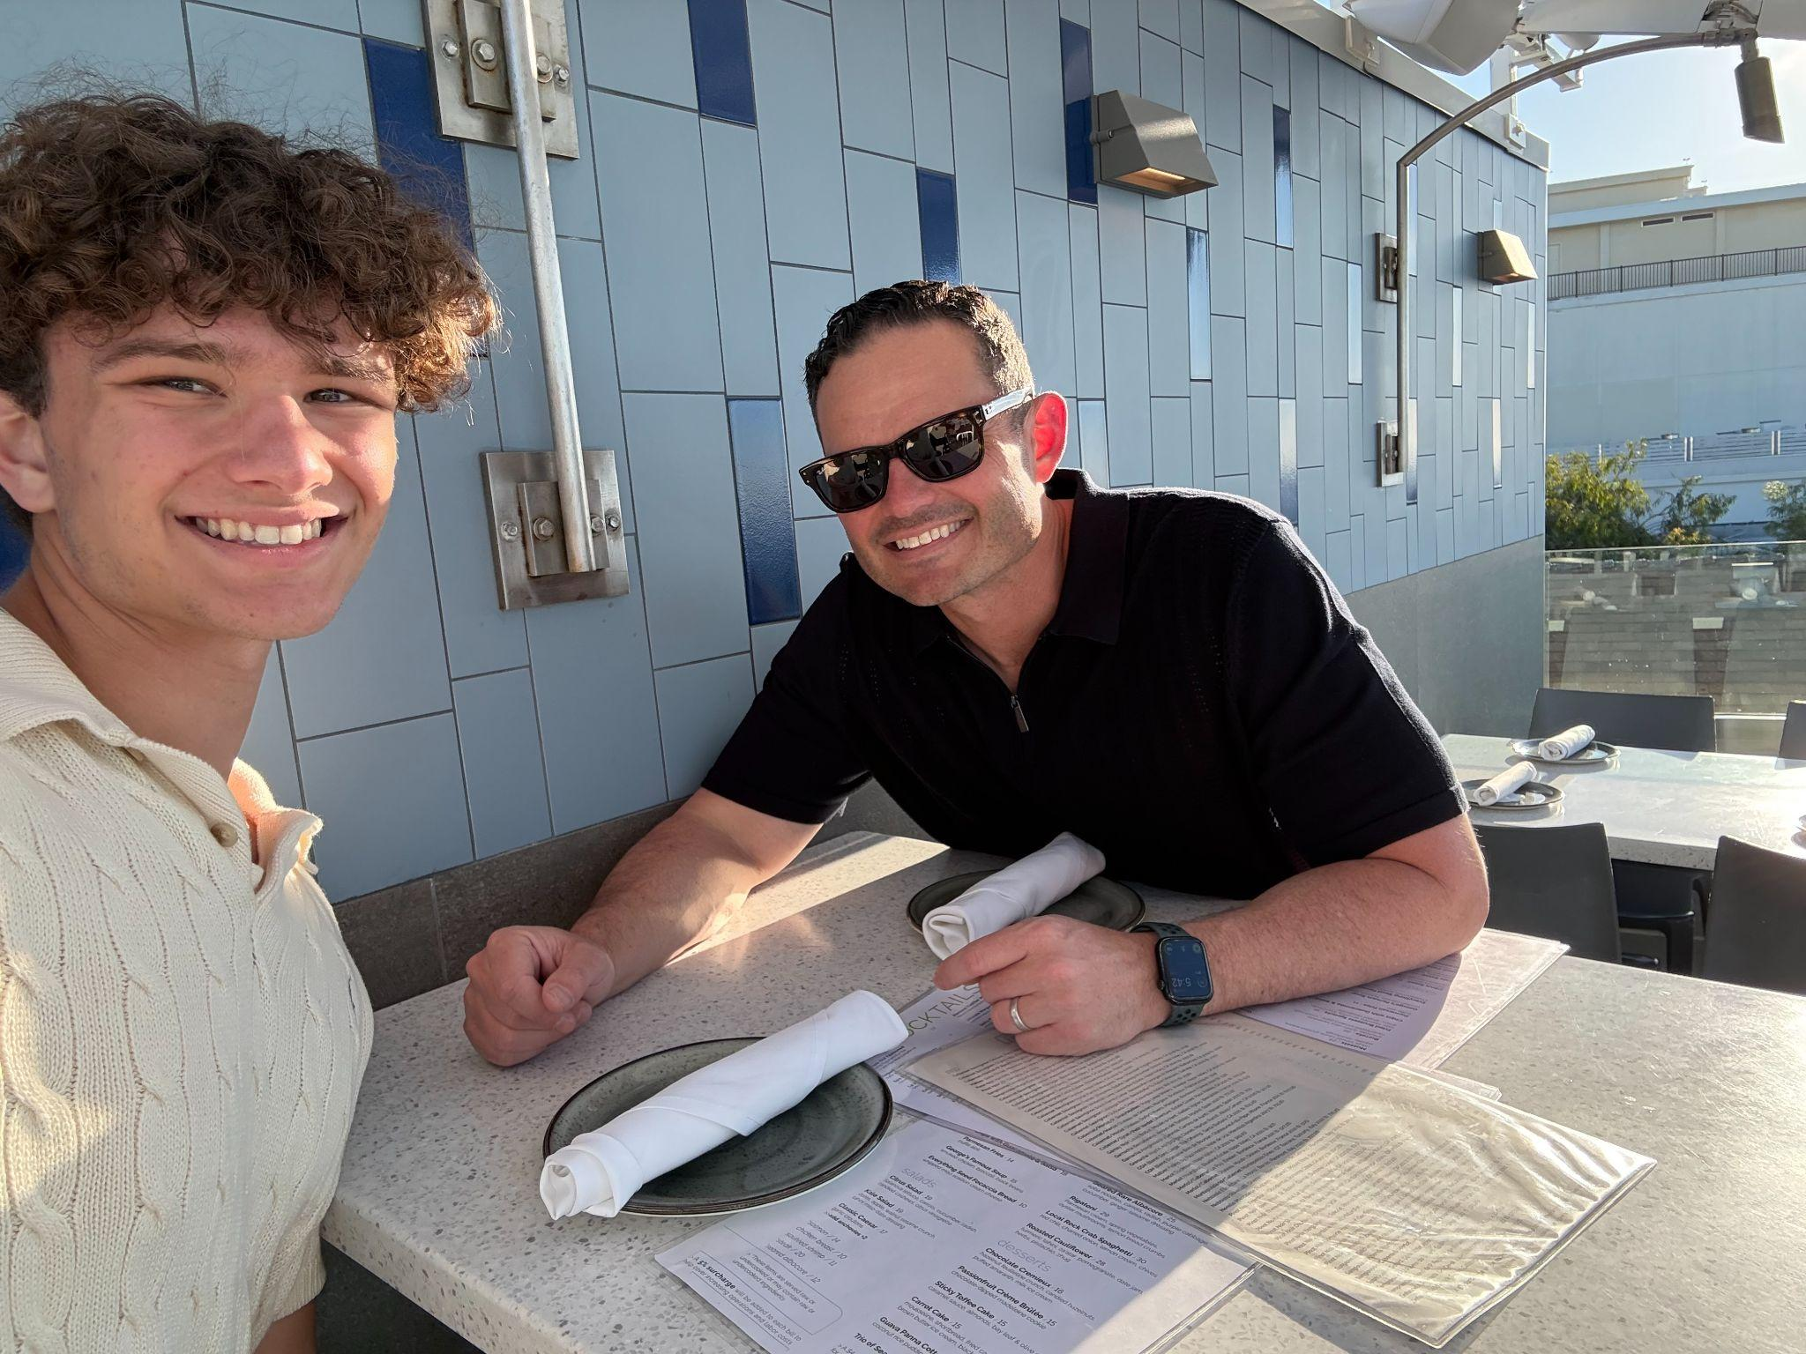
Positive Moments:
Earned excellent grades
Grew in my Faith
Improved body image and gym performance
Excelled in things I love
Grew relationship with friends and family

Slide 5
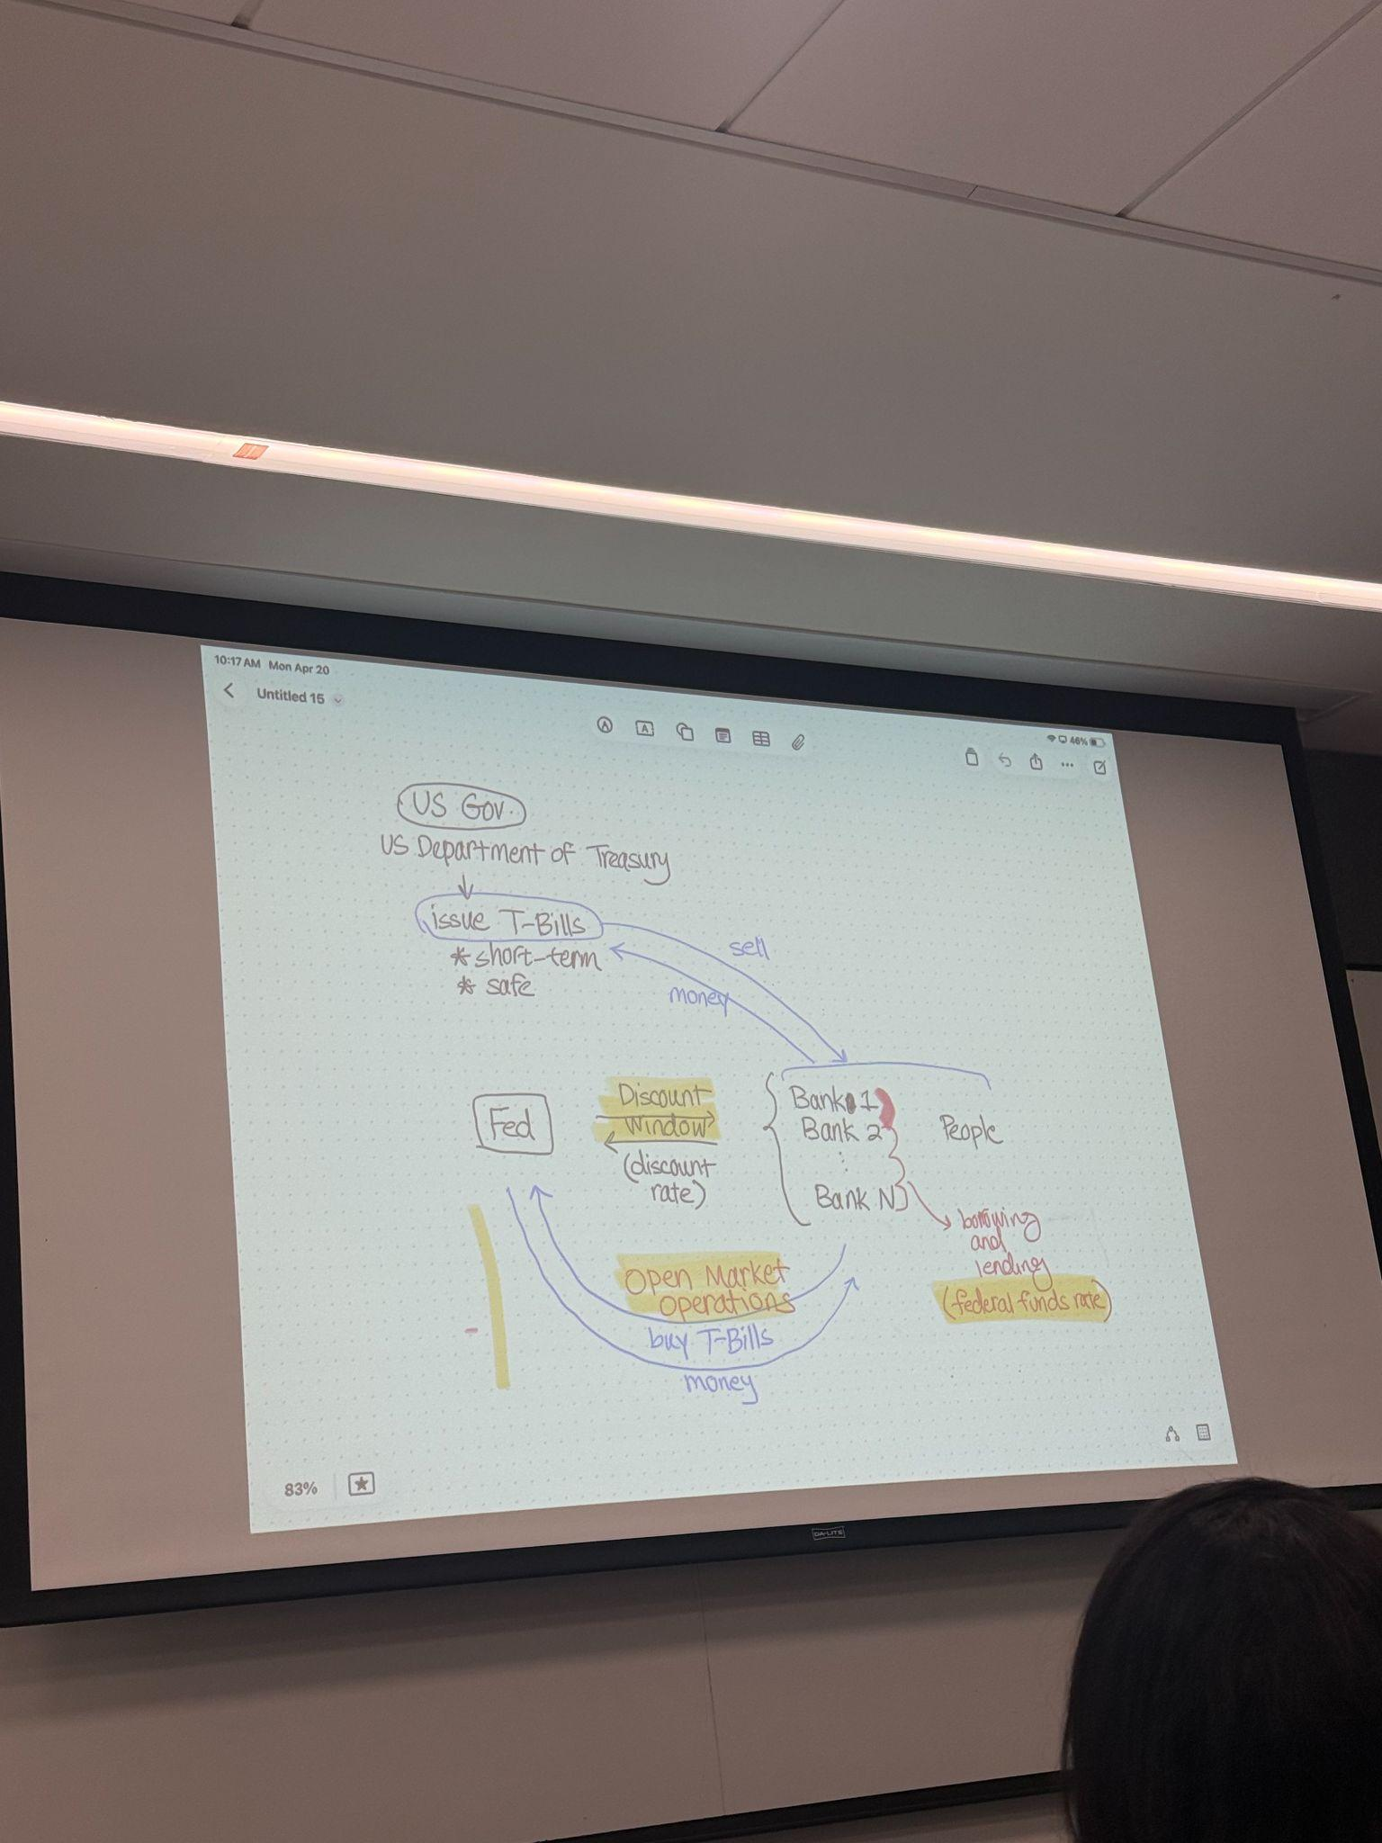
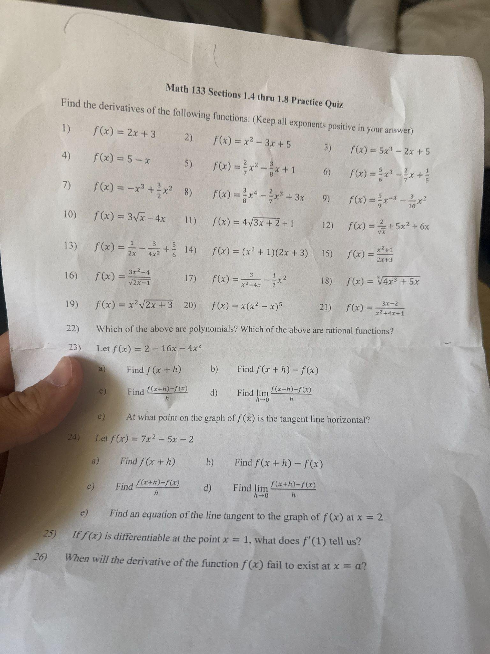
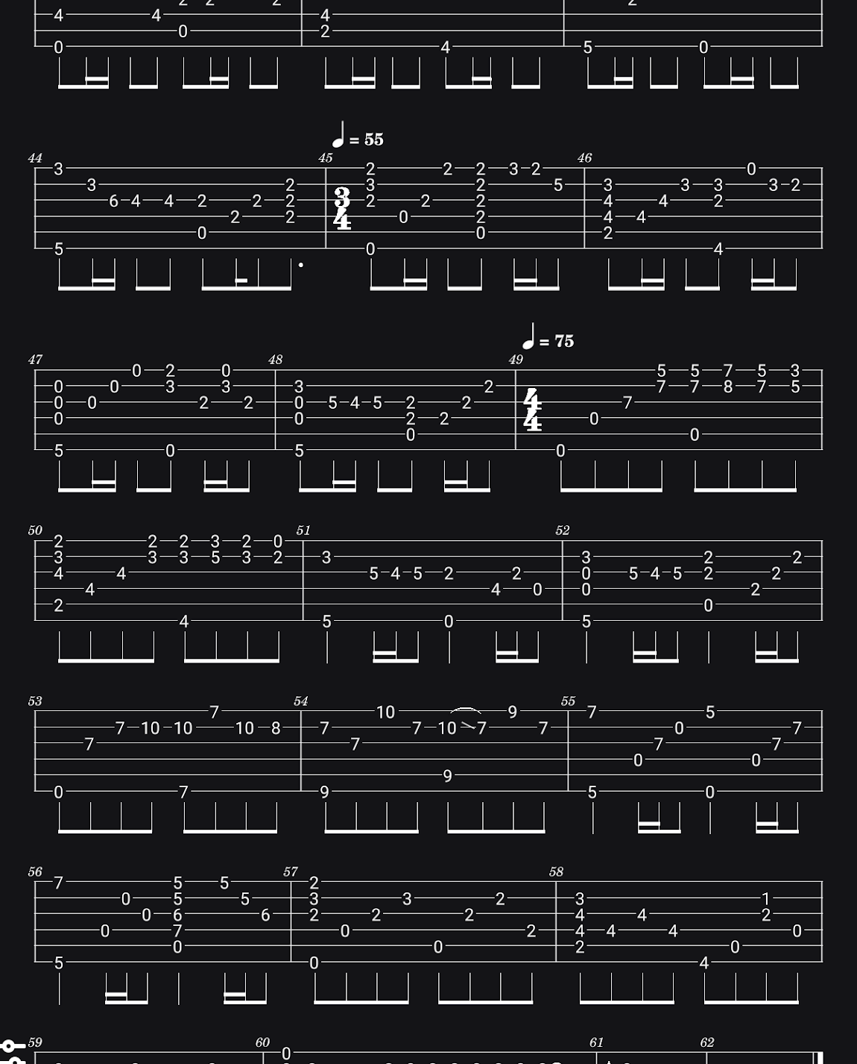
Trials and Tribulations:
Didn’t get the internship I was seeking
Very stressed towards end of the year
Spiritually distant at beginning of the semester i.e, Faith was weaker

Slide 6


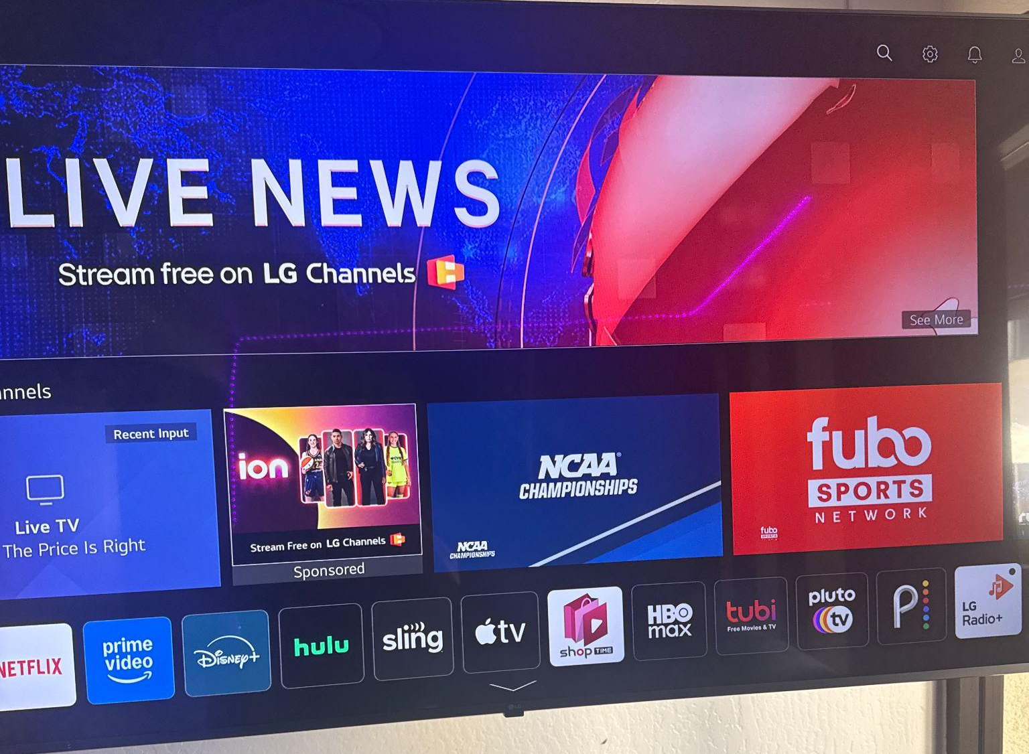
Underlying Technological Importance
Group chats helped people stay connected
Online assignments and reminders kept school organized
Social media showed what was happening locally and nationally
Technology captured memories that would otherwise be forgotten

Slide 7

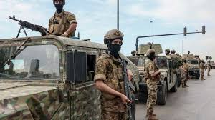
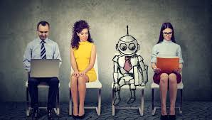
Changes Around me-
AI being integrated into the classroom (positive, good tool)
Politics intensifying, media seemed to sway the opinions of my peers
Questions over AI and job security

Slide 8
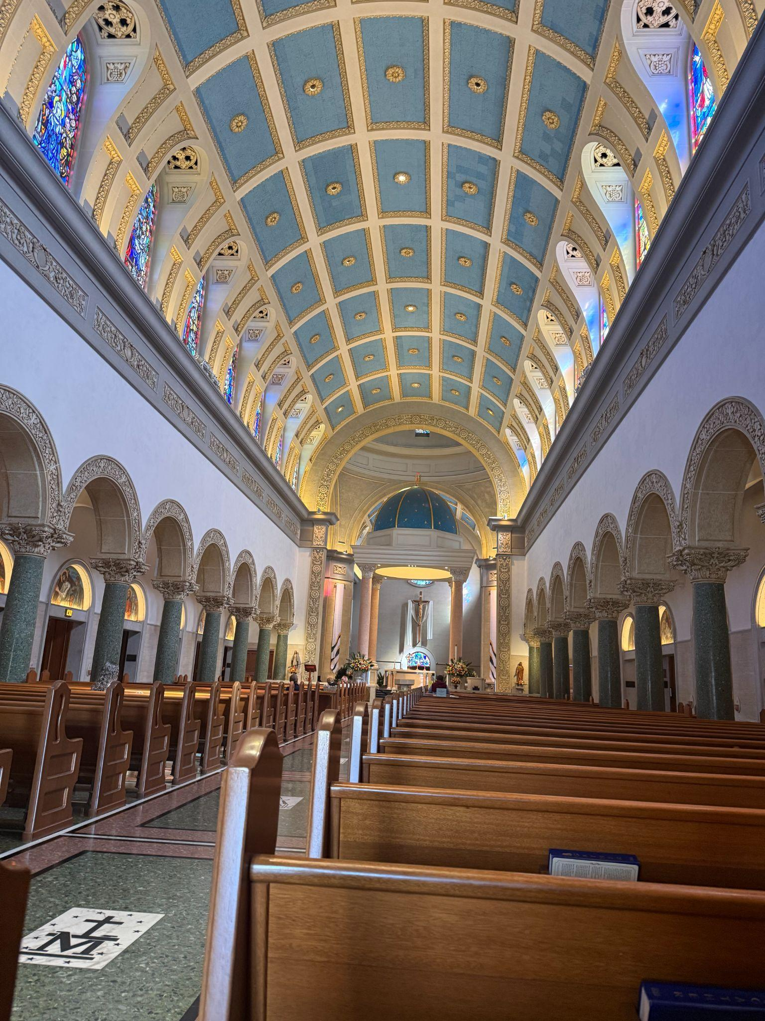
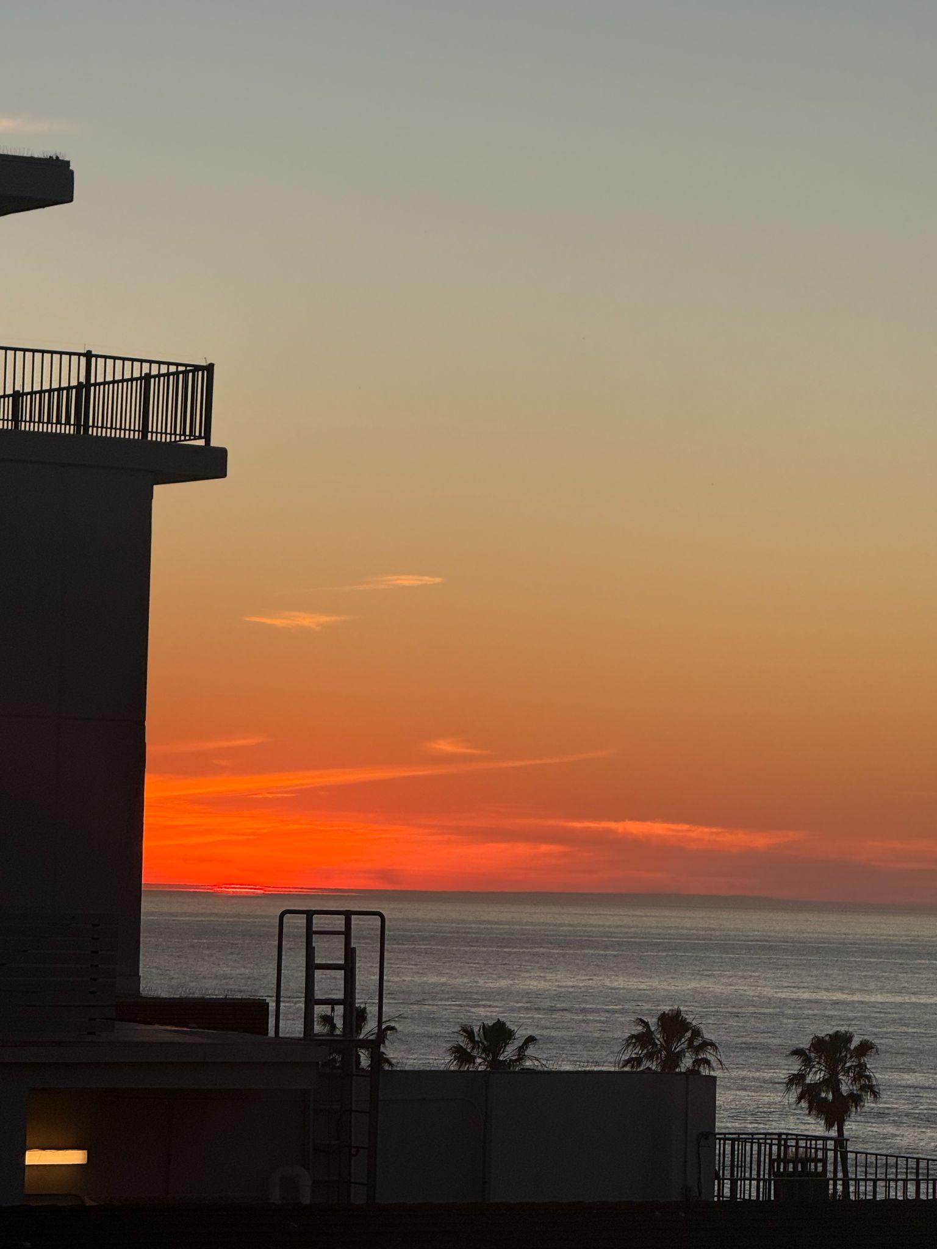
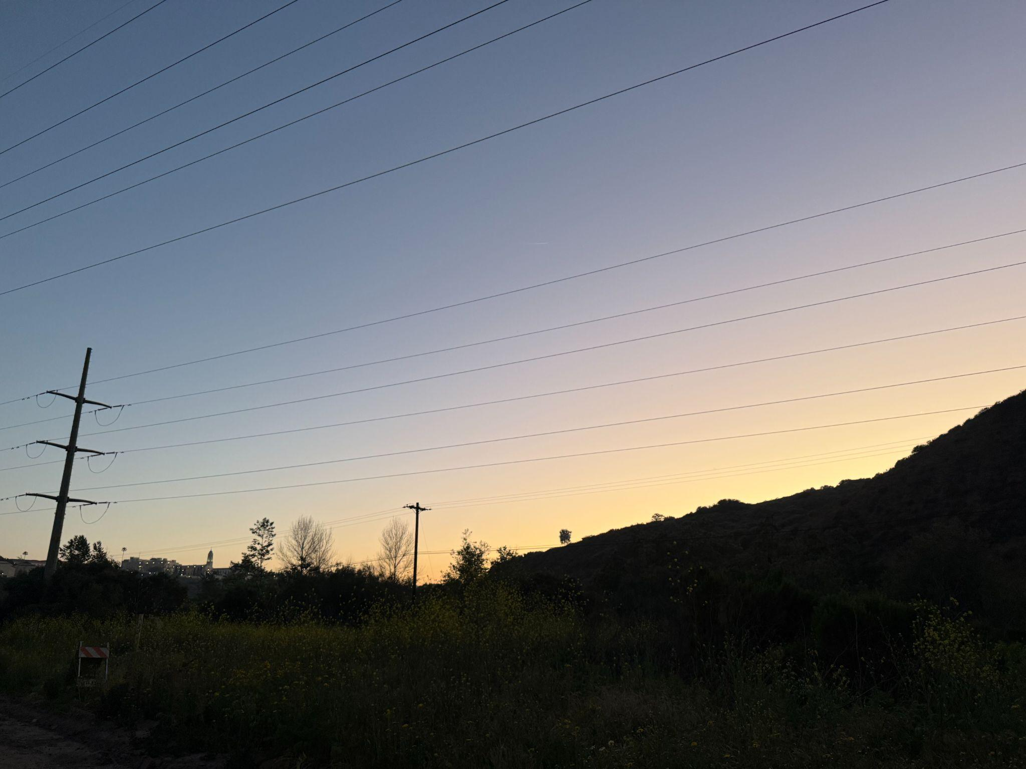
What This Semester Taught Me:
Balance is important
Find joy out of the work you are doing
Technology playing a larger and larger role
Faith is bigger than I think

Slide 9
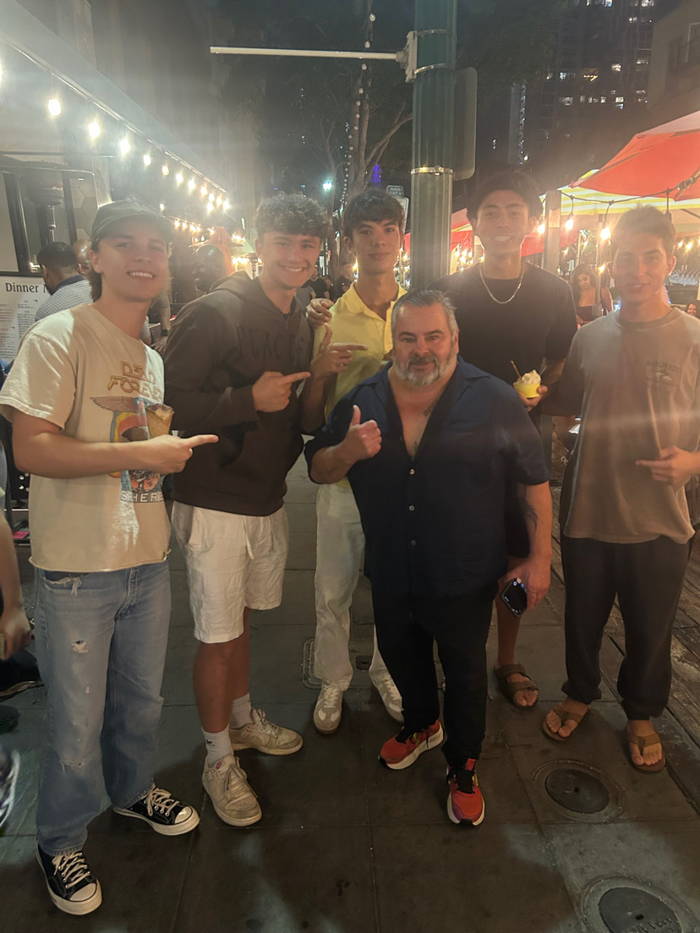
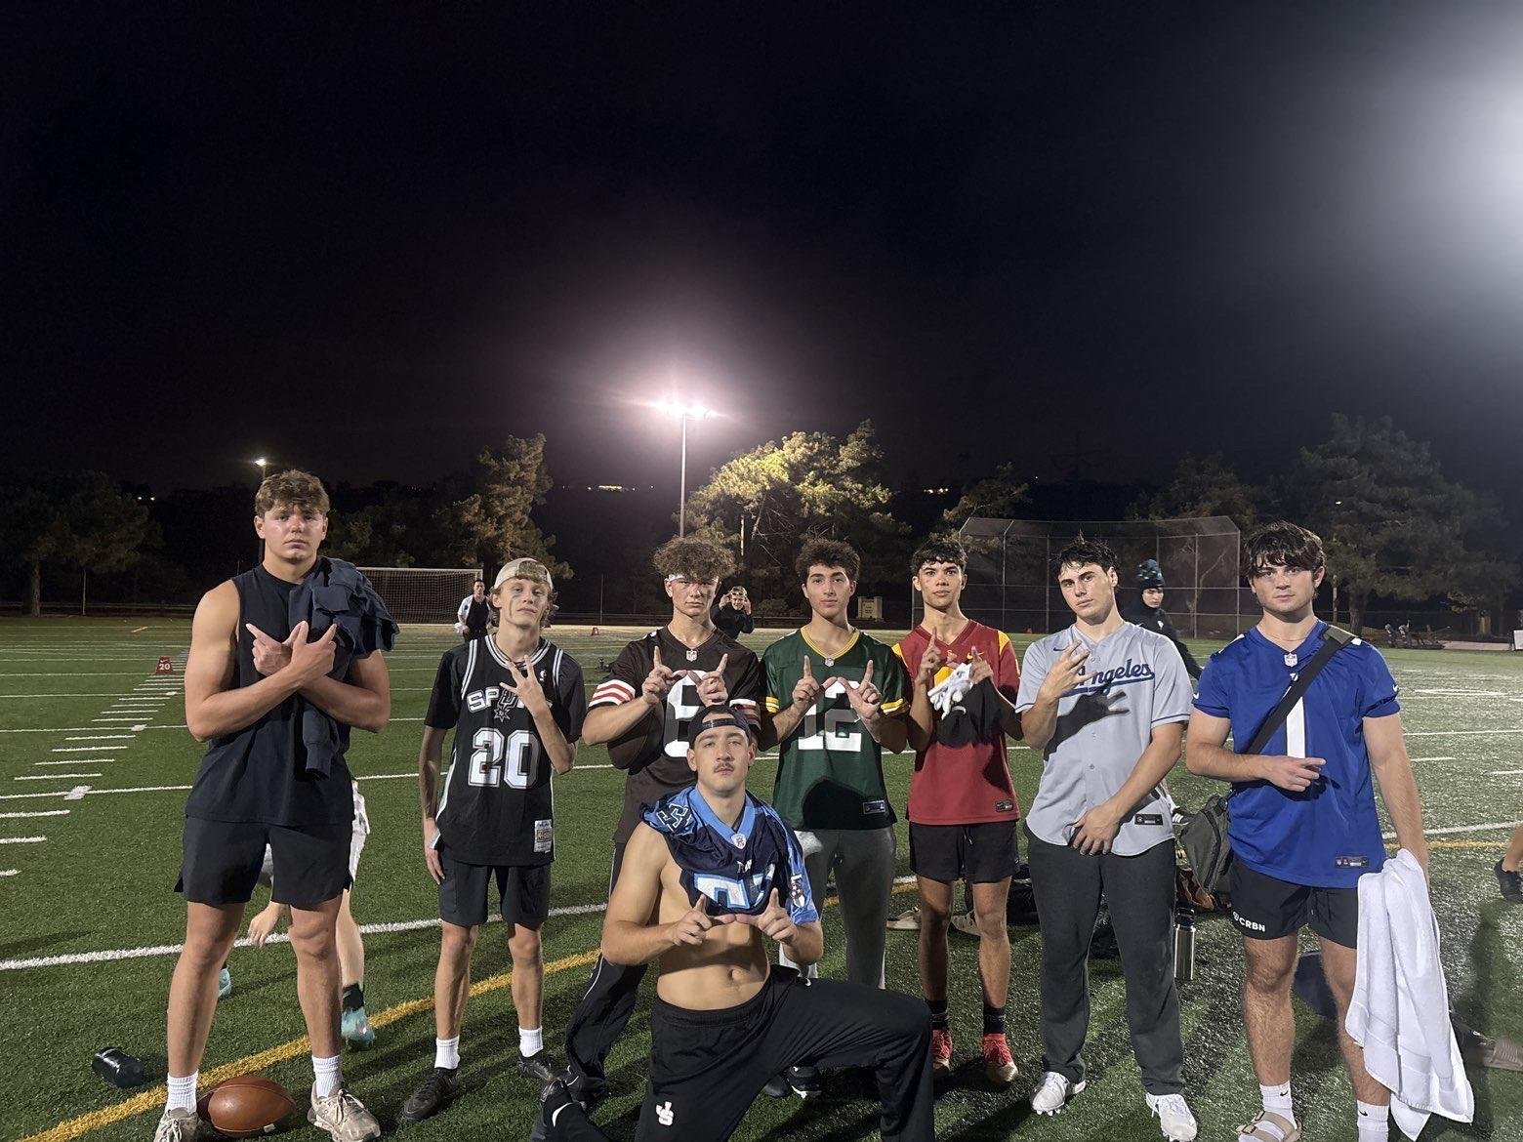
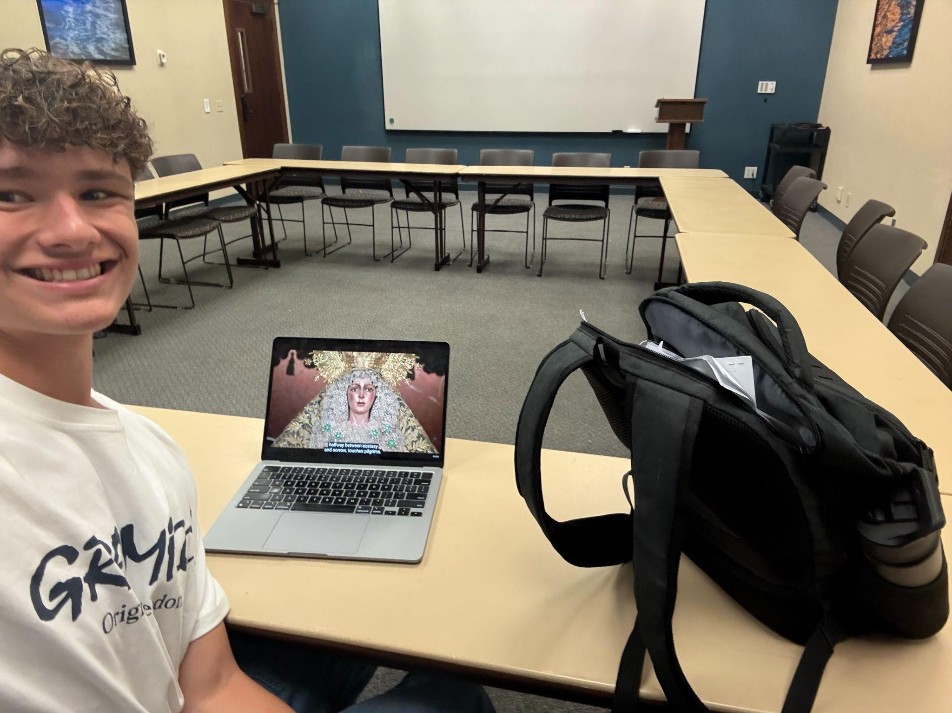
Future Expectations
Keep up my hard work in school
Keep growing my Faith
Continue developing my body image
Keep working towards my career

