Slide 1
Time Capsule Final Project
Fausto Valenzuela

Slide 2
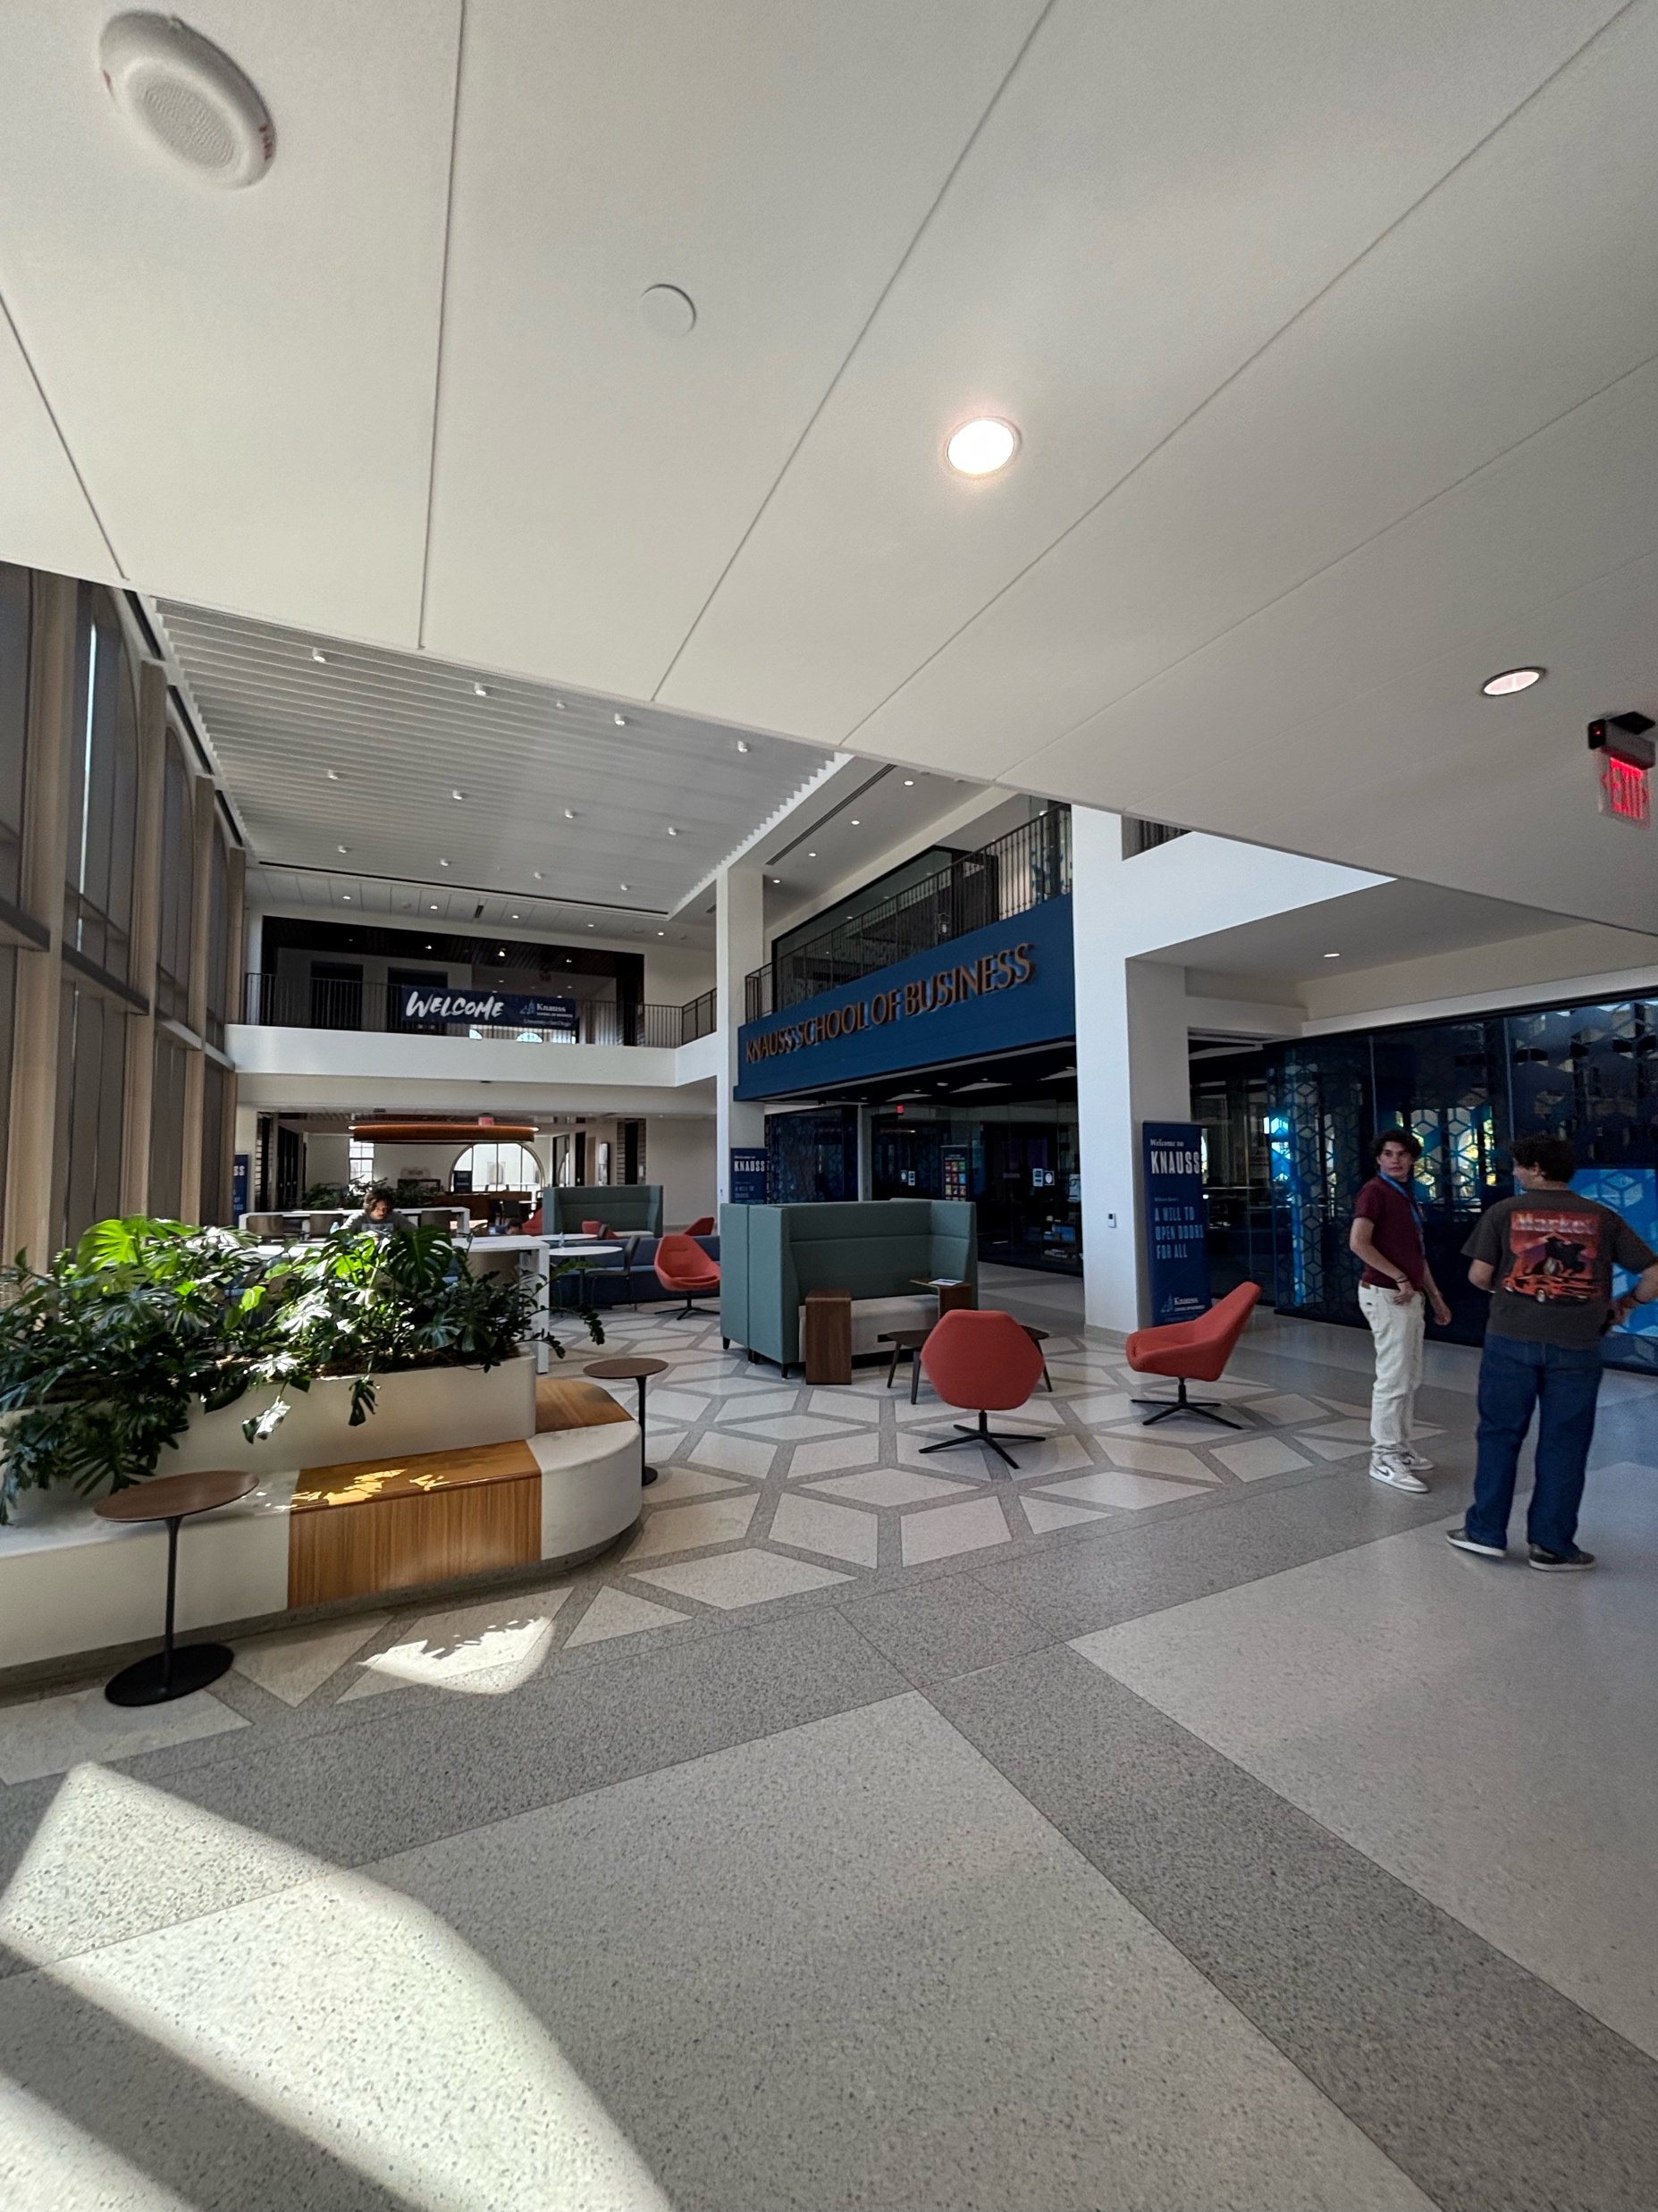
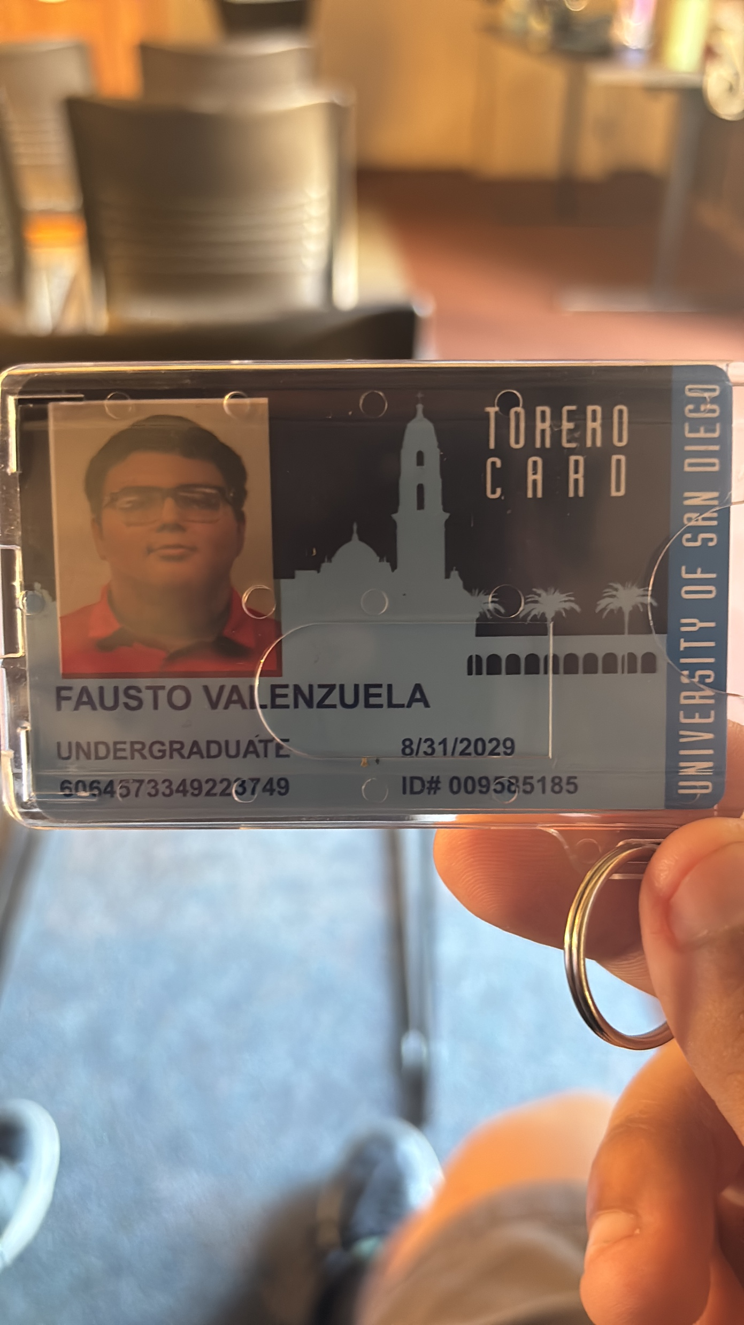
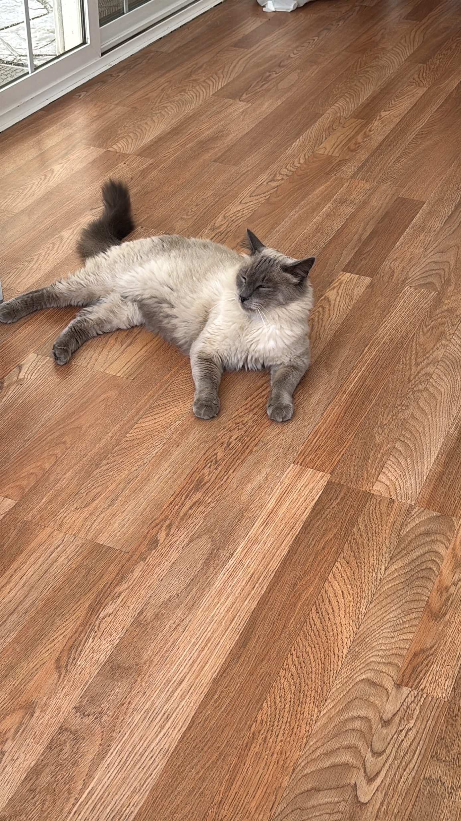
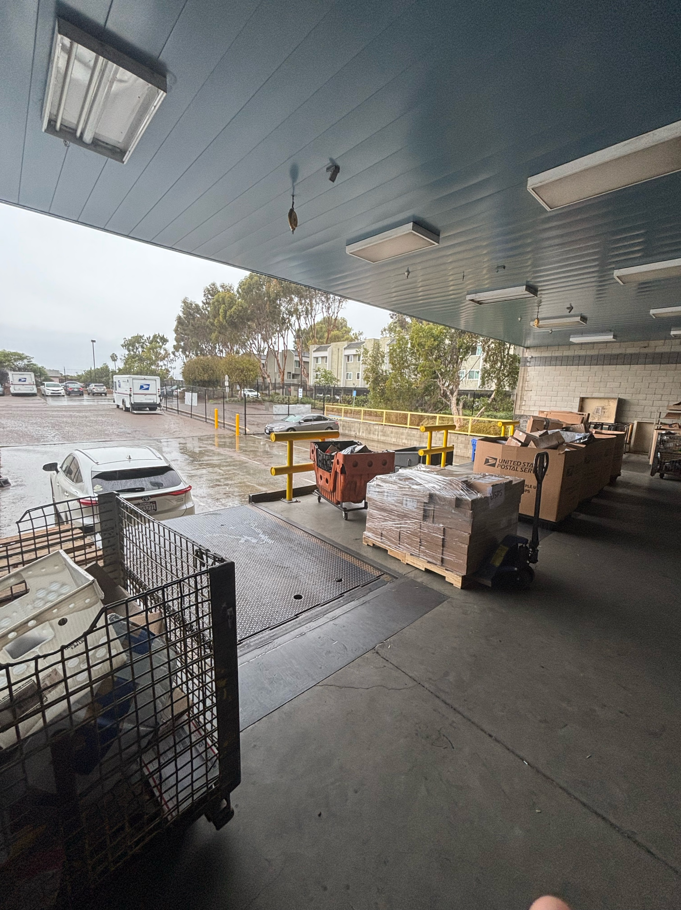
Items that happened in the semester individually, with friends, groups, locally, nationally

Slide 3



Items that did not happen that you wanted, expected

Slide 4
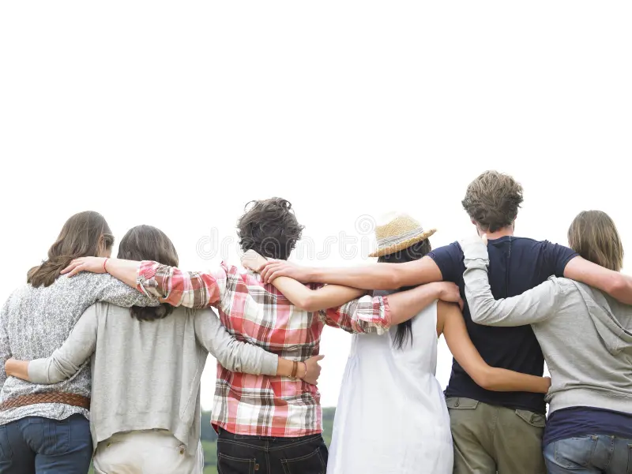
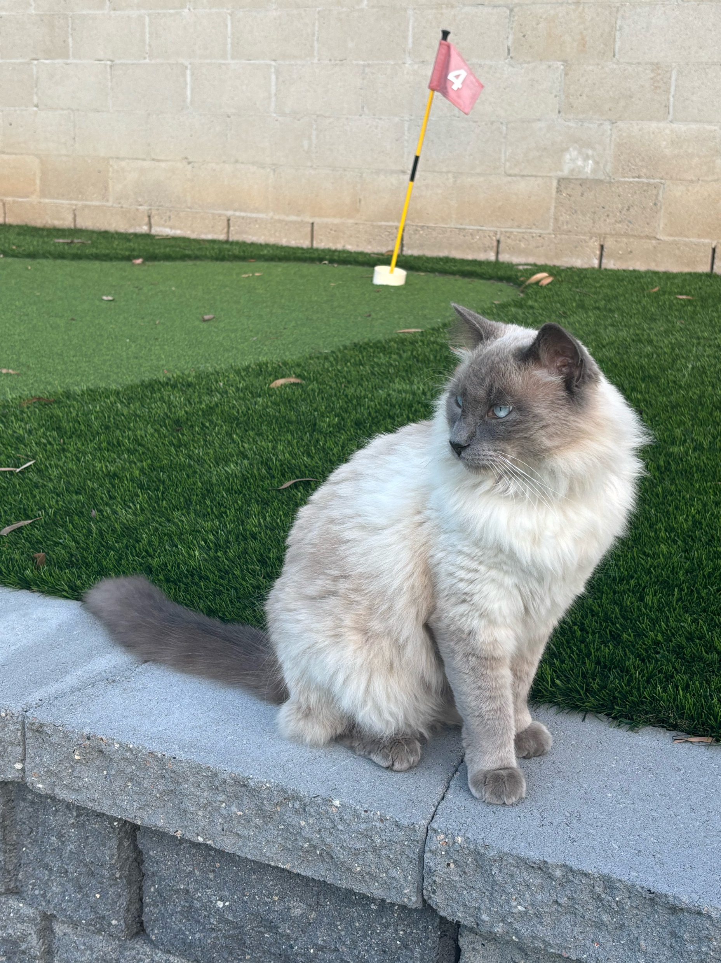
Items that you experienced that have touched your life this semester in an positive way

Slide 5


Items that you experienced that were sad or negative that you wish not to be experienced again

Slide 6
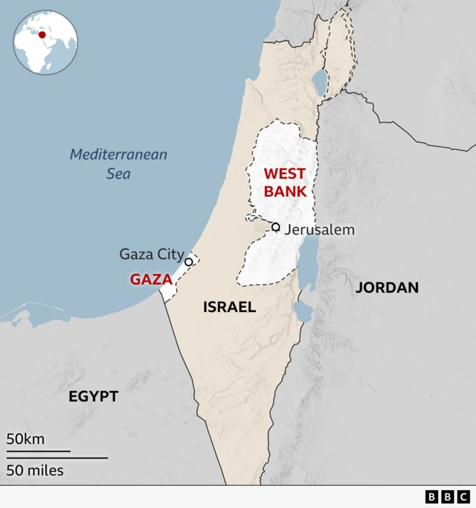

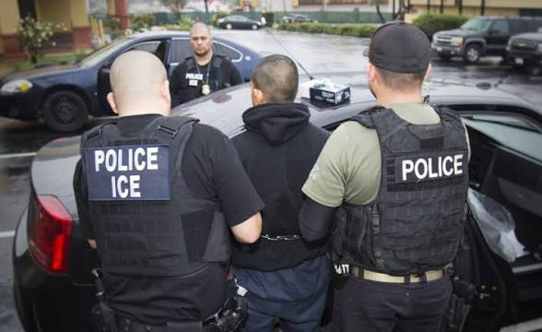
Items that were highlighted by news, media advertisements/messages, government, other countries, other sources

Slide 7

Items that illustrates changes to processes (buying food other items), laws/restrictions

Slide 8
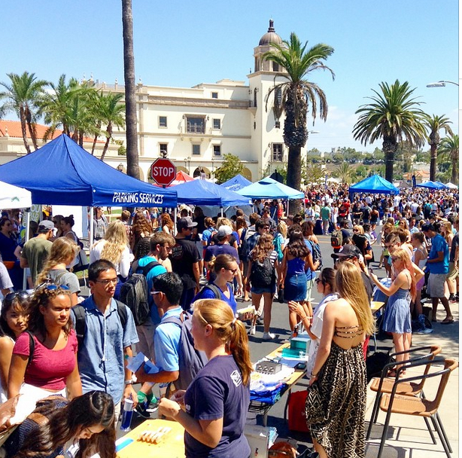
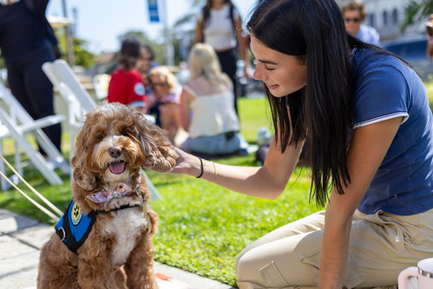
Items that illustrates people’s creativity to assist others (i.e. drive by birthday parties)

Slide 9
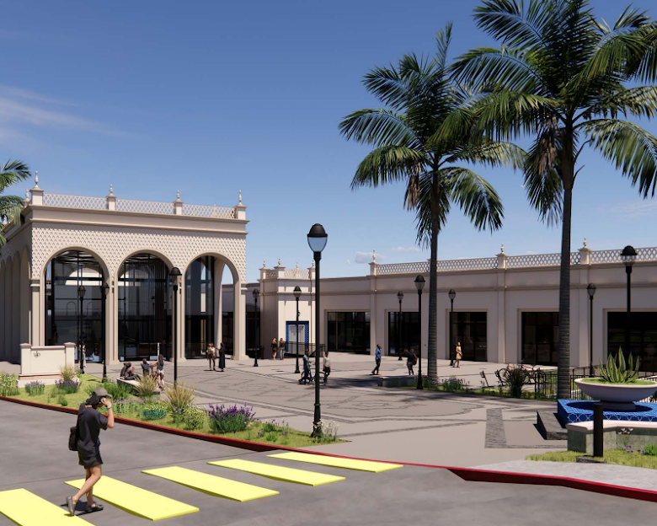
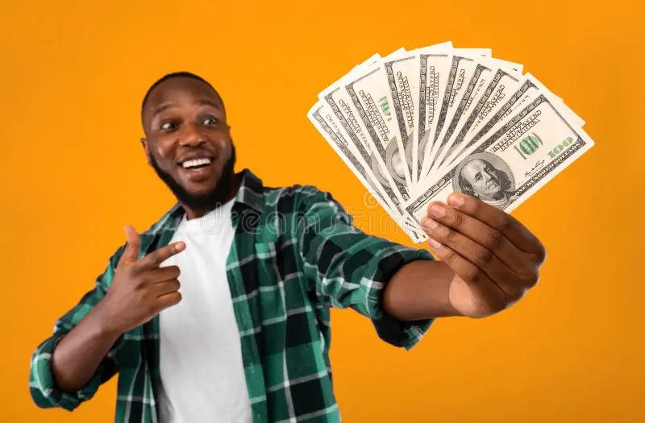
Other relevant items to discuss the semester you had, the semester you wanted, and the semesters that you wish to have in the future.

Slide 10
Final message
Overall this semester was more of a learning experience as I switch from being a high schooler to a college student. I had the opportunity to try new things and have more time to hang out with my friends. Stress from work and school did affect me but it helped me learn a lot more of time management and how I control my day. I was able to get a job and save up money and have a lot more free time during dead hours throughout the semester. Overall I was able to have a schedule that was up to me rather than having the same thing during high school and it felt very liberating. I made a lot of new friends and I am excited for the upcoming semester which I have a little bit experience from this semester to help me out.

