Slide 1
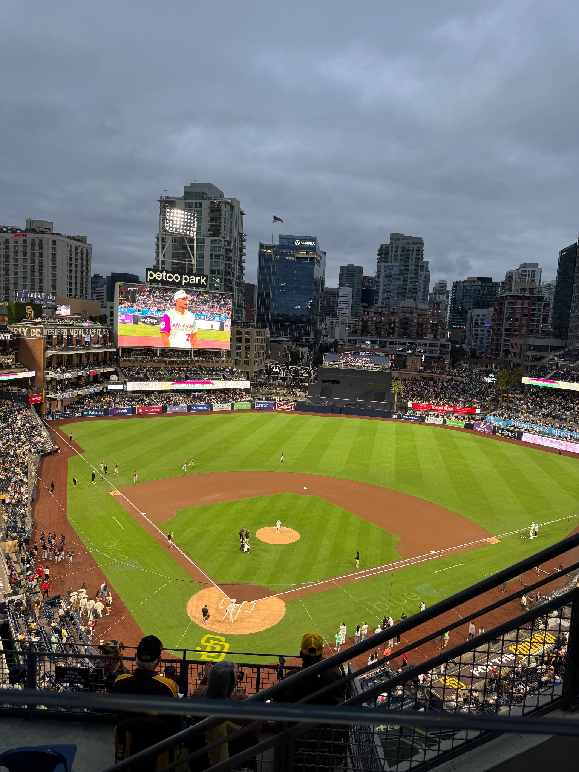
Semester Reflection
Moments, lessons, and what I want next
Brandon Keith / ITMG 100 05

Slide 2
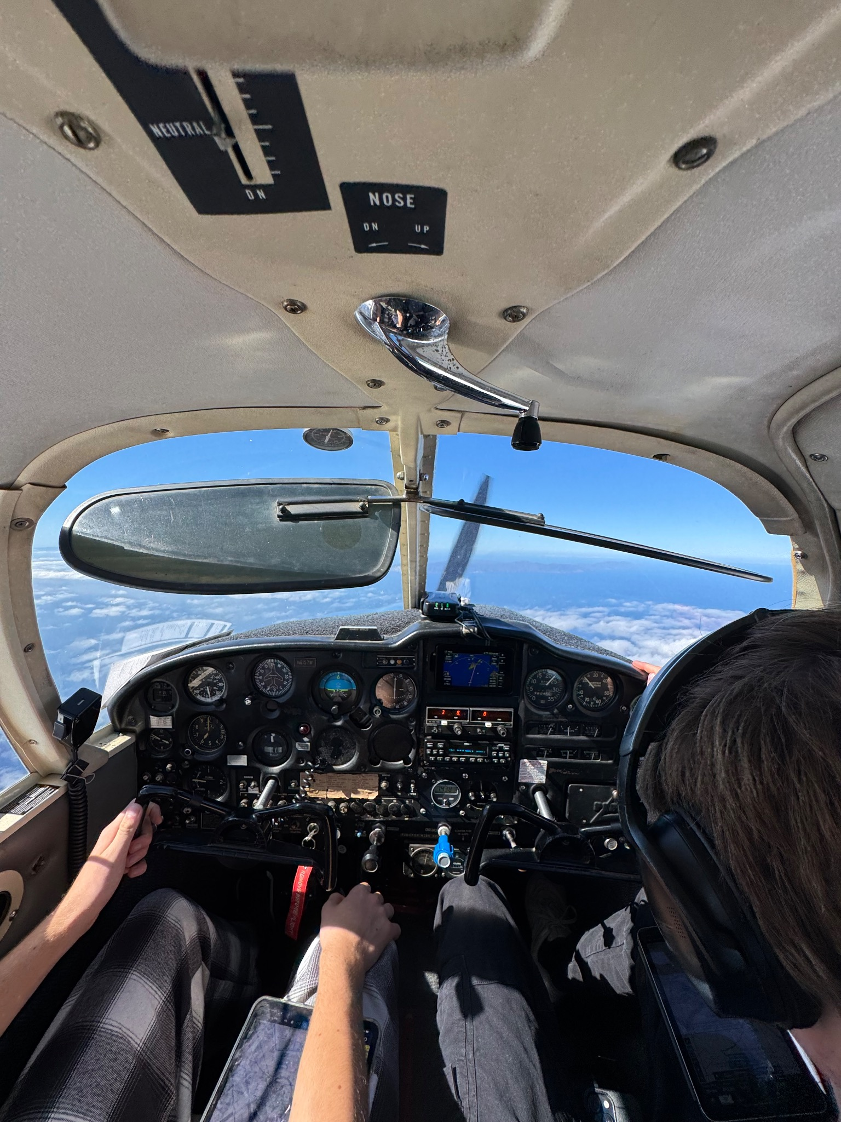
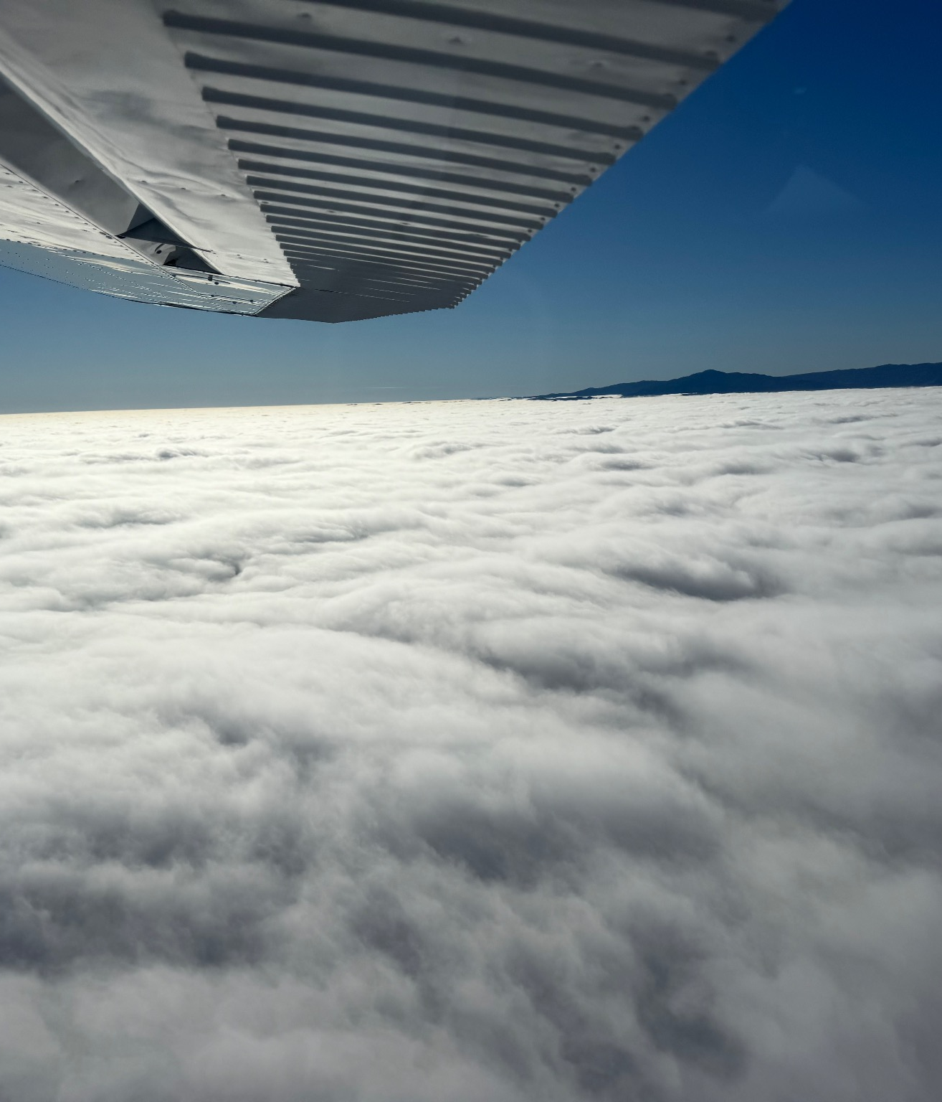
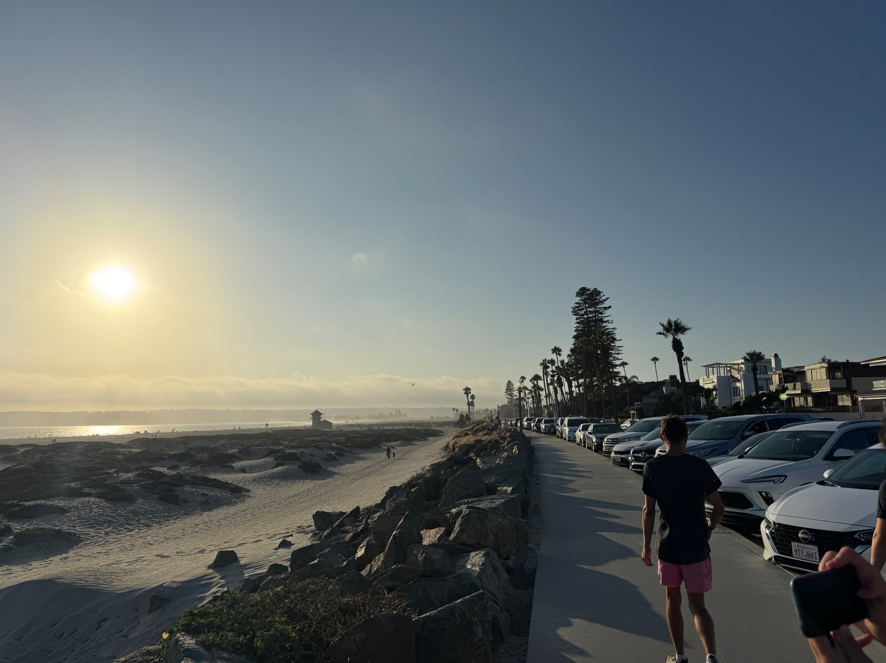
What happened this semester
Highlights I did individually + with friends (local adventures + new experiences).
Friends
Local
Flying to Catalina with friends
San Diego: a fun night out
Beach sunset walk
Flying to Monterey above the clouds

Slide 3
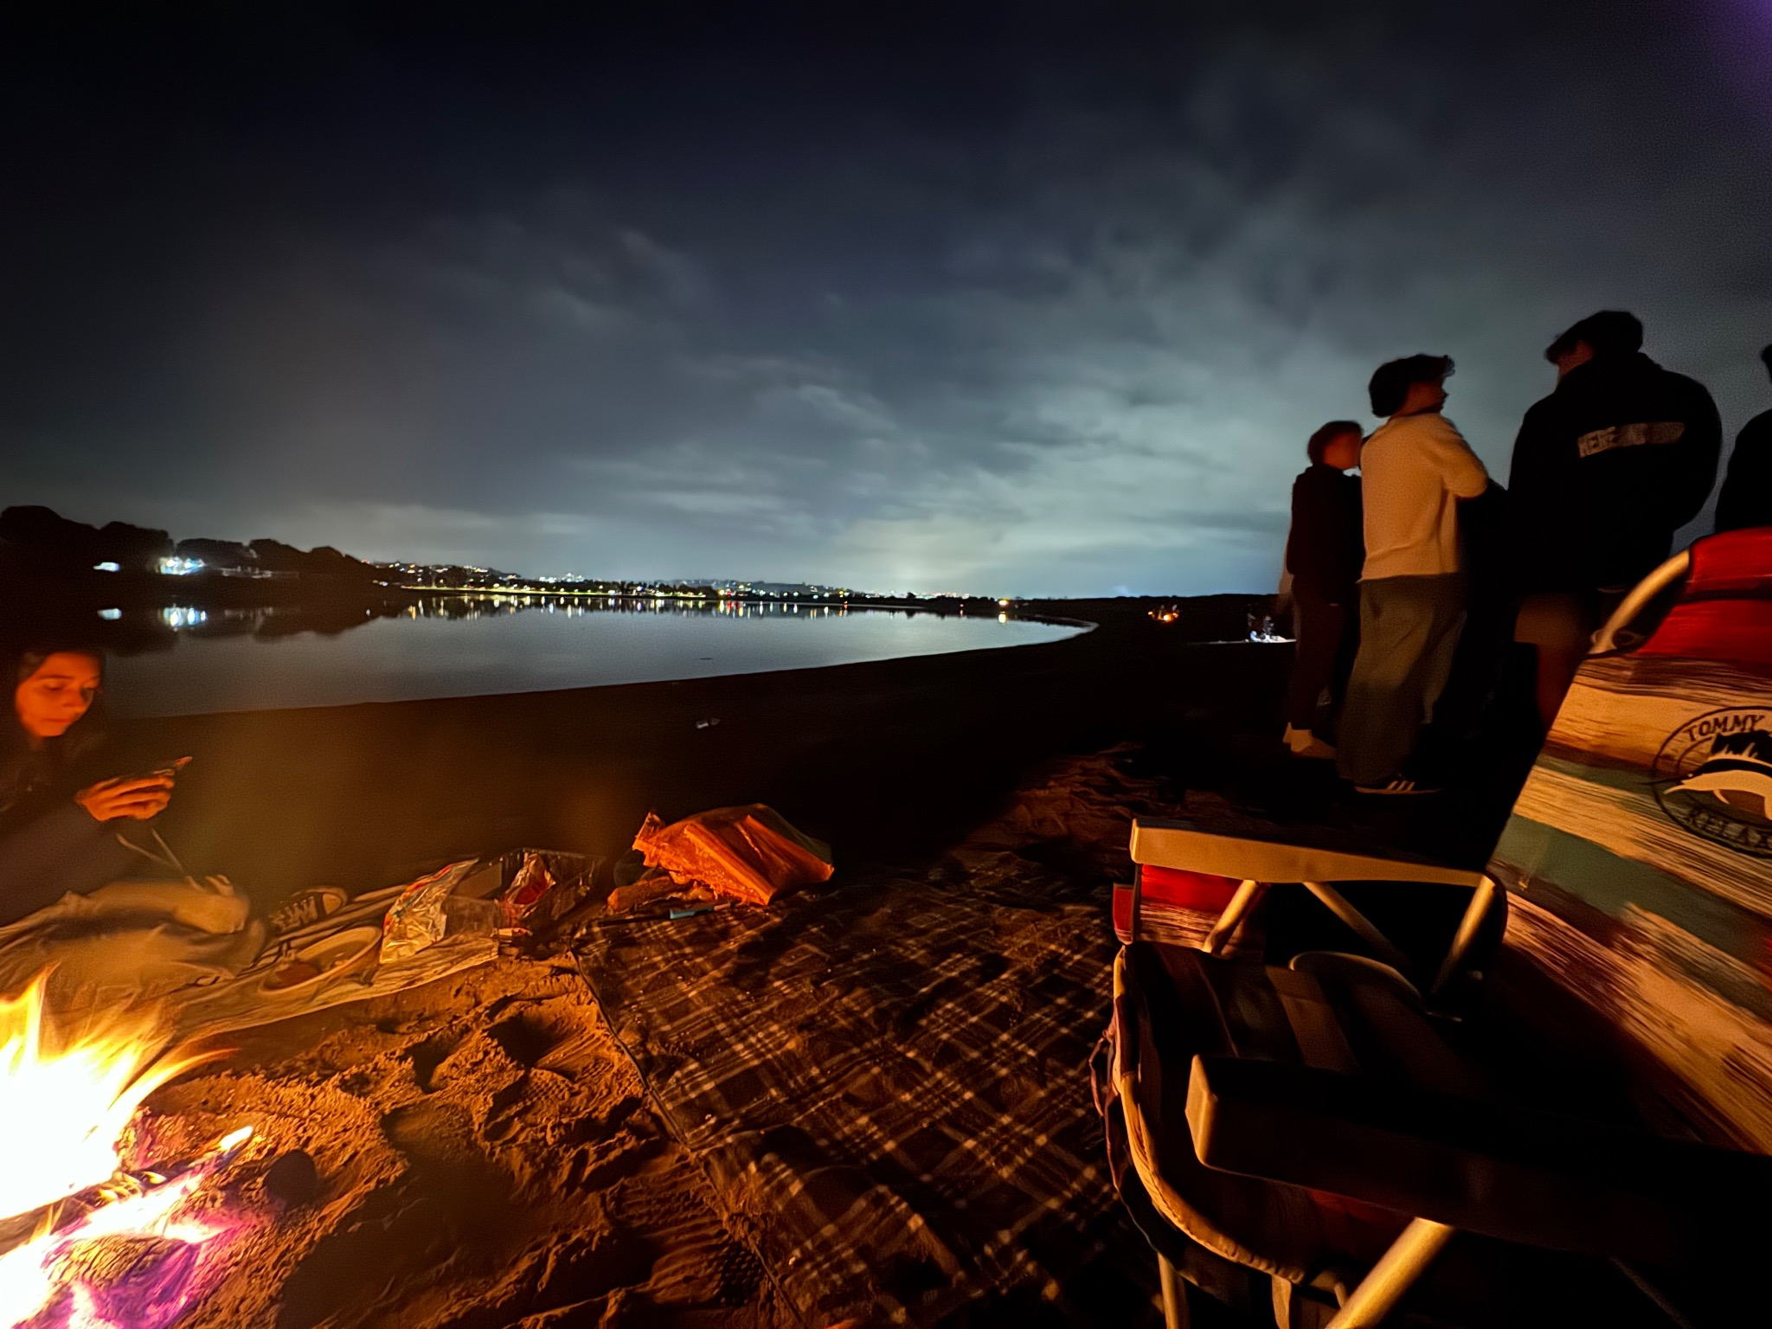
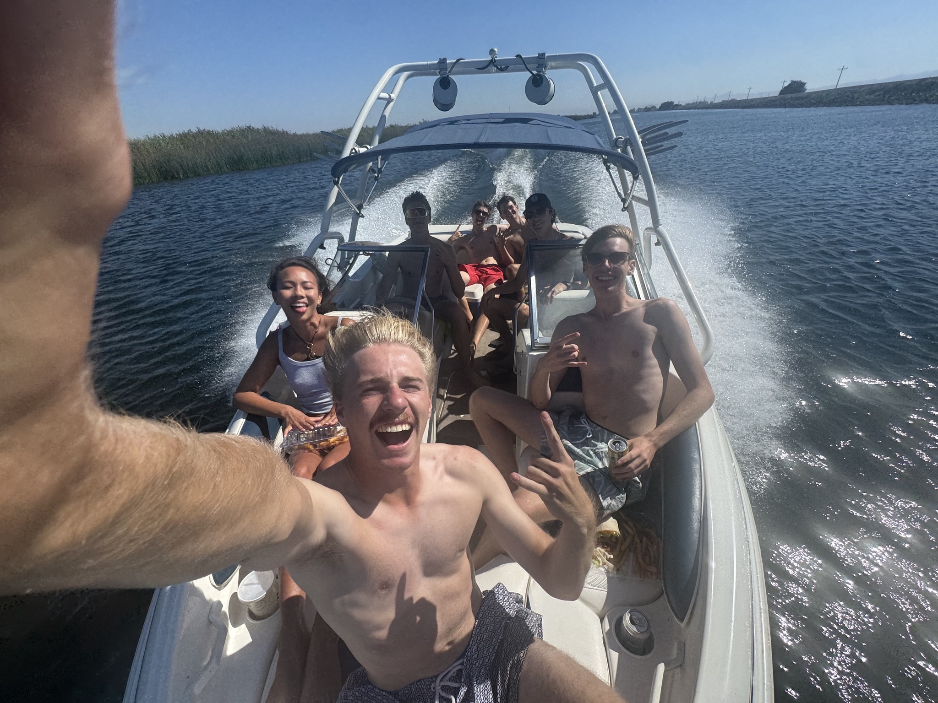
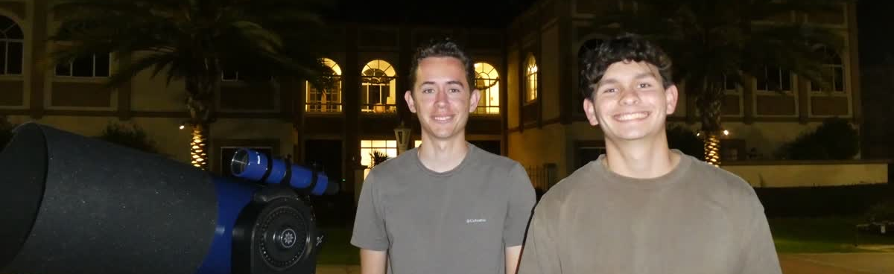
With friends & groups / What I want next semester
Positive experiences that touched my life
Mission Bay campfire
Exploring the night sky

Slide 4
Positive experiences that touched my life
What I’m grateful for this semester.
I flew to Catalina with a few of my closest friends.
It was a nice break from being in Sandiego

Slide 5
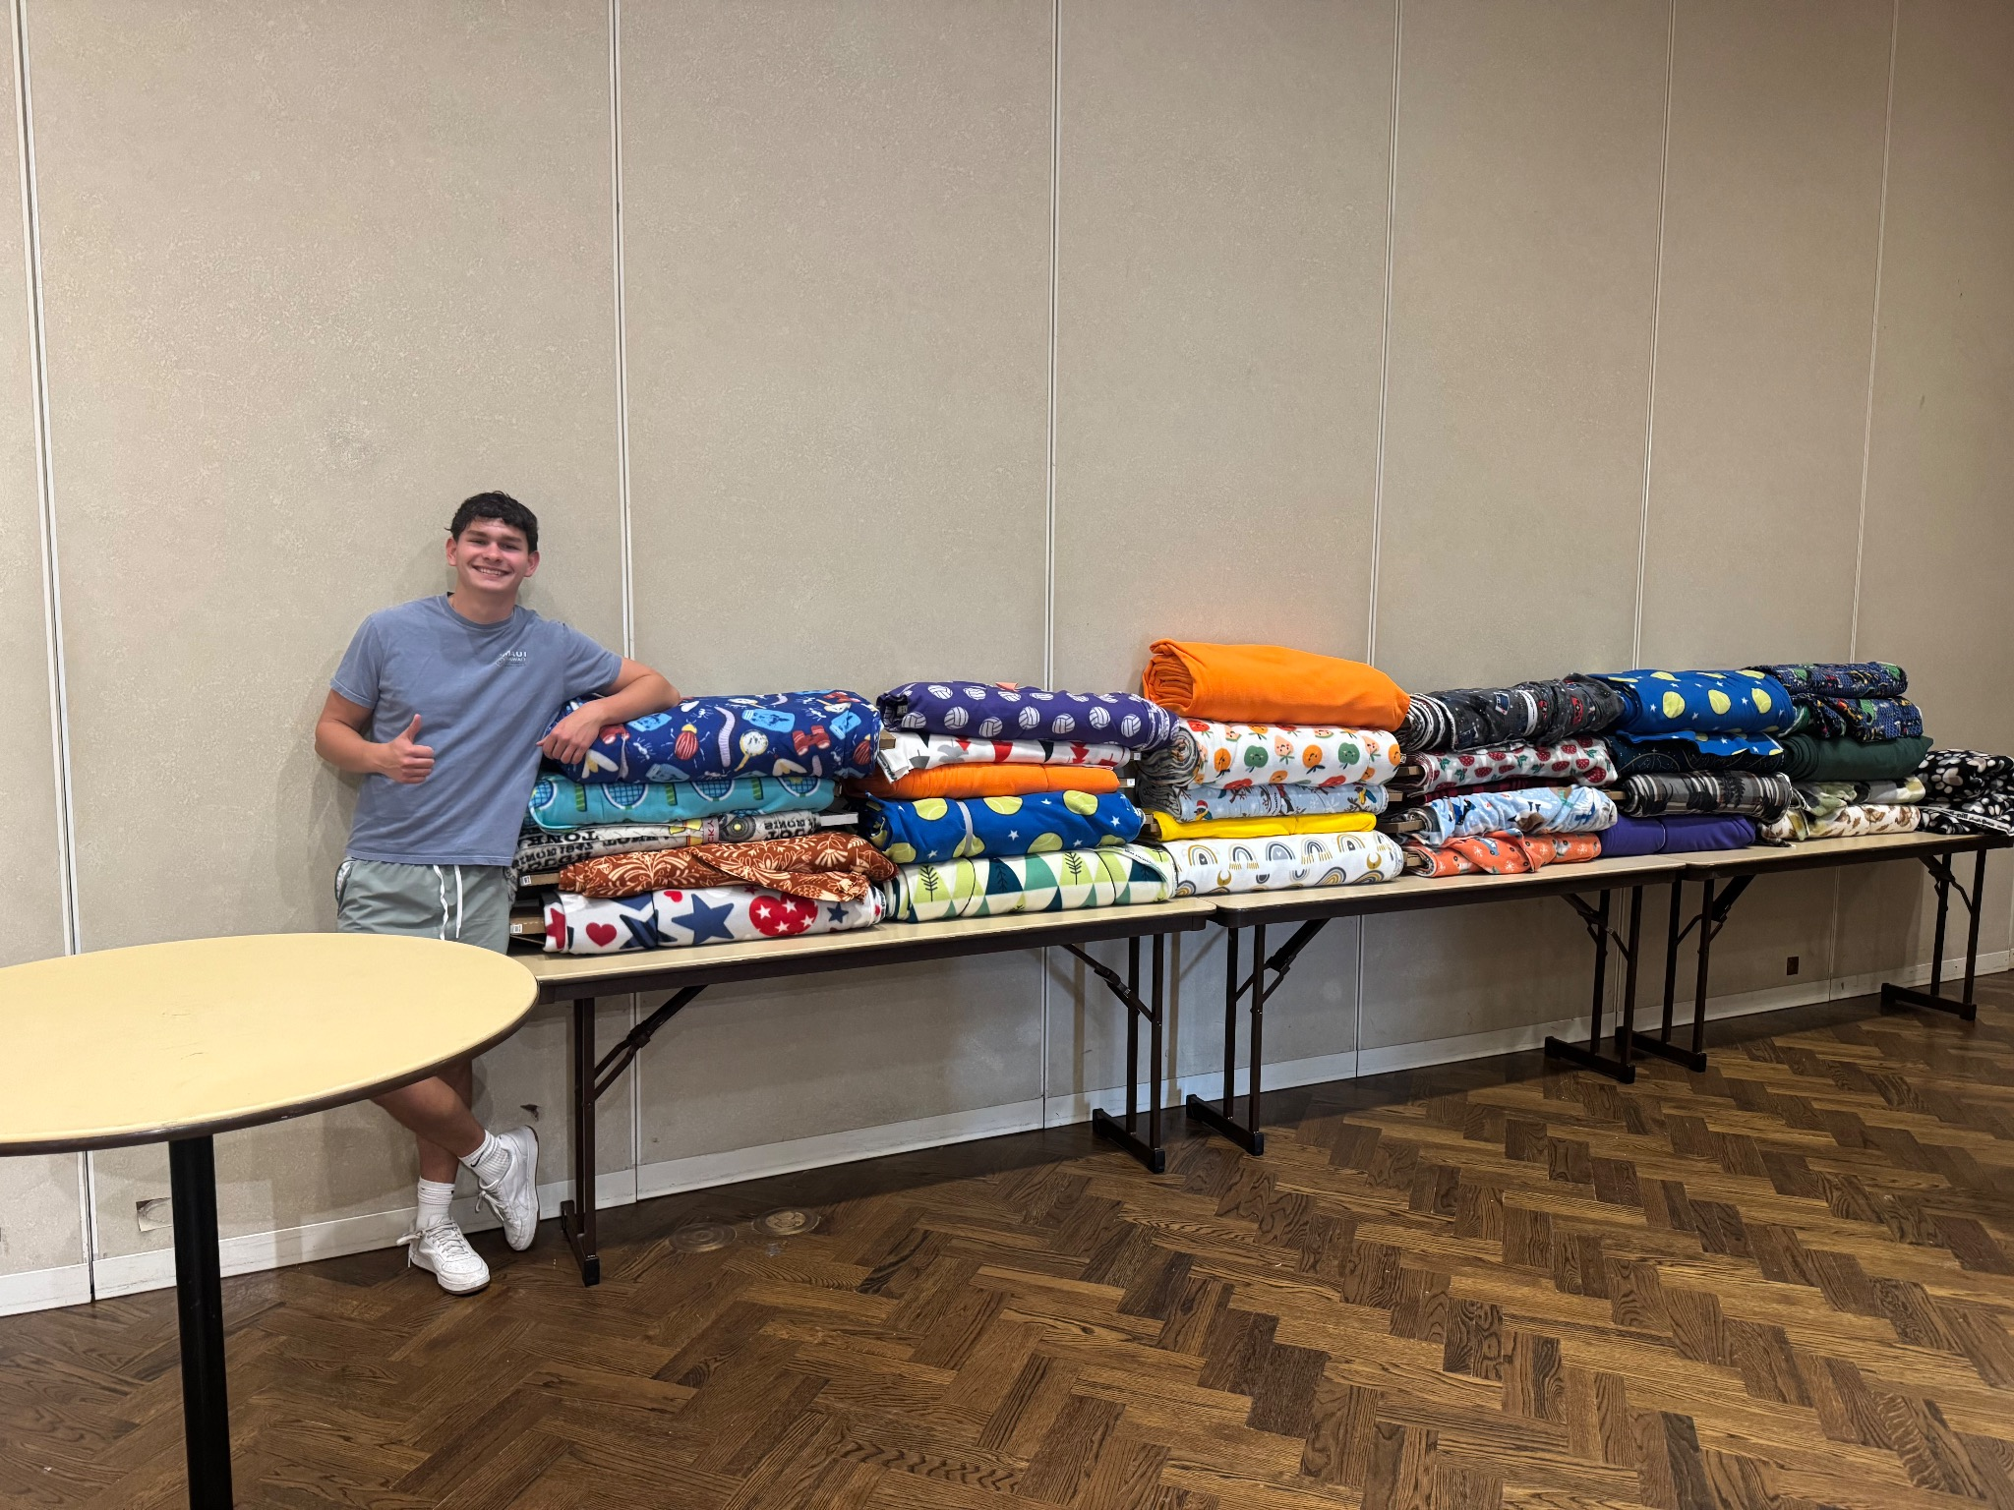
Creativity + kindness to help others
How people showed up for each other this semester.
Blanket drive: donating time/effort to help families stay warm.
Fun way to encourage student to help give back to the community

Slide 6
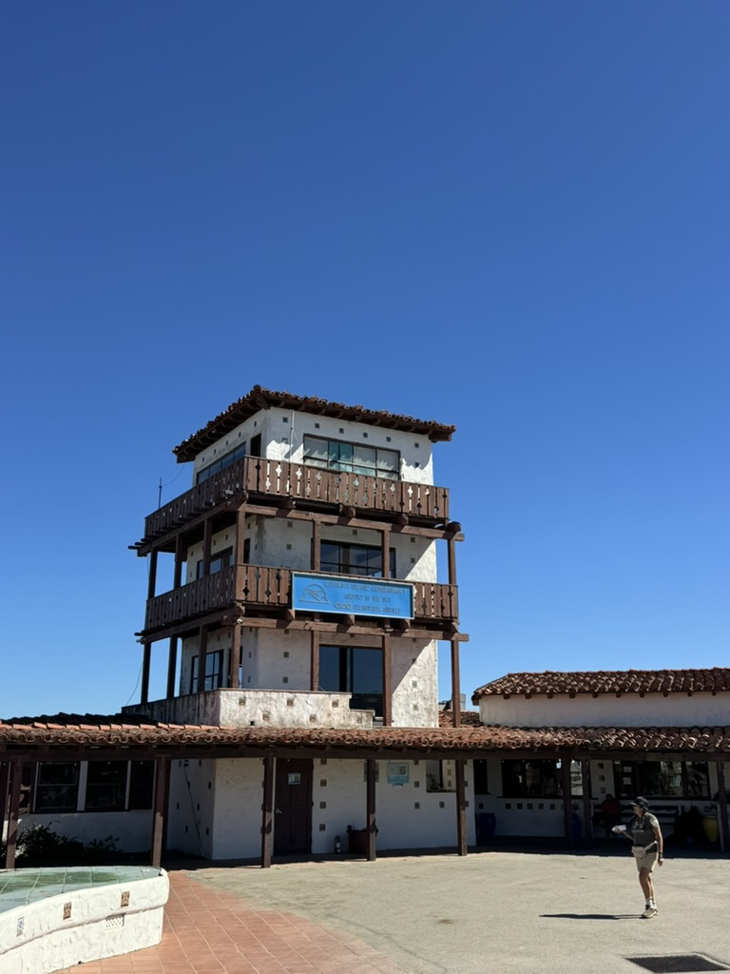
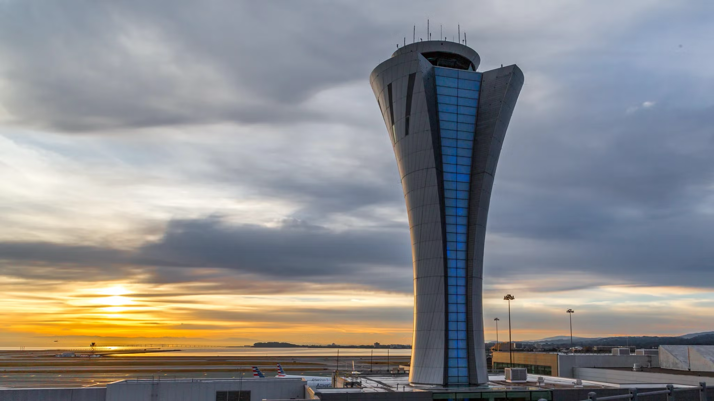
Changes to processes, rules, and routines
Things that felt different this semester (and how I adapted).
Old air traffic control tower on Catalina, which goes to show how far technology has advanced in recent years.
Catalina Island

Slide 7
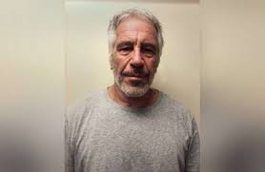
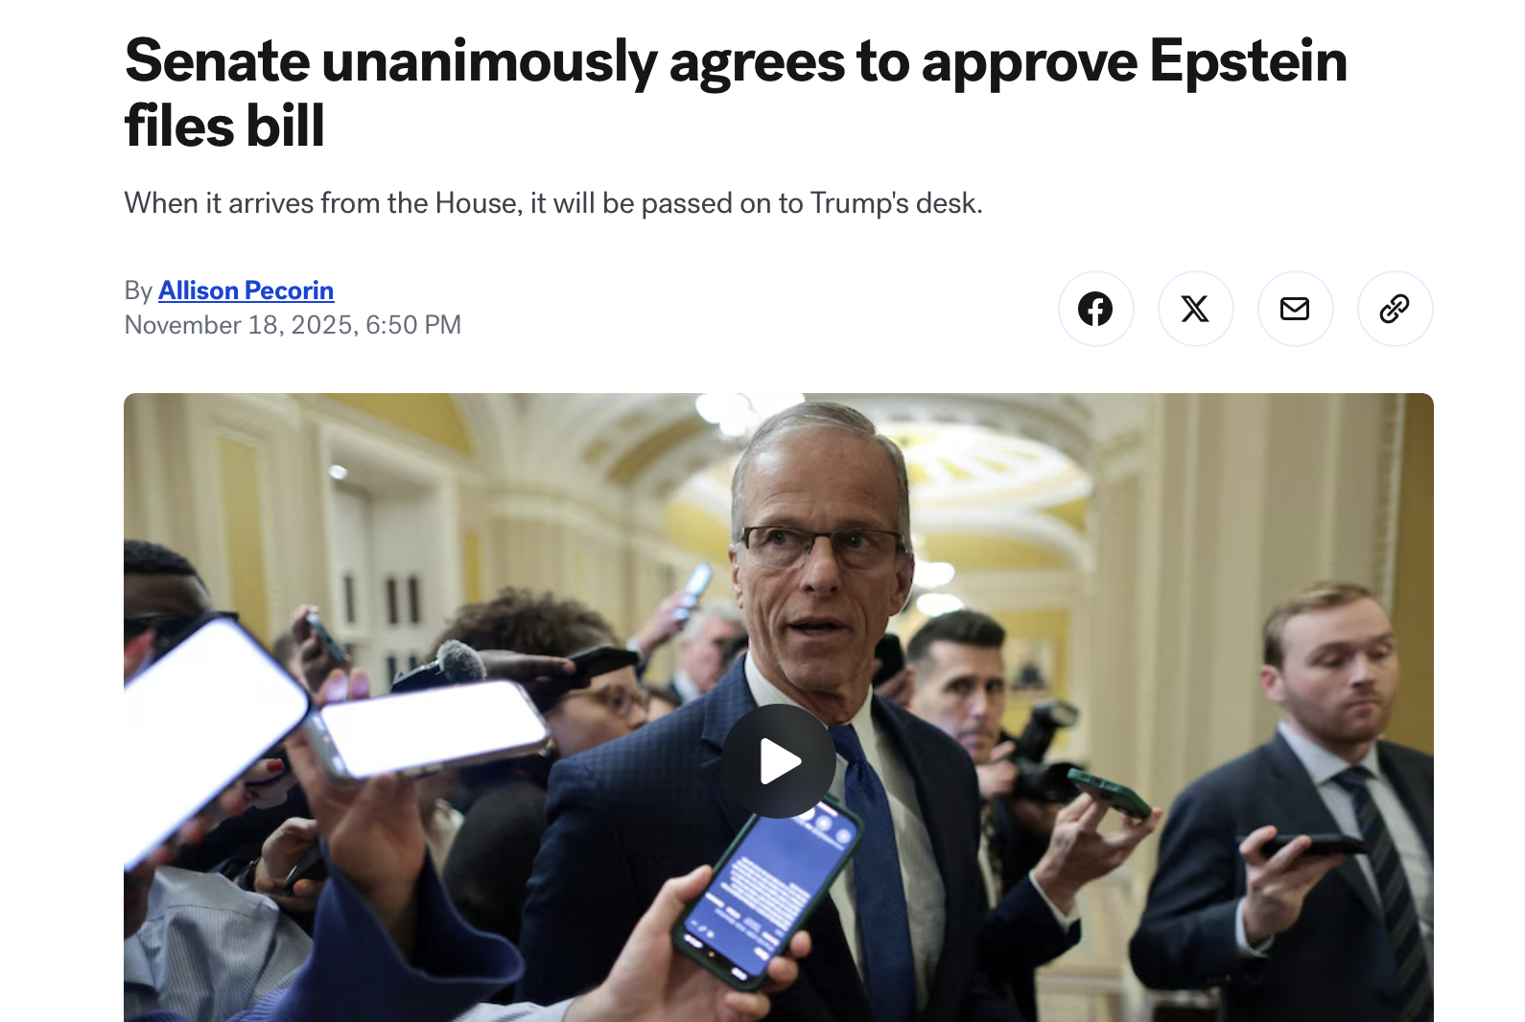
News, media, and messages
Jeffrey Epstein was a big element frequently on the news this semester, with his data base of clients on a list.
Hopefully his list gets released soon so we can get answers

Slide 8
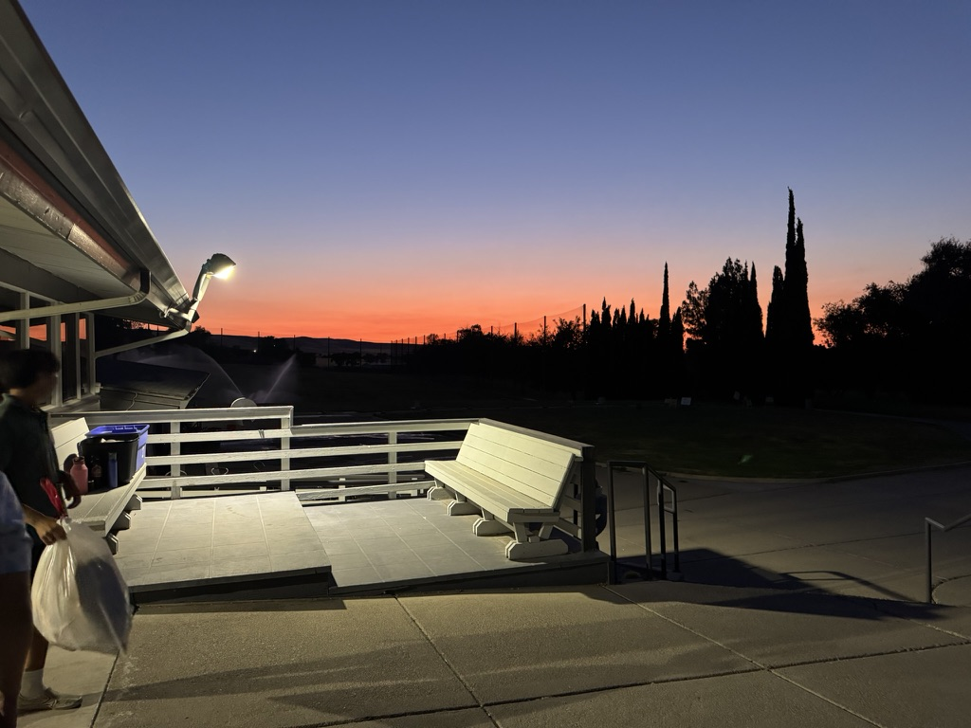
What didn't happen (but I wanted it to)
Not everything goes to plan — here’s what I expected and what I learned.
I wanted to get a Job but didn’t have the availability in my schedule. Watching the numbers in my bank go down made me sad.
I will get a job next summer
Photo from my old job

Slide 9
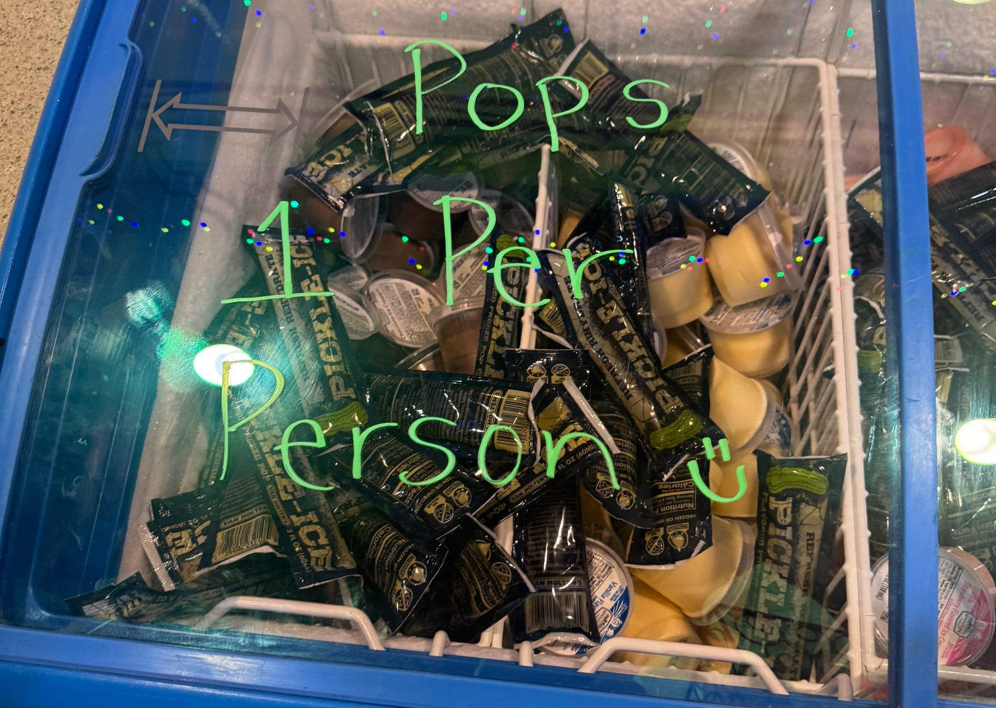
Hard moments I don't want repeated
Pickle Night.
Pickle Night was the most disgusting specialty food night at USD, I hope they never bring it back.
I don’t think I could ever eat a pickle again
These were called Pickle Pops.

Slide 10
Written Statement / Explanation
The first 4 slides satisfies:
· Items that you experienced that have touched your life this semester in an positive way
Items that happened in the semester individually, with friends, groups, locally, nationally
Other relevant items to discuss the semester you had, the semester you wanted, and the semesters that you wish to have in the future
Flying, baseball games, and friends made this semester better
The 7th slide satisfies:
Items that were highlighted by news, media advertisements/messages, government, other countries, other sources
Jeffery Epstein is a case with mystery and doubt and mistrust.
The 5th slide satisfies:
· Items that illustrates people’s creativity to assist others (i.e. drive by birthday parties)
It was a cool experience to help Dr. Rebman set up for the blanket drive
The 8th slide satisfies:
Items that did not happen that you wanted, expected
I wanted to get a job but I applied way too late in the semester.
The 6th slide satisfies:
· Items that illustrates changes to processes (buying food other items), laws/restrictions
I think its fascinating how far technology has progressed in
the last 75 years, comparing Catalina airport to San Francisco International
The 9th slide satisfies:
Items that you experienced that were sad or negative that you wish not to be experienced again
I wish to never experience pick night at University of Sandiego ever again

Slide 11
Closing thought
I learned lots of new things this semester and am excited for more

