Slide 1

1st Semester Time Capsule
Mohammed Alrabiah
Fall 2025

Slide 2
THINGS I GOT TO DO

Slide 3
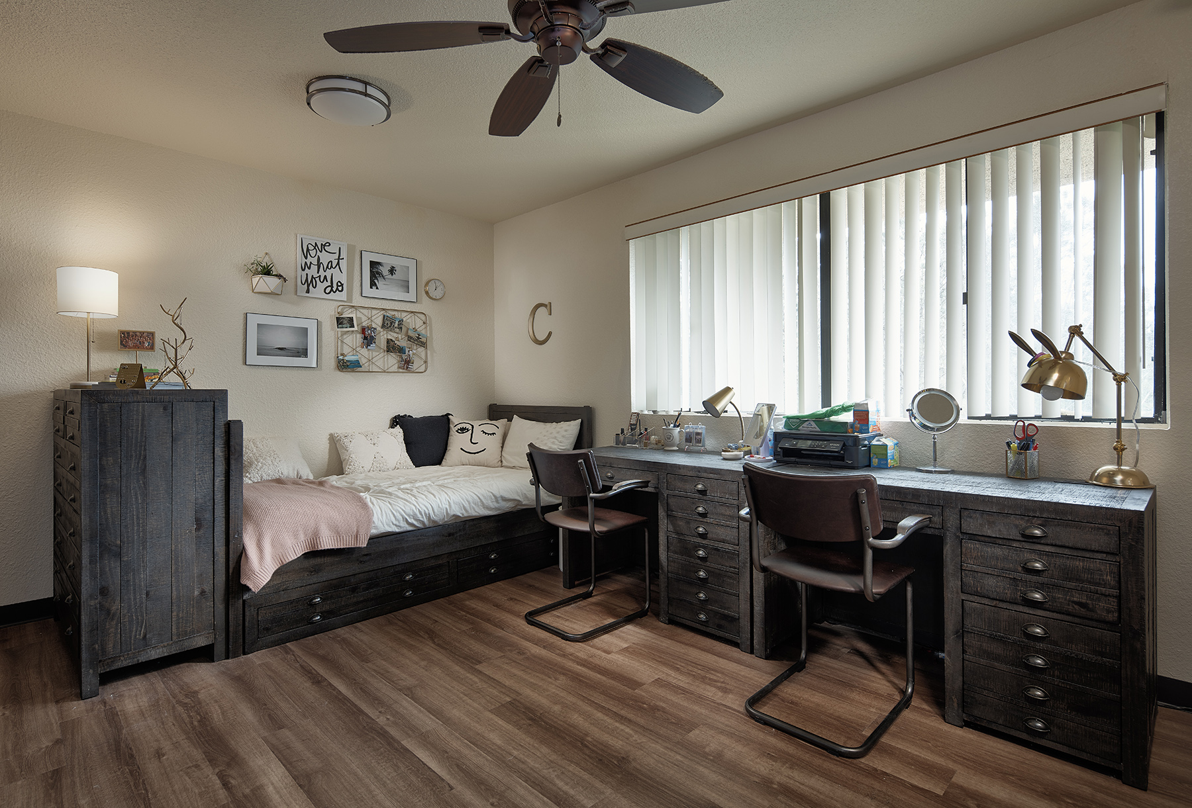
August 2025
Moved into college and experienced dorm life for the first time.

Slide 4
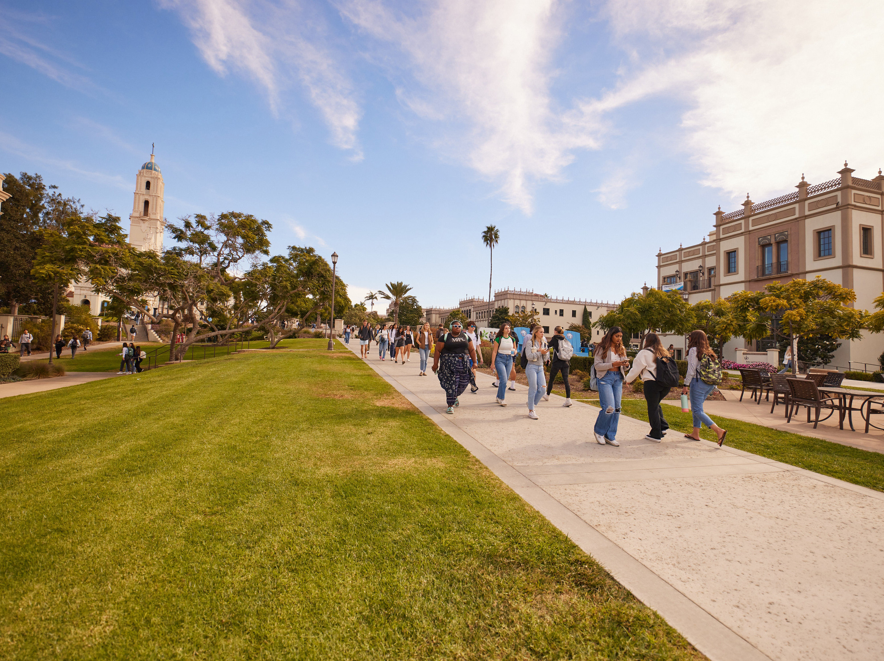
September 2025
Started building a routine around classes, workouts, and social life.

Slide 5
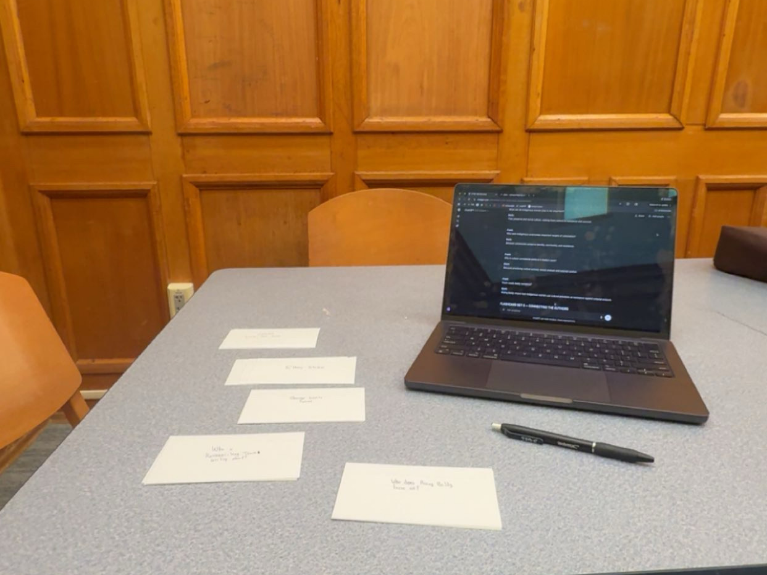
October 2025
Spent late nights studying and talking with friends.

Slide 6

November 2025
Campus started to feel familiar rather than overwhelming.

Slide 7
THINGS I DIDN’T GET TO DO

Slide 8
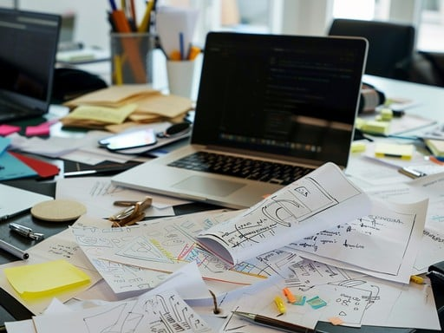
September 2025
Didn’t feel fully organized or productive right away.

Slide 9
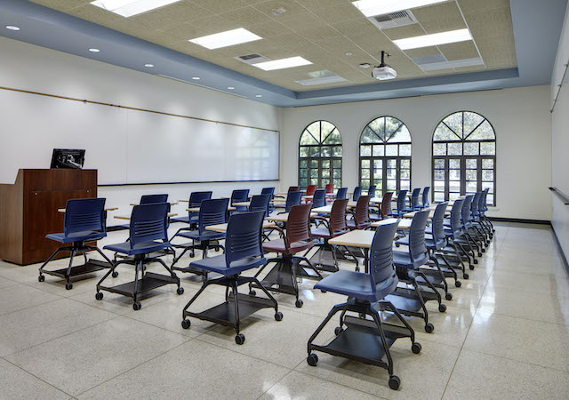
October 2025
Wasn’t as involved as I expected to be early in the semester.

Slide 10
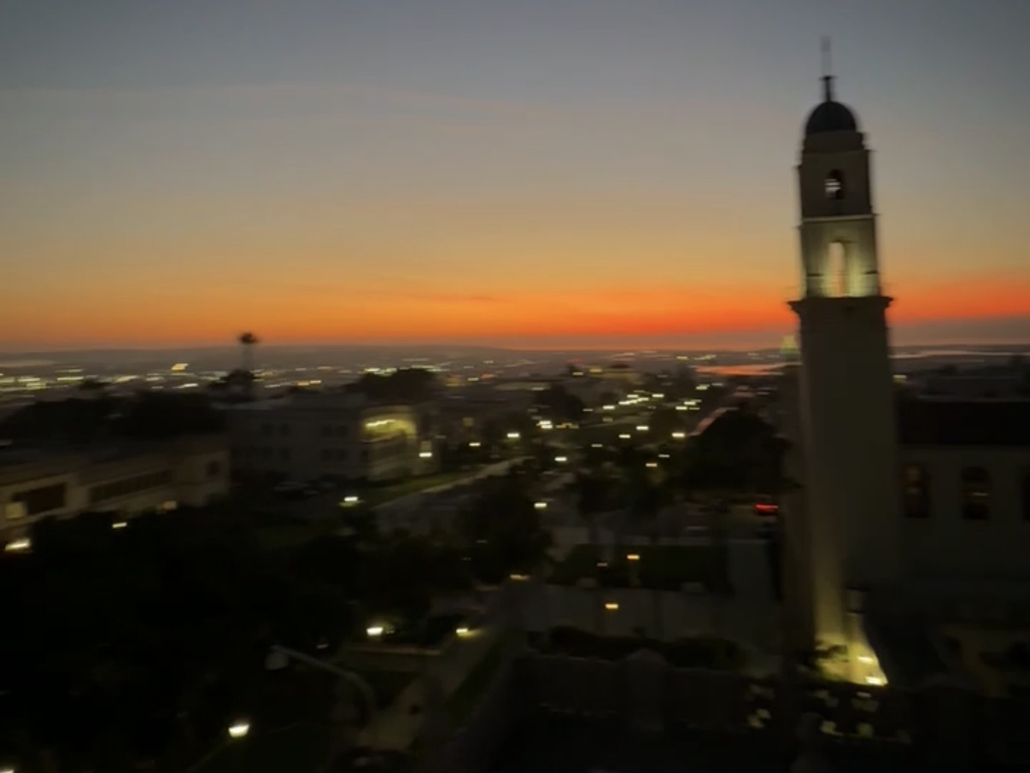
Throughout the Semester
Didn’t always give myself time to slow down.

Slide 11
THE POSITIVES

Slide 12
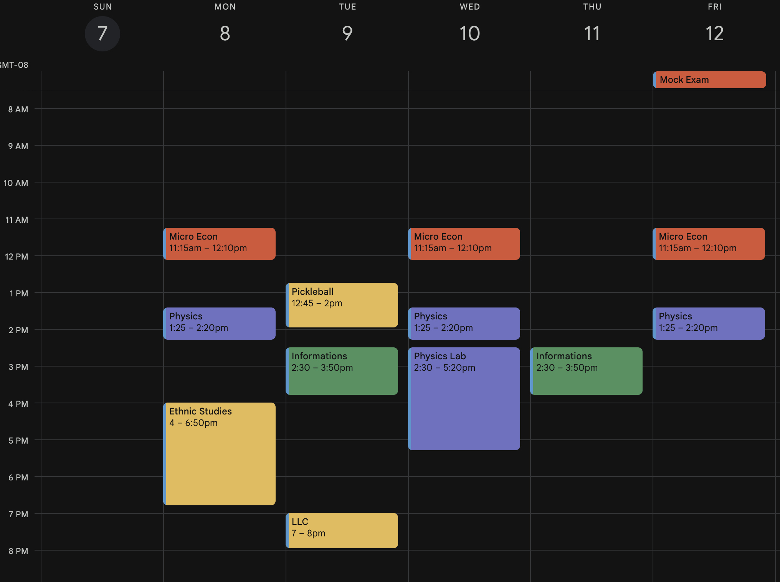
September 2025
Gained independence by managing my own schedule.

Slide 13
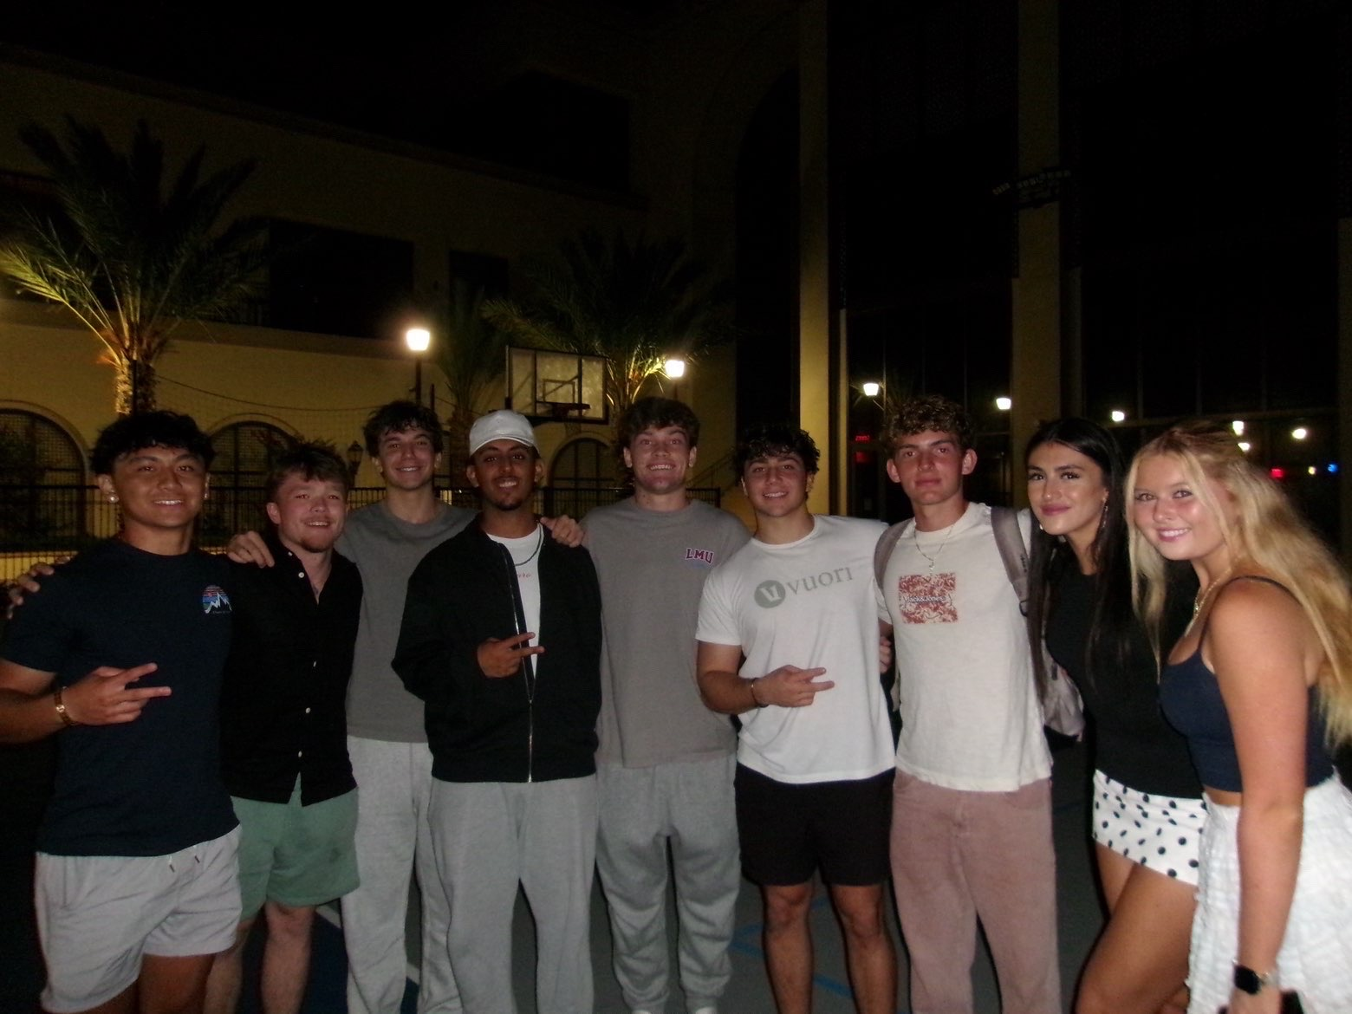
October 2025
Built friendships that made college feel easier.

Slide 14
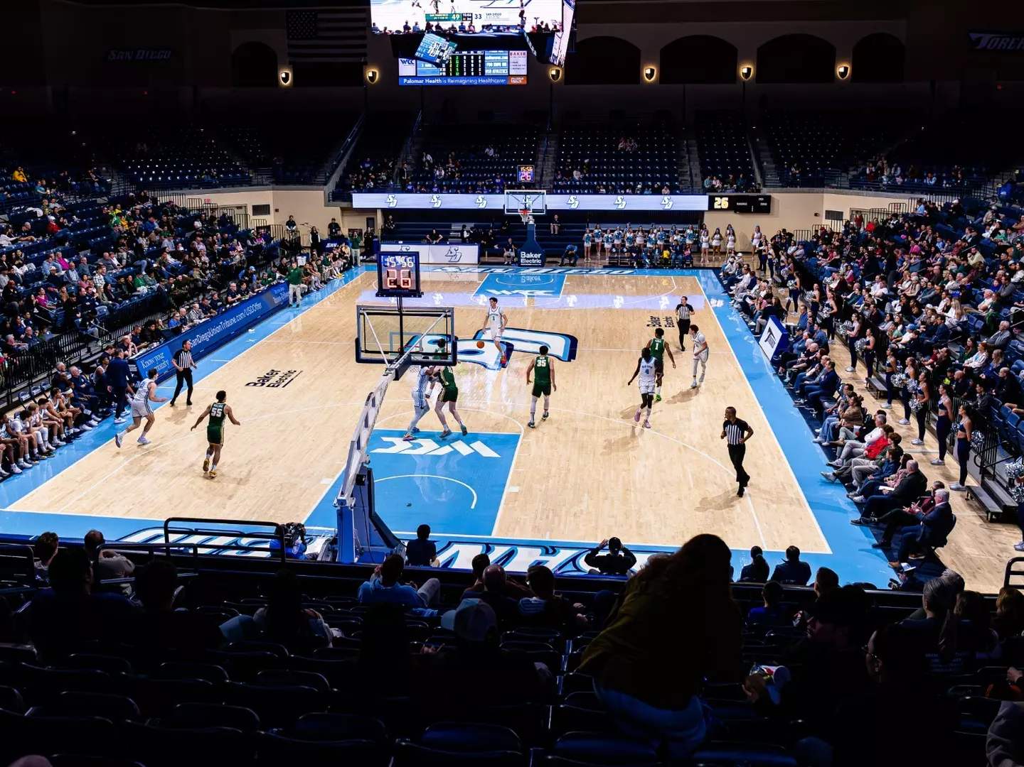
November 2025
Found comfort in routines during stressful weeks.

Slide 15
SAD / DIFFICULT MOMENTS

Slide 16
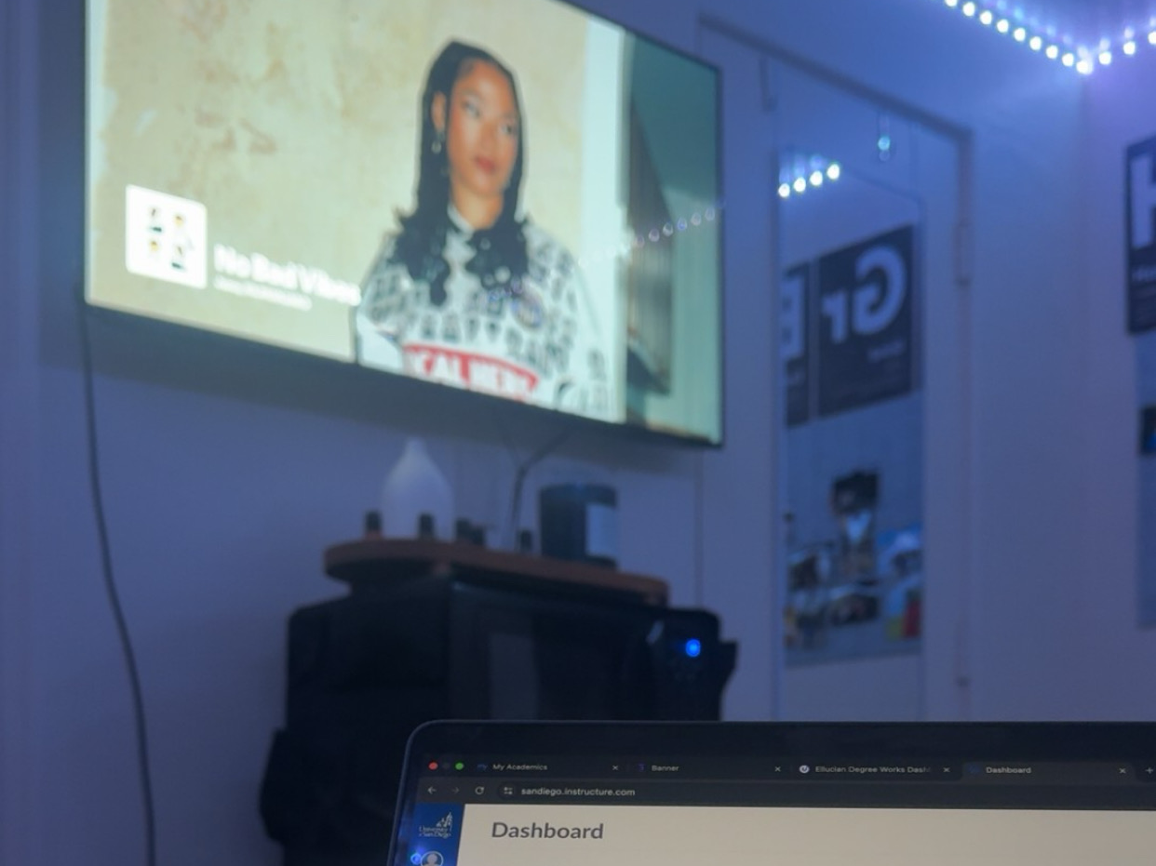
September 2025
Homesickness showed up during quiet moments.

Slide 17
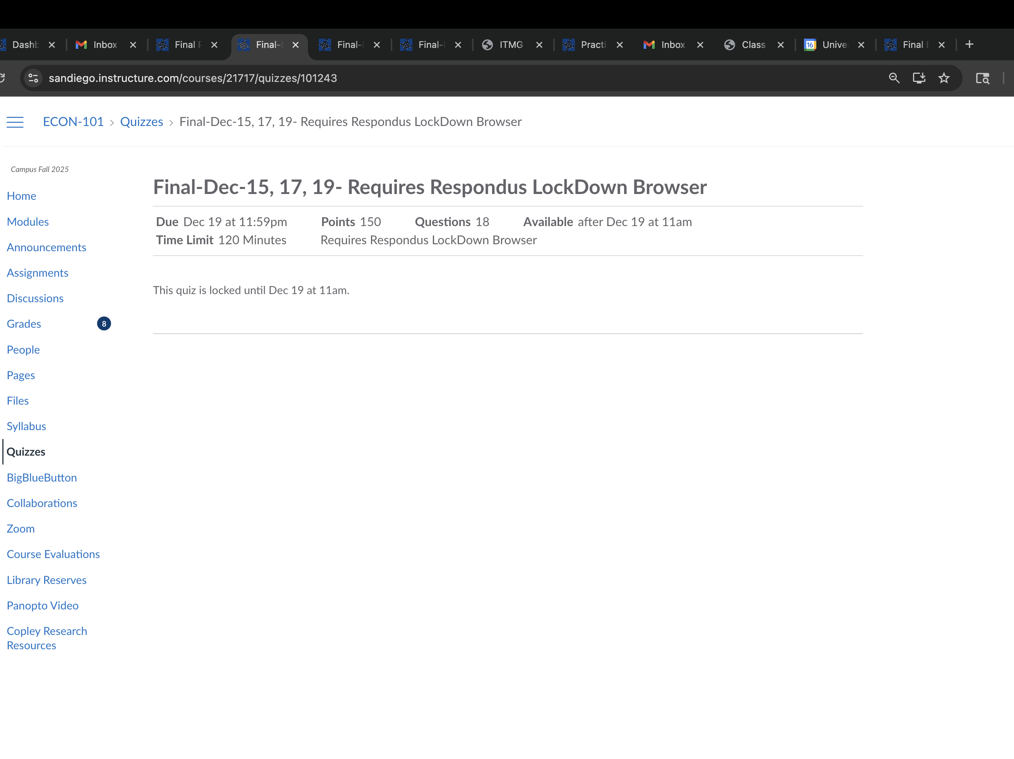
October 2025
Deadlines piling up caused mental fatigue.

Slide 18
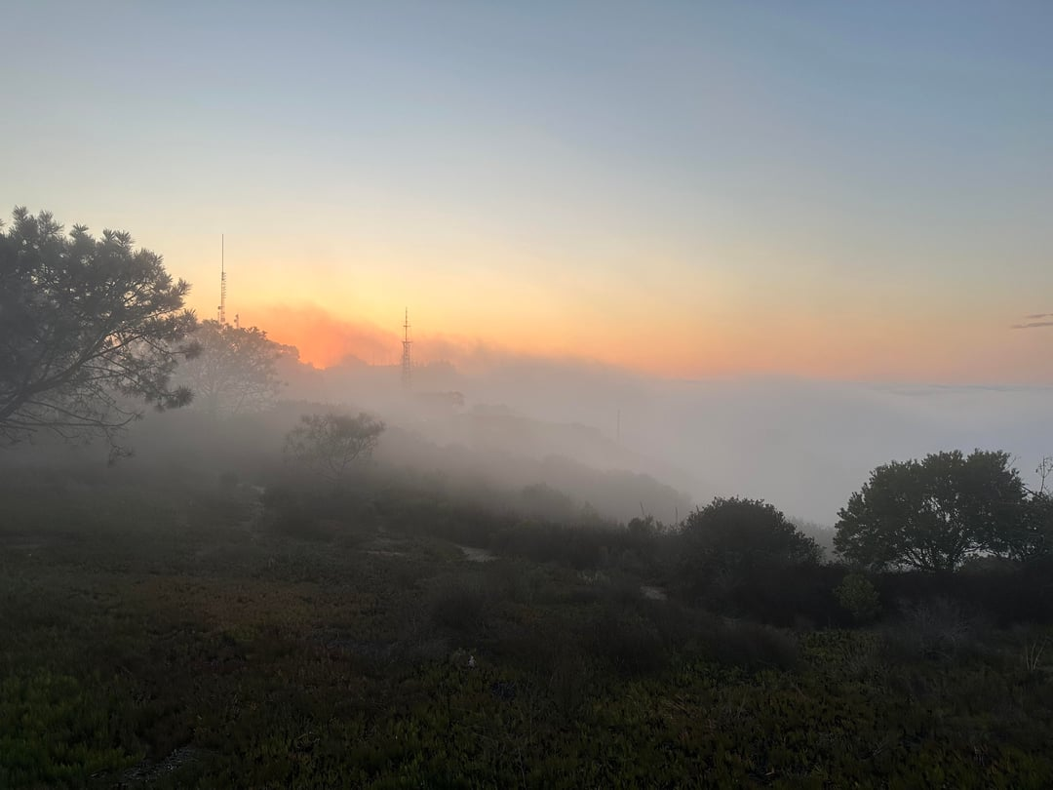
November 2025
Some weeks were more about surviving than excelling.

Slide 19
WHAT HAPPENED IN THE WORLD

Slide 20

Fall 2025
Constant exposure to global news through my phone.

Slide 21


1,200 × 800
Fall 2025
Technology made it harder to disconnect.

Slide 22
CHANGES TO THE WAY I LIVE

Slide 23

Fall 2025
Assignments and communication moved fully online.

Slide 24

Fall 2025
Apps replaced memory for deadlines and reminders.

Slide 25
CREATIVITY & SUPPORT

Slide 26
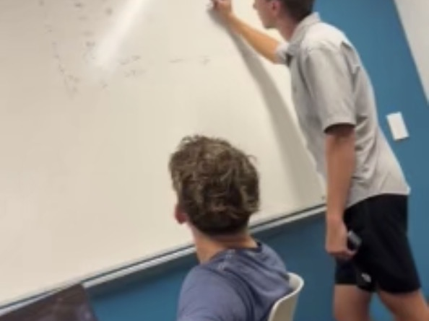
Throughout the Semester
Friends helped each other with notes and reminders.

Slide 27
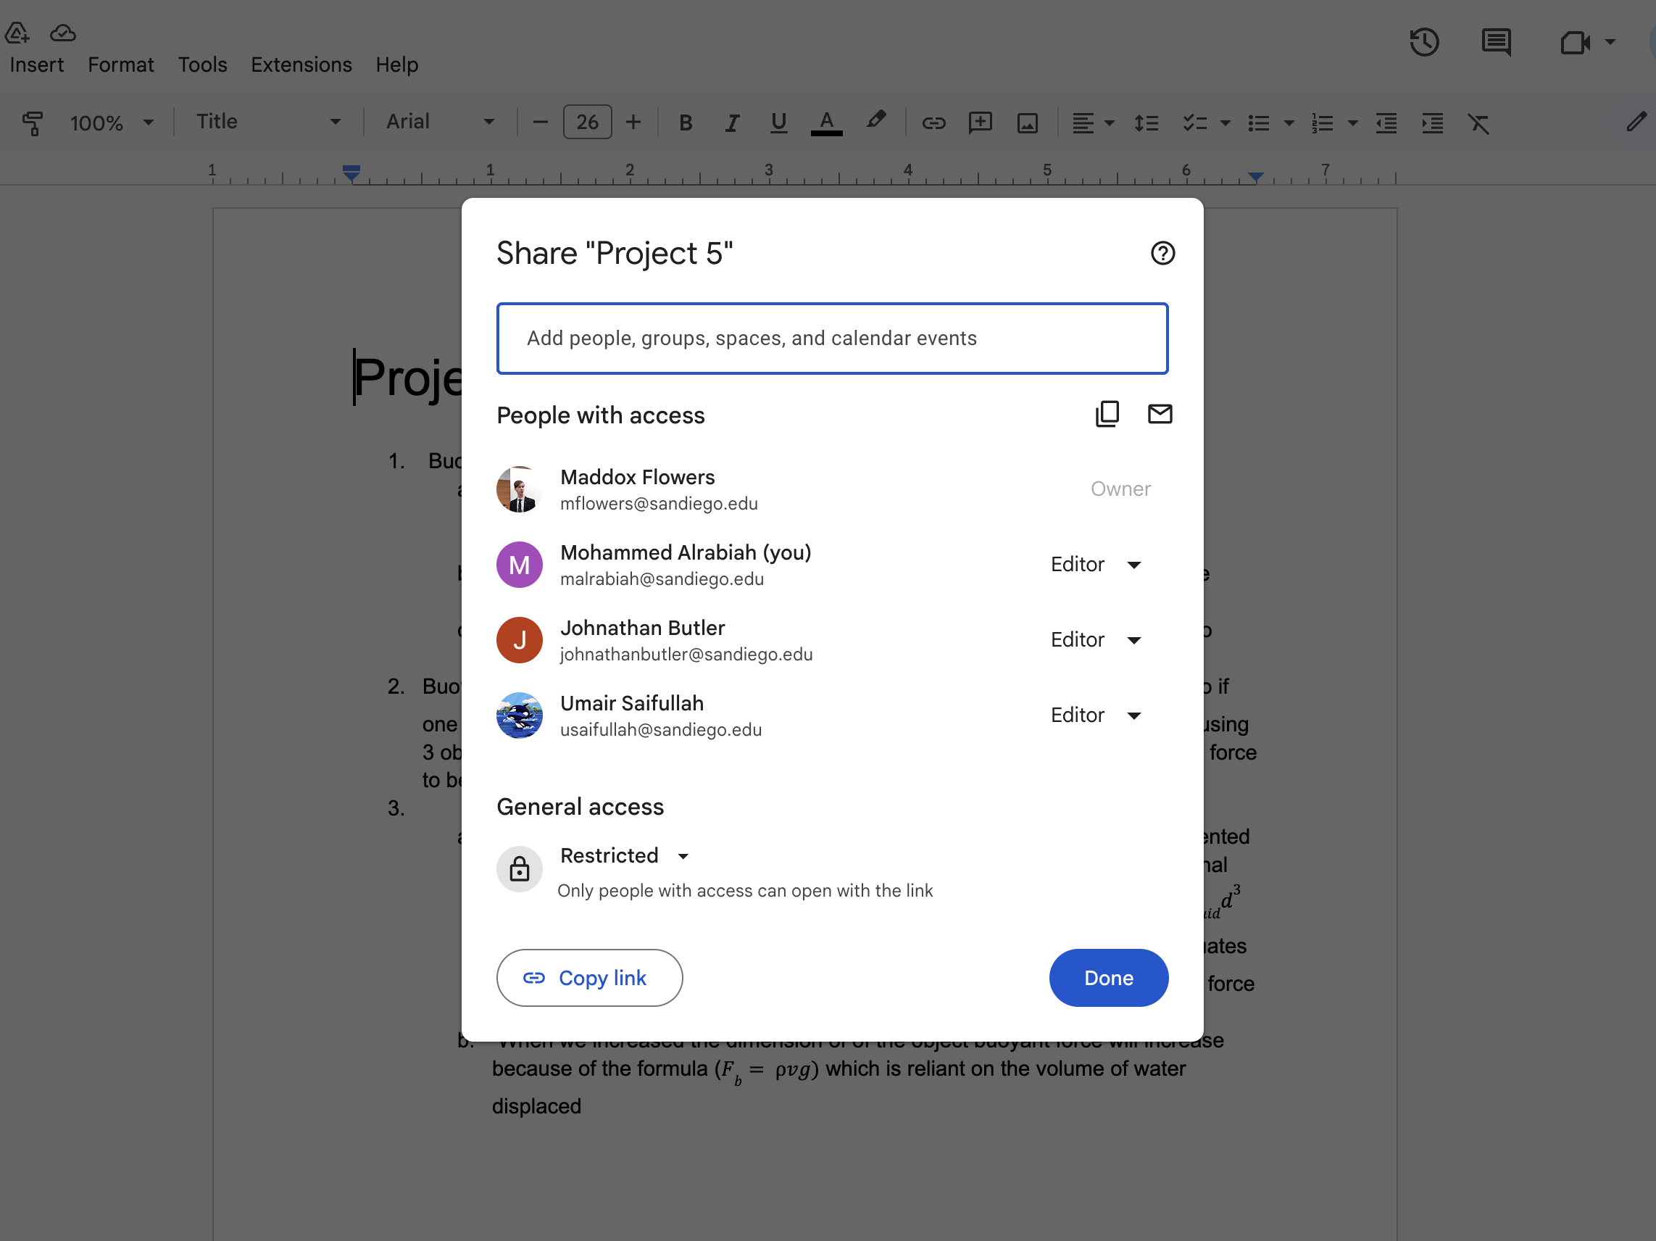
Throughout the Semester
Technology made collaboration easier.

Slide 28
LOOKING FORWARD

Slide 29

Spring 2026
I want to use technology more intentionally.

Slide 30

Looking Back
This semester wasn’t about perfection — it was about adjustment.

