Slide 1




Time Capsule
Sophia Sung

Slide 2
Items that happened in the semester individually, with friends, groups, locally, nationally

Slide 3

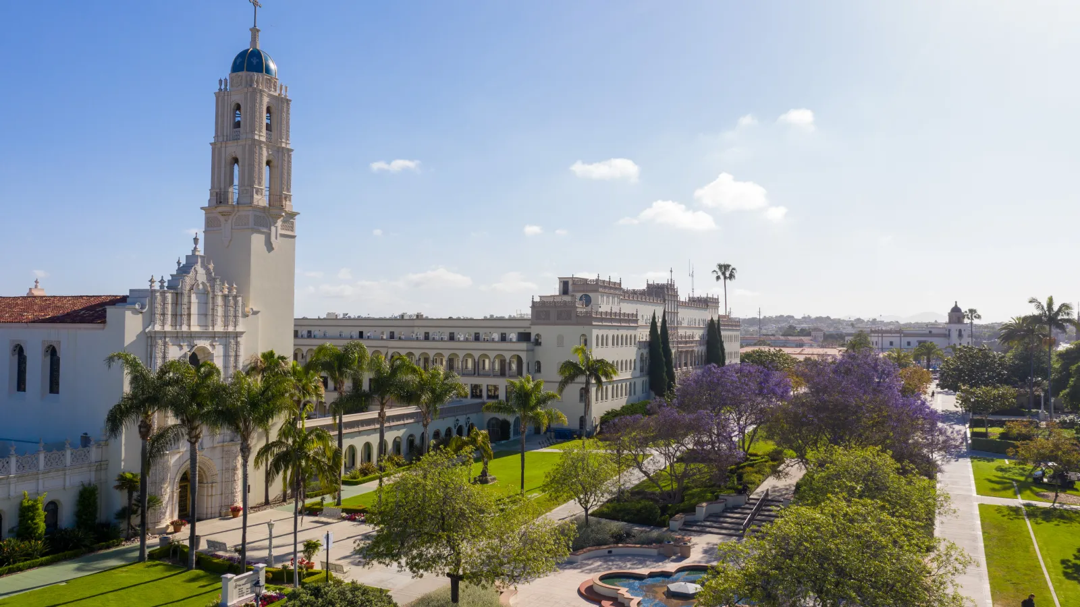
Notes:
This semester at USD has been such a unique experience–I’ve met so many amazing people, and I’ve learned so much, and I’ve seen and gone to places that were really eye-opening.

Slide 4
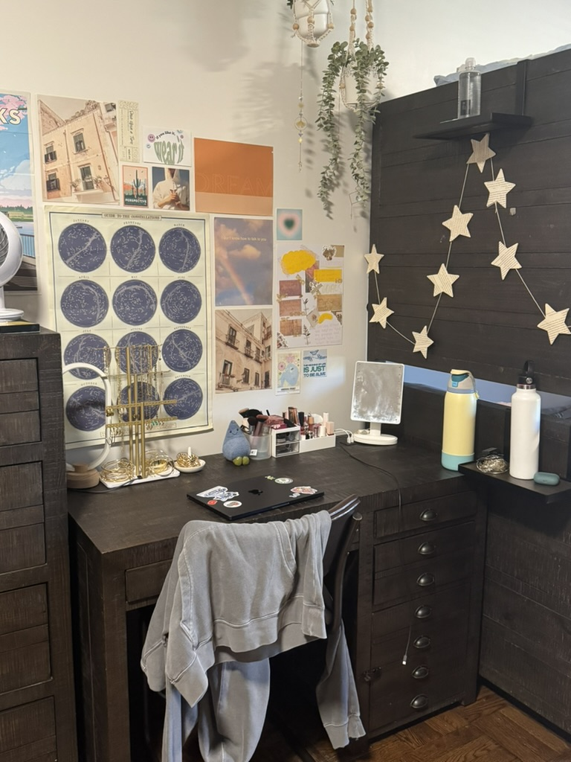

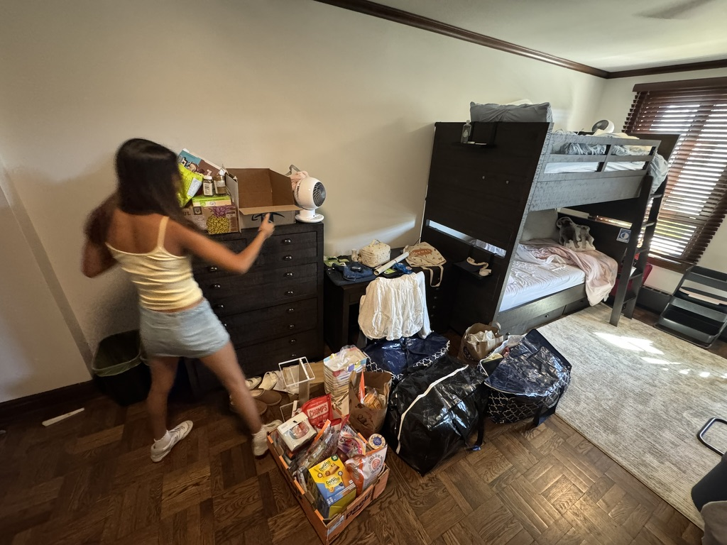
Notes:
I arrived to USD two weeks earlier than the other incoming freshmen because I became a part of a program called College Corps, which is a volunteering program at our school.

Slide 5
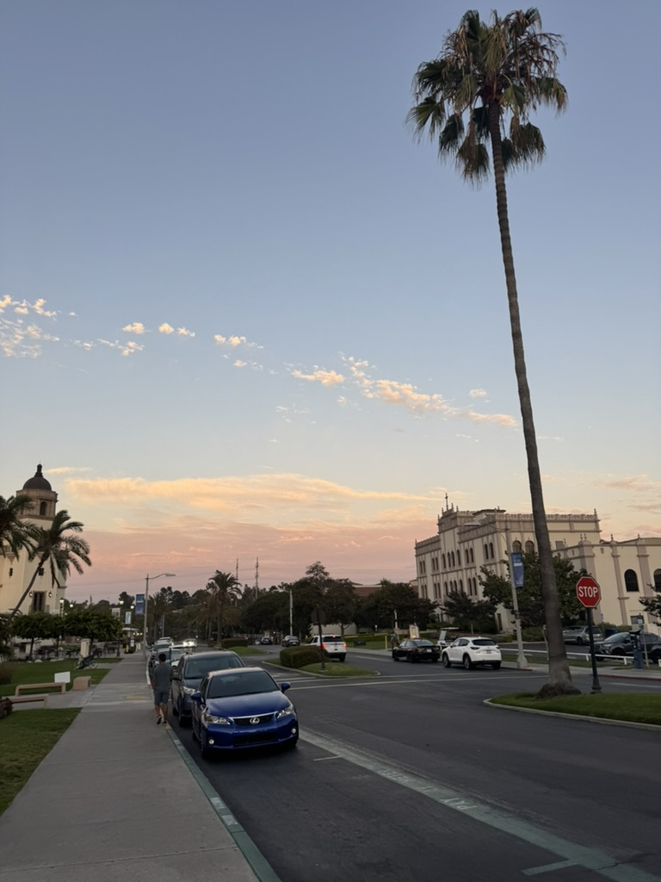
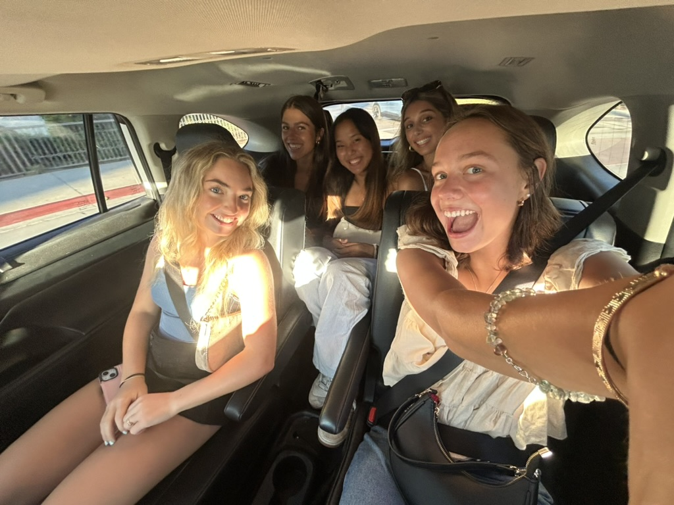

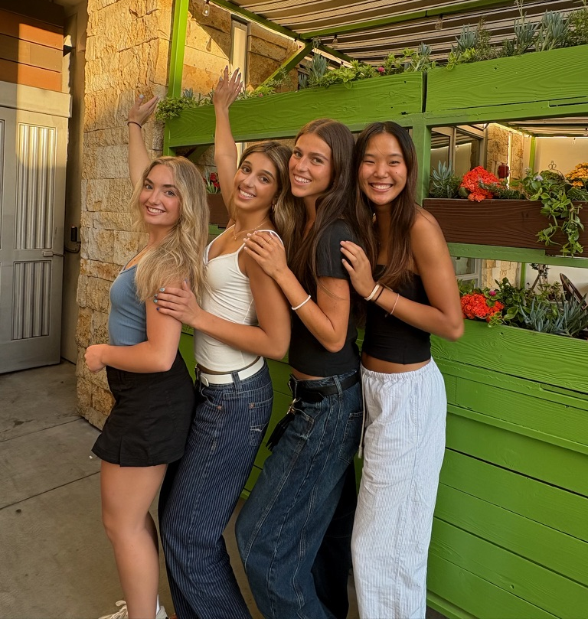
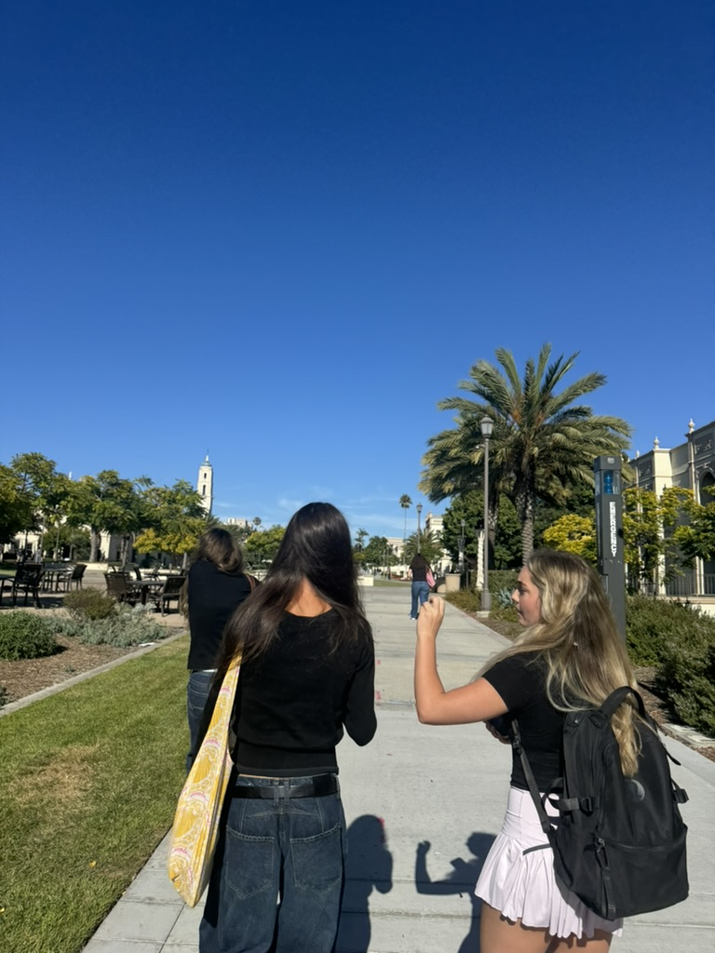

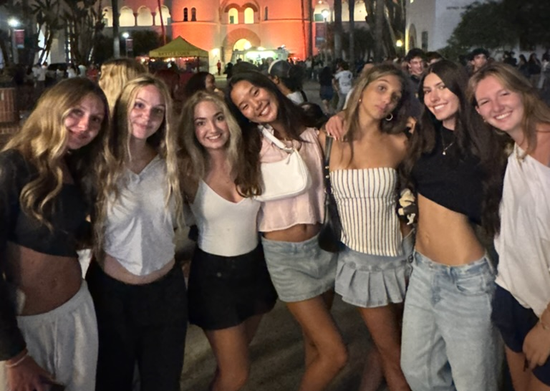
Notes:
I was really intimidated at first, but I met the sweetest people there and developed a support system that I could rely on and turn to when I needed advice or help.

Slide 6

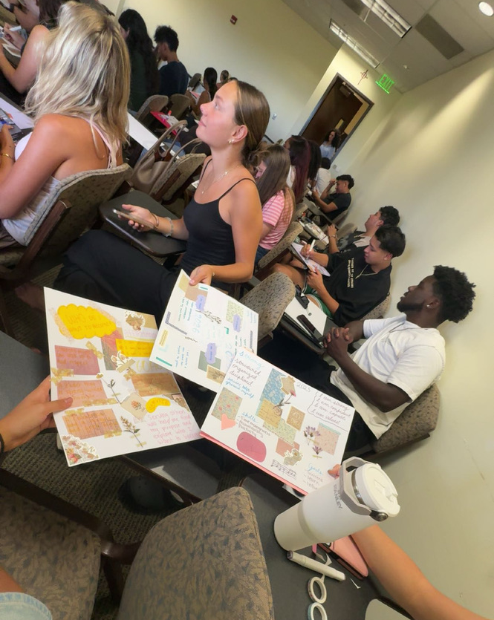
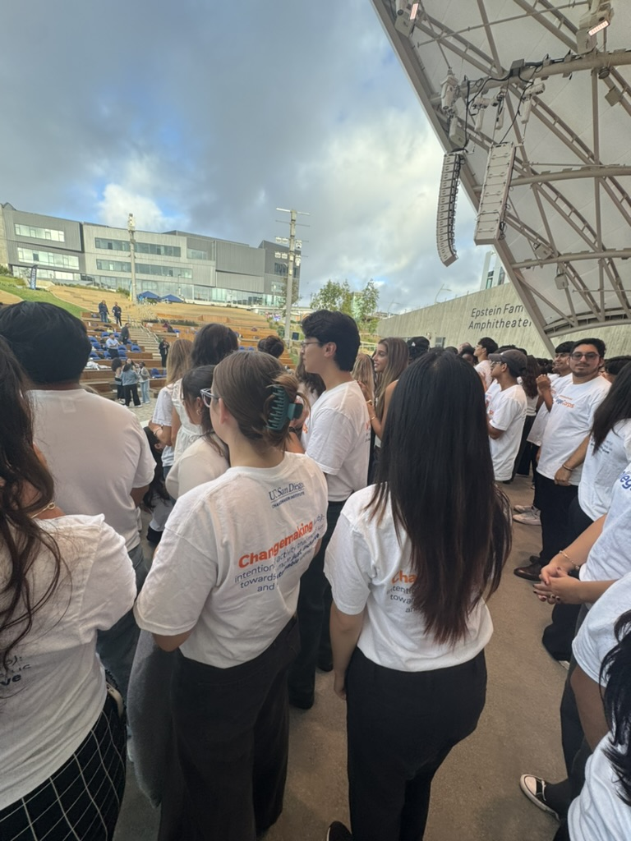
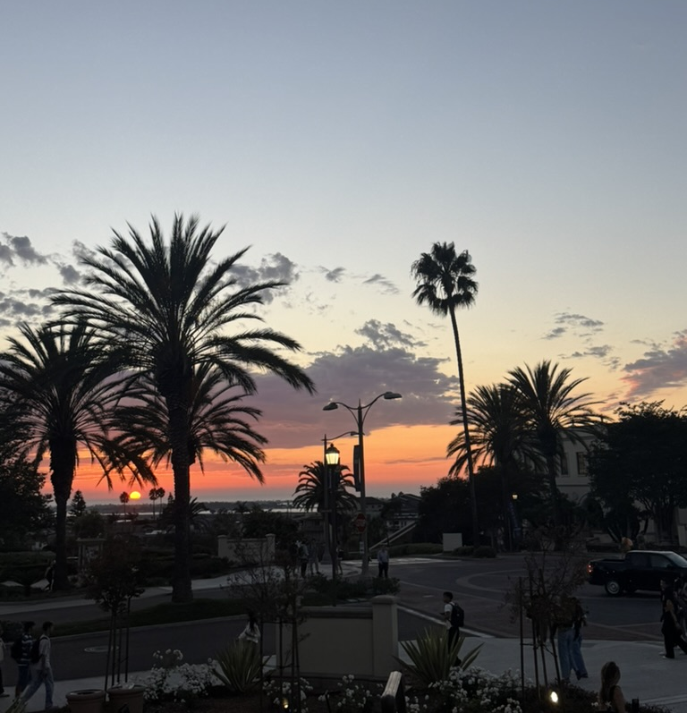
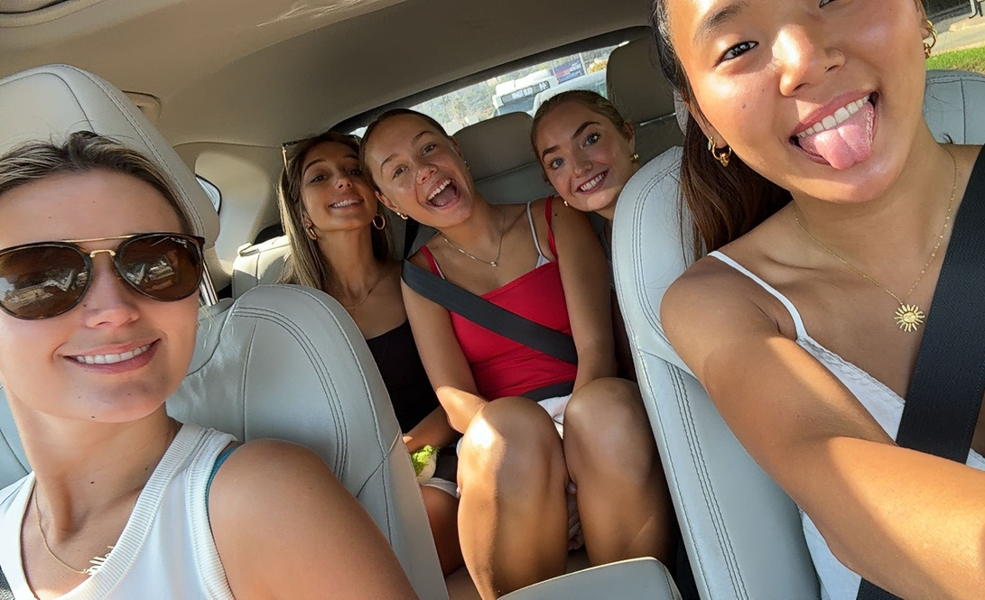
Notes:
It definitely had its ups and downs. I was really overwhelmed with all the people I was meeting at once and everything I was learning, and we were also forced to train for long hours during the day. But I honestly have no regrets and enjoyed the experience.

Slide 7
Items that did not happen that you wanted, expected

Slide 8
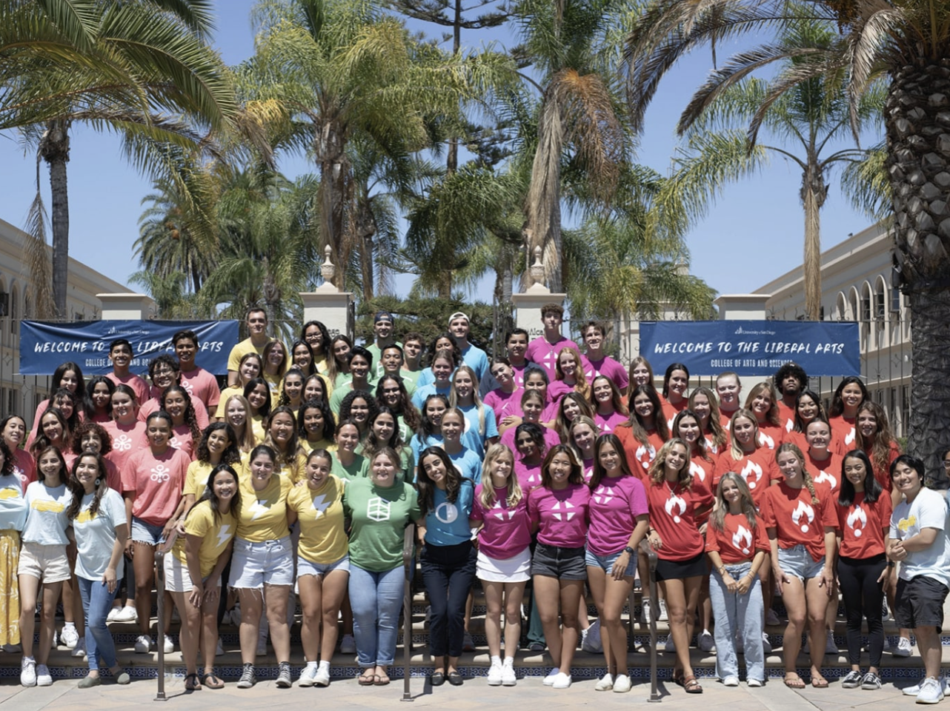
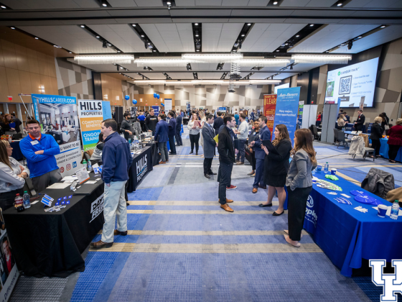
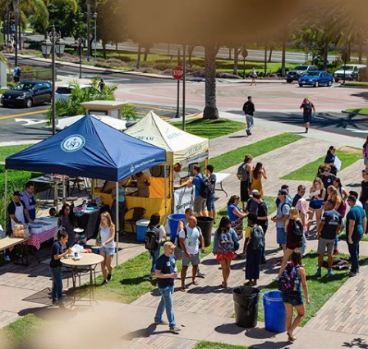
Notes:
Reflecting on this semester, I wish that I had involved myself more with the USD community through joining clubs and consistently participating in a variety of campus events and activities. At the beginning, I was definitely ambitious and joined lots of organizations but when there were actual events, I always found myself busy with work, school, or simply being too tired to attend. In the future, I’ll make it a point to commit to the clubs I join, instead of just being a passive member so that I can meet others and explore my interests.

Slide 9
Items that you experienced that have touched your life this semester in an positive way

Slide 10

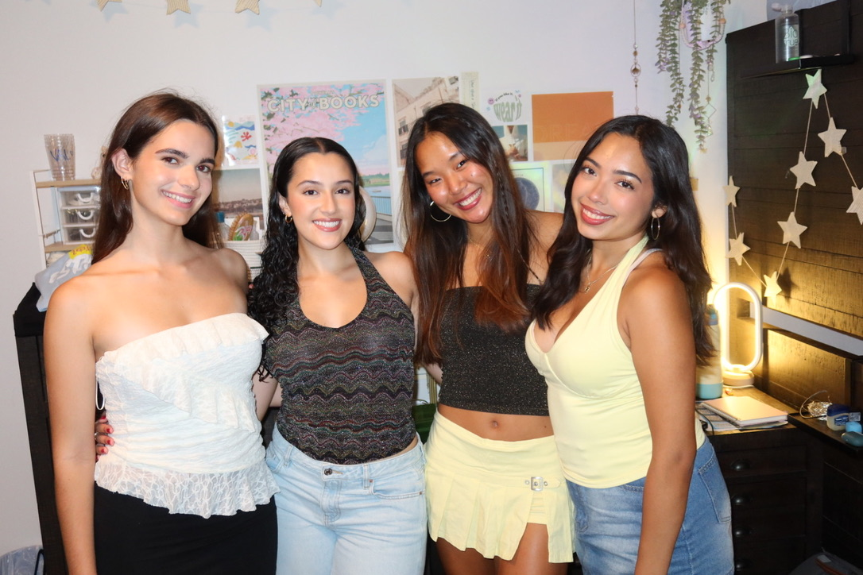
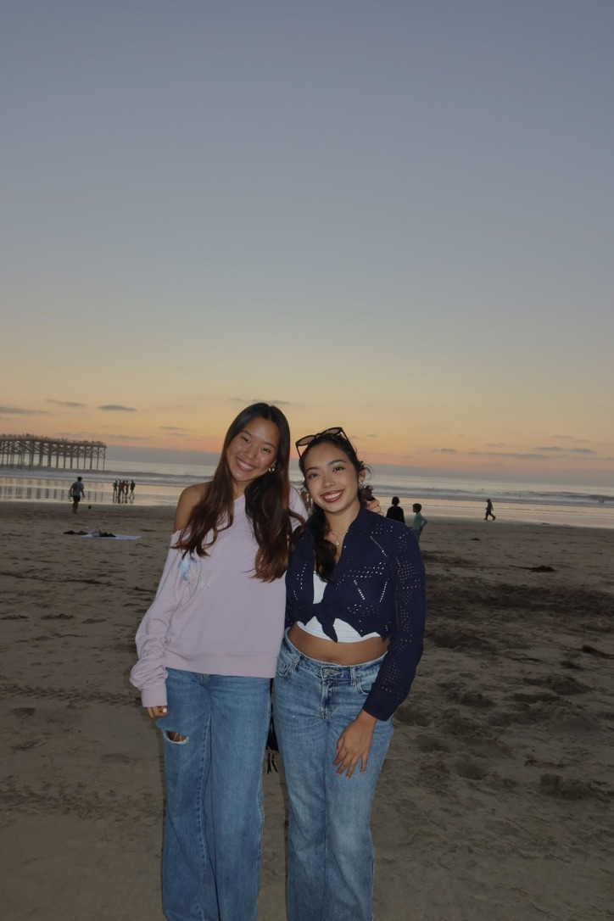
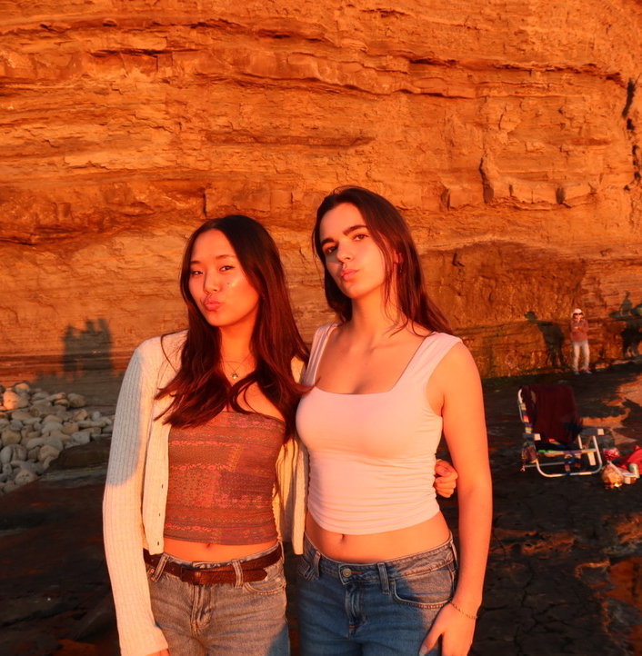
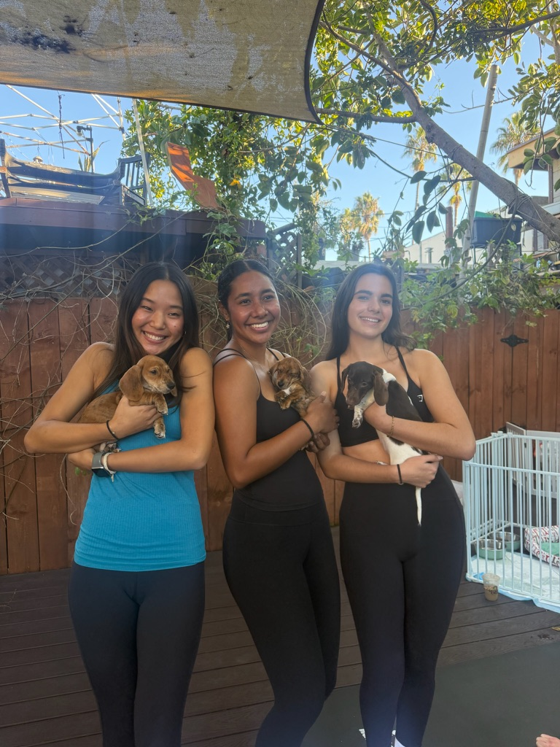
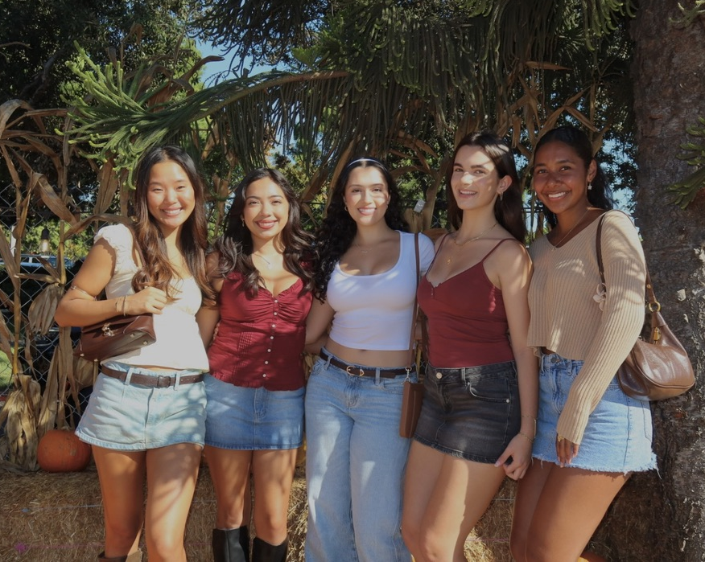
Notes:
Once everyone began to settle in, I immediately connected with my roommates and together we met more people and explored San Diego together. I’ve loved just building a routine for myself–going to the gym and staying active while also balancing that with my academics and social life.

Slide 11
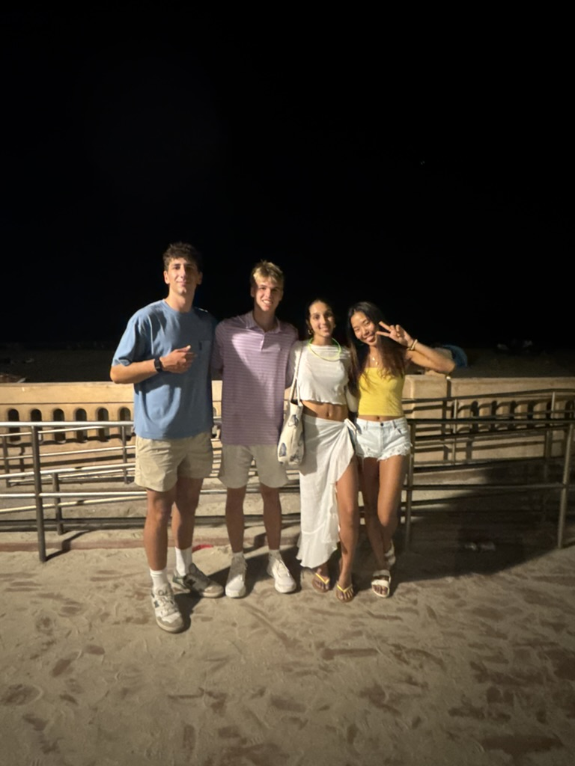
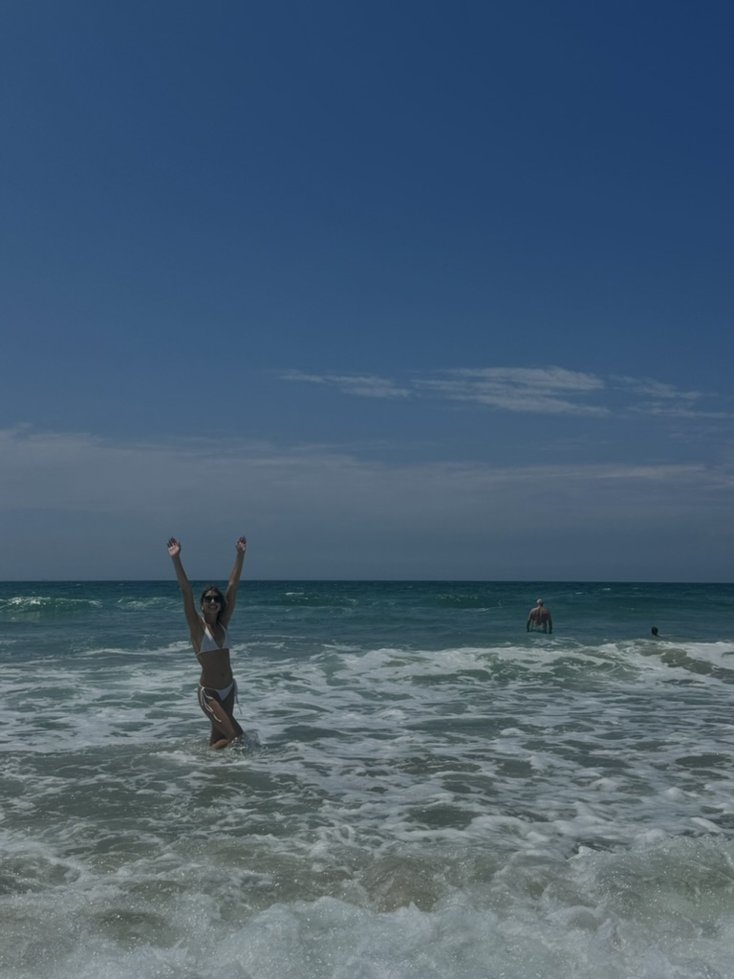
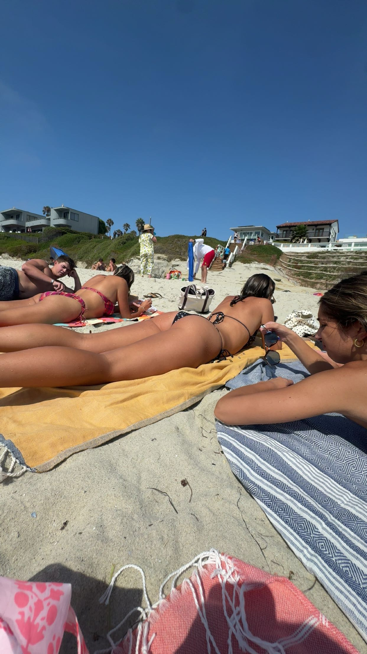
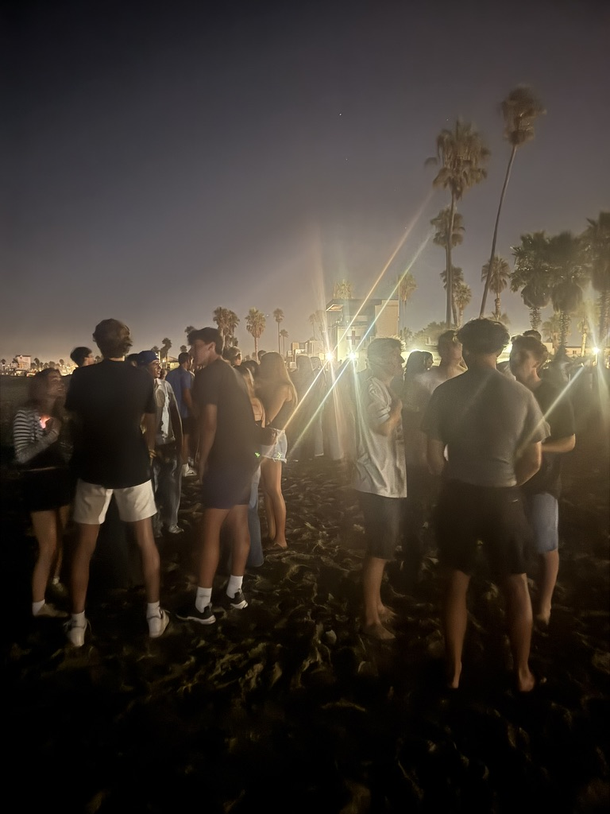
Notes:
This for sure touched my life this semester in a positive way--my favorite days were ones spent by the beach, just soaking in the beauty and sunshine and discovering hidden places in the city. When school got hard, it was nice to escape the stress by just taking myself off campus and exploring with my friends. I moved here from Seattle so the warm weather was so nice to get accostumed to and it kept me sane through the hectic semester.

Slide 12
Items that you experienced that were sad or negative that you wish not to be experienced again

Slide 13

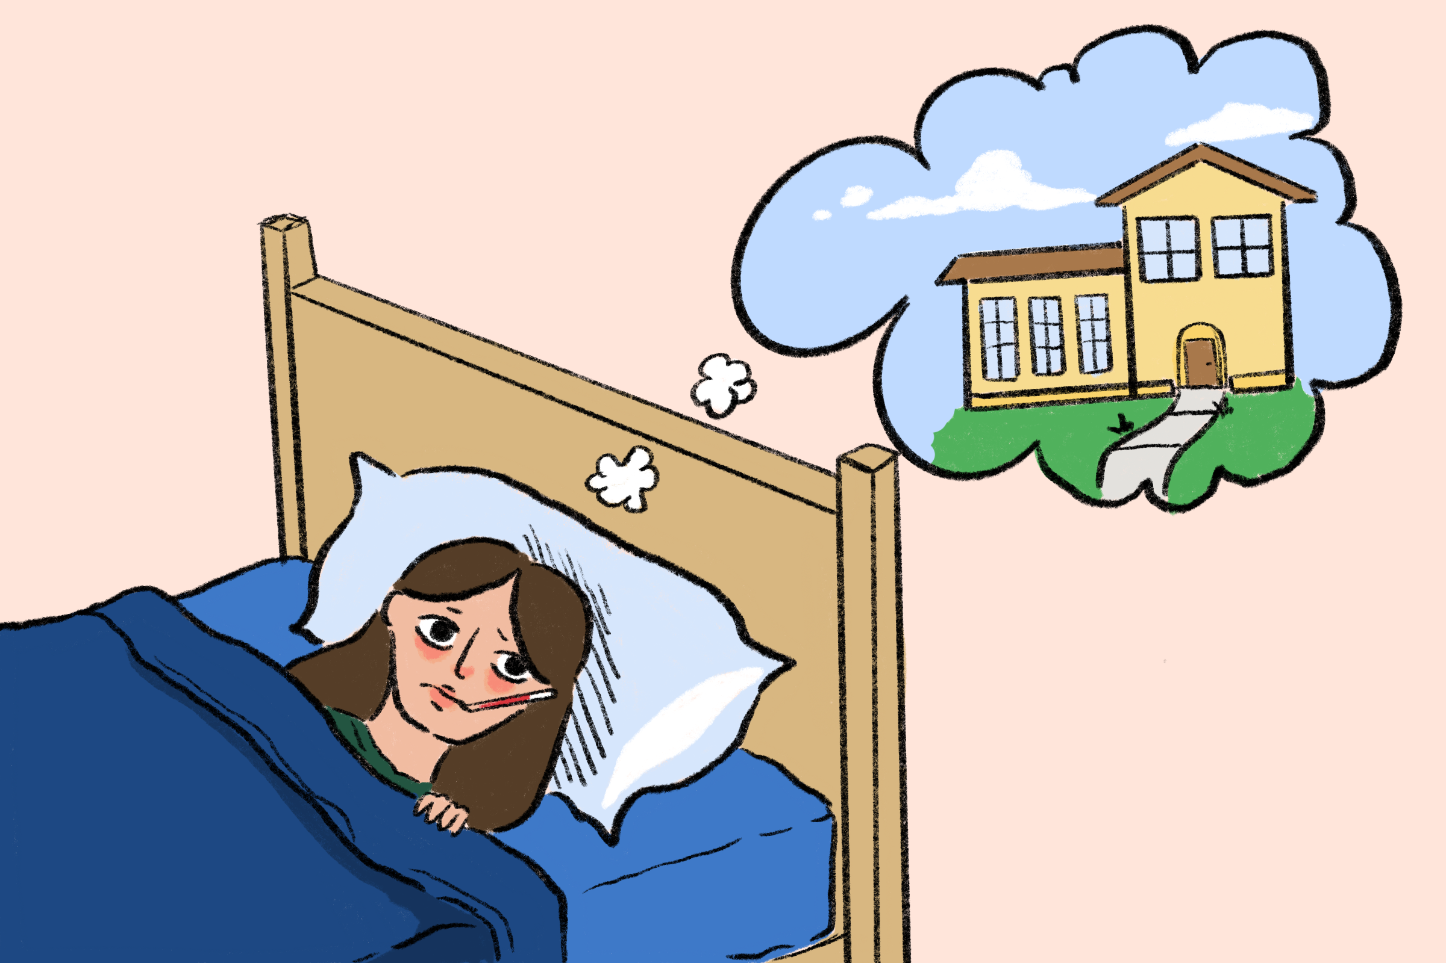
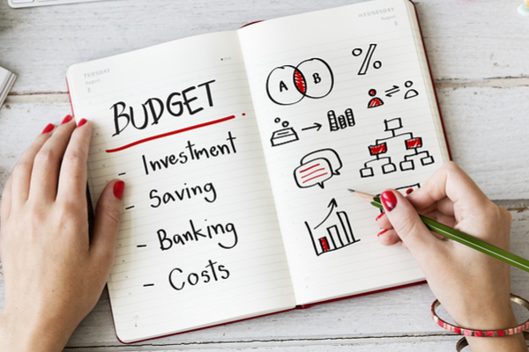

Notes:
As amazing as this semester has been, there were for sure moments that were negative or challenging–experiences I hope not to repeat. Balancing everything sometimes felt overwhelming, and there were days when the stress caught up to me. Being homesick was a strong emotion I felt, especially in the earlier days when everything was so new. Managing finances and adjusting to being more independent was another learning curve that sometimes felt discouraging, but taught me a lot about responsibility. I know that the homesickness feeling probably won’t ever go away, but I hope I’ll begin to adapt to my life here in a smoother way, hopefully next semester.

Slide 14
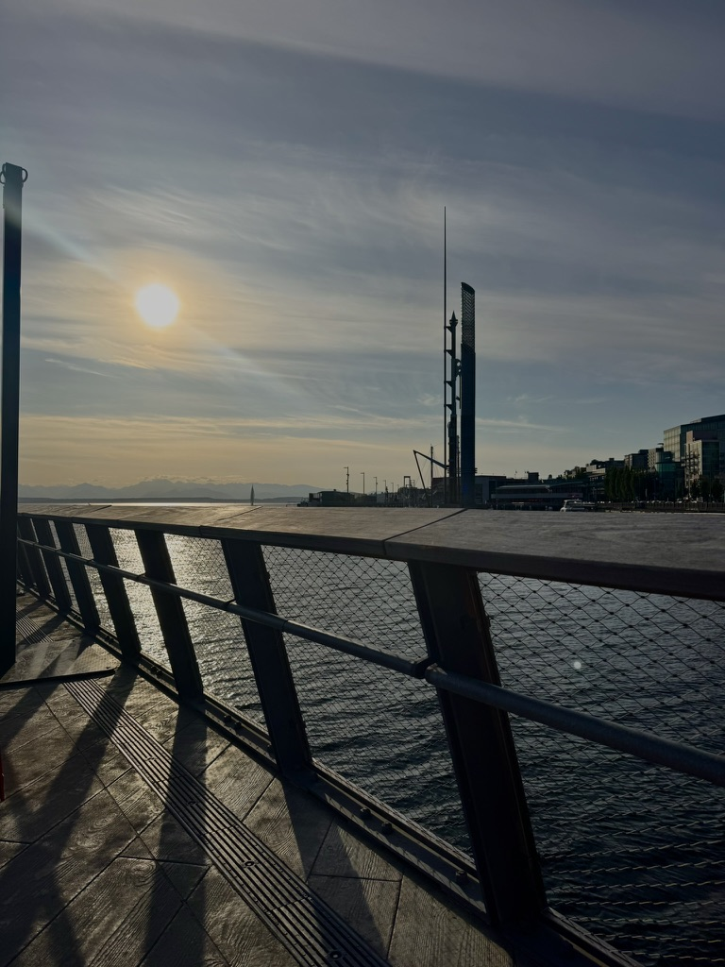
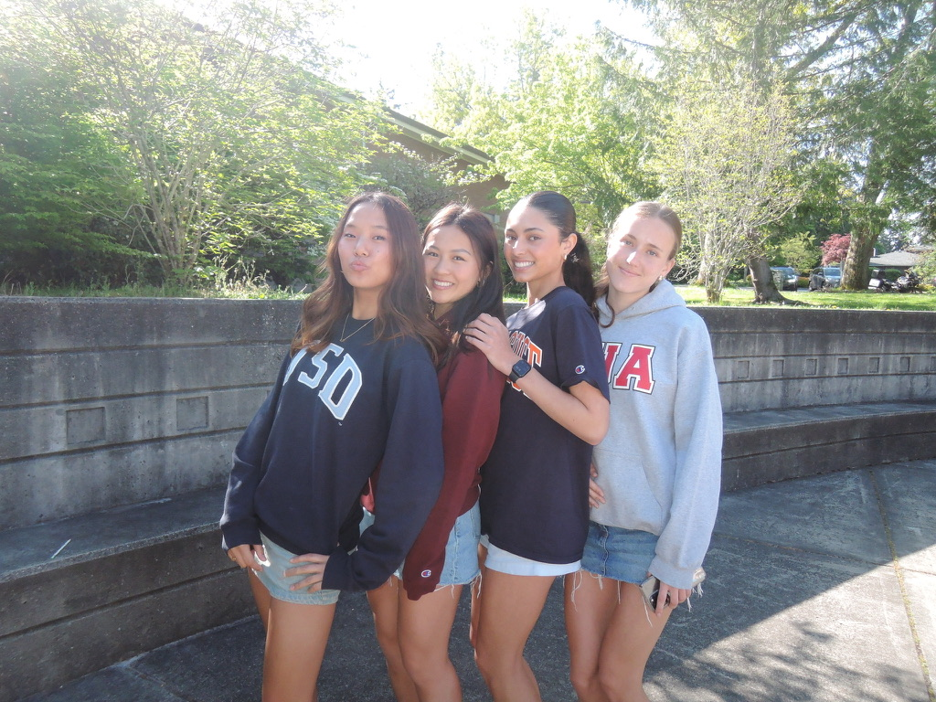
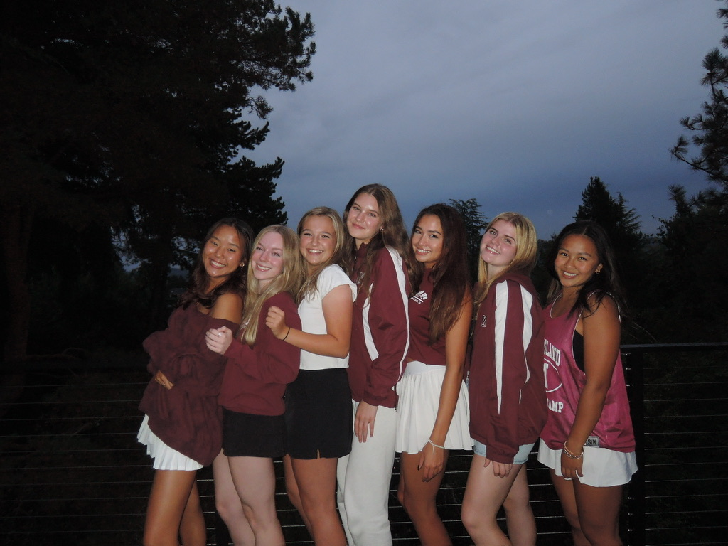
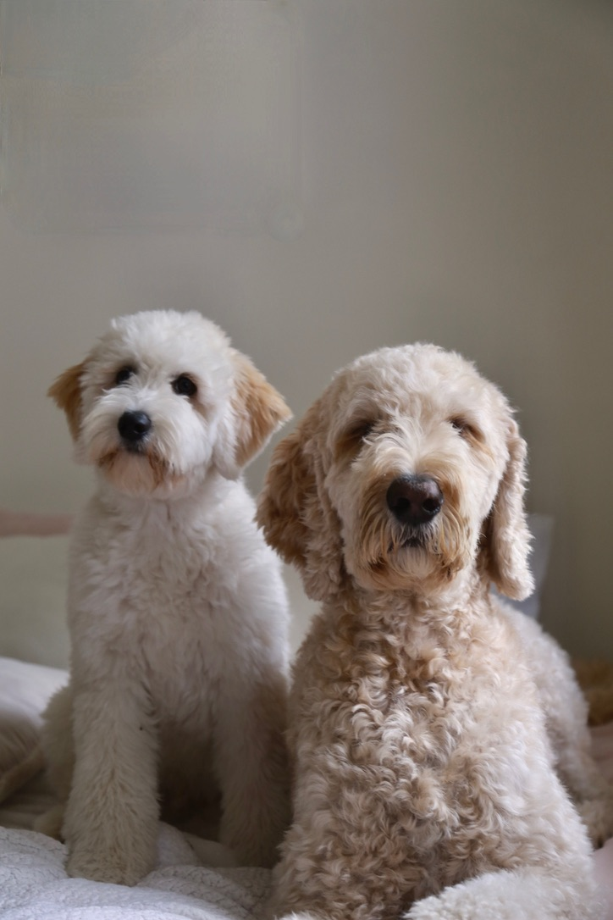
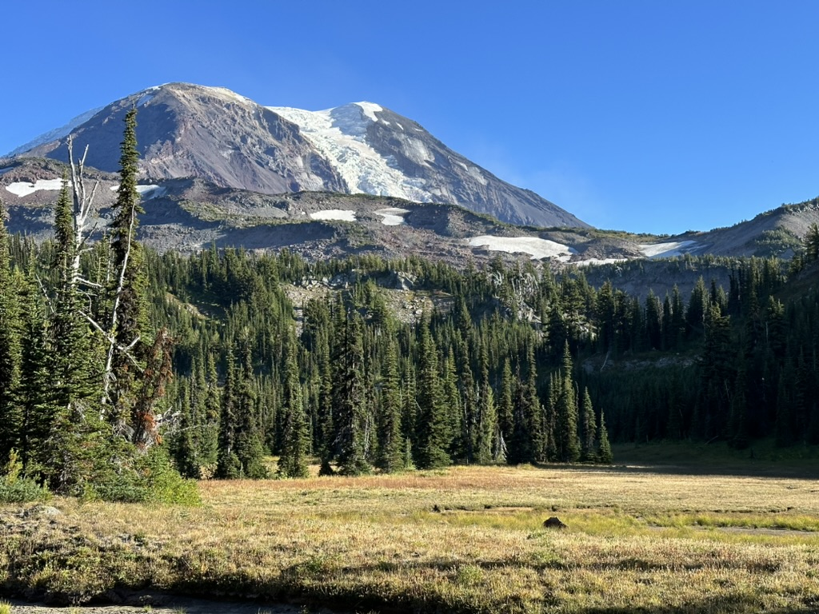
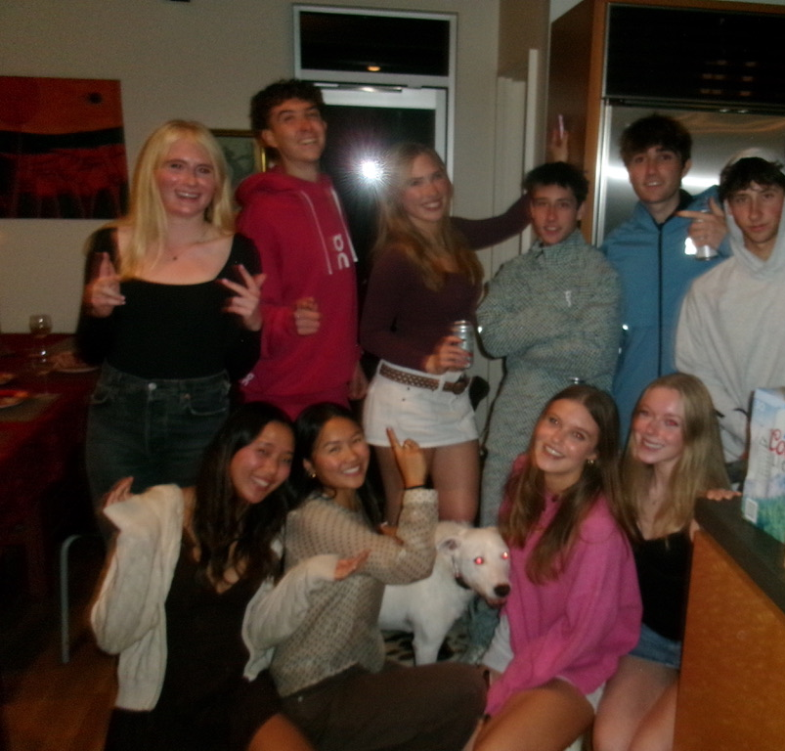
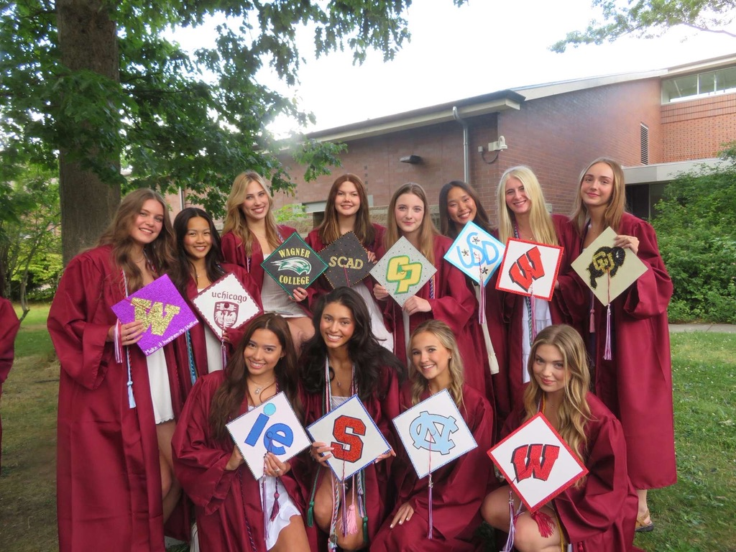
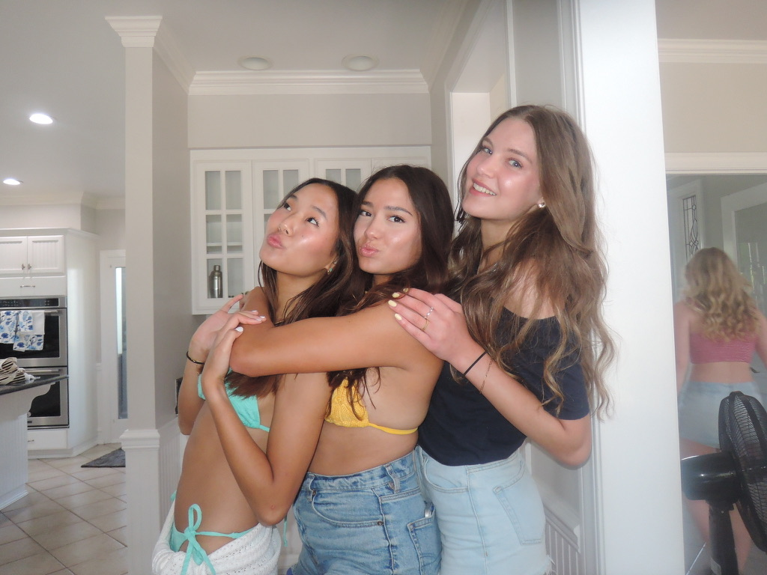
Notes:
These are just some of the places and people that I miss from home. Missing my dogs was a feeling I didn’t expect to be so overwhelming but I’m really excited to see them and everyone at home.

Slide 15
Items that were highlighted by news, media advertisements/messages, government, other countries, other sources

Slide 16
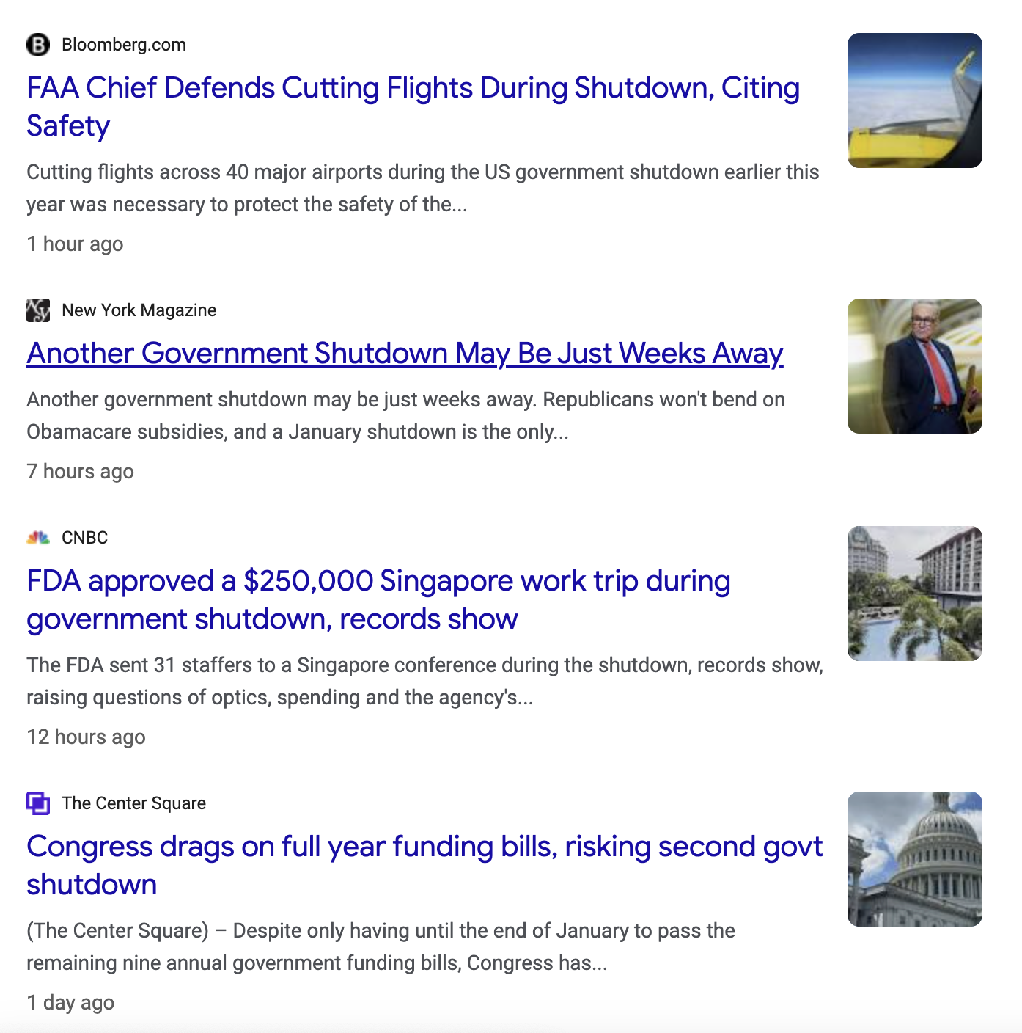


Notes:
This semester was also shaped by what was happening nationally. The government shutdown was constantly in the news, and talked about in my classes. Seeing the uncertainty in real time made me more aware of how political decisions affect our everyday life, and the people in it. Even if it didn’t directly change my daily routine, it added another layer of uncertainty and made a lot of students, including me, nervous about delays with financial aid and traveling.

Slide 17
Items that illustrates changes to processes (buying food other items), laws/restrictions

Slide 18


Notes:
The acceleration of AI’s dominance in every single field also can’t be ignored. I found myself stressing more about job stability in the future and questioning the fields I want to go into. As a student in information systems, I am both excited and scared about the potential AI holds and what I should do now to prepare. I talked to my economics professor and she was warning me about going into certain job markets in the business industry, which was a little scary because I do plan on majoring in business. So it’s just something to think about. Ai’s dominance has definitely impacted changes to processes–for example professors have different grading criteria catered to AI and its relevance to make sure students aren’t relying on it. The new California state law regulating AI requires transparency for advanced AI systems and protection for users from AI misinformation. All of this made me more intentional with my AI usage and being aware of how technology is reshaping our lives and processes.

Slide 19
Items that illustrates people’s creativity to assist others (i.e. drive by birthday parties)

Slide 20
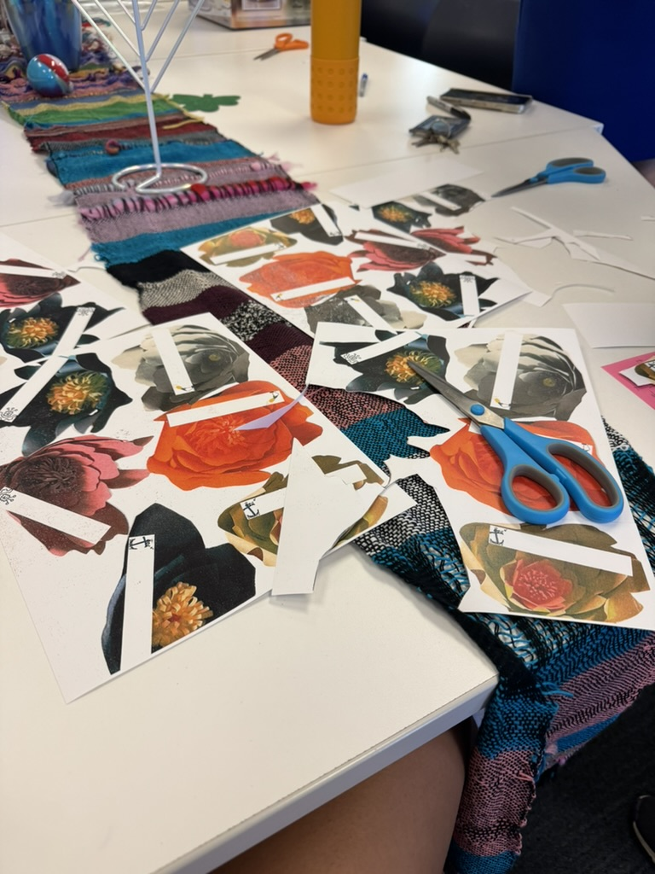
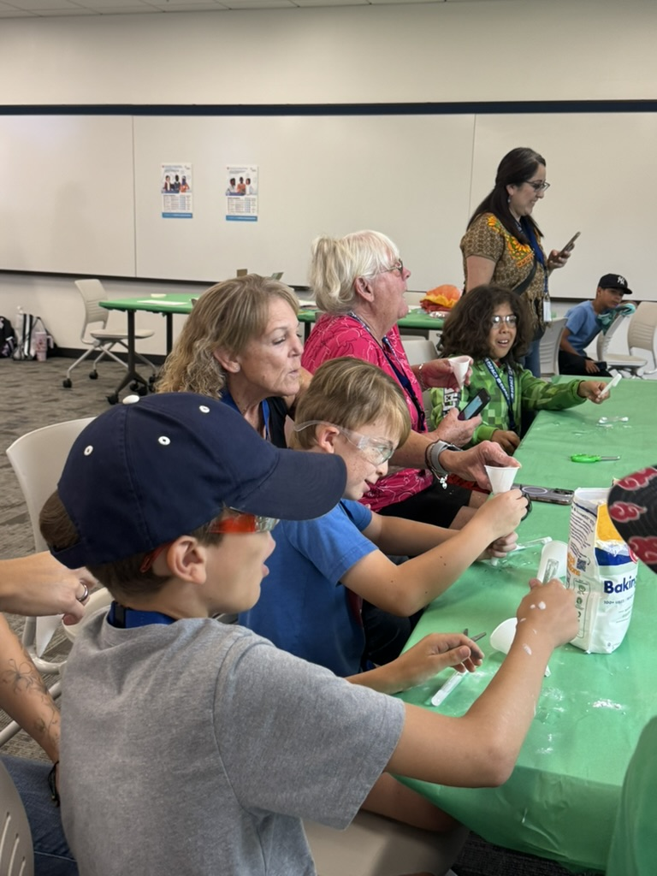
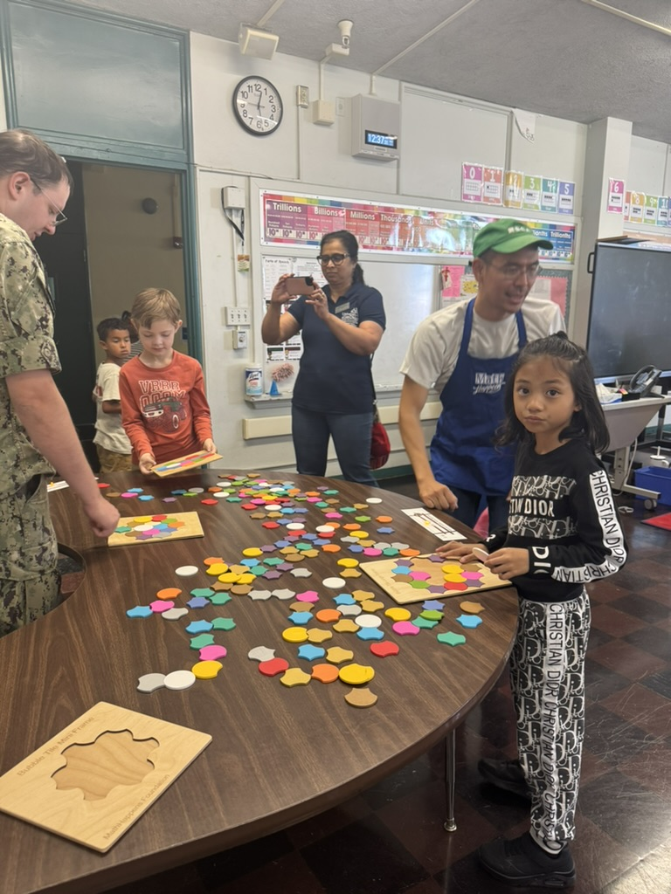
Notes:
It has for sure been inspiring to see how people’s creativity in assisting others fosters a community of support and love. Through college corps and my volunteering with the Jacob’s Institute, I’ve had the opportunity to participate in so many impactful events. For example, we’ve worked with elementary school students in workshops that teach the kids about science, technology, and art in creative ways. One of the workshops was a minecraft lab where students made their own digital house that had to meet certain needs. Through this, they learned how to think critically about design and accessibility while still having fun. It was amazing to watch them problem solve and offer assistance to them and see the light bulb go off in their head when they have an idea. It showed me how when people, especially kids, are given the space to be creative and imagine solutions, they naturally think about how to help others. Participating in workshops like this has strengthened my passion for giving back to the community.

Slide 21
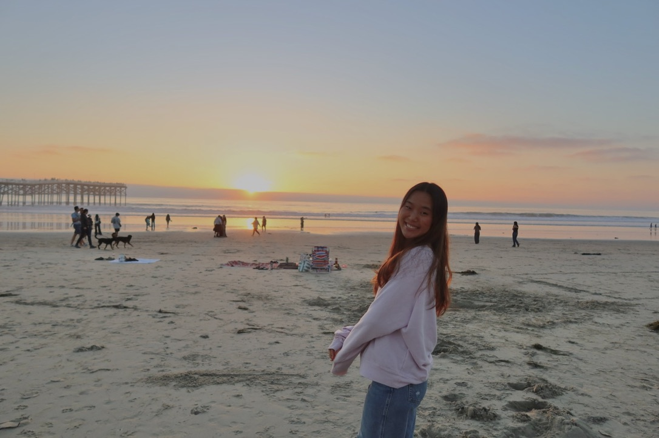
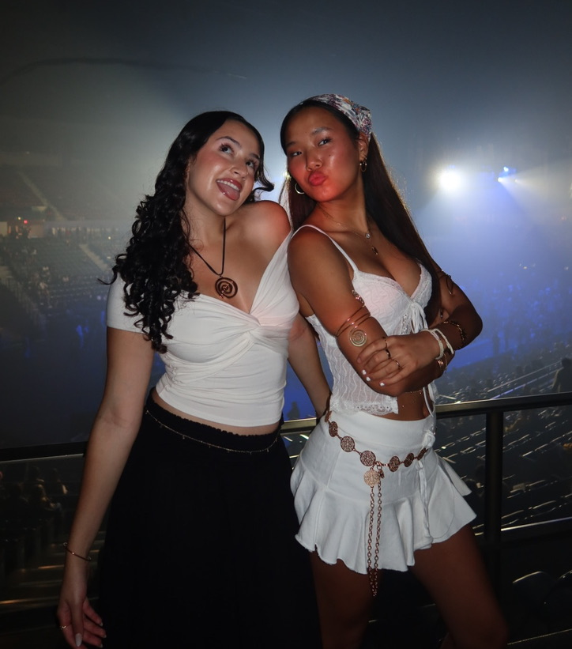
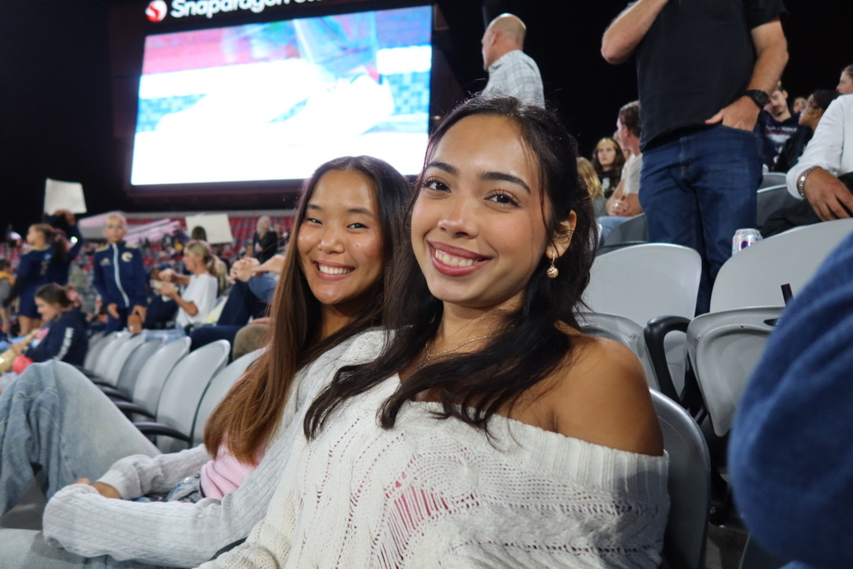
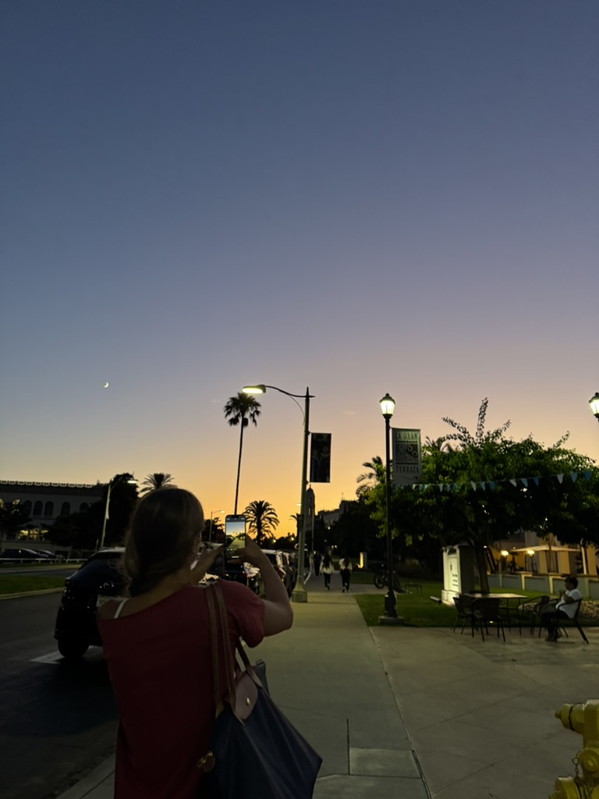
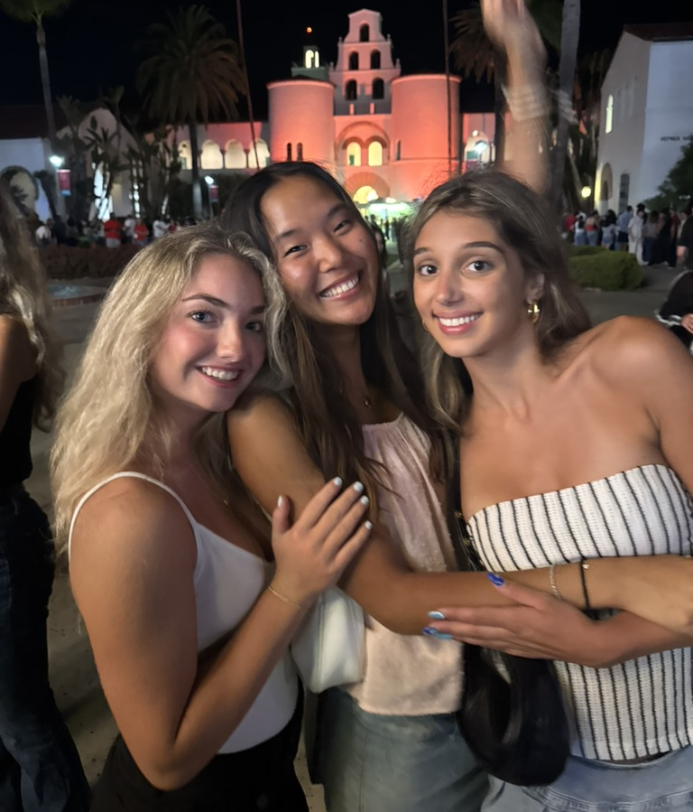
Notes:
Overall, this semester has been transformative, physically, mentally, and emotionally and I’m excited for what the next one has to offer!

