Slide 1
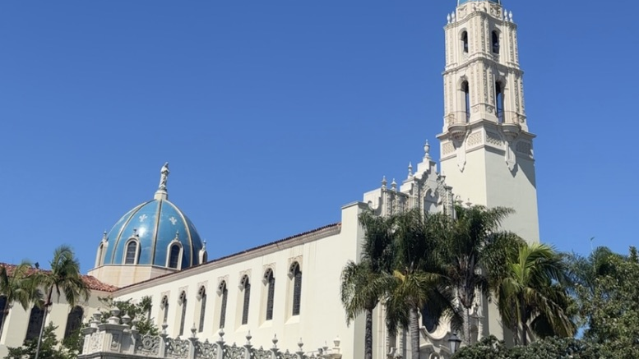
My Fall 2025 Semester Reflection
Leah Corsaro

Slide 2
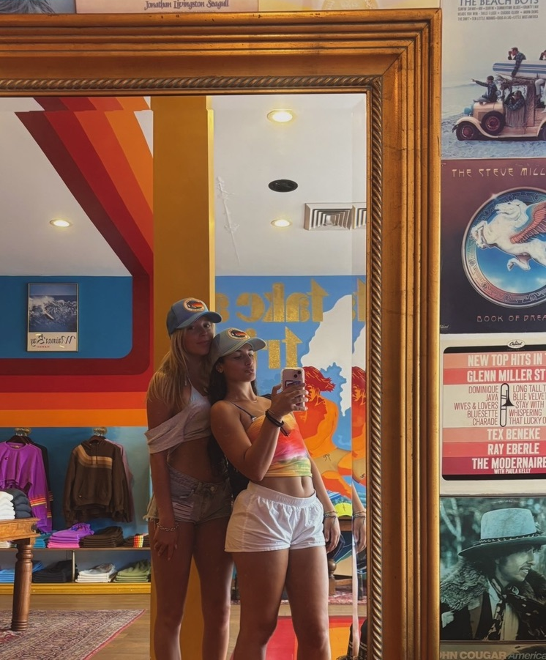
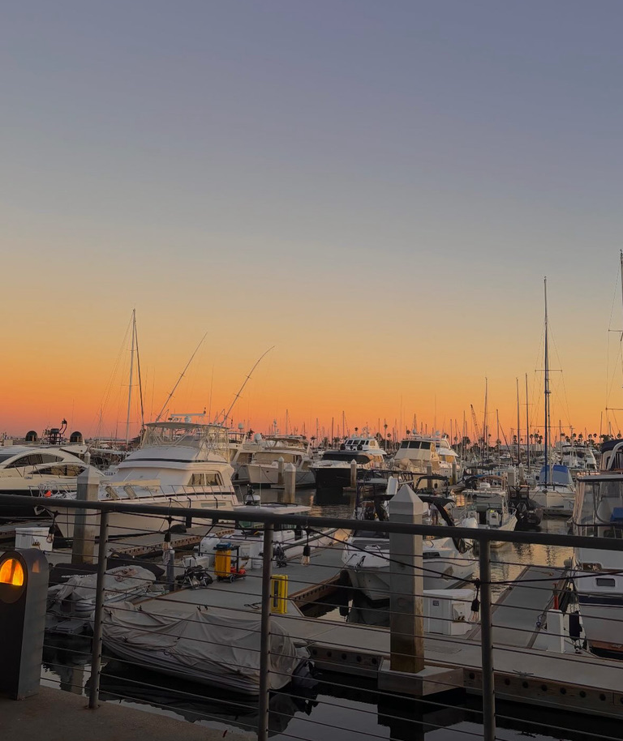
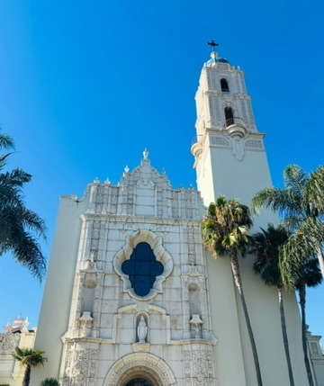
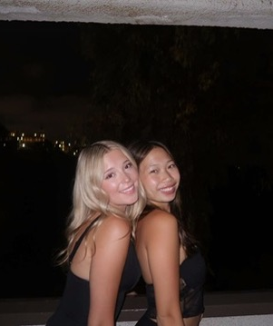
Things That Happened This Semester
August 2025
Toured USD for the first time
Started classes
Welcome Week – met many new friends
First trip to Fashion Valley
First visit to La Jolla
Taylor Swift & Travis Kelce announced their engagement

Slide 3
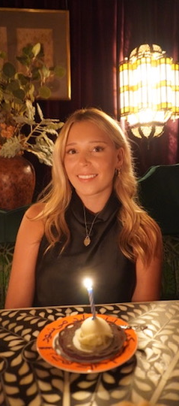
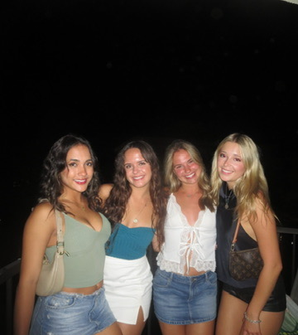
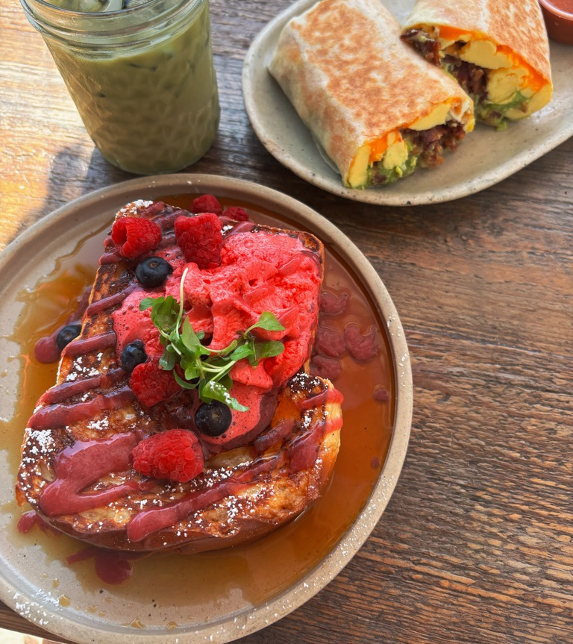
September 2025 My birthday – September 30 Went to the beach and tried new restaurants in San Diego Visited UTC Tried a fun restaurant called Leila Jimmy Kimmel suspended after comments about Charlie Kirk

Slide 4
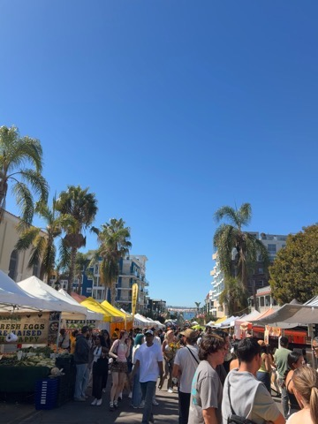
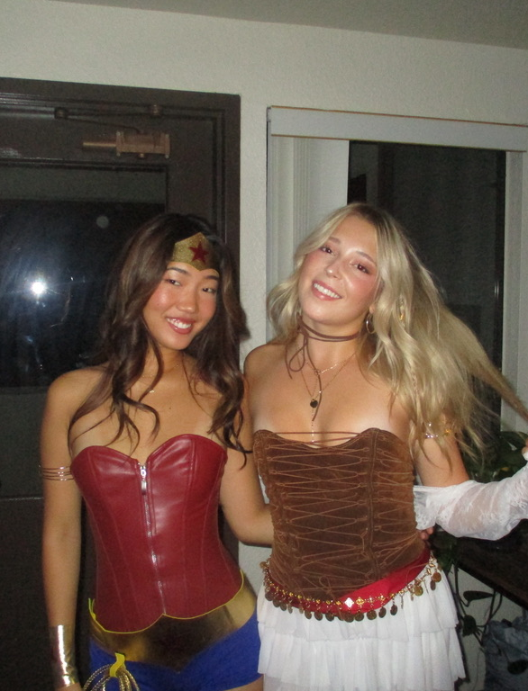
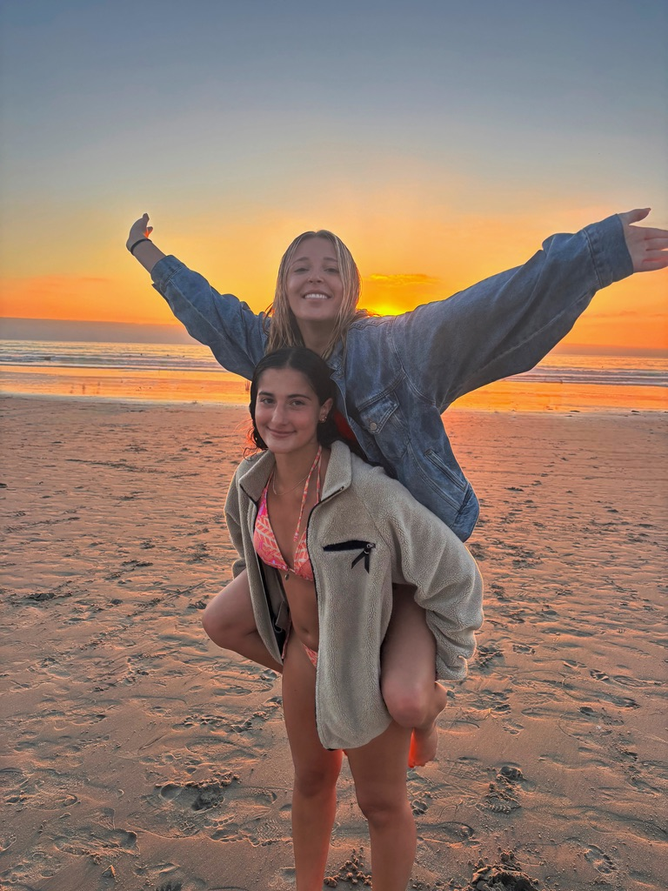
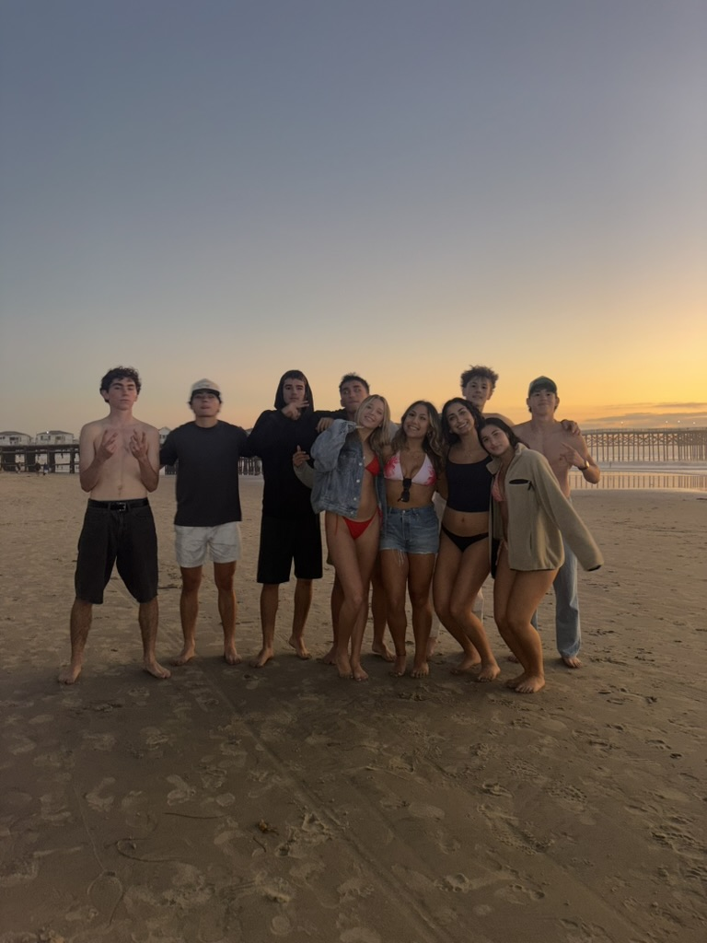
October 2025 Halloween Friends visited me at college Malcolm Todd event La Jolla farmers market Watched the beach sunset

Slide 5
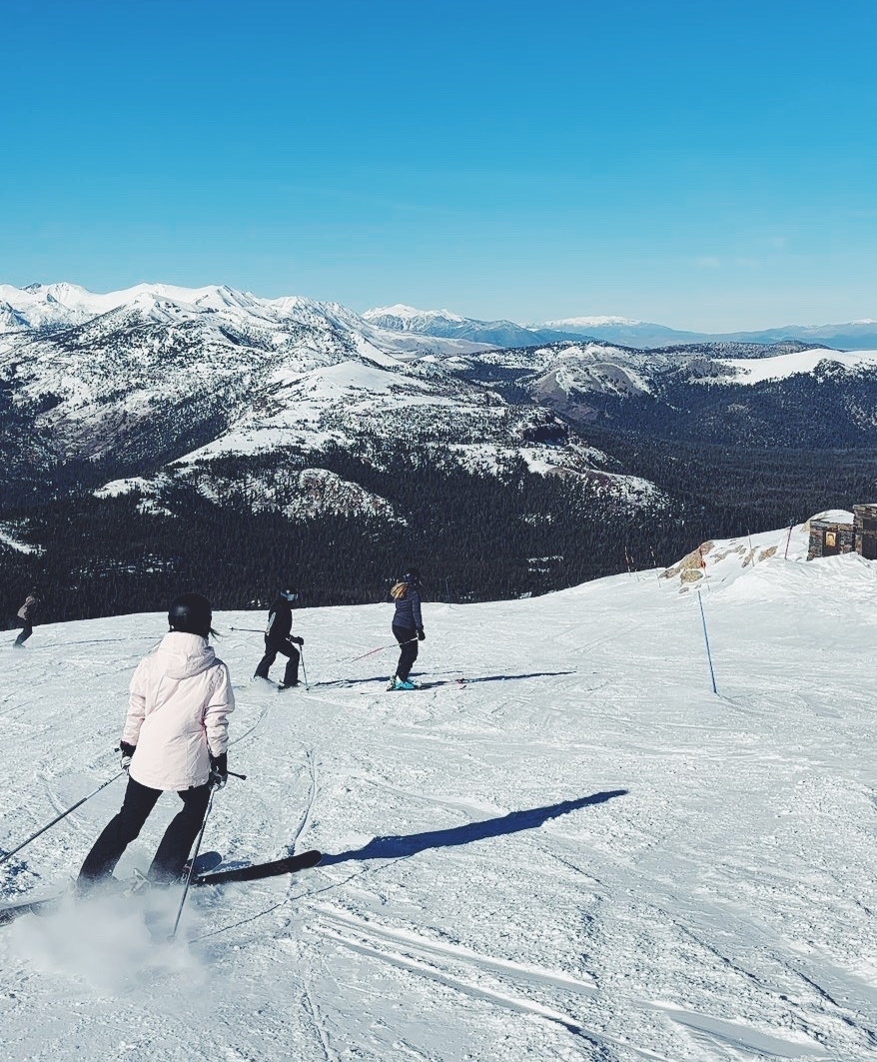
November 2025 Went skiing during Thanksgiving Visited family

Slide 6
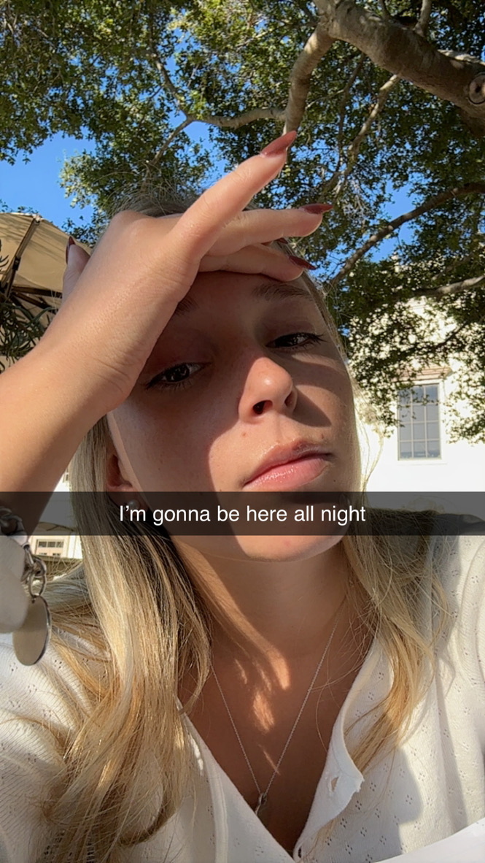
Things That Did Not Happen (But I Wanted) Doing better on midterms Joining a business fraternity

Slide 7
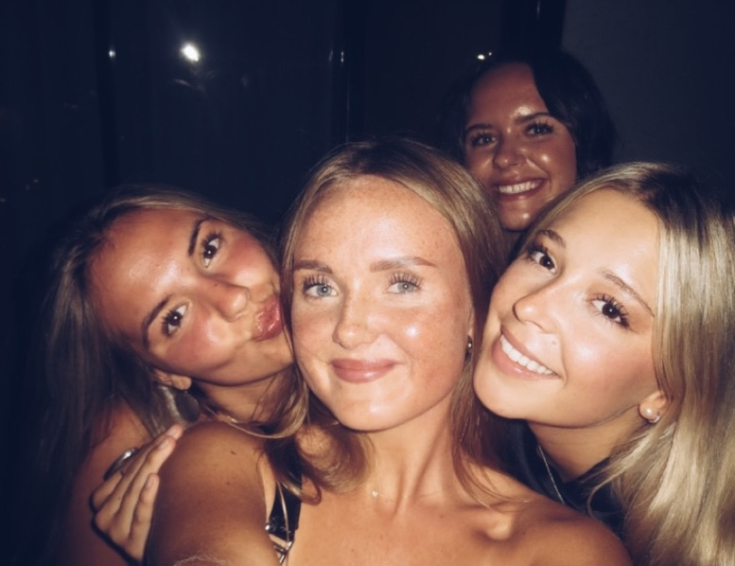
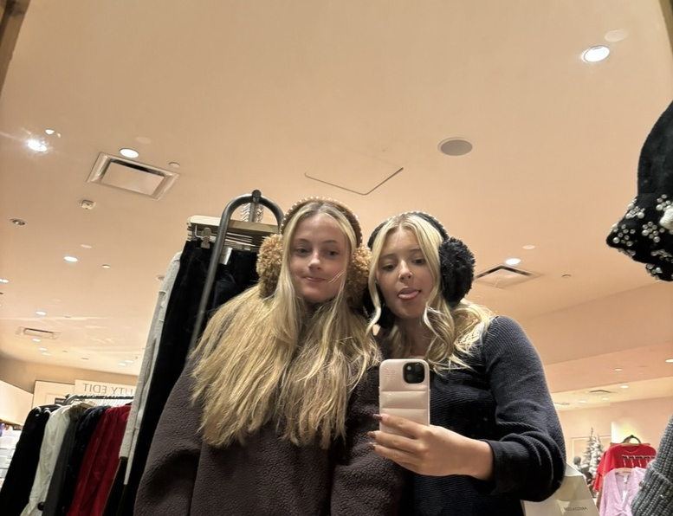
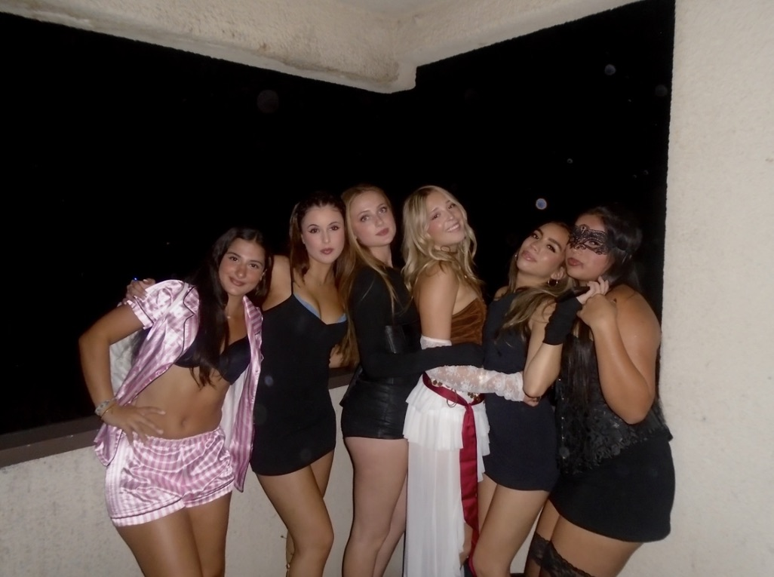
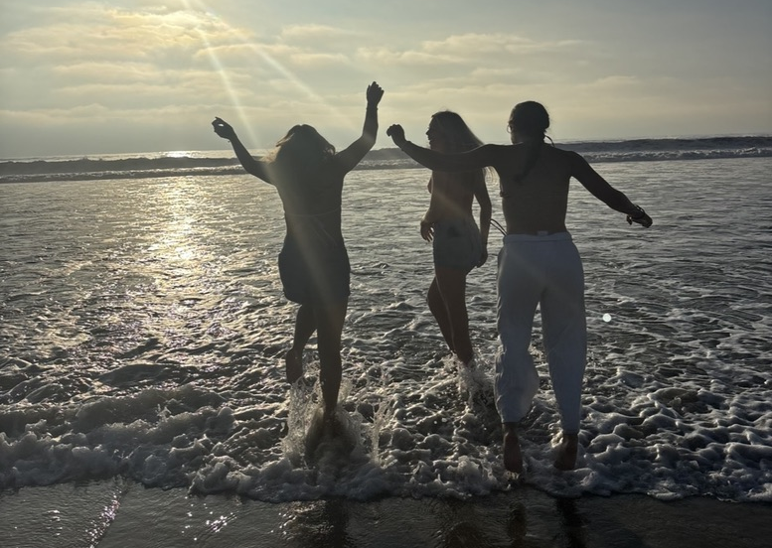
Positive Experiences Meeting new friends Experiencing life outside of home

Slide 8
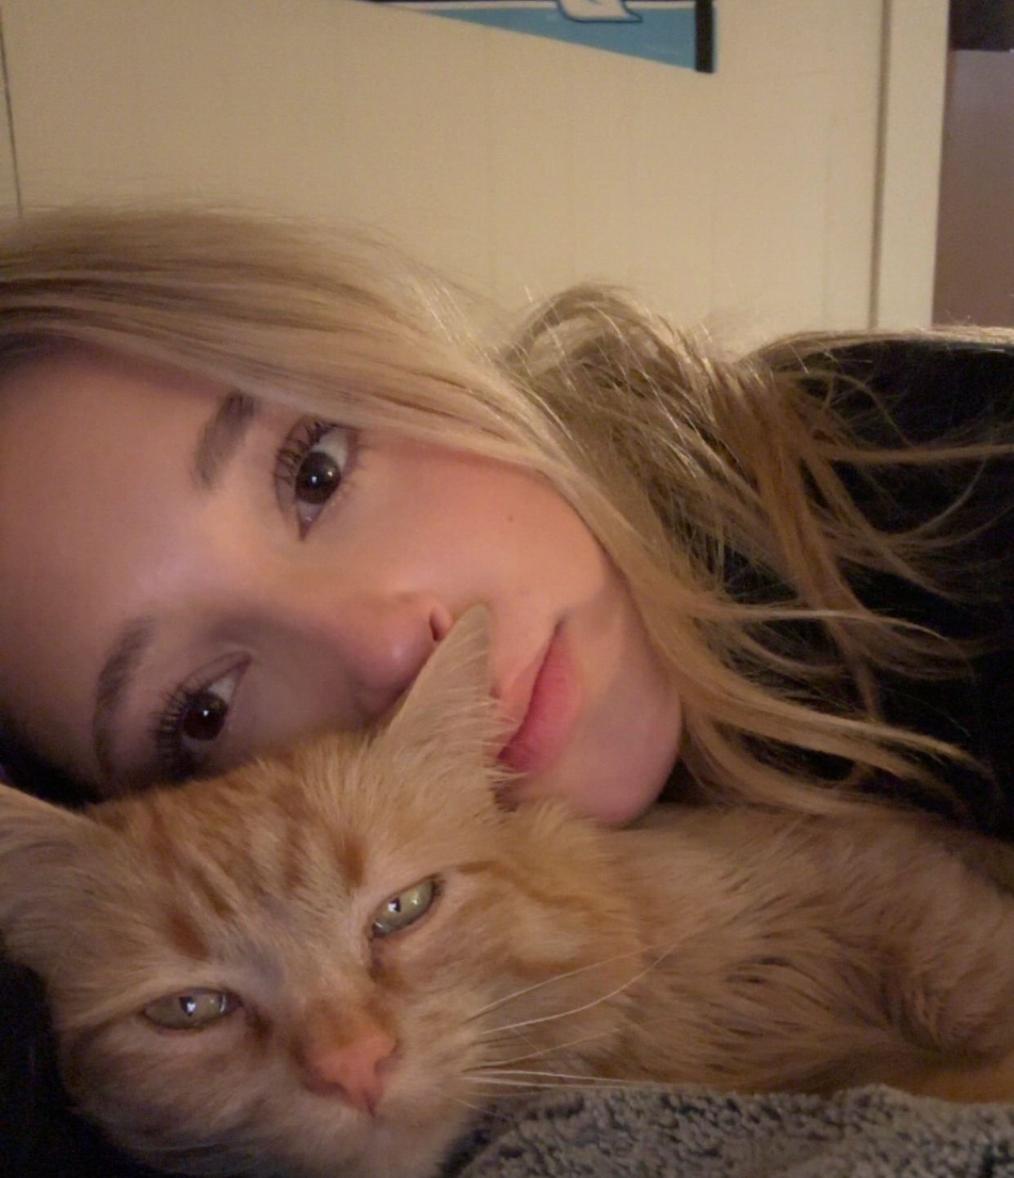
Negative/Sad Experiences Missing my cat and my family

Slide 9
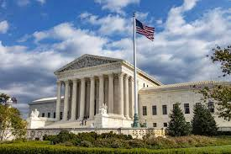
News, Media & World Events Federal government shutdown began October 1, 2025 Shutdown used to implement major layoffs in federal agencies Ongoing Israel–Gaza conflict, including a U.S.-brokered ceasefire Humanitarian crisis and continued fighting reported

Slide 10
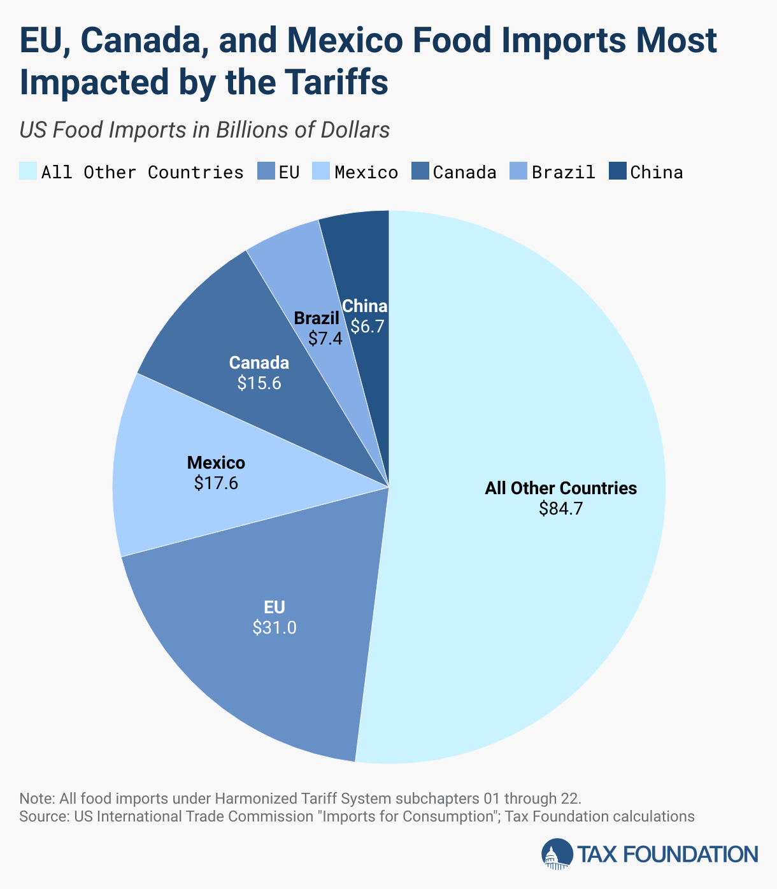
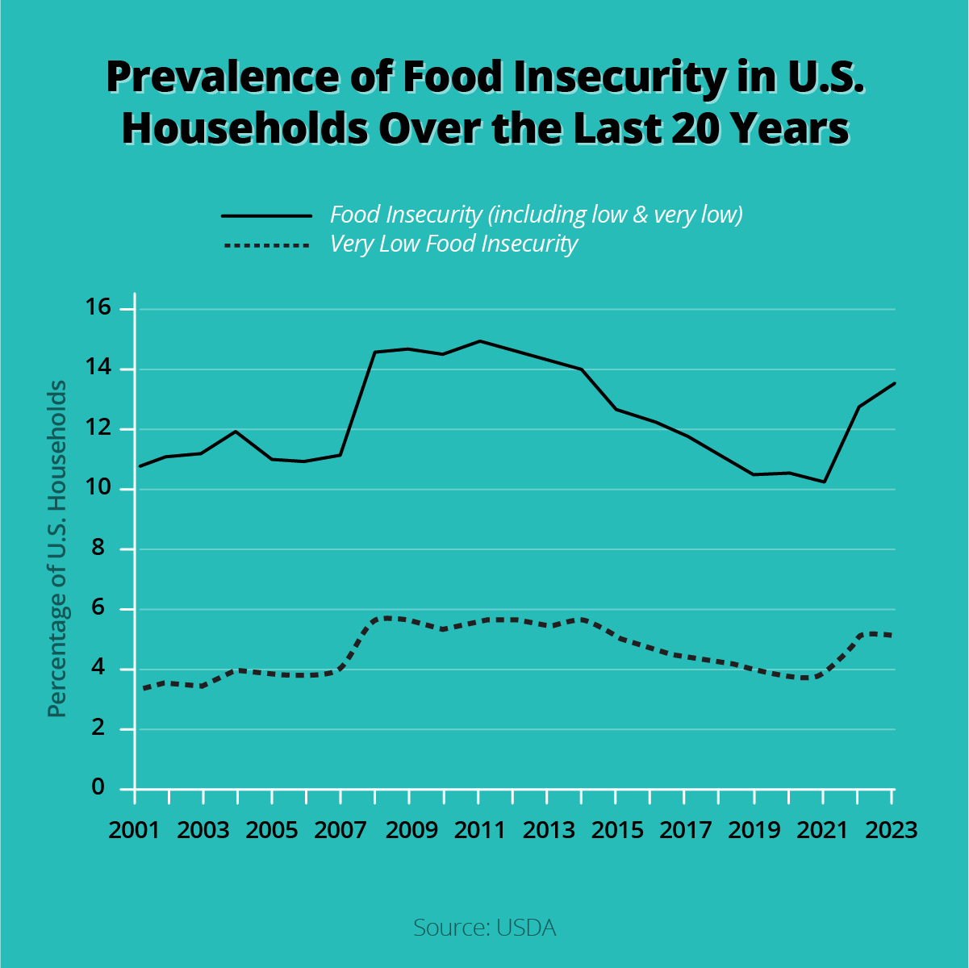
Changes in Processes, Laws & Restrictions Updates to U.S. food assistance programs New California consumer and environmental laws Increased tariffs affecting everyday consumer prices

Slide 11
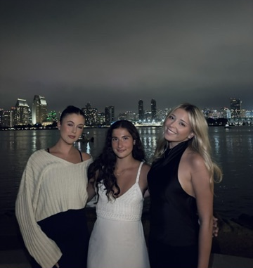
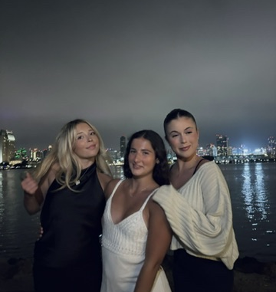
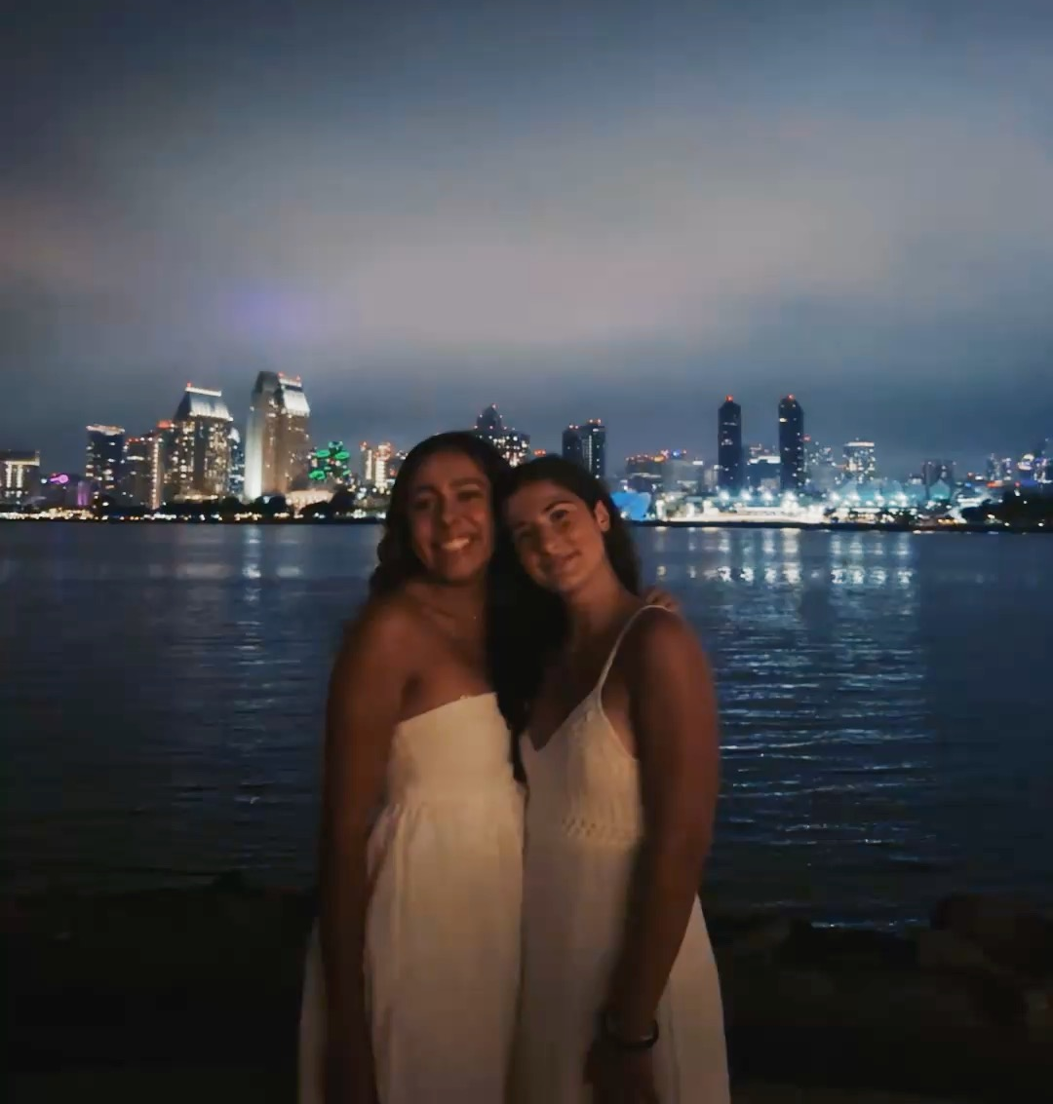
Creativity & Helping Others Friends and I planned a birthday celebration We all got dressed up, went out to eat, and took pictures together

Slide 12
Reflections & Future Goals This Semester: Had a good start, made friends, and explored San Diego What I Wanted: Join more organizations and perform better academically Future Semesters: Join a sorority Meet more people and expand my network Join more clubs and get more involved at school Do well in classes and grow personally

