Slide 1

My First Semester In The U.S: Fall 2025
Charlie Gillespie

Slide 2
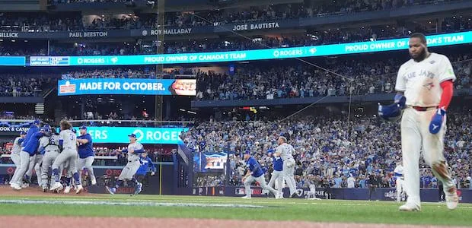
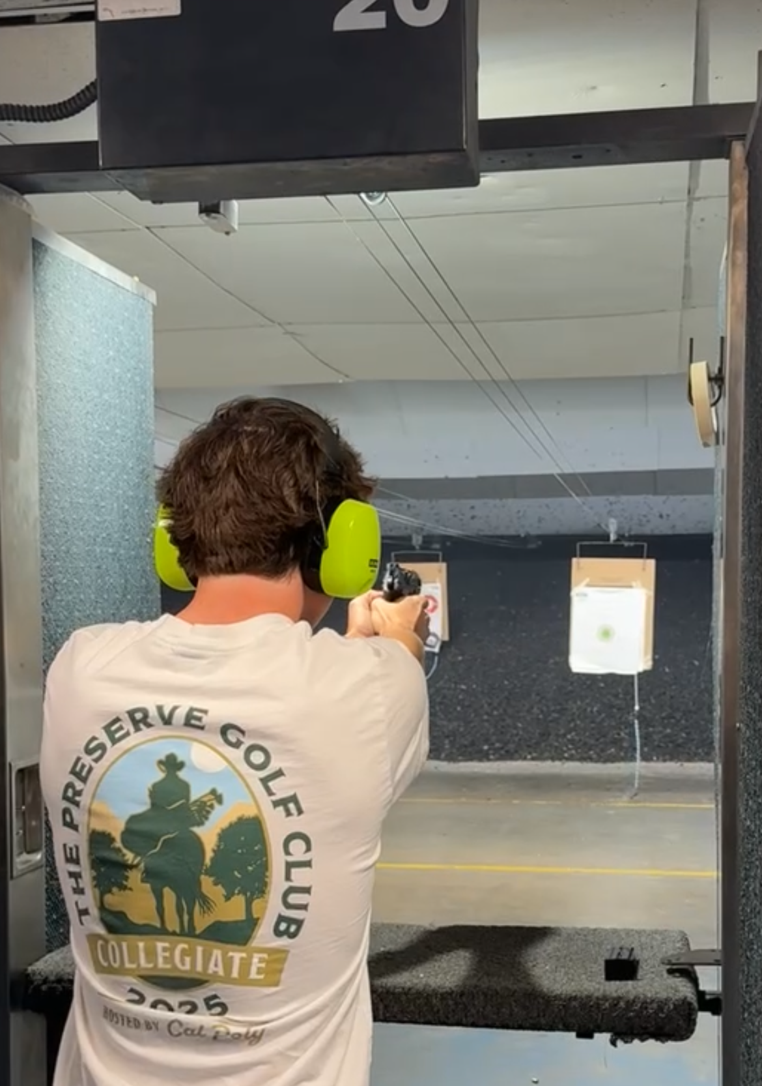
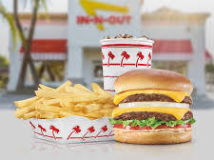
What Happened This Semester?
-Blue Jays lose the World Series
-Had In-N-Out for the first time
-Shot a gun for the first time

Slide 3
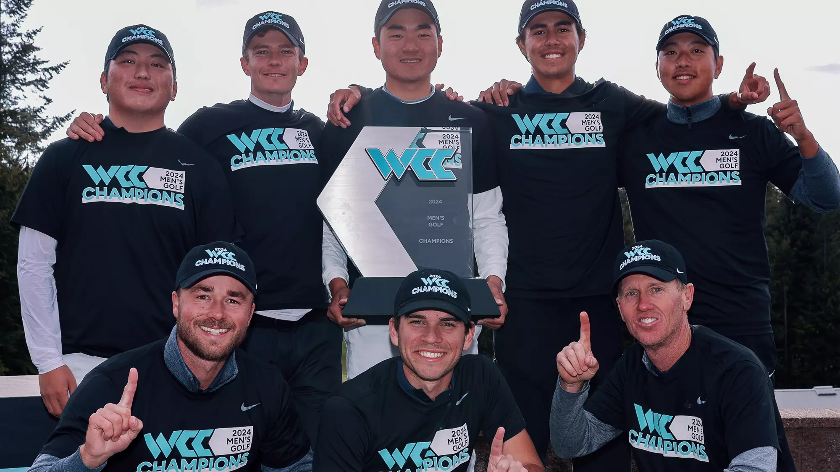
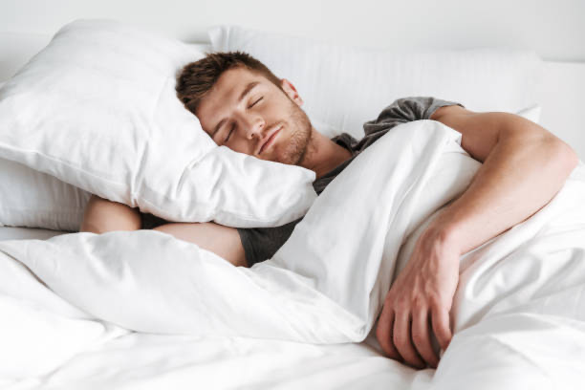
Something I Wanted To Happen This Semester But Did Not
-Win a golf tournament as a team for the University of San Diego
-Getting quality sleeps

Slide 4


Things That Positively Impacted My Life
-The coaching staff of the men’s golf team caring for me on and off the course
-Great guidance in my professional and social life

Slide 5
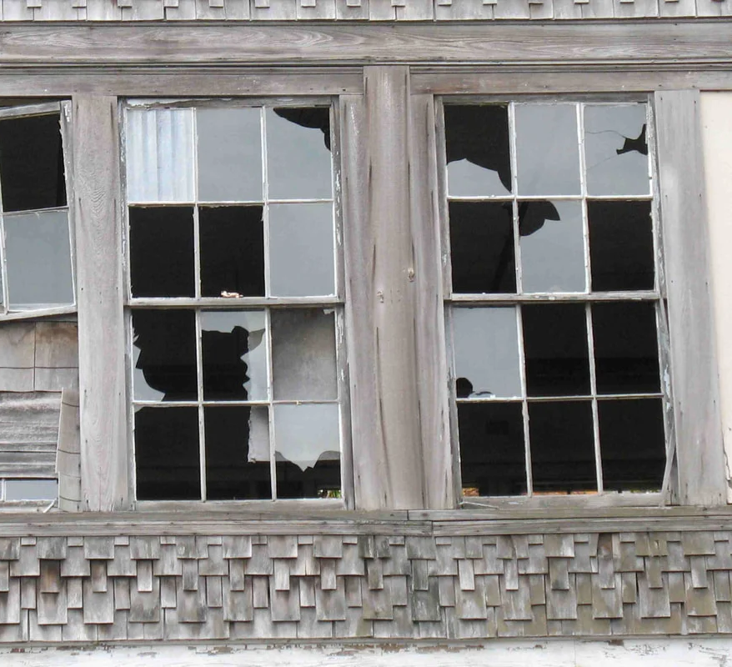
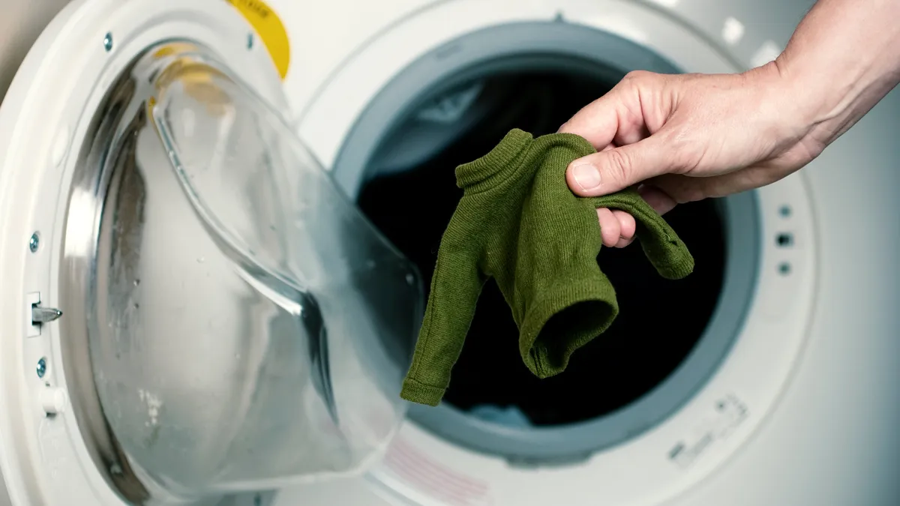
Negative Experiences
-Locked out of my dorm room at 6am
-Shrunk many of my favorite t-shirts

Slide 6
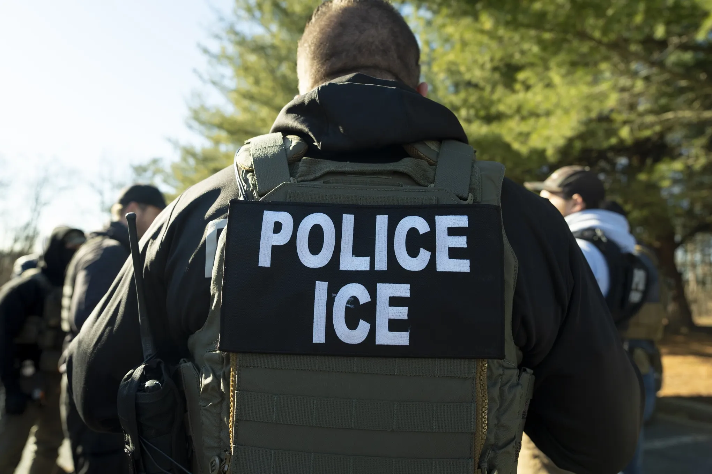
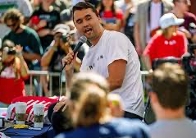
Relevant Events In Media
-Ice raids along the southern border, especially in San Diego
-Assassination of a public figure on a college campus

Slide 7

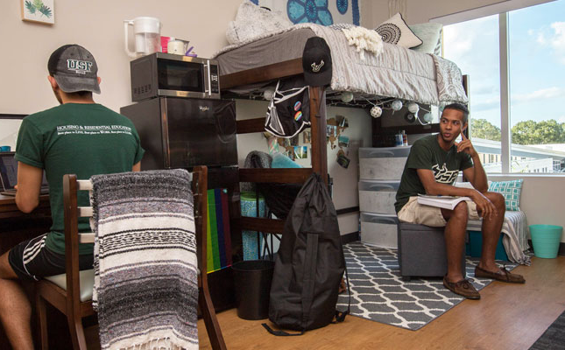
Change To Processes
-Not having a car for transportation
-Living with a roommate
-Cooperation with lifestyles and habits

Slide 8
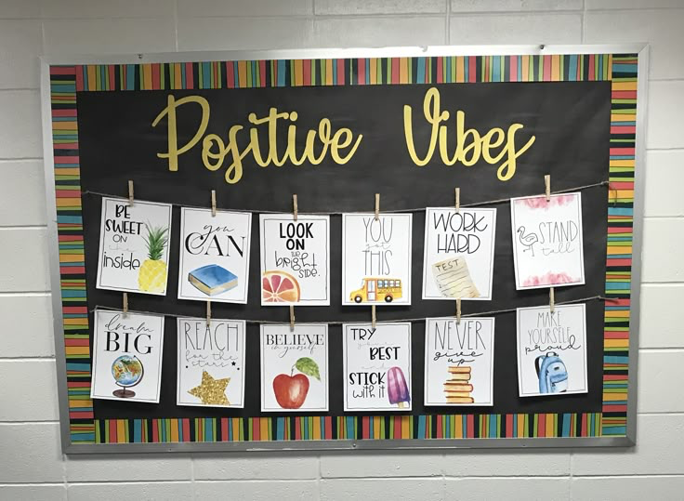
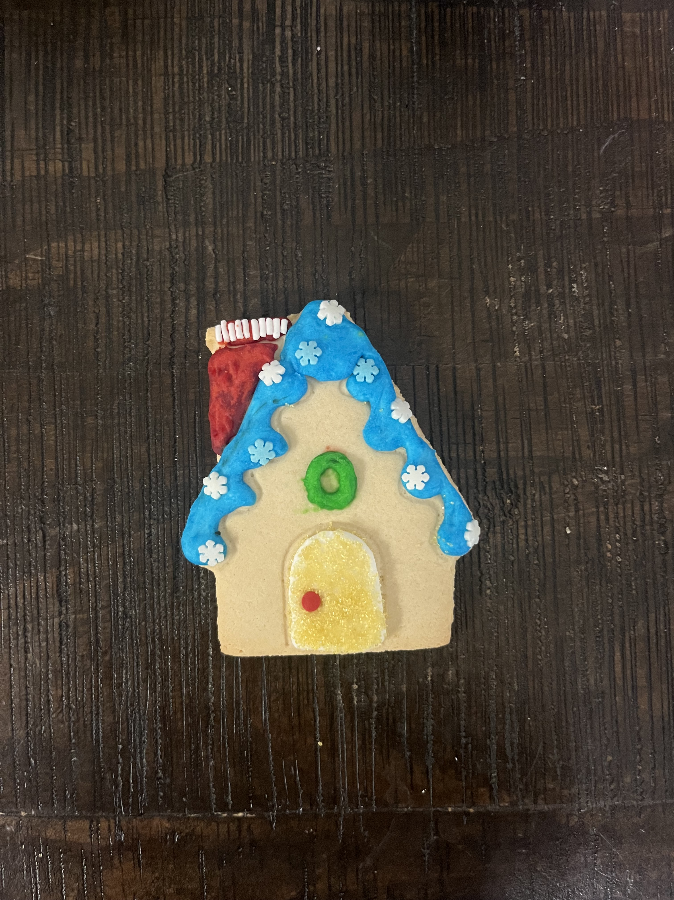
Creative Kindness
-Words of positivity on a bulletin board in dorm building
-Walk past it most days
-Had a friend make a cookie for me at a Torero Tuesday event

Slide 9
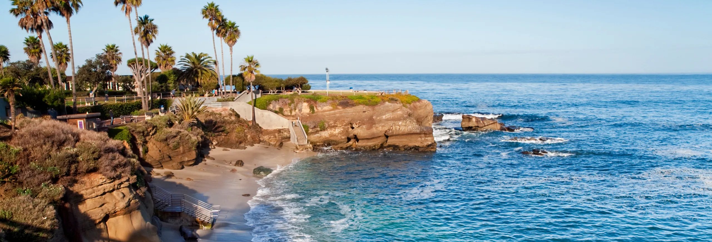
Going Forward
-Do more social ‘San Diego’ activities

Slide 10

Thank You!

