Slide 1

My Semester at USD
Abraham Gonzalez

Slide 2
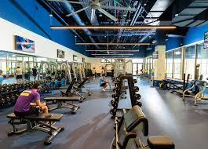
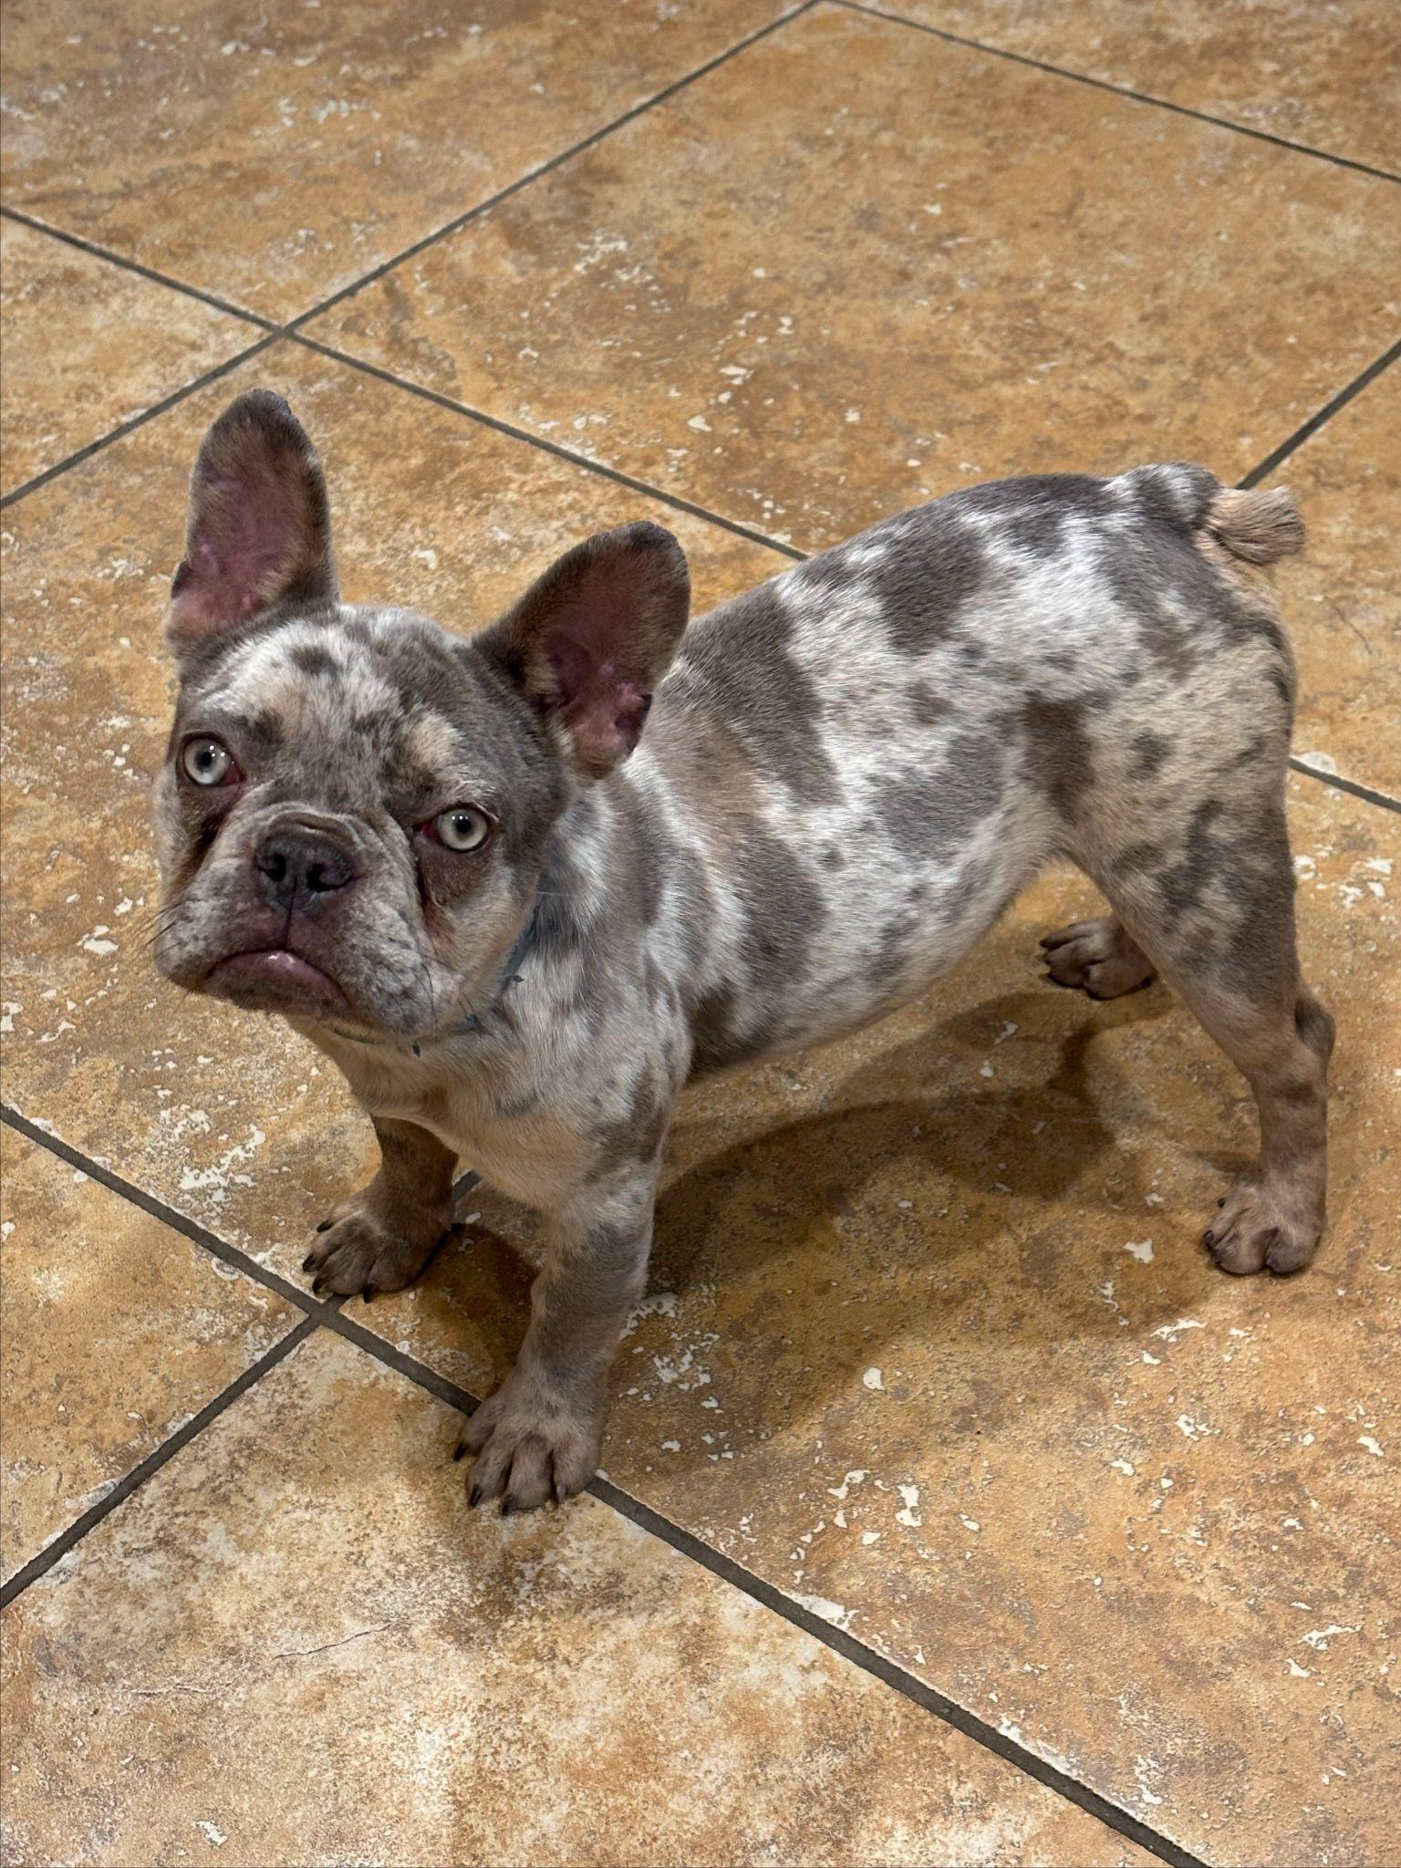
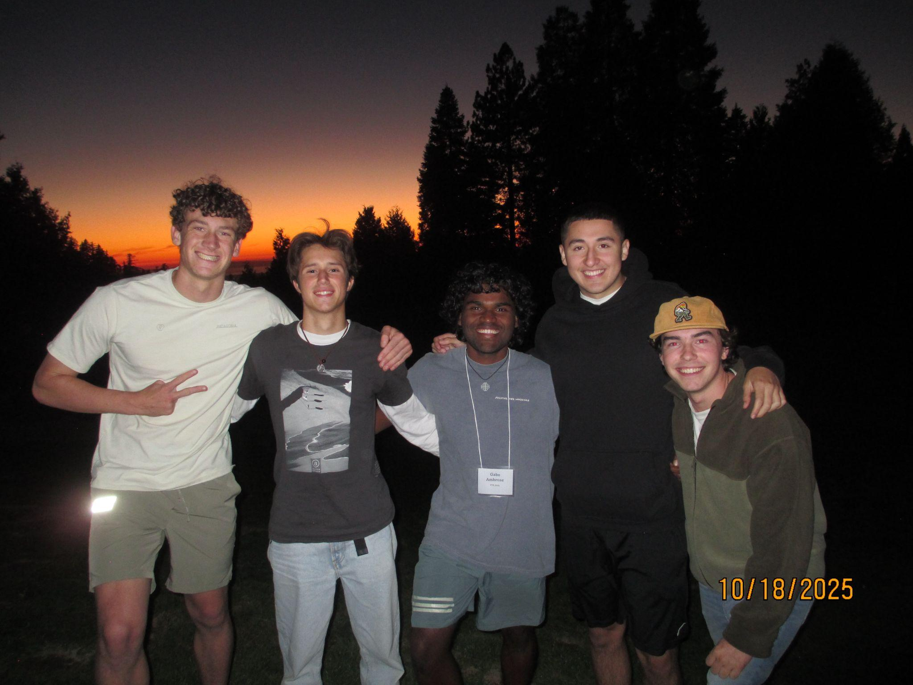
Moments that Happened
-Moments with friends on and off campus
-Personal growth throughout the semester
-Got a new dog

Slide 3
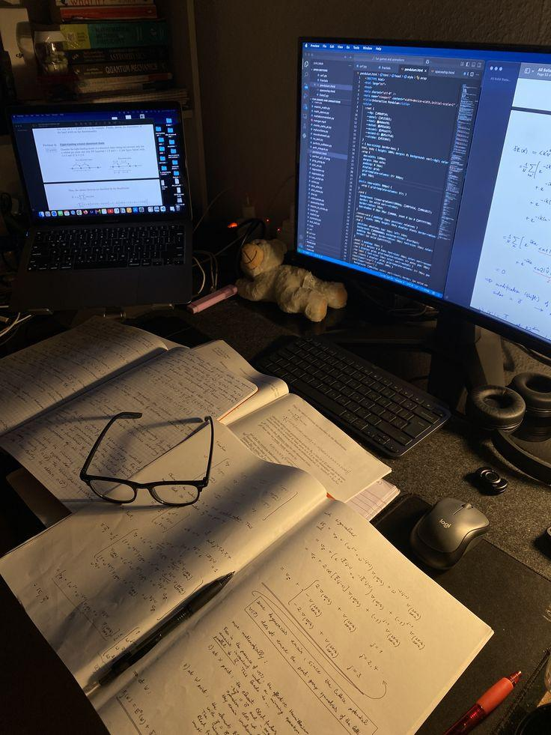
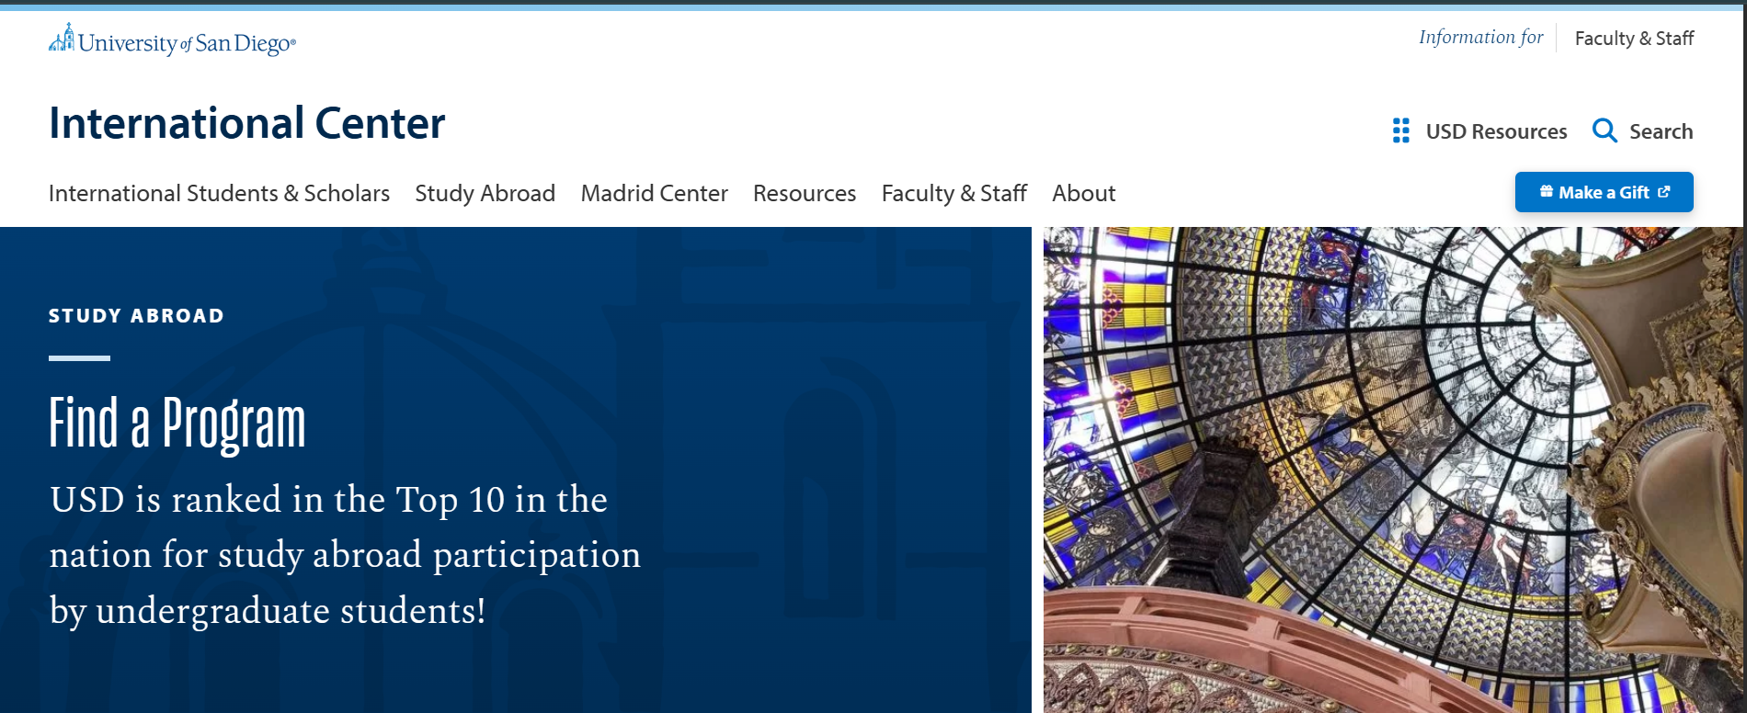
Moments that did not happen
-Plans that did not work out as expected
-Opportunities I hoped for but didn’t receive
-Adjusting to unexpected challenges

Slide 4
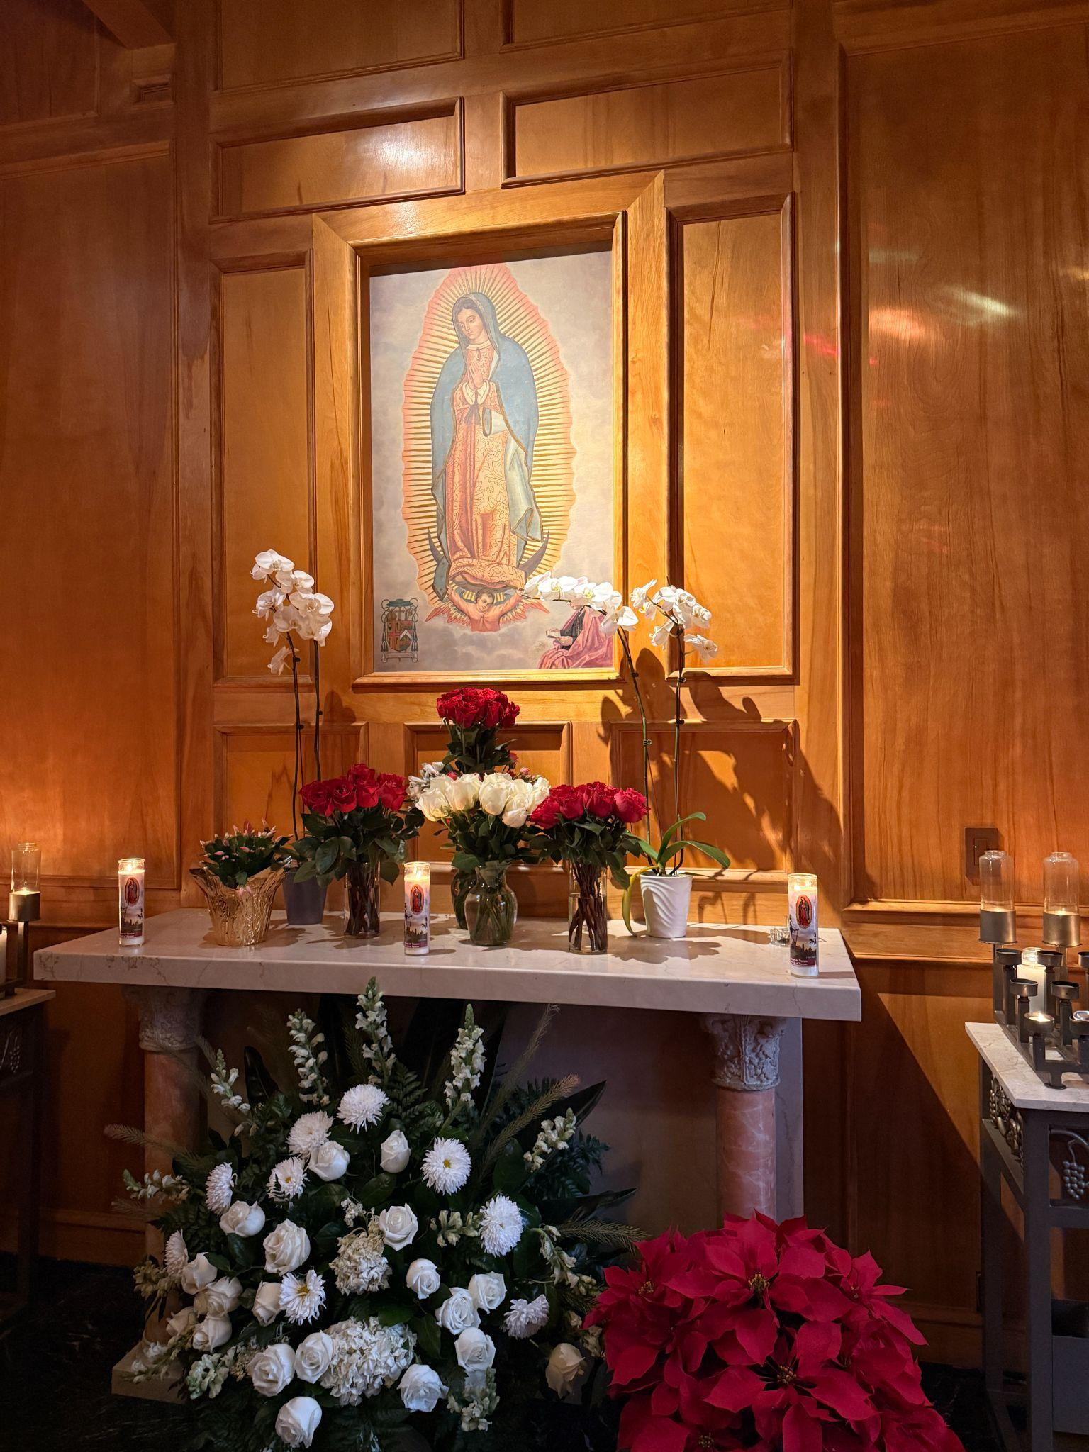
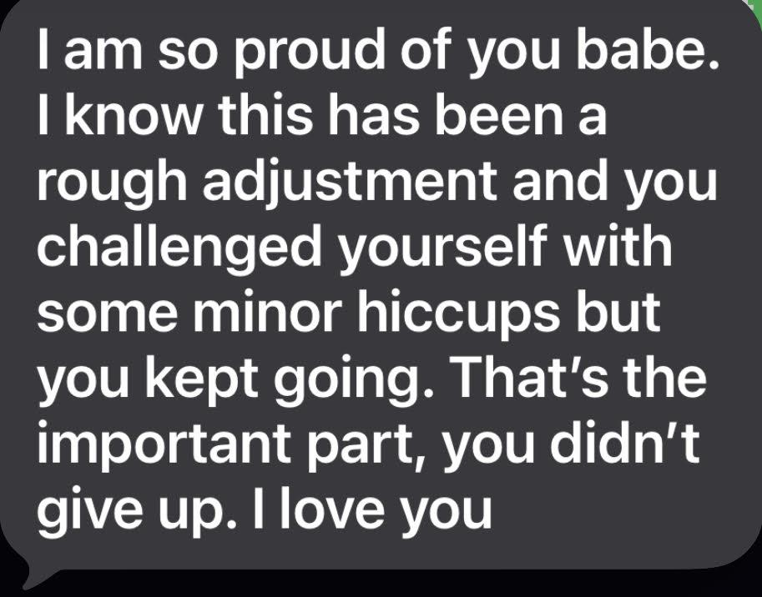
Positive Experiences
Continuing to grow in my faith
Strong support from my family

Slide 5

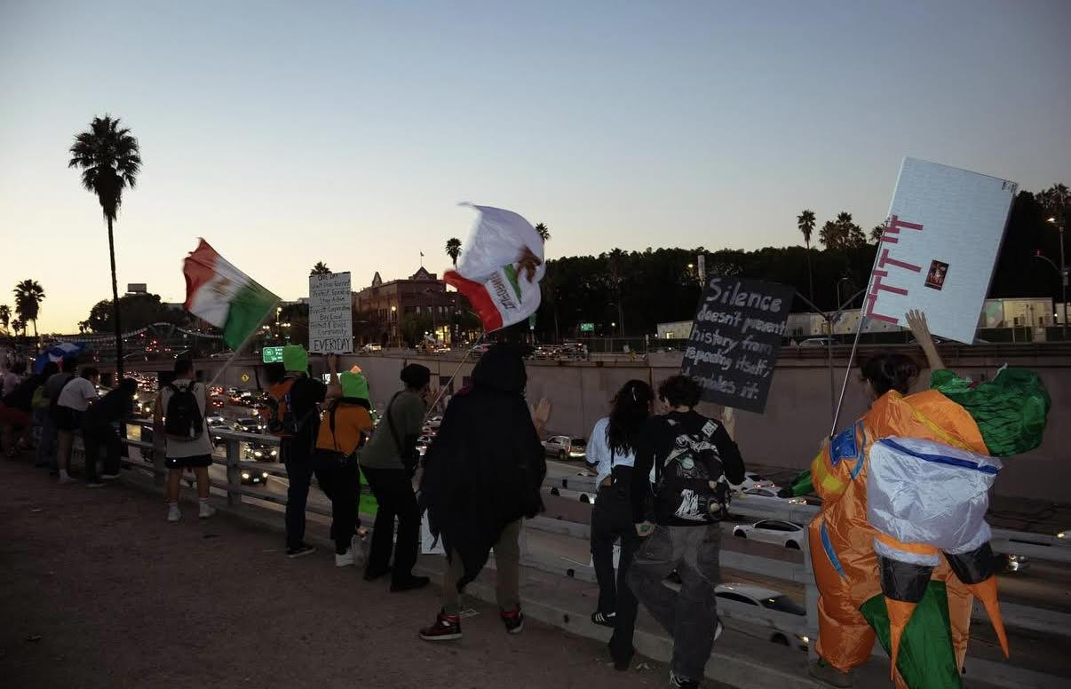

Items highlighted in media & news
-Social media shaping opinions and emotions
- ICE Raids
-Advertisements influencing spending habits

Slide 6


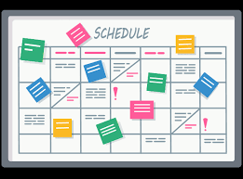
Changes in Processes & Daily Life
-Changes in how food and items are purchased
-Increased use of technology such as AI and communication
-Adapting to new routines

Slide 7
Reflection on the Semester I had
My semester was overall a very meaningful one. I was able to grow in my faith, become closer with my family through different hardships and challenges, and meet new people along the way. I am grateful to now be able to call some of those people good friends. I was also blessed with opportunities this semester, including the chance to attend the University of San Diego, which pushed me to grow both personally and academically.

