Slide 1

Time Capsule Final
Project
Zoe Caldwell

Slide 2
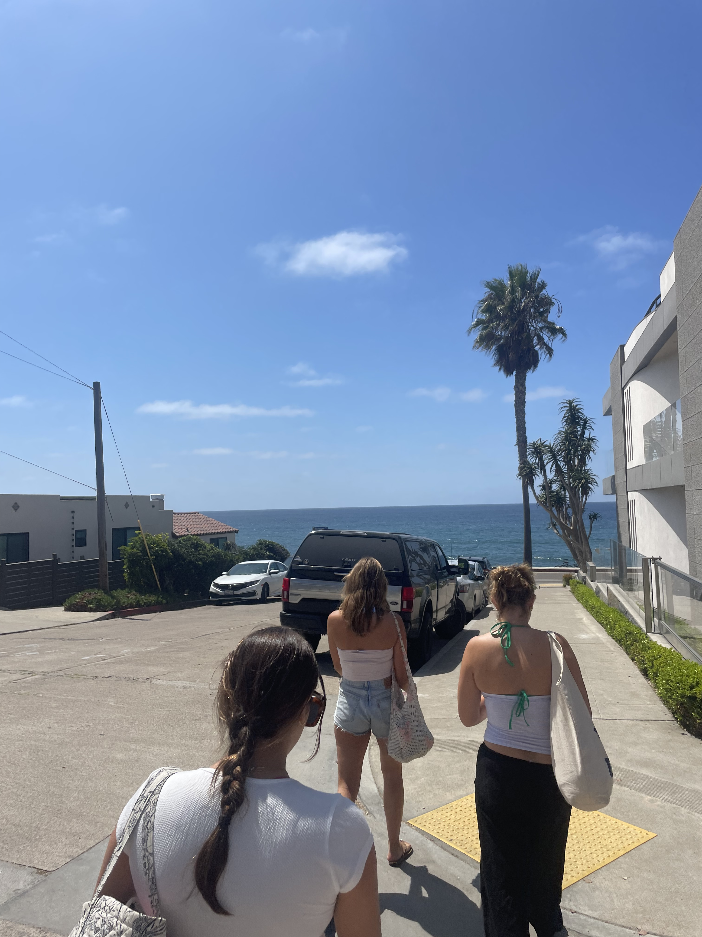
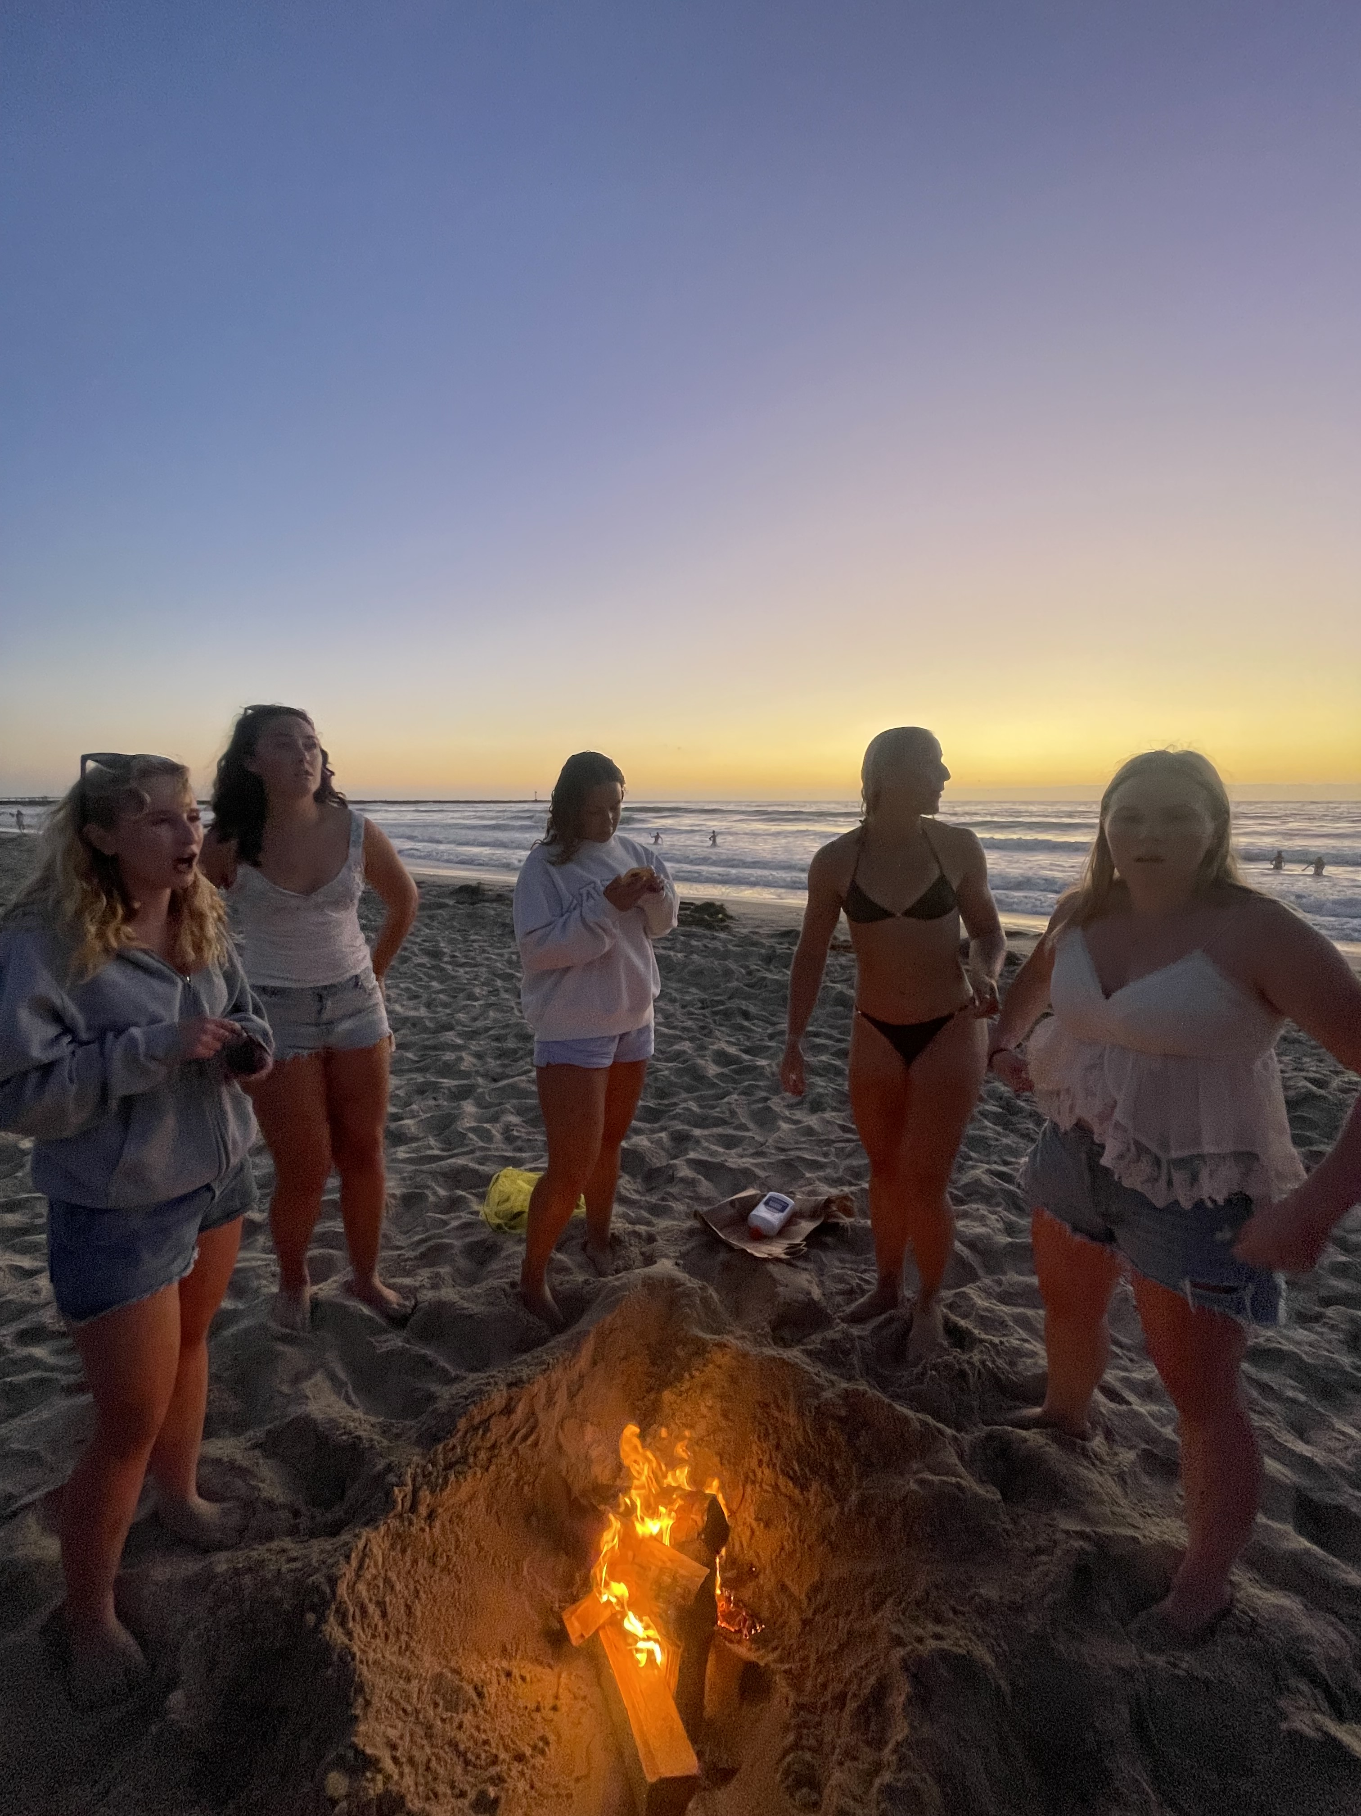
Items that happened in the semester individually, with friends, groups, locally or nationally
Going to the beach with friends

Slide 3
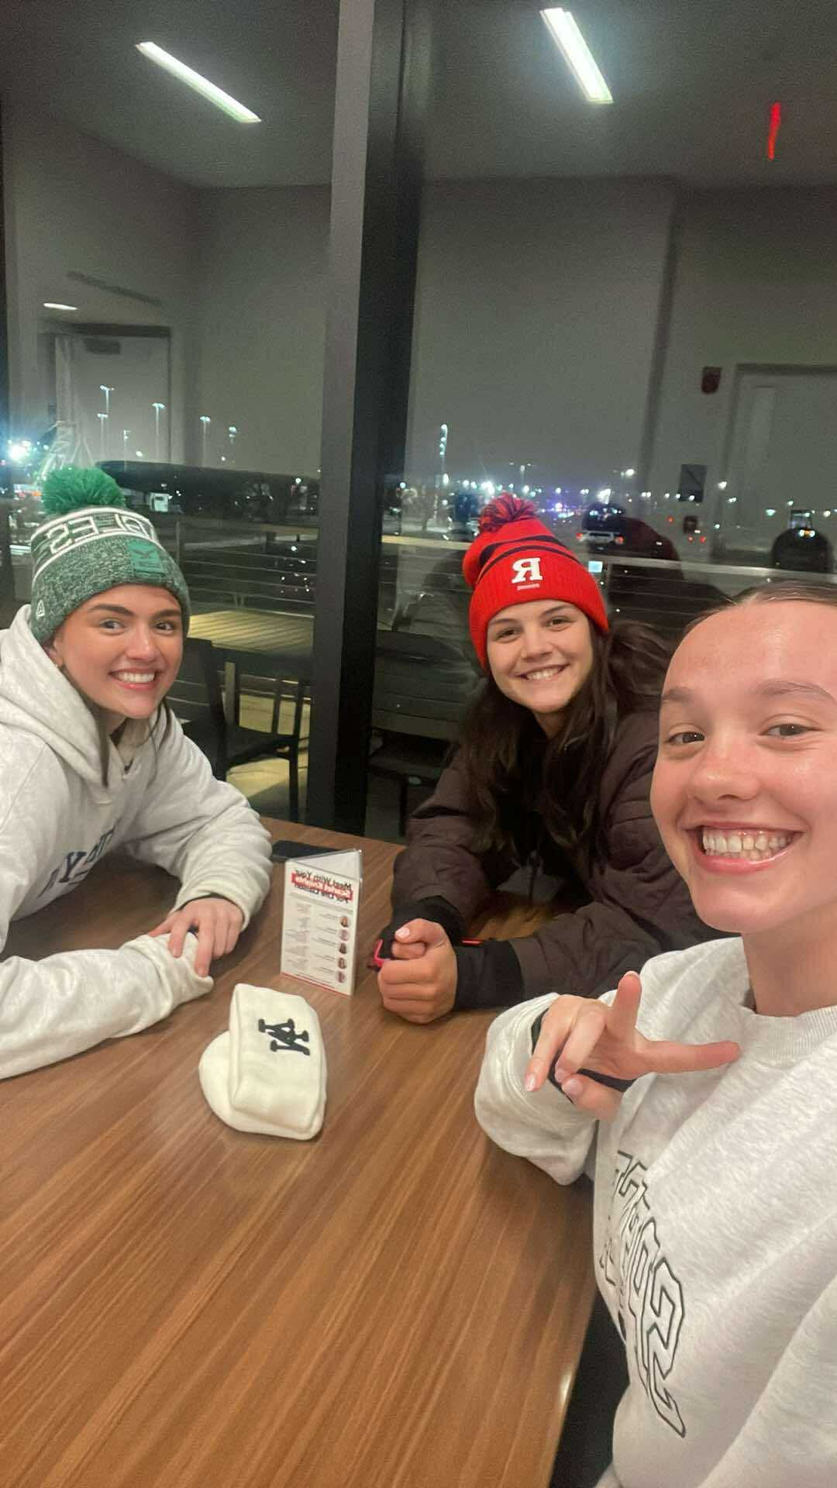
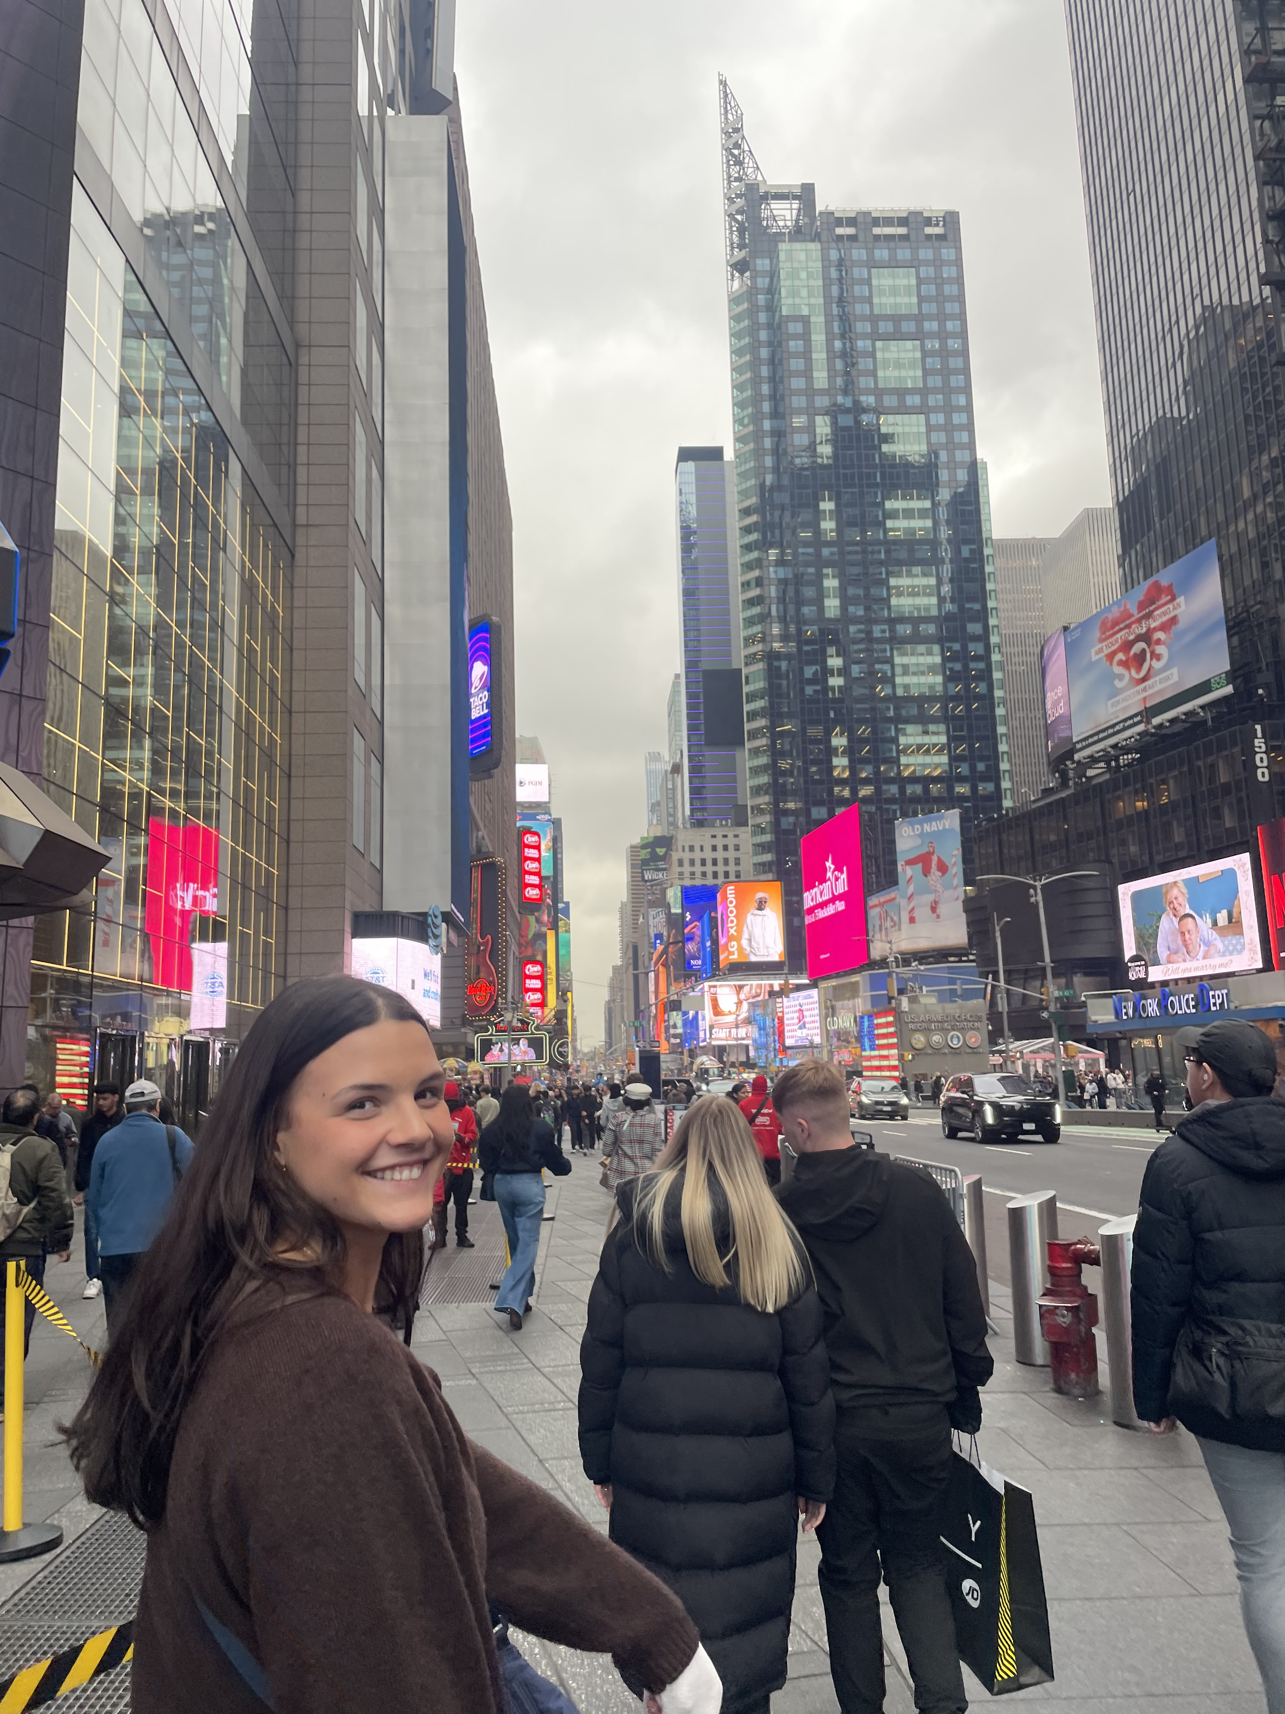
Items that happened in the semester individually, with friends, groups, locally or nationally
Visted my home friends in NYC

Slide 4
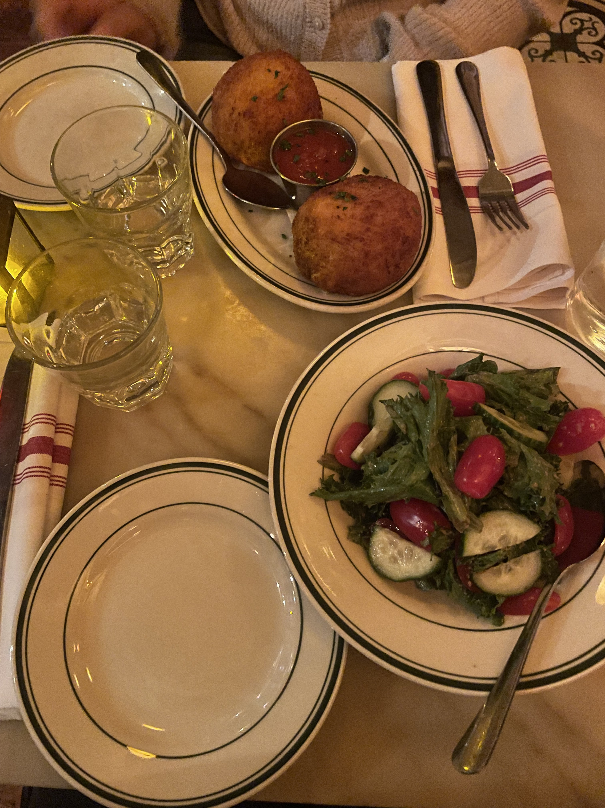
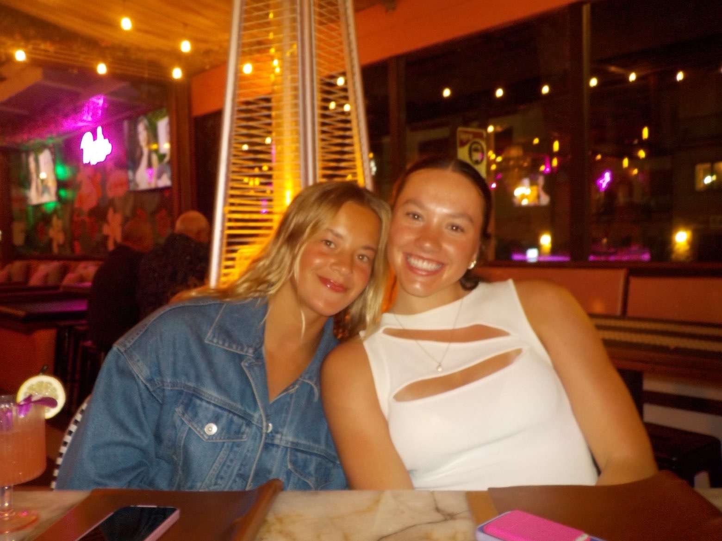
Items that happened in the semester individually, with friends, groups, locally or nationally
Going out for dinner with friends

Slide 5
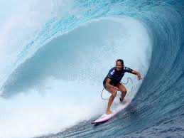
Items that did not happen that you wanted, expected
Wish I went surfing here

Slide 6
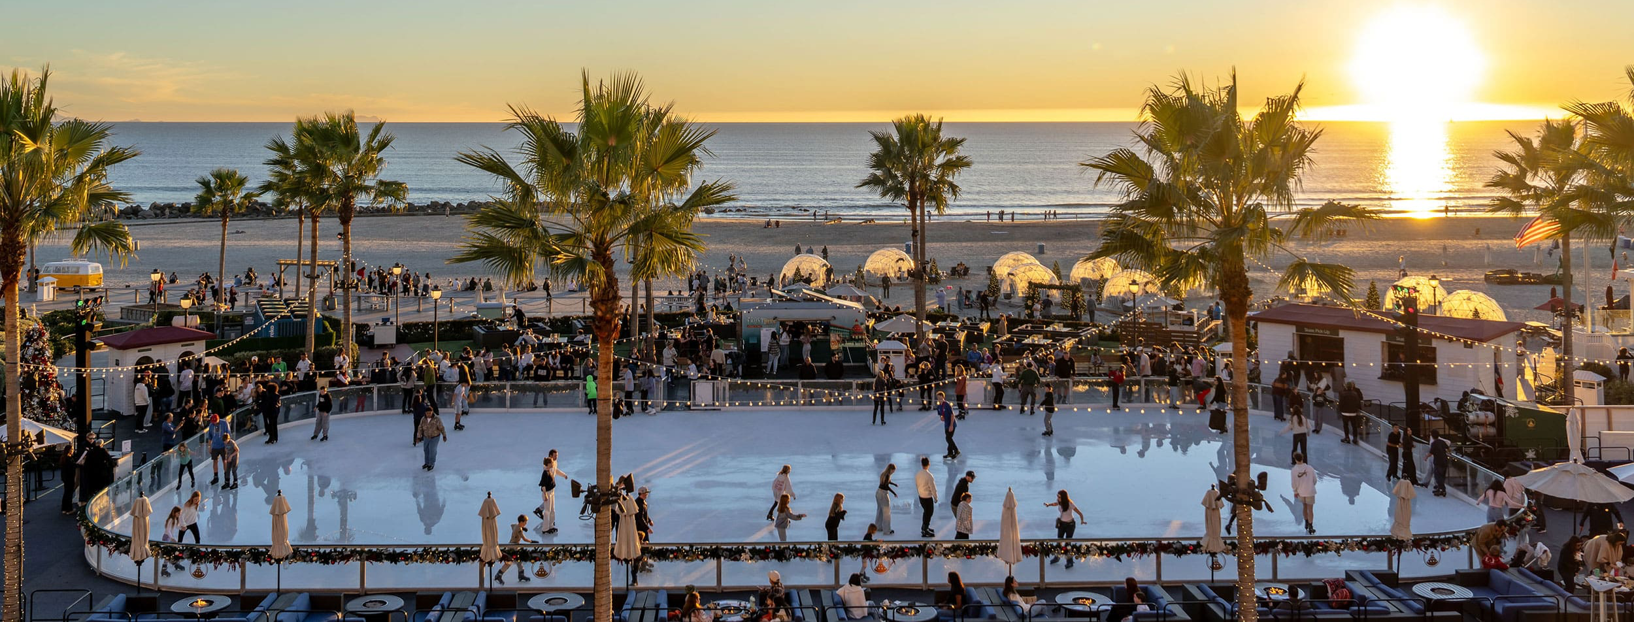
Items that did not happen that you wanted, expected
Ice skating by the Sea

Slide 7
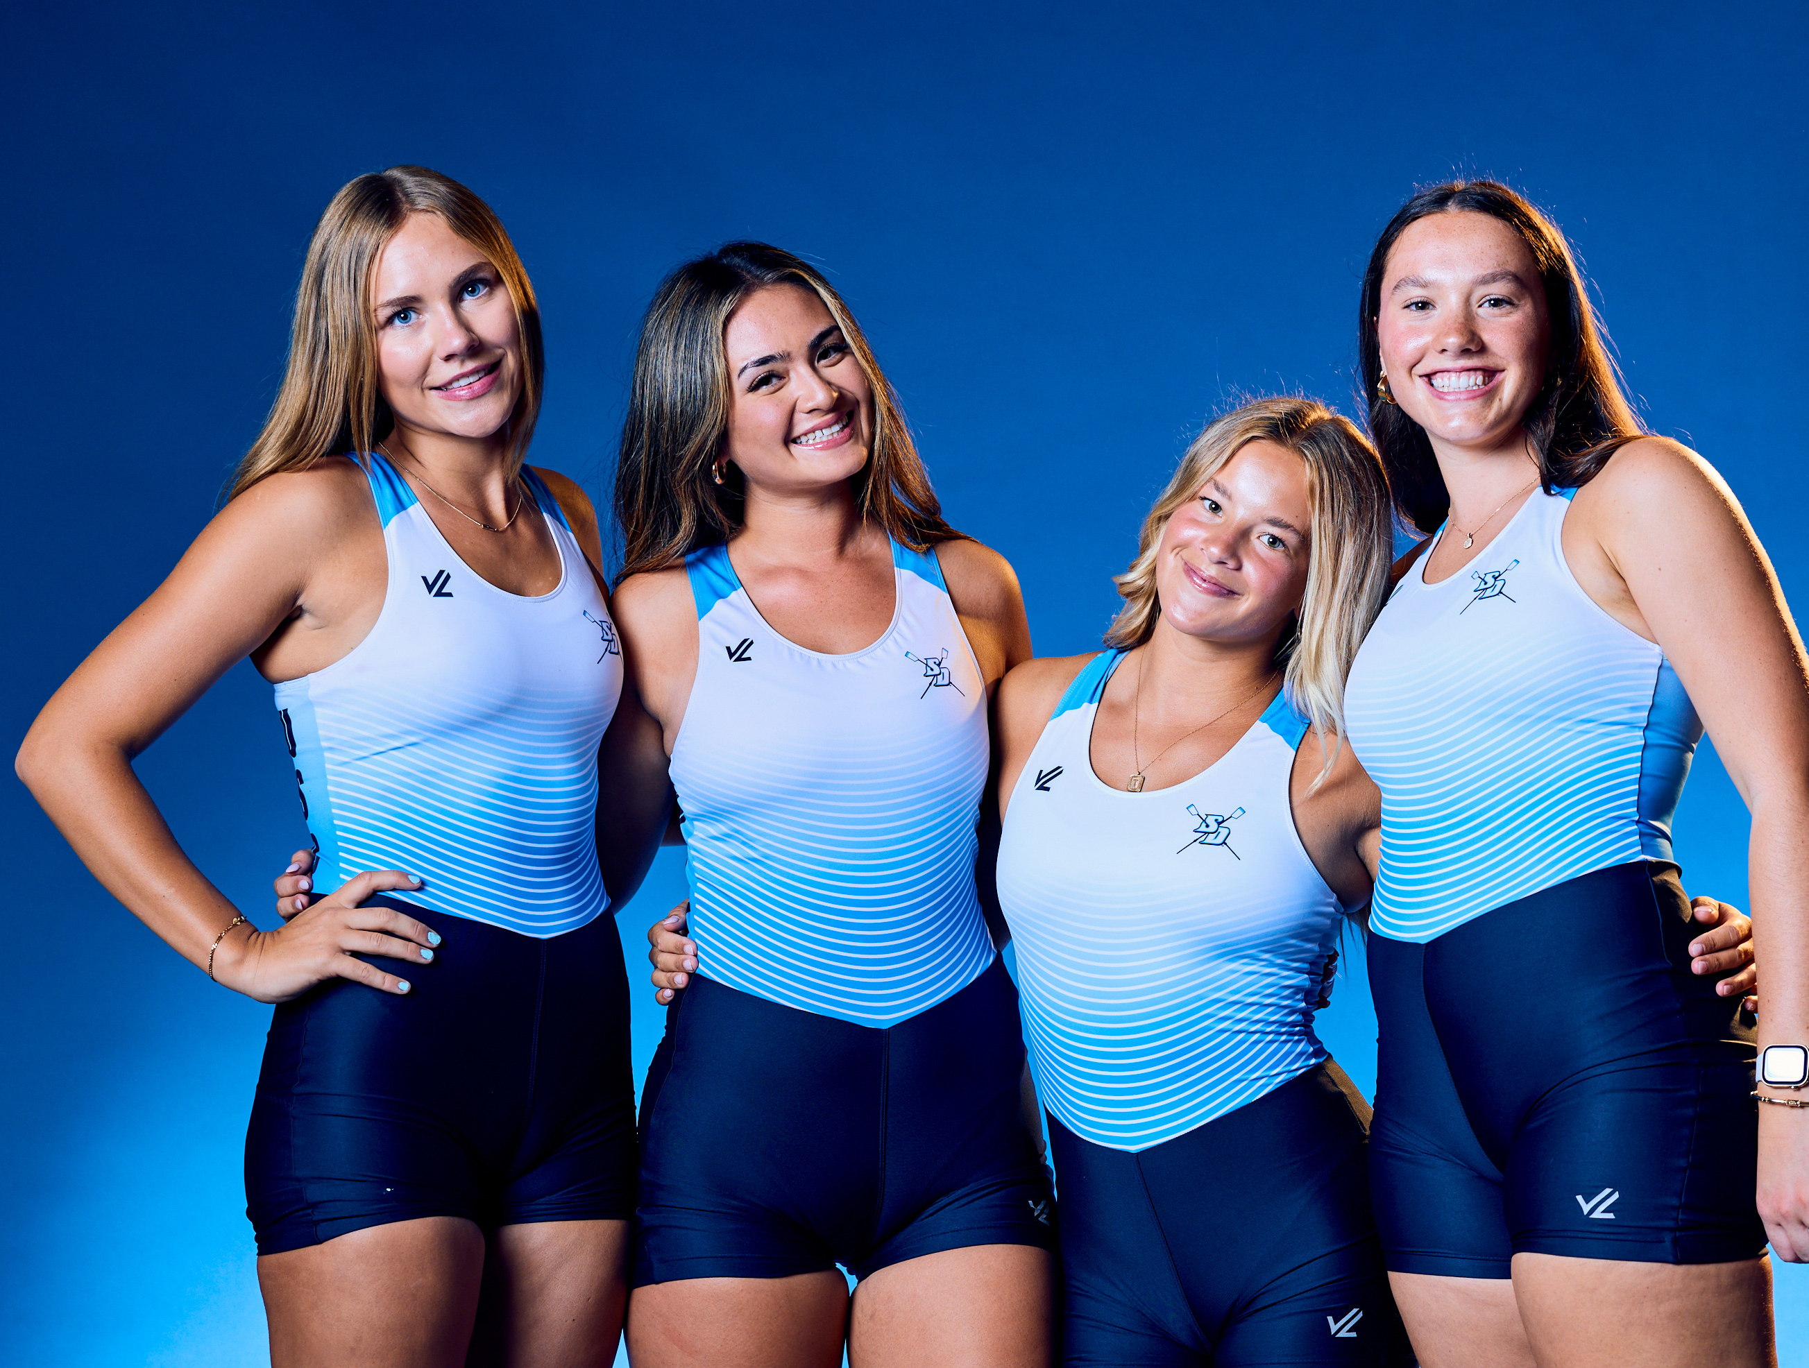
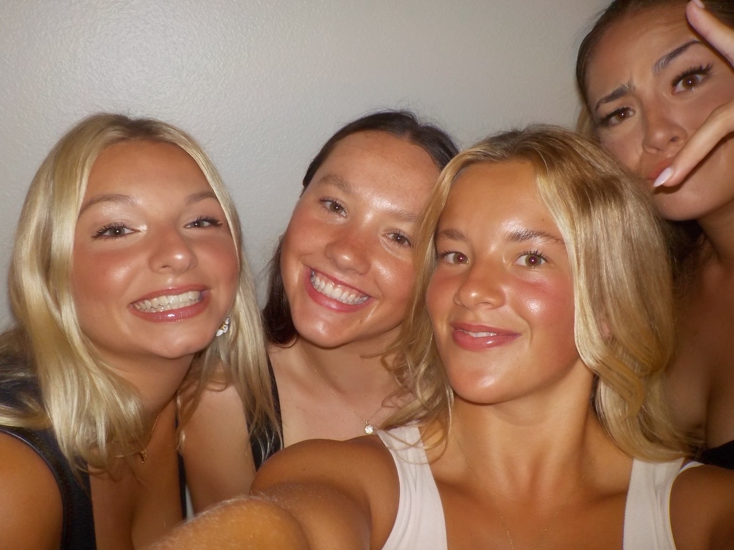
Items that you experienced that have touched your life this semester in a positive way
The rowing team

Slide 8
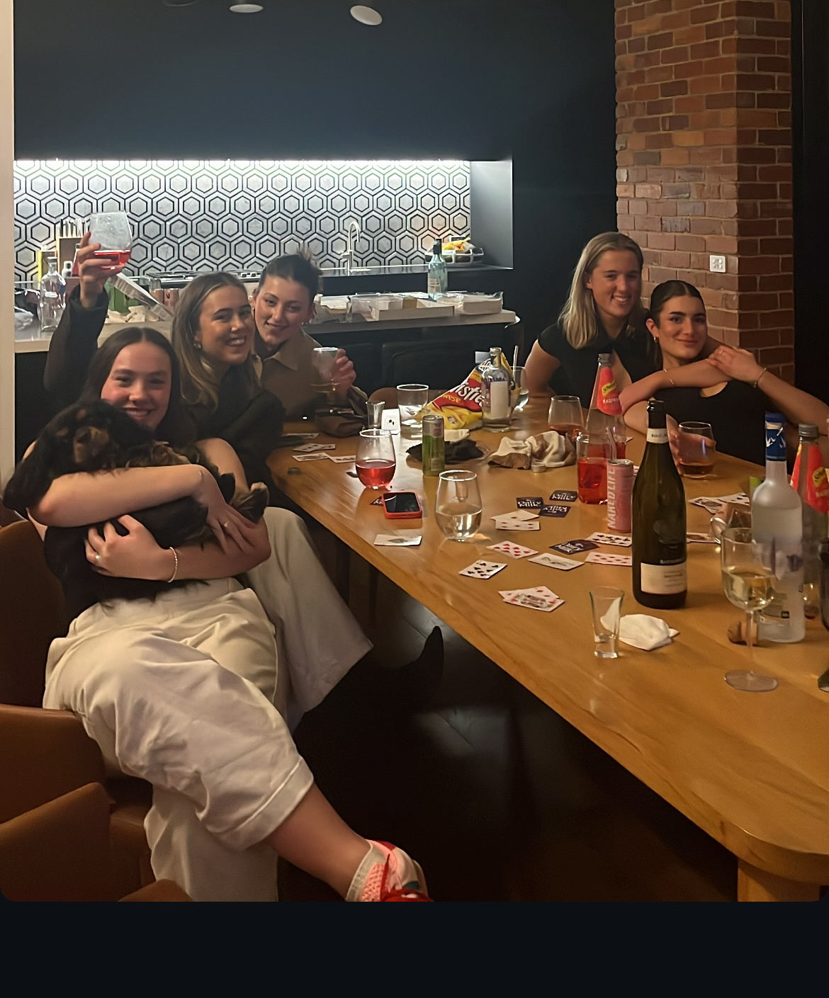
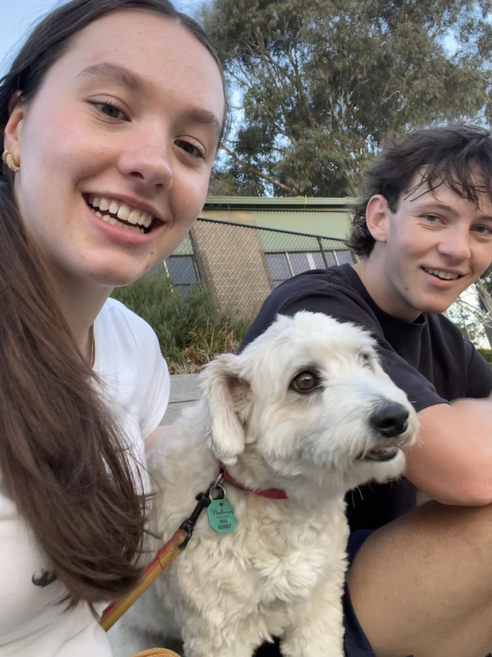
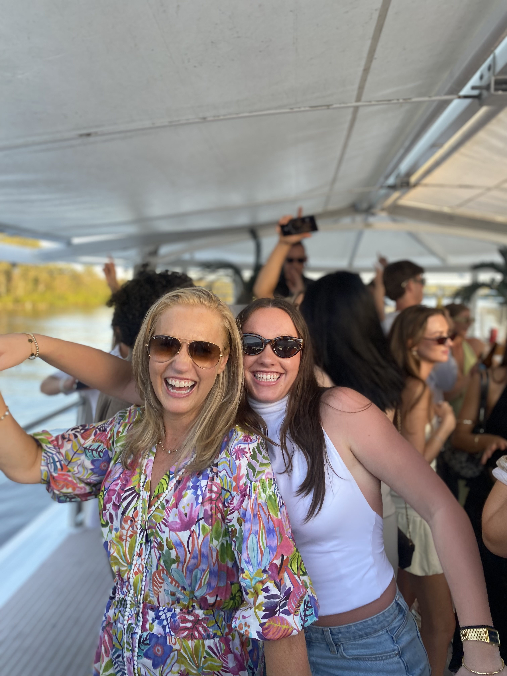
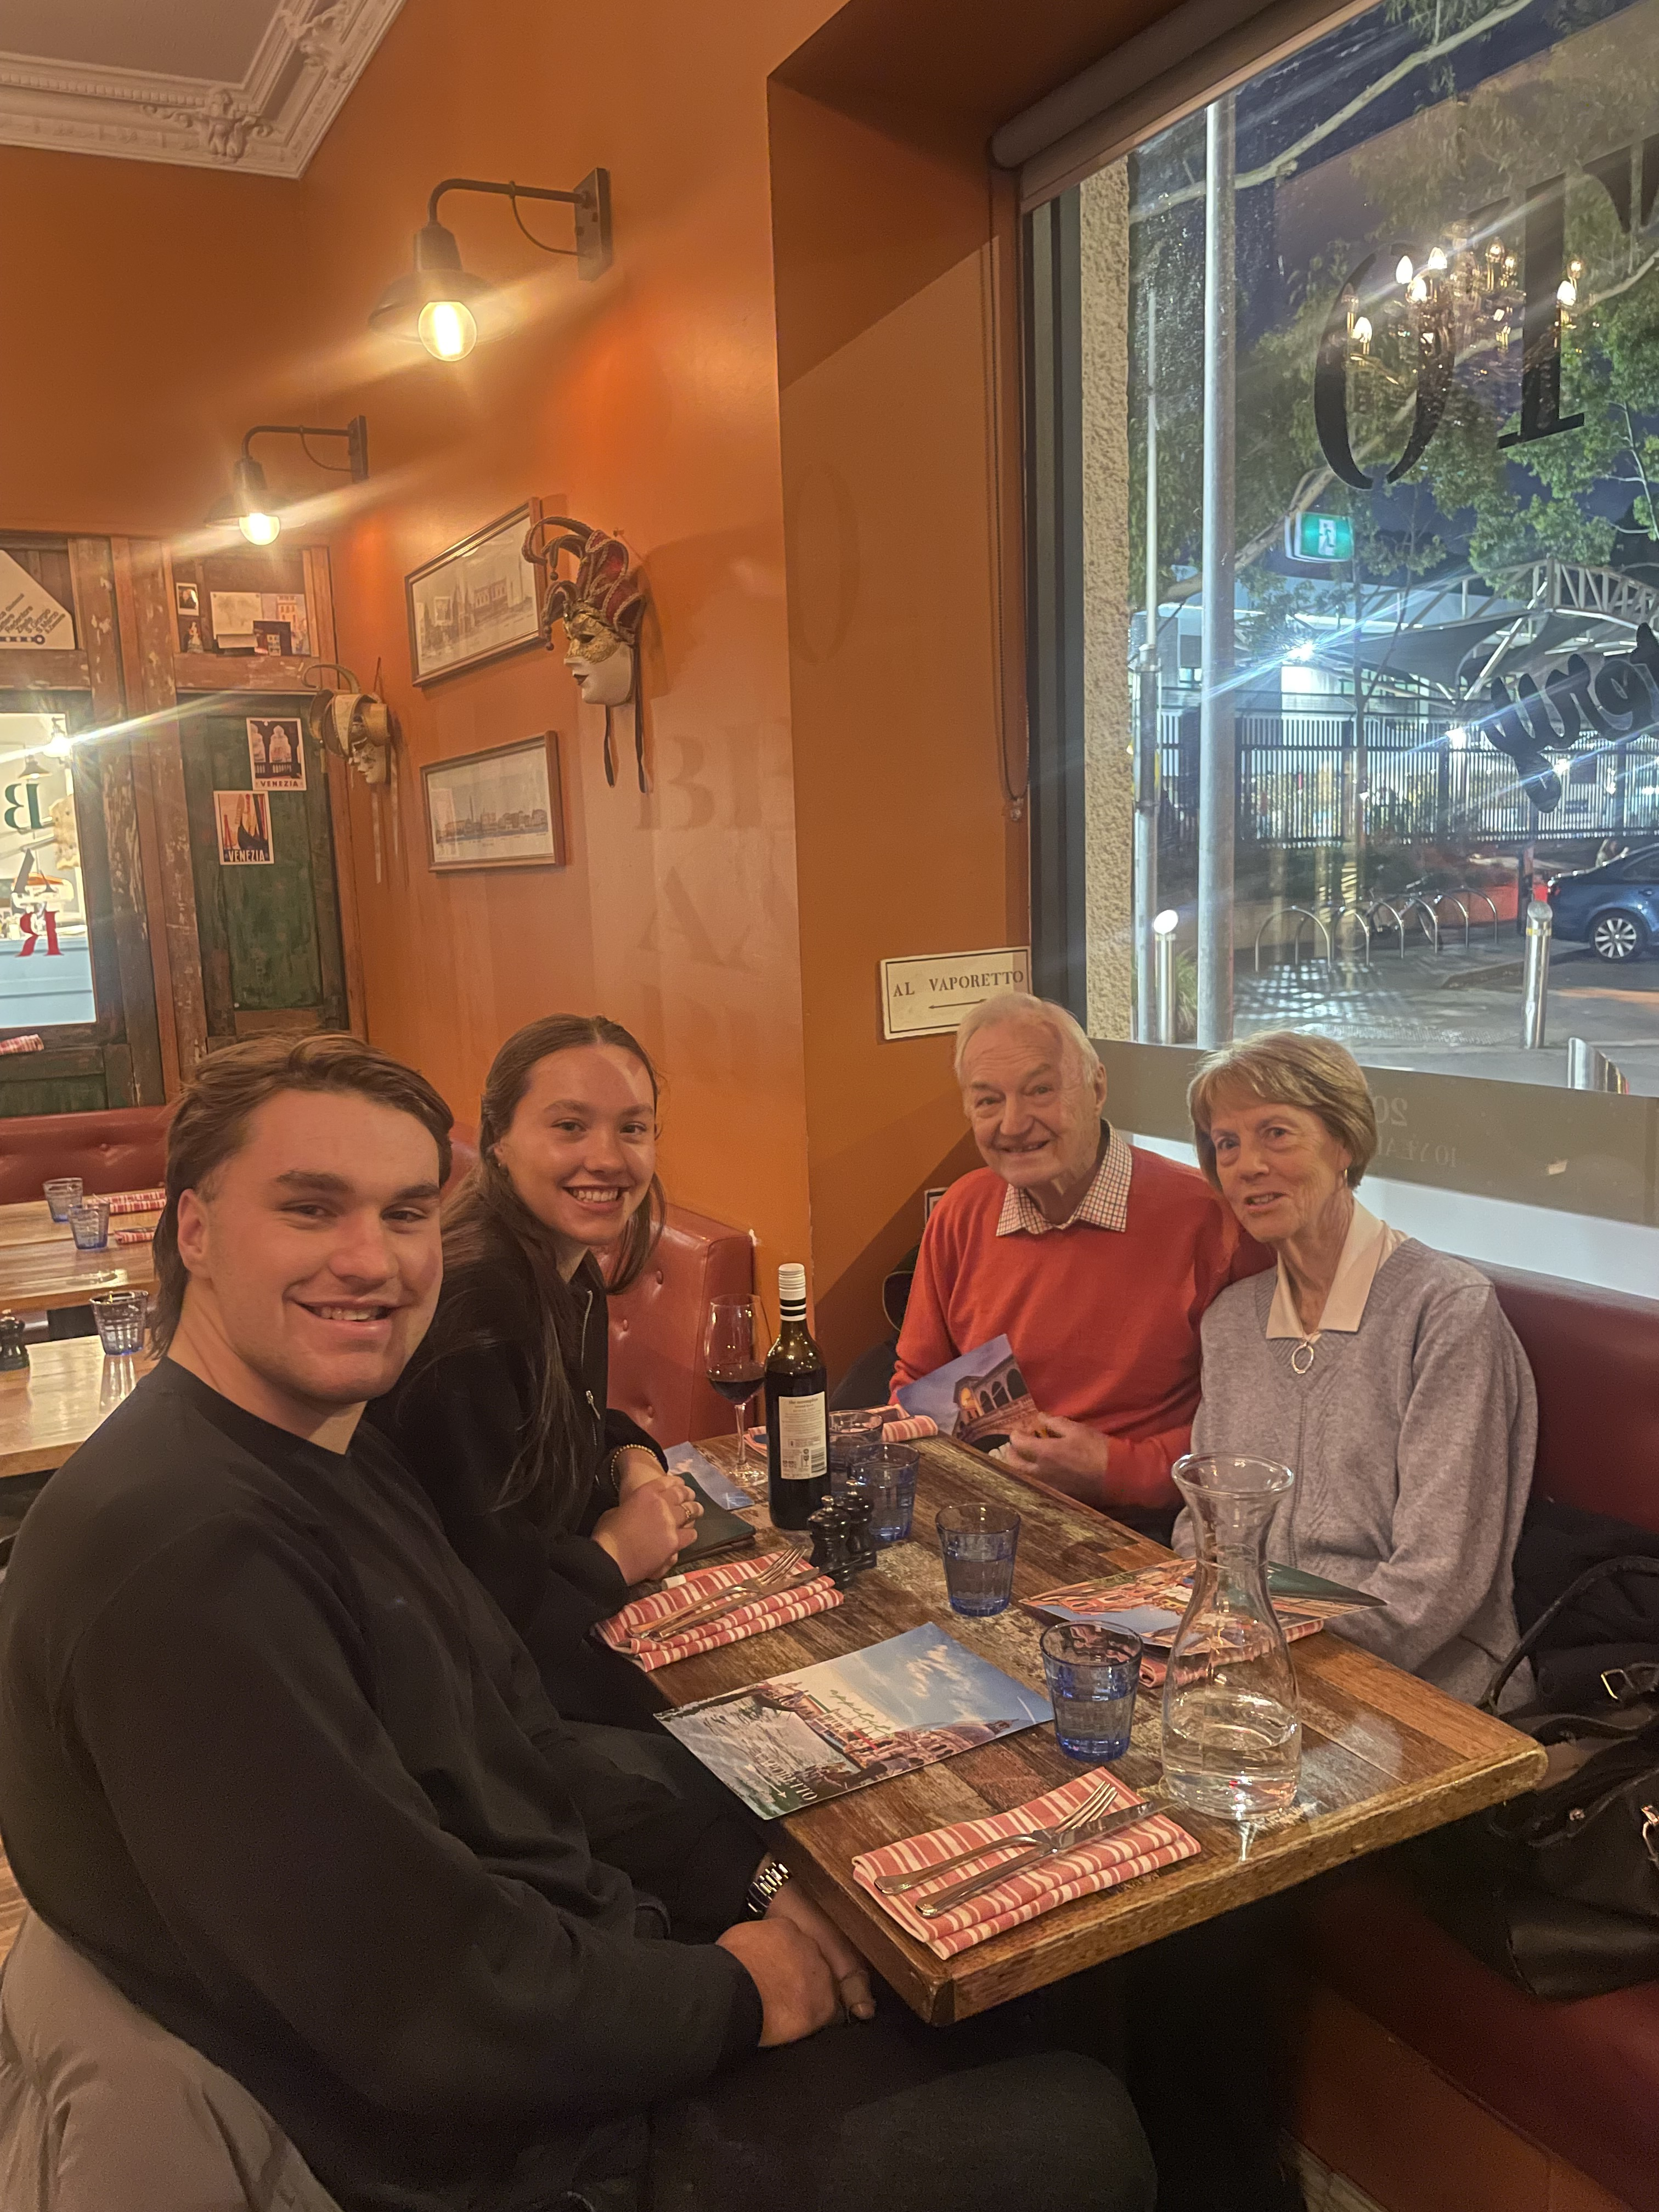
Items that you experienced that were sad or negative that you wish not to be experienced again
Being so far from my friends and family

Slide 9

Items that were highlighted by news, media advertisements/messages, government, other countries, other sources
US Government Shut Down

Slide 10

Items that were highlighted by news, media advertisements/messages, government, other countries, other sources
Australian Social Media Ban for under 16s

Slide 11


Items that illustrates changes to processes (buying food other items), laws/restrictions

Slide 12
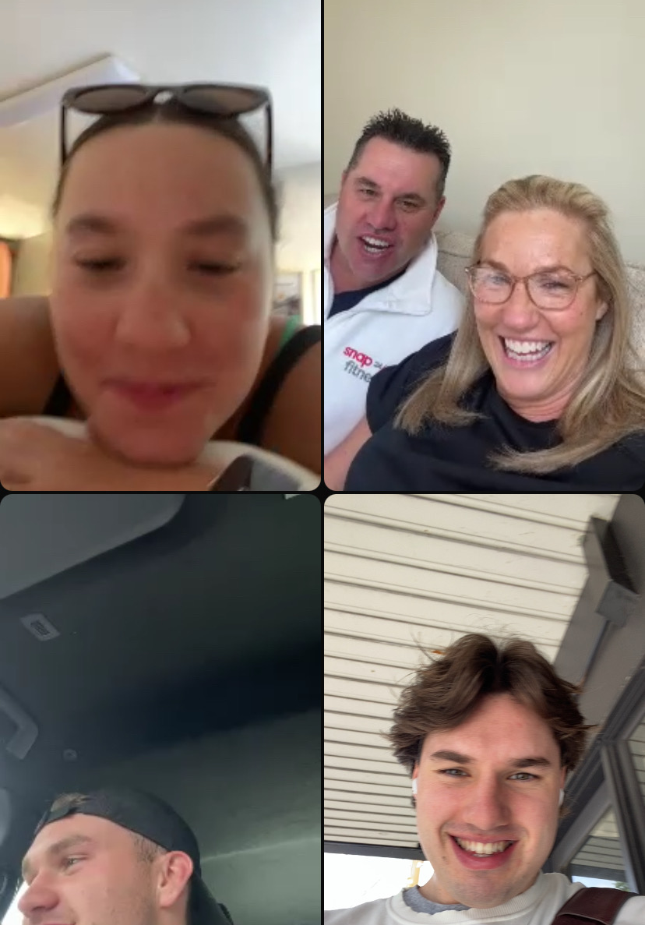
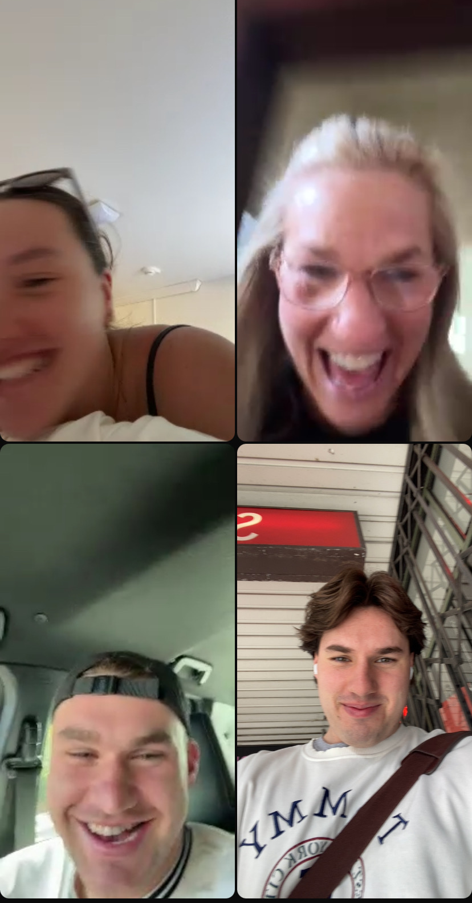
Items that illustrates people’s creativity to assist others
Calling my Mum for
her birthday

Slide 13
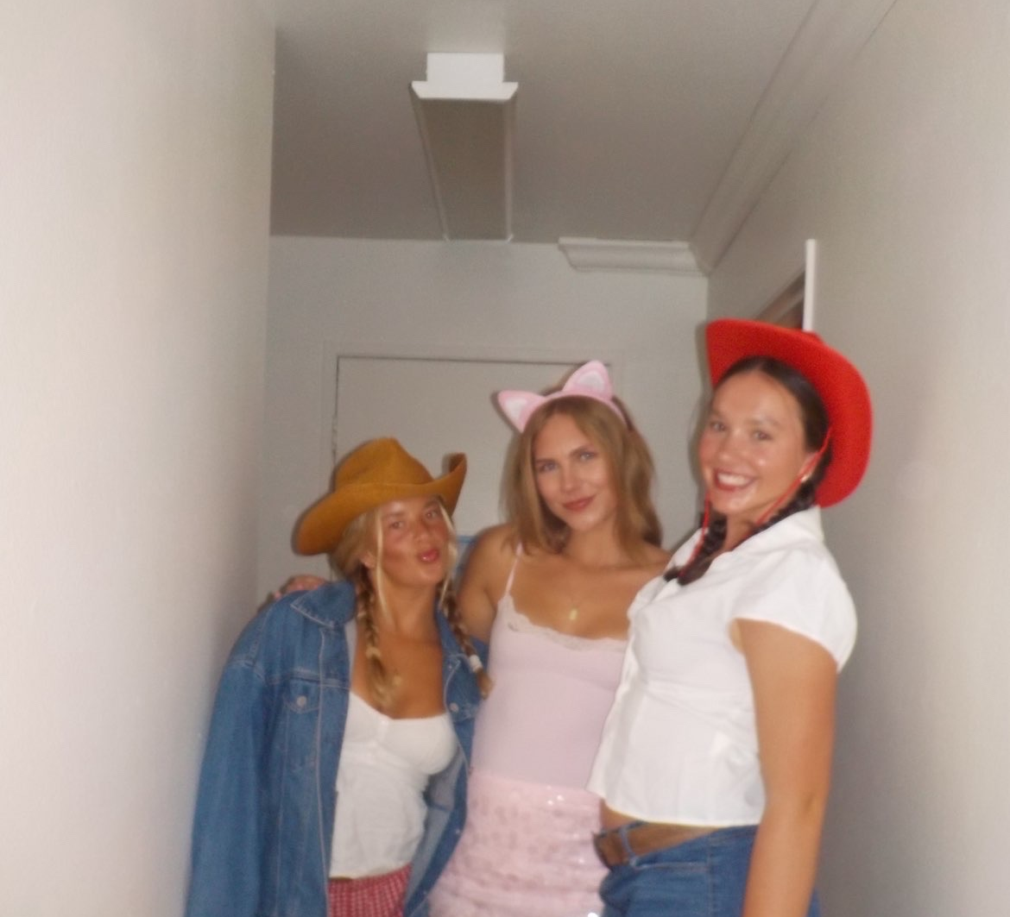
Other relevant items to discuss the semester you had, the semester you wanted, and the semesters that you wish to have in the future.
Living with roommates
for the first time

Slide 14
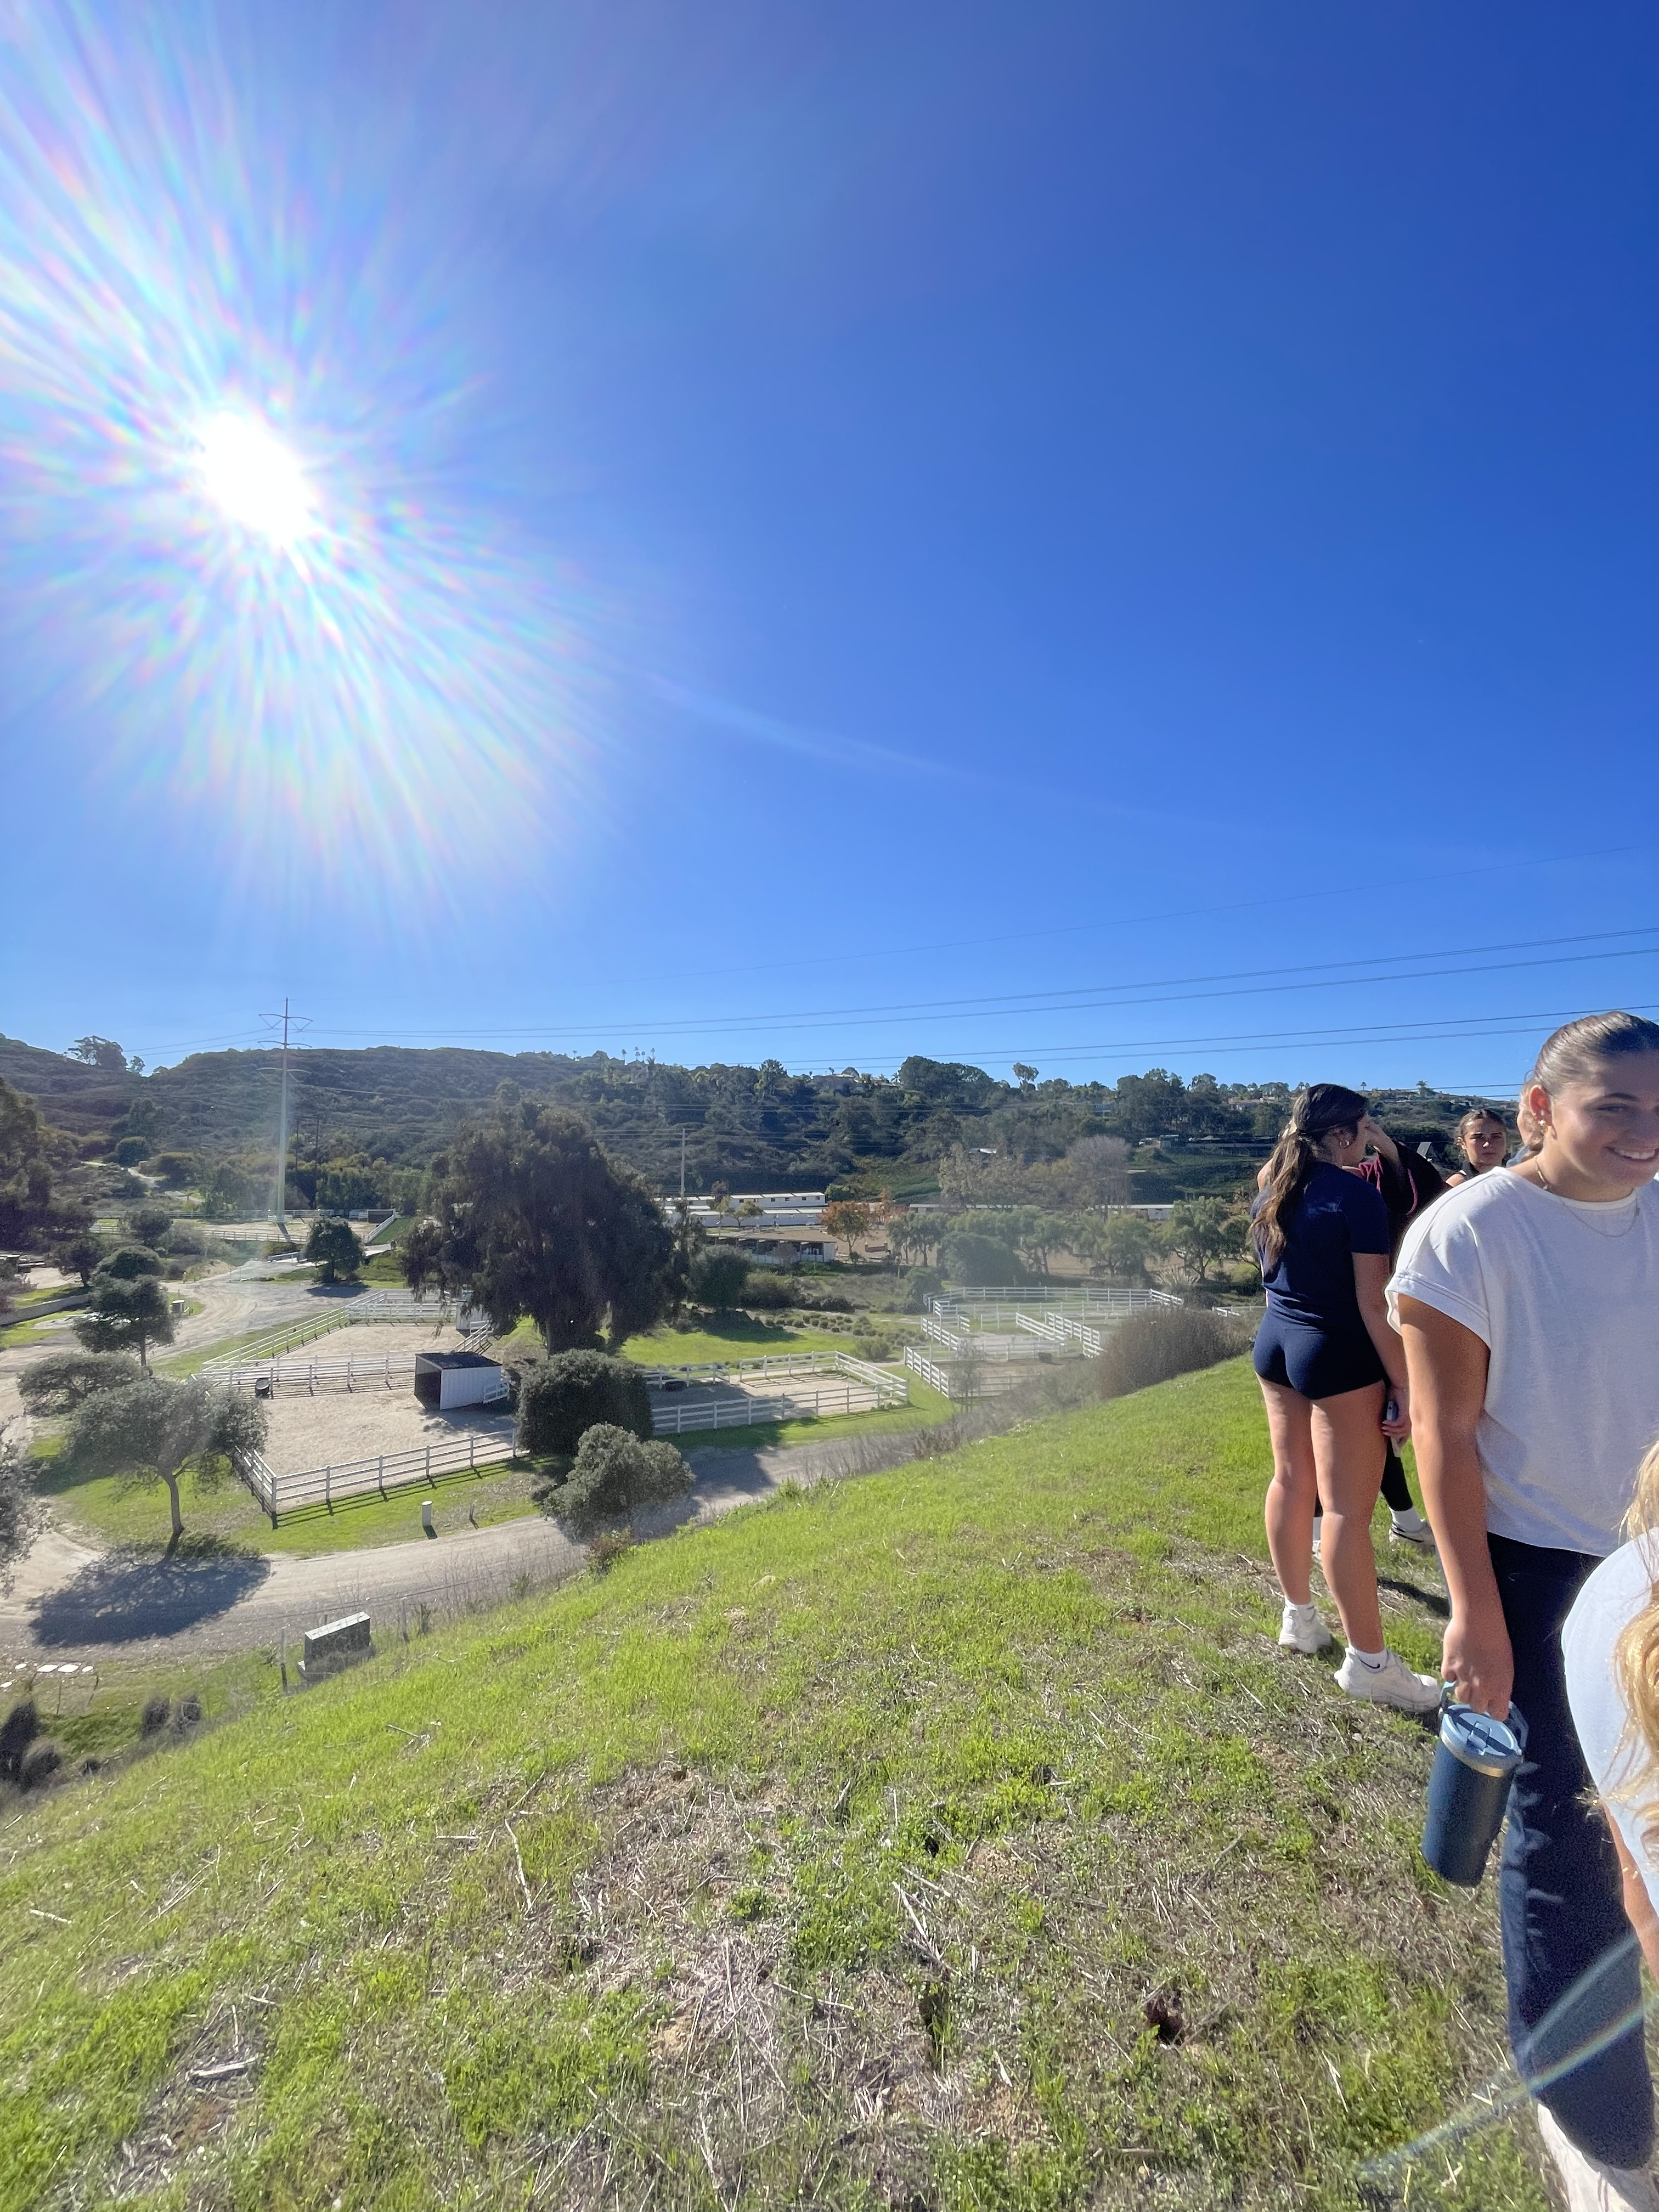
Other relevant items to discuss the semester you had, the semester you wanted, and the semesters that you wish to have in the future.
Bonding with my
teammates

