Slide 1

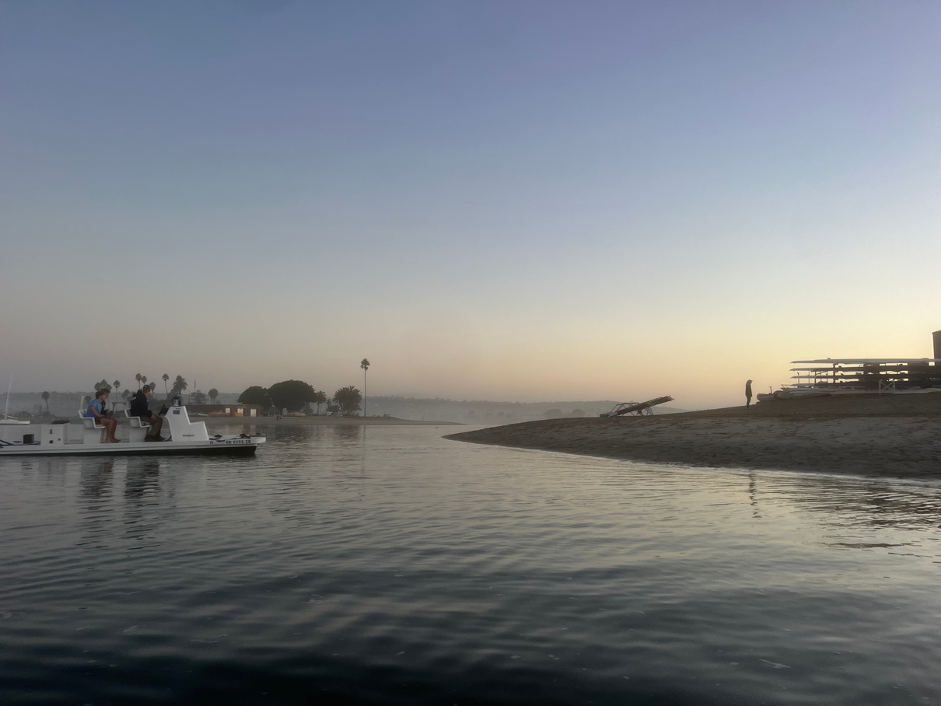
My Semester in Review
TIME CAPSULE FINAL
Shayna Blumenfeld

Slide 2
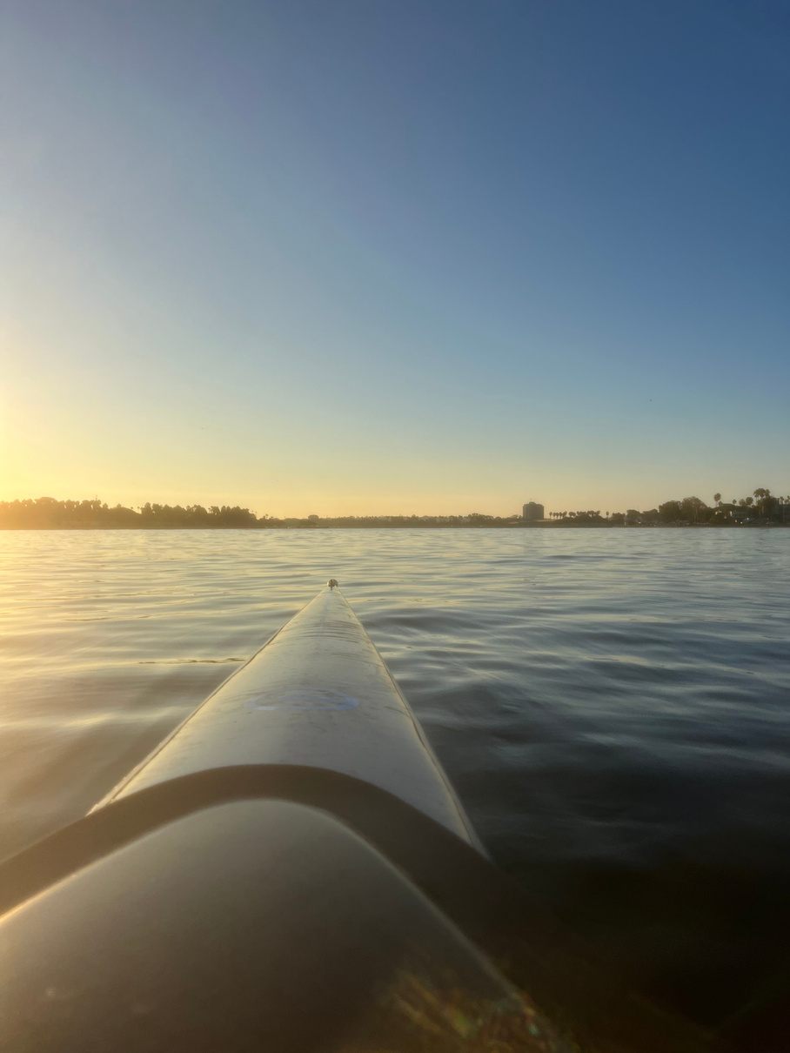
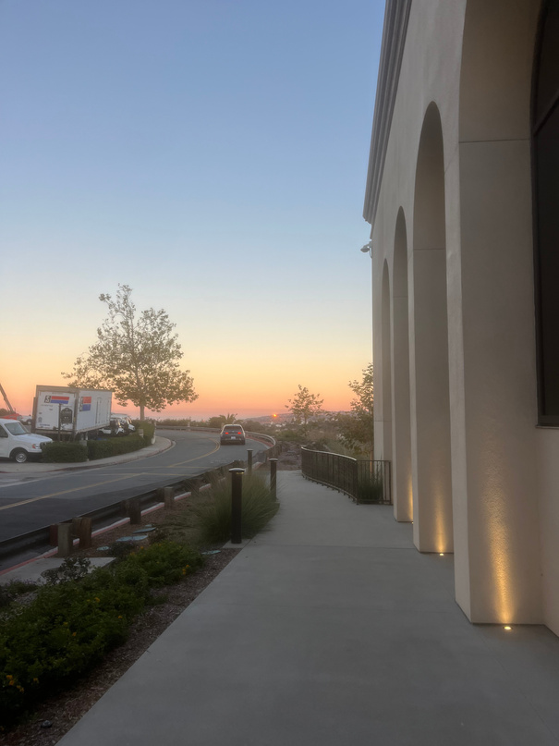
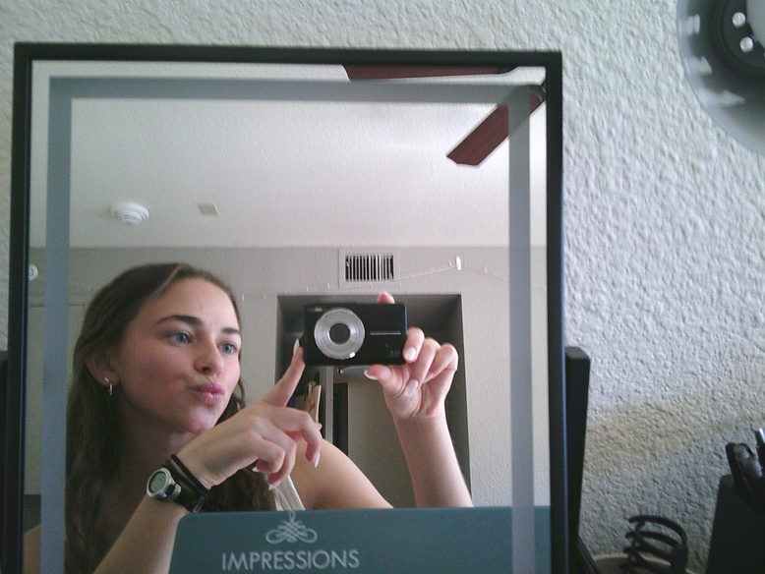
individual experiences
Going on walks in the mornings
Getting to watch the sunrise on the bay.
Getting ready by myself - very peaceful!

Slide 3
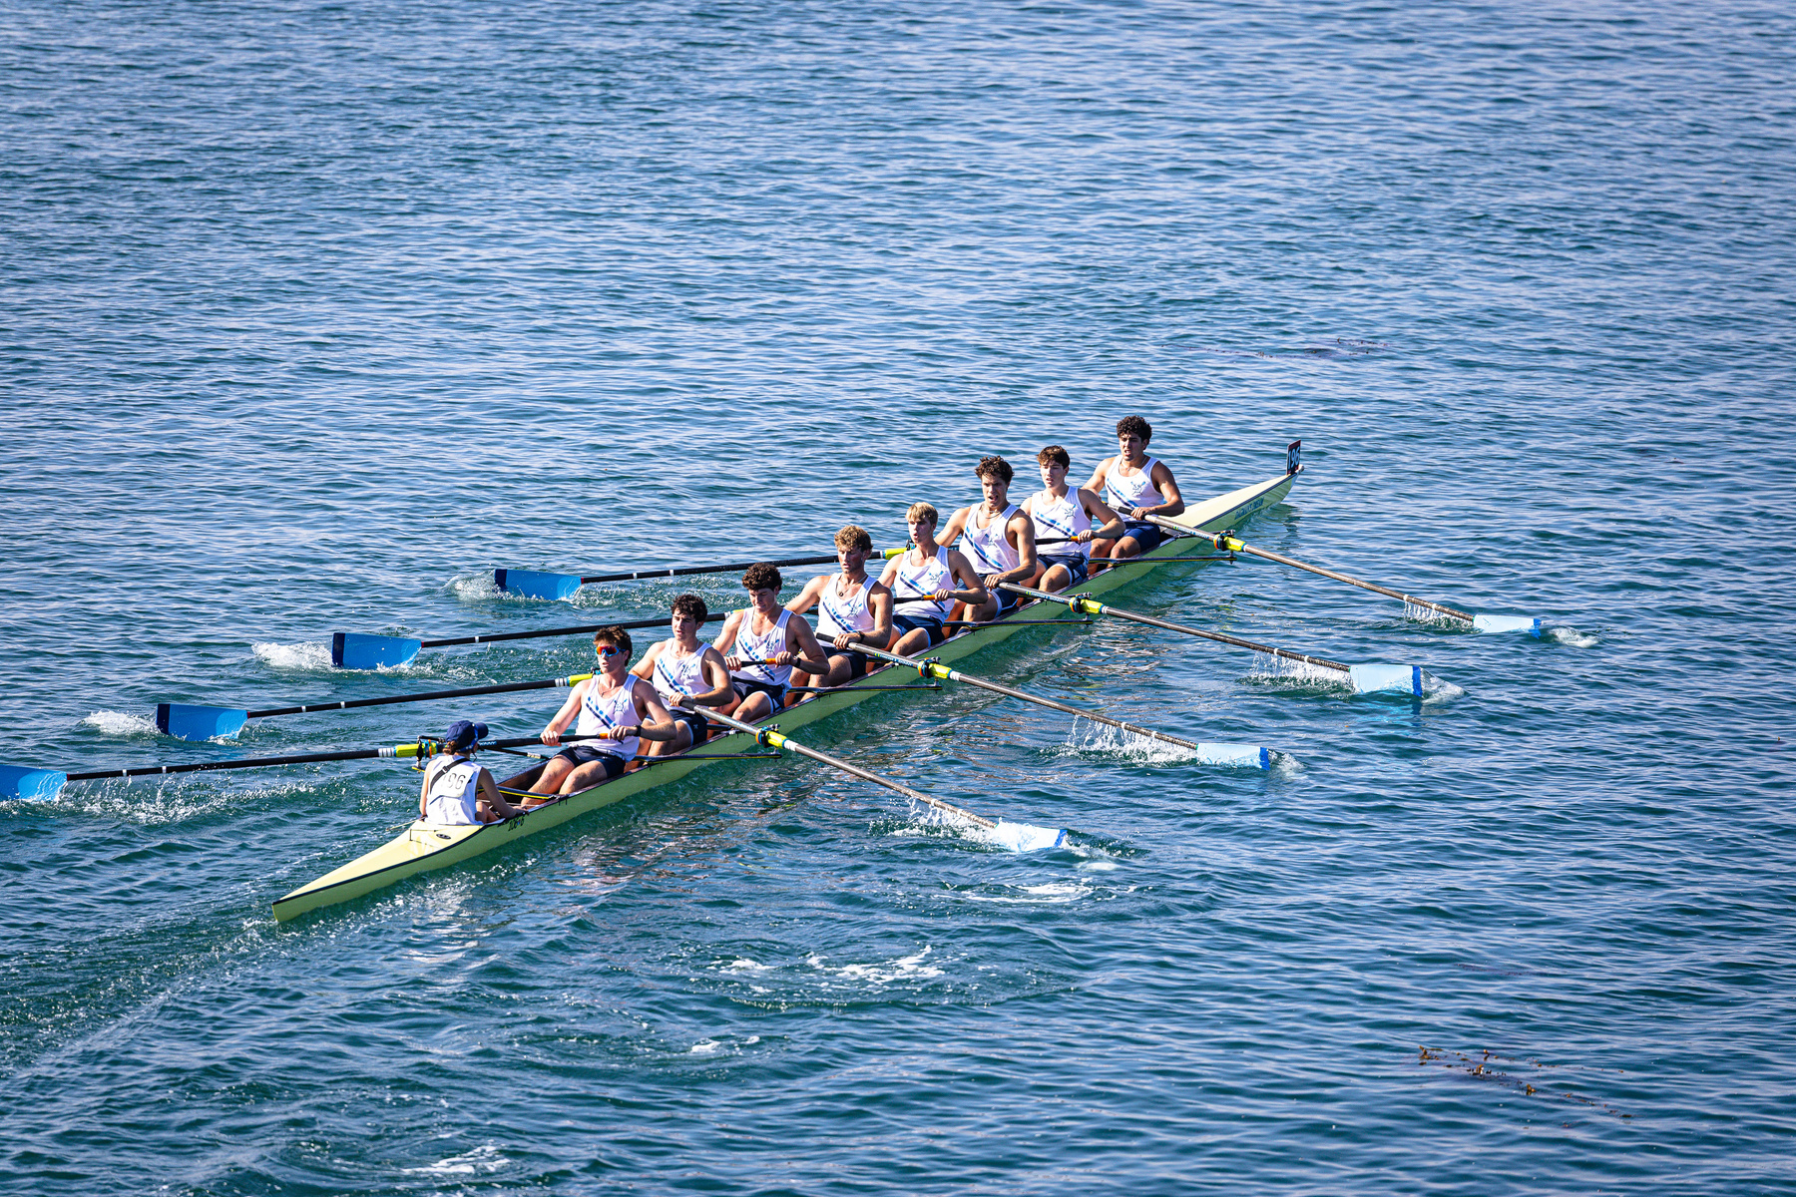
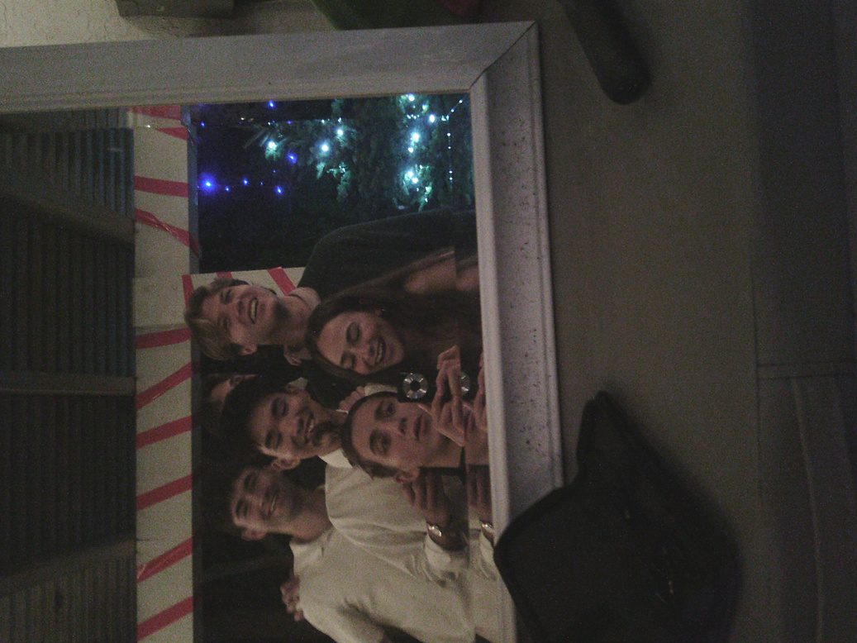
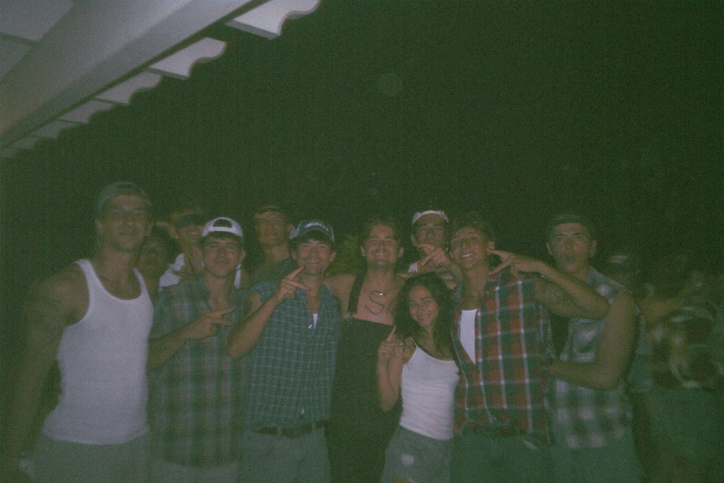
experiences with friends & groups
Winning Fall Classic in the Freshman 8+
Cutting my friends hair!
Experiencing fun nights together as a team

Slide 4
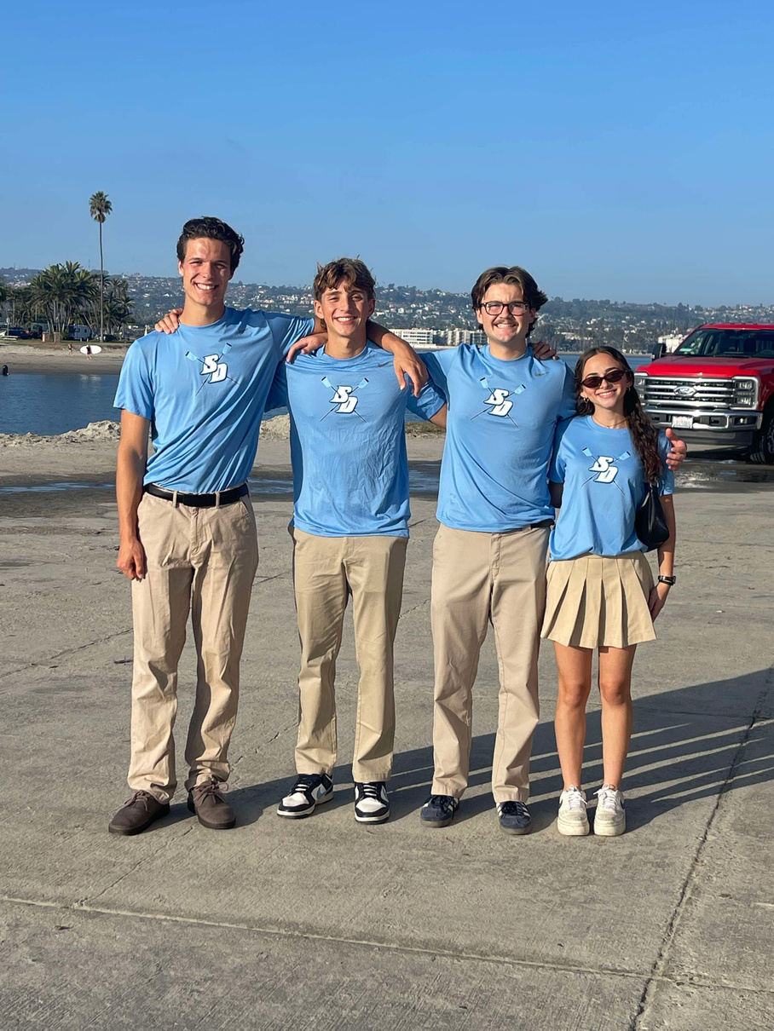
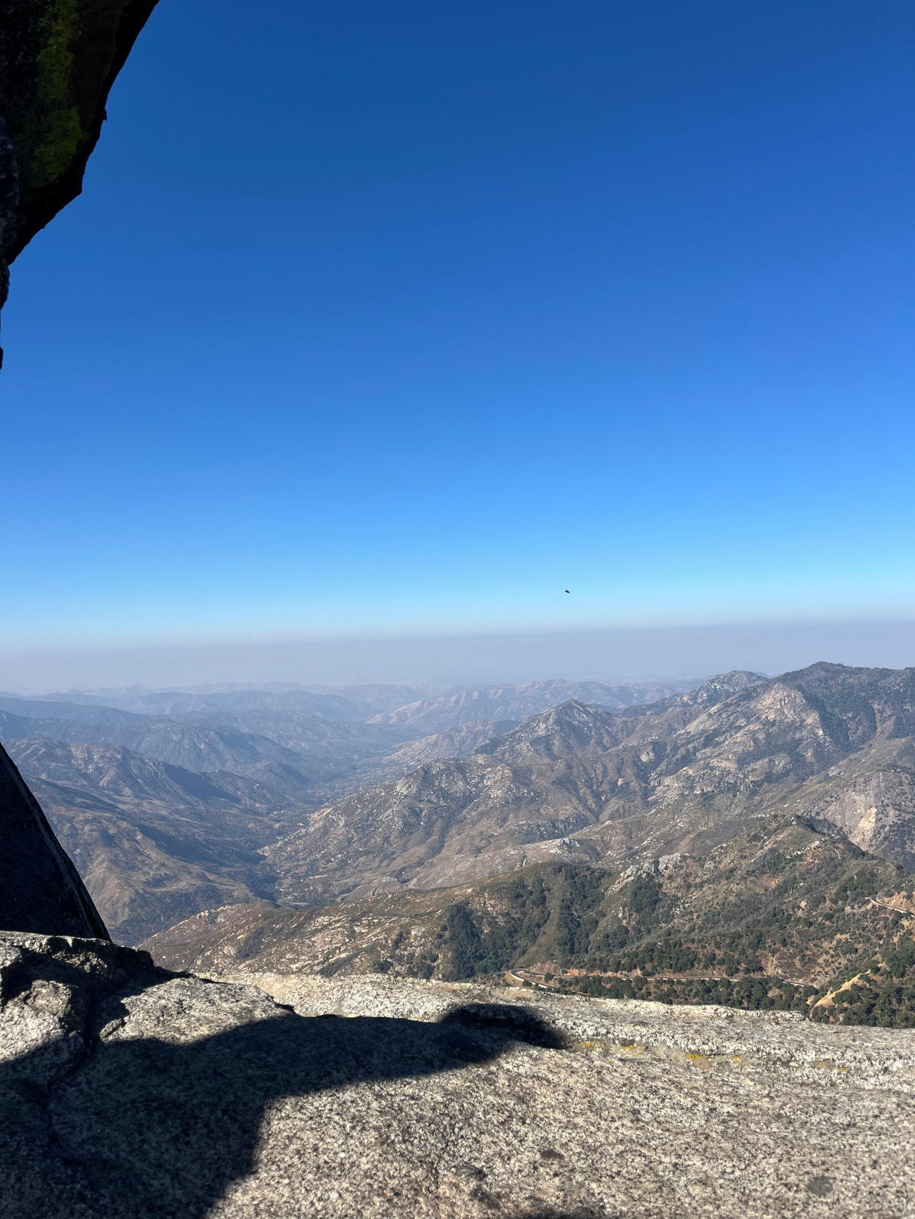
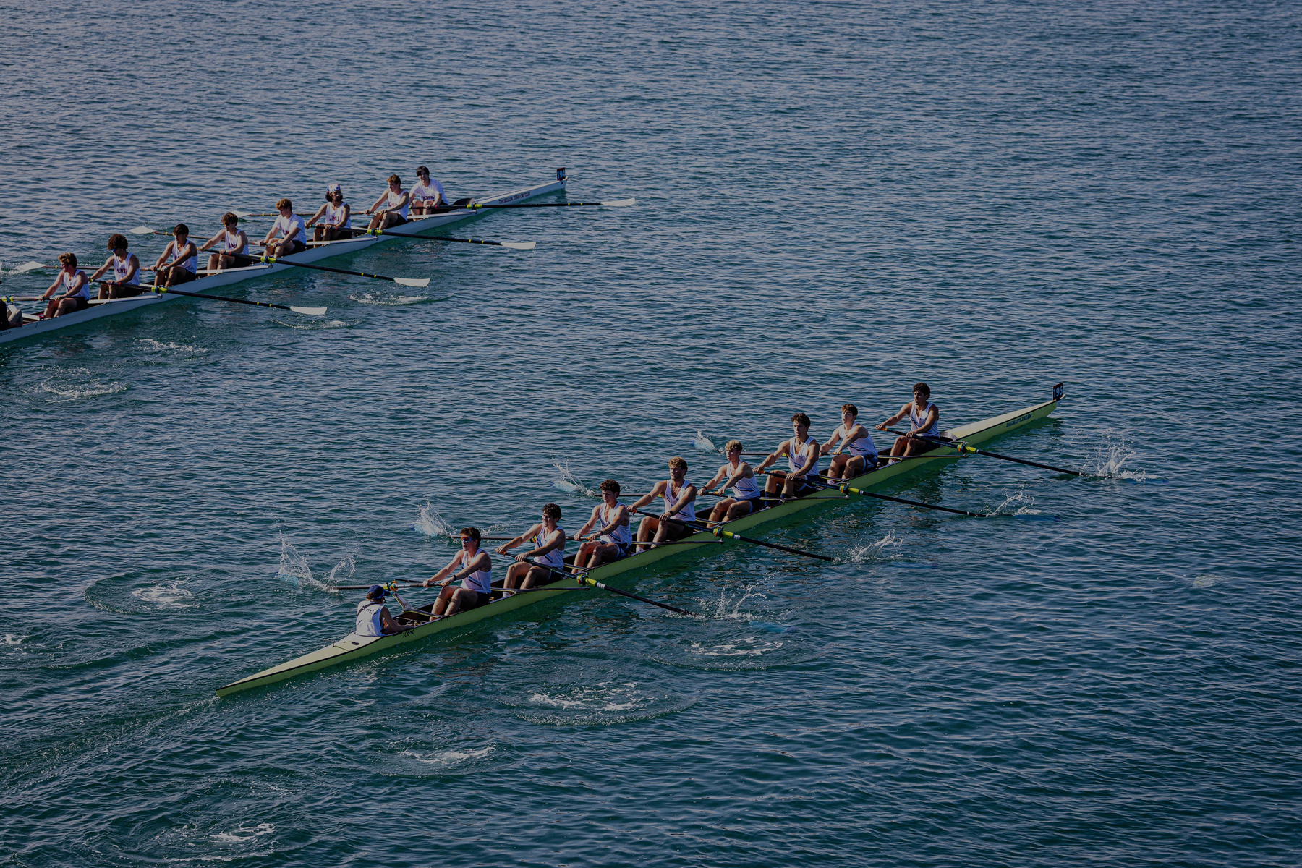
Trip to Sequoia National Park
San Diego
Fall Classic Regatta
local &
national events

Slide 5
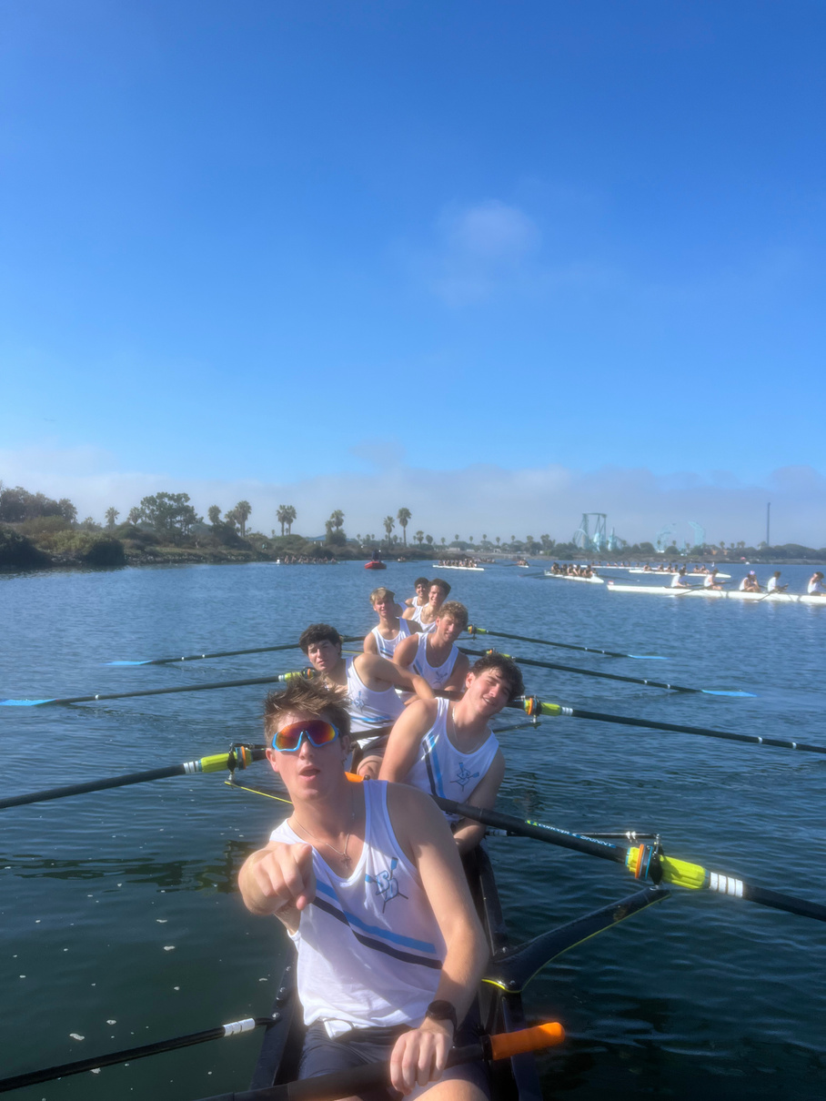

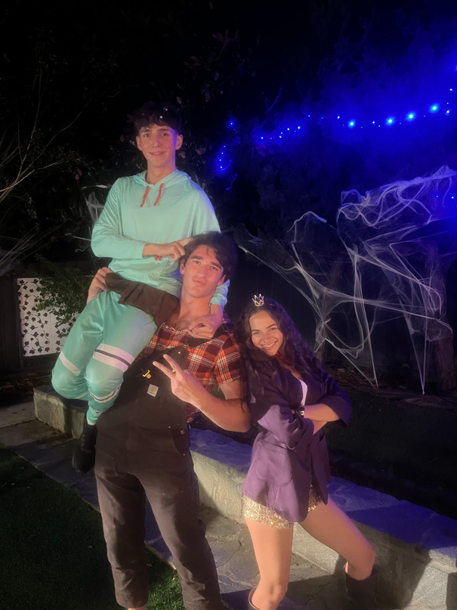
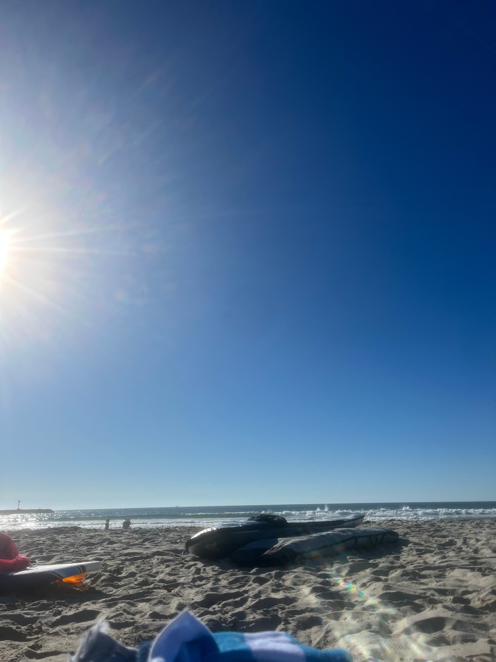
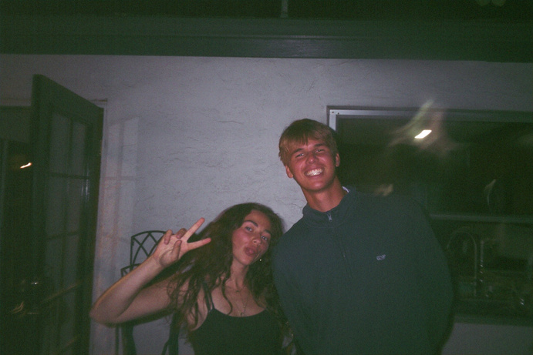
positive experiences
My first collegiate races
Being able to go to the beach in November
Making new friends

Slide 6
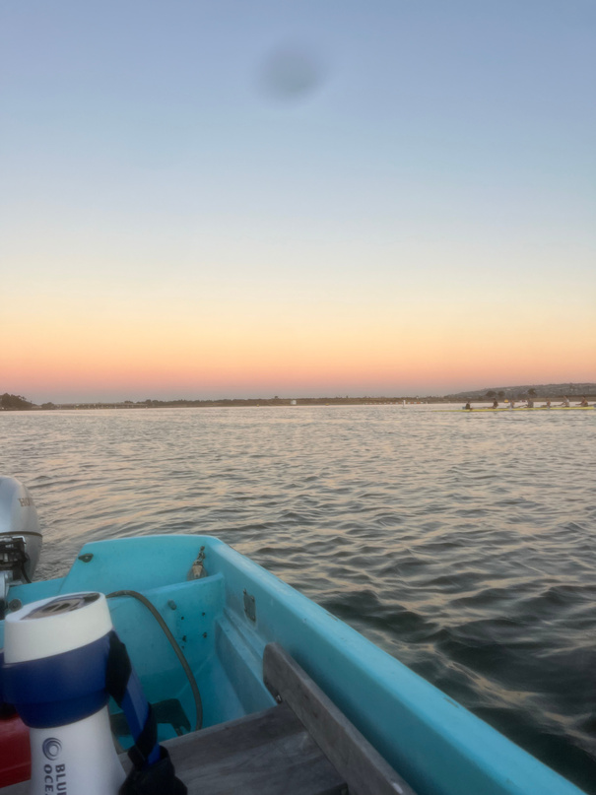
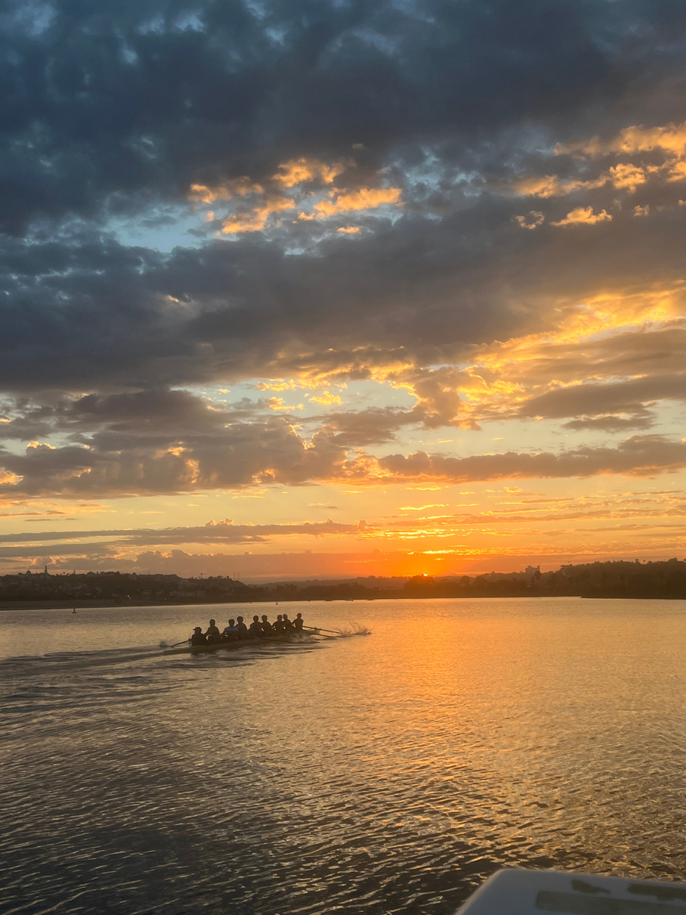
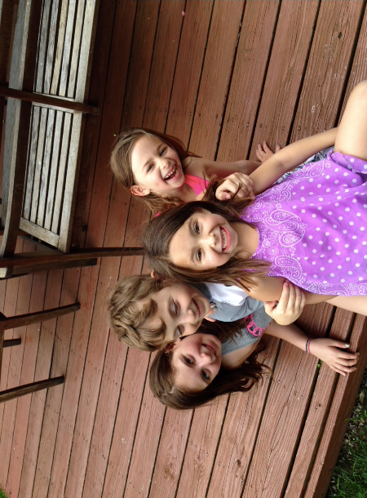
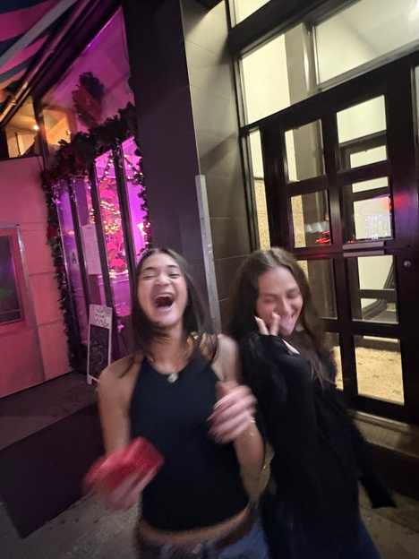
negative experiences / challenges
Not being in a boat for most of the season
Experiencing school without my best friend
Being away from my family

Slide 7
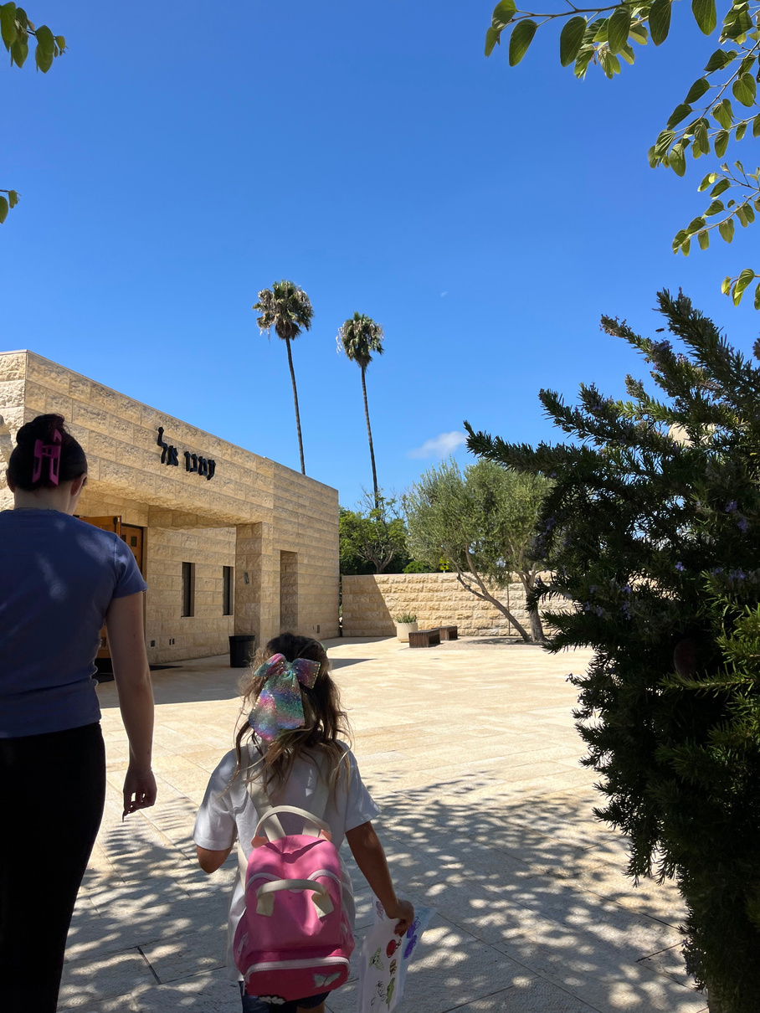
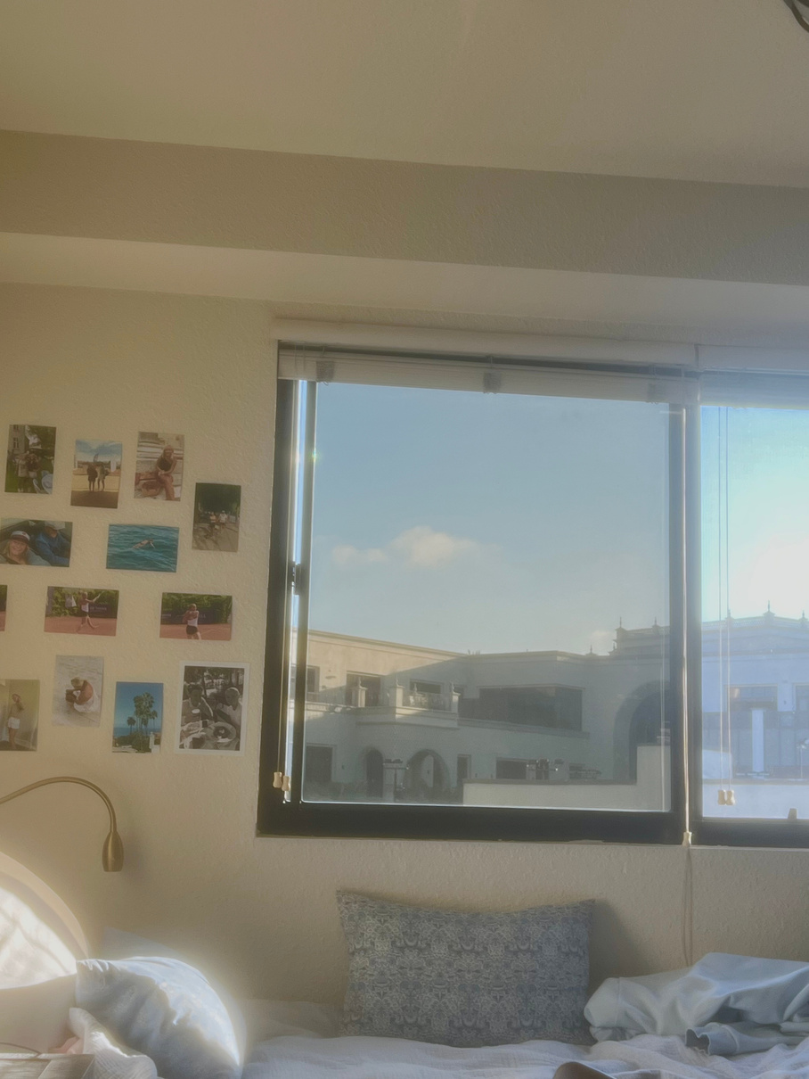
creativity & helping others
Working at my Torah School job on Sundays & keeping in touch with my Judaism
Being able to put fun pictures and memories up on my walls & make my dorm feel like home

Slide 8
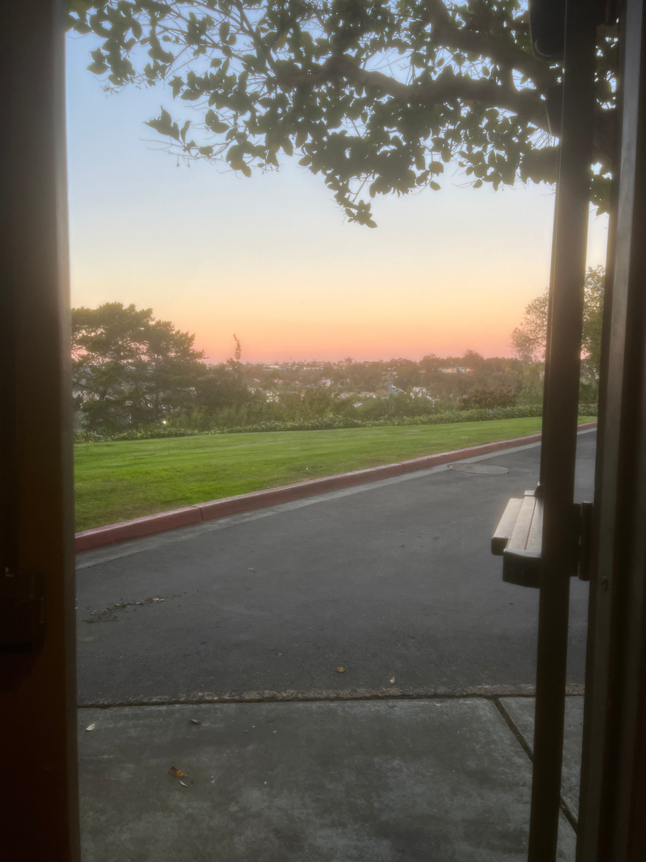
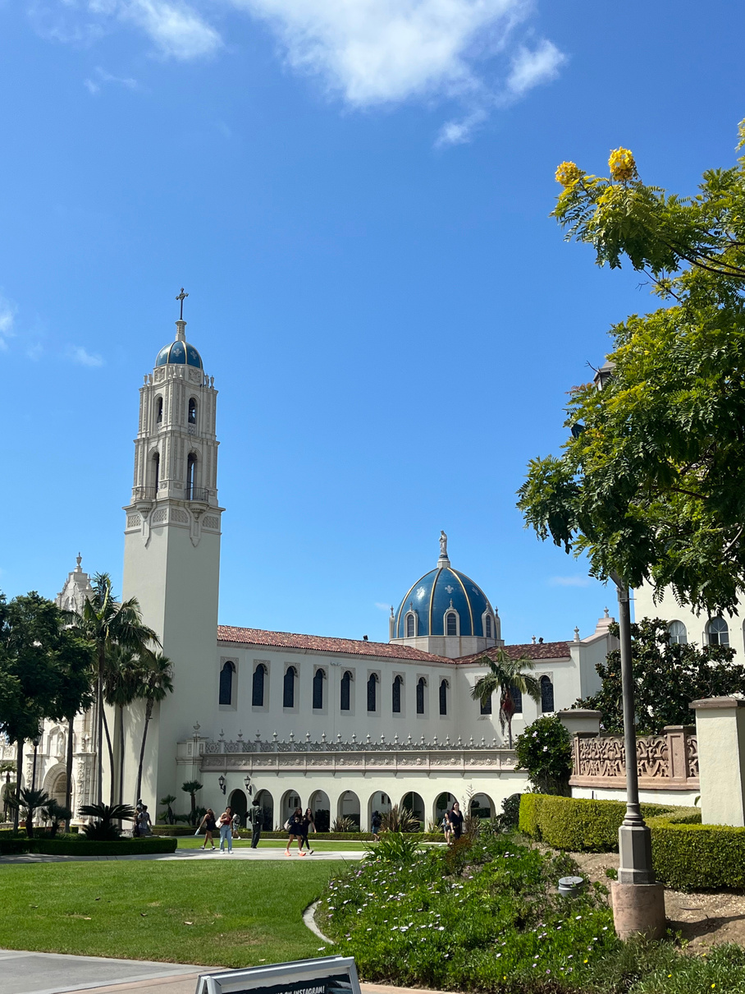
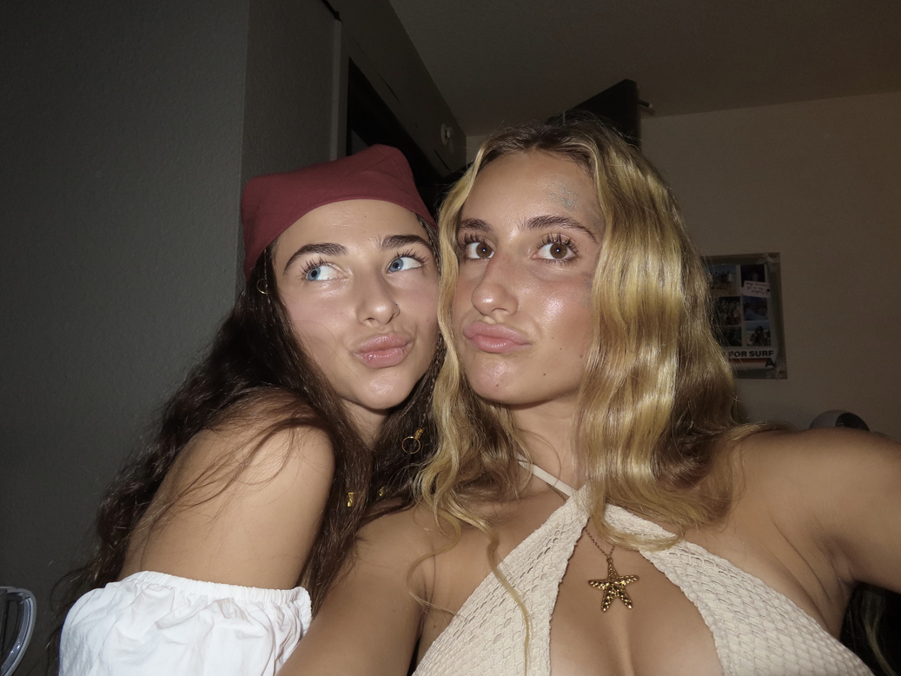
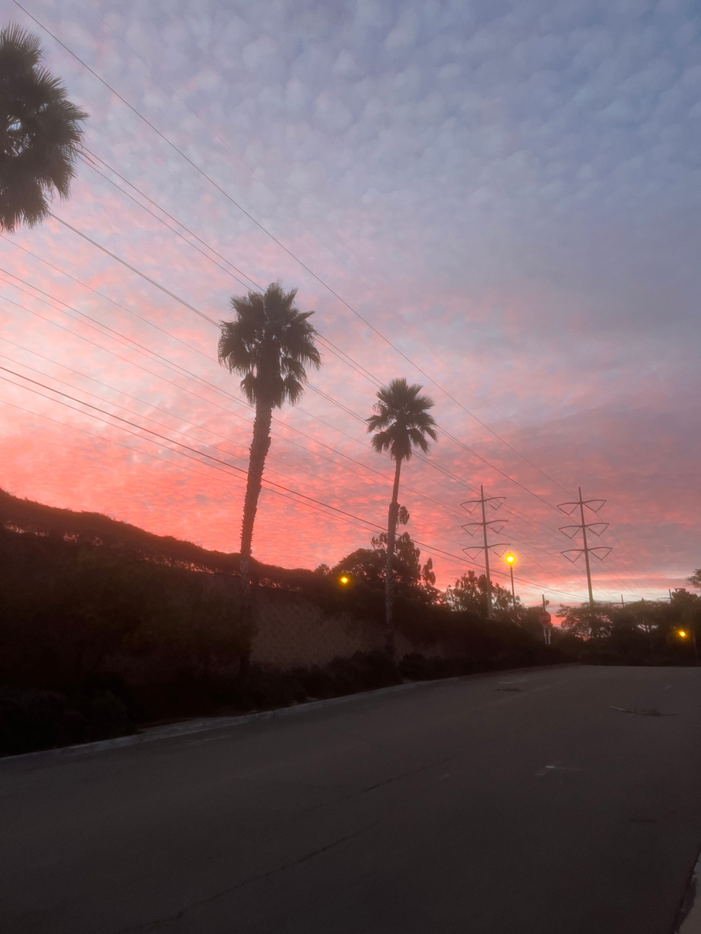
future goals & reflections
Making & strengthening new connections
How lucky am I to be living in California?!

