Slide 1
Time Capsule Project
Keshava Gregorek

Slide 2
Items That Happened This Semester

Slide 3
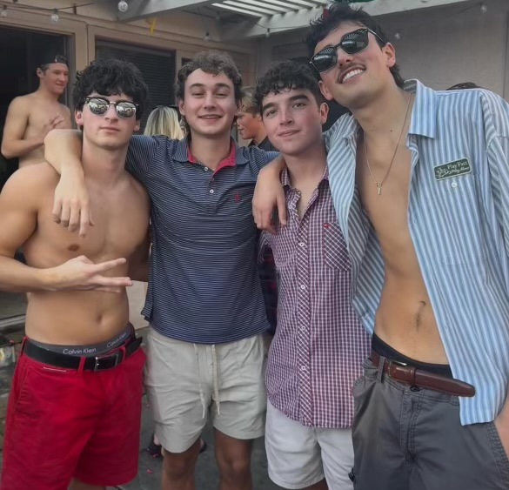
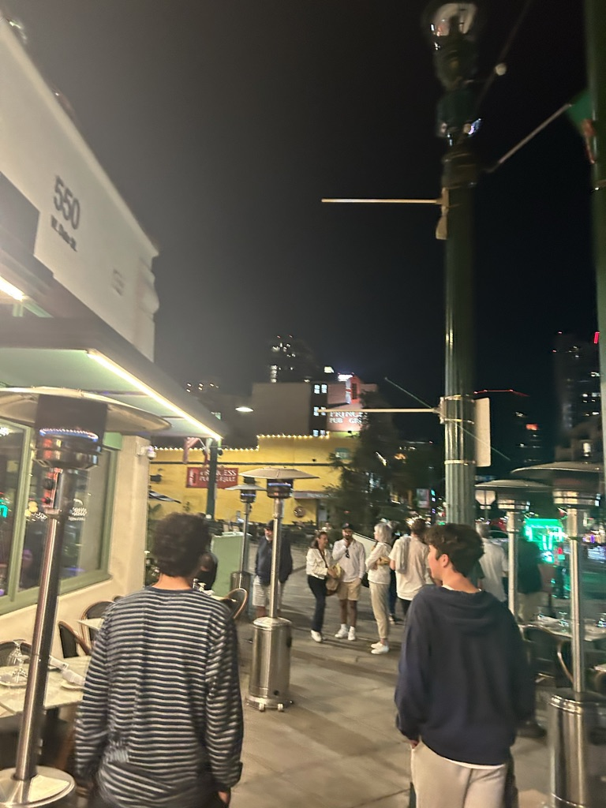
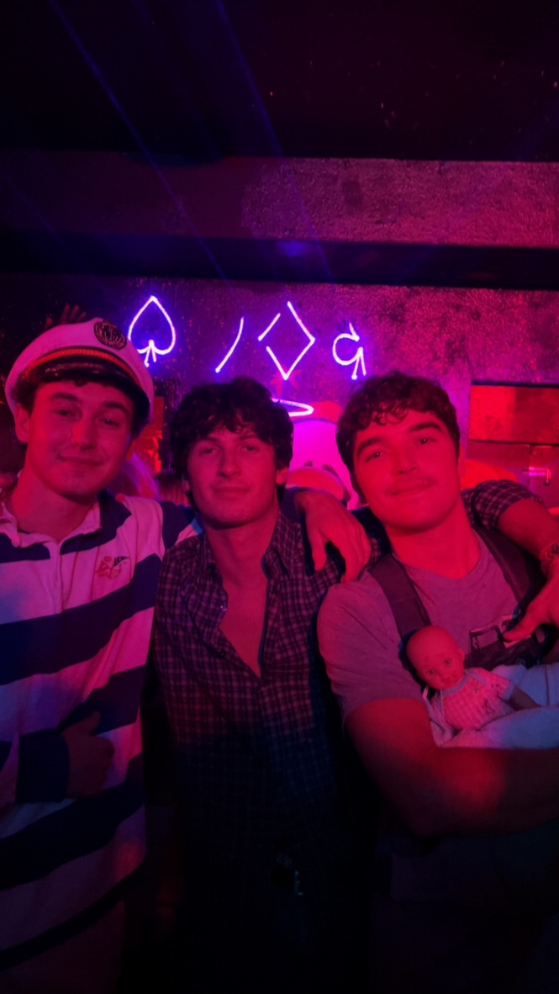
Spent Quality Time With Friends

Slide 4
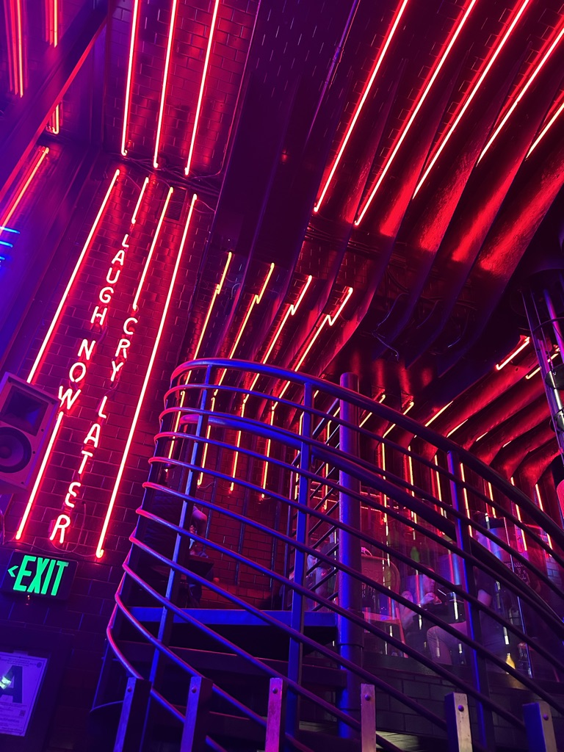
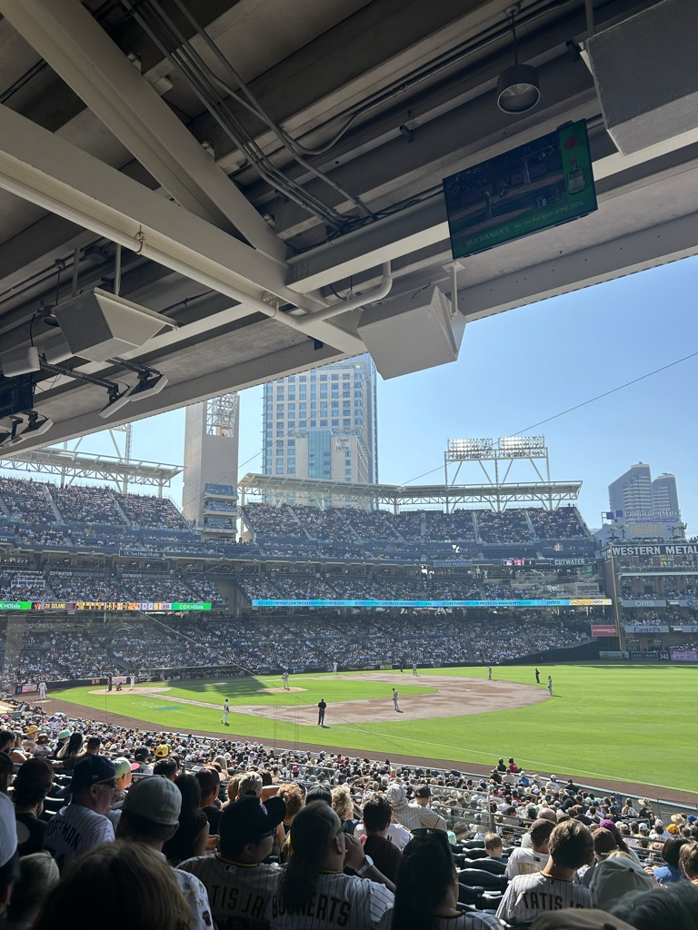
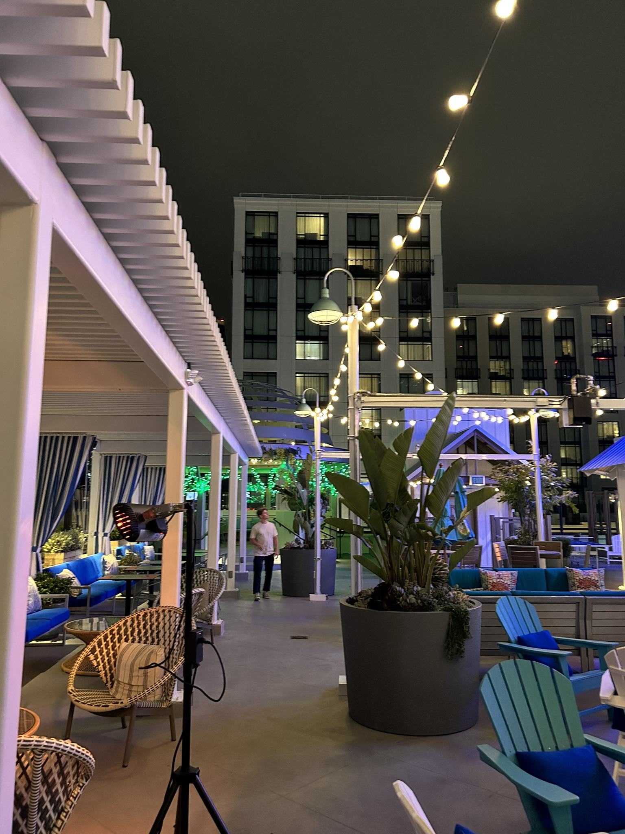
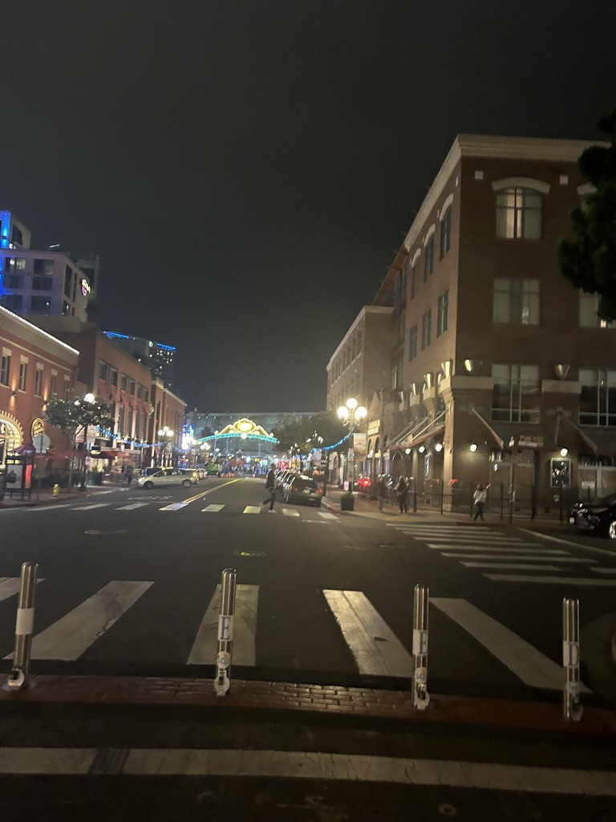
Explored Downtown

Slide 5
Things That Did Not Happen That I Expected

Slide 6
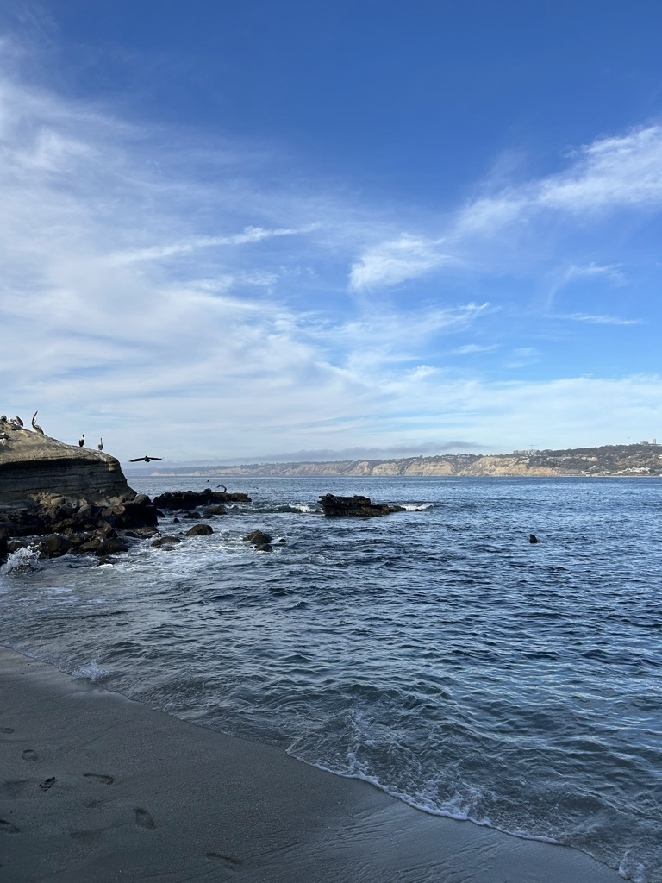
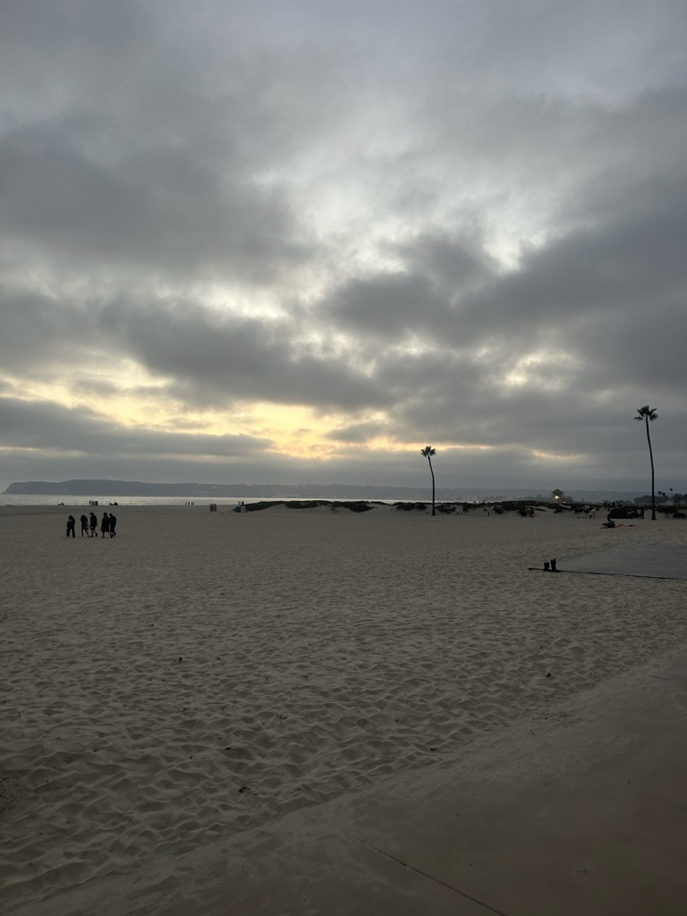
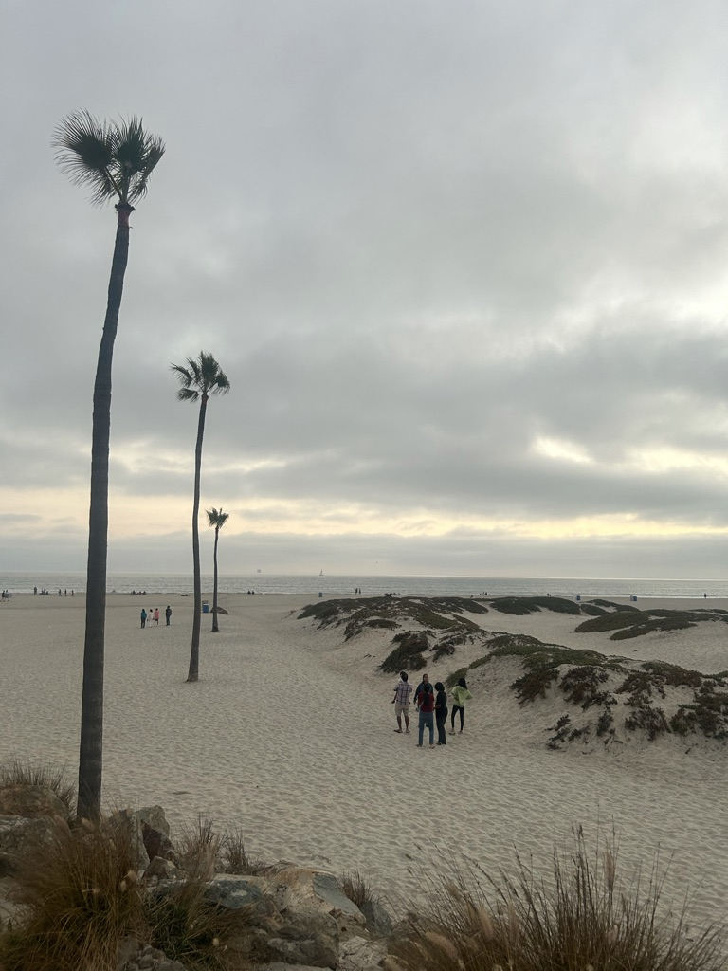
I expected to spend more time at the beach this semester

Slide 7
Items that Have Touched My Life

Slide 8
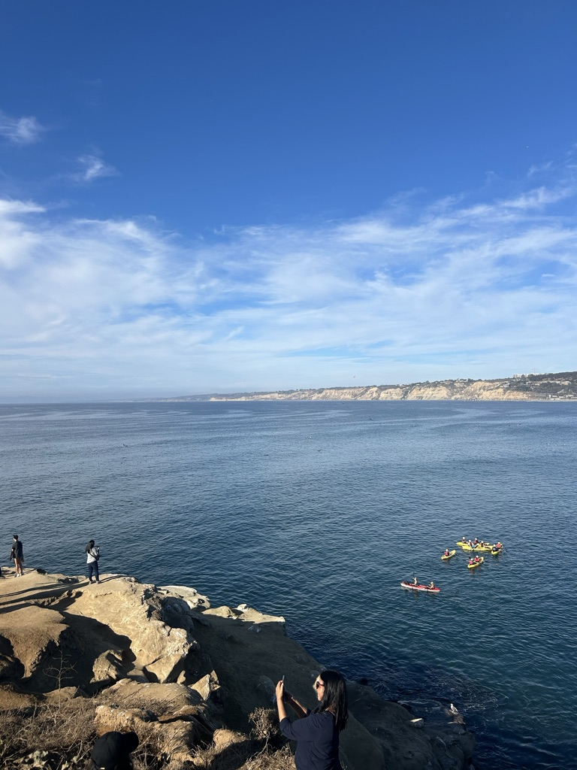
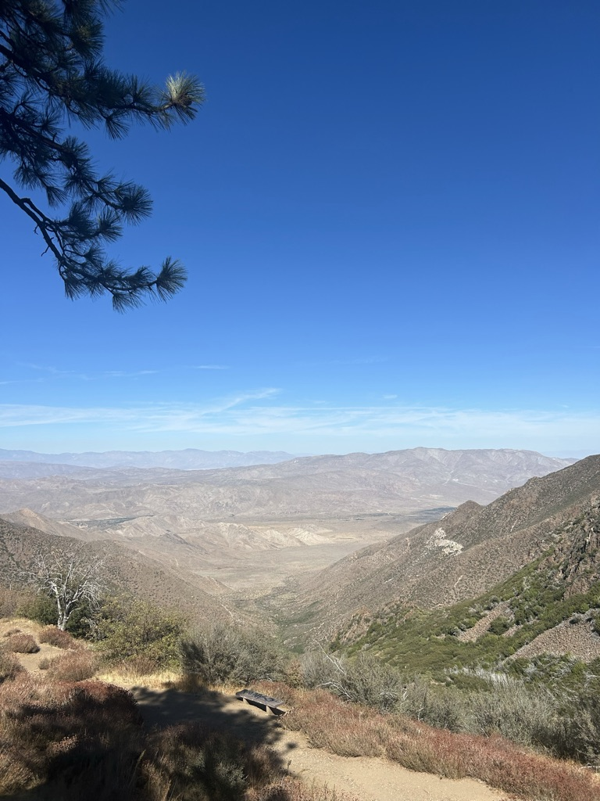
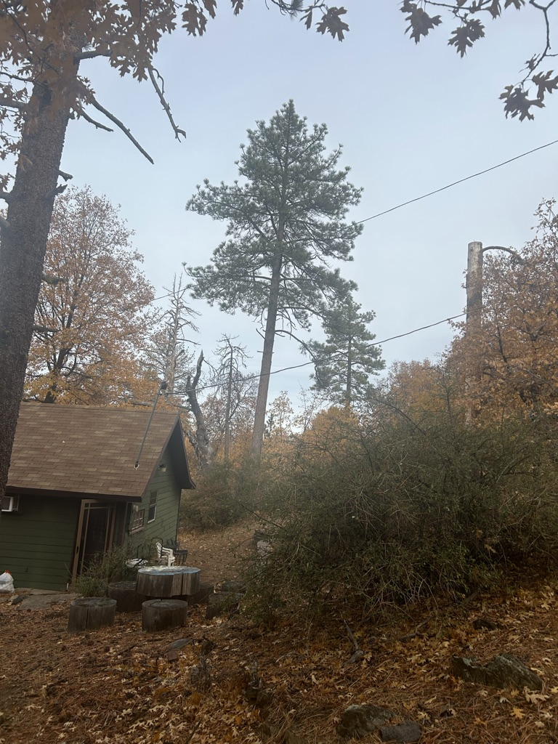
The amazing weather mixed with the breathtaking landscape and nature has brought an immense boost to my mood

Slide 9
Items That I Experienced That Were Negative

Slide 10
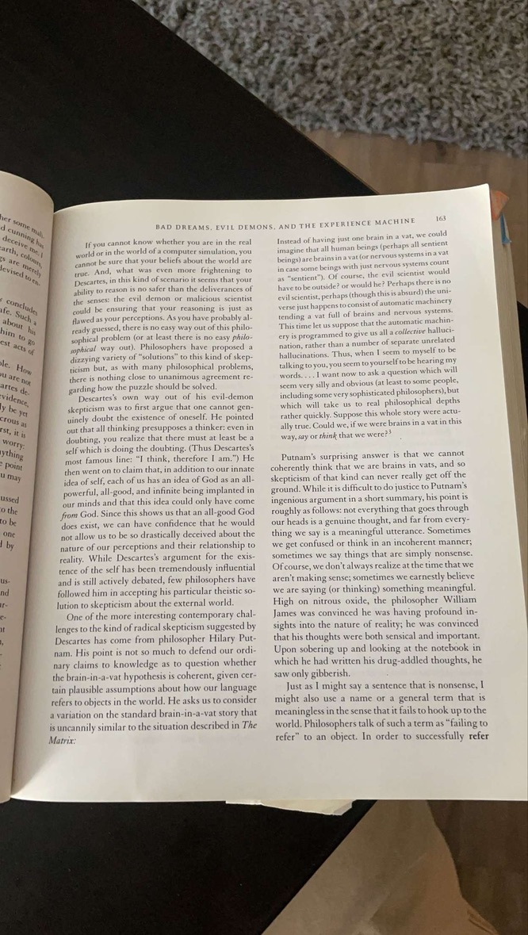
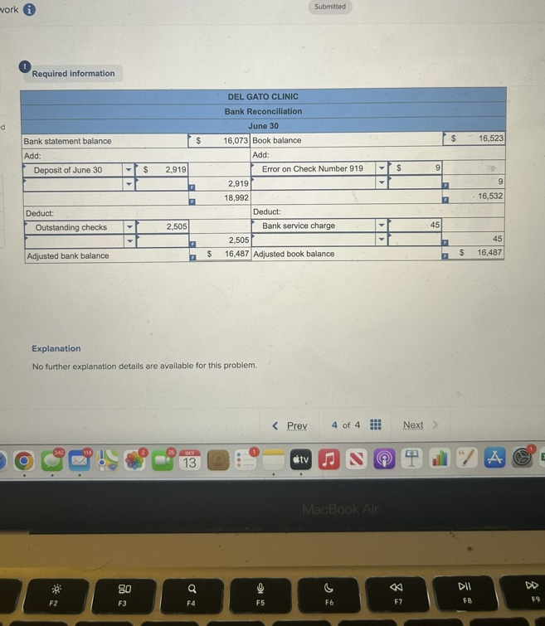
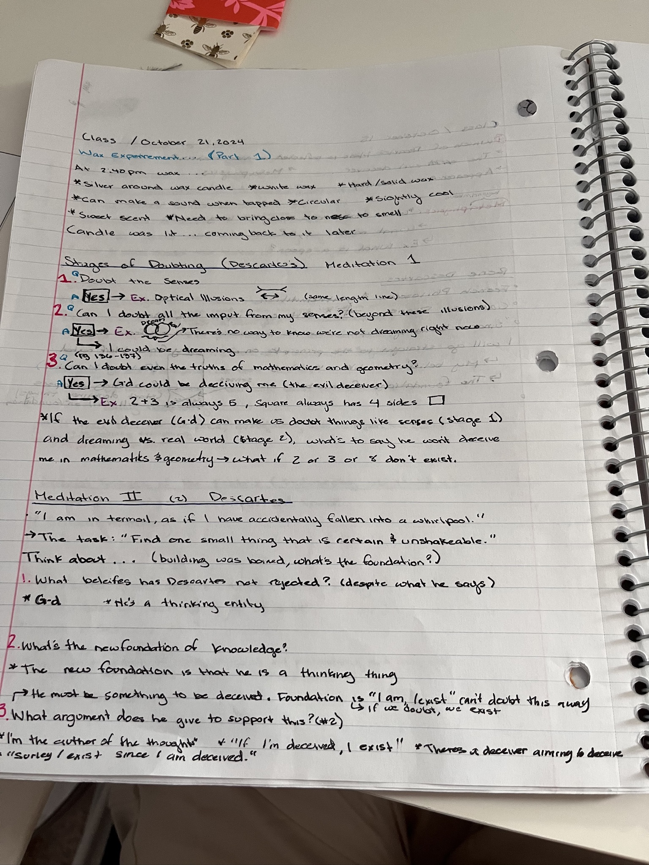
Staying Up Late To study, Due to Poor Time Management

Slide 11
Items Highlighted In News/Media

Slide 12
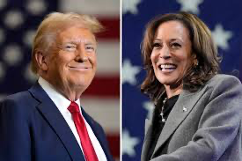
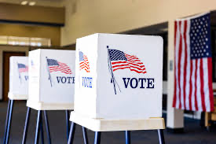

Slide 13
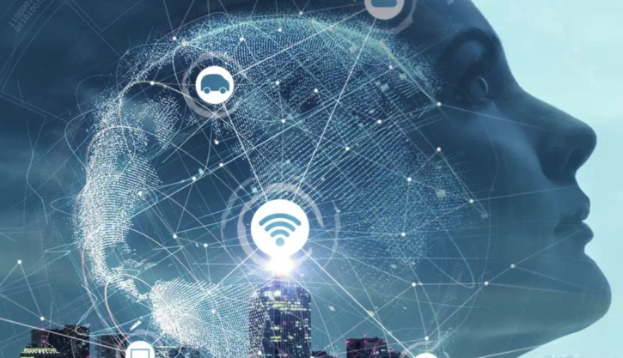
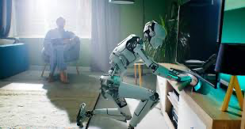
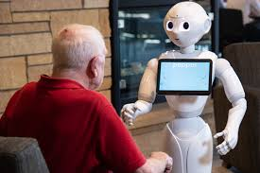
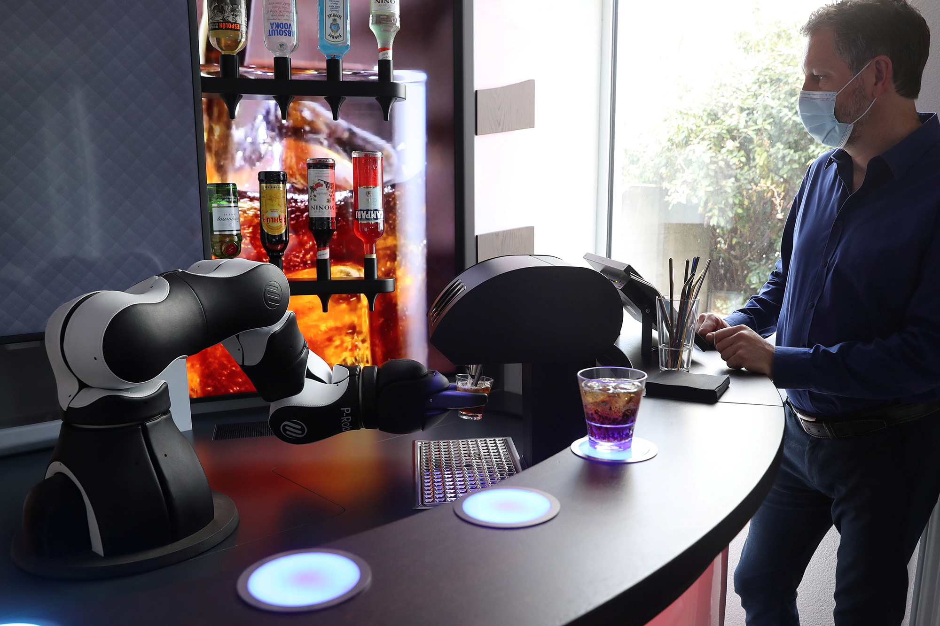
Quickly Growing Advancements In AI
AI Robots Learning Through Observing the actions of humans
AI Robot Caregivers
Ai Bartenders

Slide 14
Items that show change to processes

Slide 15
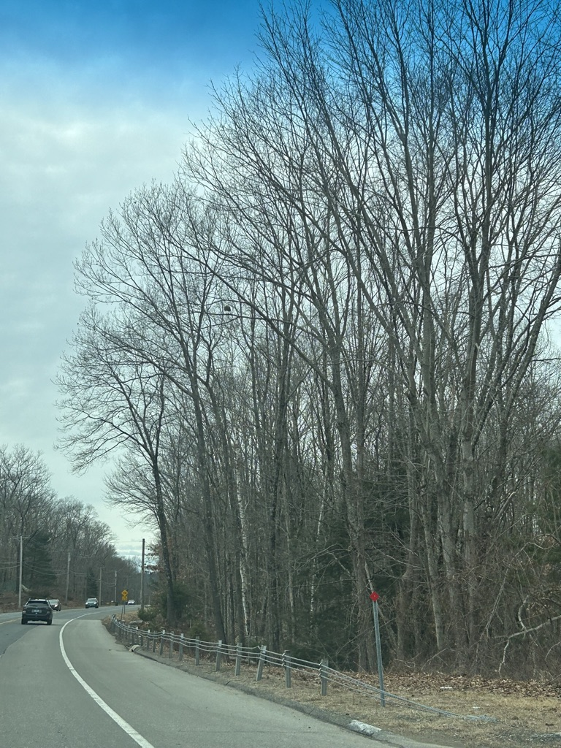
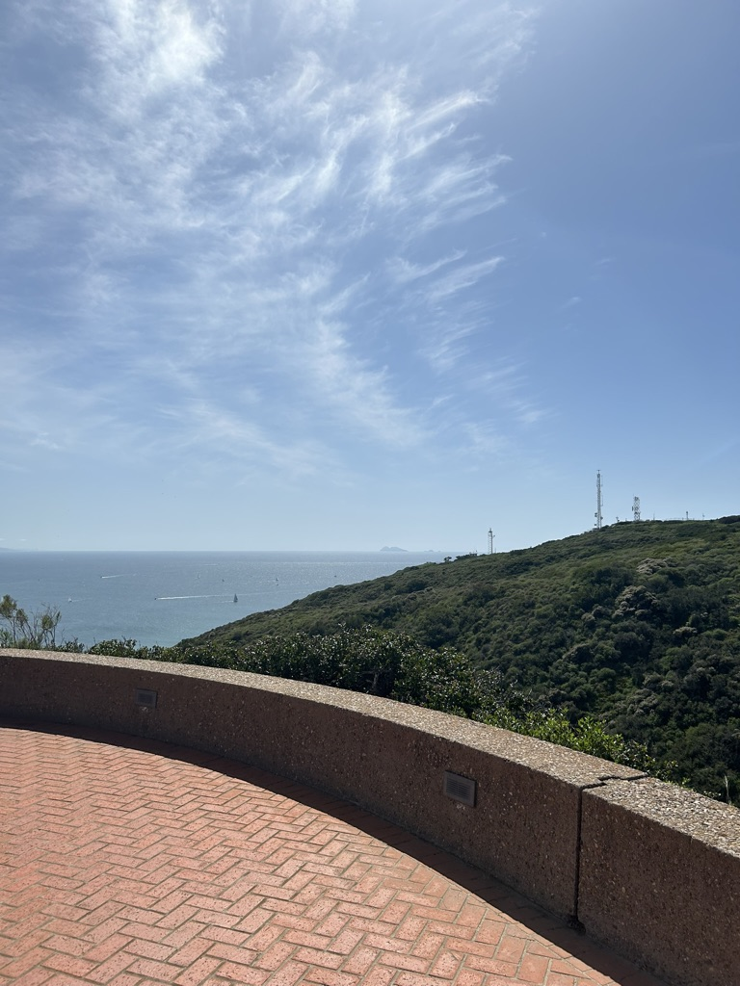
Acclimating To The New Weather
Going from the cold of the northeast to San Diego was not the worst change in the world

Slide 16
Items That Include People Helping Others

Slide 17
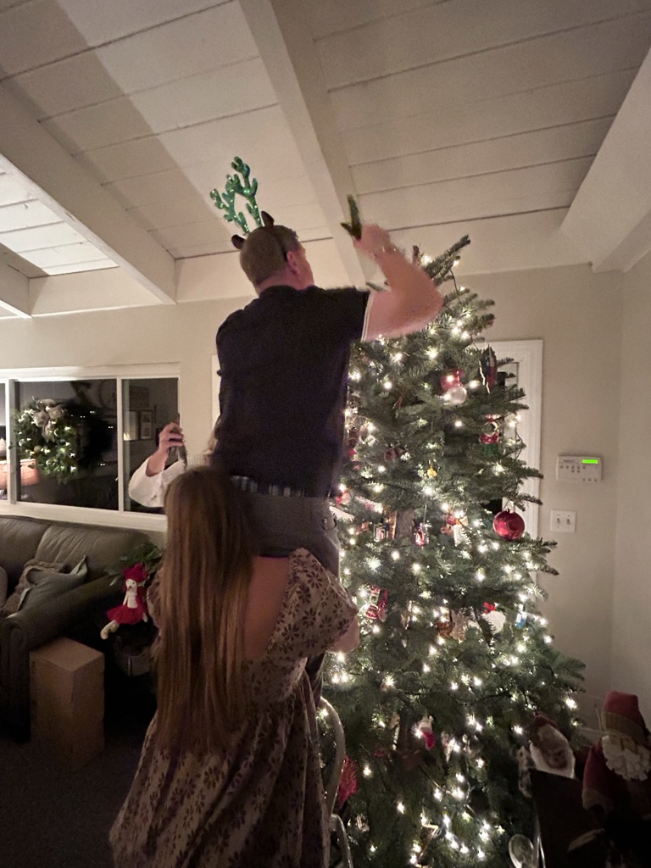
Helped Put Up a Christmas Tree for My Friends Grandmother

Slide 18
Semesters I Wish To Have In The Future
This Photo by Unknown Author is licensed under CC BY-SA

Slide 19
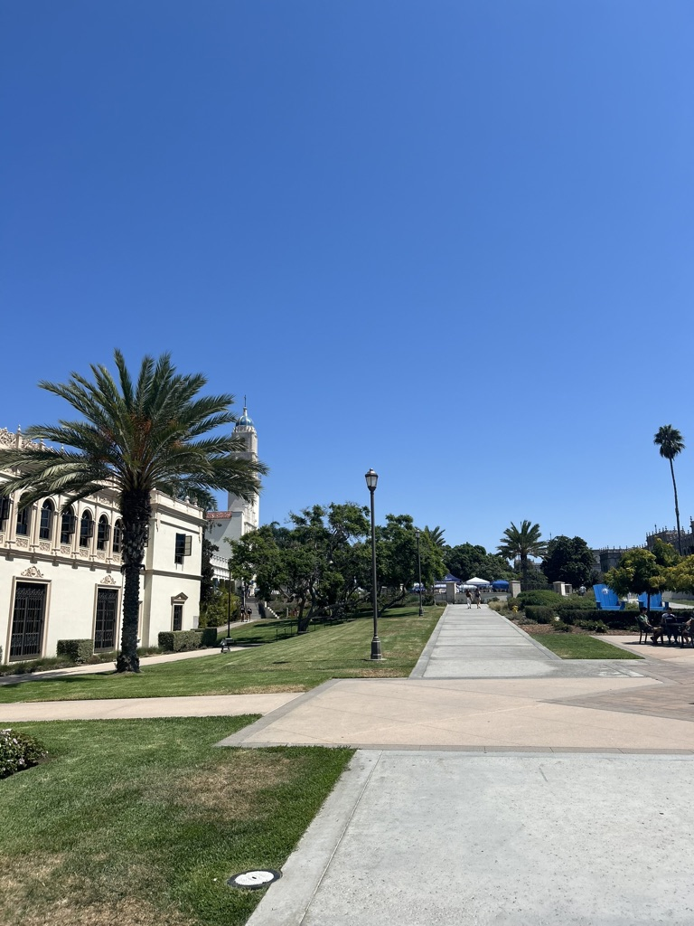
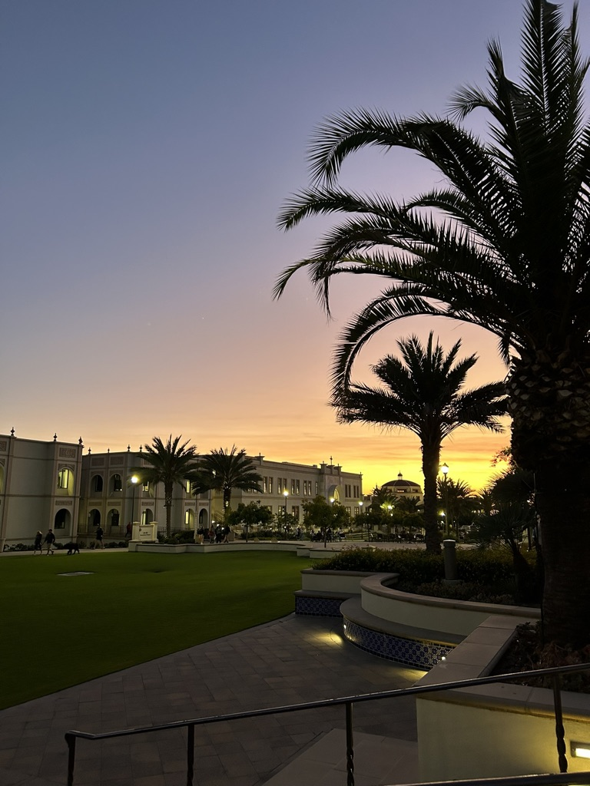
After A Great Semester, I can Only Wish For More to Come in The Future

Slide 20
Thank You!

