Slide 1
Exam Review
BUAN 370

Slide 2
WHERE Clause Options (1 of 4)
Selecting rows with conditional restrictions
WHERE clause is used to add conditional restrictions to the SELECT statement that limit the rows returned by the query
Syntax:
SELECT columnlist
FROM tablelist
[WHERE conditionlist ]
[ORDER BY columnlist [ASC | DESC] ];
Using comparison operators on character attributes
May be used to place restrictions on character-based attributes
Using comparison operators on dates
Date procedures are often more software-specific than other SQL procedures

Slide 3
WHERE Clause Options (2 of 4)
Comparison Operators
Symbol | Meaning
= | Equal to
< | Less than
<= | Less than or equal to
> | Greater than
>= | Greater than or equal to
<> or != | Not equal to

Slide 4
WHERE Clause Options (3 of 4)
Selecting rows with conditional restrictions
WHERE clause is used to add conditional restrictions to the SELECT statement that limit the rows returned by the query
Syntax:
SELECT columnlist
FROM tablelist
[WHERE conditionlist ]
[ORDER BY columnlist [ASC | DESC] ];
Using comparison operators on character attributes
May be used to place restrictions on character-based attributes
Using comparison operators on dates
Date procedures are often more software-specific than other SQL procedures

Slide 5
WHERE Clause Options (4 of 4)
Logical operators: AND, OR, and NOT
SQL allows you to include multiple conditions in a query through the use of these logical operators
Boolean algebra is dedicated to the use of logical operators
Old-style joins
Generally not recommended
Make complex queries more difficult to maintain
Susceptible to undetected errors
Special operators
BETWEEN
IN
LIKE
IS NULL
NOT

Slide 6
Aggregate Processing (1 of 3)
Takes a collection of rows and reduces it to a single row
SQL provides useful aggregate functions that count, find minimum and maximum values, calculate averages, etc.
Aggregate functions
Count
MIN and MAX
SUM and AVG
Grouping data
GROUP BY clause syntax:
SELECT columnlist
FROM tablelist
[WHERE conditionlist ]
[GROUP BY columnlist ]
[ORDER BY columnlist [ASC | DESC] ];

Slide 7
Aggregate Processing (2 of 3)
Some Basic SQL Aggregate Functions
Function | Output
COUNT | The number of rows containing non-null values
MIN | The minimum attribute value encountered in a given column
MAX | The maximum attribute value encountered in a given column
SUM | The sum of all values for a given column
AVG | The arithmetic mean (average) for a specified column

Slide 8
Aggregate Processing (3 of 3)
HAVING clause
Operates very much like the WHERE clause in the SELECT statement
HAVING clause is applied to the output of a GROUP BY operation
Syntax:
SELECT columnlist
FROM tablelist
[WHERE conditionlist ]
[GROUP BY columnlist ]
[HAVING conditionlist ]
[ORDER BY columnlist [ASC | DESC] ];

Slide 9
What is a subquery?
A Subquery or Inner query or Nested query is a query within SQL query and embedded within the WHERE clause.
A Subquery is a SELECT statement that is embedded in a clause of another SQL statement.
They can be very useful to select rows from a table with a condition that depends on the data in the same or another table.
A Subquery is used to return data that will be used in the main query as a condition to further restrict the data to be retrieved.
The subquery can be placed in the following SQL clauses they are WHERE clause, HAVING clause, FROM clause.

Slide 10
Processing Multiple Tables Using Subqueries
Subquery–placing an inner query (SELECT statement) inside an outer query
Options:
In a condition of the WHERE clause
As a “table” of the FROM clause
Within the HAVING clause
Subqueries can be:
Noncorrelated–executed once for the entire outer query
Correlated–executed once for each row returned by the outer query

Slide 11
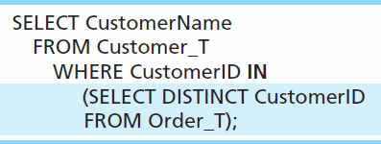
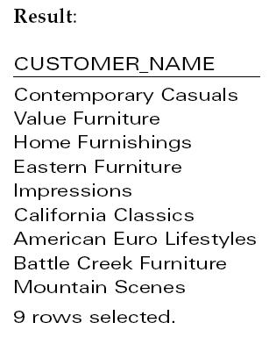
Subquery Example
Show all customers who have placed an order
The IN operator will test to see if the CUSTOMER_ID value of a row is included in the list returned from the subquery
Subquery is embedded in parentheses. In this case it returns a list that will be used in the WHERE clause of the outer query

Slide 12
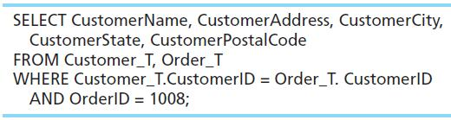
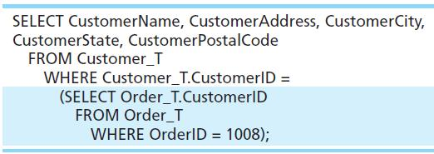
Join vs. Subquery
Some queries could be accomplished by either a join or a subquery
Join version
Subquery version

Slide 13
Advantages/Disadvantages Joins
Advantages Of Joins:
The advantage of a join includes that it executes faster.
The retrieval time of the query using joins almost always will be faster than that of a subquery.
By using joins, you can maximize the calculation burden on the database i.e., instead of multiple queries using one join query. This means you can make better use of the database’s abilities to search through, filter, sort, etc.
Disadvantages Of Joins:
Disadvantage of using joins includes that they are not as easy to read as subqueries.
More joins in a query means the database server has to do more work, which means that it is more time consuming process to retrieve data
As there are different types of joins, it can be confusing as to which join is the appropriate type of join to use to yield the correct desired result set.
Joins cannot be avoided when retrieving data from a normalized database, but it is important that joins are performed correctly, as incorrect joins can result in serious performance degradation and inaccurate query results.

Slide 14
Advantages/Disadvantages Subqueries
Advantages Of Subquery:
Subqueries divide the complex query into isolated parts so that a complex query can be broken down into a series of logical steps.
It is easy to understand and code maintenance is also at ease.
Subqueries allow you to use the results of another query in the outer query.
In some cases, subqueries can replace complex joins and unions.
Disadvantages of Subquery:
The optimizer is more mature for MYSQL for joins than for subqueries, so in many cases a statement that uses a subquery can be executed more efficiently if you rewrite it as join.
We cannot modify a table and select from the same table within a subquery in the same SQL statement.

Slide 15
Subqueries Key Characteristics
Key characteristics
A subquery is a query (SELECT statement) inside another query
A subquery is normally expressed inside parentheses
The first query in the SQL statement is known as the outer query
The query inside the SQL statement is known as the inner query
The inner query is executed first
The output of an inner query is used as the input for the outer query
The entire SQL statement is sometimes referred to as a nested query
Subquery can return one or more values
One single value (one column and one row)
A list of values (one column and multiple rows)
A virtual table (multicolumn, multirow set of values)

Slide 16
Subqueries Key Characteristics Cont.
WHERE subqueries
Most common type of subquery uses an inner SELECT subquery on the right side of a WHERE comparison expression
IN subqueries
IN operator: used to compare a single attribute to a list of values
IN subquery: values are not known beforehand, but can be derived using a query
HAVING subqueries
HAVING clause: used to restrict the output of a GROUP BY query by applying conditional criteria to the grouped rows
Multirow subquery operators: ALL and ANY
ALL operator compares a single value with a list of values returned by the first subquery using a comparison operator other than equals
ANY operator compares a single value to a list of values and select only the rows greater than or less than any value in the list

