Slide 1
Welcome to ITMG100
Professor Rebman
Olin Hall Room 127
Office Hours: See syllabus
Email: carlr@sandiego.edu

Slide 2
Agenda
Syllabus Review
R and R Studio
DataCamp
EPIC/GUAC
About me
ITK ACT

Slide 3
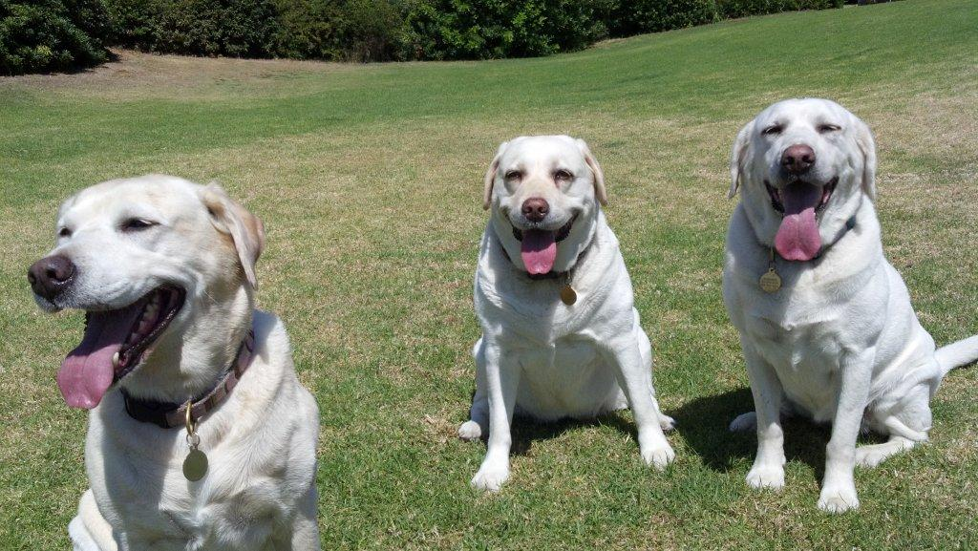

My Background…

Slide 4


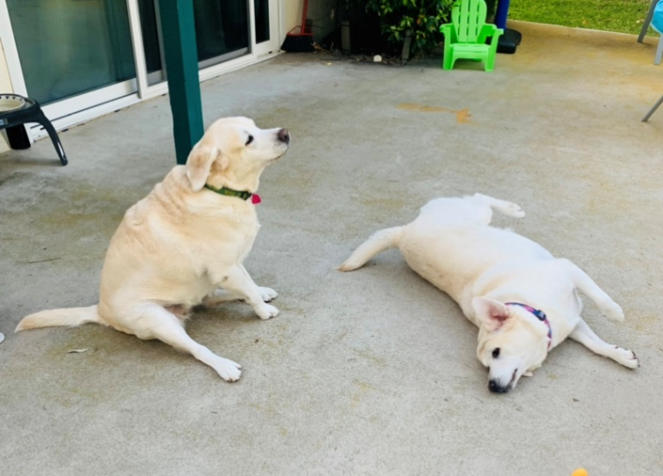
My Background ..a little closer to present

Slide 5
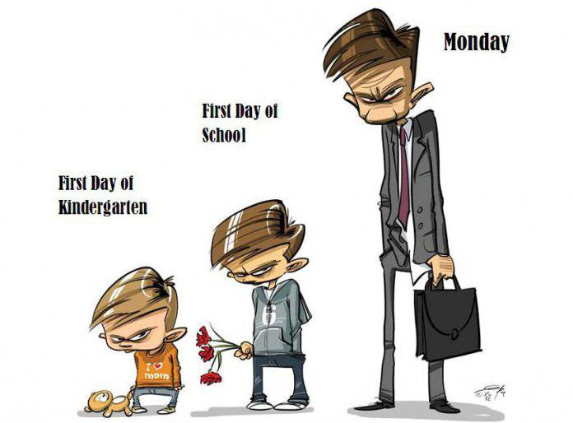
BUAN 314/370
Carl M. Rebman, Jr. Ph.D
Phone: 619-260-4135
E-mail: carlr@sandiego.edu
Office: Olin 127
Office Hours: T 1:45-2:15 pm & 4:00- 5:00 pm
W 12:00- 2:00pm
TH 1:45-2:15 pm &4:00- 5:00 pm

Slide 6
Course description
Advances in our capability to generate and collect information coupled with decreasing disk-space prices are pushing us toward a world centered around data management. Data preparation and storage are the foundation of today’s business analytics.
They ensure data are properly processed for later meaningful analysis. Data preparation includes data cleansing and data transformation. The objective of data preparation is to collect the data from various sources into a single location and transform it into a form that is ready for later analysis

Slide 7
Course description cont
Databases are at the heart of modern commercial application development for data storage. Once data is prepared and properly stored, the first step of analysis usually involves summarizing basic facts about what has happened in the past. This preliminary examination of data falls in the category of descriptive analytics (exploratory data analysis). The purpose of this course is to provide a comprehensive introduction of the data management process - from data preparation, storage, to descriptive analytics applications.

Slide 8
Data analytics is fun and it pays
Analytics is time-intensive, but it pays off!
Average “Business Analyst” salary is ≈$84,484 (Indeed.com, 2024)
“Analytics Manager” salary is ≈ $137,513 (Salary.com, 2024).
Salaries of seasoned “Data Scientists” exceed $156,846 annually. (Glassdoor.com, 2024)

Slide 9
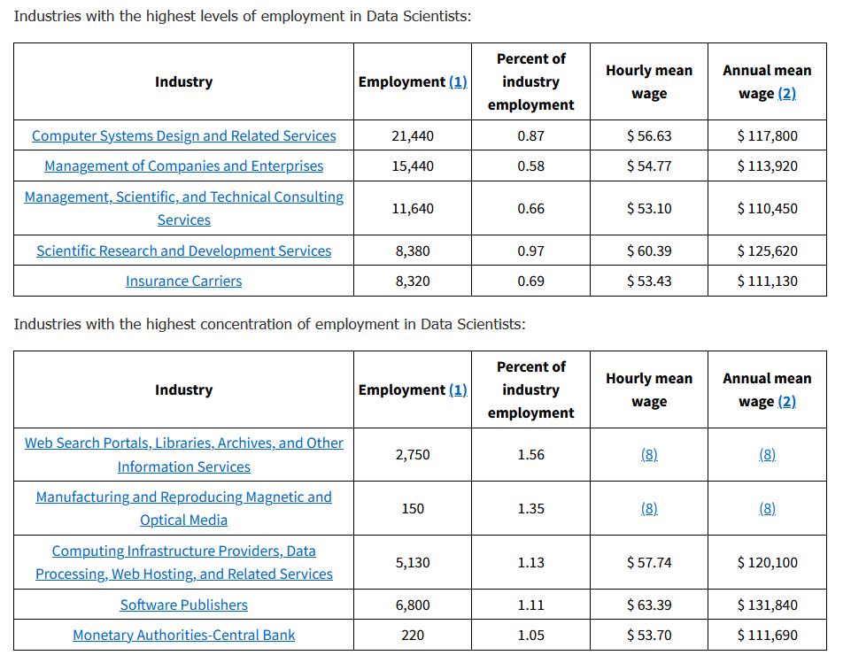

Slide 10
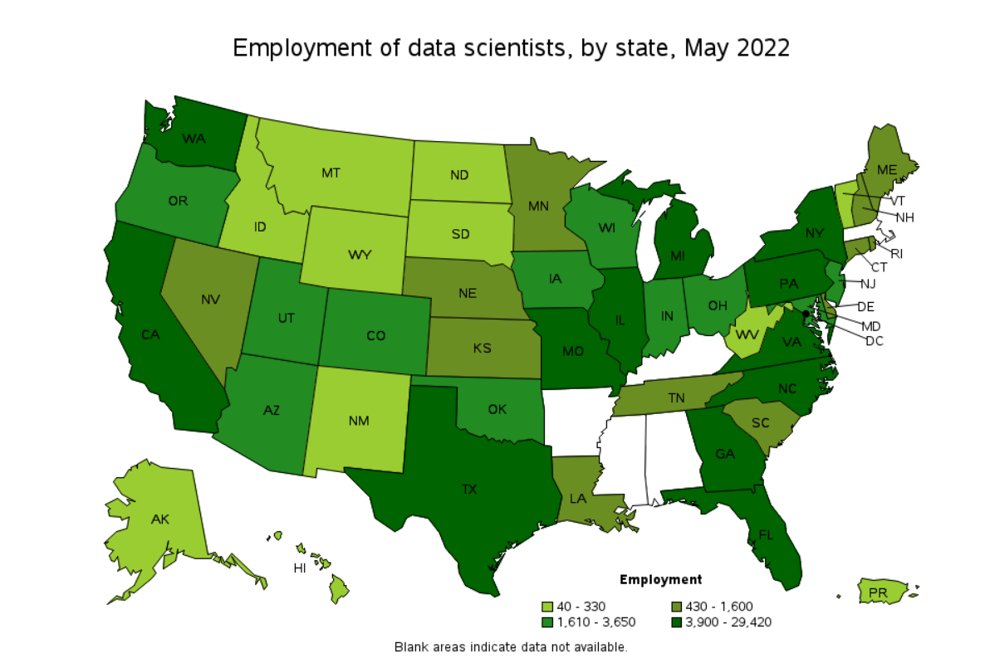

Slide 11
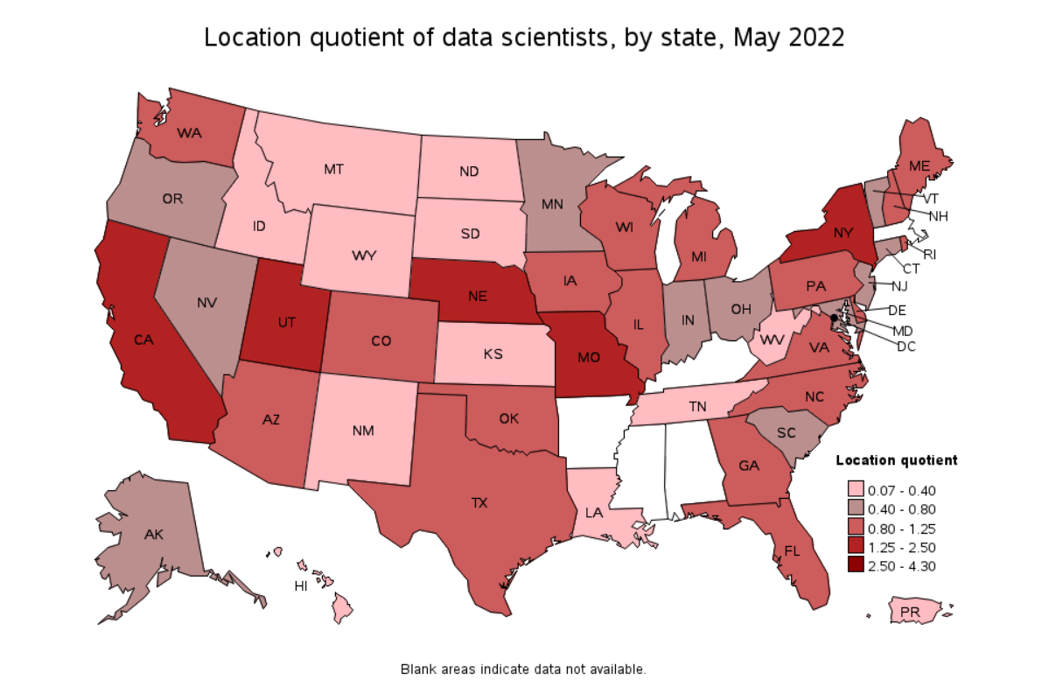

Slide 12
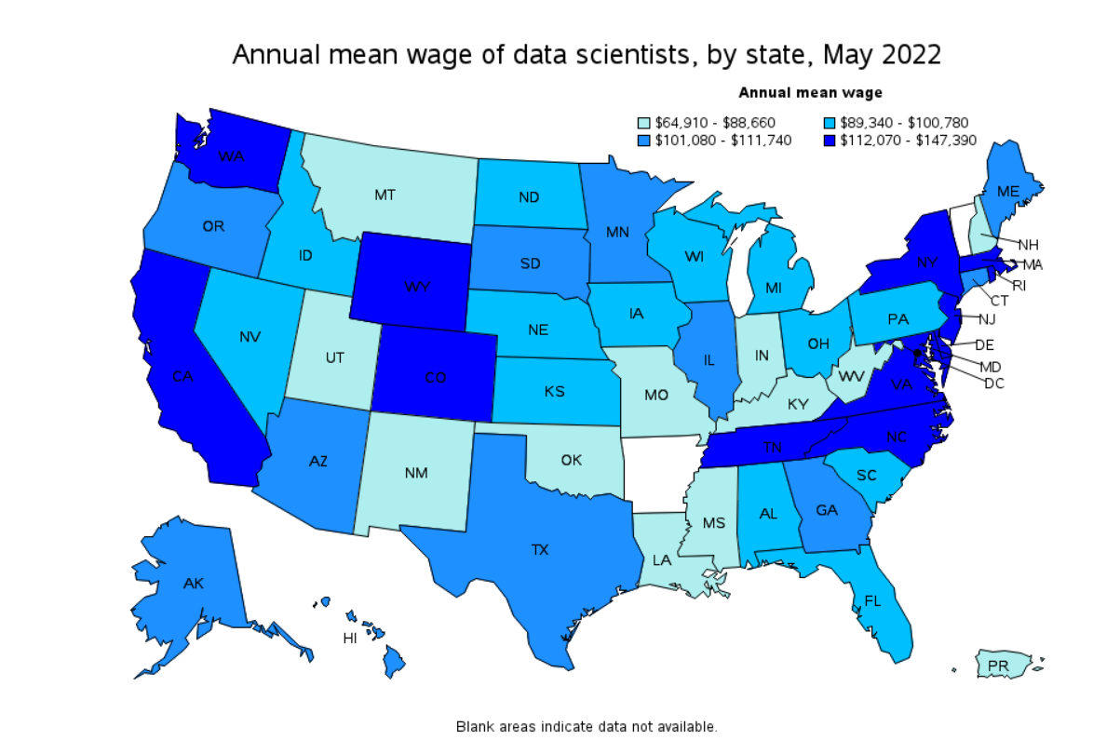

Slide 13
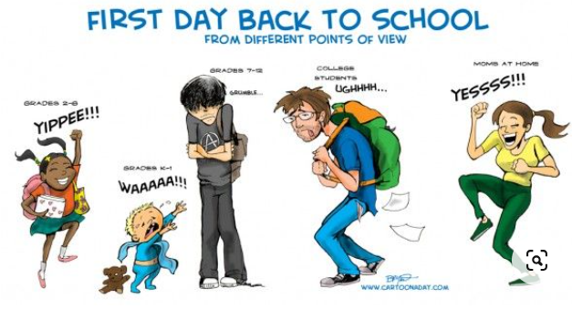
Course Breakdown
7 weeks of R and Descriptive Statistics
6 weeks of Database theory, practice with SQL application (with an access primer)
2 weeks of Direct Data Cleaning, preparing, analyzing, presenting

Slide 14
Course outcomes
After taking this course you will be able to:
Describe and identify different basic data structure and their characteristics
Identify and explain analytics uses in real world business situations.
Interpret and communicate results to both technical and non-technical audiences.
Access large datasets and doing the “wrangling” needed to prepare them for analysis
Describe basic relational database and data warehouse concepts
Write SQL queries for a variety of data definition and data manipulation scenarios
Identify appropriate visualizations for different types of data and best practices for creating visualizations

Slide 15
Workload expectation
2 hours: reading the relevant assigned readings and taking your own notes on the readings
1 hour: reviewing examples and notes from lecture
1 – 2 hours: working on assignments (worked examples, code chunks, problem sets, projects)
1 – 2 hours: going to office hours and/or reviewing with peers (group study)
1 hour: troubleshooting and researching

Slide 16
REQUIRED TEXTBOOKS
R Programming for Data Science, Roger D. Peng, The Johns Hopkins University, Leanpub. This book will act as a reference guide for programming in R. It contains useful examples including the code, output, and hyperlinks to video lessons associated with the book made by the authors. It can be found for free online at https://leanpub.com/.
Database Design – 2nd Edition by Adrienne Warr and Nelson Eng is used under a CC BY 4.0 International License. Download for free from the B.C. Open Textbook Collection https://opentextbc.ca/dbdesign01/ .

Slide 17
RECOMMENDED TEXTBOOKS
A First Course in Database Systems, 3rd Edition, by Jeffrey Ullman and Jennifer Widom. ISBN- 13: 978-0136006374 ISBN-10: 9780136006374
ggplot2: Elegant Graphics for Data Analysis, Hadley Wickham, Springer, 2nd Edition. Several of the worked examples will be referenced as case studies.
Exploratory Data Analysis with R, Roger D. Peng, The Johns Hopkins University, Leanpub. This book is also written in R and contains some useful worked examples with code, output, and hyperlinks to video content made by the author. This will also act as a reference guide for a few of the worked case studies we will investigate. It can be found for free online at https://leanpub.com/.
Statistical Inference for Data Science, Brian Caffo, The Johns Hopkins University, Leanpub. This book is a reference guide intended to review concepts introduced in ECON 216 but introduces the material with coded examples in R. We will not work directly from this resource, but it should provide for a good review of material if you are rusty. It can be found for free online at https://leanpub.com/.
Regression Models for Data Science in R, Brian Caffo, The Johns Hopkins University, Leanpub. This book is a bit more advanced in terms of mathematical background, but will be a useful reference guide for reviewing material introduced in ECON 216 and examples implementing regression models in R. It can be found for free online at https://leanpub.com/.
Resource for relational database and SQL: http://ovid.cs.depaul.edu/Classes/CSC355-S14/CSC355-links.htm

Slide 18

Software TOOLS
[R, a statistical computing package that can be downloaded for free here: https://www.r-project.org/.
RStudio, An integrated development environment (IDE) for R, an open source statistical computing software package. You can download the most recent (desktop) version (compatible for Mac and Windows) for free at www.rstudio.com. All other packages and extensions can be loaded seamlessly from within the IDE. (It is also possible to run RStudio remotely using a virtual machine (VM) by setting up a free account and carefully poking around here: https://dataplatform.cloud.ibm.com/.)
GitHub, a version control software that will be helpful when it comes to collaborative editing of data or documents in the cloud. Will also require PC users (but not Mac) to download Git (Mac users will need to use their terminal window). You can download Git for Windows here: https://git- scm.com/download/win.
SQL (Structured Query Language), a language used to query relational databases. We will leverage a virtual MS SQL Server as well as an open source library in R called sqldf that will allow us to run SQLite queries from within RStudio.
Microsoft Excel. All computers in the labs have this installed.
MS SQL Server. Access will be provided via EPIC.
Microsoft Access. All computers in the labs have .

Slide 19
Different APPLICATION INTERFACES Used
Canvas and carl.sandiego.edu website SIMUCAST
Course Content
Grades
EPIC – Direct Access to SQL Server and Walmart/Dillard/Tyson data hosted by the University of Arkansas
DataCamp
Homework Assignments
PC needed for Access
https://guacamole.sandiego.edu/guacamole/#/

Slide 20
Professionalism (attendance, participation, etc)
Attendance is critical for success in this class. It is in the student's best interest to attend class every day. It is understood that events may cause one to have to miss class to which advance notice is preferred. A portion of the course grade is allocated towards professionalism (includes attendance, class participation and professionalism).
Failure to be in class in the event attendance is taken can result in a reduction in this grade component. This can also include being late after attendance has been taken or leaving class early. Furthermore, failure to attend more than 50% of all class lecture (and/or lab sessions) will result in failing the course. Lastly keep in mind that attendance, participation, and professionalism are three separate items, that is, you need to more than just show up; you are expected to be prepared and contribute to class activities and discussion

Slide 21
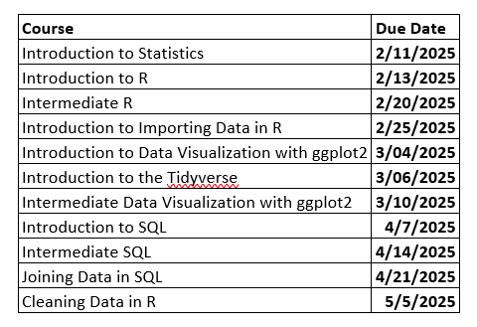
datacamp
This course will leverage DataCamp, an online learning platform, to help introduce concepts related to both the course content (theory) and applications that will leverage a state-of-the-art software visualization tool, Tableau. You will need to enroll in the DataCamp course in order to access and submit assignments (first one is due before 2/11/24). There is approximately one assignment per week up to first week of May. Assignments can take more than 2 hours for any given week, so you should allocate your time carefully to these activities

Slide 22
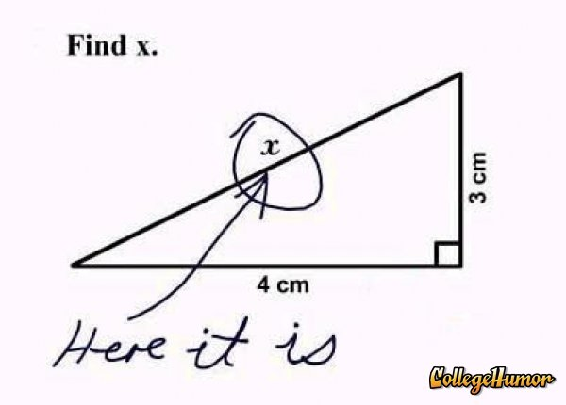
Excel Exam Dates
There will be two noncumulative midterm exams administered at approximately weeks 5 and weeks 10 of the course. The final exam takes the form of the final project for the course.
Analytics Programming Exam 12 March 2024
SQL Skills Exam
25 April 2024

Slide 23
Course project
The goals of the team project are (1) to integrate and apply what you have learned in the class; (2) to give you experience working in team situations; and (3) to enhance your communication and presentation skills.
Throughout the course, you will complete two major analytics tasks: a descriptive task and a database task. Details for these two tasks will be made available after the appropriate material has been covered.
In general, the projects will provide you the opportunity to express yourself creatively within the constraints of the task using the statistical software package to showcase your analysis and demonstrate your competency with coding and debugging your work.

Slide 24
COURSE GRADE

Slide 25
Classroom decorum and email
In extreme cases the instructor reserves the right to decrease the letter grade by an entire letter for a student due to inappropriate behavior.
I teach other classes, and this is the fastest way for me to know who I’m responding to. Put your full name at the end of email messages as well. Your email decorum should be professional. You should make sure you address the email formally and properly and use college level grammar.

Slide 26
Academic integrity
You, your colleagues, faculty, staff, and alumni are the University of San Diego. These and many other persons have worked very hard since the founding of USD in 1949 to build a quality university. The philosophy and mission of USD http://www.sandiego.edu/about/mission-vision-values.php emphasizes the idea of personal and academic integrity.
The following is a synopsis of the academic integrity policy. For more information click on this hyperlink http://www.sandiego.edu/associated-students/branches/vice-president/honor-council/integrity-policy.php or download this pdf http://www.sandiego.edu/conduct/documents/HonorCode.pdf

Slide 27
Student disability policy
The University of San Diego complies with the American with Disabilities Act and Section 504 of the Rehabilitation Act It is a University of San Diego Disability Services policy that when students are scheduling exams (midterm exams or final exams) in the DLDRC, they must submit an “Authorization to Administer Exam” at least one week prior to the exam date.
If a student does not give DLDRC this notice, the DLDRC can deny them the right to the accommodation, as the DLDRC is not given adequate time to prepare (and set up office space during established exam scheduling times.) Please provide me (your instructor) with a Letter of Accommodation drafted by the DLDRC as soon as possible. There are no retroactive accommodations for Disabled students

Slide 28
Student athletes
You are responsible for providing me advanced written notice, (email), any time you will be unable to attend class. You are also responsible for determining alternate dates/times to make up missed work in class. Without written notice, no assignments, quizzes or tests, either due or taken in class, can be made up.

Slide 29
Tentative course topics

Slide 30
Tentative course topics cont

Slide 31
Tips for Success
Show up and do the work! Don’t get behind
Ask for help if you need it but try to learn to solve the problem on your own, use google, Stack Overflow, reddit
Use the buddy system
Time manage the class!

Slide 32

College Tips…
Time Manage
Let common sense rule your life
Compartmentalize and Prioritize
Develop networking skills and a network
Don’t make a “mountain out of a mole hill”

