Slide 1

Predictive Analytics
S. Levkoff, PhD, CAP®
University of San Diego
Knauss School of Business
The Learning Problem
Descriptive Analytics & Data Management
S. Levkoff, PhD, CAP®
University of San Diego
Knauss School of Business
Introduction to Analytics

Slide 2
Data and analytics
The Institute for Operations Research and Management Science (INFORMS) defines ANALYTICS as…
“…the scientific process of transforming data into insights for making better decisions.”

Slide 3
Branches of analytics
There are three categories of analytics problems:
  Descriptive
  Prescriptive
  Predictive

Slide 4
Descriptive
Descriptive methodologies are a collection of models that help describe the problem situation for further analysis.

Slide 5
Descriptive
Descriptive methodologies are a collection of models that help describe the problem situation for further analysis.

Slide 6
Descriptive
Descriptive methodologies are a collection of models that help describe the problem situation for further analysis.
Descriptive methods are exploratory in asking the question, “What happened?”

Slide 7
Descriptive
Descriptive methodologies are a collection of models that help describe the problem situation for further analysis.
Descriptive methods are exploratory in asking the question, “What happened?”

Slide 8
Descriptive
Descriptive methodologies are a collection of models that help describe the problem situation for further analysis.
Descriptive methods are exploratory in asking the question, “What happened?”
Usually involve some sort of summary statistics or visualizations to describe the data.

Slide 9
Descriptive
Descriptive methodologies are a collection of models that help describe the problem situation for further analysis.
Descriptive methods are exploratory in asking the question, “What happened?”
Usually involve some sort of summary statistics or visualizations to describe the data.

Slide 10
Prescriptive
Prescriptive methodologies offer solutions that provide specific quantifiable answers that can be implemented to solve a problem.

Slide 11
Prescriptive
Prescriptive methodologies offer solutions that provide specific quantifiable answers that can be implemented to solve a problem.

Slide 12
Prescriptive
Prescriptive methodologies offer solutions that provide specific quantifiable answers that can be implemented to solve a problem.
A prescriptive model answers the question, “What is the best action or outcome?”

Slide 13
Prescriptive
Prescriptive methodologies offer solutions that provide specific quantifiable answers that can be implemented to solve a problem.
A prescriptive model answers the question, “What is the best action or outcome?”

Slide 14
Prescriptive
Prescriptive methodologies offer solutions that provide specific quantifiable answers that can be implemented to solve a problem.
A prescriptive model answers the question, “What is the best action or outcome?”
Often involves Optimization

Slide 15
Prescriptive
Prescriptive methodologies offer solutions that provide specific quantifiable answers that can be implemented to solve a problem.
A prescriptive model answers the question, “What is the best action or outcome?”
Often involves Optimization

Slide 16
Predictive
Predictive methodologies are more focused on explaining causal relationships to predict the future (or understanding how past events affects future events).

Slide 17
Predictive
Predictive methodologies are more focused on explaining causal relationships to predict the future (or understanding how past events affects future events).

Slide 18
Predictive
Predictive methodologies are more focused on explaining causal relationships to predict the future (or understanding how past events affects future events).
A predictive model answers the question of “What could happen?”

Slide 19
Predictive
Predictive methodologies are more focused on explaining causal relationships to predict the future (or understanding how past events affects future events).
A predictive model answers the question of “What could happen?”

Slide 20
Predictive
Predictive methodologies are more focused on explaining causal relationships to predict the future (or understanding how past events affects future events).
A predictive model answers the question of “What could happen?”
Predictive methodologies often involve either forecasting - looking backwards to look forwards - or simulation - building a model based on theory and letting it “run forward” to see what happens.

Slide 21
Predictive
Predictive methodologies are more focused on explaining causal relationships to predict the future (or understanding how past events affects future events).
A predictive model answers the question of “What could happen?”
Predictive methodologies often involve either forecasting - looking backwards to look forwards - or simulation - building a model based on theory and letting it “run forward” to see what happens.

Slide 22
Example #1
Classify each of the following problems as requiring the use of either descriptive, prescriptive, or predictive analytics:
A shipping company needs to calculate the cheapest route to travel in order to make all of its scheduled deliveries on time.
Prescriptive!
  Keyword is cheapest! It is asking for the best solution which requires Optimization.

Slide 23
Example #2
Classify each of the following problems as requiring the use of either descriptive, prescriptive, or predictive analytics:
A real estate company wants to know how much adding an extra bedroom to their luxury condo units would affect the market price of those units.
Predictive!
  It is asking how something would affect something else – a causal relationship!

Slide 24
Example #3
Classify each of the following problems as requiring the use of either descriptive, prescriptive, or predictive analytics:
Climate scientists want to understand the degree to which the climate has changed over time.
Descriptive!
  Asking about what happened! Not what will happen or how human activity has influenced what will happen!

Slide 25
Example #4
Classify each of the following problems as requiring the use of either descriptive, prescriptive, or predictive analytics:
A stock analyst wants to know the likelihood that the market will be in recession next year using historical return data.
Predictive!
  Using the past to predict the future!

Slide 26
Example #5
Classify each of the following problems as requiring the use of either descriptive, prescriptive, or predictive analytics:
An online vendor wants to use its data to figure out the revenue maximizing price to charge for its product.
Prescriptive!
  Keyword is maximizing! It is asking for the best solution which requires Optimization.

Slide 27
The analytics pipeline
Business Problem Framing
Analytics Problem Framing
Data Extraction and Preprocessing
Methodology Selection
Model Building
Solution Deployment
Lifecycle Maintenance

Slide 28
Business Problem Framing
Obtain or receive the problem statement and usability requirements
Identify stakeholders
Determine whether the problem is amenable to an analytics solution
Refine the problem statement and delineate constraints
Define an initial set of business benefits
Obtain stakeholder agreement on the business problem statement

Slide 29
Analytics Problem Framing
Reformulate a business problem statement as an analytics problem
Develop a proposed set of drivers and relationships to inputs
State the set of assumptions related to the problem
Define key metrics of success
Obtain stakeholder agreement on the approach

Slide 30
Data Extraction & Preprocessing
Identify and prioritize data needs and resources
Identify means of data collection and acquisition
Determine how and why to harmonize, rescale, clean, and share data
Identify ways of discovering relationships in the data
Determine the documentation and reporting of findings
Use data analysis results to refine business and analytics problem statements

Slide 31
Methodology Selection
Identify available problem solving approaches (methods)
Select software tools
Model testing approaches
Select approaches

Slide 32
Some popular software tools

Slide 33
Our toolkit
Microsoft Excel
  The standard course text is based around his software. Analysis and Solver tools recommended.
R
  A statistical data mining package available for download at the CRAN Project website: https://www.r-project.org/. All of the other leanpub texts on the reading list are written for R.
RStudio
  An integrated development environment (IDE) for R. Think of this as a more interactive “shell” that R wears on top of itself to look nicer from a user interface perspective. It is available for download here: https://www.rstudio.com/products/rstudio/download/
Stack Overflow
  A great source for anything programming / statistics / analytics related. Any questions or problems about programming syntax / commands can most likely be found / resolved here: https://stackoverflow.com/

Slide 34
Model Building
Identify model structures
Evaluate models and data
Calibrate models and data
Integrate the models

Slide 35
Solution Deployment
Perform business validation of the model
Deliver report with the findings
Create model, usability, and system requirements for production
Support deployment

Slide 36
Lifecycle Maintenance
Document initial structure
Track model quality
Recalibrate and maintain the model as new data becomes available
Support training activities
Evaluate the business benefit of the model over time and compare to maintenance costs

Slide 37
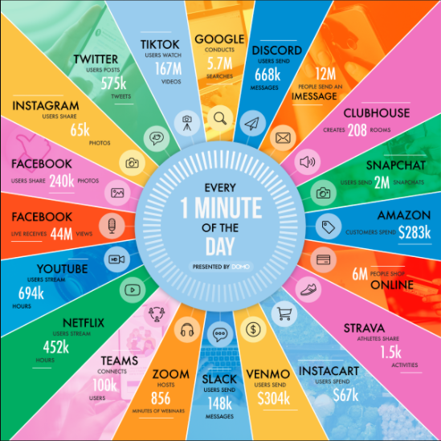
BIG Data!
As of July 2021, the internet reaches 65% of the world’s population – a 10% increase since January 2021 (domo.com)
How big is big?
  Total amount of data consumed globally in 2021 is estimated to be 79 zettabytes (Statista).
  A zettabyte is one trillion gigabytes of data.
  This number is projected to grow to 180 zettabytes by 2025 (Statista).
Over 90% of the data that exists today was created in the last two years (domo.com).
Oil and land used to be out most valuable resources…
Now it is information!

Slide 38
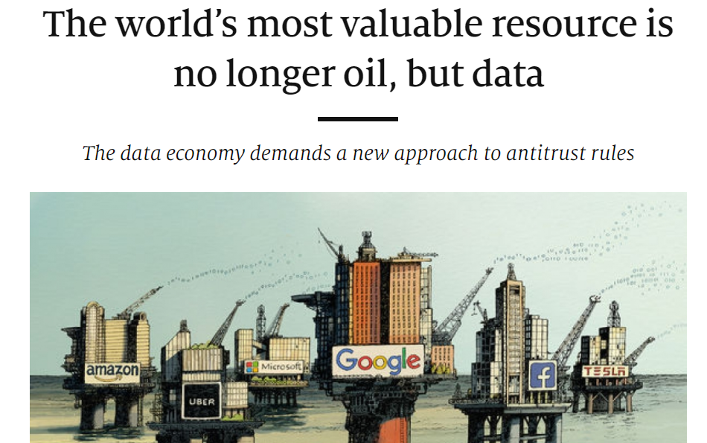

Slide 39
Leveraging Analytics
Humans excel at:
Common Sense
Morals
Imagination
Compassion
Abstraction
Dilemmas
Dreaming
Generalization
Cognitive Systems excel at:
Locating Knowledge
Pattern Recognition
Natural Language Processing
Machine Learning
Eliminating Bias
Endless Capacity

