Slide 1
University of San Diego/ACCION
Web Training Seminar
Dr. Carl Michael Rebman, Jr.
Associate Professor of Information Technology and Electronic Commerce

Slide 2
Introduction
About Me
About this session
  Starting from the very beginning
  If too basic we can speed it up—I do have a lot of slides
  First we will discuss websites what they are and how they work
  Second we will talk about how websites can help our business
  Third—the really cool thing is learning how to create a website.
  Fourth we will learn about how to promote our website in the cyberspace world

Slide 3
The basics of websites-HTTP & HTML
This session is intended to be a guide to help you better understand the world of http and html.
In case you do not already know http stands for hypertext transport protocol, and html stands for hypertext markup language.
There is a good chance that this sounds a little ‘greek’ to you but the concepts are fairly simply.
A protocol is simple a set of rules that have been established that allows things to happen. For example in America it is protocol to thank someone after they have done something to try to help you.
However a protocol cannot work unless everyone speaks the same language. Hence the reason for html. It is the language that http follows.

Slide 4
More Basics on web pages/sites
There is a still a large mystique that surrounds web pages.
It appears that many people think it to be a magical thing that you can type in an address inside of a program like Internet Explorer or ?? and all of a sudden a page appears.
However, there really is nothing magical about this. In reality all you are doing is making a telephone call to a number (which in this case is a file) and hoping to get an answer (just as you normally hope to hear someone when you ‘dial up.’
The other part of reality is that your web page is a similar type of answering machine device.
Just as you make the decision as to what people will hear when you are not home, your web page is your way of introducing people to yourself.

Slide 5
The Internet mechanics
Have you ever wondered what, exactly, happens when you type in a URL into your browser's Address bar?
The Internet is based on a client-server model, where your Web browser is the client, and the Web server is the server.
In the client-server model, the client opens up a channel of communication with the server and requests a resource.
The server receives the request, locates the resource being requested, and sends it to the client, closing the channel of communication.

Slide 6
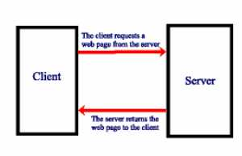
Here is how it visually looks like

Slide 7
Thinking about websites as a concept
However, as you already know web pages can be more than for personal use, a business can design them to take orders, provide information, and many other things.
The main point to understand is that one should give some consideration as to what people will think and do when encountering your web page.
It is also important to think not in terms of pages, but as an overall web site.
Many of you may have created web pages that show pictures of yourself, or perhaps provide some links to other places, but there is little design thought about how to make the experience for the visitor more pleasurable or easier to find what he/she is looking for.

Slide 8
Attracting and Retaining Online Customers
Basic rule of commerce
  Offer valuable products/services at fair prices
Additional e-commerce rules
  The Web site should offer something unique
  The Web site must be aesthetically pleasing
  The Web site must be easy to use and fast
  The Web site must motivate people to visit, stay and return
  You must advertise your presence on the Web
  You should learn from your Web site

Slide 9
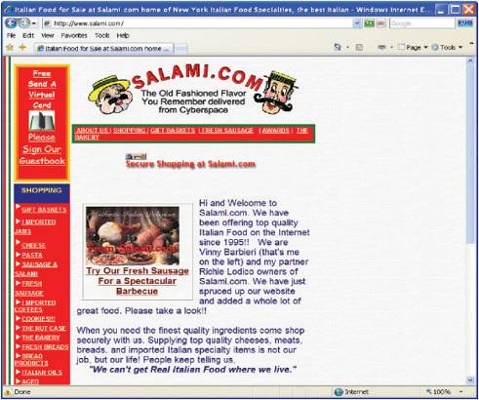
Web Site Rules: Rule 1
Offer something unique
  Offer hard-to-find goods
    Global audience
    Reasonable prices

Slide 10
Web Site Rules: Rule 2
Website must be aesthetically pleasing
  Use of color schemes, backgrounds, high quality images
  Clear, concise and consistent layout
    Increases chances of return
    Can separate a Web site from the competition

Slide 11
Web Site Rules: Rule 3
Website must be easy to use and fast
  Easy navigation
  Fast download speed
    Average user will wait only a couple of seconds for a website to download
  Present brief summary information with hyperlinks
    Allows users to “drill down”

Slide 12
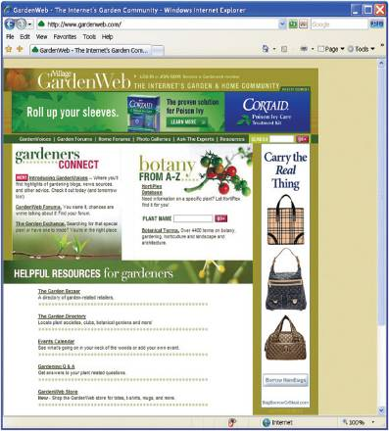
Web Site Rules: Rule 4
Web site must motivate people to visit stay and return
  Create a community
    GardenWeb
      Users share tips
      Buy from each other

Slide 13
Web Site Rules: Rule 5
Advertise your presence on the Web (II)
  Pay-per-click
    Only pay for advertising when user clicks on it
    Affiliate marketing – Web site owners post ads on their site
    Problem: click fraud – artificially clicking on ads to create revenue
      Network click fraud
      Competitive click fraud

Slide 14
Web Site Rules: Rule 5
Advertise your presence on the Web
  Pull marketing
    A passive method of attracting to a specific site
    Include the Web site address on all promotional materials
    Advertise your Web site on other sites

Slide 15
Web Site Rules: Rule 6
Learn from your Web site
  Who are your customers?
  What are they doing?
Web analytics
  Analyze behavior of visitors
    Path the visitors take
    Length of the visit
    Number of pages viewed
    Page from which they exit

Slide 16
Web Design Considerations
Screen Resolution
Download times
Visual Structures
  Use of white space
  Guiding the user’s eye
  Hyperlinks
  Hierarchy
Transitions
Page length

Slide 17
How people read websites
People rarely read Web pages word by word; instead, they scan the page, picking out individual words and sentences.
As a result, Web pages have to employ scannable text, using
  highlighted keywords (hypertext links serve as one form of highlighting; typeface variations and color are others)
  meaningful sub-headings (not "clever" ones)
  bulleted lists
  one idea per paragraph (users will skip over any additional ideas if they are not caught by the first few words in the paragraph)
  the inverted pyramid style, starting with the conclusion.
  half the word count (or less) than conventional writing

Slide 18
More on Websites continued part II
Word on web pages need to be credible (ie. good writing, graphics)
Viewers detest “marketese” that is promotion language that they cannot verify if it is true or not.
Three main types of web language
  Scanable- where information can be easily found and determined, ie. bulleted lists
  Objective- language written in paragraph form (least effective)
  Combination- a mix between the two (most effective)

Slide 19
Web Design Considerations Part III
Knowing HTML Limitations
Design Considerations
Understanding Download Times
Using very little glitz.
Check Out Your Own Web Site
Understanding Your Service Provider
Final Web Design Considerations

Slide 20
HTML Limitations
HTML (HyperText Markup Language) is a very general language designed to place information on web pages. It is not a word processing or desktop publishing tool. The sooner you come to grips with this fact, the faster you will become an effective webdesigner. Here's why:
  No two browsers show a page quite the same way.
  Even if everyone were to use the same browser, not everyone would have the same resolution as you.
  It really never was intended to be as specific as a word processor, and its fundamental structure reflects this.
  Nobody owns the web. Therefore, standards are rather difficult to enforce.

Slide 21
Design Considerations
Assume everyone has their screen set to 640x480 and 256 colors..
This minor detail is very often overlooked by web authors.
  If you want to go "wide", then make sure that what you consider the material of primary importance to your reader is located on the left side of the screen.
  Forces the user to use the right-left scroll bar to read the text.
  Banner and navigation art can be unrecognizable. Even worse scenarios are possible with background images.
  Do use TABLES (now supported by almost all browsers) to create some white-space in your pages.
  Use very basic color schemes and avoid noisy background images.
  Always use ALT (image descriptions) with your images so that people with text browsers can use and understand your pages. Not doing this could prevent a lot of people from enjoying your site.

Slide 22
Understanding Download Times
Nobody has their own personal T-1 connection to the web.
Okay, so maybe you have one, but a lot of people are using either 28.8K or 56(haha)K modems. As a rule of thumb, do not create pages that take more than 30 to 60 seconds to load at 28.8K. You can accomplish this by:
  Using graphics sparingly, and using color reduction when possible.
  Use Interlaced GIF images (89a standard) when possible. These provide a nice fade-in effect that allows people a sneak preview of your image as it comes into view.
  If you do have a lot of images to present on one page, use thumbnails (small versions) and link the larger images to them. If the reader wants, they can then view the picture in its full glory!
  Always indicate the HEIGHT and WIDTH of your images. Many browsers cannot display any part of the page until it knows all of the dimensions of the objects that the page consists of.

Slide 23
But the browsers can be different
Internet Explorer
Firefox
Opera
Irider
Safari (mostly for Apple)
Flock

Slide 24
Understanding Your Service Provider
Make sure you put your site where it belongs.
If you are placing your site on your personal webspace that came with your Internet service, make sure you are aware of any restrictions. These include:
  Maximum number of page accesses per month.
  Maximum number of bytes downloaded per month.
  Restrictions on commercial messages. Some providers even consider naming your employer a violation that could cause you to be charged commercial rates!
  Can you have CGI-BIN and Server Side Includes. If not, you cannot have a nice interactive website.

Slide 25
More Web Design Considerations
SPELLING & GRAMMAR: I cannot stress the importance of proper spelling and grammar strongly enough.
Never include an image in any page that you are calling from somebody else's site! It is very rude in that it steals bandwidth from the owner of the image. This can cause them to incur charges as well as have their site slow down. Actually, the odds are it will be your page that suffers! If you must, just take a copy and put it on your server. Do give credit where credit is due.
But you can get free stuff from http://www.reallybig.com/default.shtml

Slide 26
Avoid Using Glitz in Your Web Page
Avoid Glitz and the Cutting Edge of Web Technology.
  Use animation sparingly. An animation is a nice touch and a great way to draw somebody's attention to something you want to feature. There is however, nothing as annoying and distracting than a collection of flashing images all over the screen.
  Keeping in mind that no two browsers handle things quite the same, avoid what are called browser specific tags. If the viewer's browser does not support the tag, the item will either be ignored, or displayed as plain text.

Slide 27
In-class Exercise
Almost Time to go live
Let’s begin with an HTML primer

Slide 28
Web Page Elements
Title
Bookmarks
Body
Background
Normal text
Paragraph
Bulleted list
Headings
Images
Horizontal Rules
Image map
Hotspot
Animated images
Hyperlinks

Slide 29
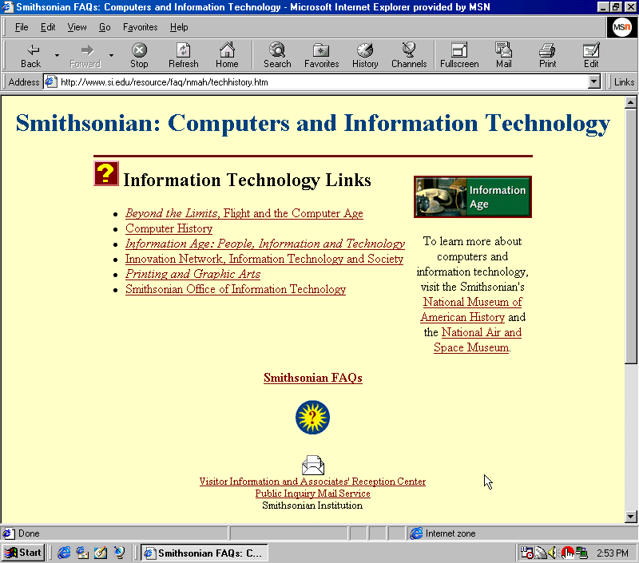
Web Page Elements
title
heading
horizontal rule
image
paragraph
body
links
bulleted list
animated image

Slide 30
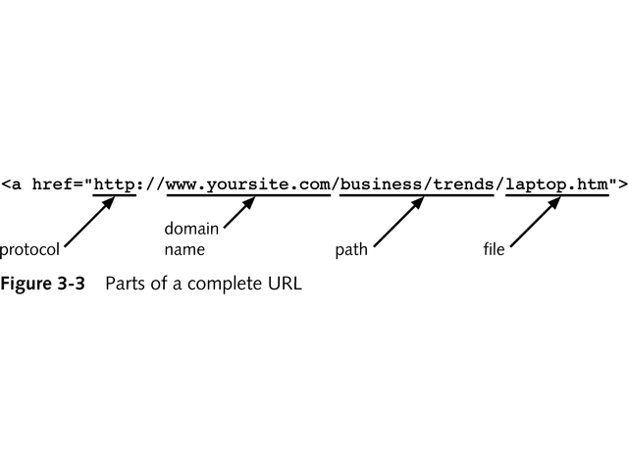

Slide 31
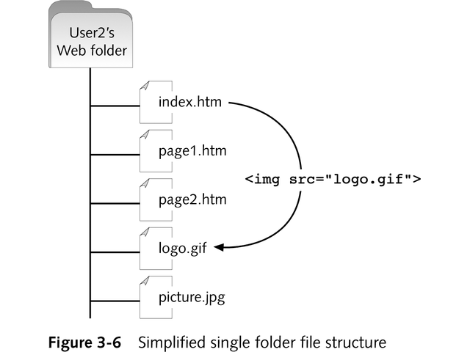

Slide 32
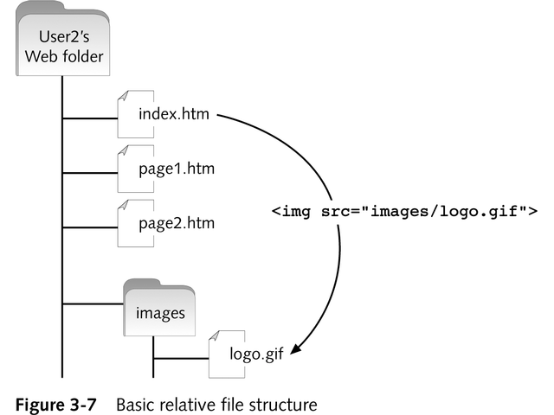

Slide 33
Now what is your web site?
It is going to start on your computer.
You will create a file and then you will have to send it a server. I have created a temporary account for you but in the future you will need to find a new home.
The bad news you will have to pay for this. You can check on the web or look at this site they have a lot of options http://www.register.com/titan/index.rcmx?
The good news is that you can choose the name for your site—well if it is available

Slide 34
Types of website creation tools
Notepad
Microsoft Frontpage (soon to be Expression)
Macromedia/Adobe Dreamweaver
Third party software like CoffeeCup or Cosmi Website Creator
Other templates easytemplates.com
Note some cost $$ others are free but you have to do more work

Slide 35
Ok time to go to work
First your website location is http://mississippi.sandiego.edu/your_site_name
Then you will need a username and password to access the server
Username msit588
Password is !.ms588
Now it is up to you to create the content please refer to the web worksheet.

Slide 36
So you have your website
Now what do you?
How do you go about promotion on the web??

Slide 37
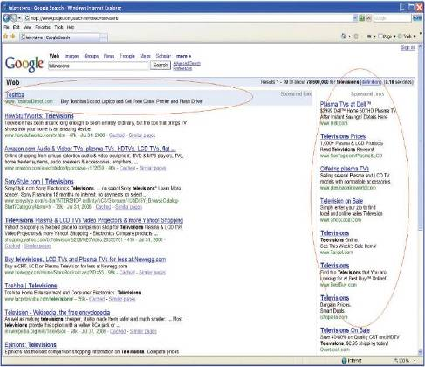
Search Engine Advertising
Sponsored search
  Pay to ensure a spot on top of search results page
  Company in control of ad positioning
  Pay-per-click
  Can get costly

Slide 38
Search Engine Optimization
Position within search results based on complex formula
Site owner has no control over the position of the ad
Optimization based on
  Web site updates
  Use of key terms
  Unethical “tricks”

Slide 39
Securing Payments in the Digital World
90 % of users have changed online behavior because of fear of identity theft
1/3 of online purchasers cut back on the volume of purchasing
More than 1/2 of shopping carts are abandoned
Need for secure forms of online payment

Slide 40
Conclusion
You have a start of a website which can be seen by your friends and family literally right now and you have also seen how much out there is you can do.

