Slide 1
Getting to Be EPIC
Going to SQL

Slide 2
Learning Objectives
Examine Structured Query Language (SQL)
Select data using criteria in SQL

Slide 3
In class Practice
SMSS OVERIEW
SELECT FROM
SELECT FROM WHERE
material revised from University of Arkansas/Microsoft Enterprise Consortium, originally prepared by Jennifer Kreie

Slide 4
What you will need
For these SQL lessons, you need your EPIC user account and password. You can log in remote at https://waltonlab.uark.edu/ and work through the browser or there is an option to download the Horizon Client and run a direct application.
Remember BE EPIC when using EPIC
Excellence
Professional
Innovative
Collegial

Slide 5
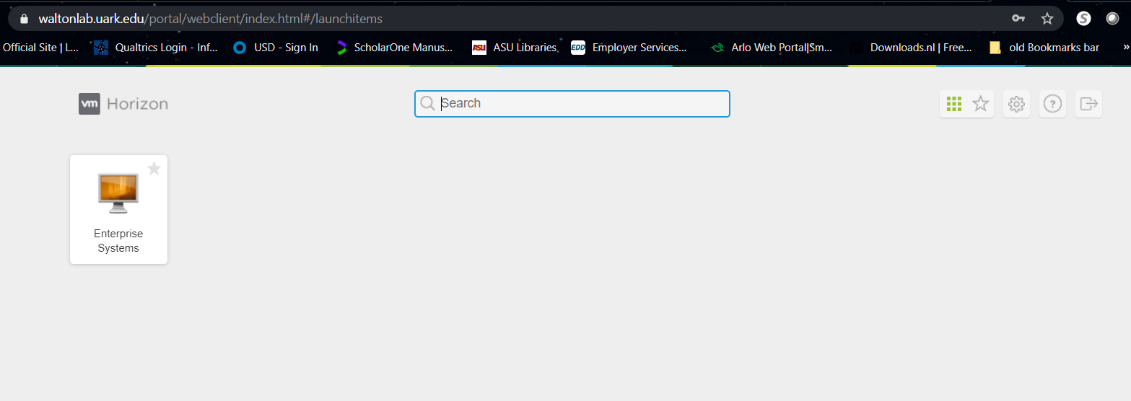
After selecting remote Client – CLICK on Enterprise sys

Slide 6
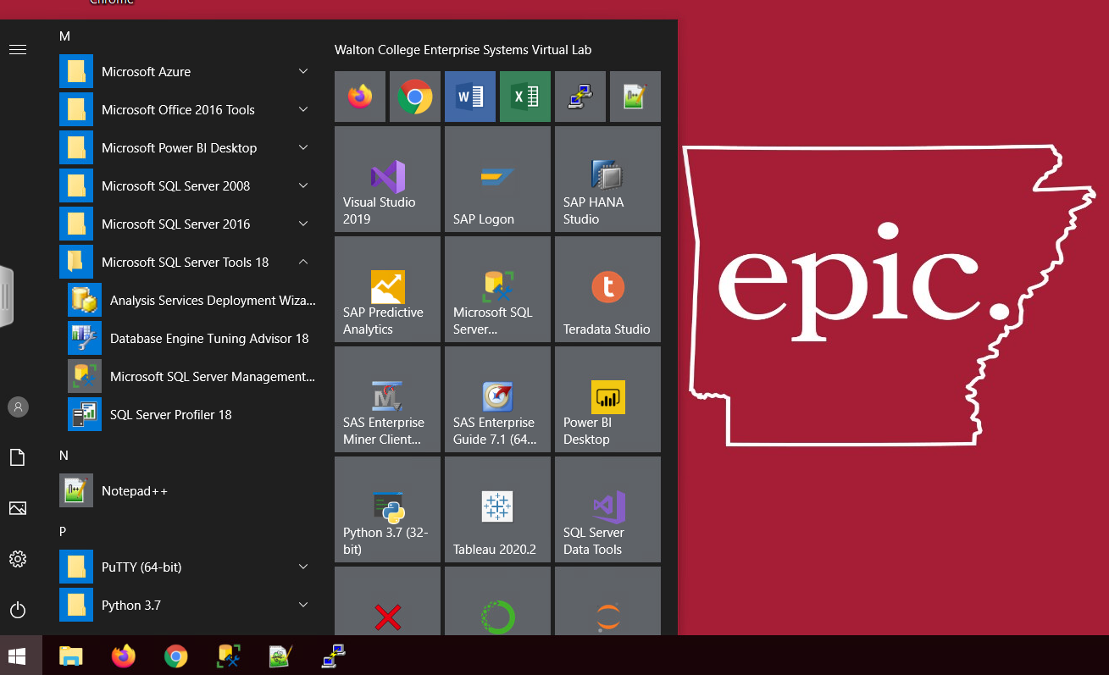
Starting Screen
There are three ways to access SMSS (MS SQL Management Server Studio
Through icon on the task bar, through icon on startup, and through the listing of installed applications.

Slide 7
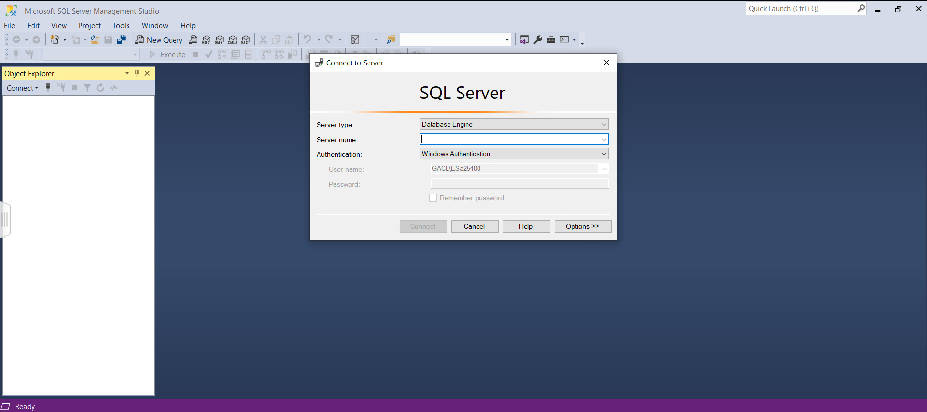
After splash screen comes up, you will also be required to login into the SQL Server

Slide 8
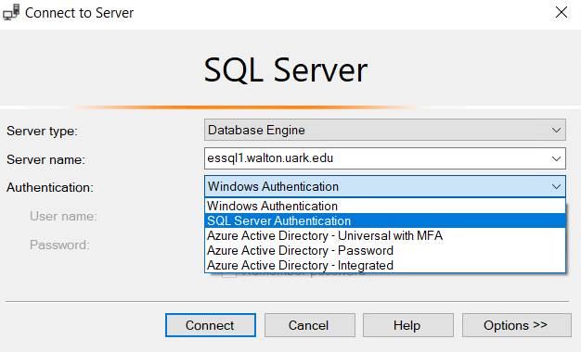
SMSS LOGIN
You will need the exact name of the server.
essql1.walton.uark.edu
There are several types of authentication, and you only need to be concerned with 2 of them.
WINDOWS Authentication will allow you to run queries and does not give you any access to your own db, or creating tables, etc. You also do not need to supply anymore credentials since you have validated yourself in the earlier remote access step
SQL Server Authentication – this will be necessary if you want to use your own db, create tables, import, etc, and YOU WILL need to authenticate yourself again.
You should be able use your same UARK login

Slide 9
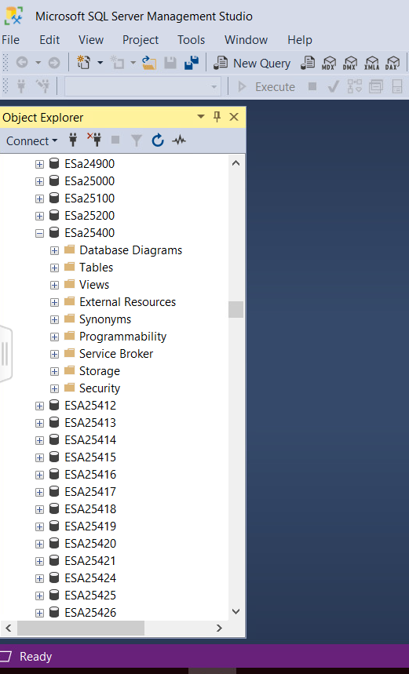
Object EXPLORER pane
The Object EXPLORER provides a hierarchical view of databases maintained by a SQL Server installation.
Username (database name)
Schema name
Object name

Slide 10
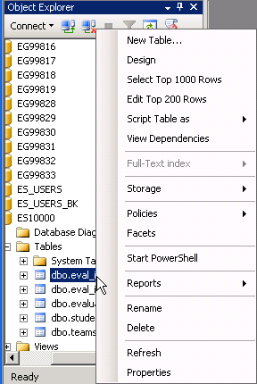
Object EXPLORER Context menu
The context-sensitive menu (right-click) gives you several options when working with objects such as tables.
Top 1000
Top 200
and more …

Slide 11
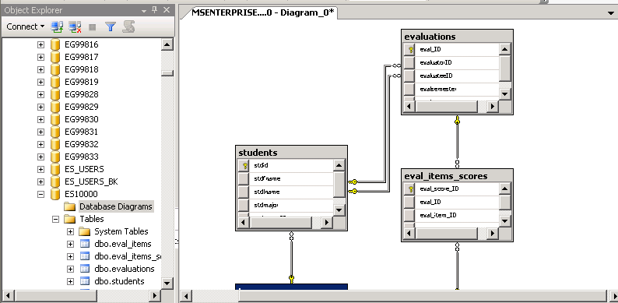
Database Diagram
An easy way to see how a list of tables comprise a database is to create a diagram.
This diagram shows the relationships between table.
For a database with a lot of table, such as AdventureWorks2008, you can select a subset of tables for a diagram.

Slide 12
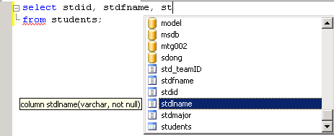
Query Editor Window
IntelliSense features helps you enter SQL code.
Suggestion: When writing SQL commands, enter the table(s) first to help IntelliSense feature help you.

Slide 13
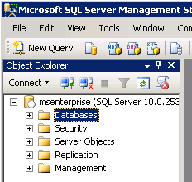
Object Explorer in MSSMS
In the Object Explorer select and expand the Database section.
Locate your account ID in the list NOT the account shown here.

Slide 14
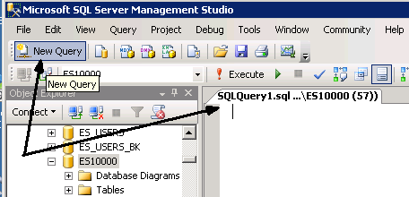
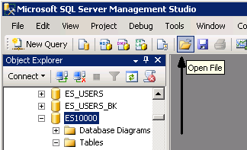
SQL pane
First make certain you download the 3 SQL Scripts from the course website (while in the EPIC remote access)
Either click New Query to open an SQL pane and paste in the contents of the “create” script OR …
Open the CREATE script file, which opens the SQL pane with the file contents.

