Slide 1
Sleep & Health
Data-Mining
Project
BUAN 370 Carl Rebman
Created By:
Jack Peterson, Alexandra Pragastis

Slide 2
Executive Summary
This Data Set provides an analysis of 374 individuals who reported their duration and quality of sleep, as well as their activity that day.

Slide 3
CLeaning the Data
01
02
Rename Variables
Find and Eliminate NULLS/ Unwanted Variables
03
04
Visualizations
Queries

Slide 4
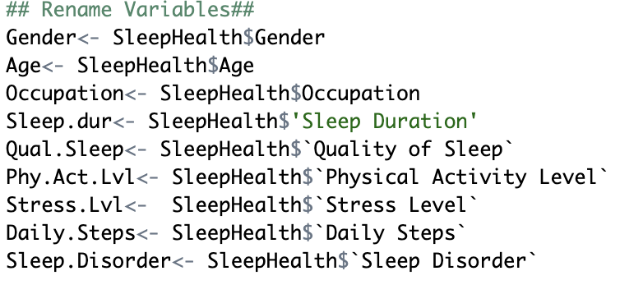
01
Rename Variables

Slide 5
02
Remove Unwanted Data

Slide 6
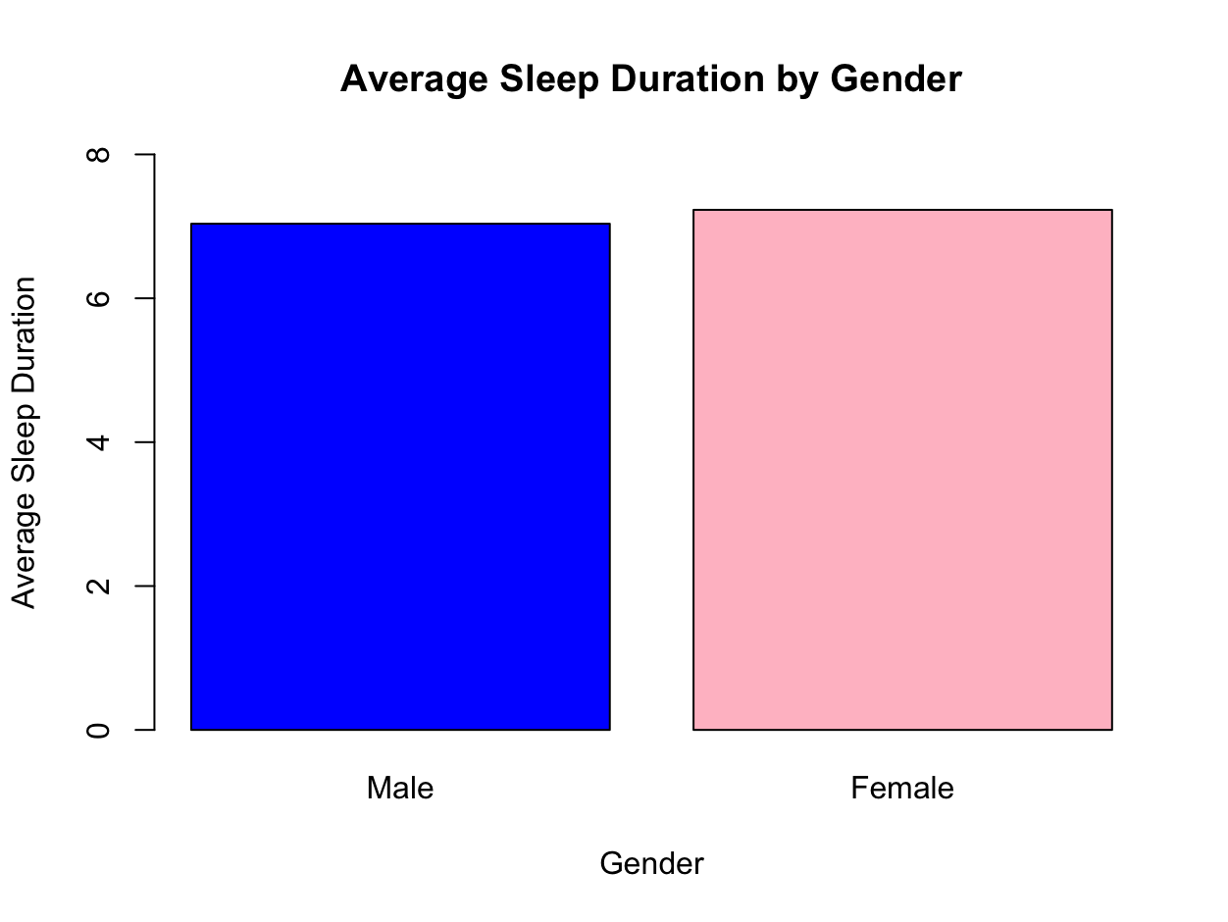
Average Sleep By Gender
Average Sleep by Gender
Male: 7.03 hrs
Female: 7.23 hrs

Slide 7
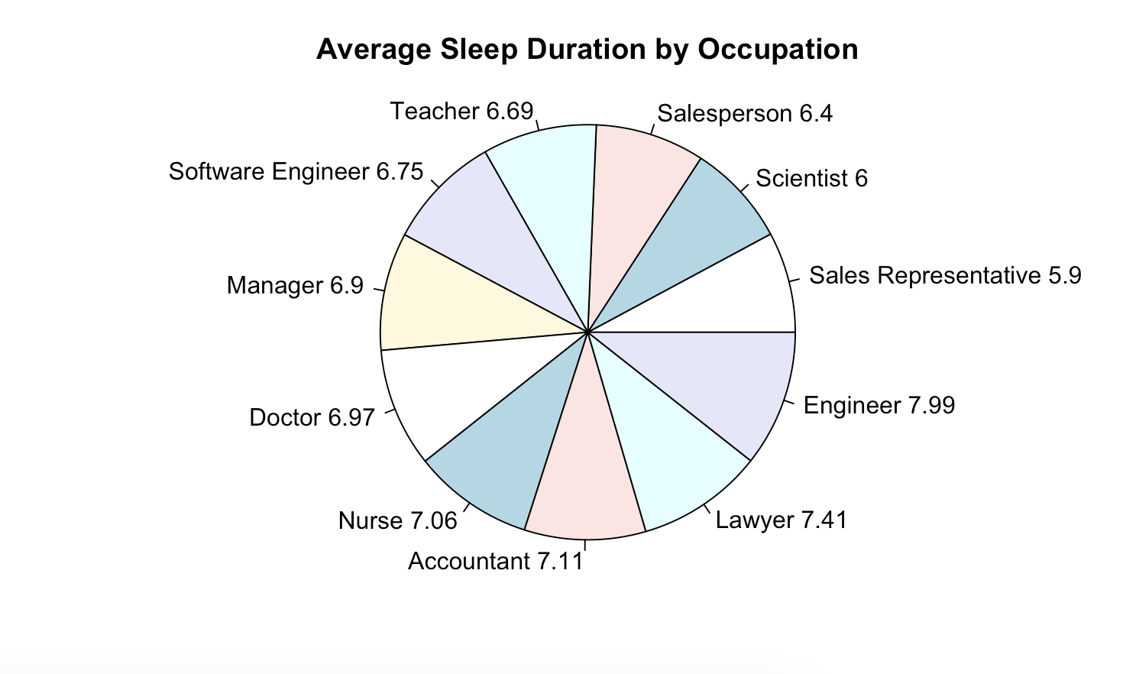
Average Duration of Sleep by Occupation

Slide 8
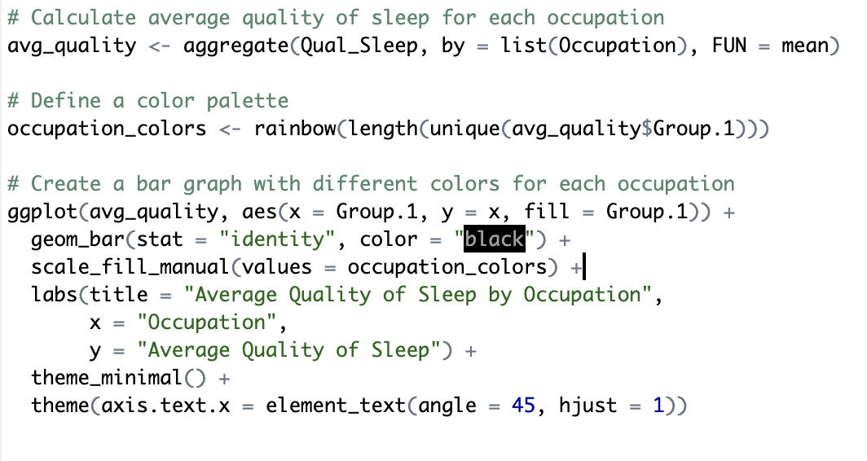
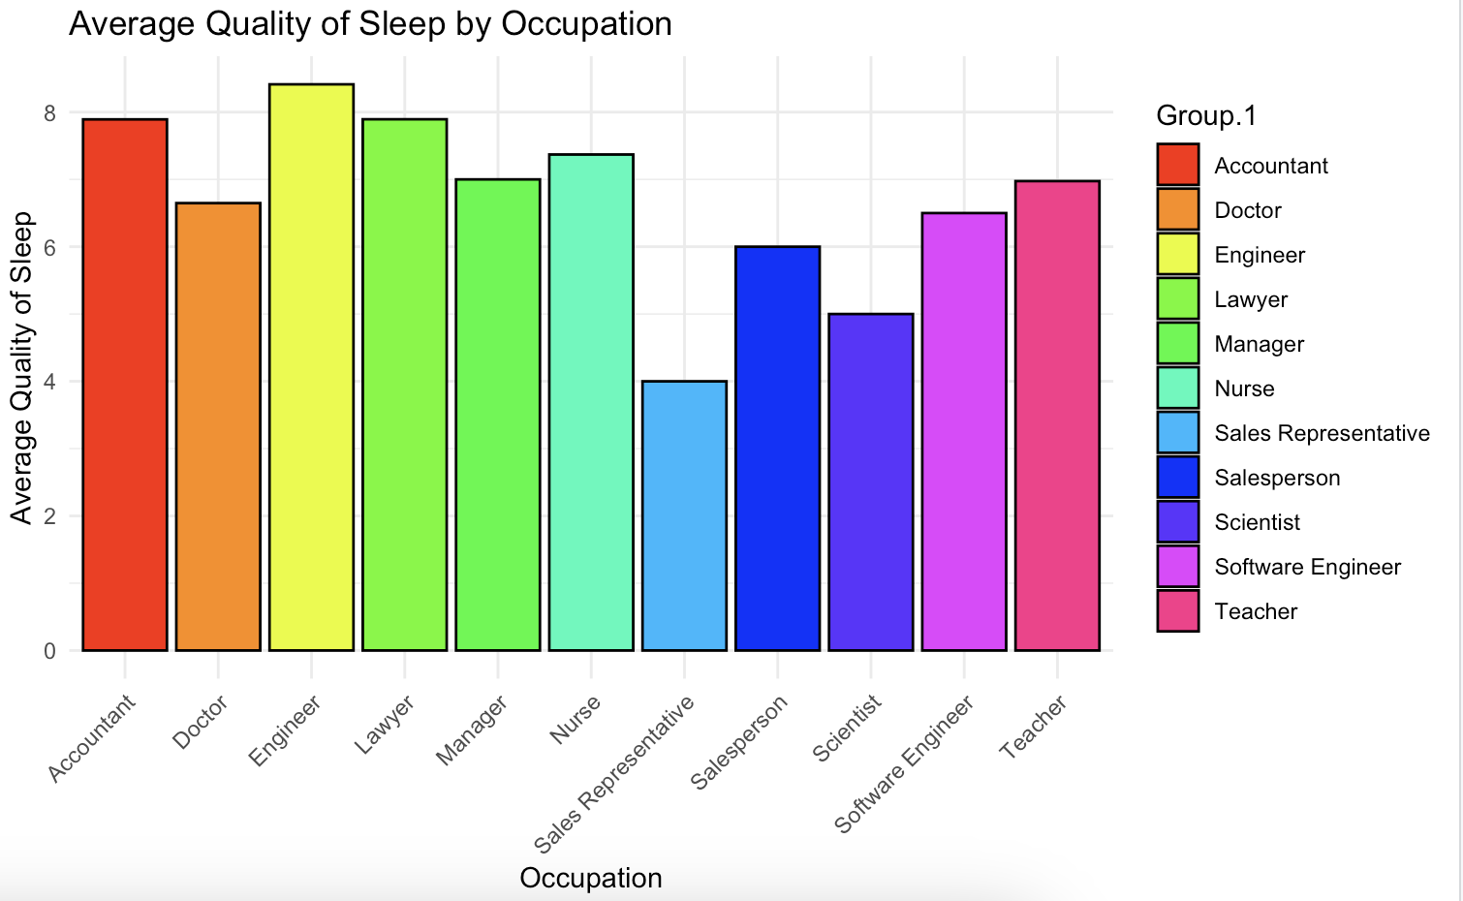
Sleep Quality by Occupation

Slide 9
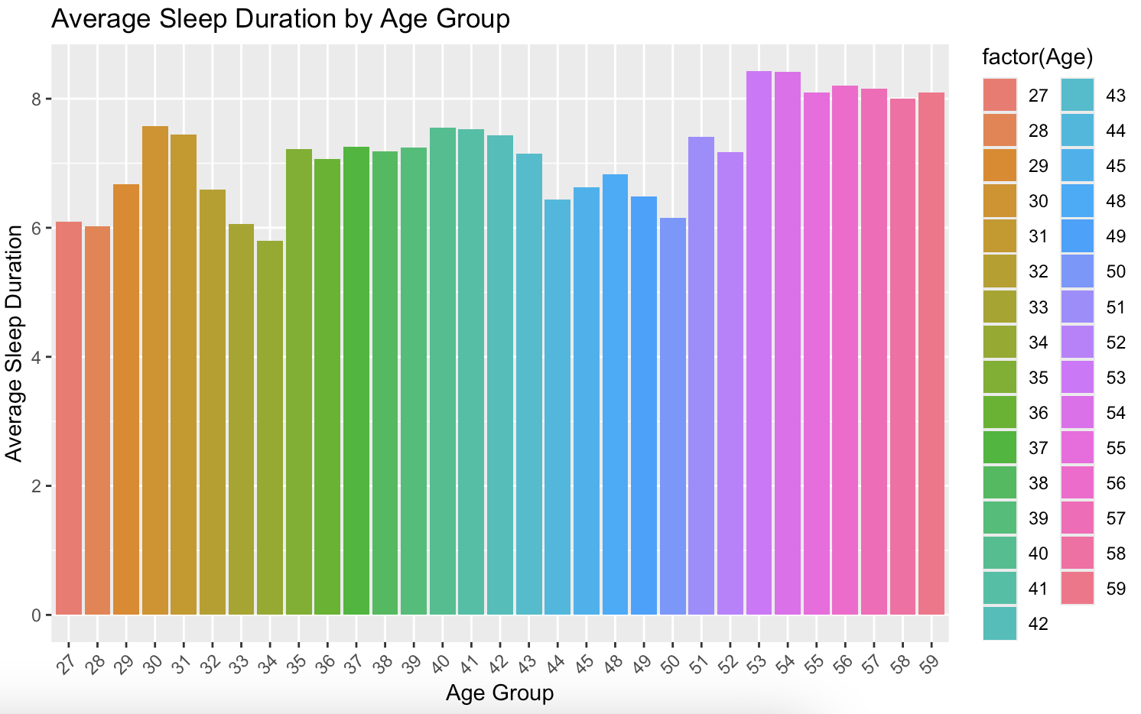
Sleep Duration By Age Group

Slide 10
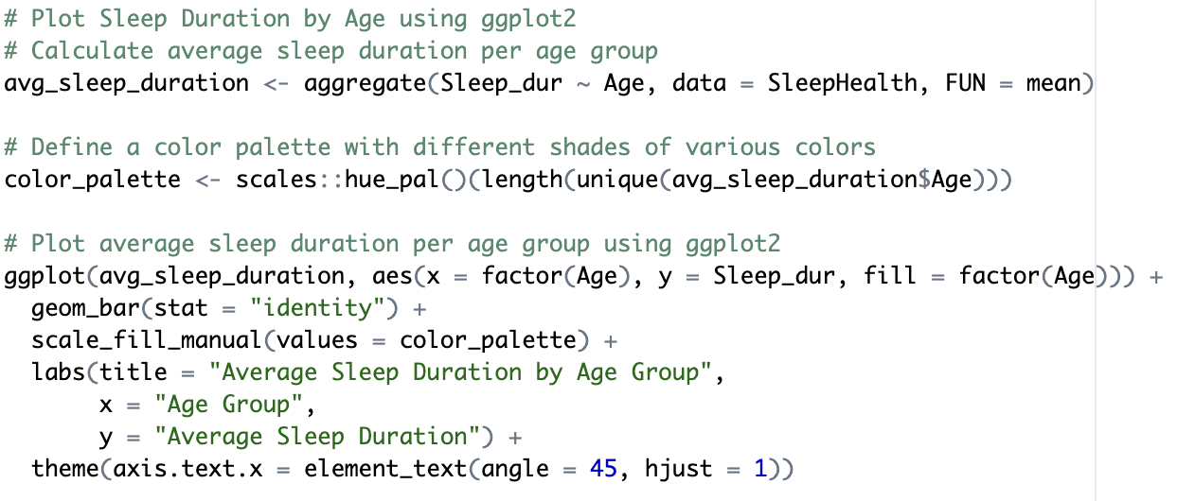
Sleep Duration By Age Group
CODE Chunk

Slide 11
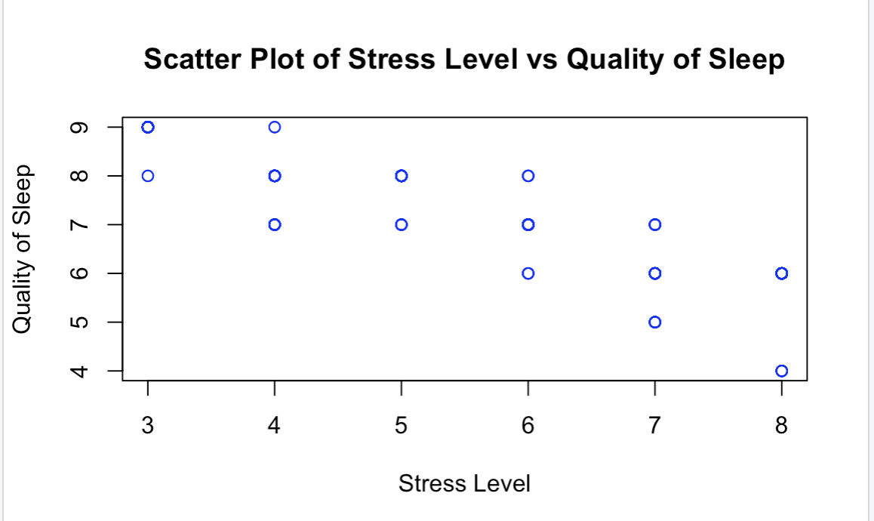
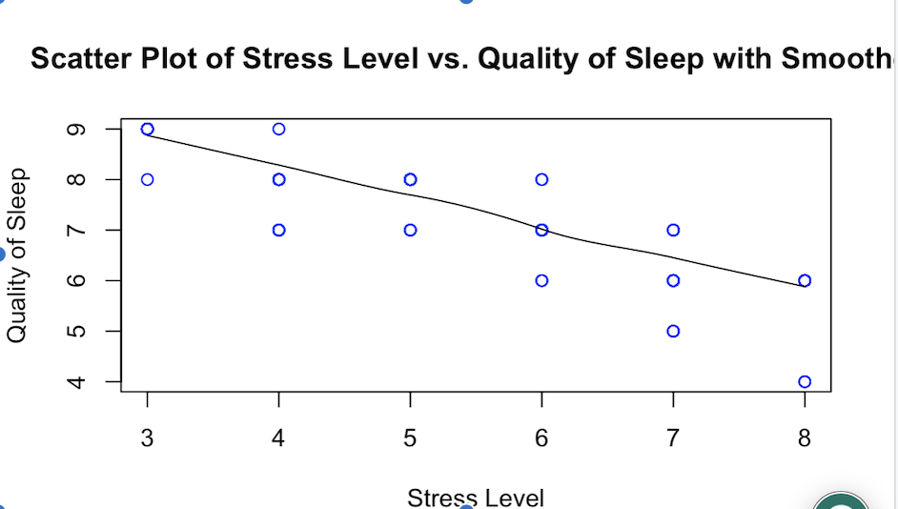
Sleep Quality by Stress Level
Negative Correlation between
the quality of sleep and the
stress levels of the individuals

Slide 12
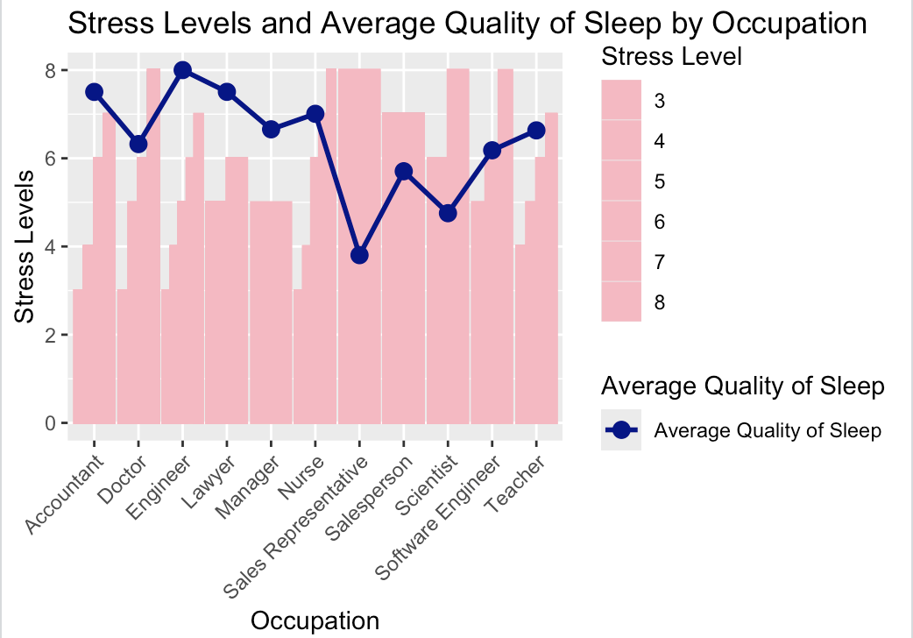
Stress Level and Quality of Sleep by Occupation

Slide 13
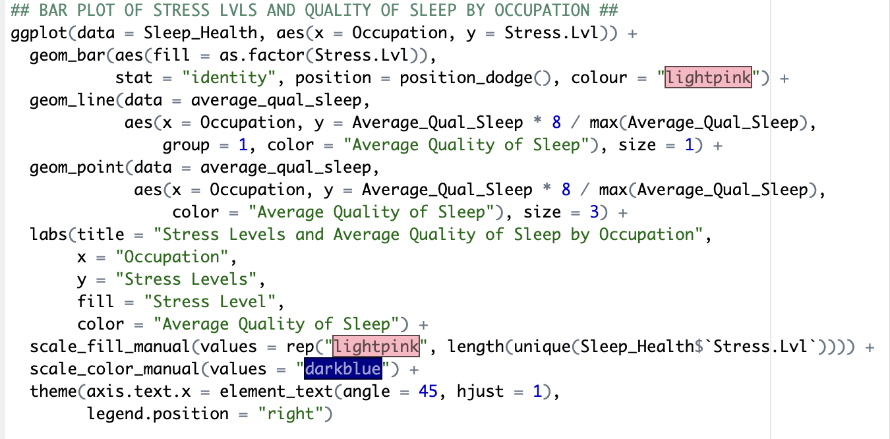
Stress Level and Quality of Sleep by Occupation (R CODE)

Slide 14
Q1
Queries : 1
Variable Introduction: Limit 5

Slide 15
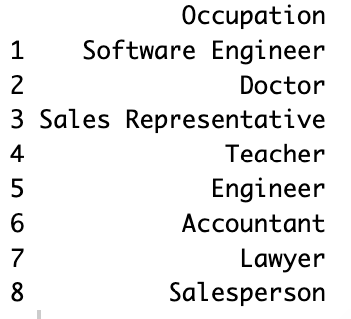
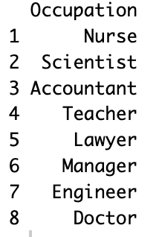
Q2-3
Queries : 2-3
Occupation by Gender

Slide 16
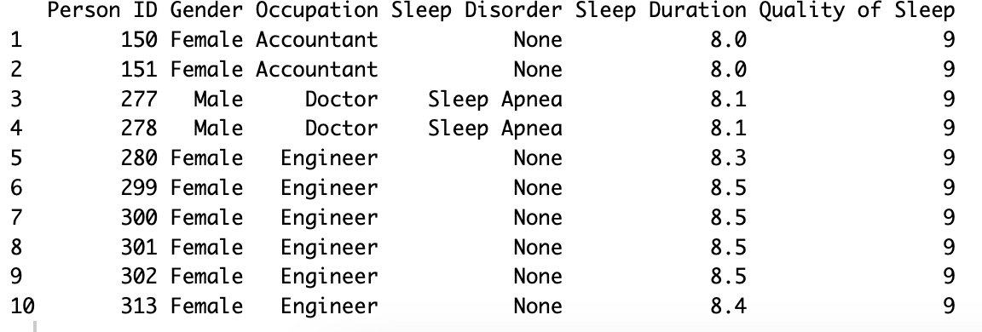
Q4
Queries : 4
Individuals with the Highest Sleep Quality

Slide 17
Q5
Queries : 5
How Sleep Disorders affect Sleep Quality

Slide 18
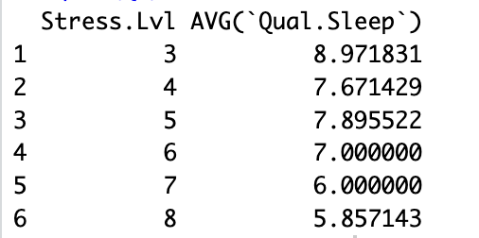
Q6
Queries : 6
How Stress Affects Sleep Quality
As stress increases within an individual, their sleep quality goes down

Slide 19
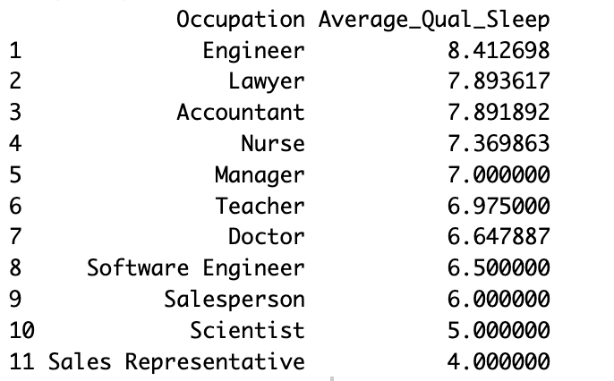
Q7
Queries : 7
Average Quality of Sleep by Occupation

Slide 20
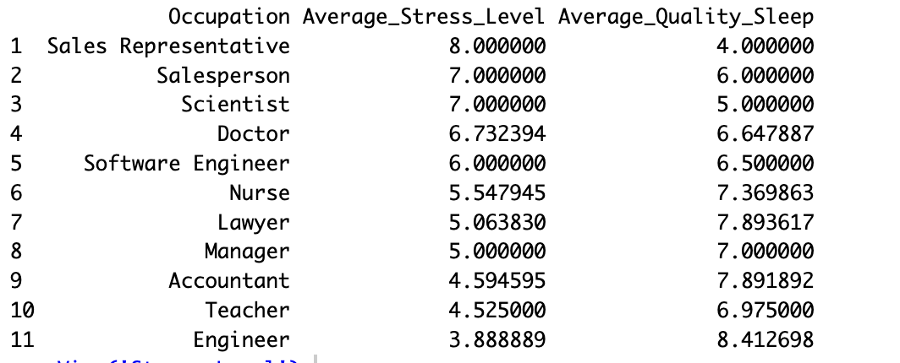
Q8
Queries : 8
Stress Level by Occupation

Slide 21
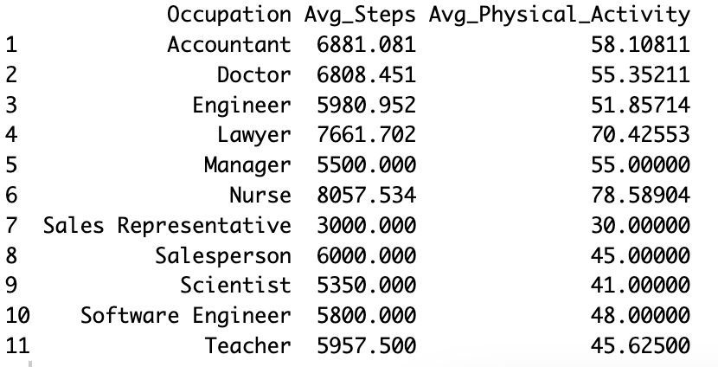
Q9
Queries : 9
Average Physical Activity Level and Steps by Occupation

Slide 22
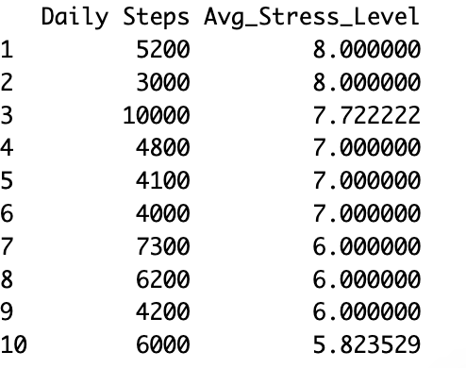
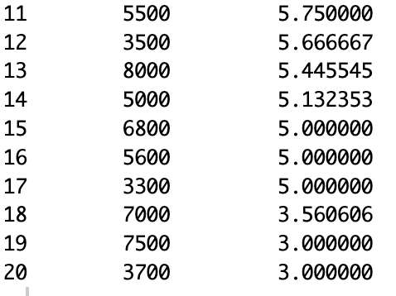
Q10
Queries : 10
Average Stress Level per Daily Steps Thresholds

Slide 23
Q11
Queries : 11
Person w/ the Highest Sleep Quality

Slide 24
Q12
Queries : 12
Person w/ the Highest Sleep Quality and Physical Activity

Slide 25
Thank You

