Slide 1
Data mining project
By Michael Lewis and Sebastian Radilla

Slide 2
Executive Summary
-Fama French Model
-Five factors:
RMRF - Market Risk or Excess Returns of market
SMB - Small cap. stocks compared to high cap. stocks
HML - Value stocks compared to growth stocks
RMW - robust compared to weak operating profitability
CMA - firms that invest conservatively compared to firms that invest aggressively.
APPL vs VGT - Performance
Notes:
Michael

Slide 3
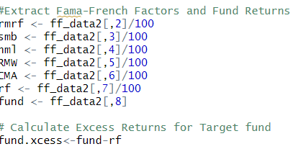
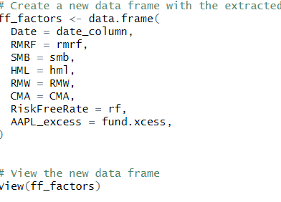
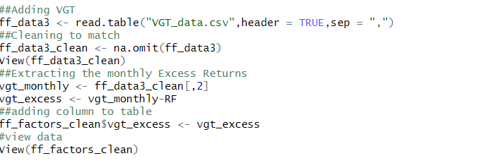
Data Cleaning
--Manually created database
-Downloading all of the monthly historical data for AAPL and VGT for the past 10 years, (06/2014 - 03/2024).
-Download historical data for the five factors from Kenneth R. French data library,
-Date from Yahoo finance as a primary key
-Date from our Kenneth R. French data as the foreign key to merge the data
-This was all stored into a data set called ff_data2
-Calculated the excess returns for AAPL for each month by subtracting the returns from the risk free rate.
-Extract factors in decimal form and add VGT excess returns
-na.omit to get rid of these rows with NA observations.
-Addition of two categorical variables: technology company and COVID
Notes:
Michael

Slide 4
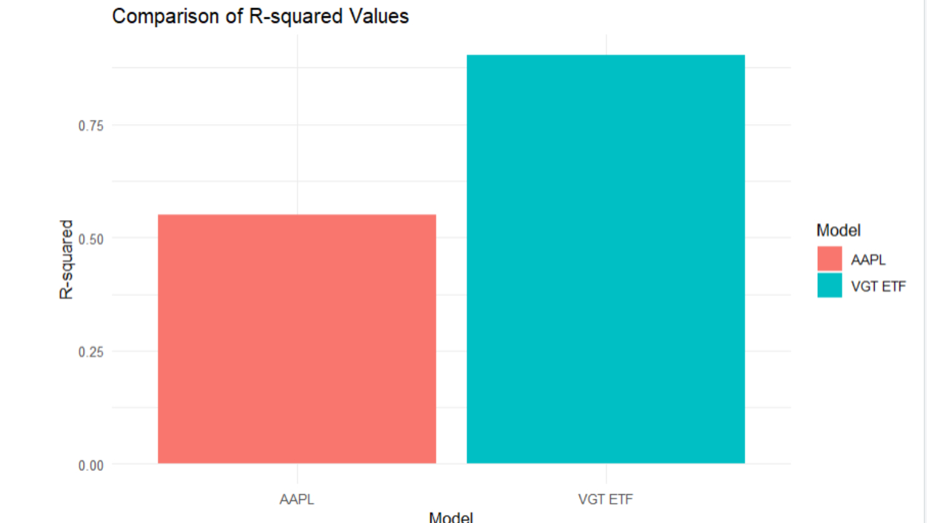
Visualization 1: APPL vs VGT excess returns
Model for VGT explained a lot more of the variability in excess returns than APPL, most likely because the index of many stocks more closely resembles the overall market.
Notes:
Sebastian

Slide 5
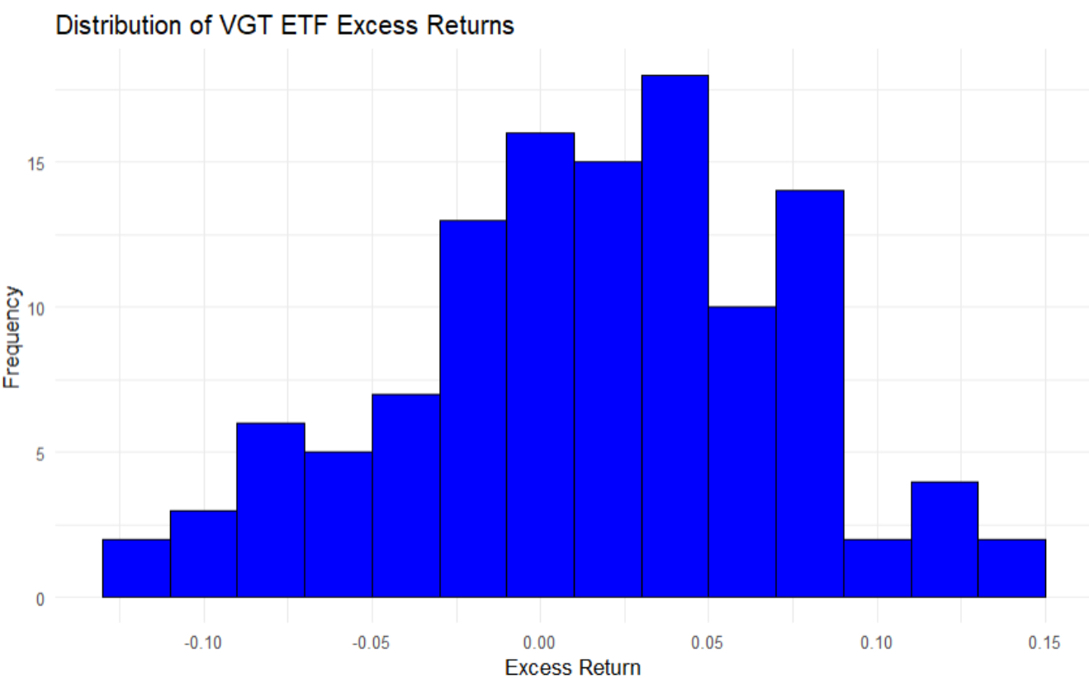
Visualization 2: Distribution of VGT ETF Excess Returns
-Highest frequency of excess returns for VGT is between 0 and .05%
-The excess returns for VGT are normally distributed over the past 10 years.
Notes:
Sebastian

Slide 6
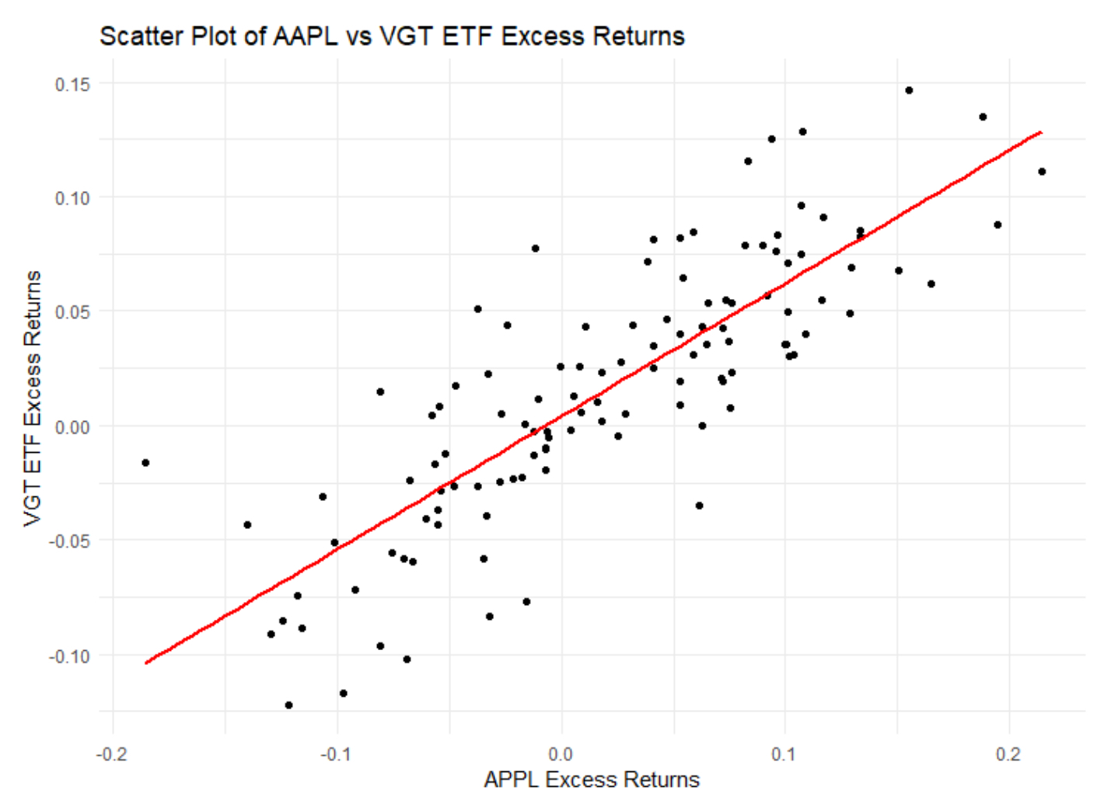
Visualization 3: APPL vs VGT Excess returns
VGT and AAPL excess returns are positively correlated as AAPL is one of the holdings in the VGT index
Notes:
Sebastian

Slide 7
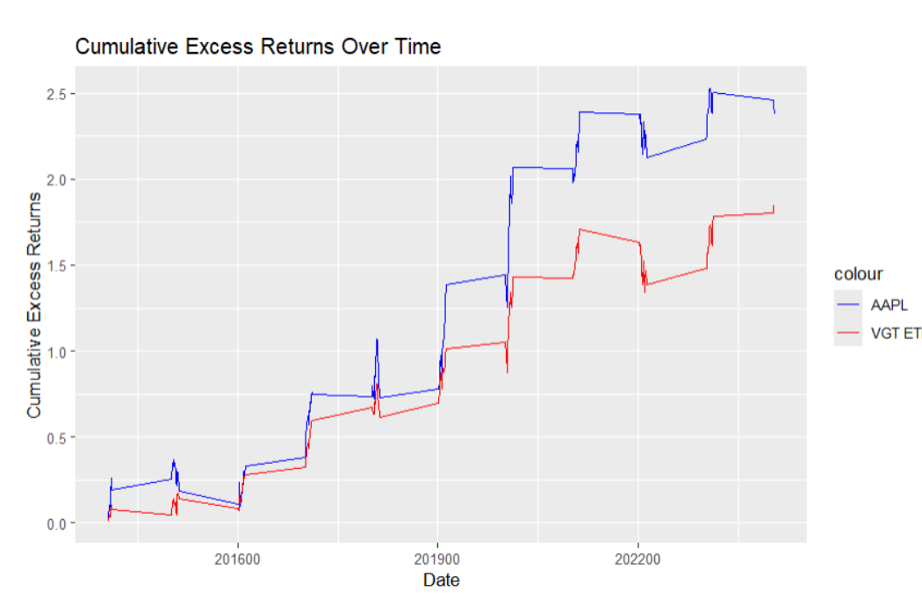
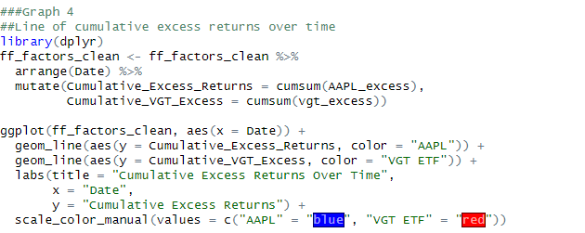
Visualization 4: Cumulative Excess returns over 10 years
-AAPL cumulatively outperformed VGT over the 10 years,
- Similar Beta, moves in similar pattern.
Notes:
Michael

Slide 8
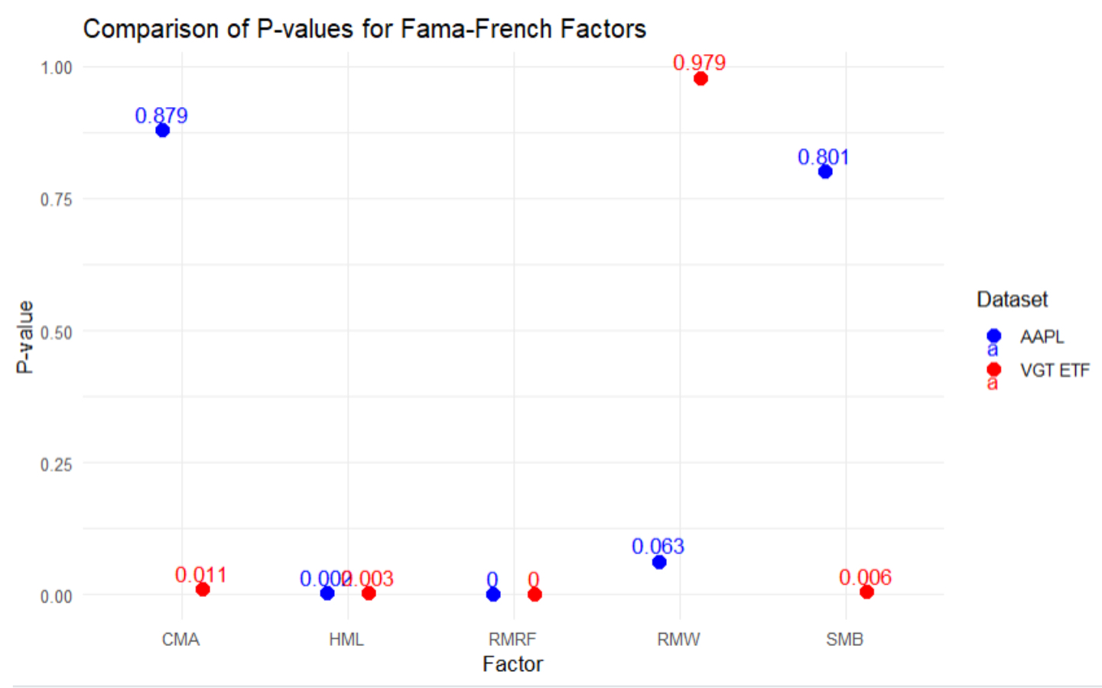
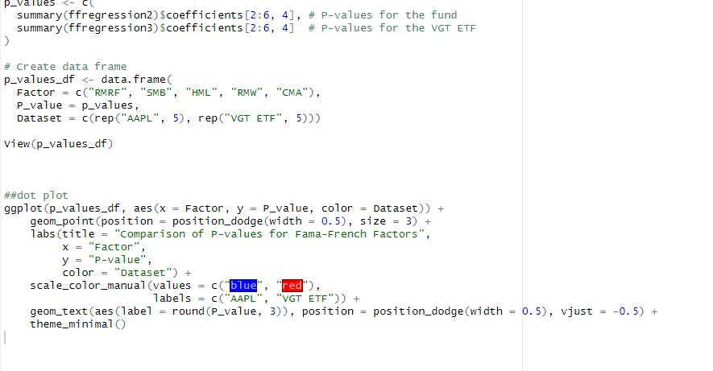
Visualization 5: P Values dot plot
Significant <= 0.05
HML and RMRF are most significant for both models.
Notes:
Michael

Slide 9
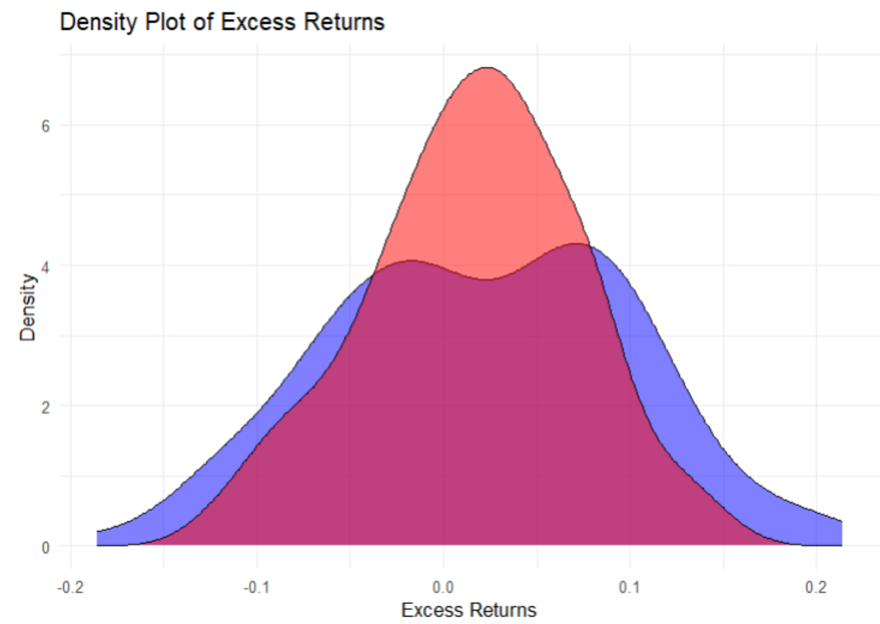
Visualization 6: Distribution of returns
Normal Distribution for VGT and bimodal distribution for AAPL
Notes:
Michael

Slide 10
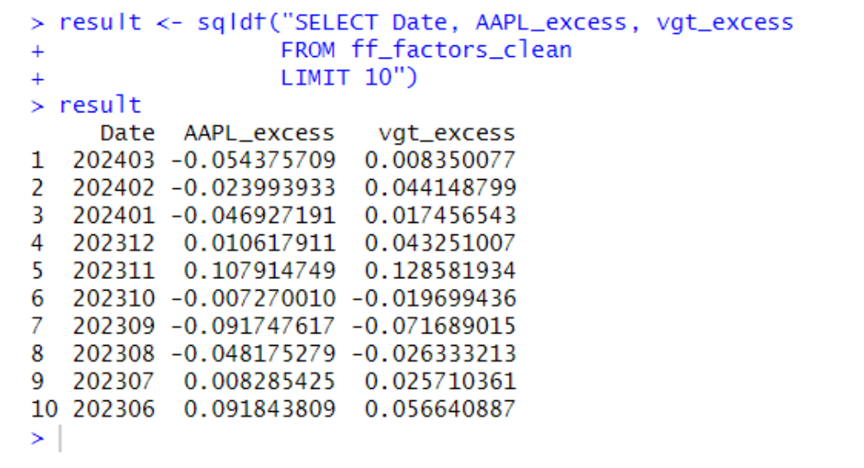
Query 1: Introduction
Focus variables such as Date, AAPL_excess and VGT_excess, and limit them to the first 10 observations.
Notes:
Sebastain

Slide 11
Query 2: Months that ETF outperform APPL
51 months in total where VGT outperformed AAPL relative to the risk free rate
Notes:
Sebastian

Slide 12
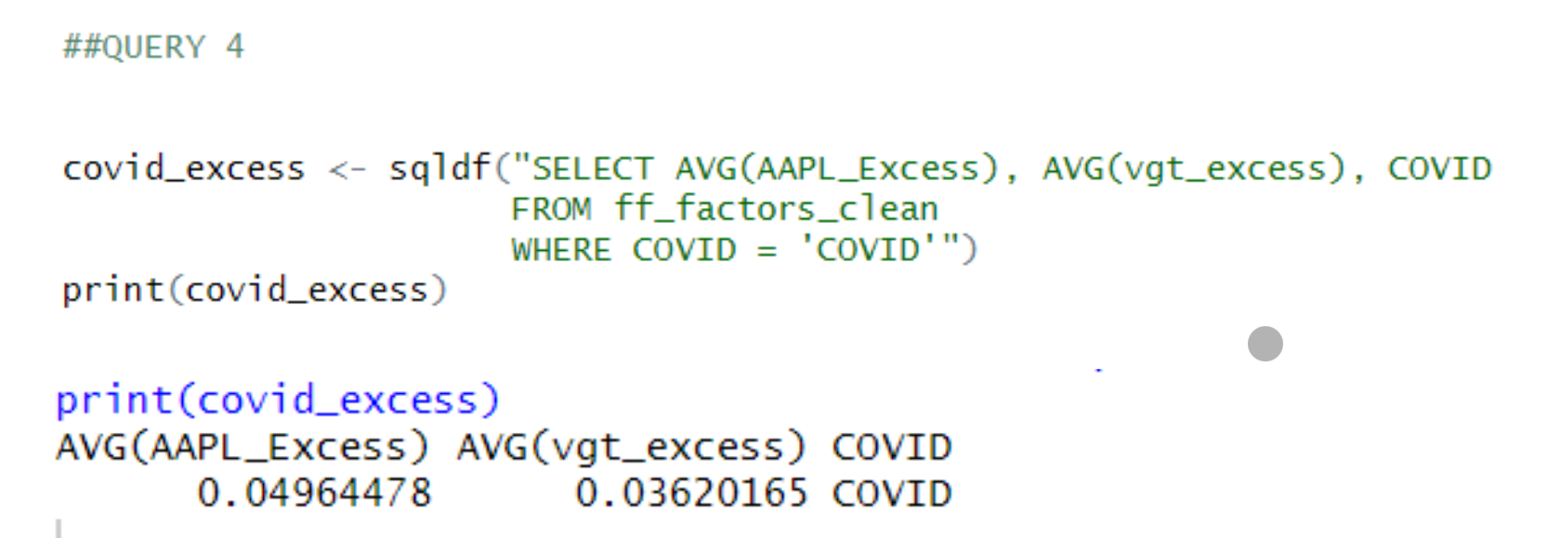
Query 3 / Query 4: Avg Excess Returns
As expected, AAPL had the highest average, with VGT coming in second and the market having a very low and the smallest average.
AAPL and VGT saw increased average excess returns specifically during COVID.
Why? This could be due to technology companies not being shocked as hard as the overall market during COVID.
Notes:
Sebastian

Slide 13
Query 5: Validating the Beta
Apple has a higher standard deviation which is congruent with our Betas.
Notes:
Michael

Slide 14
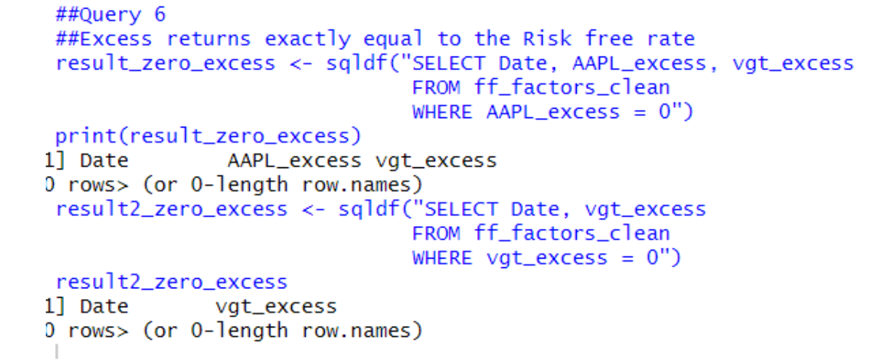
Query 6: Excess returns = Risk free rate
More risk but same return? Never
Notes:
Michael

Slide 15
Query 7: Cumulative Excess returns
AAPL cumulatively outperformed VGT by approximately .524%
Notes:
Michael

Slide 16
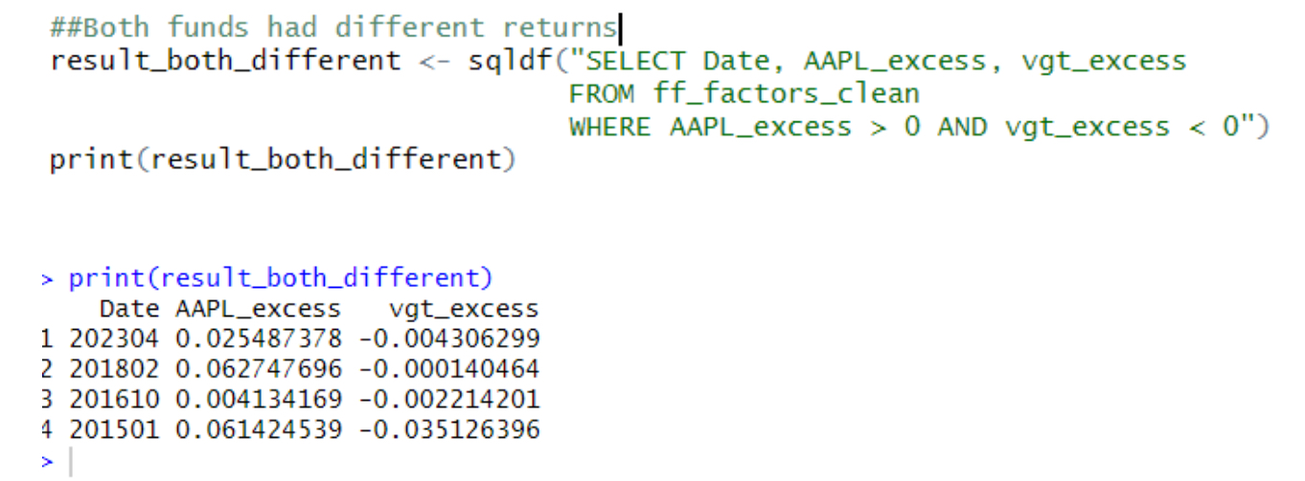
Query 8: Both funds have opposite returns
4 out of 117 months when returns were opposite
Notes:
Michael

Slide 17
Query 9: All Fama French factors positive
This illustrates when all of the different months where all Fama French risk factors were positive, which was only four. This happened once in 2022, once in 2021, and twice in 2019.
Notes:
Sebastian

Slide 18
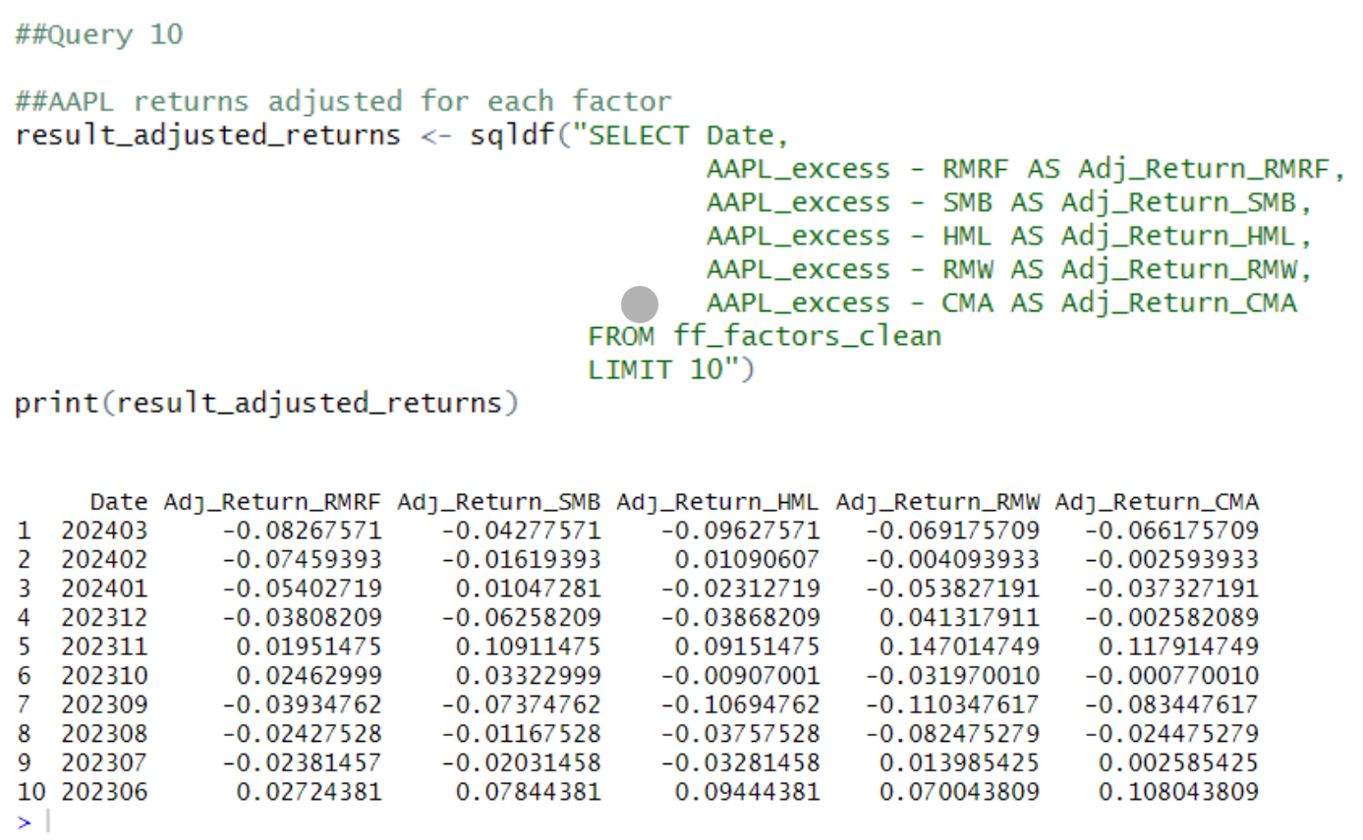
Query 10: APPL risk adjusted returns
AAPL’s adjusted excess returns to each of the five factors. When returns are positive, it signals that it outperformed relative to that risk factor. Any negative value signals that it underperformed that factor.
Notes:
Sebastian

Slide 19
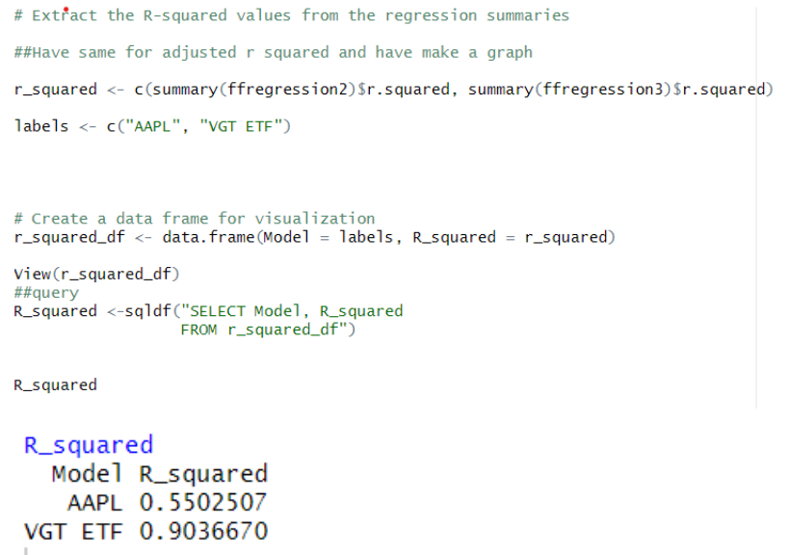
Query 11: R Squared values
We created a new data frame with the extracted R-squared values from our regression summaries. This allowed us to write a query that would make available the values for each model in one output. These were .55 for AAPL and .90 for VGT respectively
Notes:
Sebastian

Slide 20
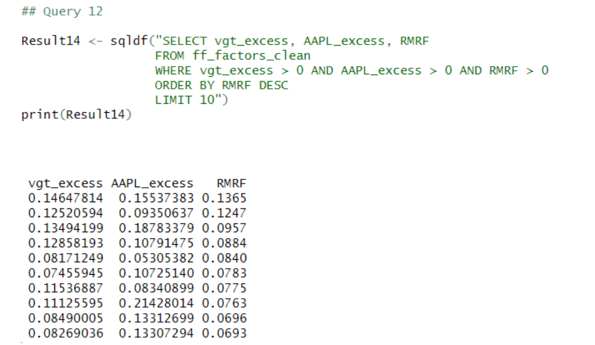
Query 12: Market‘s performance relative to both securities
The positive RMRF values signal that the overall market was performing well. When it performs well, both of these stocks should perform relatively better, and when the market is poor, they also should perform relatively poor. This pattern would be stronger with all 117 observations displayed.
Notes:
Sebastian

Slide 21
Conclusion
AAPL was the higher performing security over the 10 years compared to VGT.
A conservative investor would want to invest in an ETF such as VGT, whereas a more aggressive investor may want to bear more risk and invest in AAPL.
RMRF, or the stock’s correlation to the market, is the highest predictor of a stock’s excess returns.

Slide 22
Thank you!

